Slide 1
LECTURE 10
Study of DNA/RNA – protein interactions and chromatin accessibility

Slide 2
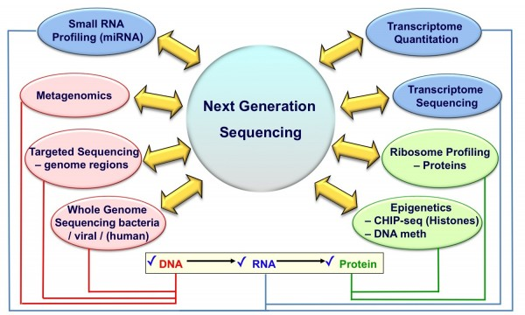
The omics-era: moving towards the study of gene expression regulation
Although genomic sequencing/resequencing, targeted resequencing and RNA-sequencing are certainly the most popular application areas of modern sequencing technologies, the ability to obtain high throughput data fits well with the growing needs of the research world
2nd generation sequencing technologies in particular have made it possible to shift to an “omics” scale analyses that were usually conducted on single target genes
In particular, it is possible to use massive sequencing to study DNA-protein interactions, or to investigate the state of chromatin accessibility, methylation of genomic DNA, and much more

Slide 3
Let’s first dive into the methods used to study chromatin structure (and accessibility)
DNase-seq
FAIRE-seq
Mnase-seq/MAINE-seq
ATAC-seq
These methods allow to study chromatin accessibility at a large scale level
ChIP-seq on the other hand allows to study the interaction between specific taget proteins and genomic DNA
Moreover, chromosome conformation capture techniques enable the study of interactions between distant regions of genomic DNA, which are associated in the 3D space. Among these we should mentioned the preparation of Hi-C and Omni-C libraries, which we have already addressed as useful tools for improving the quality of genomic assemblies

Slide 4
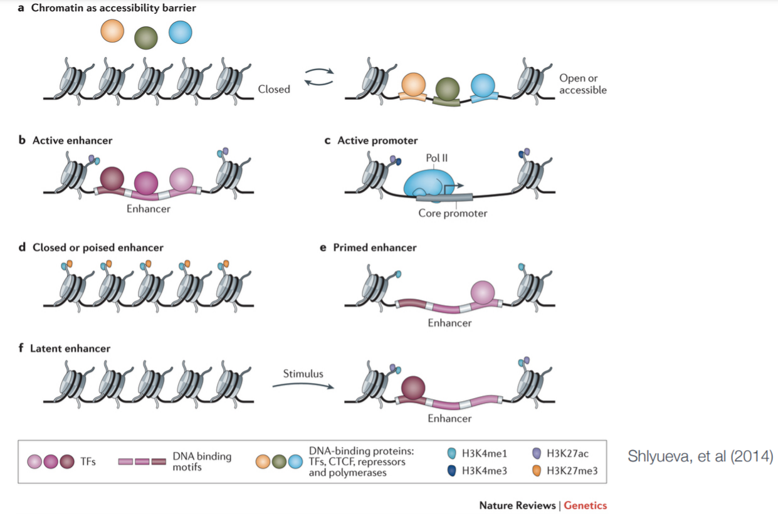
Chromatin accessibility

Slide 5
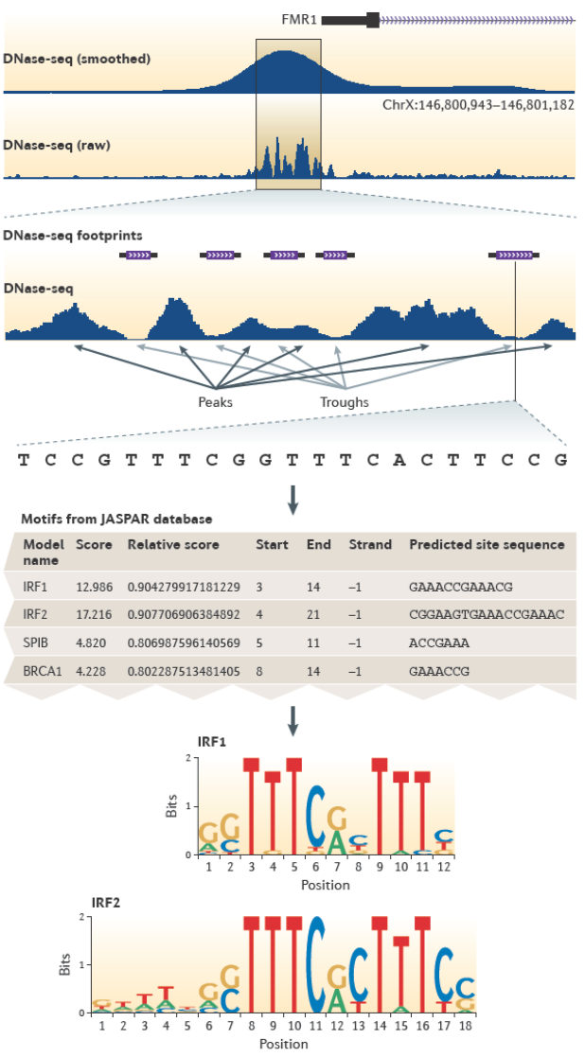
DNase-seq
DNase I is used to cut genomic DNA at regions accessible to enzymatic action
Cutting cannot occur at regions of condensed chromatin -> fragments corresponding to the ends of fragments resulting from DNase I cutting are included in the sequencing library
The reads obtained (by NGS sequencing, usually Illumina) will be mapped to regions where the cut occurred, identifying peaks and valleys, which can be defined as DNase-seq footprints
These, particularly if associated with the promoter of a gene, could indicate regions where small recognition motifs are present for the binding of transcription factors and other regulatory elements of gene expression

Slide 6
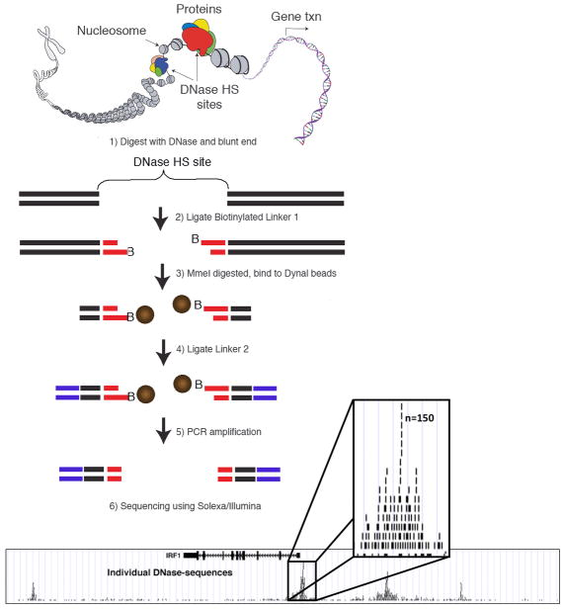
DNase-seq
This stands for DNase I hypersensitive sites sequencing
The protocol involves cell lysis for nuclei release, followed by digestion with an appropriate amount of enzyme
The ends of the obtained fragments are ligated to biotinylated sequencing adapters
The fragments are further digested (with a restriction enzyme), ligated to the second adapter, and isolated with magnetic beads (coated with streptavidin)
Reads will be mapped to sites hypersensitive to enzymatic cutting activity, i.e., regions most accessible by regulatory proteins

Slide 7
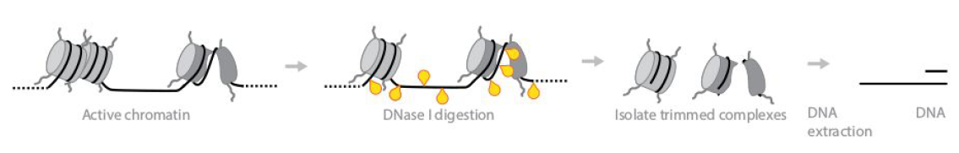
DNase-seq – pros e cons
PROS
Can detect “open” chromatin
Requires no prior knowledge of either the binding protein or the recognized DNA sequence (thus provides a “general” accessibility map)
Has very good sensitivity with regard to promoter analysis
CONS
Requires 1-5 million input cells
DNase I cuts specific sites and therefore hypersensitivity profiles may not be representative of the entire genome
Several enzymatic and purification steps are required, limiting the sensitivity of the method when low amounts of DNA are available
Requires integration of ChIP-seq data (which we will describe later) to study in detail the binding sites for specific regulatory proteins

Slide 8
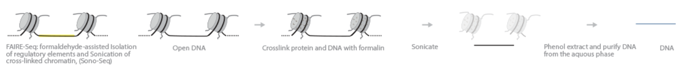
FAIRE-seq
This methodology has applications potentially similar to DNase-seq
FAIRE-seq: Formaaldehyde-Assisted Isolation of Regulatory Elements
Crosslinking between genomic DNA and histone proteins is performed by using formaldehyde
Sonication leads to breakpoints at regions of open chromatin
Following extraction by phenol/chloroform method, these fragments remain in solution and can be purified and used to construct sequencing libraries
In contrast, DNA fragments that interact with histones remain in the organic phase and are not isolated by phenol/chloroform extraction
The reads will be mapped to genomic regions corresponding to open chromatin
PROS: simple and reproducible, does not require the use of restriction enzymes or the isolation of nuclei
CONS: as with DNase-seq, is unable to identify proteins bound to open chromatin regions. Unlike DNase-seq, it leads to higher coverage in enhancers than promoters. The level of “background noise” is higher than Dnase-seq. It requires a minimum theoretical input of about 100 thousand cells, but in practice, due to the low recovery rate linked with extraction, the typical input is 1-10 million cells

Slide 9
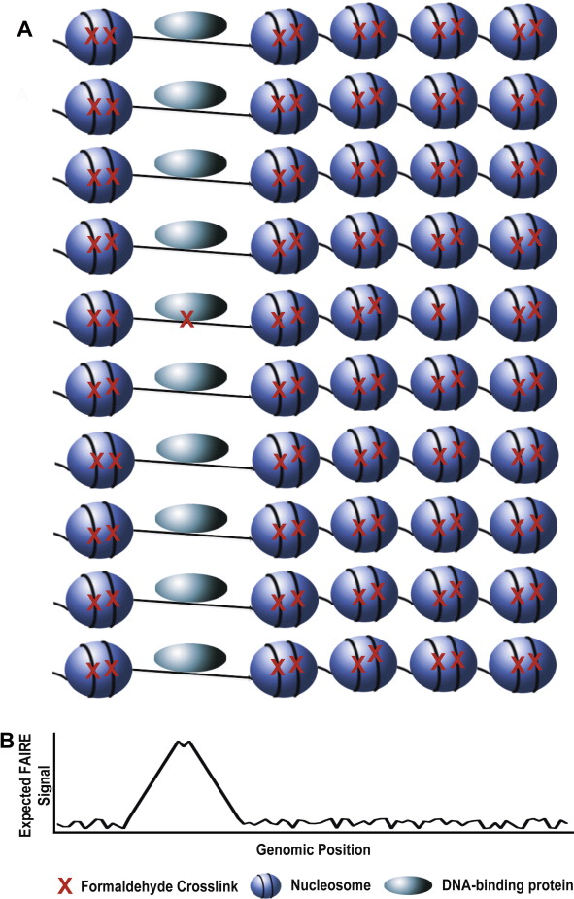
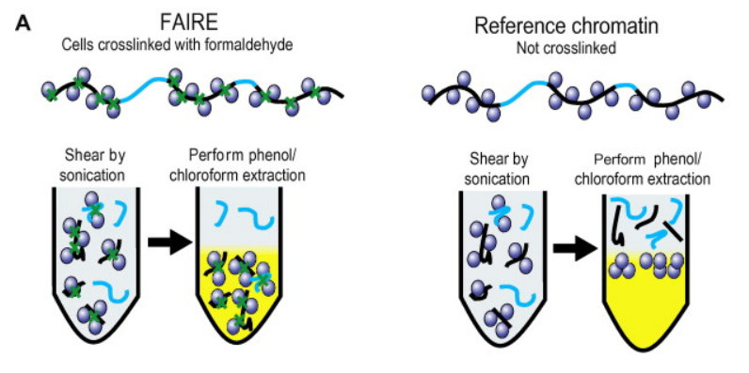
FAIRE-seq
N.B: Crosslinking with formaldehyde could potentially also lead to binding of genomic DNA to DNA-binding proteins other than histones
However, it is believed that in a cell population only a small fraction of the interactions between genomic DNA and other proteins may go through crosslinking, and consequently the expected signal should be very sharp for regions of open chromatin
N.B. a control sample is required! This is a sample processed in a similar manner but not crosslinked

Slide 10
MNase-seq/MAINE-seq
It uses Micrococcal Nuclease (MNase) from Staphylococcus aureus, a restriction enzyme that degrades non-histone-bound DNA. The digestion product, following fragment removal, is nucleosomal DNA (used to identify the location of nucleosomes in the genome)
Also called MAINE-seq: MNase-assisted isolation of nucleosomes sequencing.
Basically, sequencing libraries include the portions of genomic DNA that had been ligated to histone proteins and were therefore protected from digestion
PROS: does not require crosslinking
CONS: requires isolation of nuclei, as in the case of DNase-seq the enzymatic cutoff is not random, and in particular a cutoff bias toward genomic regions with high AT content can be observed. It is an indirect method to detect accessible chromatin (i.e. accessible chromatin will display no mapped reads. Requires from a few hundred thousand to a few million input cells

Slide 11
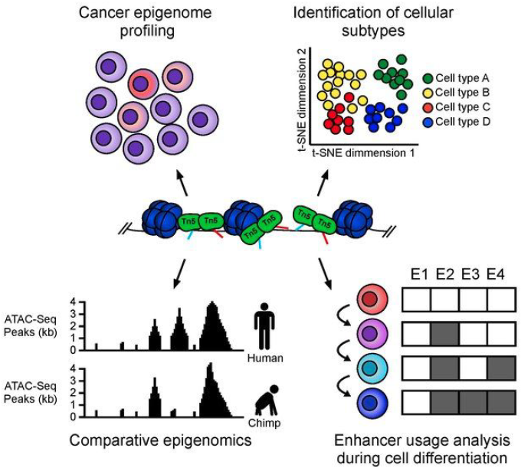
ATAC-seq
Acronym for Assay for Transposase-Accessible Chromatin using sequencing
Faster and more sensitive technique than DNase-seq, FAIRE-seq and MAINE-seq
Exploits the activity of a mutated and hyper-active T5 transposase to insert adapters into open chromatin regions
The process is similar to that already described for tagmentation
The reads will distribute at the genomic regions most accessible to transposase activity -> we will observe mapping peaks of height proportional to the accessibility of the region

Slide 12
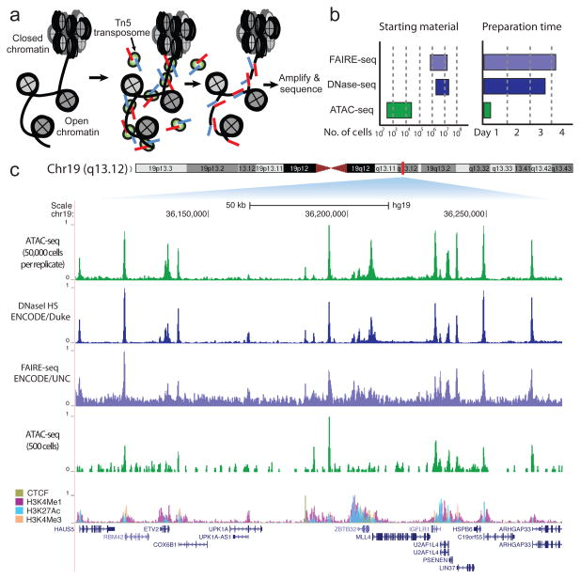
ATAC-seq
PROs
The advantages can be considerable, both in terms of time (only a few hours are needed, no overnight incubation) and complexity (no complex purification and crosslinking required, transposomes directly insert adapters, etc.), and in terms of the amount of starting material required
In general, a lower amount of input cells is required (1-100K cells)
The coupling of ATAC-seq techniques with microfluidics has enabled the development of single-cell ATAC-seq analysis techniques
These are extremely useful for assessing chromatin accessibility in cell populations, for example, in the case of oncological diseases

Slide 13
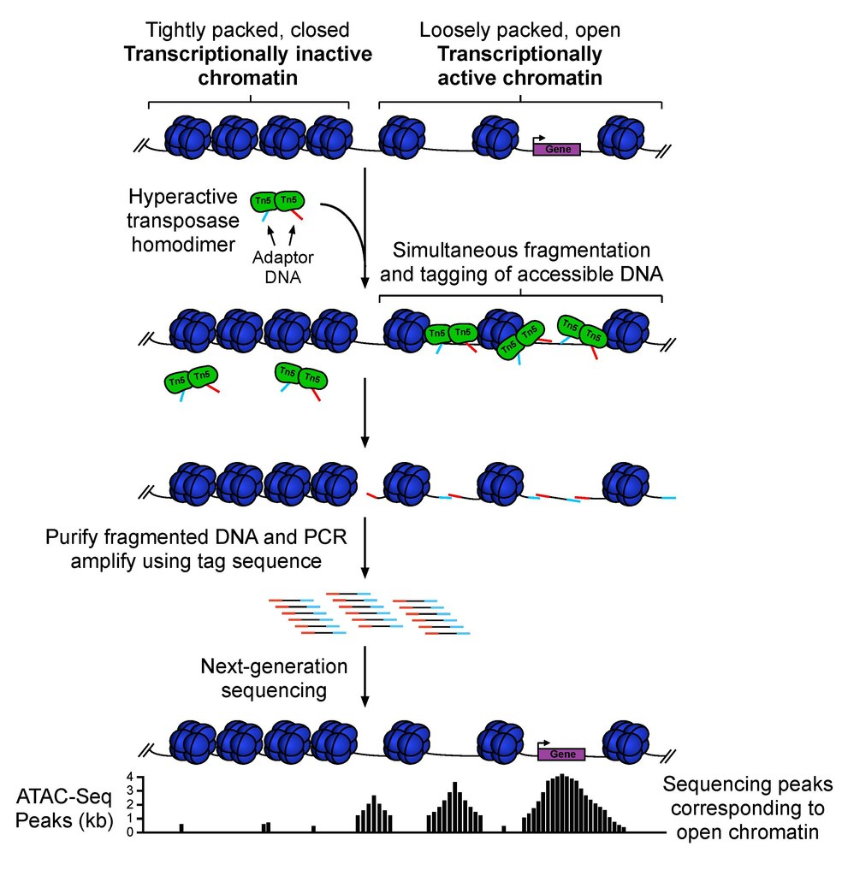
ATAC-seq
CONs
Greater sequencing coverage is required (the signal is not simply “binary,” i.e., presence/absence of mapped reads as in other methods, but coverage, proportional to the accessibility of the region, must be checked)
Contamination by mitochondrial DNA is very frequent, since transposase does not discriminate nuclear DNA from mitochondrial DNA (highly abundant) -> a considerable fraction of the reads obtained must be discarded

Slide 14
Single-cell approaches: non just RNA-seq
Single-cell techniques are potentially applicable for different types of analysis. We have already mentioned single-cell RNA-seq studies (which are relatively easy because of the abundance of RNAs in single cells) and now we have discussed ATAC-seq, but several targeted resequencing approaches could also be applied
Single-cell protocols have been also developed for Dnase-seq (https://www.nature.com/articles/nprot.2017.099) and MAINE-seq (https://www.nature.com/articles/s41586-018-0567-3), but they are NOT PRACTICAL
Regardless of the type of application, all single cell sequencing techniques involve (i) isolation of individual cells and (ii) construction of barcoded libraries, each corresponding to a single cell (or nucleus, in the case of ATAC-seq, similar to snRNA-seq)
Such isolation usually takes place through the use of specially developed microfluidic instrumentation, and sequencing is always performed using short reads
The Illumina protocol for building single cell libraries is illustrated in a video on the folder you will find in Moodle, which has already been seen while talking about scRNA-seq. An example on their operation in the ATAC-seq field, via the Chromium 10X system, is shown in a second video found on Moodle

Slide 15
Coverage and costs: how should these be calculated for this type of approaches?
The fundamental question we need to ask ourselves is, “What fraction of the target genome can have open chromatin?”
The answer depends on the species, the structure of the genome, and its size
In humans, it has been empirically shown that about 1-2% of chromatin is usually open
20-50 million reads are therefore usually considered sufficient to obtain the complete profile of a sample with Dnase-seq, MAINE-seq and FAIRE-seq
For ATAC-seq, the coverage is greater: about 50 million reads may be sufficient for comparisons between samples (e.g., before and after a treatment), but to obtain a complete chromatin accessibility map requires >200 million reads per sample

Slide 16
How much are these techniques actually used?
We can assess this based on the number of citations received by each reference paper
DNase-seq – Boyle et al. 2008, Science, https://doi.org/10.1016/j.cell.2007.12.014 - > > 1800 citazioni
FAIRE-seq – Giresi et al. 2007, Genome Research, https://doi.org/10.1101%2Fgr.5533506 -> 1200 citations
Mnase-seq/MAINE-seq – Schones et al. 2008, Cell, https://doi.org/10.1016/j.cell.2008.02.022 -> more than 1700 citations
ATAC-seq – Buenrostro et al. 2016, Nature Methods 2013, https://doi.org/10.1038%2Fnmeth.2688 -> >7000 citations

Slide 17
How much are these techniques actually used?
It is quite evident that, because of its greater convenience and the possibility of being used for single-cell approaches, ATAC-seq is becoming the approach of choice for studying chromatin structure through NGS sequencing

Slide 18
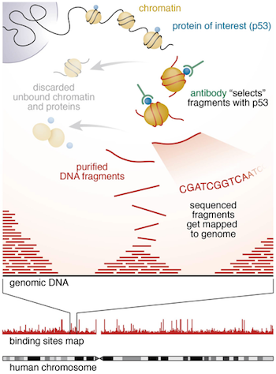
ChIP sequencing
This is a technique that combines chromatin immunoprecipitation (ChIP) with massive sequencing to identify the binding sites of a protein of interest. This protein can be:
(i) a histone; (ii) a transcription factor; (iii) any other nuclear protein
This allows to identify:
all the sites to which a given target protein is going to bind on a whole-genome scale
the “strength” of binding of the protein of interest to individual genomic regions recognized by it
Whereas the techniques described so far generated overall accessibility maps, ChIP sequencing is a protein-specific approach for proteins of interest

Slide 19
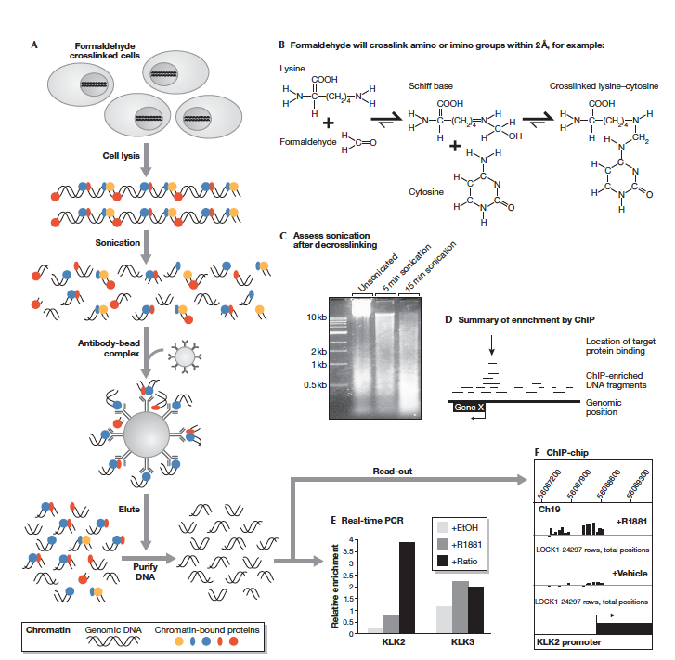
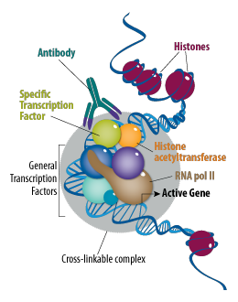
ChIP sequencing – step by step
A ChIP-seq experiment starts with cross-linking via formaldehyde (as in FAIRE-seq) between proteins interacting with genomic DNA and the genomic DNA itself
N.B. the process will generate complexes involving all proteins, including the protein(s) of interest, but also many others

Slide 20
ChIP sequencing – step by step
The cross-linking process is followed by sonication, which fragments the genomic DNA that remains cross-linked to the proteins
This is followed by immunoprecipitation, which uses an antibody that must specifically recognize the protein of interest
Immunoprecipitation takes advantage of magnetic beads, to which the antibodies are bound
ChIP-seq thus is very well suited to the study of any type of protein that can bind genomic DNA, provided that a functioning antibody can be developed against it

Slide 21
ChIP sequencing – step by step
Once the beads are recovered (after the aqueous solution, where the DNA fragments that are not crosslinked or are bound to proteins other than the one of interest remain, is discarded), the remaining DNA fragments are de-crosslinked
These are purified and can be used for the preparation of a classic second-generation NGS library (with eventual barcoding, in case more biological samples are being examined)

Slide 22
ChIP sequencing – controls and minimal input
It is essential that a control is included in a ChIP-seq analysis
This is derived from a sample processed in parallel with the sample of interest, but in which the immunoprecipitation step is not performed
Its usefulness is to provide a “baseline” of general chromatin accessibility levels -> I may find enrichment at certain genomic regions not because the protein of interest binds particularly strongly there, but rather because it is an “open” region and therefore more easily subject to non-specific interactions
Ideally, the sonication process should result in 150-400 bp fragments
The input required is usually a few tens ng of genomic DNA following immunoprecipitation
No particularly long reads are required and especially no great depth of sequencing is required (because the reads are distributed over a small fraction of the genome) -> it is sufficient to plan about 30/40M reads per sample, but it depends on the expected frequency of the number of binding sites in a genome!

Slide 23
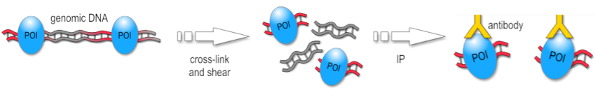
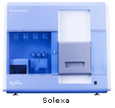
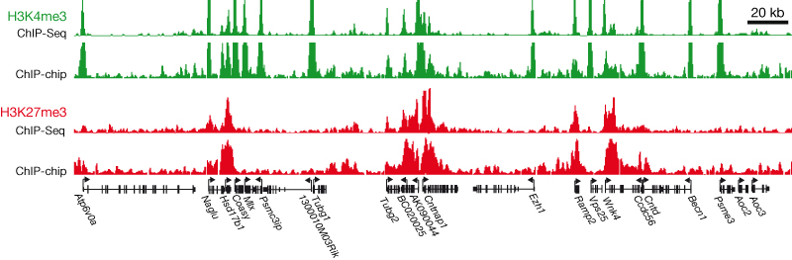
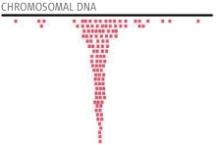
DNA + bound protein
Fragment DNA
Immunoprecipitate
Sequence
Prepare sequencing library
Release DNA
Map sequence tags to genome
& identify peaks
POI = protein of interest

Slide 24
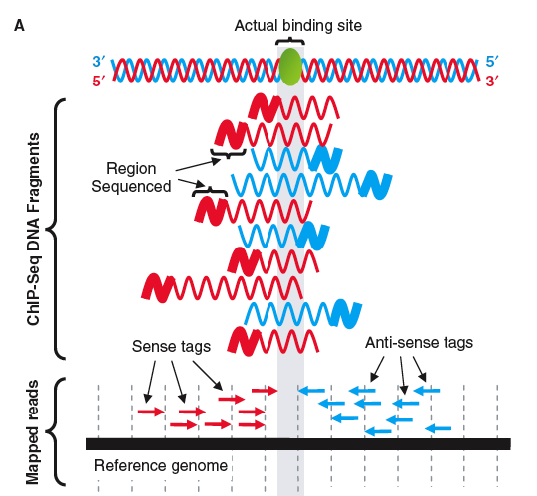
Identifying binding sites in ChIP-seq
During the mapping process, the reads will spike at the region over which the crosslink had occurred, i.e., the binding site
Obviously, we will have a bell-shaped curve, which depends on the random fragmentation related to sonication
The trace of peaks obtained in the sample of interest (immunoprecipitated) should be compared with the trace of peaks obtained from the control sample (non-immunoprecipitated)
The peaks should indicate regions specifically recognized by the protein of interest (e.g., transcription factor binding sites)

Slide 25
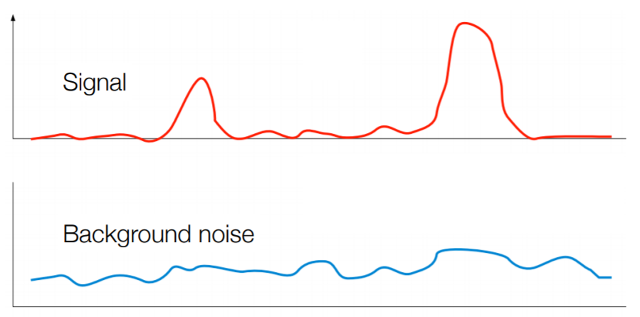
Identifying binding sites in ChIP-seq
The goal of the analysis is to be able to discriminate the signal from background noise by assigning each peak a p-value
The sequencing depth used can be crucial in identifying peaks with low height (e.g., secondary binding sites, recognized with reduced “strength” by the protein of interest)

Slide 26
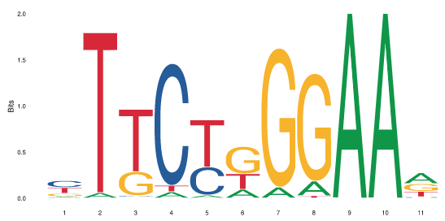
Downstream analysis (transcription factors)
Once the peaks are identified, I can ask myself:
Which gene is located closest to the identified mapping peak? (i.e., which gene is under transcriptional control of the protein of interest?). This is very useful especially for the study of transcription factors
What is the consensus DNA motif recognized and bound by the protein of interest? It is possible to extract and align DNA sequences with each other where a mapping peak is noted, generating a consensus
What functions do genes associated with mapping peaks perform? It is possible to do a functional enrichment test, as in an RNA-seq experiment, to find out what functions are regulated by the protein of interest.

Slide 27
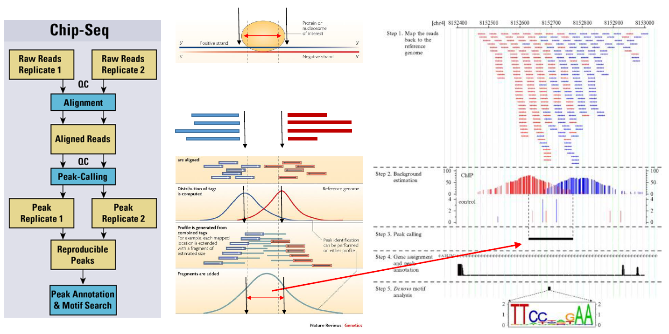
ChIP-seq: complete workflow

Slide 28
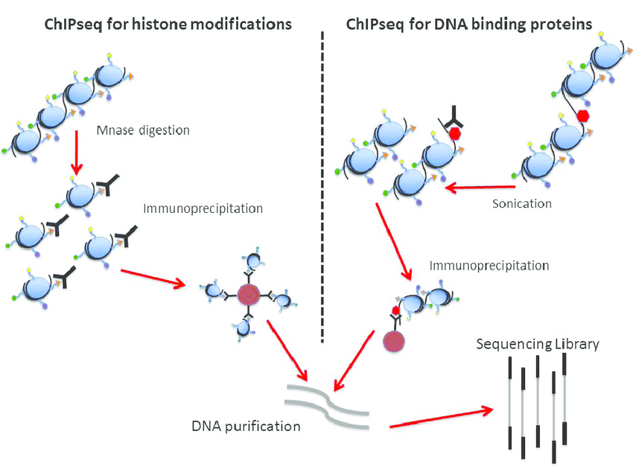
ChIP sequencing in the study of histone modifications
Different types of modifications (acetylations and methylations) at different histones are linked to different genomic regions, with different roles in the regulation of gene expression, as they determine the degree of chromatin condensation
Active promoters: H3K4me3, H3K9Ac
Active enhancers: H3K27Ac, H3K4me1
Repressors: H3K9me3, H3K27me3
Transcribed genes: H3K36me3
It is possible to use specific antibodies that can recognize these methylated or acetylated histone forms

Slide 29
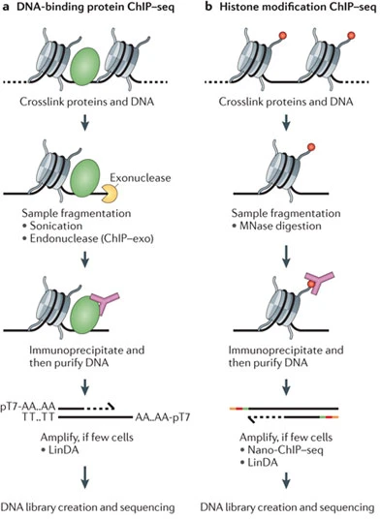
ChIP-seq: limitations and variations
Up to 10⁵ ∼ 10⁷ cells are required, for the same reasons we mentioned for FAIRE-seq (plus, the yield of immunoprecipitation is not very high)
The cross-linking process may hide some epitopes recognized by antibodies
It is possible to bypass the cross-linking process (peculiar to classical ChIP-seq, also called xChIP), by detecting only proteins that bind DNA in a very strong and long-lasting way -> it is preferentially used for ChIP studies on histones, but NOT on transcription factors
In this alternative, called nChIP (natural ChIP), DNA is not sonicated, but digested with MNase (right panel in figure). This means that sonication is replaced by MNase digestion

Slide 30
ChIP-seq: how can the number of input cell reduced?
Alternative techniques have been developed that allow us to reduce the number of starting cells
ChIPmentation (Schmidt et al., 2015) -> https://www.nature.com/articles/nmeth.3542 combines ChIP-seq and tagmentation thanks to the activity of Tn5 transposase (as in ATAC-seq). Applicable to up to 10 thousand cells for studying histones (no crosslinking, so all more labile and transient interactions are lost)
ULI-nChIP (ultra-low-input natural ChIP, Ben Amour et al., 2015, https://www.nature.com/articles/ncomms7033) optimizes the nChIP protocol to obtain histone binding profiles with as low as 10³-10⁵ cells
MOWChIP (Cao et al. 2015, https://www.nature.com/articles/nmeth.3488) optimizes the nChIP protocol by the use of microfluidics, reducing the theoretical input to as low as 100 cells
All these are low-resolution techniques, unsuitable for the study of interactions with transcription factors, and their application therefore remains limited to the study of interactions between DNA and histone proteins. In any case, since the input DNA is small, libraries need to be amplified by PCR -> higher risk of technical artifacts

Slide 31
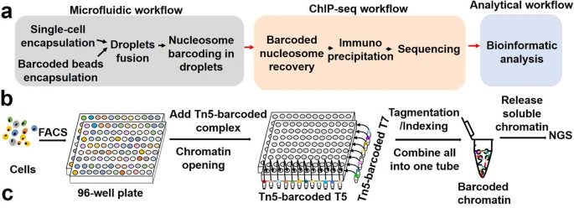
Single-cell ChIP: is it possible?
It is possible, but with many limitations: in particular, the profiles obtained from single cells are highly variable due to the low resolution of the method, and profiles of thousands of cells of the same type are therefore needed to obtain a reliable consensus
In any case, these are always approaches dedicated to the study of DNA-histone interactions
On the side, see the simplified protocols for:
drop-ChiP (droplet-based), with a strong contribution of microfluidics systems (panel A)
sc-itChIP-seq, cheaper and based on FACS cell separation, followed by library preparation by tagmentation (as in ChIPmentation)

Slide 32
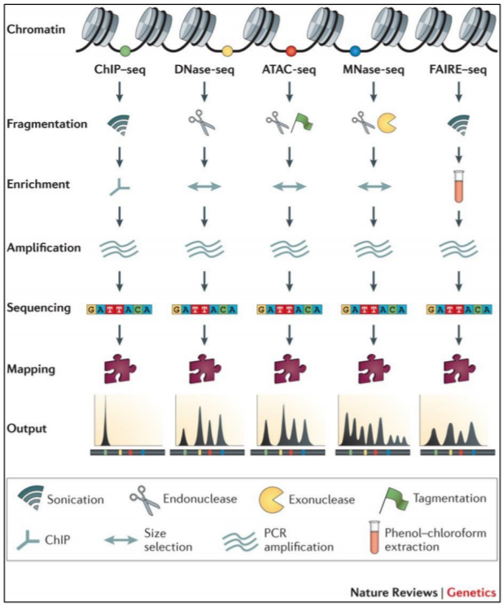
A quick summary of all the different techniques studied so far; keep in mind that, among these, only ChIP-seq allows targeting specific target DNA-interacting proteins, whereas Dnase-seq, ATAC-seq, Mnase-seq and FAIRE-seq can only provide a general chromatin accessibility profile.
The two types of approach are, nevertheless, complementary, and can be also potentially combined with RNA-seq data (or even with 5mC profiling) to obtain a comprehensive view of the different factors contributing to the regulation of gene expression

Slide 33
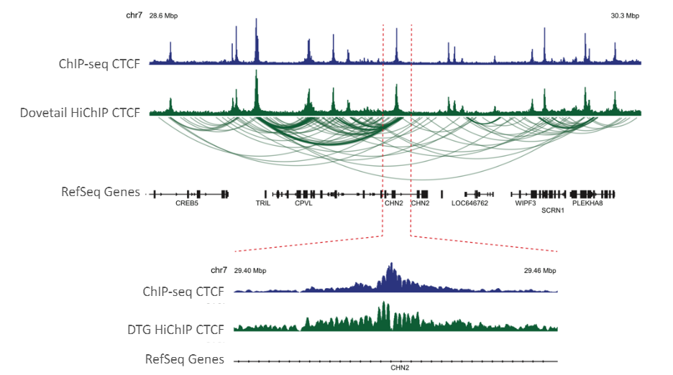
Study of long-range interactions
Recall the chromatin conformation capture methods already addressed when discussing the preparation of particular libraries sequenced in paired-end mode to obtain useful information for scaffolding contigs in the de novo assembly of complex genomes
Hi-C library preparation techniques are based on this approach. Real interaction maps are obtained, which can be correlated with the genomic coordinates of the ChIP-seq mapping peaks

Slide 34
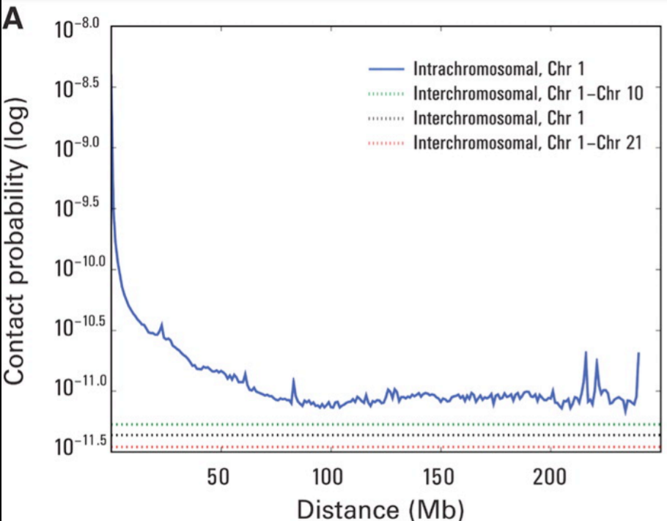
How distant can the paired genomic regions be in an Hi-C library?
Probability of contact decreases exponentially with distance
Contacts above distances of 50 Mb become decidedly rare (note the log scale in the graph)
Although interchromosomal contacts are possible (dashed lines), these are generally very rare

Slide 35
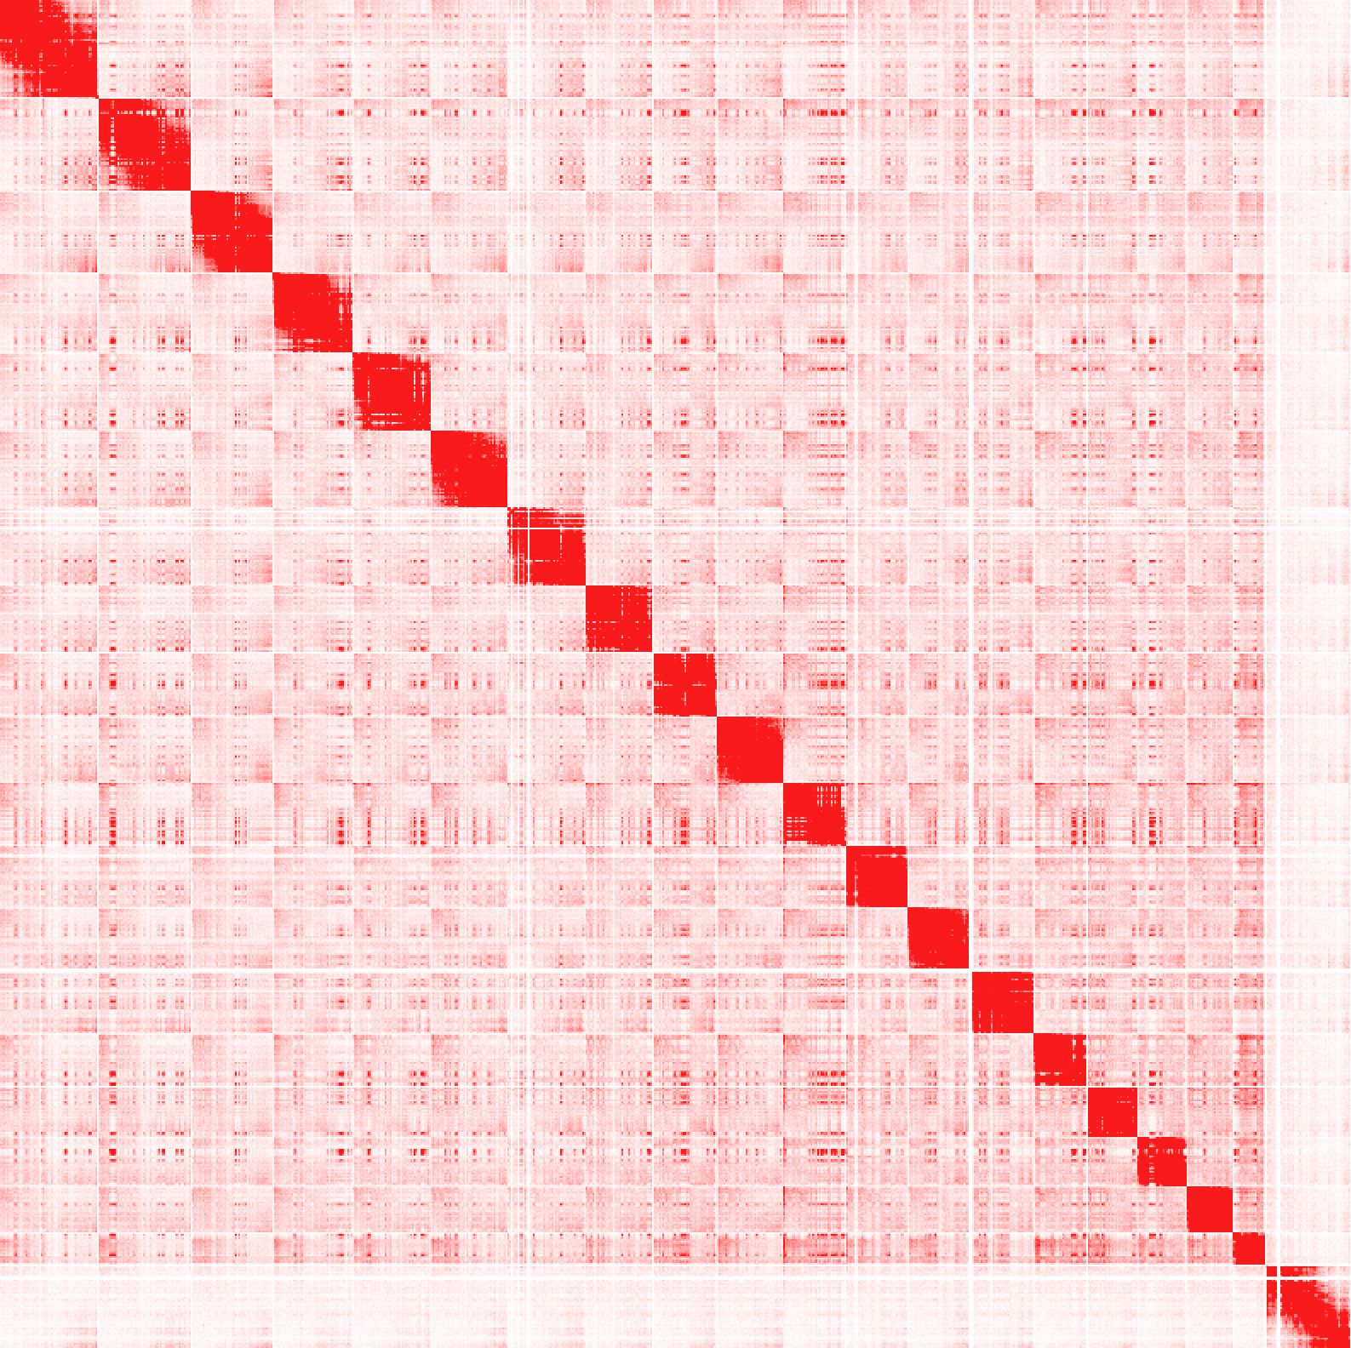
Interpretation of Hi-C contact maps
Mapping paired-end reads obtained by Illumina sequencing of a Hi-C (and omni-C) library allows the creation of contact maps that highlight (even visually, rather intuitively) individual chromosomes.
Appropriate algorithms thus allow a very efficient level of scaffolding of contigs, potentially achieving chromosome-scale assembly.

Slide 36
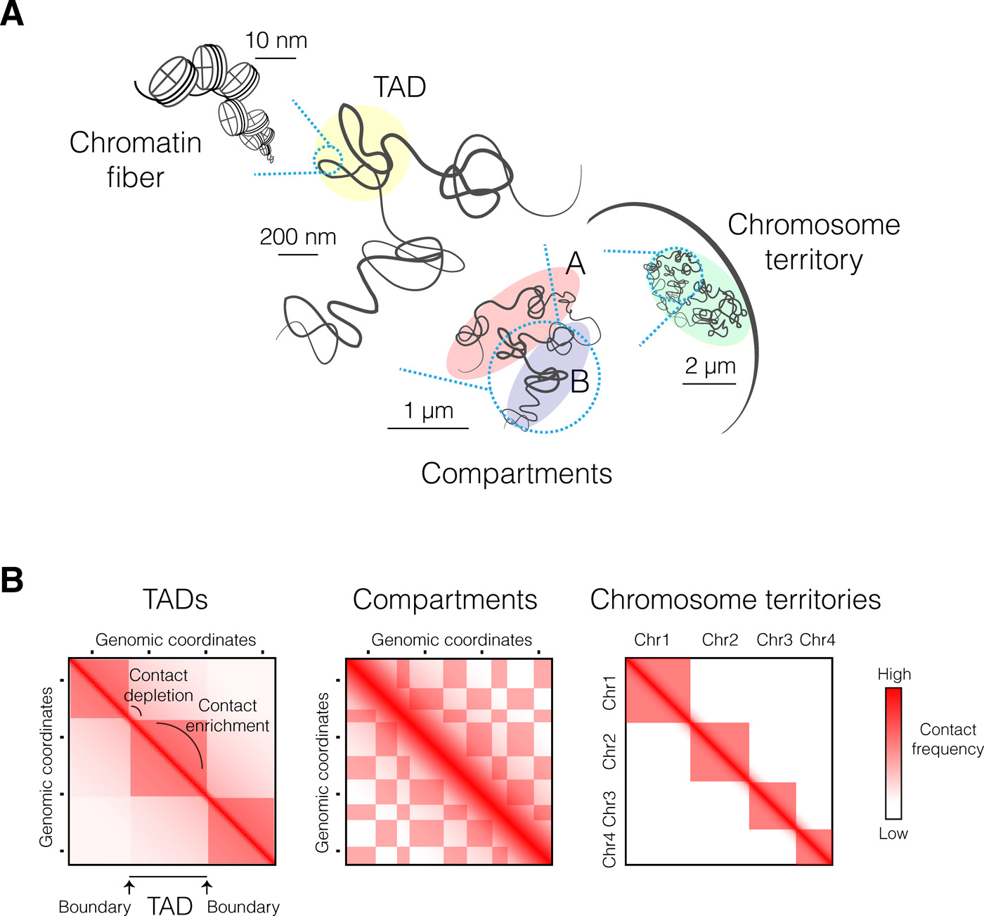
How can Hi-C contact maps be used to study the structure of chromatin?
Besides chromosomes, we can identify lower layers of structural organization, based on the presence of regions with contact enrichment or depletion
At large scales, chromosomes segregate into regions of preferential long-range interactions that form two mutually excluded types of chromatin, referred to as “A” and “B” compartments. A compartments correspond to gene-rich and active chromatin, while B compartments are mostly enriched in repressive chromatin
TADs (Topologically Associated Domains): domains of preferential internal chromatin interaction

Slide 37
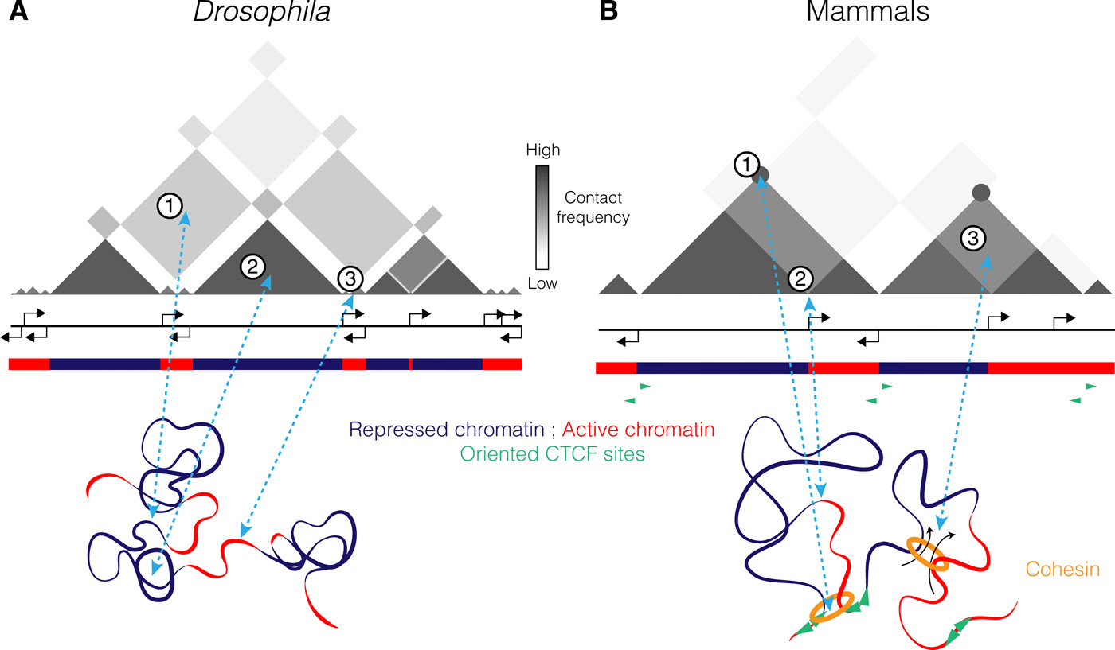
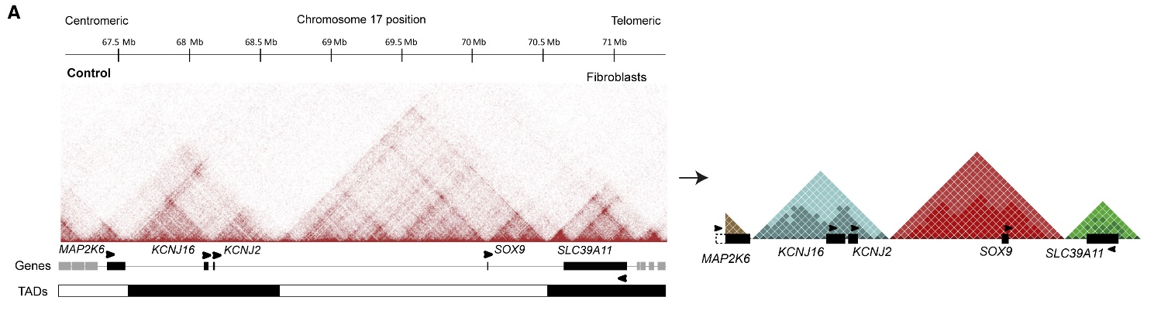
How can Hi-C contact maps be used to study the structure of chromatin?
TADs emerge as high-density “squares” in the contact maps, and their boundaries correspond to regions with depleted contacts
TADs usually identify important blocks of genomic sequence, characterized by the presence of co-regulated genes (since they belong to a “co-folded” portion of chromatin, which would make their promoters and associated regulatory elements simultaneously accessible to the interaction with transcription factors, RNA pol II and other regulatory proteins

Slide 38
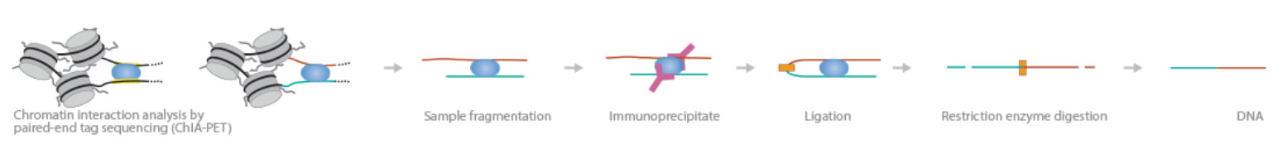
Study of long-range interactions
Similar techniques to Hi-C can be used to study how DNA-binding proteins may be involved in the formation of complex chromatin structures
One of these is ChIA-PET (Chromatin Interaction Analysis by Paired-End Tag sequencing), which is useful when one wants to study, by immunoprecipitation, regions bound by the same DNA binding protein (e.g. cohesins), which therefore are be associated with each other in 3D space
In this case, no crosslinking is necessary, since only highly stable interactions are studied: upon fragmentation, two distinct genomic DNA regions are expected to be still bound to the target protein
This can be immunoprecipitated, and recovered DNA fragments can be ligated and used for short-read paired-end sequencing, generating contact maps
reference: Fullwood et al. 2009, https://doi.org/10.1038/nature08497, cited about 2000 times

Slide 39
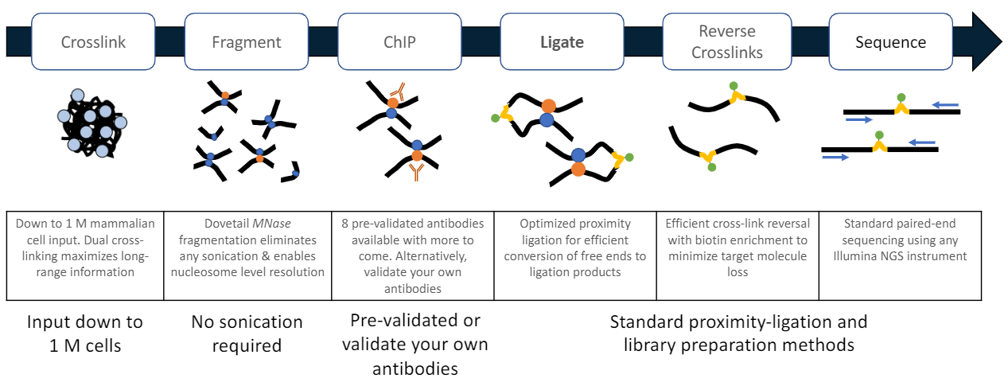
Study of long-range interactions
HiChIP approach: this is an improvement of Chia-PET, which uses crosslinking (like Hi-C!) and requires much lower genomic DNA inputs (even 100 times lower!). Chia-PET approaches require >100 million cells
Combination of Hi-C and ChIP-seq approaches to obtain information regarding the association of genomic regions distant by several Mb via the same interactor protein. Reference: Mumbach et al. 2016, Nature Methods, https://doi.org/10.1038%2Fnmeth.3999 -> cited > 700 times

Slide 40
RNA/protein interactions
Like genomic DNA, RNA can also interact with proteins, albeit transiently and significantly less stably
If specific antibodies are available to recognize the protein of interest, it is possible to adopt techniques similar to those described in previous slides for ChIP-seq and related methods
However, one of the most interesting applications concerns the interaction between messenger RNAs and the ribosome, as it is possible to study in detail the coupling between transcription and translation (which often do not occur synchronously and with direct proportionality)
Thus, we refer to studies of the translatome, as opposed to those of the transcriptome (i.e. based on the recovery of all poly-adenylated RNAs, regardless of their interaction with ribosomes)

Slide 41
Ribo-Seq/ART-Seq
Ribosome profiling, a technique also called active mRNA translation sequencing
Allows the analysis of ribosome-associated mRNA molecules undergoing active translation
A digestion with RNase digests all RNA molecules except the parts “protected” by attached ribosomes
This is followed by rRNA depletion and preparation of the sequencing library as in an RNA-seq approach
Reads related only to actively transcribed mRNA molecules are obtained
This better reflects translation rate than mRNA abundance alone
Requires particularly laborious preparation and is only applicable to species that have a reference genome available

Slide 42
Ribo-Seq/ART-Seq
RNA extraction is required to maintain ribosome and mRNA association
Cycloheximide is added to block interaction at the translation start site (tRNA entry and exit are stalled)
Following digestion with RNase, it is necessary to recover ribosome/mRNA complexes with special chromatographic columns or centrifugation in sucrose gradient
This is followed by extraction in phenol/chloroform to remove co-purified ribosomal proteins
The reads will be distributed mainly at the translation start site, but also over the rest of the CDS. Instead, we do not expect any reads mapped to the UTRs
Refrence: Ingolia et al. 2009, Science, https://doi.org/10.1126/science.1168978, cited about 3500 times

Slide 43
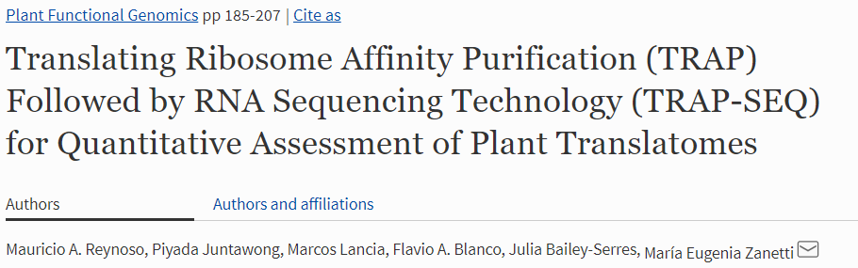
TRAP-seq: an alternative to Ribo-seq
In this case, antibodies (immobilized on magnetic beads) are used to isolate bound mRNAs from ribosomes, taking advantage of the presence of ribosomal accessory proteins
A similar technique (NET-seq) may allow, using different antibodies (directed against the RNA pol II complex), to isolate mRNAs undergoing active transcription -> reads will be distributed along the entire length of mRNA molecules
This is an interesting technique, far less used than Ribo-seq.
Reference paper cited < 100 times

Slide 44
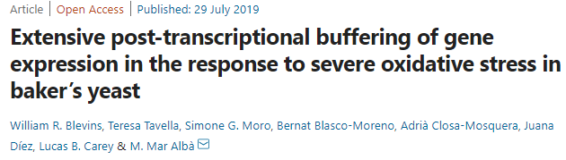
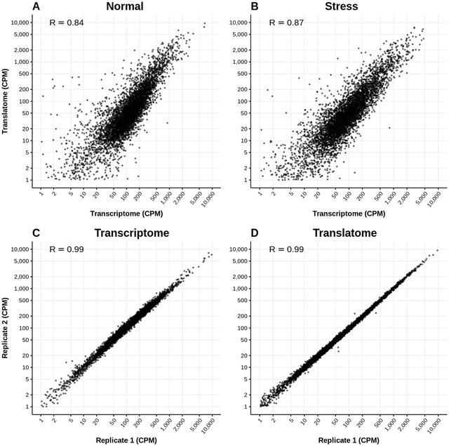
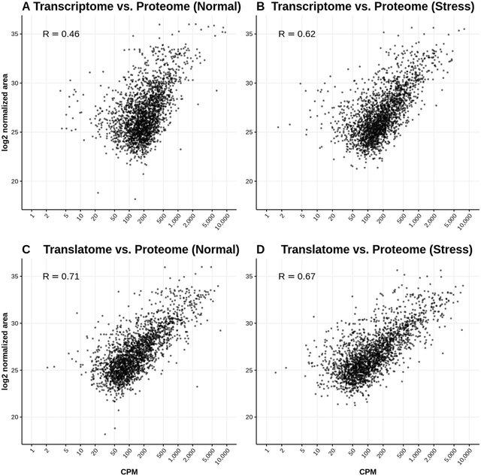
Transcriptome vs traslatome vs proteome
There is usually a greater correlation between the translatome and proteome than there is between the transcriptome and proteome
However, the correlation is not perfect, because proteins also have a turnover that is regulated in a very fine manner

Slide 45
RIP-seq
Used to study RNA-protein complexes
Immunoprecipitation with specific antibodies against the proteins of interest takes place
This is followed by digestion with RNase and extraction of the protected fragments, which are then reverse-transcribed and used to generate a sequencing library
The reads generated from the library can be mapped against a reference genome (or transcriptome)
The technique allows high-resolution mapping of mRNA binding sites recognized by the proteins of interest (the mapping is not uniform along the entire transcript and focuses only on regions recognized by the protein of interest)
Reference paper: Zhao et al., 2010, Molecular Cell, https://doi.org/10.1016/j.molcel.2010.12.011 -> cited > 1200 times

Slide 46
CLIP-seq
Similar aim to RIP-seq, but it adopts a crosslinking step by UV between the target protein and its bound mRNAs
Crosslinking is followed by (i) immunoprecipitation (important to enrich the library in mRNA regions recognized by the protein of interest); (ii) digestion of the mRNAs by RNase T1; (iii) elimination of the crosslinked protein by proteinase K treatment; (iv) reverse transcription into cDNA
The library thus prepared will originate reads that map only to protein-binding sites
Crosslinking is not always efficient and the fragments generated for the library are typically very short -> several improvements have been developed (iCLIP, erCLIP, BrduCLIP, etc.).
Reference paper: Licatalosi et al. 2008, Nature, https://doi.org/10.1038/nature07488, cited >1400 times

Slide 47
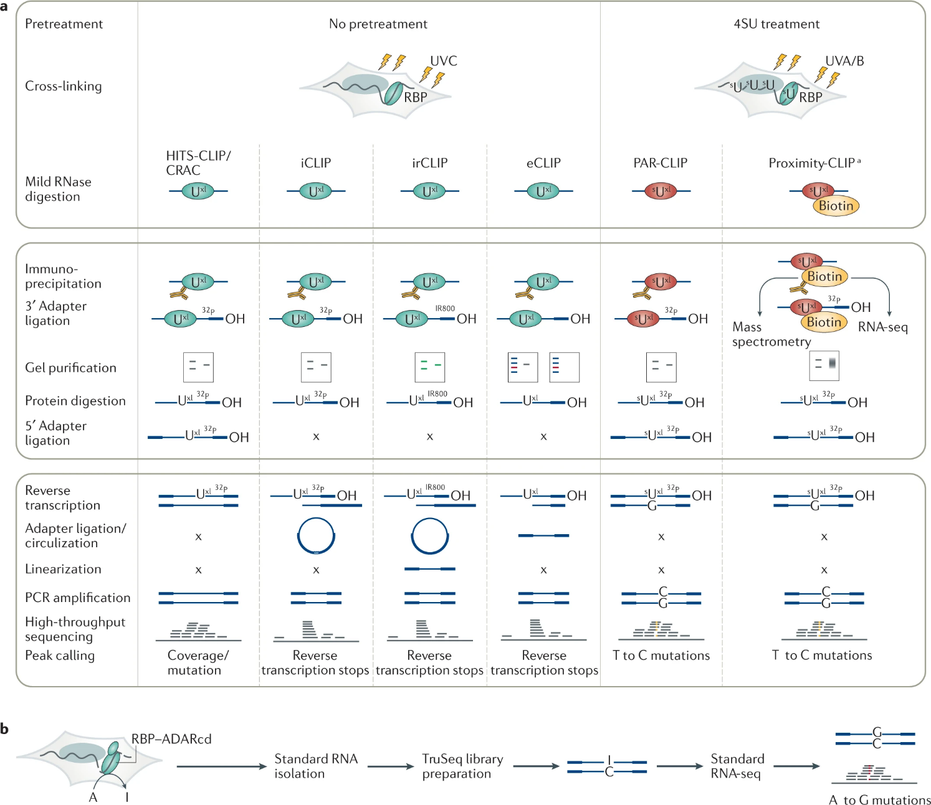
CLIP-seq variations
The different variants of CLIP-seq may differ in many steps, but they all aim to improve the resolution of the analysis, reducing cost and computational complexity
Regions recognized by the target protein are identified by a peak of mapped reads only in the original protocol (indicated here by HITS-CLIP)
In other cases, such regions are characterized by “steps” in the mapping of reads (determined by reverse transcription stops), or by the presence of point mutations (with a technique involving a pre-treatment with modified nucleotides that are incorporated in mRNA, similar to some approaches also used in epigenomics and epitranscriptomics, which we will see in the next lecture)
Some more in a detailed paper here: https://www.nature.com/articles/s43586-021-00018-1

Slide 48
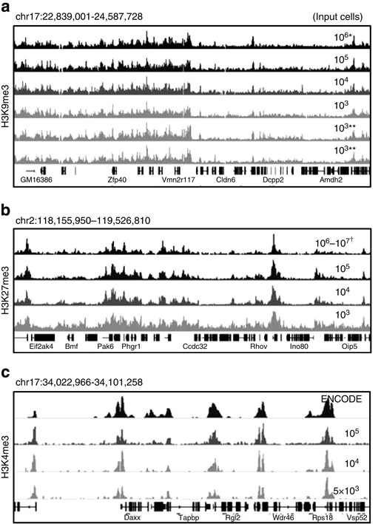
Getting used to interpret graphic representations: what are we seeing?
These are profiles of histones H3K9me3 (panel a), H3K27me3 (panel b) or H3K4me3 (panel c) obtained in 3 distinct genomic regions with gradually decreasing numbers of input cells
The image is taken from https://www.nature.com/articles/ncomms7033 and concerns the ULI-nChIP technique
The line with “chr” introduces the genomic location with coordinates
The dashed bars at the bottom indicate genes with exons (thick tracts) and introns, immediately giving us an idea of the distribution of modified histones bound to gene and intergenic regions

Slide 49
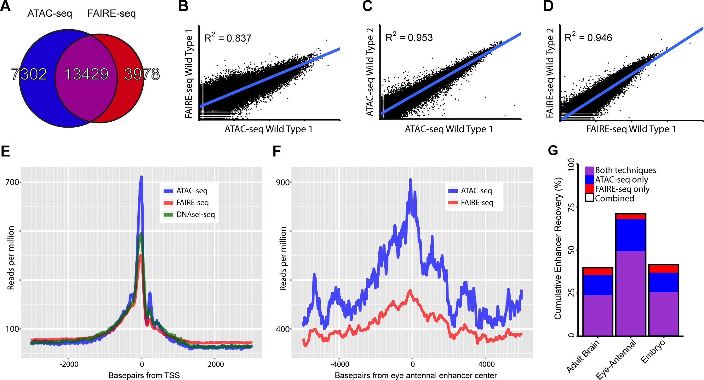
Getting used to interpret graphic representations: what are we seeing?
This is a comparison of ATAC-seq and FAIRE-seq on the same samples
(a) shows the number of total peaks identified by the two techniques
(b), (c) and (d) show scatter plots for the number of log-scale counts obtained for individual peaks
(e) and (f) show distribution of reads around transcription start sites and a specific enhancer for ATAC-, FAIRE- and DNase-seq.
Note the higher background noise for FAIRE- and Dnase-seq in graph E (the peak is less high), while ATAC-seq allows much better detection of peaks related to enhancers (this is also shown in panel g)

Slide 50
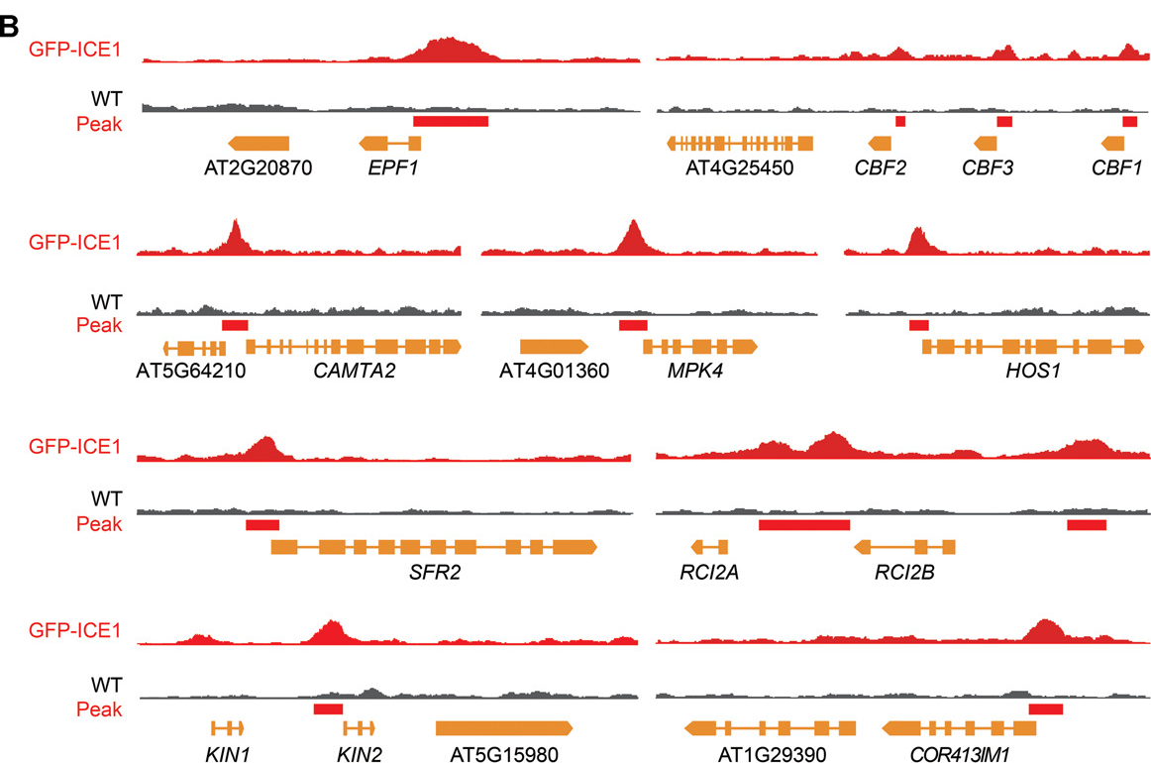
Getting used to interpret graphic representations: what are we seeing?
The graph shows the mapping peaks from a ChIP-seq analysis done using an antibody specific for the transcription factor ICE1 in Arabidopsis
Statistically significant peaks are indicated by a red bar: note their position at the promoters (usually in the immediate 5' of the target genes)
The target genes are CBF transcription factors and a number of COR (cold-responsive) genes, all activated in response to cold stress
https://onlinelibrary.wiley.com/doi/full/10.1111/jipb.12918

Slide 51
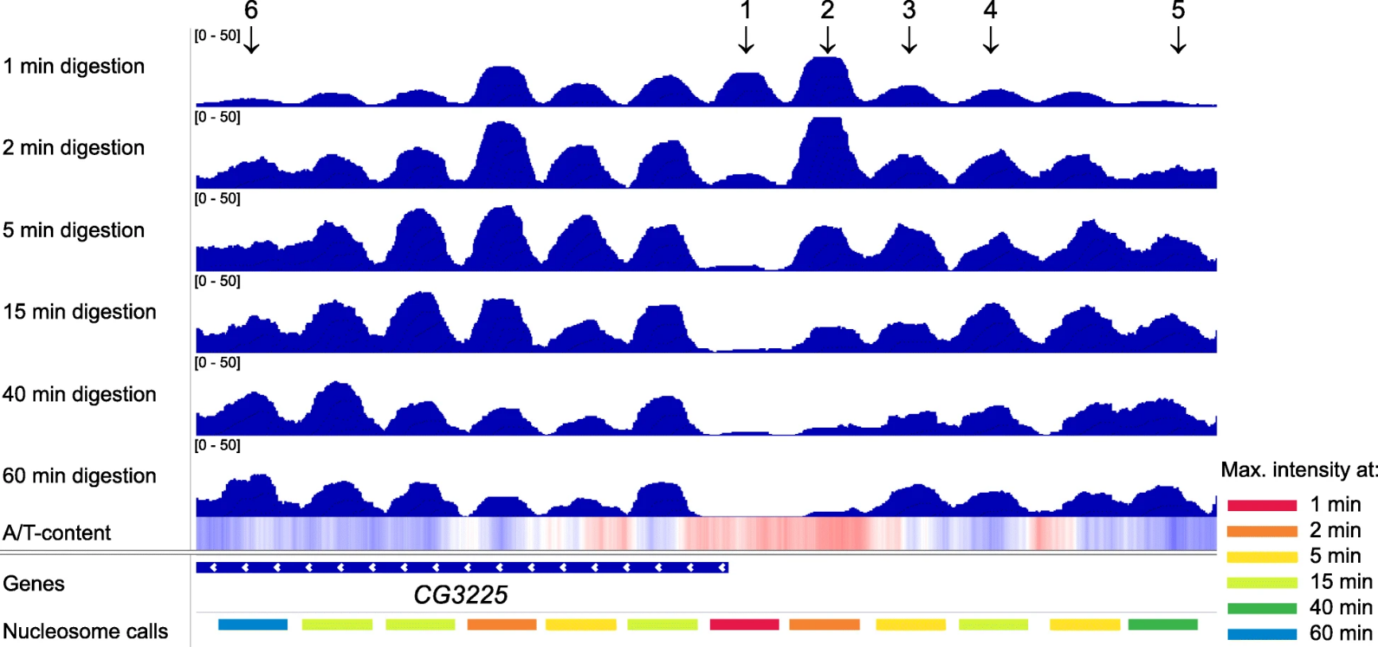
Getting used to interpret graphic representations: what are we seeing?
This is a reads mapping profile obtained with Mnase-seq, which shows how the periodicity of the peaks varies with enzymatic digestion time: very labile associations with histones lead to progressive loss of signals in regions of chromatin where there are few nucleosomes (we are at a transcription start site - CG3225 is a gene). Note the periodicity of the peaks
From: https://link.springer.com/article/10.1186/s13059-019-1815-z

Slide 52
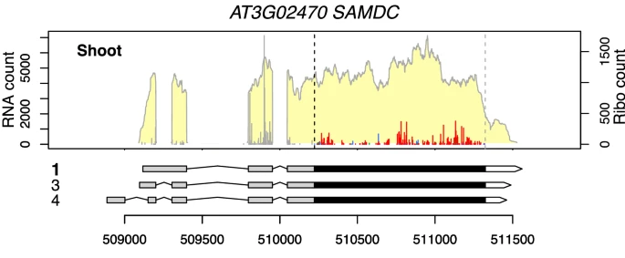
Getting used to interpret graphic representations: what are we seeing?
This is a comparison of mapping profiles of reads obtained with RNA-seq (yellow plot) and Ribo-seq (peaks in red and gray) versus the annotation of a gene with 3 alternative splicing isoforms. CDS is shown in black, UTRs in gray and white
What do you think the presence of peaks in gray area before the initial ATG codon suggests?
From: https://link.springer.com/article/10.1186/s13007-021-00824-4

