Slide 1
LECTURE 11
Epigenomics and epitranscriptomics

Slide 2
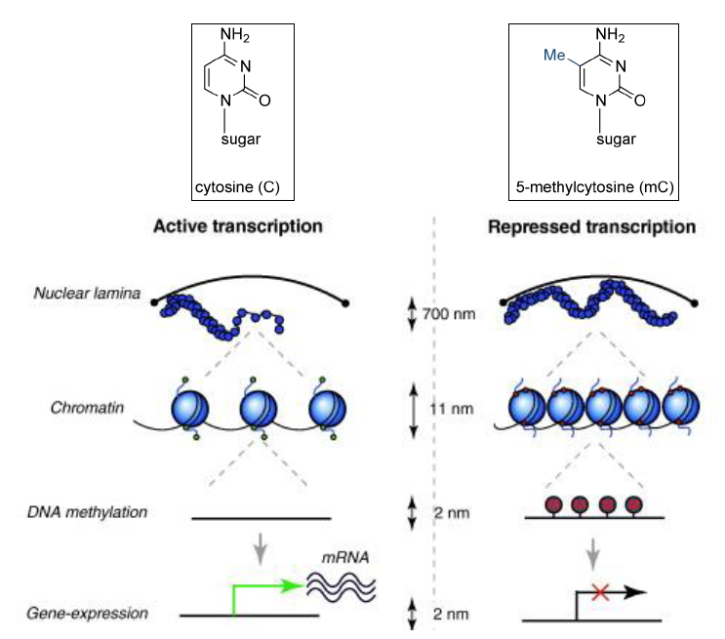
Studying genomic DNA methylation levels
As you may know from other courses, DNA methylation is one of the most important epigenetic modifications
This occurs through the addition of a methyl group on the fifth carbon of a cytosine (forming 5-methylcytosine, 5-mC) preceding a guanine (CpG)
Certain genomic regions are particularly rich in CpG dinucleotides, especially in CpG islands, which are often found in gene promoters (with an association of about 40% of mammalian genes and almost all housekeeping genes)
In addition to 5-methylcytosine, other similar potential gDNA modifications are also known: 5-hydroxymethylcytosine (with activating function), 5-formylcytosine and 5-carboxylcytosine

Slide 3
Studying genomic DNA methylation levels
QUICK DISCLAIMER
The functional consequences you may know about DNA methylation are generally referred to human and, more in general, to vertebrates
DNA methylation patterns in other eukaryotes (e.g. plants and invertebrates) are:
Totally different in terms of distribution
Totally different in terms of functional consequences
If you ever plan to work on any organism other than a vertebrate, you may consider the equation DNA methylation = repression of gene expression as untrue
Quick example: in several invertebrates, CpG islands DO NOT EXIST. Methylation mostly occurs within the gene body and is associated with actively transcribed genes that require high stability (housekeeping genes, for example)

Slide 4
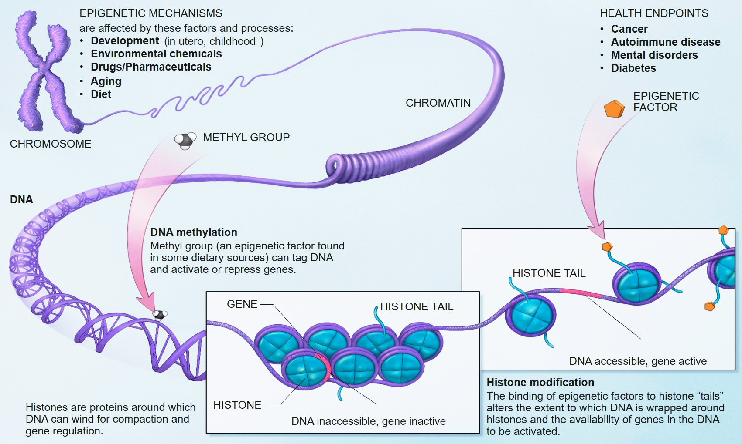
Why should we study epigenomic modifications?
The methylation status of DNA (together with the methylation/acetylation level of histone proteins) regulates gene expression (in vertebrates), and its alterations can be linked to the development of diseases of various kinds
In addition, methylation is a dynamic process, which fundamentally regulates, for example, embryonic development, X-chromosome inactivation, cell development, etc.
N.B. We have already discussed in the last lecture how it is possible to study (through ChIP-seq) the distribution of histones that exhibit post-translational modifications. Instead, today we will address the topic of modifications directly affecting genomic DNA

Slide 5
Large scale epigenomic studies
Initially, the study of epigenetic modifications was related to the use of methylation-dependent restriction enzymes capable of implementing a cut (or not) at the same CpG site depending on the methylation status of the internal cytosine
This approach was only possible on a small scale, on a few target genes at a time. Inability to characterize often heterogeneous methylation levels (because not all cells have the same methylation levels in a tissue)
Growing need to move these investigations to a larger scale (whole genome) by combining them with NGS techniques. Interest in studying less “extreme” methylation patterns than an on/off situation, quantifying the average methylation level in a tissue or cell population
In human, the focus has been mostly placed on the study of CpG islands, defined as regions that have at least 500bp in length, GC content greater than 55% and a rate of CpG dinucleotides observed/expected > 0.65

Slide 6
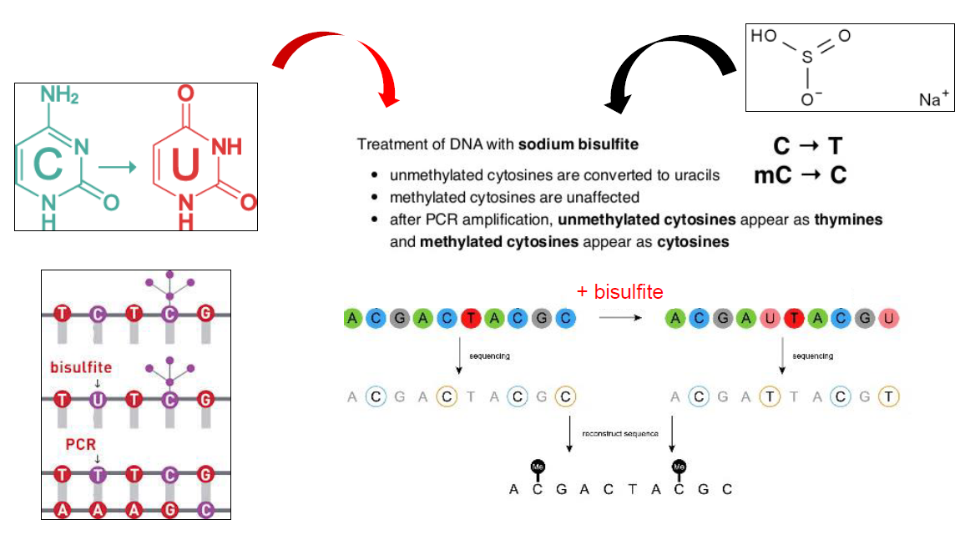
Large scale epigenomic studies
The breakthrough came with the possibility of sodium bisulfite treatments
This process converts all unmethylated cytosines, by deamination, to uracil, while the methylated ones are not altered
Upon sequencing, cytosines converted to uracil are read as thymines
Unmethylated Cs are marked by C->T mutations in mapped reads

Slide 7
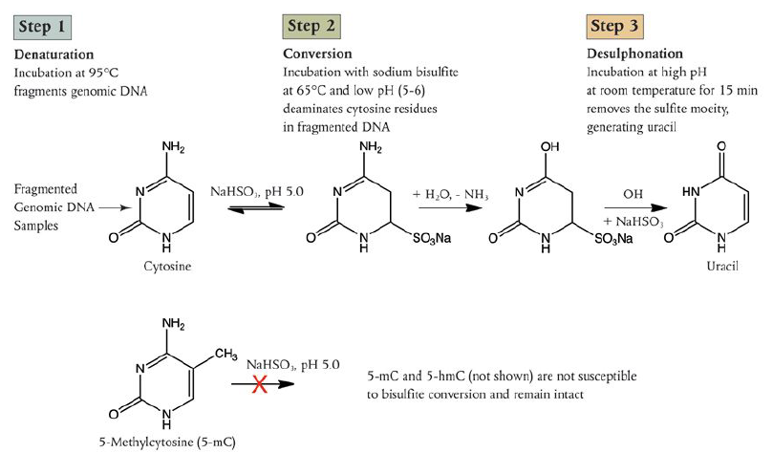
Bisulfite sequencing
In the classical protocol, bisulfite treatment is carried out after the fragmentation of genomic DNA
Conversion of non-methylated cytosines to thymines reduces sequence complexity, with obvious issues to be taken into account during mapping and bioinformatic analysis
Parameters used for alignment of reads with the reference genome should be adjusted to tolerate many more SNPs
N.B. any SNPs present genome-wide where a C should be mutated to a T would not be tractable with a BS-seq approach
N.B. bisulfite sequencing does not distinguish methylcytosines from hydroxymethylcytosines

Slide 8
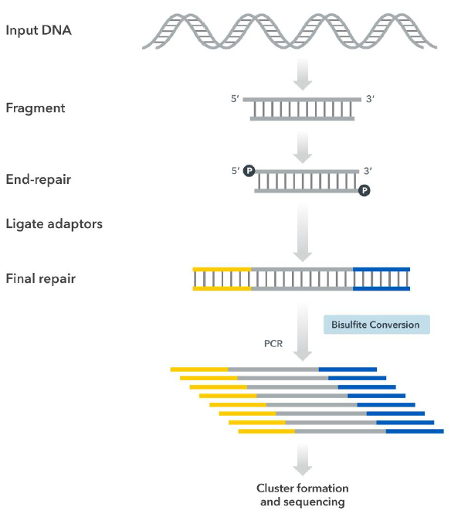
Bisulfite sequencing
How much sequencing is required?
The reads distribute evenly over the entire length of the genome, so it is appropriate to calculate a coverage similar to what would be used with a WGR approach (i.e., >30X)
It is common to use short read PE sequencing
Not all reads will turn out to have consistent profiles at a given position! Sequencing data are derived from a heterogeneous cell sample, in which only some cells may be subject to methylation. The level of methylation for each CpG should therefore be quantified based on the percentage of mapped reads that do not contain a C/T SNP

Slide 9
Bisulfite sequencing – important reference papers
All recent bisulfite-seq developments are linked with the original publication by Frommer et al. 1992 (PNAS, https://doi.org/10.1073%2Fpnas.89.5.1827), cited over 4000 times and written in a pre-NGS era (initially theorized as compatible with Sanger sequencing)
Today, the term bisulfite-seq is often misused to define various methylation site analysis techniques (including those not based on sequencing, such as those based on more microarray-like approaches) that are based on the conversion of unmethylated cytosines to uracil
The first article to intuit the possibility of combining genomic DNA treatment with sodium bisulfite was that of Colella et al. 2003 (Biotechniques, https://www.future-science.com/doi/10.2144/03351md01), using 454 pyrosequencing
We can then consider the work of Lister et al. 2009 (Nature, https://doi.org/10.1038/nature08514) on the methylation profile of the human genome as the one that revealed the full potential of the technique (article cited nearly 5000 times!)

Slide 10

Reduced Representation Bisulfite Sequencing
RRBS-seq can be used to optimize costs and analyze multiple samples in parallel (fewer reads per sample are needed, or when the starting material does not warrant a large amount of genomic DNA
The idea is to digest genomic DNA with MspI (a restriction enzyme insensitive to the presence of methylated cytosines at CpG sites), so as to generate digested fragments that contain CpG sites at the ends
“Biased” data are obtained on regions with high CpG content, thanks to a size selection step, which is used to keep fragments between about 50 and 200 bp in length (very long fragments from regions with low CpG density are discarded)
It is a method that can cover 10-15% of CpGs and is therefore useful for studying specific sites, but not optimal for obtaining complete methylation profiles on a whole-genome scale
Meissner et al. 2015 (Nucleic Acids Resarch, https://doi.org/10.1093/nar/gki901) -> paper cited about 1200 times

Slide 11
Bisulfite sequencing – issues
Bisulfite sequencing requires an input of several micrograms of genomic DNA
Bisulfite treatment is very aggressive and leads to DNA fragmentation (which occurs after the sonication of genomic DNA) -> up to 90% of the input genomic DNA can be lost! To obtain a sufficient amount of ligated fragments, library preparation requires amplification
There is no possibility of discrimination between 5-methylcytosine and 5-hydroxymethylcytosine, although the biological significance of the 2 modifications is different
Conversion of unmethylated cytosines may be incomplete: only single-chain DNA can be converted, so it must be ensured that genomic DNA is denatured before proceeding with treatment, so as to avoid obtaining erroneous signals
Incomplete desulfonation of samples can inhibit subsequent reactions, limiting the sequencing yield of the library

Slide 12
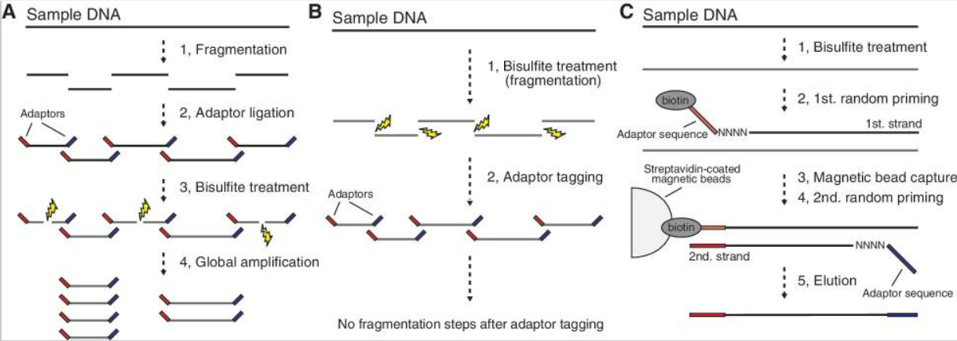
Bisulfite sequencing – possible alternatives
The PBAT (post-bisulfite adapter tagging) method was designed to overcome the problem related to DNA degradation: bisulfite treatment is no longer performed on fragmented genomic DNA (classical approach, panel A below), but is itself used to fragment the DNA (PBAT approach, panel B)
Fragments are then prepared by the addition of adapters containing random biotin-linked primers, which enable their isolation
Miura et al. 2013 (Nucleic Acids Research, https://doi.org/10.1093/nar/gks454)
The required quantity of genomic DNA drops to about100 ng
An alternative strategy for poor amounts of genomic DNA is the combination of BS-seq with tagmentation -> see next slides

Slide 13
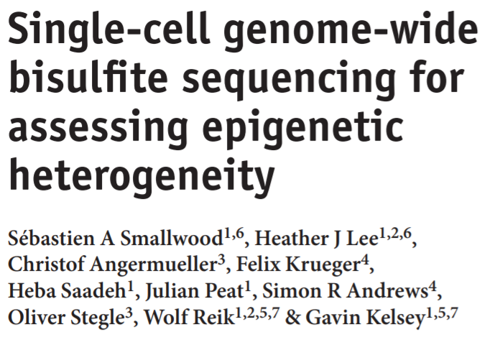
Single-cell bisulfite sequencing
Very useful approach for some applications where analytical resolution on the single cell is required
The amount of genomic DNA that can be extracted from the single cell is very low -> an approach similar to that described above for PBAT needs to be used
Study on oocytes, single cells isolated from the earliest stages of embryonic development, etc.
Whether the technique can be used depends on the ability to effectively isolate single cells -> we rely on the same microfluidics technologies already developed for scRNAseq, ATAC-seq, etc. approaches.
Articolo citato oltre 900 volte dal 2014

Slide 14
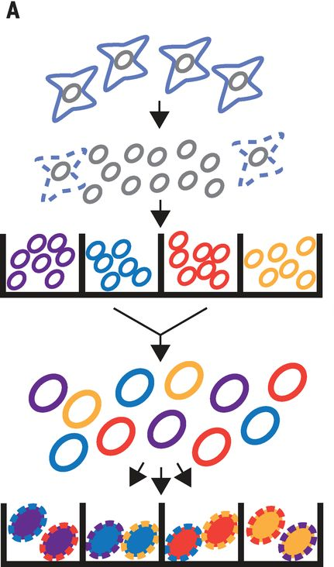
Single-cell combinatorial indexing: obtaining single-cell data without isolating single cells
Our ability to obtain single-cell data is severely limited by the ability to isolate individual cells, and microfluidics approaches are not always applicable, often also leading to non-negligible cell loss
“sci” (single-cell combinatorial indexing) approaches allow working on pools of nuclei, assigning unique combinations of adapters to the DNA fragments generated from each individual nucleus without the need to isolate them individually
Nuclei are partitioned into many wells containing many nuclei each
Tn5 transposase activity is exploited (as in ATACseq), which in adds an initial barcode to the DNA fragments it generates within the nuclei (which remain intact!)
The nuclei from the various wells are then mixed together, diluted, and redistributed to other wells, where a second barcode is added by PCR -> each nucleus will feature a unique pair of barcodes, because it is statistically unlikely, given the number of cells and wells, that two different nuclei could receive exactly the same 2 barcodes by chance
Cusanovich et al. 2015
First «sci» approach(initially developed for ATAC-seq)
https://www.science.org/doi/10.1126/science.aab1601
Step 1: separation of nuclei into wells, addition of barcode 1 by Tn5 transposase (barcode = color of the nuclear membrane)
Step 2: Pooling and redistribution of nuclei, addition of barcode 2 by PCR (internal color of nuclei)
Approach with great potential in single-cell approaches for studying methylation, where sample loss is relevant

Slide 15
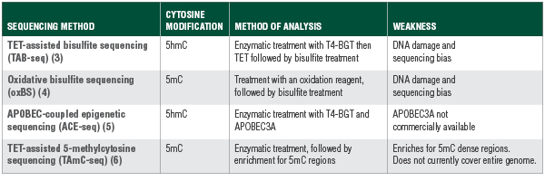
Alternatives to bilsulfite sequencing
As mentioned earlier, bisulfite sequencing does not allow discrimination of 5-methylcytosine from 5-hydroxymethylcytosine
Some enzymatic or nonenzymatic treatments performed serially may allow this problem to be overcome
These are in many cases aggressive methods, which tend to physically damage genomic DNA -> require considerable input of genomic DNA!

Slide 16
Alternatives to bilsulfite sequencing
TAB-seq (TET-Assisted Bisulfite sequencing) uses an enzymatic treatment with a T4 Phage ß-glucosyltransferase (T4-BGT), followed by a second enzymatic treatment with Ten-eleven translocation (TET) dioxygenase, prior to bisulfite treatment
T4-BGT glucosylates 5-hydroxymethylcytosine to beta-glucosyl-5-hydroxymethylcytosine (5ghmC), while TET converts methylated cytosines to 5-carboxylcytosine
Subsequent bisulfite treatment fails to convert 5ghmCs, which are protected, but converts both unmethylated cytosines and 5-carboxycytosine -> all cytosines are sequenced as T, except 5-hydroxymethylcytosines -> specific hydroxymethylation profiles are obtained
Yu et al. 2012 (Cell, https://doi.org/10.1016/j.cell.2012.04.027) -> paper cited more than 1000 times

Slide 17
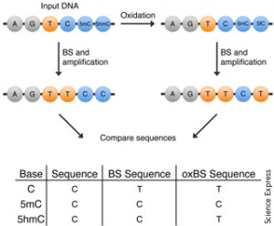
Alternatives to bilsulfite sequencing
Oxidative bisulfite sequencing is another method by which 5-methylcytosine can be discriminated from 5-hydroxymethylcytosine
An oxidative agent, potassium perrutenate, converts 5hmC to 5-formylcytosine, which can be converted to uracil by bisulfite treatment. This treatment, however, does not affect 5-methylcytosine
The result is that only 5-methylcytosines, but not 5-hydroxymethylcytosines, will be sequenced as C, while all others will be sequenced as T -> specific methylation (but not hydroxymethylation) profiles are obtained
Booth et al. 2012 (Science, https://doi.org/10.1126/science.1220671)

Slide 18
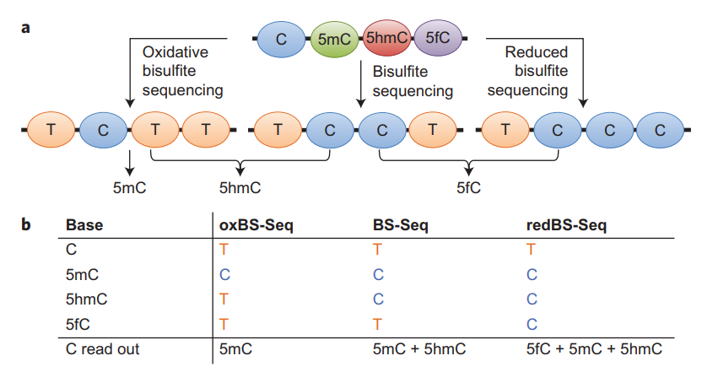
What about 5-formyl cytosines?
Bisulfite treatment does not discriminate between unmethylated C and 5fC (both are converted to U and read as T during sequencing)
Reducing BS-seq (RedBS-seq) allows this discrimination, protecting 5fC from the action of sodium bisulfite
It uses the reducing agent sodium borohydride before the treatment with sodium bisulfite
This method does not, by itself, identify directly 5fC
It needs to be combined with classical BS-seq and oxidative BS-seq

Slide 19
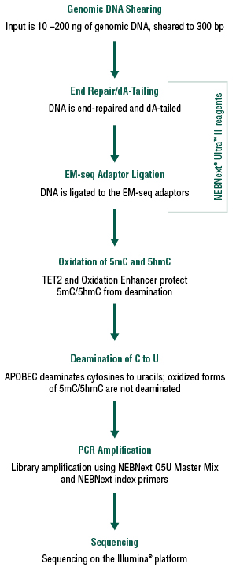
Enzymatic methyl-seq: a novel approach
This technique exploits the enzymatic activity of APOBEC to deaminate cytosines to uracil. APOBEC, however, does not distinguish cytosines from its methylated forms, and it is therefore necessary to combine the activity of TET2 and an oxidative enhancer, which modifies 5-methylcytosines and 5-hydroxymethylcytosines to forms that are not susceptible to the action of APOBEC
APOBEC = family of cytosine deaminases
Basically, cytosines are sequenced as thymines, and its methylated and hydroxymethylated forms are sequenced as cytosines, leading to the same result as bisulfite sequencing
A lower amount of input DNA is required (10-200 ng)
On the side, you can see the protocol used for the Enzymatic Methyl-seq Kit (EM-seq™) library preparation protocol developed by New England Biotechnologies
This is a recently developed method! Vaisvila et al. 2021 (Genome Research, https://doi.org/10.1101/gr.266551.120) -> more than 300 citations to date

Slide 20
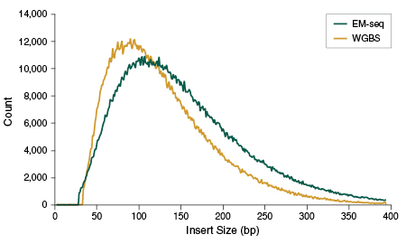
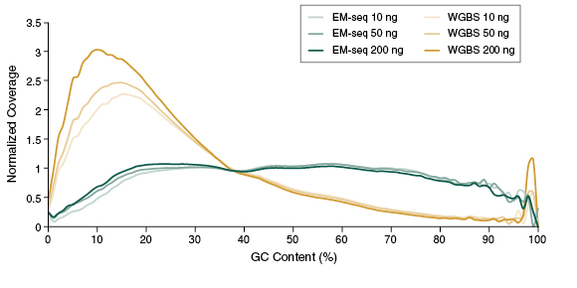
Enzymatic methyl-seq: a novel approach
ADVANTAGES OVER BISULFITE-SEQ
Less aggressive toward genomic DNA -> larger fragment sizes compared to BS-seq (methyl-seq is indicated in the side graphs as “EM-seq”)
Less representation bias toward sequences with “extreme” GC content -> libraries obtained with BS-seq are highly enriched in AT-rich regions
Ability to detect more CpG sites at the same sequencing depth
N.B.: All the techniques seen so far provide single-nucleotide resolution, pinpointing single nucleotides that have been modified

Slide 21
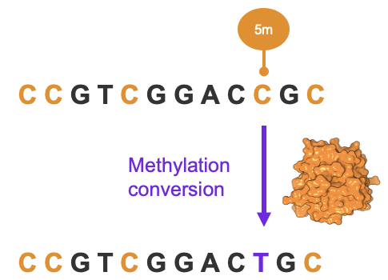
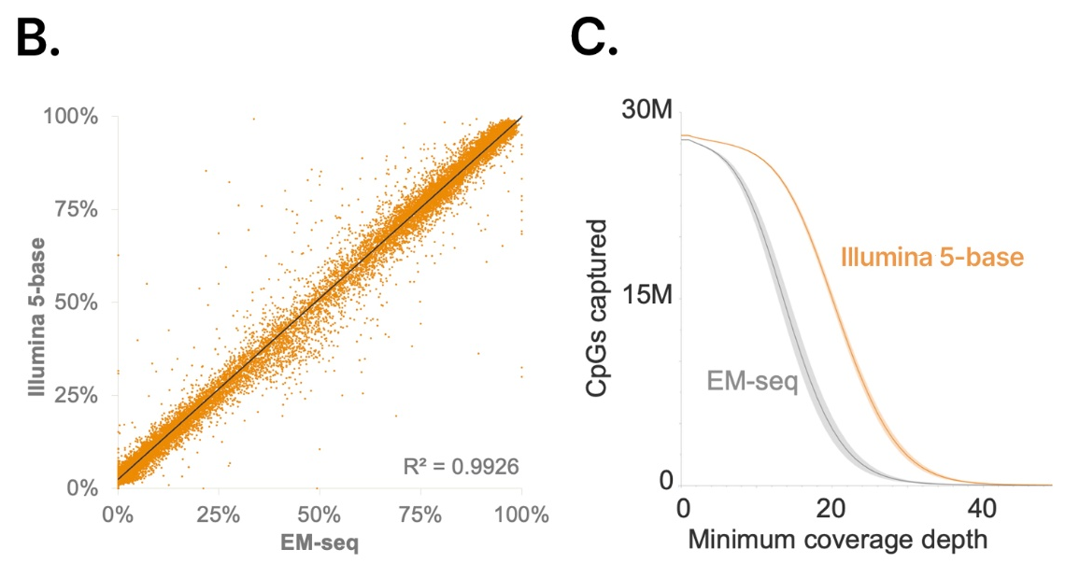
Illumina 5-base solution: the latest entry on the market
The philosophy is similar to EM-seq, since it uses an enzymatic conversion
However, in this case the encymatic conversion targets 5-methylcytosines and converts them to thymine -> this is exactly the contrary of what happens in most other 5mC profiling approaches
The advantage of this approach is that, unlike EM-seq and other techniques, this should allow a highly efficient discrimination between true polymorphisms and 5mC
This is allowed by leveraging the information derived from the complementary DNA strand, which is not enzymatically converted. This is due to the use of a methylation-aware calling software
The correlation with EM-seq is very good, but the sensitivity of Illumina 5-base solution is much higher (i.e. a lower sequencing coverage is required for each sample)
N.B.: the Illumina 5-base solution is a brand new technology and many technical details about the library preparation strategy are still unknown

Slide 22
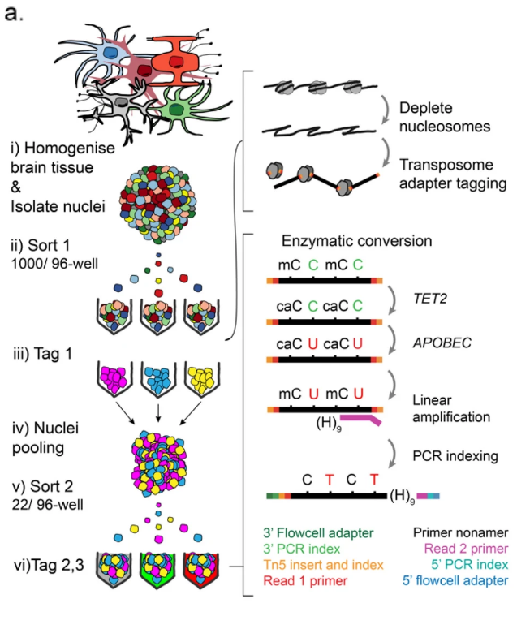
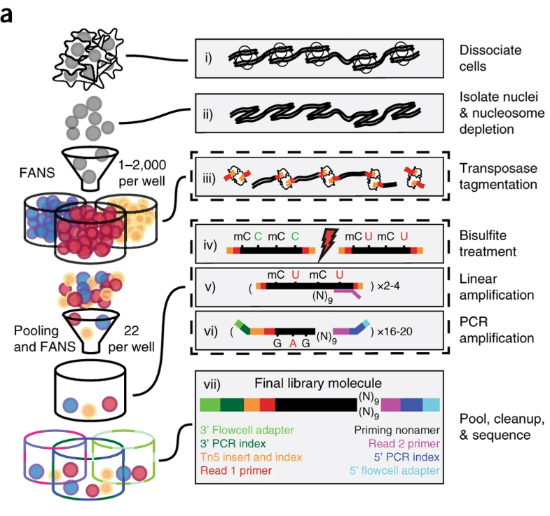
sciMET e sciEM: last generation single-cell approaches
We mentioned a few slides ago the usefulness of single-cell combinatorial indexing (sci) approaches for obtaining sequencing data traceable to single nuclei without the need to separate them one by one
The two state-of-the-art approaches that combine these approaches with BS-seq and EM-seq are called sciMET and sciEM, respectively
Mulqueen et al., 2018
https://www.nature.com/articles/nbt.4112
Chatterton et al., 2023
https://cellandbioscience.biomedcentral.com/articles/10.1186/s13578-022-00938-9

Slide 23
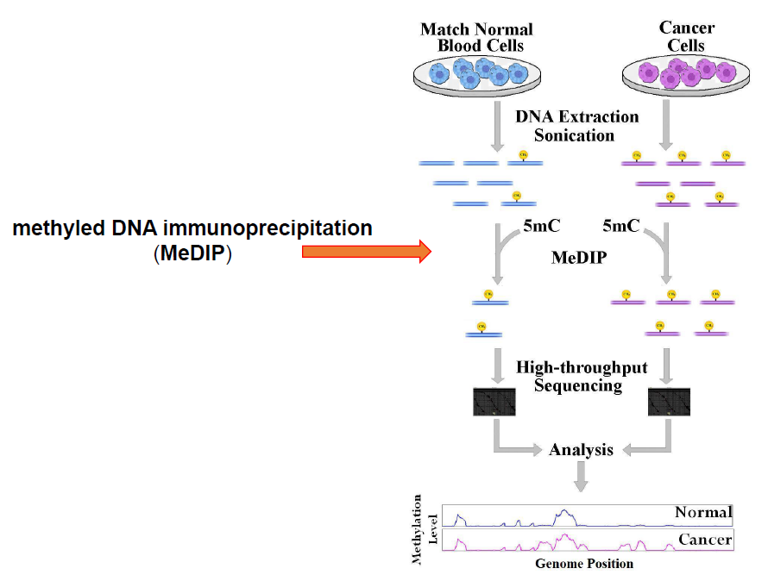
Alternatives to bisulfite-seq: MeDIP-seq
Methylated DNA immunoprecipitation sequencing
Variant: hMeDIP-Seq if the interest is the study of 5-hydroxymethylcytosines
Genomic DNA is fragmented by sonication
Antibodies specific for 5mC (or h5mC) are used that, conjugated to magnetic beads, can allow isolation of DNA fragments of interest
Mappable reads are obtained at positions where one or more methylated or hydroxymethylated cytosines are present
Weber et al. 2005 (Nature Genetics, https://doi.org/10.1038/ng1598). Reference paper cited about 2000 times

Slide 24
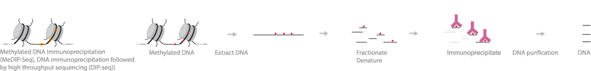
Alternatives to bisulfite-seq: MeDIP-seq
PROs
Allows coverage of the entire genome, and antibody-based enrichment is free from bias related to GC content of certain genomic regions
Does not require enzymatic conversions, is a much less aggressive method for genomic DNA, and thus requires a much lower input
CONs
Resolution is lower than BS-seq -> no nucleotide-by-nucleotide methylation traces are obtained, but simply mapping peaks at regions of DNA rich in 5-methylcytosines (or 5-hydroxymethylcytosines)

Slide 25
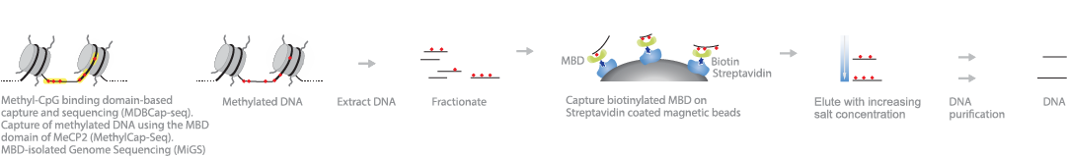
Alternatives to bisulfite sequencing: MBDcap-seq
Different protocol variants have been published, named in different manners: MDBcap-seq, MethylCap-seq, MBD-seq
Utilizes the ability of Methyl-CpG-binding (MBD) family proteins to bind methylated DNA (but not regions rich in 5-hydroxymethylcytosine)
Sonicated genomic DNA is incubated with biotinylated MBD proteins, thus allowing isolation of the bound fragments by streptavidin-conjugated magnetic beads
The fragments are then purified and used to create sequencing libraries
Like the previous method, it is less aggressive and does not require enzymatic conversions, but it does not offer single-nucleotide resolution comparable to BS-seq and methyl-seq

Slide 26
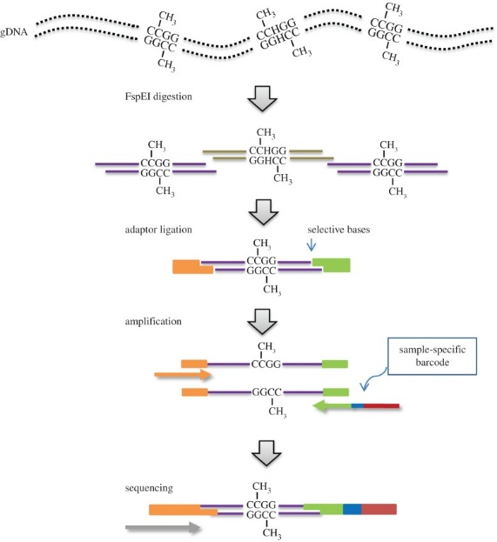
Alternative to bisulfite sequencing: Methyl-RAD
Technique inspired by RAD-sequencing (an approach dedicated to population genomics studies), and more specifically the 2b-RAD technique
The basic idea is to use a method of reducing complexity, allowing genome-scale methylation profiles to be obtained with a relatively low number of reads
Restriction enzymes capable of making a cut only in the presence of methylated cytosines are used -> the cut is made upstream and downstream of the site at a well-defined distance -> by size selection, fragments all of the same size are obtained, which can then be ligated with adaptors and sequenced

Slide 27
Limitations for the study of non-model organsims
All of the techniques we have discussed so far require, in order to track methylated sites, a mapping of reads to the reference genome
In non-model organisms, for which a reference genome is not available, these approaches are not possible
Even if a fully sequenced genome were available, the biological interpretation of the data would be largely dependent on the quality of the assembly and the quality of the gene annotation
Imagine a genome in which many genes are not annotated correctly: we would not have the ability to connect mapping peaks with the functional elements to which they are linked
Keep in mind that the regulatory elements of gene expression outside vertebrates and a few model invertebrates, plants and fungi are almost completely unknown

Slide 28
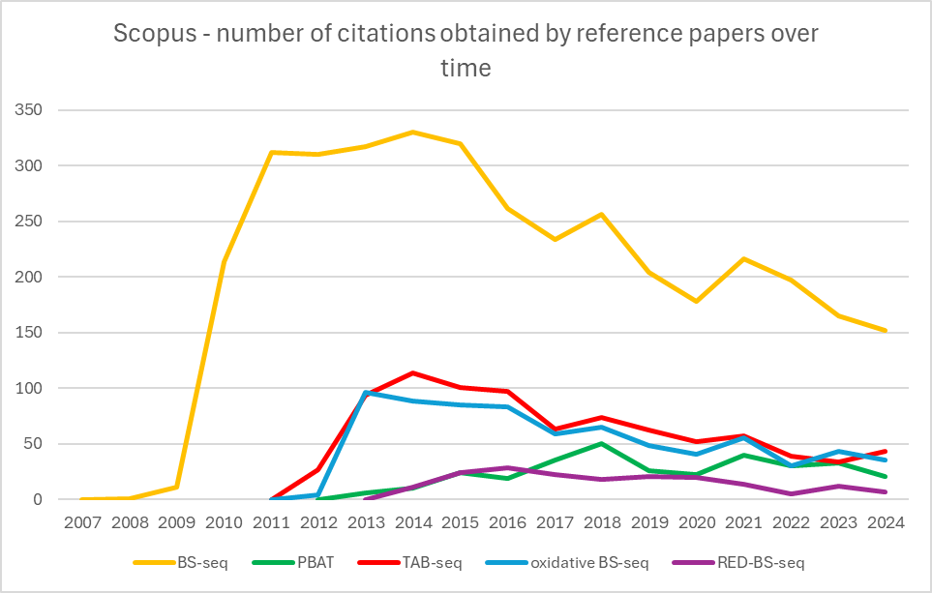
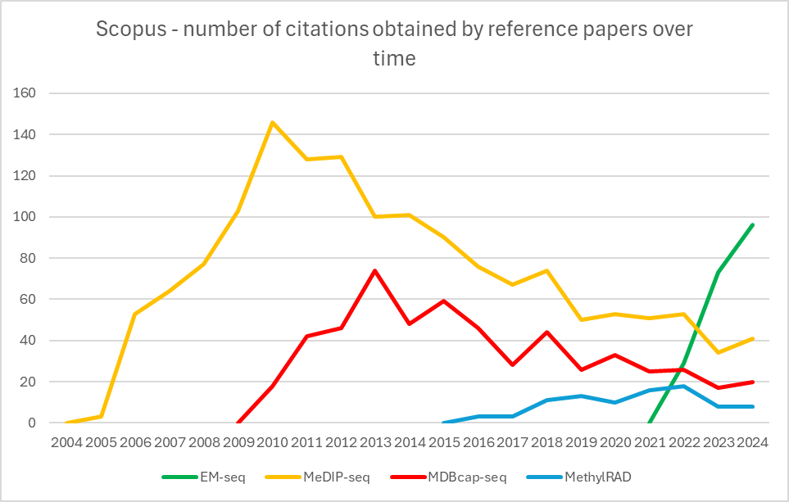
DNA methylation study: trends
BS-seq and other chemical treatment-based variants
Alternative approaches (enzymatic, restriction-based or immunoprecipitation-based)

Slide 29
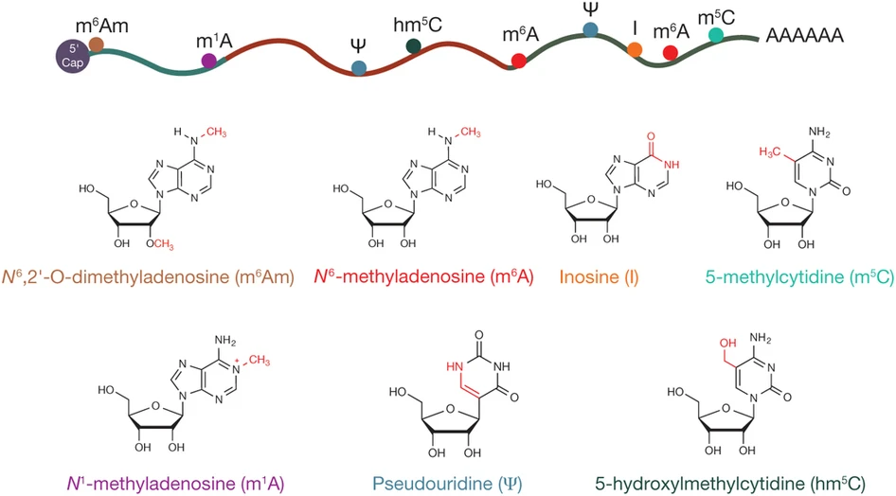
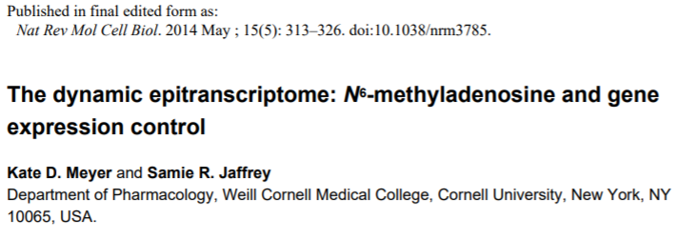
From epigenomics to epitranscriptomics
Even mRNAs can undergo base modifications through a process known as RNA editing
RNA editing can involve both mRNAs and other classes of RNAs and results in substitutions with “classic” bases or with rare and unusual nucleotides
N6-methyladenosine (M6A): this is the most abundant and studied modification in mRNAs

Slide 30
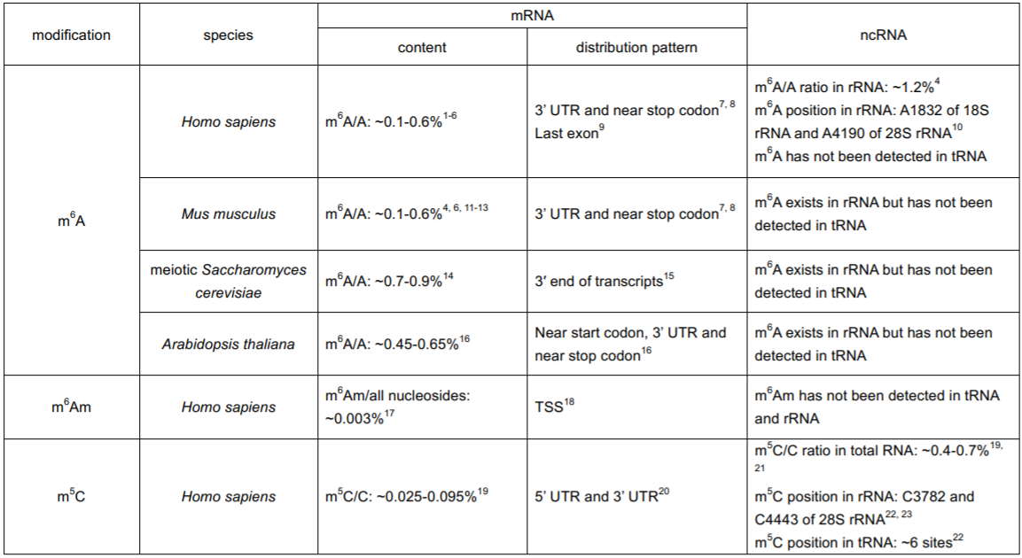
From epigenomics to epitranscriptomics
Some epitranscriptomic modifications are much more common than we realize

Slide 31
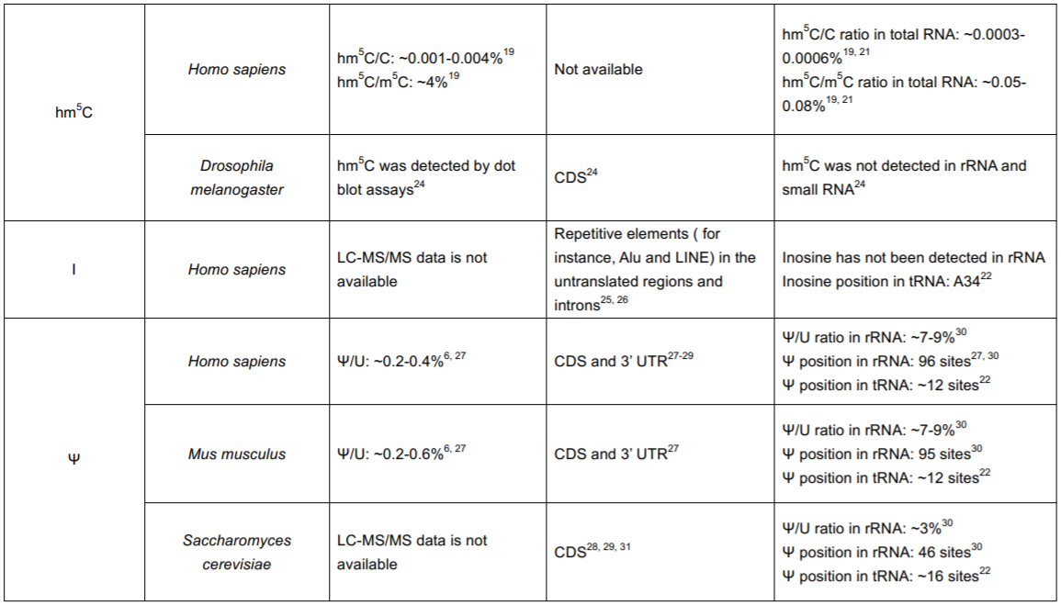
From epigenomics to epitranscriptomics

Slide 32
Epitranscriptomics: general issues
As we have already discussed extensively, almost all sequencing techniques involve the preparation of libraries that must match double-stranded DNA, thus requiring retrotranscription of RNA to cDNA
This process could lead to the loss of direct information regarding the presence of the modified nucleotide (during retrotranscription usually the 4 classical dNTPs are used)
In case a reference genome is not available, it would not be possible to map any SNPs resulting from chemical or enzymatic conversion processes of the modified nucleotides
The number of reads obtained for each transcript will be variable and dependent in each case on expression levels, making any quantitative approach difficult
Some rather ingenious protocols had to be devised to overcome some of these limitations, although the simplest approach is related to the possibility of immunoprecipitating RNAs using antibodies capable of recognizing the modified nucleotides

Slide 33
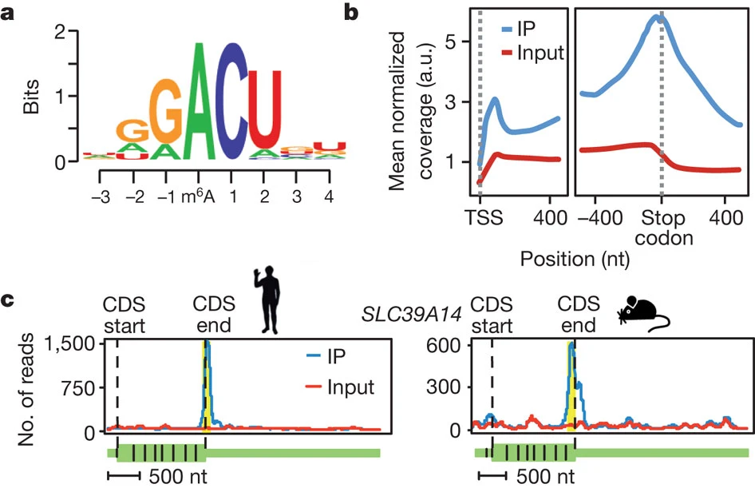
MeRIP-Seq/m6A-seq
Method used to study N6-methyladenosine (actually two very similar techniques, published under a different acronym). Inspired by RIP-seq
Use anti-M6A antibodies to immunoprecipitate RNA molecules containing M6AModification that is estimated to affect about 7000 human genes and occurs mainly at stop codons and long internal exons
Occurs at highly conserved sites in human and mouse -> indirect evidence of important (though not fully understood) functional role, certainly regulating gene expression and alternative splicing

Slide 34
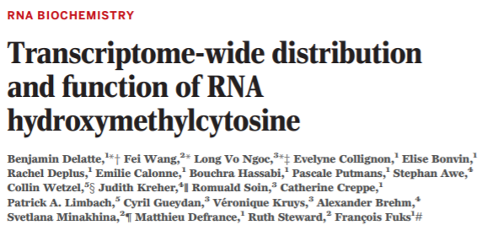
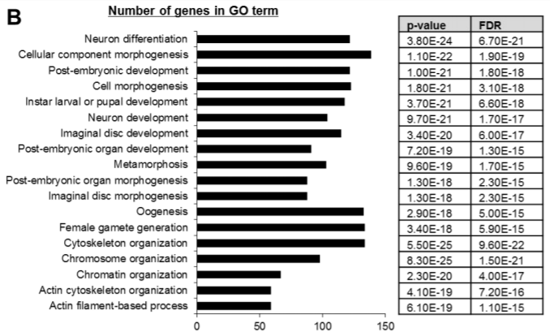
hMeRIP-Seq
Exactly identical to the previous strategy, but focused on 5-hydroxymethylcytosine
It is a modification that appears to promote translation
It is of particular importance in Drosophila -> relatively rare epitranscriptomic modifications in vertebrates could be very important and widespread in other phyla
«hydroxymethylated RNA are found to be most abundant in the Drosophila brain, and Tet-deficient fruitflies suffer impaired brain development, accompanied by decreased RNA hydroxymethylation.“
To answer the biological question regarding the function of these modifications, one can ask whether transcripts that exhibit it are enriched in certain functions! -> the one opposite is an example of how approaches based on hypergeometric assays can also find application outside of RNA-seq experiments

Slide 35
MeRIP-Seq/hMeRIP-Seq: issues
These methods cannot detect modifications at the single nucleotide level
Methylation sites for m6A usually occur in clusters
The fragments included in the library certainly include at least one methylated site, but we cannot know at what exact location
We expect in any case, taking into account the mapping of many reads, that the methylated site falls roughly in the center of the mapping peak
The resolution of the technique (precisely because of the presence of m6A clusters) is equal to read length (thus short single-end reads sufficient)
A large amount of starting RNA is required
There is no method to directly assess the presence of peaks related to false positives -> beware of transcript coverage bias (recall what was said in the RNA-seq lectures, especially about the very different abundance of transcripts expressed at high or low levels)

Slide 36
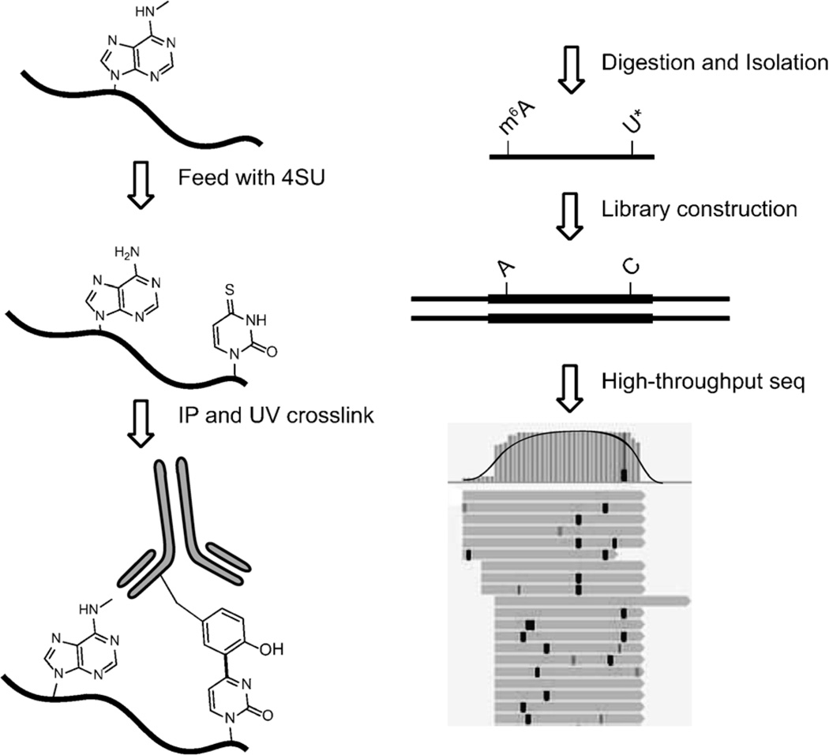
PA-m6A-seq
photo-crosslinking-assisted m⁶A sequencing
Incorporation of 4-thiouridine (4SU) into newly synthesized RNA is forced in place of U following its addition into the culture medium (N.B. not usable in vivo, except for culturable unicellular organisms)
Immunoprecipitation with anti-m6A antibody (as in MeRIP-seq), followed by crosslinking between the antibody and 4SU (which in some cases will be found adjacent to an m6A)
Fragmentation to obtain fragments of just over 30 nt, followed by (1) removal of antibody by digestion with proteinase K and (2) reverse transcription, incorporating C instead of 4SU
Increased resolution compared to MeRIP-seq up to a few tens of nucleotides, but this method still lacks the ability to pinpoint the precise site. In addition, m6A that are far from sites where 4SU has been incorporated cannot be mapped
Sites where 4SU has been incorporated are marked by T -> C SNPs

Slide 37
miCLIP-m6A
Strategy to map methylation sites at the single nucleotide level: “mi” -> m6A individual; CLIP = cross-linking immuno-precipitation (already cited for mRNA-protein interaction studies)
N.B. this technique refers to the publication by Grozhik et al. 2017; there is a technique described by the same name by other authors that uses a different ptotocol
Anti-m6A antibodies are cross-linked to RNA by the action of ultraviolet light
RNA-antibody complexes are precipitated and purified and later retrotranscribed to cDNA; the antibody is degraded with proteinase K
The cDNA fragments are truncated during retrotranscription (or, in a slightly different protocol, introduce C->T mutations) at position +1 relative to the m6A site -> increased single-nucleotide resolution

Slide 38
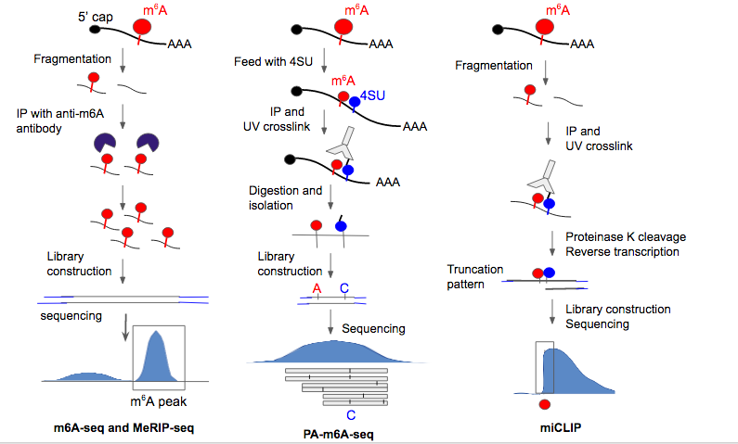
m6A detection methods – a comparison
Increasing resolution

Slide 39
m6A detection – the quantification problem
The techniques described so far allow us to identify (with varying accuracy) the location of m6A BUT DO NOT ALLOW to determine the extent to which transcripts are modified at a given position
For example, only 10% of mRNAs of a given type might have m6A at a given position, but the mapping result would not allow us to make a quantitative estimate (partly because the number of reads mapped to a given position is directly proportional to the level of methylation, but also to the level of expression, as in an RNA-seq)
The m6A-LAIC-seq (m6A-level and isoform-characterization sequencing) technique attempts to solve this problem: full-length mRNAs are immunoprecipitated with anti-m6A antibodies and both the eluate (containing the recognized mRNAs) and the supernatant (containing the mRNAs lacking m6A) are used separately for library preparation
Spike-ins of known synthetic RNAs are added to both samples, which will be used to normalize the abundances of the mRNAs in the two samples and perform a comparison for the detection of the enriched mRNAs in each of them

Slide 40
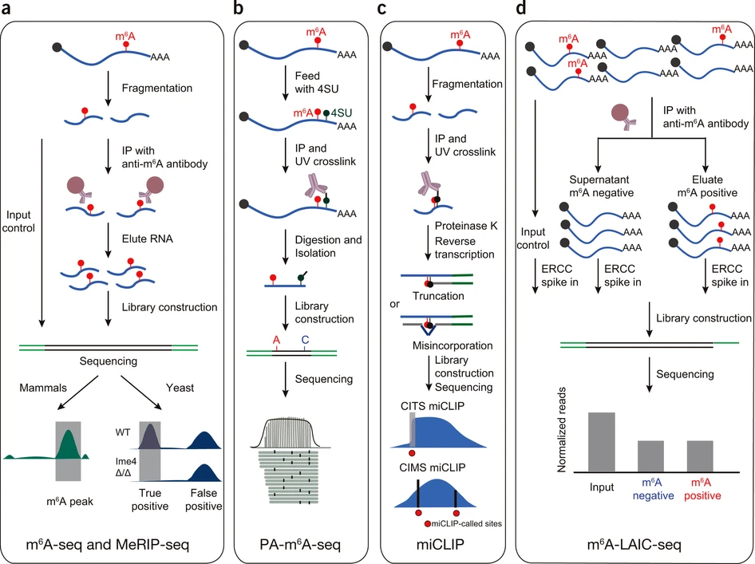
Metodi per il rilevamento di m6A – un confronto
M6A POSITIONAL INFORMATION ONLY
INFO ABOUT THE RELATIVE ABUNDANCE OF mRNAs WITH AND WITHOUT M6A

Slide 41
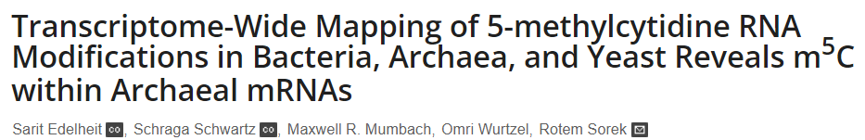
m5C – una modificazione abbondante anche negli RNA
m5C is also quite frequent in several classes of RNAs, including several long non-coding RNAs, tRNAs but especially in rRNAs, where it appears to significantly influence the accuracy of the protein translation process
The methods developed for the study of m5C were initially based on a bisulfite sequencing protocol adapted for RNA (Edelheit et al. 2013, https://doi.org/10.1371/journal.pgen.1003602)
Keep in mind that bisulfite treatment is very aggressive and ill-suited to a perishable molecule such as RNA. It is possible to reduce the incubation temperature because of the single-helix structure of RNA
However: (i) the treatment is very aggressive and greatly degrades mRNAs; (ii) C->U conversion at lower temperatures is not efficient in regions where RNAs create secondary structures; (iii) the concomitant presence of other modifications protects some m5Cs from conversion

Slide 42
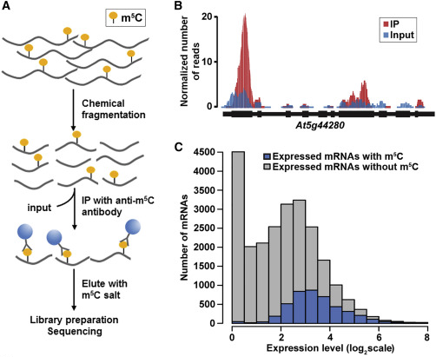
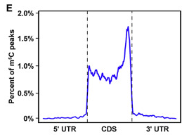
m⁵C-RIP-seq
Given the issues with bisulfite treatment of RNAs, it is preferred to use an immunoprecipitation-based technique similar to MeRIP-seq and hMeRIP-seq
The use of an anti-m5C antibody allows the precipitation of mRNA molecules in which this modification is present: the technique is called m⁵C-RIP-seq (Cui et al. 2017, https://doi.org/10.1016/j.molp.2017.09.013)
Transcript fragmentation, which occurs prior to immunoprecipitation and retrotranscription, leads to mapping peaks at the most methylated regions, but without achieving single-nucleotide resolution
In Arabidopsis m⁵C are found in the CDS (but not in the UTRs) of some mRNAs undergoing low translation activity by ribosomes, but are particularly abundant at the initial ATG codon and STOP codon

Slide 43
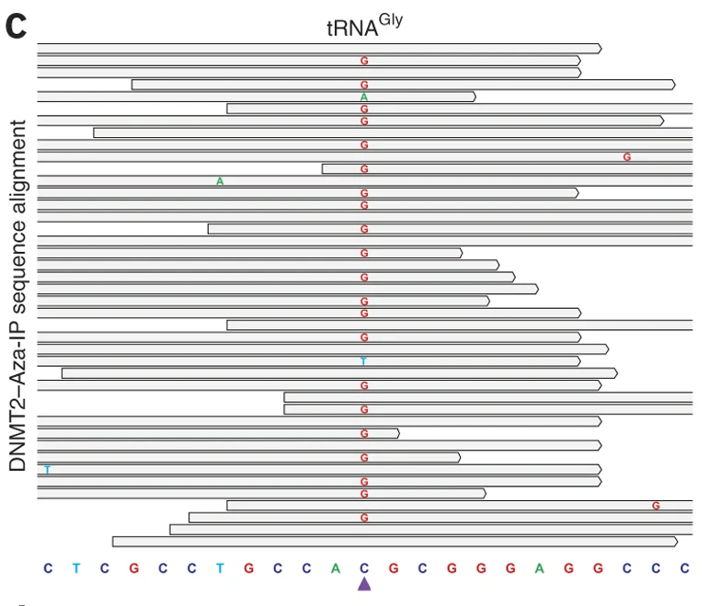
m5C single-nucleotide profiling
mRNAs sites subject to methylation by the RNA enzyme m5C methyltransferase can be identified
Cells (in in vitro experiments only) are incubated with the presence of 5-AZAcytidine in the culture medium. This C analogue is incorporated into newly synthesized mRNAs and results in the formation of stable binding between methyltransferase and its methylation target site
An antibody against methyltransferase is used to immunoprocipitate the enzyme/RNA complexes, followed by retrotranscription
This leads to detachment of the methyltransferase and creation of a gap at the single nucleotide where the complex was present -> this will be retrotranscribed as G and detected as SNP C -> G in sequencing
This technique is named Aza-Ip-Seq (Khoddami e Cairns, 2023, https://doi.org/10.1038/nbt.2566)
A similar protocol to miCLIP introduces mapping “steps” at the +1 position relative to the methylation site, thanks to the use of a mutated methyltransferase that creates stable complexes between enzyme and methylation target site

Slide 44
ICE-seq
Method used for inosine profiling, i.e., detection of adenosine-to-inosine modified sites
RNA is treated with acrylonitrile, in parallel with an untreated control. The treatment modifies inosine to N1-cyanoethylinosine and results in the retrotranscription of inosine-containing RNAs being truncated at the position where I is present. Hence the acronym ICE -> Inosine Chemical Erasing
This results in reads whose mapping at the modified sites will drop and where in parallel an alteration in the ratio of A (arising from the unmodified RNAs) to G (arising from the modified RNAs) will be observed in the samples processed without acrylonitrile treatment. This technique offers quantitative data with single nucleotide resolution, but not without problems
The procedure is technically complex and extremely laborious. In addition, it is difficult to distinguish the signal from background noise, and it becomes almost impossible to detect “rare” modifications

Slide 45
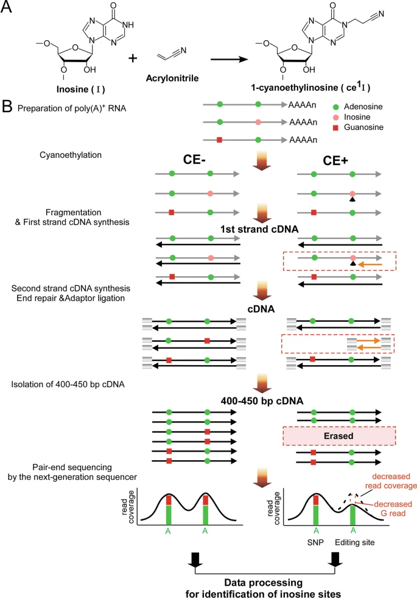
ICE-seq
In the control sample (acrylonitrile -) the inosines are sequenced as G (mixed A/G sequencing signals will be noted at a given site)
In the acrylonitrile+ sample, the signal at the same site will be “clean”

Slide 46
Pseudo-seq
A similar method to that described for inosine profiling is available for the detection of pseudouridine, the quantitatively most abundant RNA modification (especially in tRNAs, rRNAs, and snoRNAs), less so in mRNAs and lincRNAs
As in ICE-seq, a reagent is introduced that can chemically modify pseudouridine
This is CMCT (N-cyclohexyl-N′-b-(4-methylmorpholinium) ethylcarbodiimide metho-p-toluene-sulfonate)
CMCT converts pseudouridine to CMC-Ψ, which causes retrotranscriptase stalling, resulting in reads that will terminate at pseudouridine. A variation of this method can use a derivative of CMCT (azido-CMCT), which facilitates biotinylation of the modified mRNAs, enabling their pull-down (CEU-seq)
Like ICE-seq this is a method with single nucleotide resolution, which generates “steps” in reads coverage at the sites where pseudouridines are present. However, it is very aggressive (much starting RNA is needed) and is not a quantitative approach (conversion is incomplete)

Slide 47
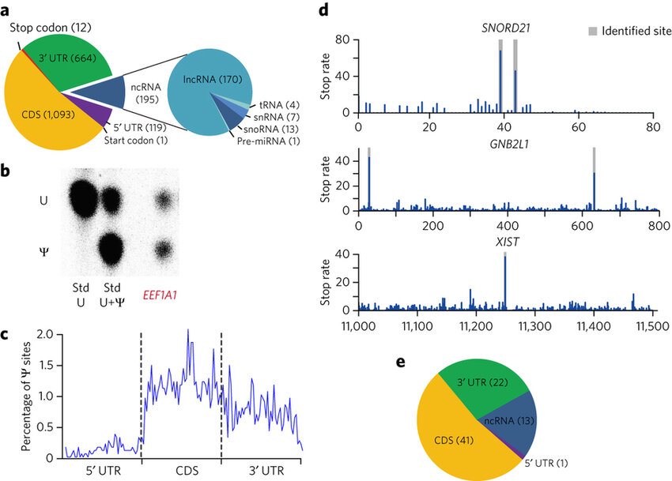
Pseudo-seq/Ceu-Seq: an example
General profile of the occurrence of pseudouridines (in% of total nucleotides observed in a given portion) on human mRNAs: note the preponderance in CDS and 3'UTR, accompanied by the almost total absence in 5'UTR
Map of the position of pseudouridine sites in 3 mRNAs: peaks identify the end of the alignment between reads and reference transcript sequence

Slide 48
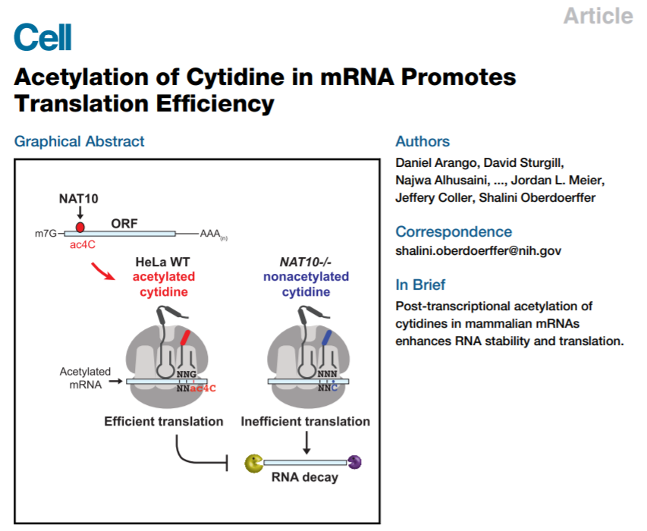
ac4C-seq
Rilevazione di N-acetilcitidina (ac4C)
Il processo di acetilazione della citosina sembra essere legato ad una maggiore stabilità degli mRNA, portando ad un incremento della traduzione
Ricordiamoci che non sempre trascrizione e traduzione vanno di pari passo!
E’questo il motivo per cui non sempre i dati di RNA-seq trovano un riscontro perfetto nei dati proteomici (ricordiamoci il discorso fatto sulla correlazione trascrittoma/proteoma e traslatoma/proteoma)

Slide 49
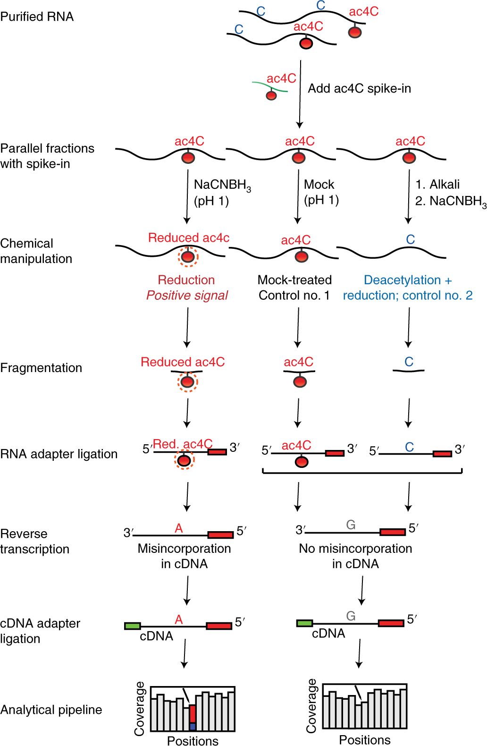
ac4C-seq
Method developed very recently to identify N4-acetylcytidine in mRNAs
It exploits the ability of sodium cyanoborohydride to reduce, under acidic conditions, acetylated cytosines
Similar to BS-seq, ac4C-seq also generates reads with modified nucleotides at acetylated cytosines, which will then be read as A
N.B. the controls consist of 1) the sample not treated with NaCNBH₃ and 2) the sample deacetylated in alkaline environment -> rather laborious procedure

Slide 50
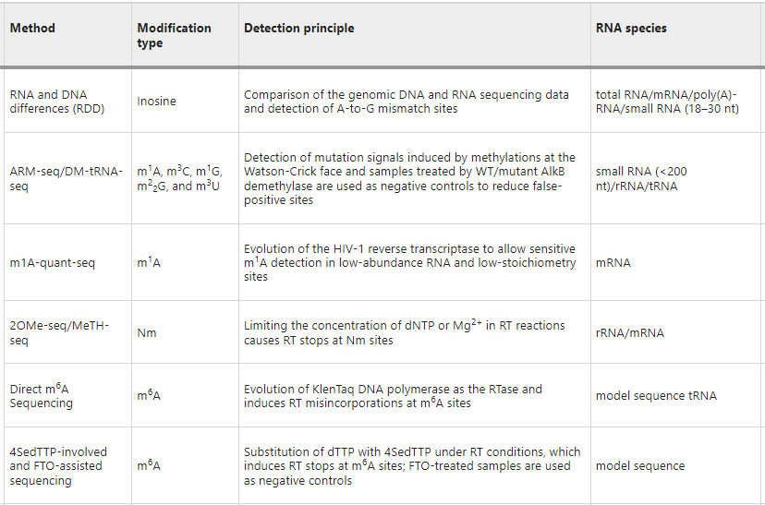
Epitranscriptomics: a high number of novel approaches
We have seen only a few of the best-known and most commonly used examples, but there are several dozen others, often only usable in specific contexts!
For a complete overview, updated to the end of 2022: https://www.nature.com/articles/s12276-022-00821-0
In this table we see some examples of methods that allow direct sequencing of modifications

Slide 51
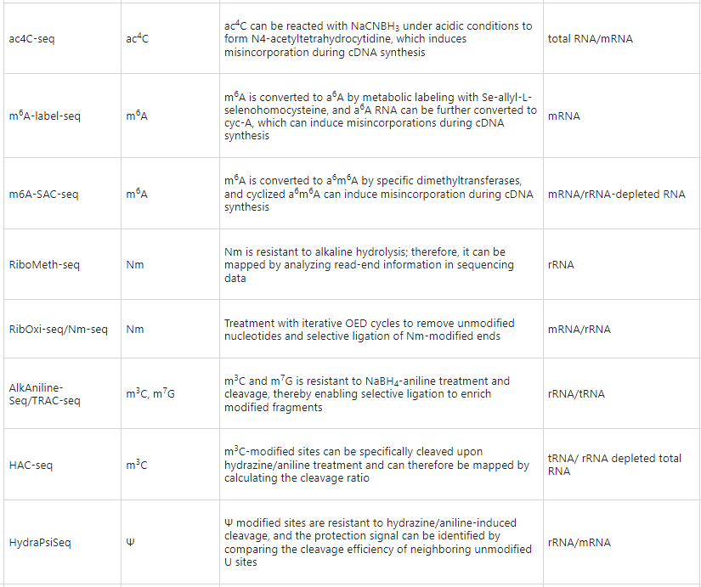
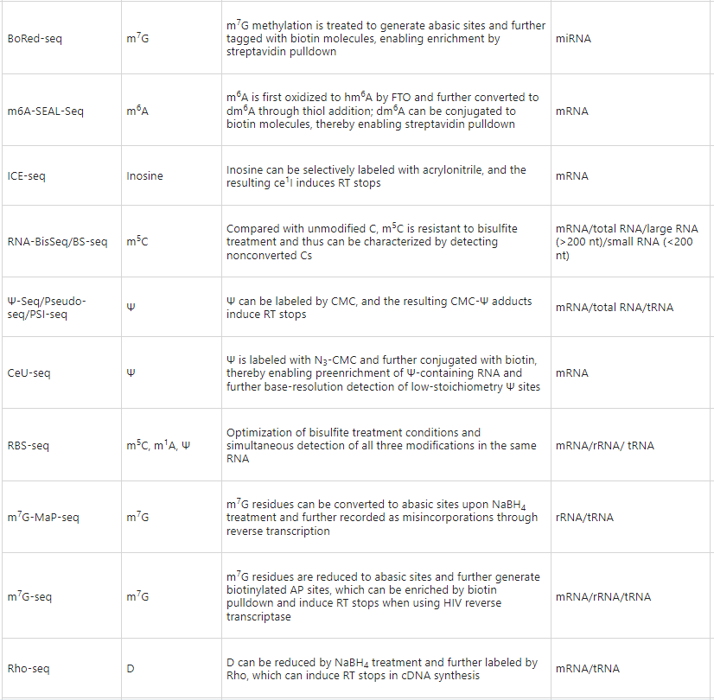
Epitranscriptomics: a high number of novel approaches
Here we see a series of chemical reagent treatment-assisted methods, with the ones we mentioned being highlighted

Slide 52
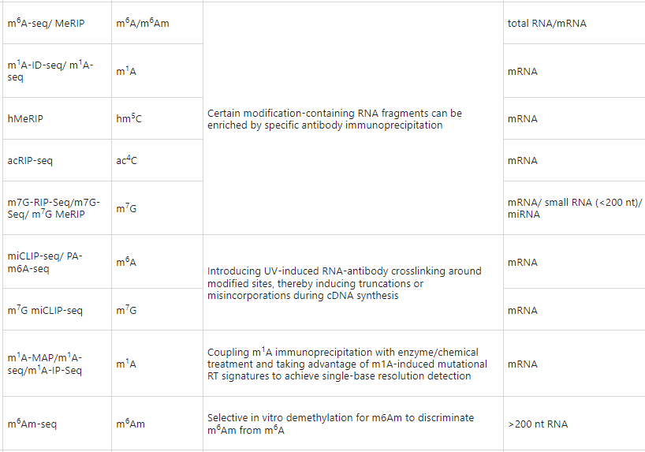
Epitranscriptomics: a high number of novel approaches
Instead, this is a series of immunoprecipitation-based methods, with those we mentioned being highlighted

Slide 53
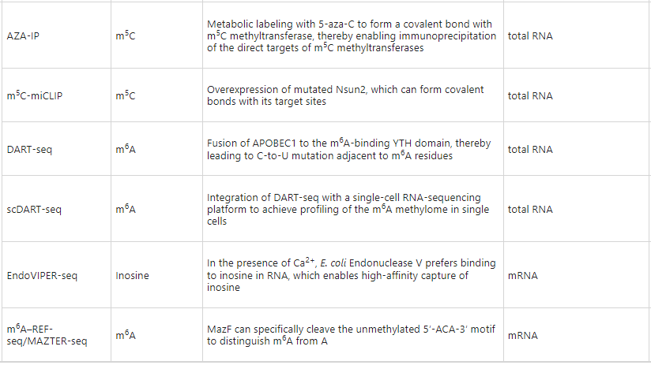
Epitranscriptomics: a high number of novel approaches
Instead, this is a series of methods based on the interaction between RNA and enzymes or proteins involved in the production of the modified nucleotides or their binding, with those we have mentioned being highlighted

Slide 54
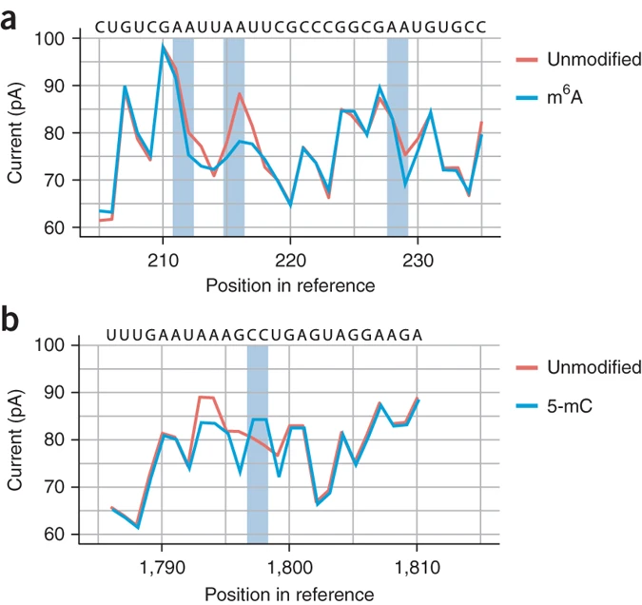
Third-generation sequencing and epitranscriptomics
The use of ONT sequencing techniques can be useful in the study of modifications at the mRNA level for at least two distinct reasons
It is possible to directly sequence mRNA molecules without the need for conversion to cDNA and amplification steps by PCR
Modified nucleotides, as they pass through, produce a characteristic alteration in the current flow through the pore, allowing rather efficient identification
Still requires bioinformatically optimal tuning to reduce error rate, but works pretty well for m6A!

Slide 55
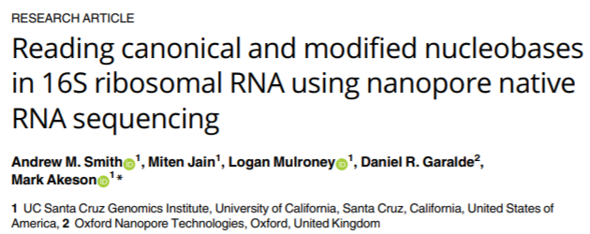
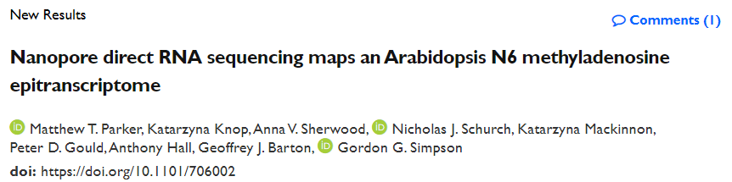
Third-generation sequencing ed epitrascrittomica
«The methods mentioned here demonstrate that ONT sequencing harbors the potential to revolutionize the transcriptome-wide prediction of RNA modifications. However, each of the available solutions currently has limitations. Differential error algorithms require matched low- and high-modification samples with identical genetic backgrounds because differences in DNA sequence (e.g., SNPs) will result in errors that are unrelated to RNA modifications. This limits the current use of these algorithms to systems where a low-modification control can be obtained on the exact genetic background of the sample of interest.”
Anreiter et al. 2020

Slide 56

An example: m6A site mapping on 7KS snoRNA
Each individual nucleotide is characterized by a p-value, derived from the analysis of reads using a specially designed algorithm
The sites that show a p-value most tending toward zero are those where the level of methylation is greatest

