Slide 1
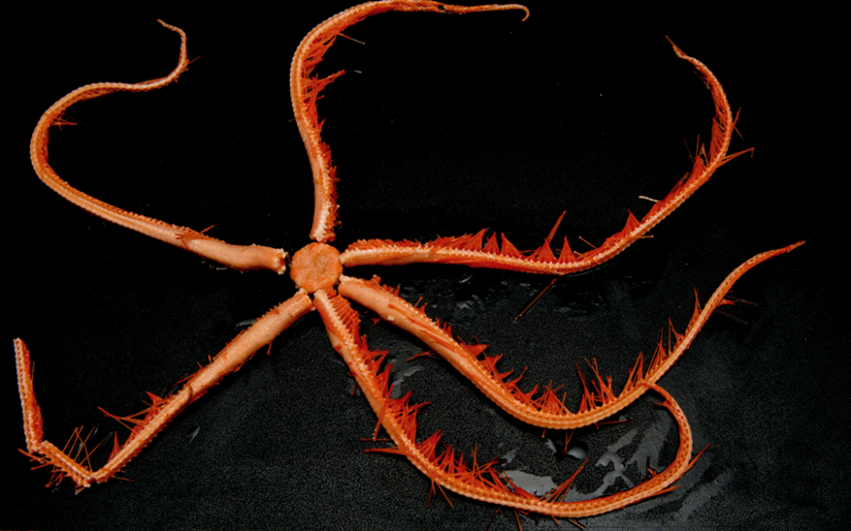
The target species for a de novo sequencing approach
Astrolirus patricki
Phylum | Echinodermata
Family | Brisingidae
Expected genome size | 1 Gb
Target coverage | 30X

Slide 2

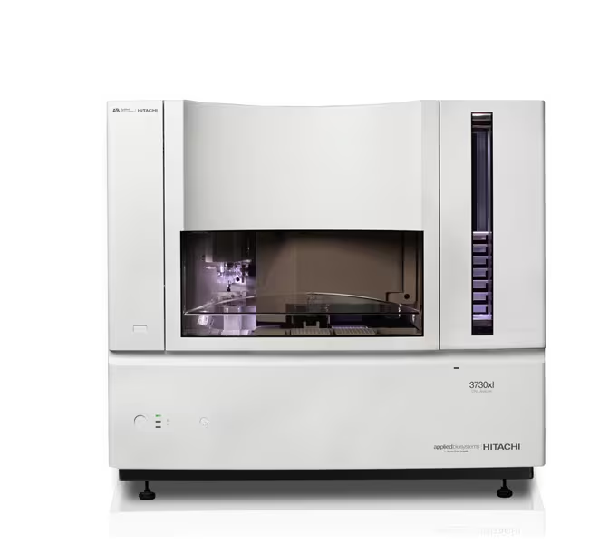
Team 1 –2002
Applied Biosystems 3730xl DNA Analyzer
number of available capillaries per plate | 96
average read length | 800 bp
paired-end mode supported | NO
runtime | 1 hour
sequencing cost per plate | 400$

Slide 3

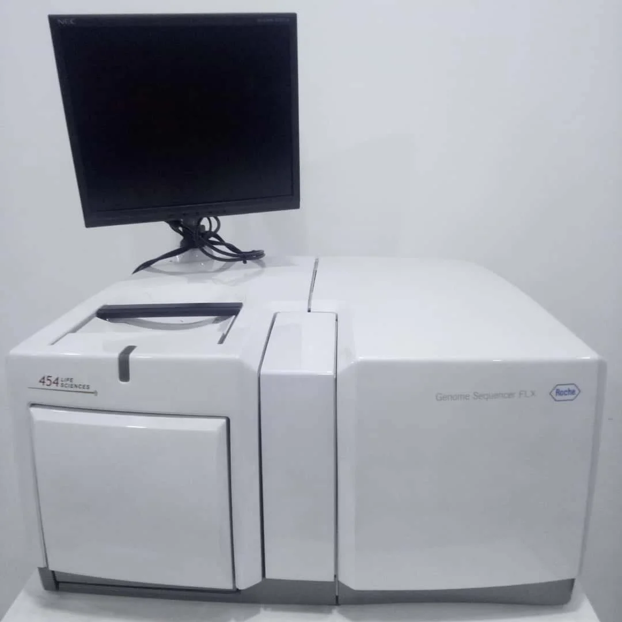
Team 2 –2008
454 Life Sciences FLX Titanium
number of available lanes per run | 1
number of polonies per lane | 1 million
average read length | 400
paired-end mode supported | NO
runtime | 9 hours
sequencing cost per lane | 8000$

Slide 4

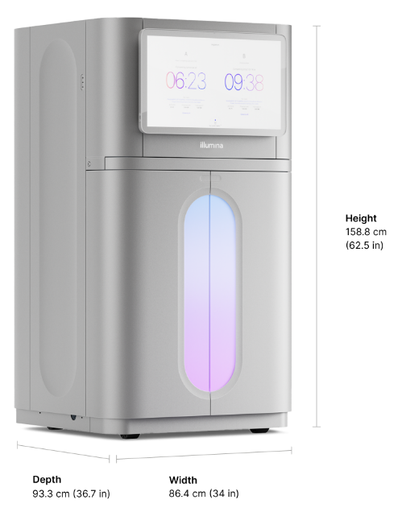
Team 3 –present time
Illumina NovaSeq 6000
number of available flowcells per run | 2
number of available lanes per run | 2 (S2 flowcell) or 4 (S4 flowcell)
number of clusters per lane | 2,5 billion
average read length | 2x150
paired-end mode supported | YES
runtime | 44 hours
sequencing cost per lane | 3800$

Slide 5

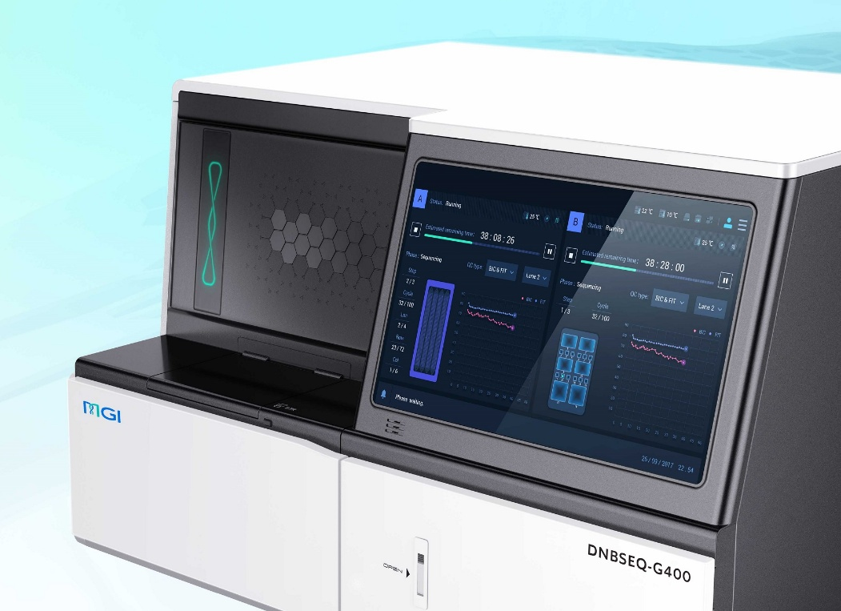
Team 4 – present time
BGI-seq DNBSEQ-G400
number of available flowcells per run | 2
number of available lanes per run | 2 (FCS flowcell) or 4 (FCL flowcell)
number of clusters per lane | 200 millions (FCS) 400 millions (FCL)
average read length | 2x150
paired-end mode supported | YES
runtime | 32 (FCS) or 50 (FCL) hours
sequencing cost per lane | 700$ (FCS lane), 850$ (FCL)

Slide 6

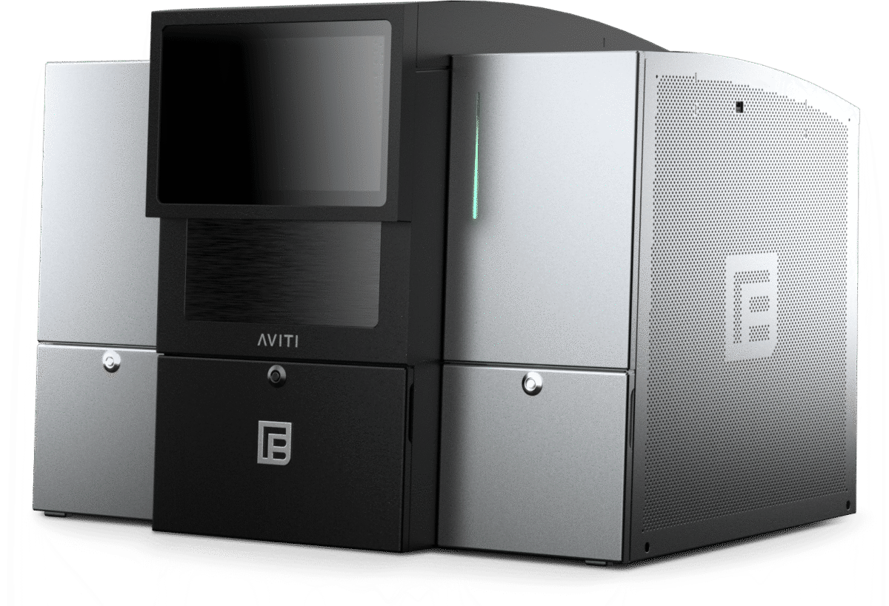
Team 5 –present time
Element Biosciences AVITI
number of available flowcells per run | 2
number of available lanes per run | 1
number of clusters per lane | 300 million
average read length | 2x300bp
paired-end mode supported | YES
runtime | 60 hours
sequencing cost per lane | 4400$

Slide 7

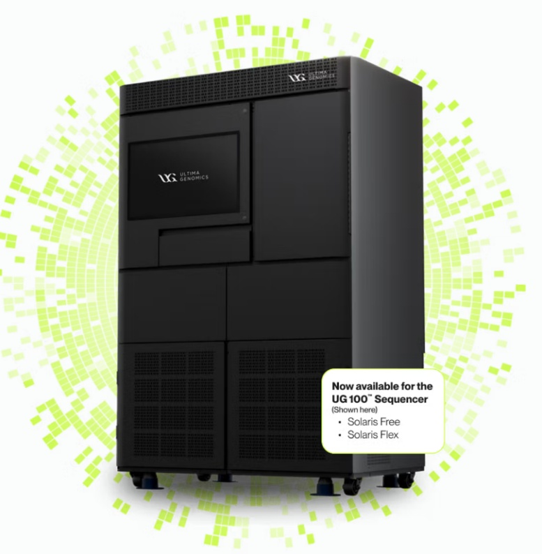
Team 6 –present time
Ultima Genomics UG100 Solaris
number of available wafers per run | 6
number of clusters per wafer | 10 billion
average read length | 250 bp
paired-end mode supported | NO
runtime | 12 hours per wafer (2 can be processed in parallel)
sequencing cost per wafer | 3000$

Slide 8

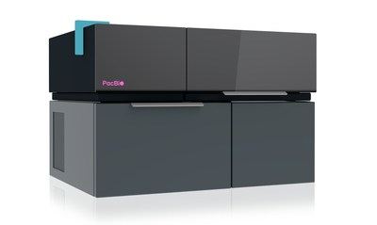
Team 7 –present time
PacBio Onso
number of available flowcells per run | 1
number of available lanes per run | 2
number of clusters per lane | 500 million
average read length | 2x150 bp
paired-end mode supported | YES
runtime | 48 hours
sequencing cost per lane | 2400$

Slide 9

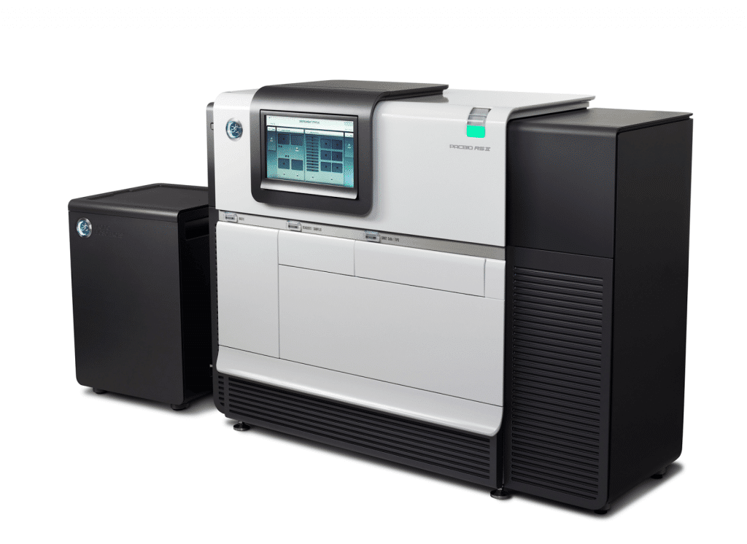
Team 8 –2013
PacBio RSII
number of available cells per run | 1
number of ZMW per cell | 50000
average read length | 20000
paired-end mode supported | NO
runtime | 6 hours
sequencing cost per cell | 2000$

Slide 10

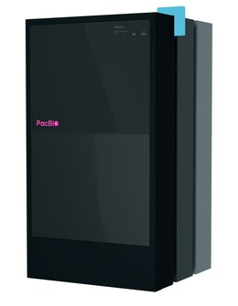
Team 9 – present time
PacBio Revio
number of available cells per run | 4
number of ZMW per cell | 6 million
average read length | 20000
paired-end mode supported | NO
runtime | 24 hours per cell
sequencing cost per cell | 2000$

Slide 11

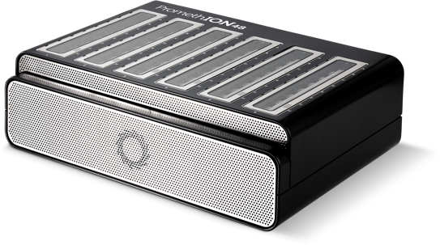
Team 10 – present time
ONT Promethion
number of available flowcells per run | 48
number of pores per flowcell | 2675 (N.B. each pore can generate multiple sequences!
average read length | variable
max output per flowcell | 150 Gb
paired-end mode supported | NO
runtime | 72 hours
sequencing cost per flowcell | 900$

Slide 12

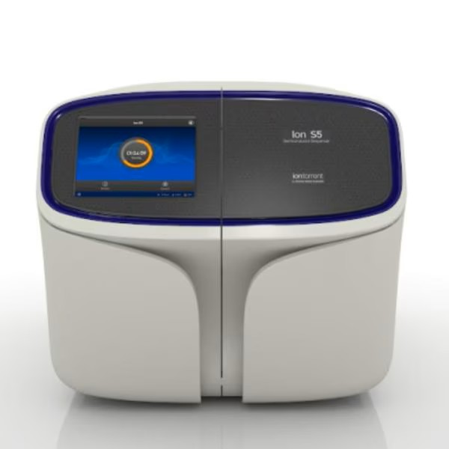
Team 11 – 2016
IonTorrent GeneStudio S5
number of available chips per run | 1
number of polonies per chip | 220 million (Ion 550 chip)
average read length | 200
paired-end mode supported | NO
runtime | 12 hours
sequencing cost per chip | 1400$

Slide 13

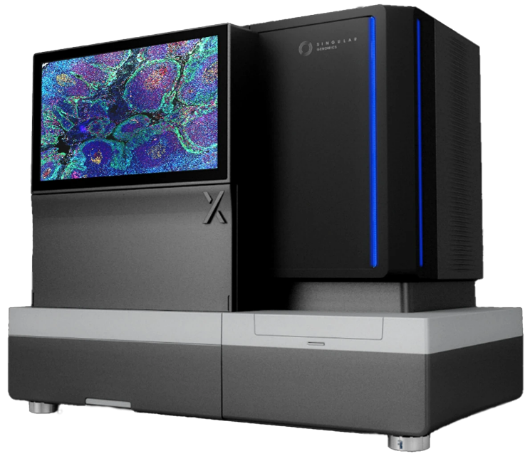
Team 12 –present time
Singular Genomics G4
number of available flowcells per run | 4
number of available lanes per run | 4
number of clusters per lane | 100 million
average read length | 2x150 bp
paired-end mode supported | YES
runtime | 19 hours
sequencing cost per lane | 300$

