Slide 1

Economic Geography
1 – Geography and Economic Geography
(What is Economic Geography?)
121EC
A.Y. 2025/2026
Prof. Giuseppe Borruso
Department of Economics, Business, Mathematics and Statistics
University of Trieste
E-mail. giuseppe.borruso@econ.units.it
Ph. +39 040 558 7008
Skype: giuseppe.borruso
Notes:
Geografia delle Reti EC 503
I Modulo
Giuseppe Borruso
1
Slides with (*) in footnotes realized by Jean-Paul Rodrigue and modified. (See copyright). I have modified and elaborated materials in order to be suitable for the current course.
Copyright ©, Dr. Jean-Paul Rodrigue, Dept. of Global Studies & Geography, Hofstra University. For personal or classroom use ONLY.

Slide 2
Learning Objectives
In general: provide the instruments that can help explaining the locations of economic activities and the relationships between activities located in space
In this lesson we will:
  Start to think why ‘geography matters’;
  Explore the links between geography and economics;
  Define a geographical space and the topics of economic geography;
  Express a definition of economic geography and its study area.

Slide 3
Topics
Geographical space, geographical concepts and Economic Geography
What is economic Geography?
Origins and evolutions of Economic Geography
Geographical models and the study of human space
Models in Economic Geography (anticipation)
Notes:
Diparimento di Scienze Geografiche e Storiche - Introduzione ai GIS
3

Slide 4
Geographical Space and Economic Geography (1/4)
Geography (today)
  = science of interpretation of the organized space
  Studies issues connected to
    Localisation (= precise spatial position of objects within a particular area of Hearth’s surface)
    Human – environment relationship
    Regions and identification of the distinctive characters of particular partitions of space
  Role of geography. Supply:
    Positional information on the exact position of events;
    Environmental information on quality of particular areas;
    Optimization = finding the ‘best’ position for things and the ‘best’ use of areas
Geographical space
  = part of the Earth’s surface inhabited, lived and organized by human beings.
  Realm in which human actions take place and interact with nature.
Environment = total sum of the conditions that regard an individual in a given point on the Earth’s surface

Slide 5
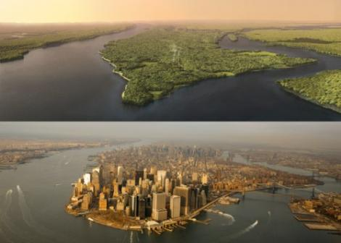
Geographical space, geographical changes
(Manhattan Island, New York)

Slide 6
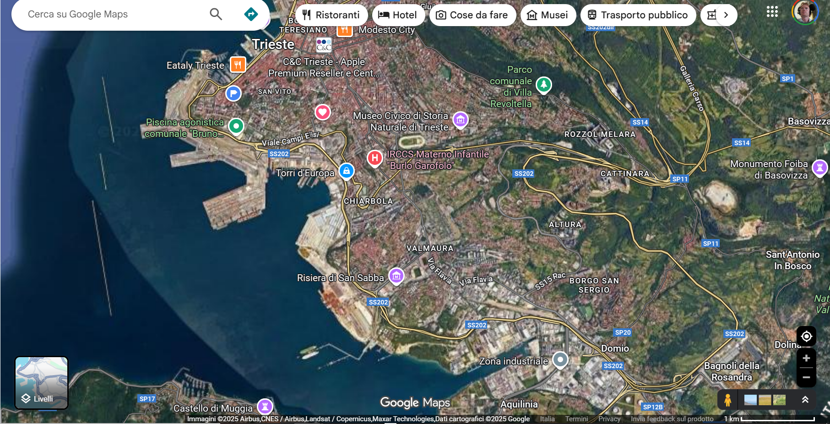
Geographical space, geographical changes
(Urban environment, port and industry)
https://www.google.it/maps/@45.6307302,13.788162,5965m/data=!3m1!1e3?entry=ttu&g_ep=EgoyMDI1MDkyNC4wIKXMDSoASAFQAw%3D%3D

Slide 7
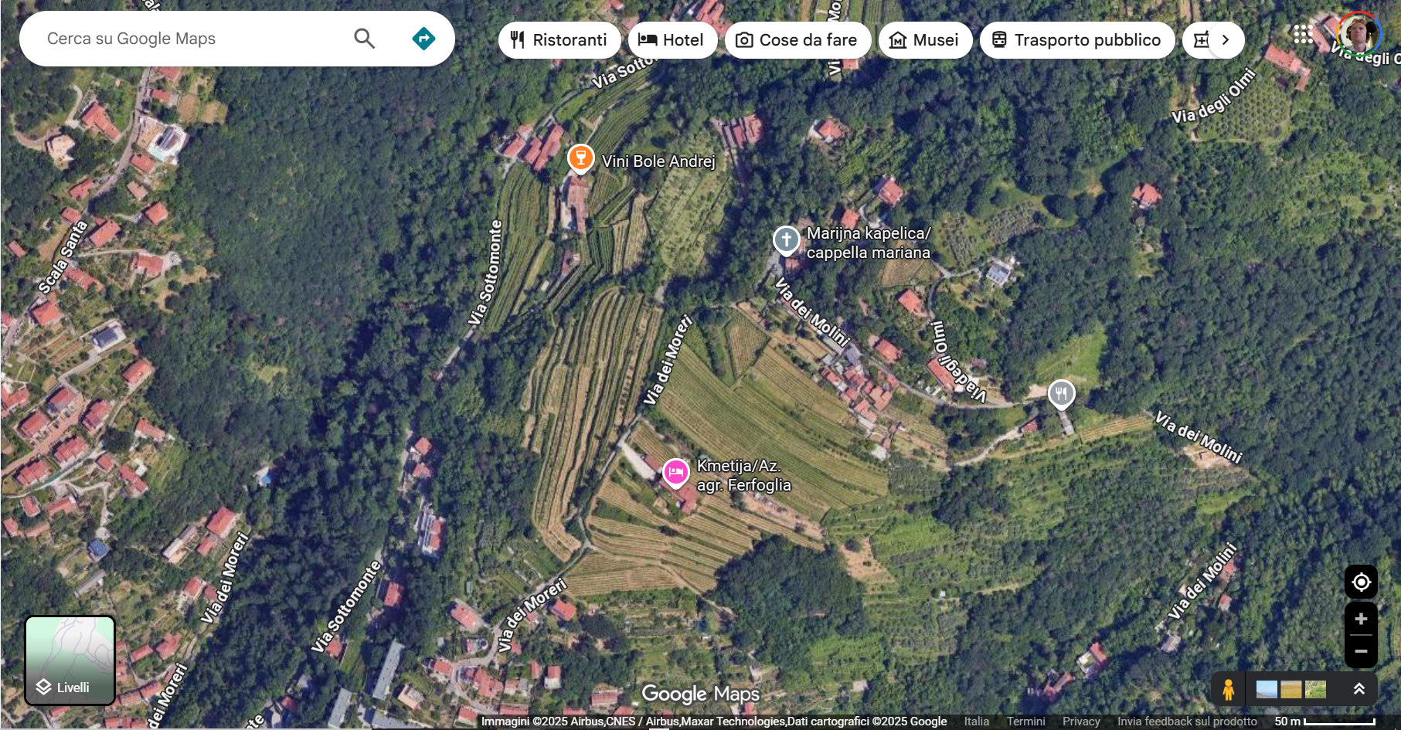
Geographical space, geographical changes
(Urban agricultural landscapes)
https://www.google.it/maps/@45.6717005,13.7796993,527m/data=!3m1!1e3?entry=ttu&g_ep=EgoyMDI1MDkyNC4wIKXMDSoASAFQAw%3D%3D

Slide 8
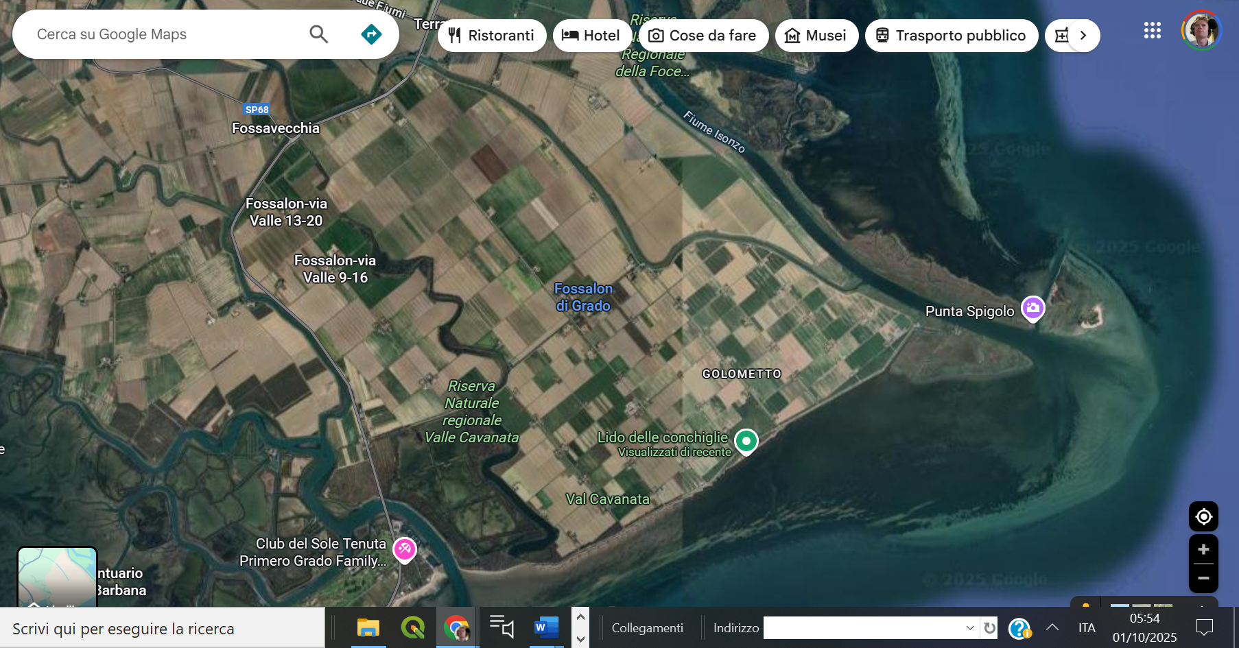
Geographical space, geographical changes
(Agricultural spaces, nature reserve)
https://www.google.it/maps/@45.7285515,13.4888251,7081m/data=!3m1!1e3?entry=ttu&g_ep=EgoyMDI1MDkyNC4wIKXMDSoASAFQAw%3D%3D

Slide 9
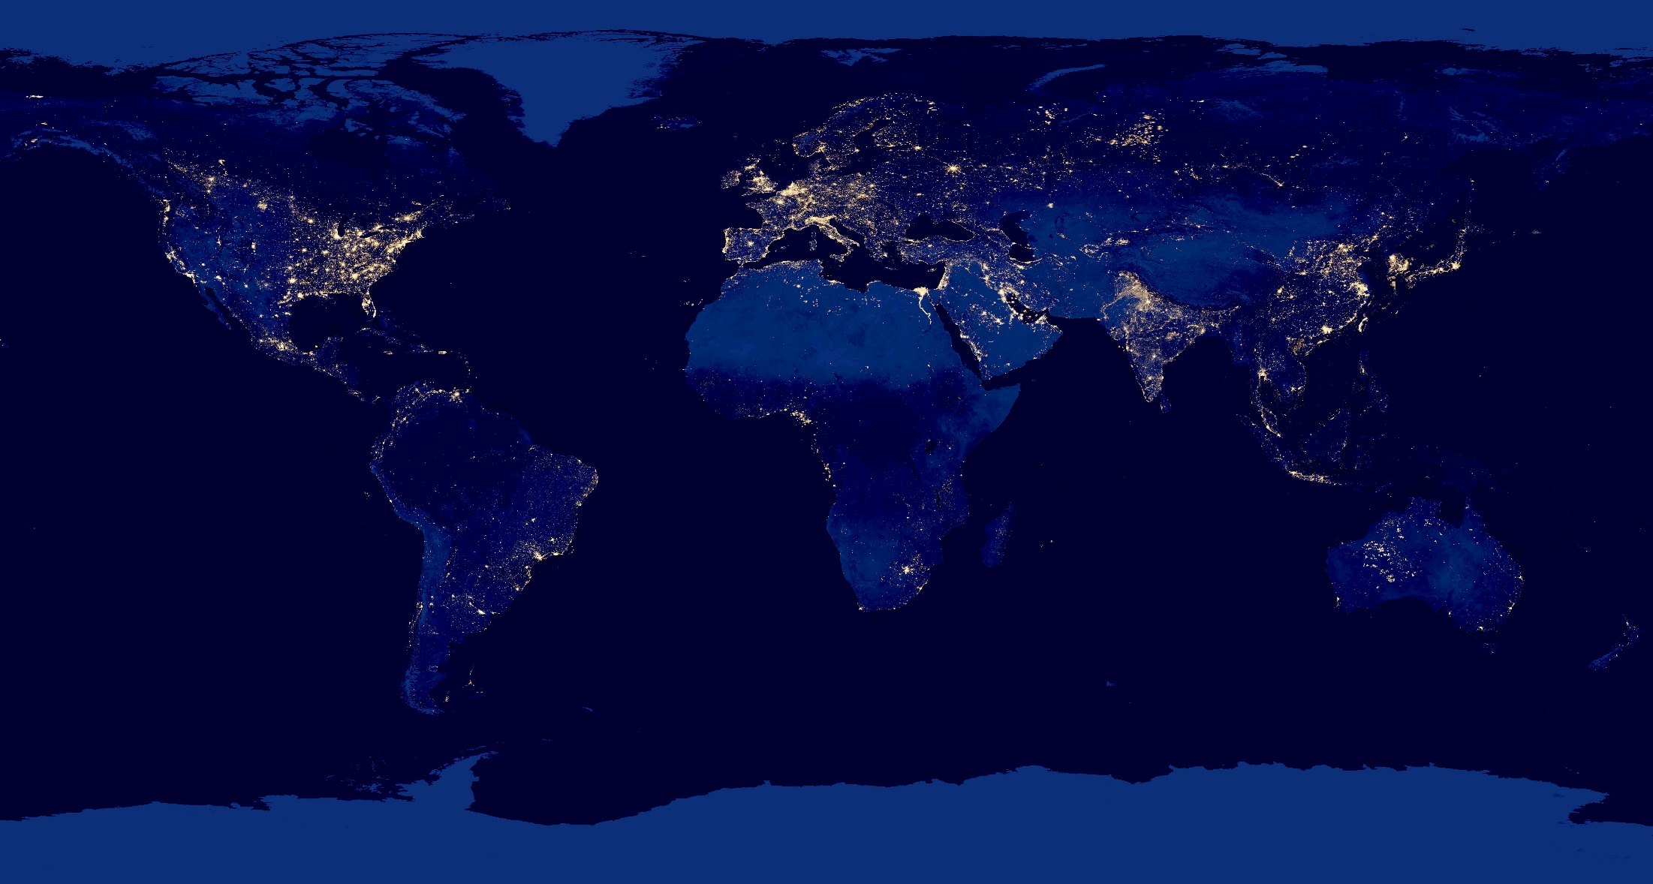
Geographical space, geographical changes
(The World At Night)
Artificial lights showing the locations of light pollution in Ocotber 2012.
NASA Earth Observatory - http://www.nasa.gov/mission_pages/NPP/news/earth-at-night.html
Composite view of Earth at night from the Suomi NPP satellite in polar orbit 512 miles above the surface, from April 18, over nine days and for 13 days ending October 23, 2012.
https://en.wikipedia.org/wiki/Globe_at_Night#/media/File:City_Lights_2012_-_Flat_map_crop.jpg

Slide 10
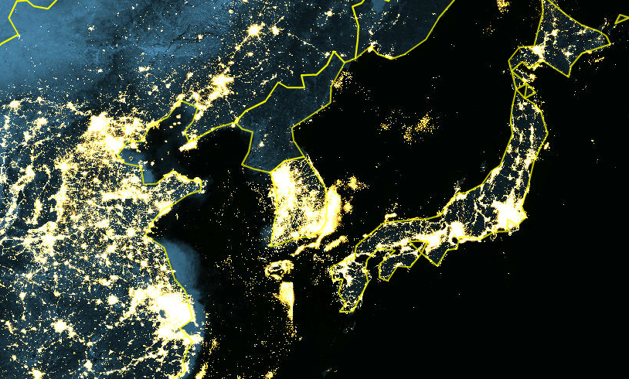
Geographical space, geographical changes
(The World At Night)
https://blog.education.nationalgeographic.org/2014/02/27/north-korea-goes-dark/
https://upload.wikimedia.org/wikipedia/commons/a/a6/Korean_Peninsula_at_night_from_space.jpg

Slide 11
Regions
A region is an area of land that has common features.
A region can be defined by natural or artificial features.
Language, government, or religion can define a region, as can forests, wildlife, climate.
Regions, large or small, are the basic unit of geography

Slide 12
Regions
Formal Region -> Landscape
Functional Region -> Function
System Region -> System

Slide 13
FORMAL REGIONS
Geographers draw formal regions on the basis of one or more measurable, shared traits that distinguish them from the surrounding area.
These traits can range from such characteristics of the local population as language, income, or religion to such physical characteristics as elevation or climate.
Many physical features, such as valleys, are easy to map as formal regions using naturally occurring boundaries.

Slide 14
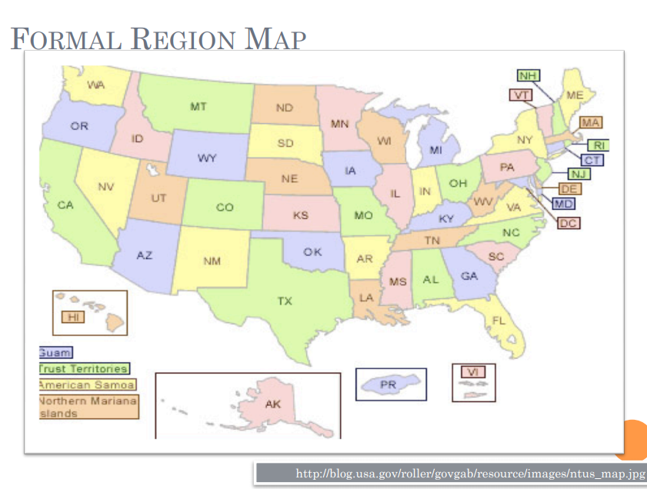

Slide 15
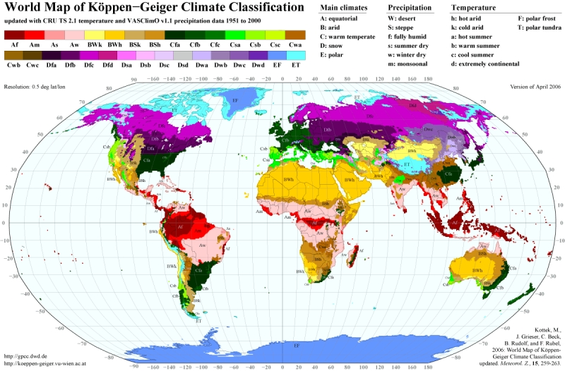
Formal region
WORLD MAP OF THE KÖPPEN-GEIGER CLIMATE CLASSIFICATION UPDATED
http://koeppen-geiger.vu-wien.ac.at/present.htm
Notes:
he most frequently used climate classification map is that of Wladimir Köppen, presented in its latest version 1961 by Rudolf Geiger. A huge number of climate studies and subsequent publications adopted this or a former release of the Köppen-Geiger map. While the climate classification concept has been widely applied to a broad range of topics in climate and climate change research as well as in physical geography, hydrology, agriculture, biology and educational aspects, a well-documented update of the world climate classification map is still missing. Based on recent data sets from the Climatic Research Unit (CRU) of the University of East Anglia and the Global Precipitation Climatology Centre (GPCC) at the German Weather Service, we present here a new digital Köppen-Geiger world map on climate classification for the second half of the 20th century.

Slide 16
Functional regions
Functional regions are defined by a system of interactions.
Picture a bicycle wheel with a central axel in the middle of the wheel, which represents the center of all the activity.
The spokes of the wheel represent links to outside areas (the tire) through transportation, communication and trade.

Slide 17
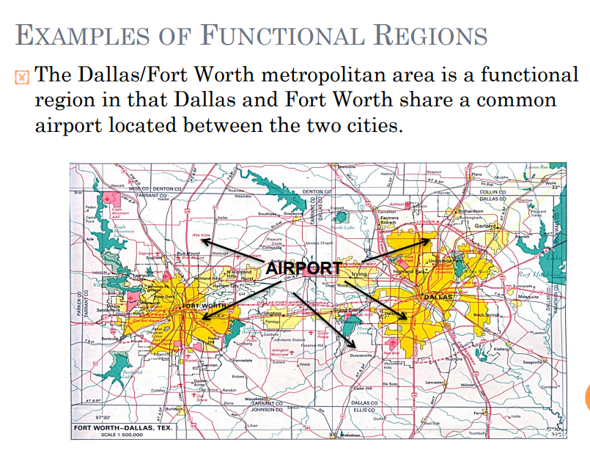

Slide 18
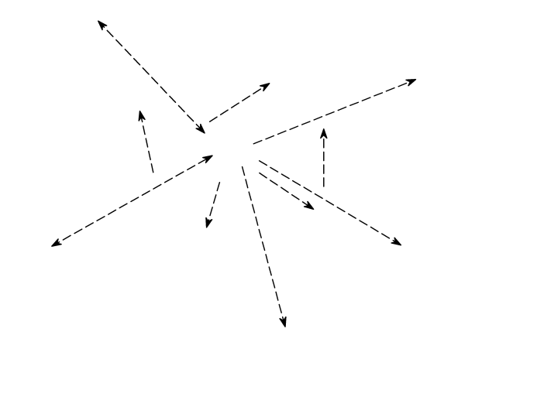
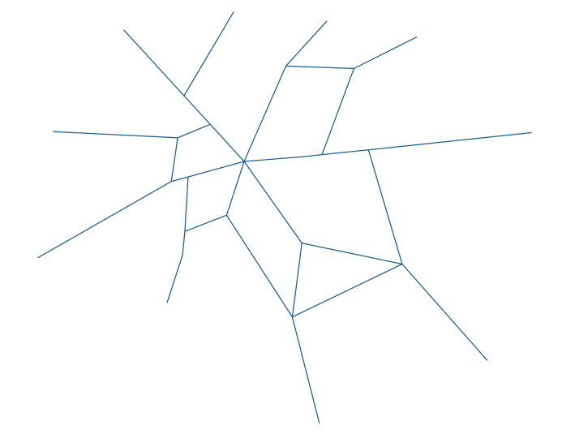
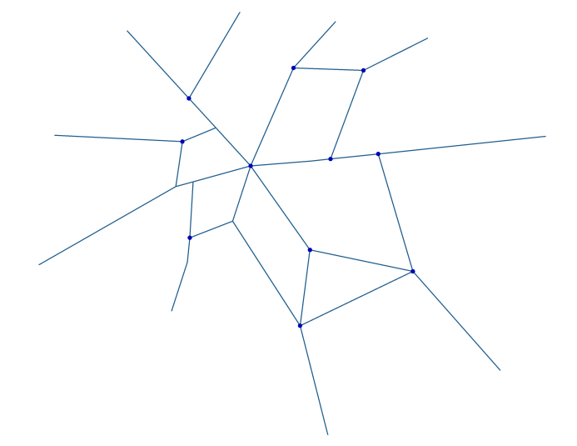
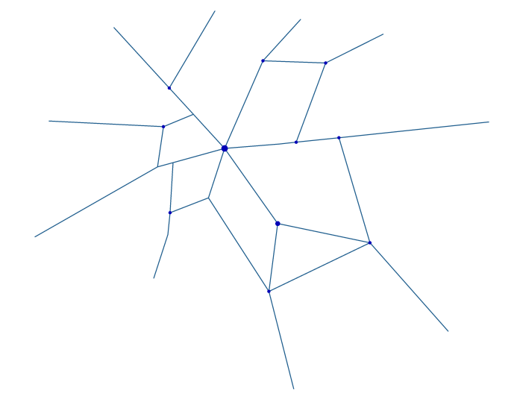
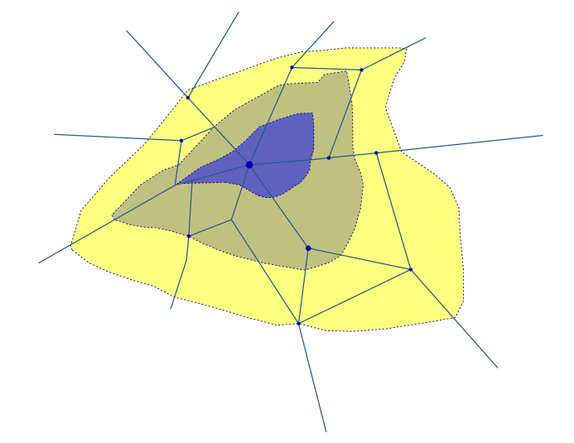
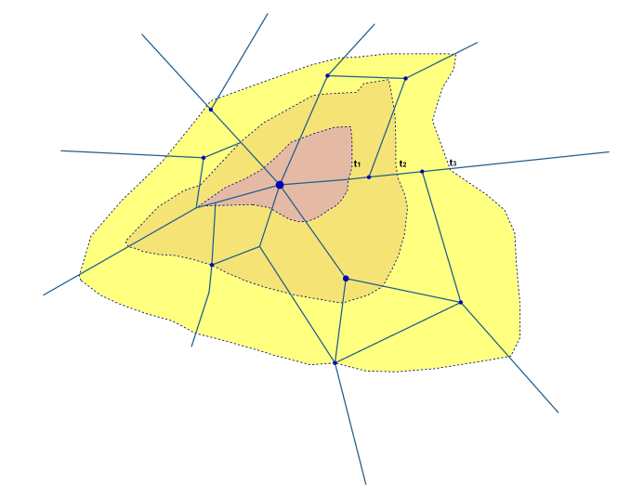
Nodal / functional regions
(Haggett, 2001)
a) Interaction and spatial flows
b) Netgworks determining flows
c) Nodes created at junctions of
links
d) Hierarchies among nodes
e) Surfaces as gradients (densities)
f) Diffusion waves through surfaces and networks
Notes:
a) e b): flussi e reti. Interazioni spaziali tra un insediamento e l’area circostante in termini di movimenti di persone, beni, fondi finanziari, informazioni.
I flussi sono di solito incanalati in reti discrete che collegano tra loro singoli insediamenti.
c) e d): i nodi sono localizzati in punti critici delle reti, e formano gerarchie articolate. Si notano anche i rapporti tra interazioni, reti, nodi e gerarchie.
e) ed f): struttura regionale nodale in termini di superfici continue di valori indicatori, a descrivere qualche aspetto della geografia umana della regione; processi di diffusione.

Slide 19
System region
Natural, anthropic elements interact in space;
Different ‘layers’ of activities do exist and interact
A system region is a region where its component are vital for maintaining its internal equilibrium
It is a territory where the internal interactions are higher than those towards the external part of the system
E.g the Tourist region is a region where tourism as an activity is the connecting element among the other factors present in that area.

Slide 20
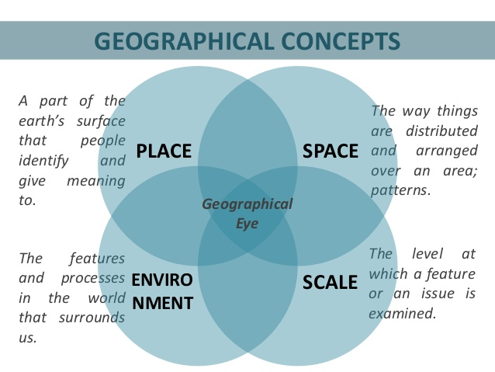

Slide 21
Geographical Space and Economic Geography (2/4)
Geography Concepts
  Location/Place
  Location: Where is it? Place: What is it like?
  Environment
  The surrounding air, land, and water shared by all living and non-living things
  Interaction
  The relationship between people and the environment and the resulting patterns/ consequences
  Region
  An area with common characteristics that are different from those of surrounding areas
  Movement
  The exchange among places of products, people, and ideas
  Pattern
  An arrangement of features
  Sustainability
  Ensuring renewal and re-growth of resources as they are consumed (used)
  Stewardship
  Human responsibility for the Earth’s well-being

Slide 22

Geographical Space and Economic Geography (3/4)
1st law of Geography (Tobler, 1970): “Everything is related to everything else, but near things are more related than those far apart” (distance decay effect)
  => Law: spatial autocorrelation (statistics) – if particular attributes of the population display a non-uniform and non-random patterning but are clustered into particular localities
  “Birds of a feather flock together”?
  => very few of us live in complete isolation from the rest of society.
  It is likely that many of our behaviours, choices, aspirations and ideals are influenced by those with whom we interact in our everyday lives.
  Geographical distance and location impart constraints on who we meet and when.
Concept of distance and economical distance (= physical distance * the cost of transport * weight of good demanded/supplied or to be acquired)

Slide 23











Spatial Interaction (Ullman, 1956; Conti, 1996)
= simplest way of conceiving relations between places and between people and places.
  The non-availability of a product in a certain place is enough to move to that place to get it
  The presence of two or more specialized places in the production of different goods will establish an interaction between them.
Functional distance substitute the physical distance
  The relation is not linear but relative to the functions plaid by places.
Conditions for a good working of the economic system
  High level of interaction
  Need to reduce the cost of the the flows of goods, services, people
Targets:
  Maximization of the interactions
  Minimization of the costs
Places and interactions among places are the building elements of the different forms of organization in space.
Places on the terrestrial space:
  Do not hold ‘personal’ quailties’;
  Are characterized by
  The position occupied in comparision to other places with which they relate
  The intensity of contacts and reciprocal exchanges

Slide 24
Spatial Interaction (Ullman, 1956; Conti, 1996)
Necessary conditions for realizing interaction (Ullman, 1956):
Complementarity
  If the demand for a given good cannot be satisfied locally, we must move to other locations where it is available;
  These locations will import goods from other locations where they can be produced;
  i.e., flows of commuters moving to a city => complementarity between the urban centre and its hinterland.
Transferability
  Each movement is a tributary of distance and related costs;
  Transferability takes place when the costs of transport pay the utility exptessed in economical terms;
  i.e., Oil: long distances. Bread: short distances (neighbourhood).
Intervening Opportunities
  Factors incentivating the movement of peopole or goods from one location to another one, chosen among a set of alternatives, virtually complementary
  i.e. urban agglomeration favouring clustering of economic and population activities;
  i.e. Top University cities attracting peopole from other cities with universities

Slide 25
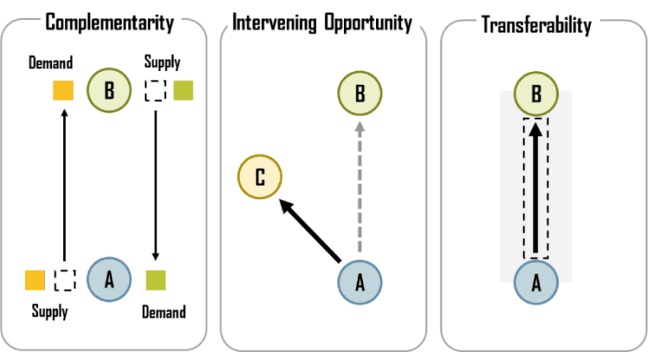
Conditions for Spatial Interaction
https://transportgeography.org/?page_id=8578
Notes:
Intervening opportunity. If location C offers similar characteristics (namely complementarity) than location B and is also closer to location A, an interaction between A and B will not occur and will be replaced by an interaction between A and C.
Transferability. Transport infrastructures (modes and terminals) must be present to support an interaction between A and B.

Slide 26
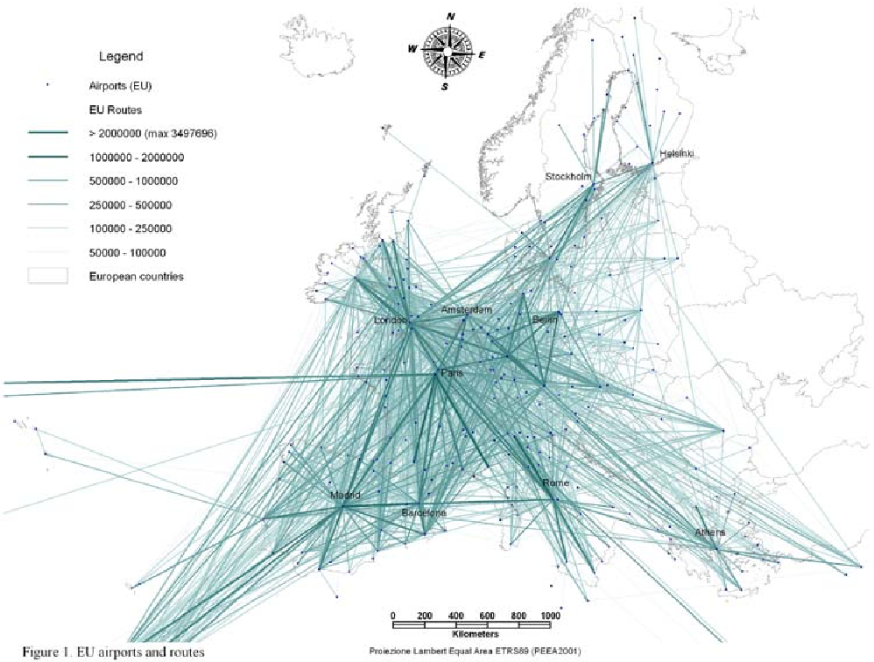
Spatial interaction in action

Slide 27
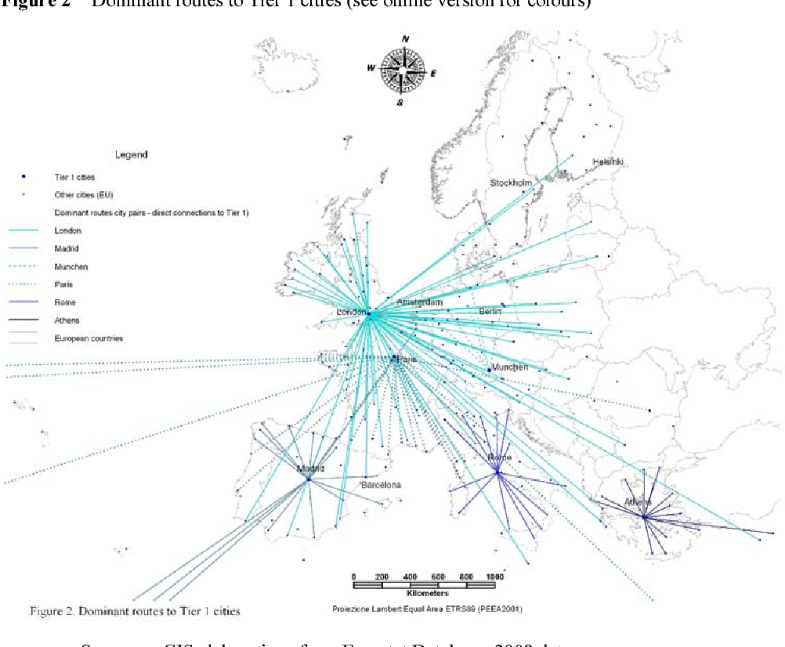
Spatial interaction in action

Slide 28
Relationship between Distance and Interaction – the Distance decay effect
The level of spatial interaction – flows between nodes / regions – is related to distance by an inverse relation;
Closer regions have a higher rate of interaction than those located far apart
Empirical evidence shows that spatial interaction is related to a relation inverse to the squared distance between settlements.
Pareto function – relation between flows and distance
F = flow; D = distance; a and b = constant
Low values of b => low slope curve – flows on a wide area
High values of b => higher slope curve – flows on a restricted area
Studies on migrations b = -2
(a similar structure deals with gravitation of urban areas / shopping centres)
F = a*D^{-b}
F = a*(1/D ²)
Linear
function
Exponential
function
Spatial interaction
Spatial interaction
Distance
Distance

Slide 29
Spatial Interaction Models – general formula
Tij : Interaction between location i (origin) and location j (destination).
Vi : Attributes of the location of origin I
Wj : Attributes of the location of destination j.
Sij : Attributes of separation between the location of origin i and the location of destination j. Also known as transport friction, friction of distance or impedance.
Notes:
Diparimento di Scienze Geografiche e Storiche - Introduzione ai GIS
29
1 ora

Slide 30
Gravitation
Reilly’s law (1929) on the forming of retail areas
Interaction of a city and its service area can be expressed as :
F = a * D ^{– b}
a = mass of a city (population or other indexes of ‘centrality’)
D = distance of places out and around the city
b = parameter to indicate the slope (=> extension of the gravitating area)
[the formula can also express the attraction generated by a mall on its catchment area, where “a” represents a measure of attraction as the floor space]
Notes:
Diparimento di Scienze Geografiche e Storiche - Introduzione ai GIS
30
1 ora

Slide 31
Geographical Space and Economic Geography (4/4)
Economic Geography:
  Focuses on the knowledge of the geographical space (as an index of human and natural evolutions) and on the management of space (as an index of the social, political and economical evolutions)
  focuses on the processes of management of production of goods and services in cities and space (more in general)

Slide 32
What is economic geography?
Explaining the causes and consequences of uneven development within and between regions is a central concern for economic geographers
The discipline’s goal has long been to offer multi-faceted explanations for economic processes (growth and prosperity as well as crises and decline ) manifested across territories at various scales: local, regional, national and global.
Contemporary economic geographers study geographically specific factors that shape economic processes and identify:
  key agents (firms, labour and the state)
  And drivers (innovation, institutions, entrepreneurship and accessibility)
  that prompt uneven territorial development and change (such as industrial clusters, regional disparities and core – periphery).

Slide 33
Economic Geography
Economic geographers study and attemp to explain the spatial configuration of economic activities
Economic activities:
  Produce goods and services;
  Transfer goods and services from one economic agent to another one;
  Transform goods and services into utility through the act of consumption
  All of these activities take place in space

Slide 34
Economic Geography
The role of economic geographer
To perceive order in the complexity of the economic space
Untangle webs of interrelated decision making
To elicit some principles that drive the evolution of the economic landscape
=> Building models to abstract from superflous details to focus on the main driving forces of the spatial economy.

Slide 35
Economic geography and time
Economic geographers have considered various key geographically specific endowments as drivers of territorial development
Early stages: agriculture, climate and natural-resources, labour supply
Industrialization: focus shifted to the geography of firms and industries, factory wages, production processes, technology and innovation, the quality and skills of labour, and the role of the state in inducing and promoting industrialization
Recently: unquantifiable and intangible contributions to territorial development, institutions, networks, knowledge and culture
New research themes are also emerging, ones that focus for example on financialization, consumption, the knowledge economy and sustainable development.
Economic geographers are bound together by a common interest in economic processes as fundamentally territorial processes as manifested in the economic fates of communities, cities and regions
The goal of the economic geography is to understand the economic processes of a place, rather than using economic factors as independent or intervening variables to explain environmental change (cultural ecologists) or socio-cultural change (cultural/social geographers).

Slide 36
Origins
British colonialism – need to study commercial geography to better understand and improve trade routes and modes of transport;
Germanic location theories of Heinrich Von Thünen and Alfred Weber (who were then followed by Walter Christaller and August Lösch) as the roots of economic geography.
  Their goal was to develop optimal location patterns for the most efficient functioning of farms, factories and cities, given geographical endowments and accessibility (e.g. transport costs).
  Location modelling subsequently crossed the Atlantic, where it was incorporated into North American economic geography and became an important foundation of regional science, thanks to Walter Isard.
Alfred Marshall – British Economist - the first to articulate the phenomenon of industrial agglomerations and he highlighted the importance of economies of scale in industrialization.
  agglomerations/clusters continue to occupy centre stage in contemporary economic geography, although today attention is increasingly shifting from economic to social, cultural and institutional dimensions of clusters
human-environmental geography - extractive resources in a territory preoccupied scholars and policy makers
economic geography since its inception combined multiple trajectories involving multiple, and sometimes contradictory, epistemologies and methodologies

Slide 37
Origins
Beginning: descriptive studies, deterministic theories;
neo-classical economics and Marxist structuralism (post WWII period);
shift towards spatial science in economic geography:
  quantitative, theoretical economic geographers and regional scientists sought to develop universal, abstract, and explanatory spatial theories for industrial location and regional economic evolution:
  Transport geography; urban geography, etc.
New issues: 1970 – 1990
  Deindustrialization; Institutions; Business management;
  Post-modernism, post-structuralism, feminist theory and cultural geography; globalization and social aspects – ‘cultural turn’ in Geography
1990 ->
  ‘new economic geography’ (NEG: geographical economists like Krugman);
  Geographically specific endowments and global networks;
  economic geographers and development geographers: shift from predominantly industrialized economies to include emerging economies

Slide 38
Economics and Economic Geography
Economic geography remains a distinctive sub-discipline in geography that focuses on economic differences, distinctiveness and disparity across places; the political, cultural, social and historical dimensions of industrial and regional development; inter-scalar (e.g. global-to-local) economic relationships and their significance for firms, industries and regions; and the causes and consequences of unevenness in the world economy.
Regardless of multiple trajectories, one of the most important and distinguishing features of economic geography from economists has been its empirical orientation. Globalization has raised new and important questions about the interconnections and interdependencies among economies, about the processes through which regions develop and compete, and about the utility of classical theories for explaining contemporary economic trends and challenges.

Slide 39
Economics and Economic Geography
Similar problems; different approaches
  Economic geography:
    Conceptualize economic issues in terms of space, place and scale.
    Tend to be empirically based.
  Economics:
    Tends to homogenize the economic world.
    The “market” is often considered as “aspatial”.
  Main areas of investigation:
    Technological change
    Geopolitics
    Cultural homogenization/localization
    Transport & communication cost reductions
    Fall of centrally planned economies
    Rise of global capital markets
    Institutions and governance World Bank, IMF, WTO, OPEC, OECD….
Notes:
39

Slide 40
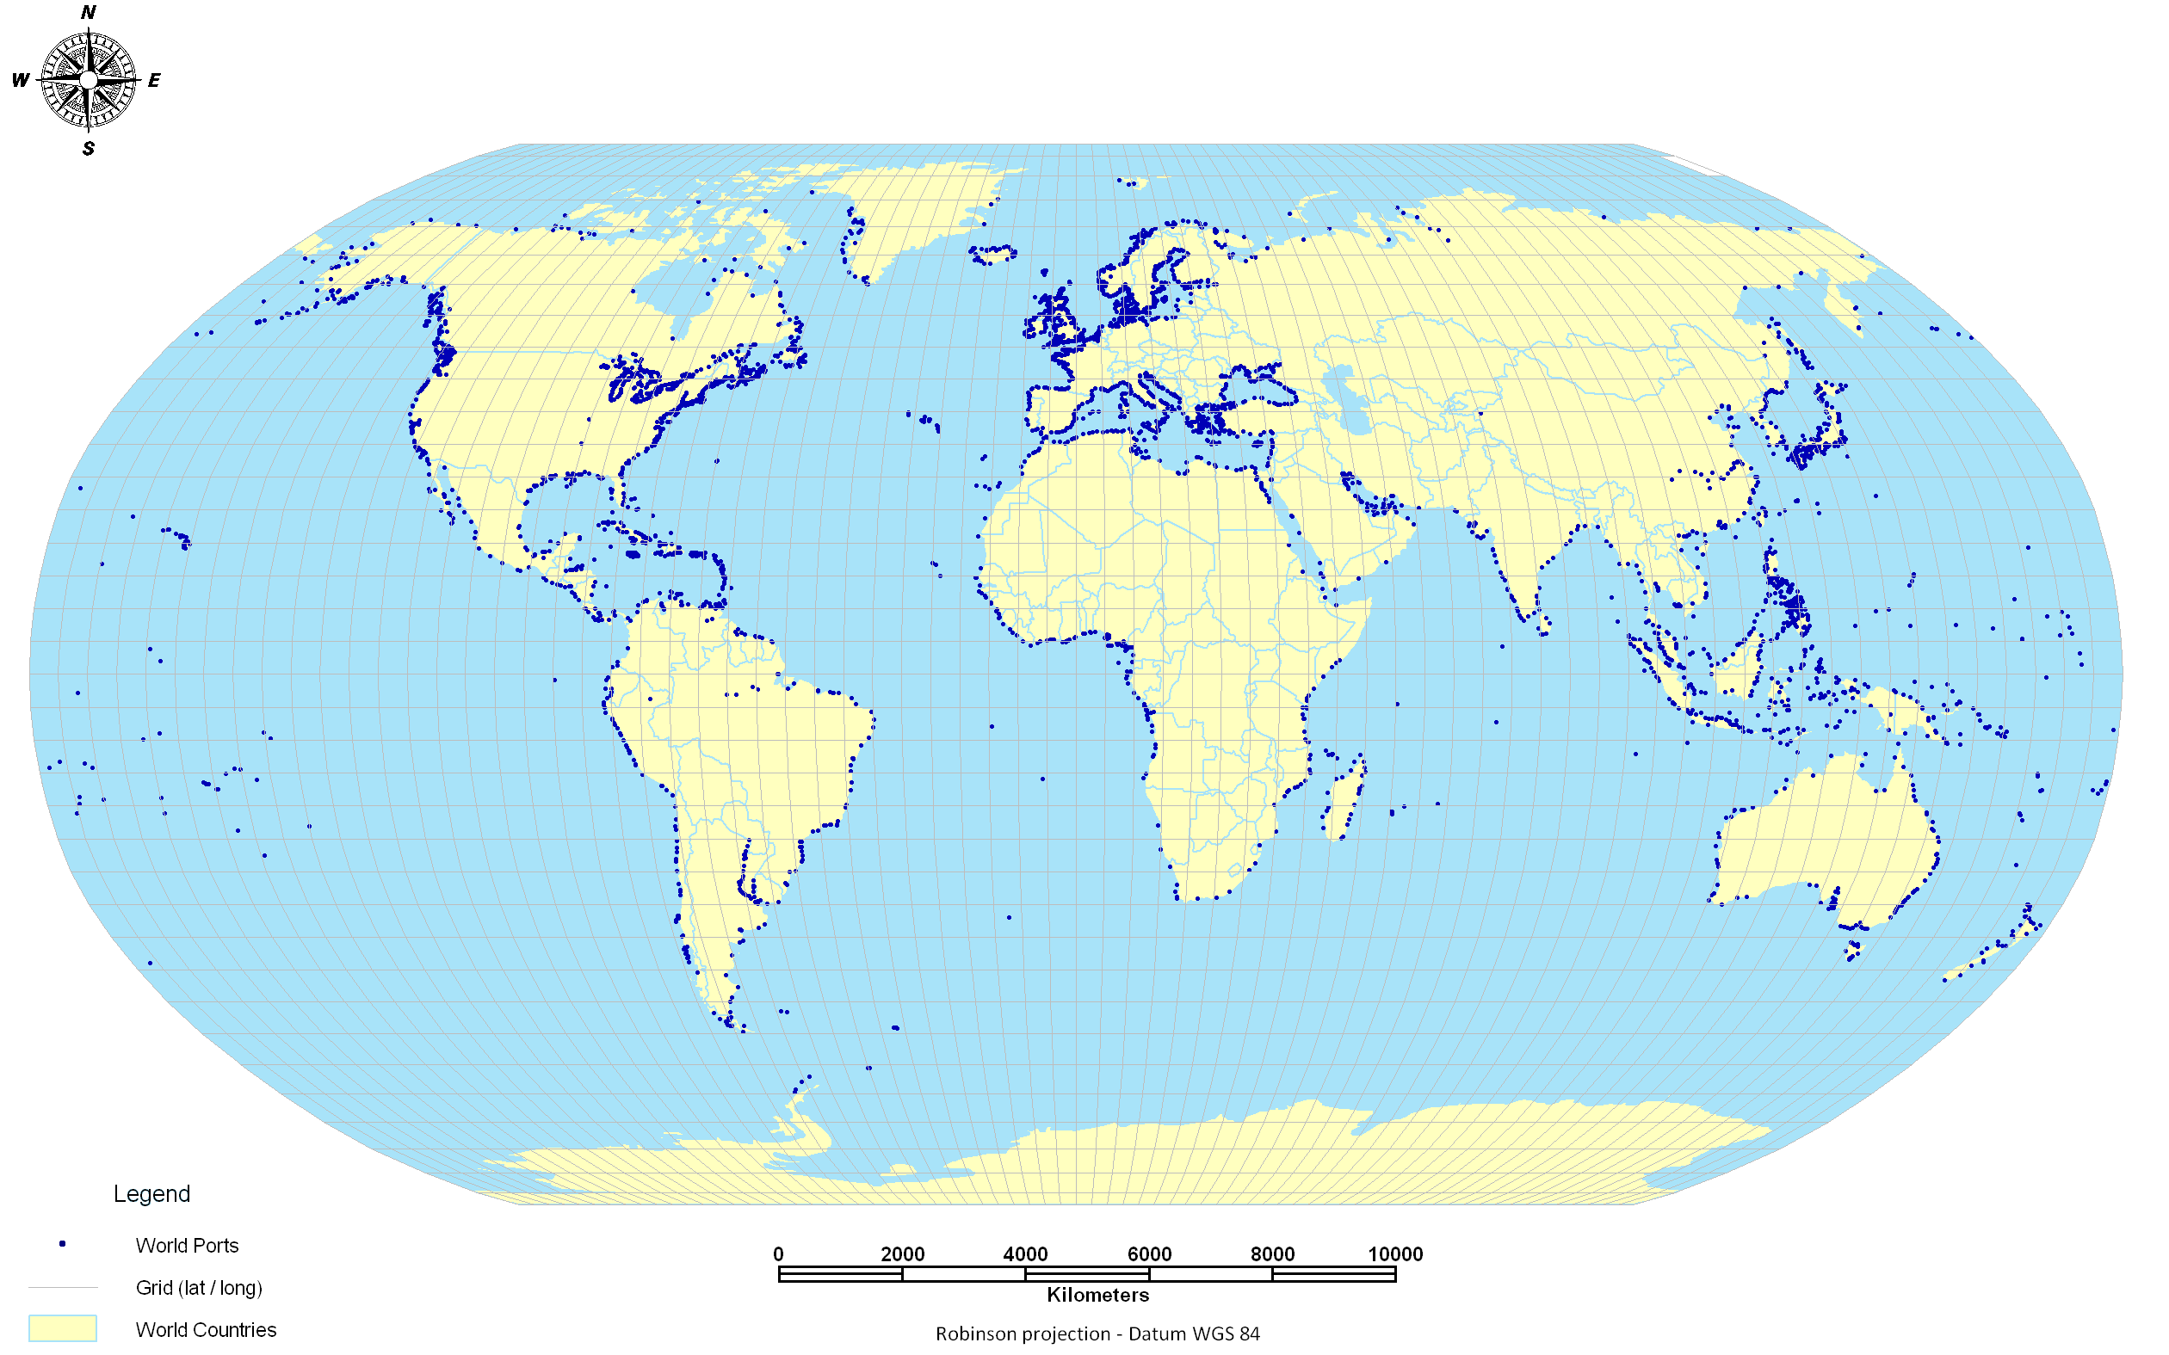
World ports

Slide 41
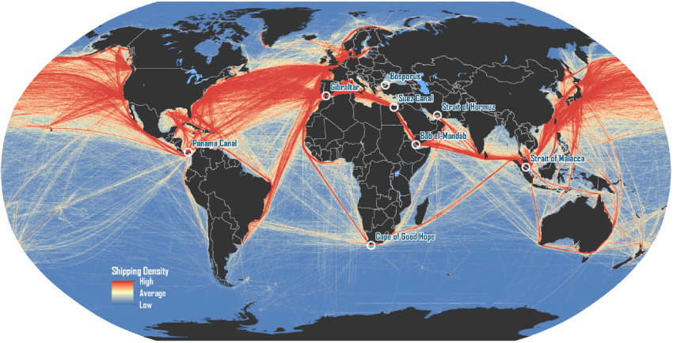
Maritime Routes and Strategic Passages
https://people.hofstra.edu/geotrans/eng/ch1en/appl1en/maritimeroutes.html

Slide 42
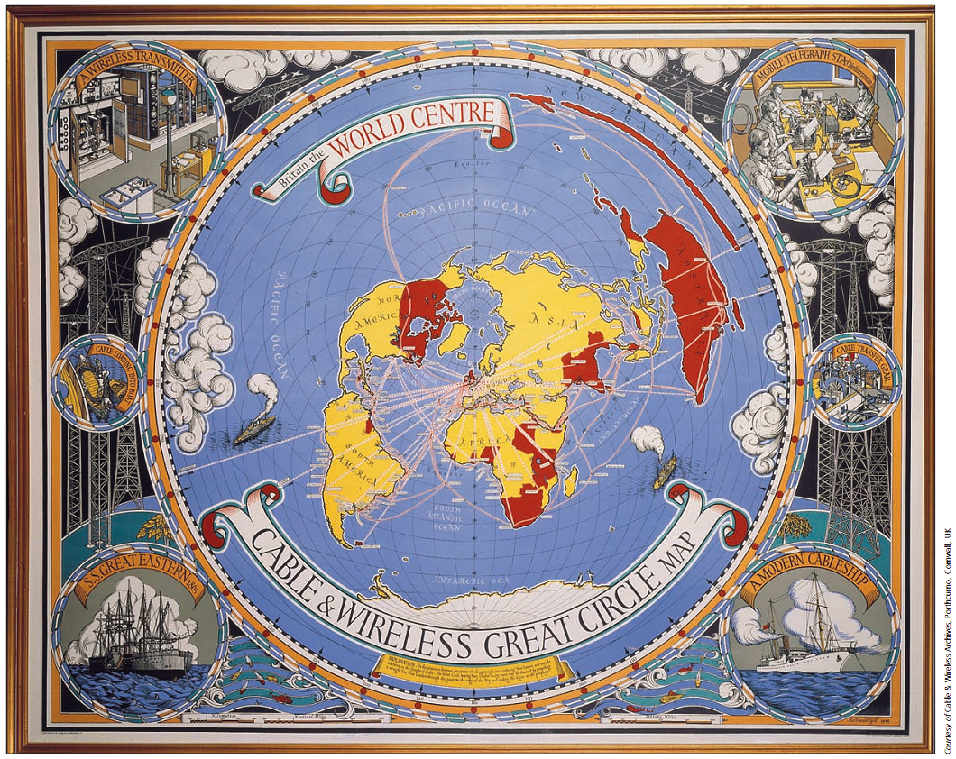
Communication networks: Cable & Wirless – telegraph cables (1945)
Notes:
Created almost a hundred years later in 1945, the map
is a colorful and attractive marketing map designed to promote
the global telecommunications network of Cable & Wireless.
C&W provided communications with the many
distant colonies, colored red on the map. The map was created
by MacDonald Gill, a noted artist and calligrapher in the 1930s
and 1940s, whose work was published in many books and as
posters.
To illustrate Britain’s role as the hub of this empire, a polar
projection has been employed, placing Britain at the center of
the map. The C&W telecommunications network consisted of a
vast system of undersea cables and wireless stations that
traversed the globe, and these are represented on the map by
solid and dotted lines. The map is clearly designed for
promotional purposes, with its rich decorative border aimed to
appeal to the general public. (Dodge & Kitchin, Atlas of Cyberspace, Addison, 2001, p. 14)
Diparimento di Scienze Geografiche e Storiche - Introduzione ai GIS
42

Slide 43
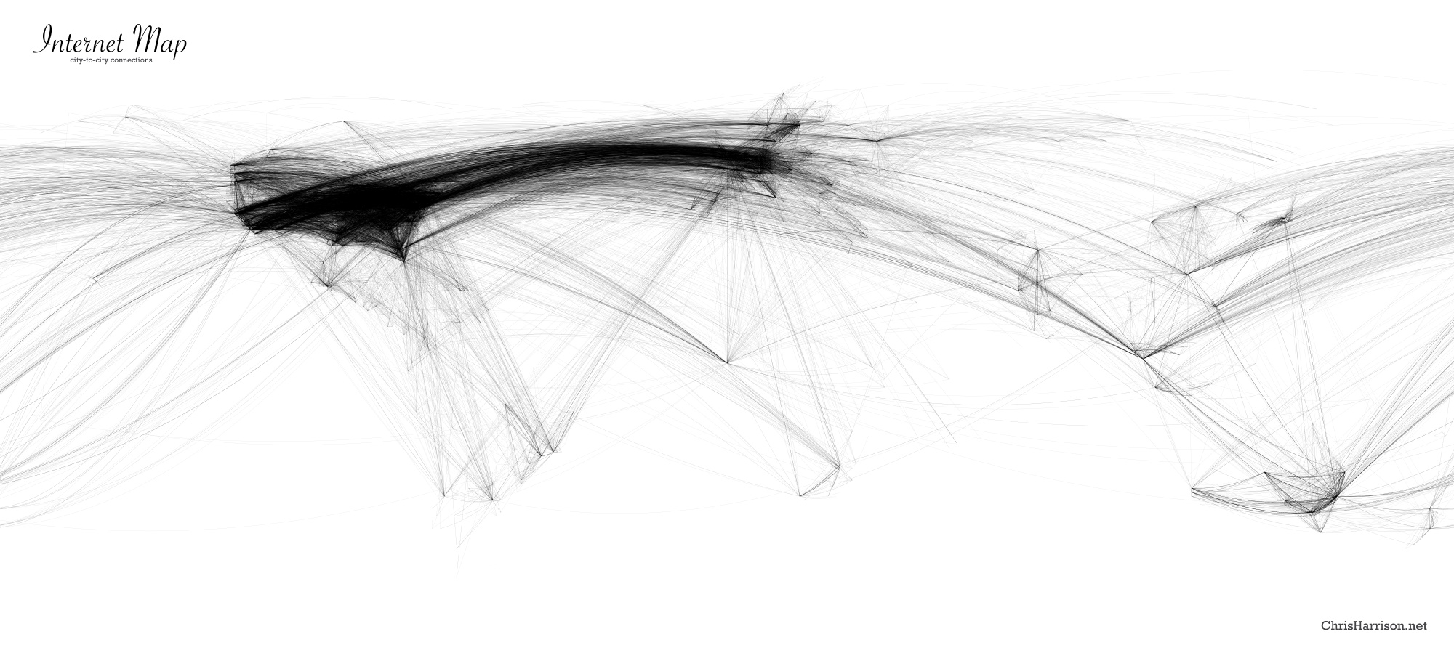
Communication flows: Internet
http://www.chrisharrison.net/projects/InternetMap/
Notes:
43
http://www.chrisharrison.net/projects/InternetMap/
The Dimes Project provides several excellent data sets that describe the structure of the Internet. Using their most recent data at the time (Feb 2007), I created a set of visualizations that display how cities across the globe are interconnected (by router configuration and not physical backbone). In total, there are 89,344 connections.
The first rendering displays the relative densities of Internet connectivity across the globe. The stronger the contrast, the more connectivity there is. It is immediately obvious, for example, that North America and Europe are considerably more connected than Africa or South America. However, it is important to note that this only reflects density of connections, and not usage - hundreds of people may utilize a single connection in an internet cafe, often the only form of connectivity people have access to in developing nations.
Additionally, three graphs were created that display how the net is connected. I should note this is not the first time graphs like this have been created - I've seen several variations, most being practical in nature (e.g. cable locations, bandwidth). I decided to pursue an aesthetic approach - one more visually intriguing and interesting to explore than useful. The intensity of edge contrast reflects the number of connections between the two points. No country borders or geographic features are shown - the only thing you see is the data. However, it should be fairly easy to orient yourself.
Note: These visualizations use a cylindrical equidistant projection. Point latitudes and longitudes were rounded to the nearest whole number and used in a flat coordinate system. This means that the planetary surface area represented by each point varies, skewing density data (both point and edge)!
Very high resolution versions have been provided for more detailed examination or print purposes. If you do decide to print, please let me know. I'd love to see a photograph of it in your home or office. Email me: chris.harrison@cs.cmu.edu.
This page was Slashdotted on Oct 5th, 2007 and in the Digg top ten on the 7th. The site survived the onslaught thanks to Hesham, Joe (courtesy of ISC), and photobucket.

Slide 44
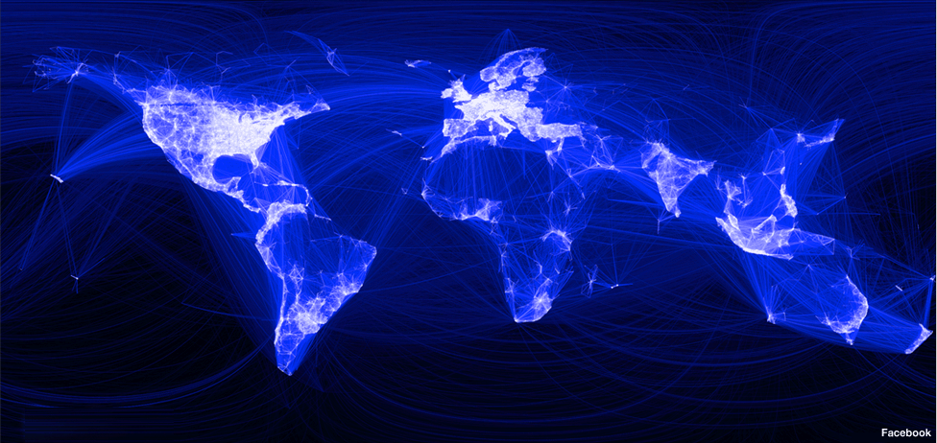
Visualizing Friendships
(Paul Butler, 14 dicembre 2010)
http://www.facebook.com/notes/facebook-engineering/visualizing-friendships/469716398919
Notes:
http://www.facebook.com/notes/facebook-engineering/visualizing-friendships/469716398919
Visualizing Friendships
pubblicata da Paul Butler il giorno martedì 14 dicembre 2010 alle ore 2.16
Visualizing data is like photography. Instead of starting with a blank canvas, you manipulate the lens used to present the data from a certain angle.
When the data is the social graph of 500 million people, there are a lot of lenses through which you can view it. One that piqued my curiosity was the locality of friendship. I was interested in seeing how geography and political borders affected where people lived relative to their friends. I wanted a visualization that would show which cities had a lot of friendships between them.
I began by taking a sample of about ten million pairs of friends from Apache Hive, our data warehouse. I combined that data with each user's current city and summed the number of friends between each pair of cities. Then I merged the data with the longitude and latitude of each city.
At that point, I began exploring it in R, an open-source statistics environment. As a sanity check, I plotted points at some of the latitude and longitude coordinates. To my relief, what I saw was roughly an outline of the world. Next I erased the dots and plotted lines between the points. After a few minutes of rendering, a big white blob appeared in the center of the map. Some of the outer edges of the blob vaguely resembled the continents, but it was clear that I had too much data to get interesting results just by drawing lines. I thought that making the lines semi-transparent would do the trick, but I quickly realized that my graphing environment couldn't handle enough shades of color for it to work the way I wanted.
Instead I found a way to simulate the effect I wanted. I defined weights for each pair of cities as a function of the Euclidean distance between them and the number of friends between them. Then I plotted lines between the pairs by weight, so that pairs of cities with the most friendships between them were drawn on top of the others. I used a color ramp from black to blue to white, with each line's color depending on its weight. I also transformed some of the lines to wrap around the image, rather spanning more than halfway around the world.
After a few minutes of rendering, the new plot appeared, and I was a bit taken aback by what I saw. The blob had turned into a surprisingly detailed map of the world. Not only were continents visible, certain international borders were apparent as well. What really struck me, though, was knowing that the lines didn't represent coasts or rivers or political borders, but real human relationships. Each line might represent a friendship made while travelling, a family member abroad, or an old college friend pulled away by the various forces of life.
Later I replaced the lines with great circle arcs, which are the shortest routes between two points on the Earth. Because the Earth is a sphere, these are often not straight lines on the projection.
When I shared the image with others within Facebook, it resonated with many people. It's not just a pretty picture, it's a reaffirmation of the impact we have in connecting people, even across oceans and borders.
Paul is an intern on Facebook’s data infrastructure engineering team.

Slide 45
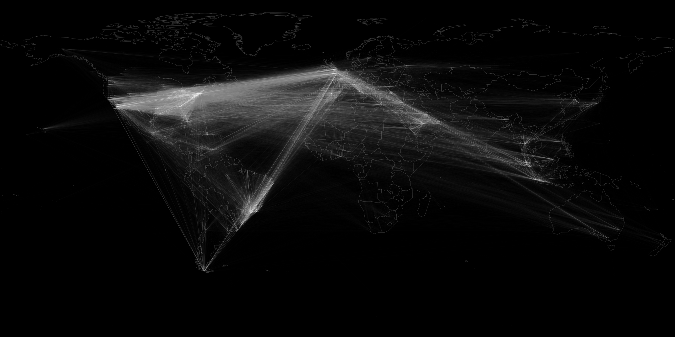
http://firstmonday.org/article/view/4366/3654
http://www.sgi.com/go/twitter/images/hires/figure13.png

Slide 46
Geographical models and the study of human space (1/2)
Complexity of relations taking place and needs to balance between economic growth and respect of biodiversity require the definition of organizational models to transform limited resources from a geographical space into social and economical opportunities of development
Model = idealized representation of the real world, built to present some properties (social and economical phenomena).
Models become necessary as reality is complex
Paradigm = a supermodel (Haggett, 2001), supplying intuitive and inductive rules on the types of phenomena under exam and the best method for their analysis
In time, Geography and Economics reduced space to its essential (basic) elements, and by their analysis comprehend the dynamics of an organized system (i.e., human settlements, productive processes, etc.).

Slide 47
Geographical models and the study of human space (2/2)
Economic geography contributed to implementing theories based on the use of the geographical space and on criteria that orientate the location of human settlements and production activities
=>
how humans transform their environment to satisfy their needs
In time Geography and Economics reduced space to its essentials, by which analyse to understand the dynamics of an organized system (settlements or production).
Economic geographers simulated reality from empirical observations in order to understand and explain the complexity of the geographical space.
The simplification become a geographical economical model, based on inductive research (top down) rather than the micro and macro approach proper of economics.
First geographical economical models and the economical ones share schematic and simplified representations of reality and the reduced number of elements of reality (new geography and quantitative geography).
A model as a simplified description of reality to represent social and / or economical phenomena.
The models to be examined will focus on the localisation of :
  Agriculture
  Industry
  Services (including transport)
  Human settlements

Slide 48
Location Theory
Concept of location
  Absolute location (coordinate system).
  Relative location (referring to other locations)
Definition
  Analyzing location decisions of firms and individuals.
    What locates where?
  Looking for a formulation / rules of behavior.
    Why?
Notes:
(*)
48

Slide 49
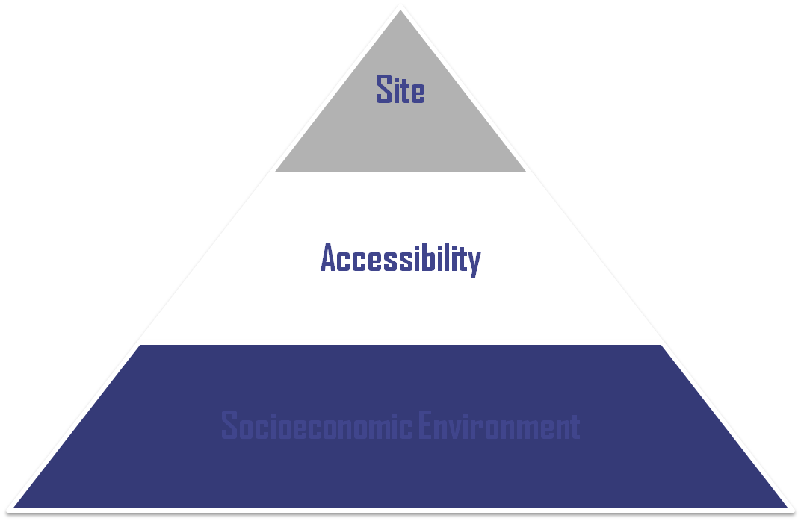
Basic Location Factors
Location
Land, utilities, visibility, transportation (local access), amenities
Micro (local)
Labor, materials, energy, markets, suppliers / customers
Meso (regional)
Capital, subsidies, regulations, taxation, technology
Macro (national)
Notes:
(*)
49

Slide 50
Location Theory
Relevance of geography
  Location is a resource multiplier:
    Using resources more effectively.
    A city is a more effective production and consumption structure.
    Some locations have higher sale potential; they differ mainly because of their accessibility.
    Accessibility can be a proxy for the value of space.
  A location can be a resource in itself:
    Bottleneck rent effect on flows (canals, bridges, tunnels).
    Capturing rent for right of passage (plus construction and maintenance of infrastructure).
Notes:
(*)
50

Slide 51
Von Thunen’s model of land use the rent function
R_{a}
A
Rent
A step forward
a: colture a
b: colture b
c: colture c
R_{b}
R_{c}
R_{d}
b
a
5
10
distance
c
 | R | p | c | t | d₀
a | 60 | 2.000 | 1.000 | 200 | 5
b | 50 | 3.000 | 2.200 | 80 | 10
c | 100 | 1.500 | 1.200 | 20 | 15
d | 50 | 2.000 | 1.600 | 50 | 8
=> D₁ = 2,5; D₂ = 5
Notes:
Diparimento di Scienze Geografiche e Storiche - Introduzione ai GIS
51

Slide 52
Von Thunen’s model of land use
A step forward
The isolated state
Modified conditions
Secondary market
Central market
River
dairy & vegetables
forestry
Intensive crop rotation
Arable and pastures
Three-field crop rotation system
Extensive stock grazing
Notes:
Diparimento di Scienze Geografiche e Storiche - Introduzione ai GIS
52
(*)

