Slide 1

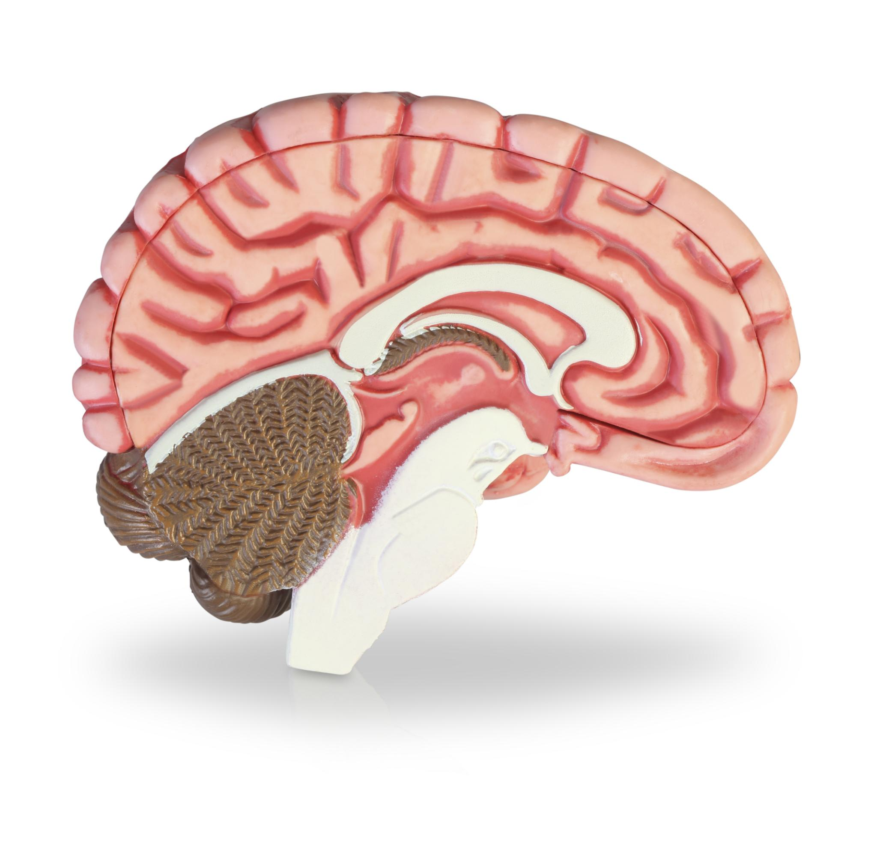
COMPARATIVE BRAIN EVOLUTION
ADD ON TO LECTURE 2

Slide 2
Definition and Examples of Homology
Definition of Homologous Structures
  Homologous structures are anatomical features inherited from a common ancestor, indicating shared evolutionary origins across species.
Brain Evolution and Homology
  Homologous brain regions share common origins despite serving different functions or morphological differences across species.
Hippocampus Example
  The hippocampus in mammals and birds evolved from a shared ancestral structure involved in spatial memory and shows developmental similarities.
MD NEUROSCIENCE- Gabriele Baj - gbaj@units.it

Slide 3
Definition and Examples of Homoplasy
Homoplasy Definition
Homoplastic structures result from convergent evolution, not shared ancestry, highlighting independent similarities.
Brain Evolution Example
Octopuses and vertebrates independently evolved complex visual centers to meet similar functional demands.
Adaptive Convergence Importance
Understanding homoplasy helps distinguish adaptive convergence from evolutionary continuity.
MD NEUROSCIENCE- Gabriele Baj - gbaj@units.it
MD NEUROSCIENCE- Gabriele Baj - gbaj@units.it

Slide 4
Comparison of Homology and Homoplasy
Feature | Homology | Homoplasy
Origin | Common ancestor | Independent evolution
Similarity | Due to shared ancestry | Due to similar function or environment
Example | Mammalian and avian hippocampus | Cephalopod and vertebrate eyes
Implication | Indicates evolutionary continuity | Indicates adaptive convergence
MD NEUROSCIENCE- Gabriele Baj - gbaj@units.it

Slide 5
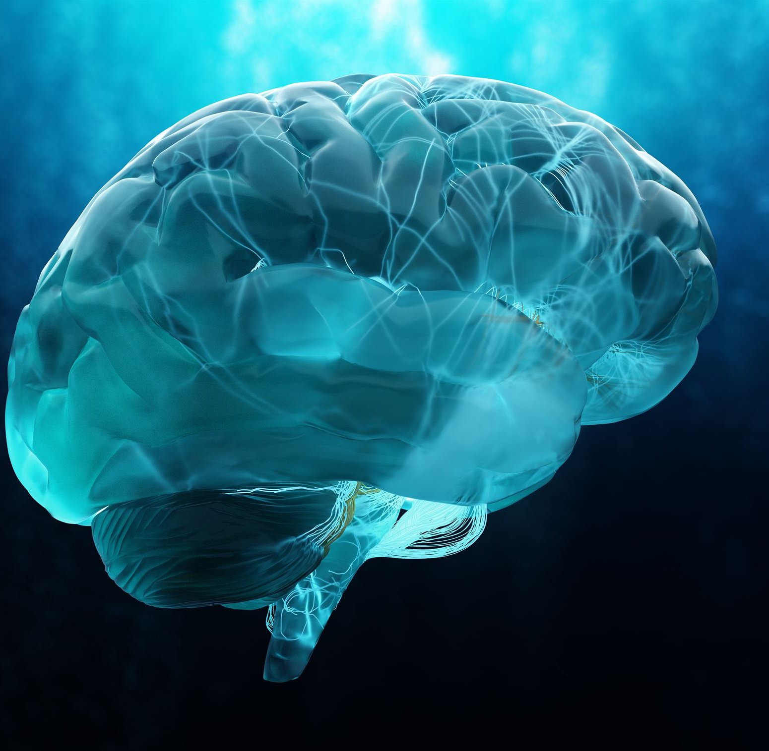
Mammalian Caudate–Putamen Complex
Structure of Striatum
  The caudate–putamen complex consists of the caudate nucleus and putamen, forming the striatum in mammalian brains.
Role in Motor Control
  This complex plays a critical role in coordinating voluntary motor movements and fine motor control.
Cognitive and Behavioral Functions
  The striatum supports learning, reward processing, habit formation, and integrates cortical signals for behavior modulation.
MD NEUROSCIENCE- Gabriele Baj - gbaj@units.it

Slide 6
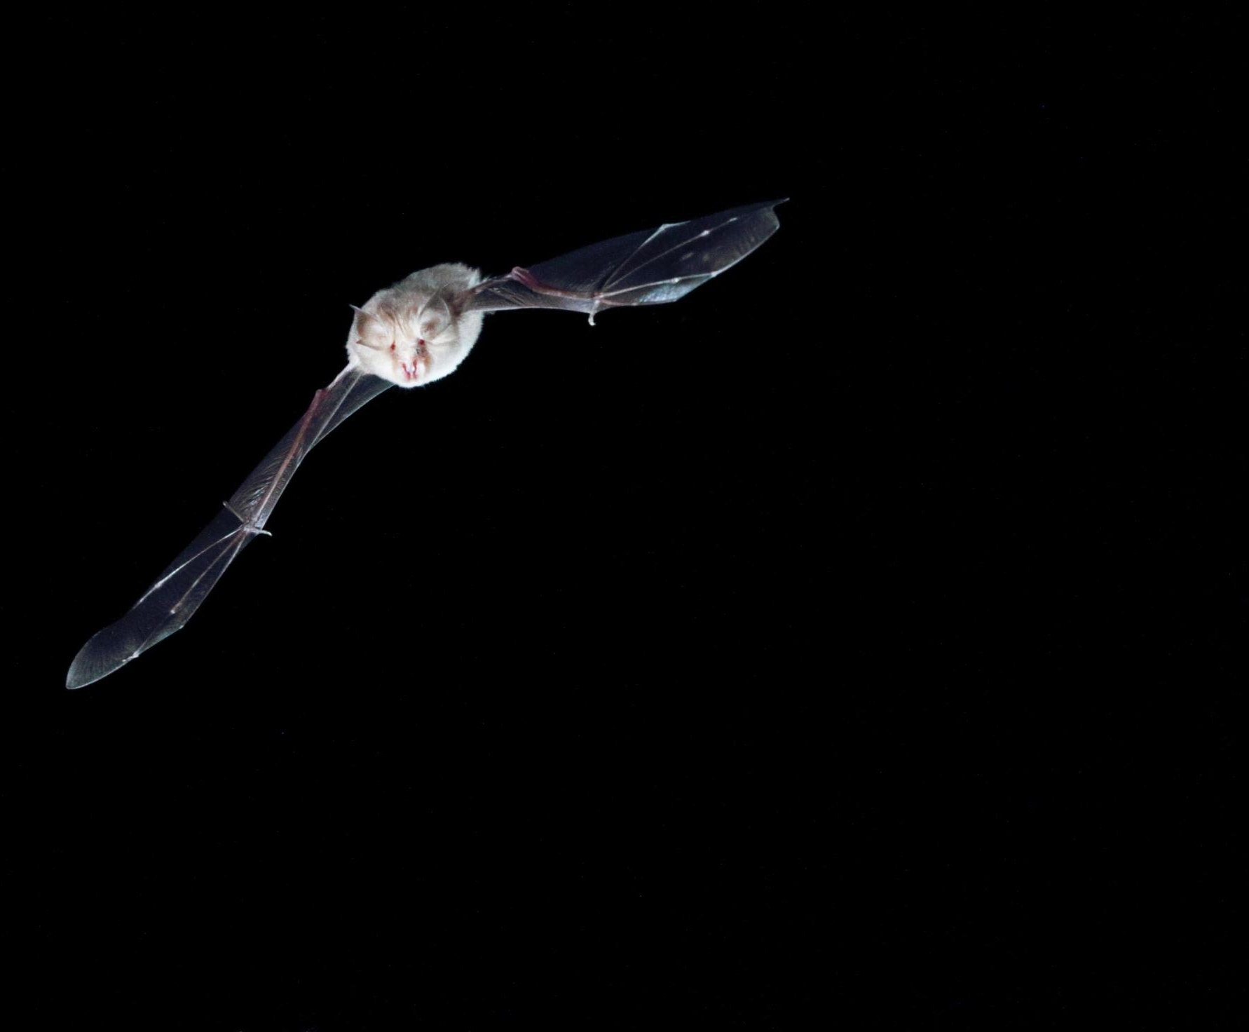
Avian Homologue of the Striatum
Medial Striatum Function
  The medial striatum in birds functions similarly to the mammalian caudate nucleus, important for motor and cognitive processes.
Lateral Striatum Correspondence
  The lateral striatum in birds corresponds to the mammalian putamen, playing a role in movement regulation.
Evolutionary Brain Organization
  Birds have a pallial–subpallial brain organization differing morphologically but maintaining functional similarities with mammals.
MD NEUROSCIENCE- Gabriele Baj - gbaj@units.it

Slide 7
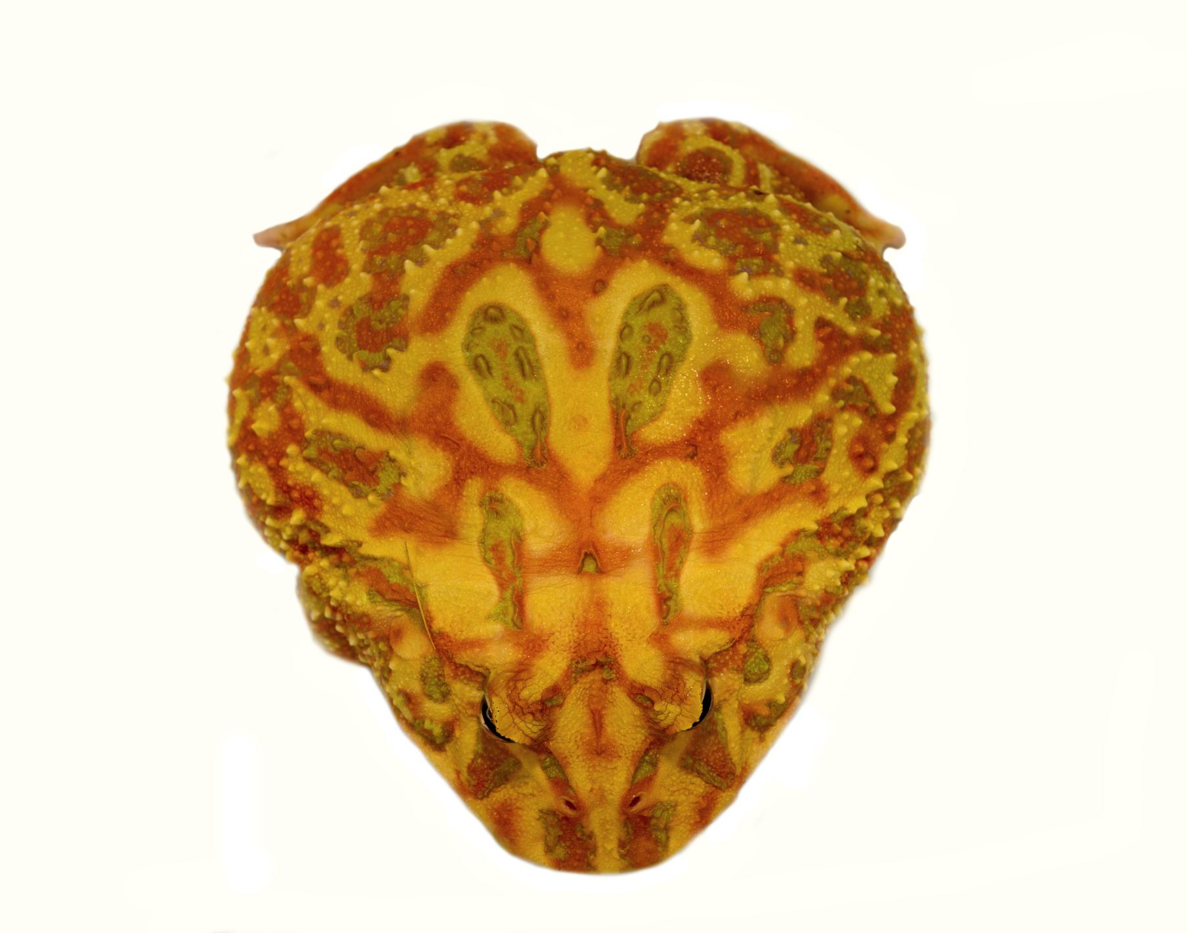
Reptilian Homologue of the Striatum
Striatum Location in Reptiles
  The reptilian striatum is situated in the subpallial region of the telencephalon, crucial for brain processing.
Dorsal Ventricular Ridge Interaction
  The dorsal ventricular ridge interacts with striatal areas despite not being directly homologous, indicating functional connections.
Conserved Neurochemical Features
  Reptilian striatum shares developmental and neurochemical traits with mammalian caudate–putamen, showing evolutionary conservation.
Role in Motor and Behavior
  The reptilian striatum plays a conserved role in regulating motor functions and behaviors across vertebrates.
MD NEUROSCIENCE- Gabriele Baj - gbaj@units.it

Slide 8
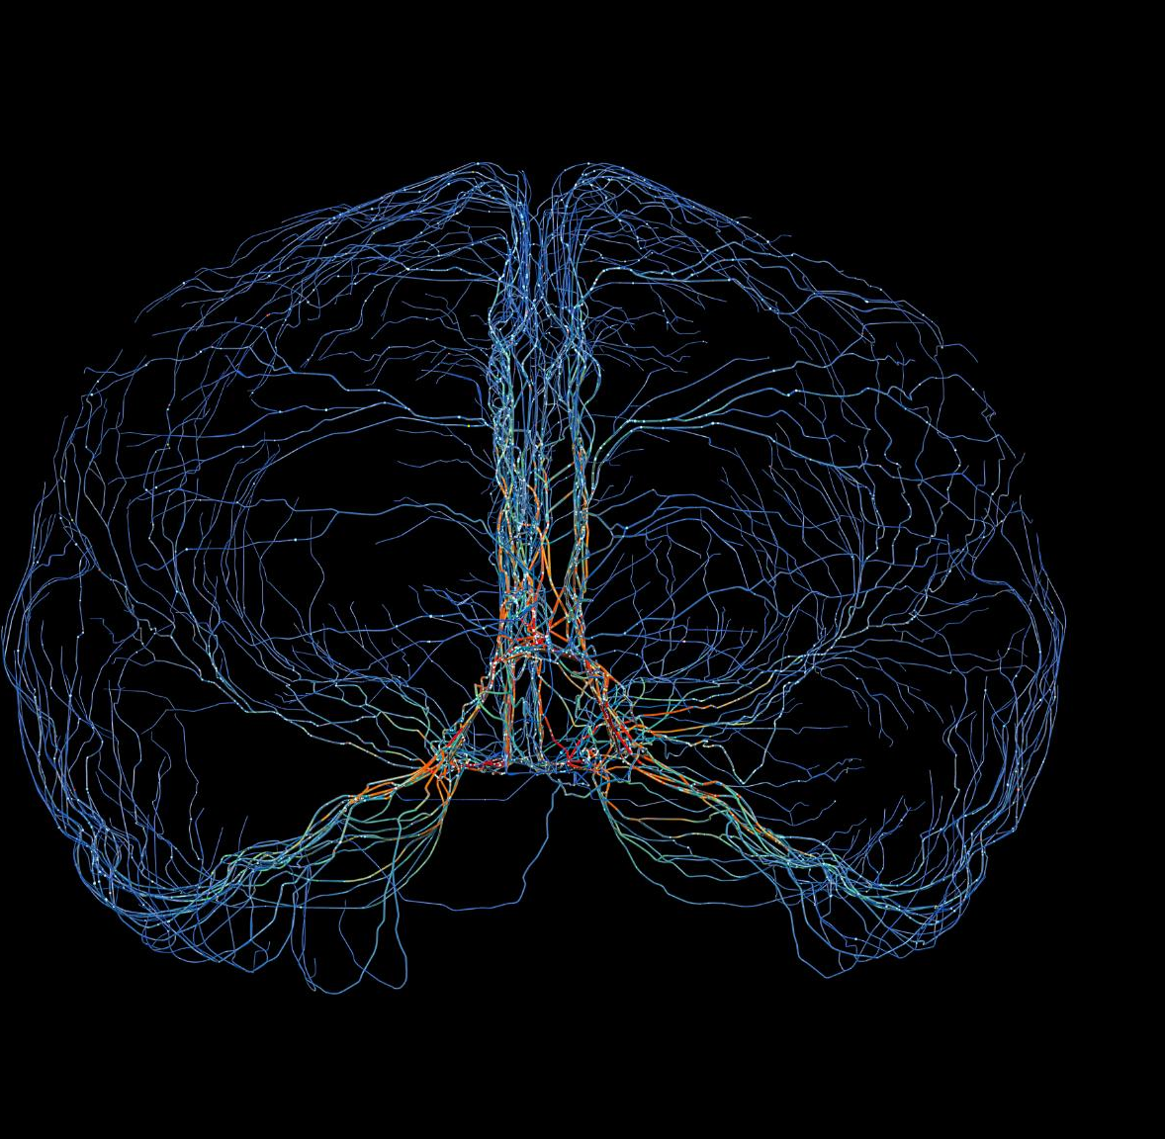
Evidence Supporting Homology
Developmental Origin
  Striatal structures originate from the lateral ganglionic eminence during embryonic development across species.
Neurochemical Markers
  Dopamine receptors and GABAergic neurons show similar expression patterns in striatal regions among mammals, birds, and reptiles.
Connectivity Patterns
  Striatal connectivity includes input from pallial regions and output to motor systems, highlighting evolutionary continuity.
MD NEUROSCIENCE- Gabriele Baj - gbaj@units.it

Slide 9
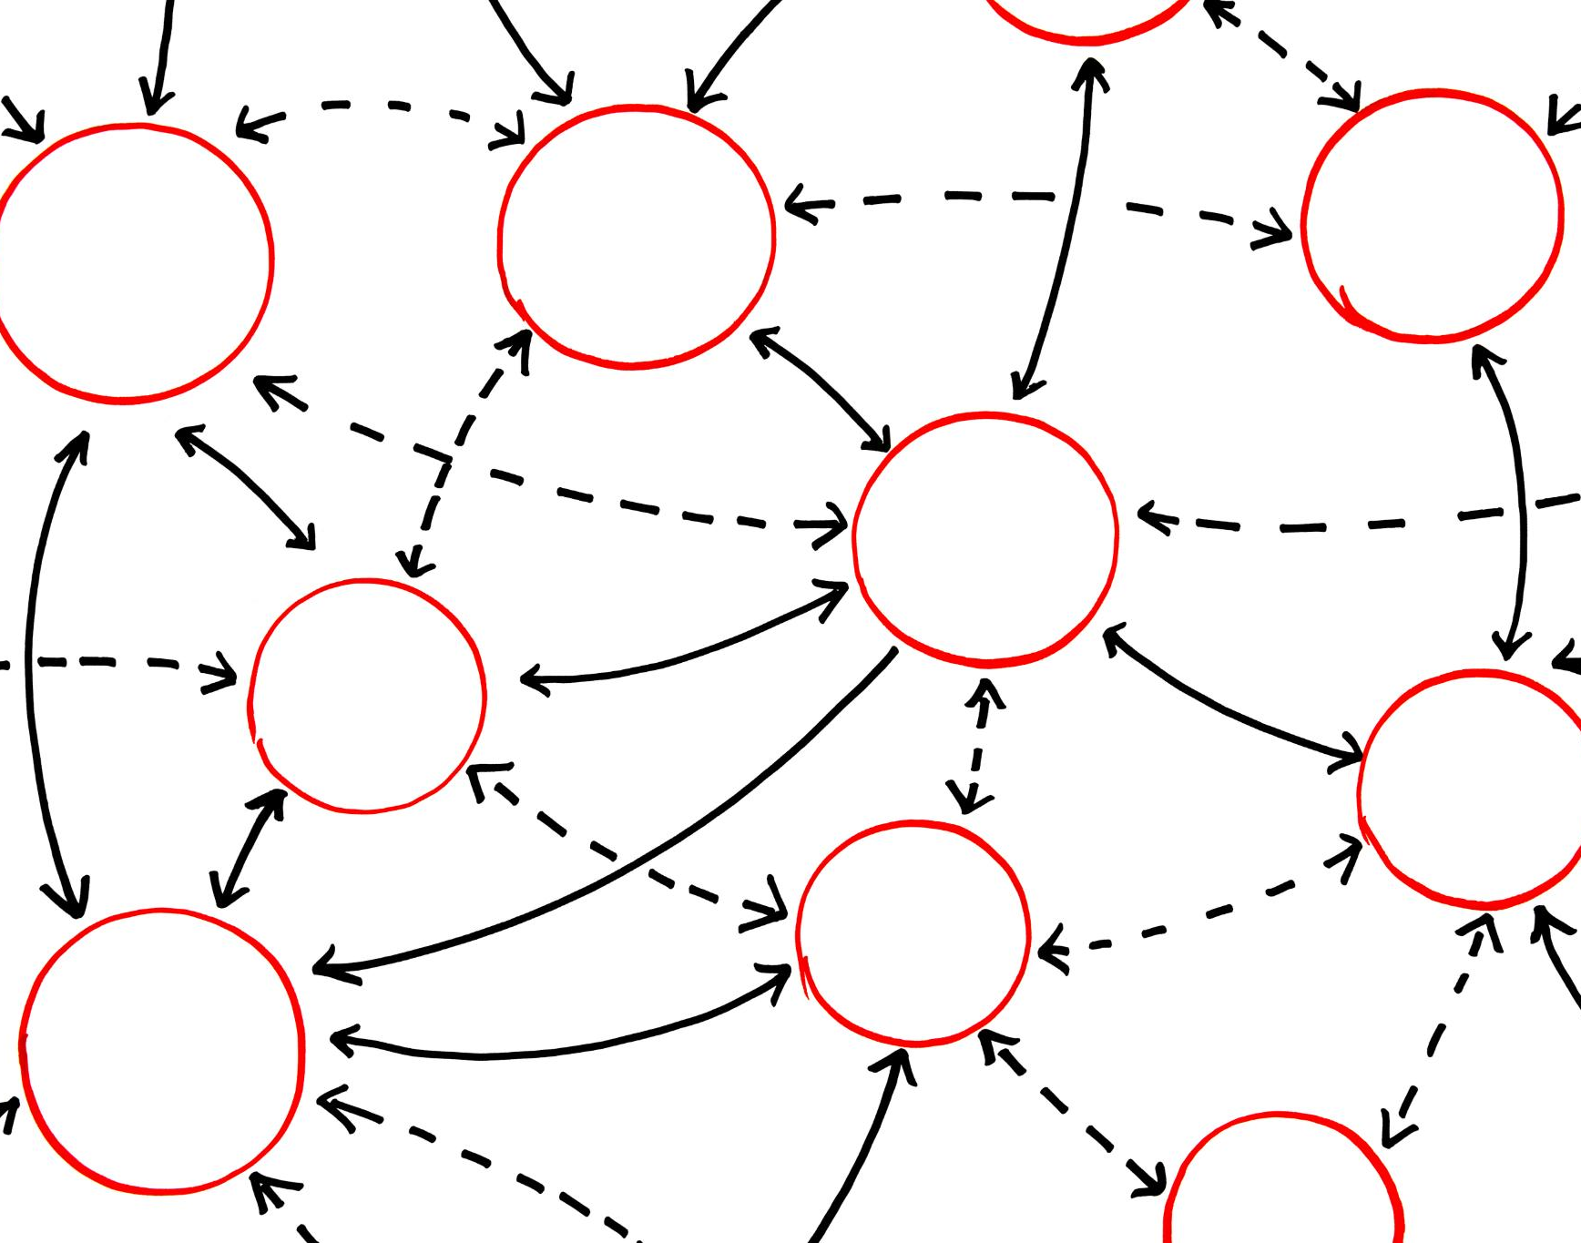
Taxonomy: Classification Based on Anatomy
Anatomical Basis of Taxonomy
  Taxonomy classifies organisms based on shared anatomical traits to organize biological diversity meaningfully.
Hierarchical Categories
  Organisms are grouped into categories like phylum, class, and order according to anatomical similarities.
Example of Vertebrates
  Vertebrates share backbones and are grouped together despite differing external appearances among species.
Evolutionary Insights
  Taxonomy reveals evolutionary relationships and key defining traits among biological groups.
MD NEUROSCIENCE- Gabriele Baj - gbaj@units.it

Slide 10
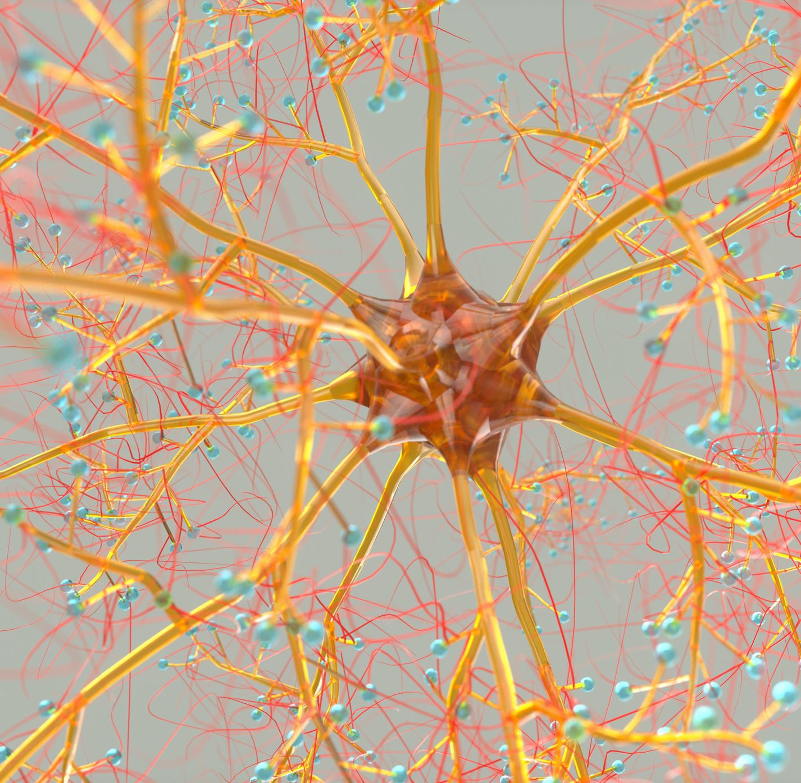
Topology: Spatial Organization of Structures
Spatial Arrangement Focus
  Topology studies the positions and relationships of body parts beyond their size or shape differences.
Connectivity Pathways
  It highlights how structural pathways like blood vessels and nerves connect different anatomical structures.
Topological Conservation Example
  The adjacency of heart and lungs with shared vessels is preserved across vertebrates, demonstrating topological conservation.
MD NEUROSCIENCE- Gabriele Baj - gbaj@units.it

Slide 11
Comparison of Taxonomy and Topology
Aspect | Taxonomy | Topology
Focus | Classification based on anatomical traits | Spatial relationships and connectivity
Goal | Group organisms by shared features | Understand structural organization
Example Use | Classifying mammals vs. reptiles | Mapping nerve pathways in vertebrates
MD NEUROSCIENCE- Gabriele Baj - gbaj@units.it

Slide 12
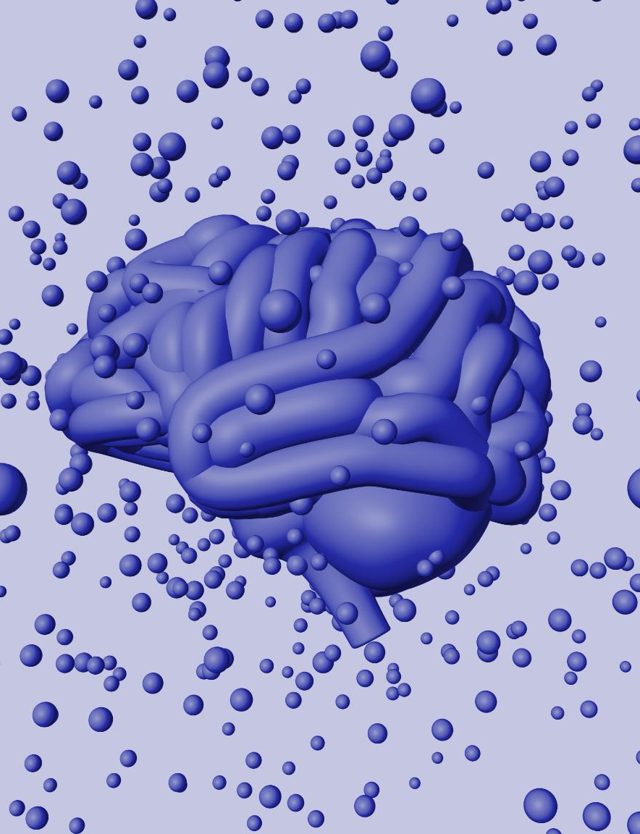
Ontogenesis: Individual Brain Development
Neural Tube Formation
  Neural tube formation is an early embryonic process that establishes the foundation of the central nervous system.
Neurogenesis and Synaptogenesis
  Neurogenesis generates new neurons, while synaptogenesis forms connections, both critical for brain maturation.
Cortical Layering
  Cortical layering organizes neurons into layers, crucial for advanced brain functions and cognitive development.
MD NEUROSCIENCE- Gabriele Baj - gbaj@units.it

Slide 13
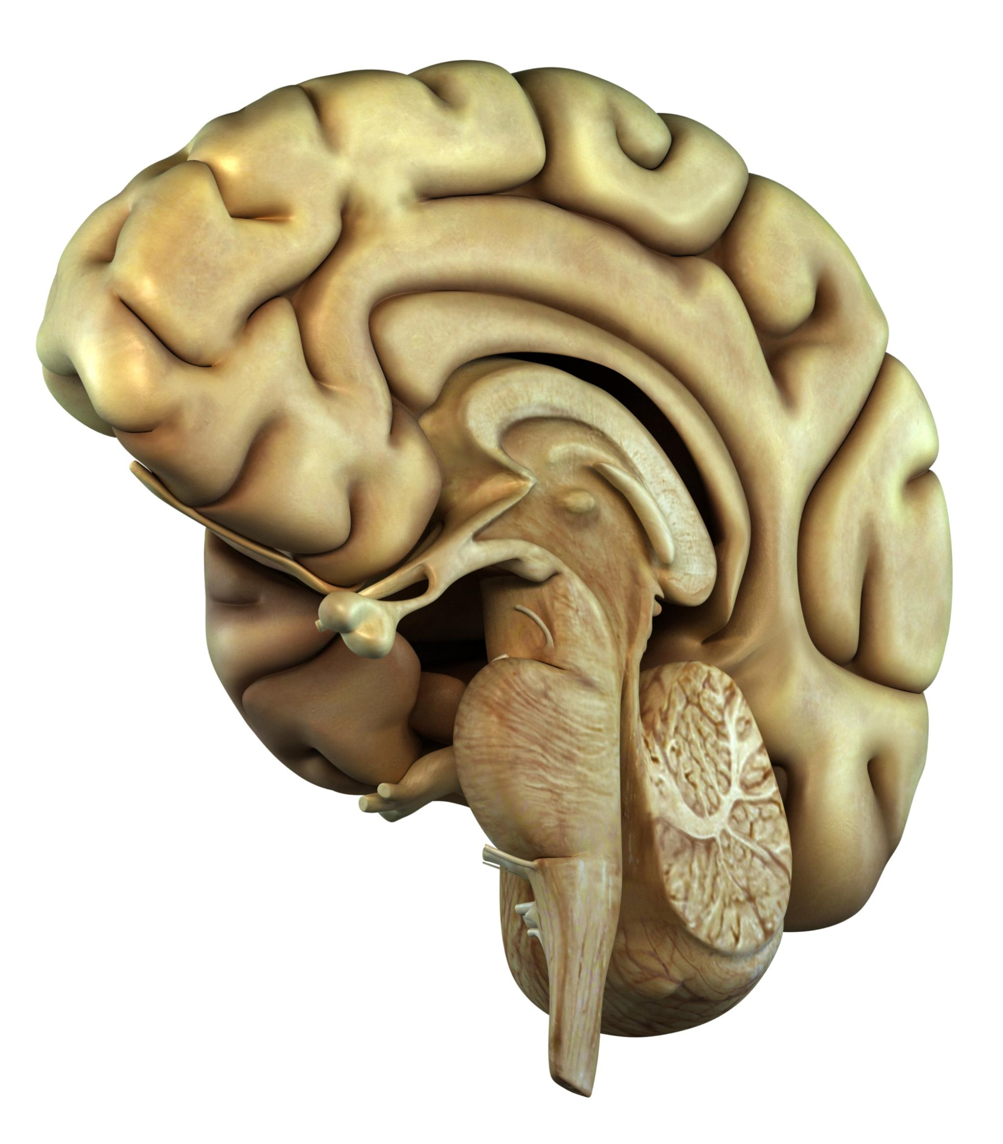
Phylogeny: Evolutionary History of Brain Structures
Evolutionary Relationships
  Phylogeny studies evolutionary relationships to understand how brain structures evolved among species.
Ancestral Traits Identification
  Phylogeny helps identify ancestral brain traits shared across species through comparative analysis.
Neocortex Evolution
  Tracing neocortex evolution reveals complex brain region emergence from reptiles to mammals.
MD NEUROSCIENCE- Gabriele Baj - gbaj@units.it

Slide 14
Comparison of Ontogenesis and Phylogeny
Aspect | Ontogenesis | Phylogeny
Focus | Individual development | Species evolution
Timescale | Lifespan of one organism | Millions of years across species
Methods | Embryology, developmental biology | Comparative anatomy, evolutionary biology
Goal | Understand how brain forms and matures | Understand how brain structures evolved
Example | Cortical folding in human fetus | Expansion of neocortex in primates
MD NEUROSCIENCE- Gabriele Baj - gbaj@units.it

Slide 15
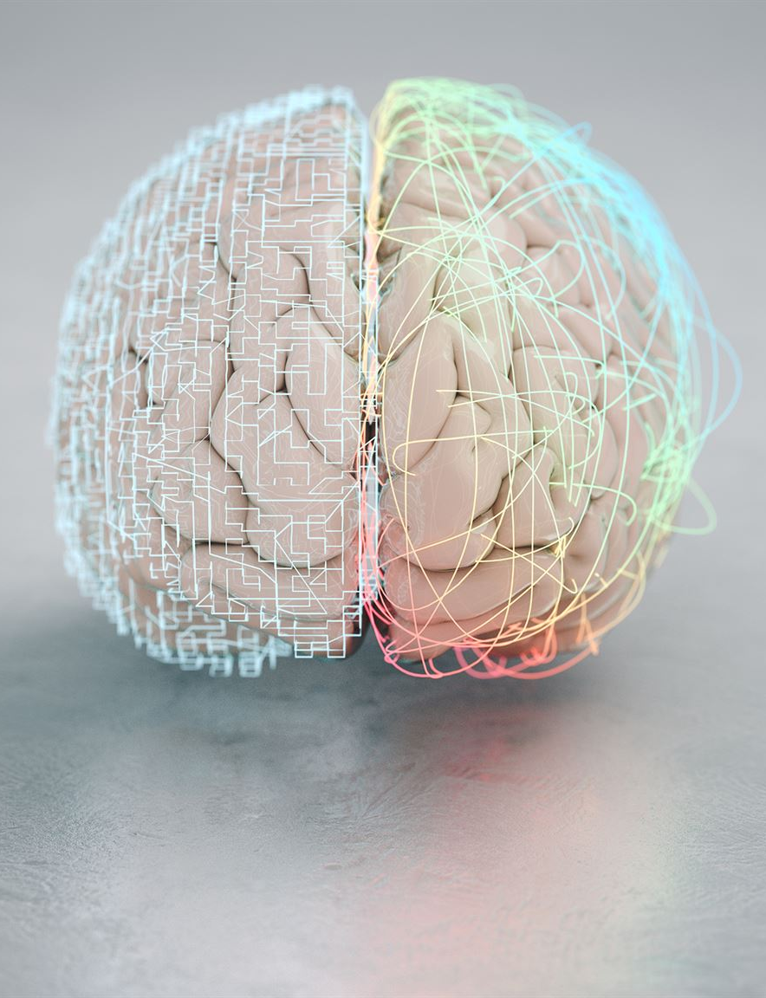
Definition and Application of Neurocladistics
Neurocladistics Overview
  Neurocladistics uses cladistic methods to study brain evolution by comparing neuroanatomical traits across species.
Phylogenetic Tree Construction
  Researchers build phylogenetic trees from brain features to reveal evolutionary relationships and ancestral structures.
Identifying Neural Traits
  The method distinguishes shared derived traits from primitive neural features to understand brain region development.
MD NEUROSCIENCE- Gabriele Baj - gbaj@units.it

Slide 16
Monophyletic Groups
  Groups including an ancestor and all its descendants represent monophyletic clades in evolution.
Ancestral vs Derived Traits
  Plesiomorphic traits are ancestral and widespread, while apomorphic traits are derived and unique to lineages.
Shared Traits in Evolution
  Symplesiomorphic traits are shared ancestral traits, while synapomorphic traits are shared derived traits defining clades.
Unique Derived Traits
  Autapomorphic traits are unique derived features found only in a single taxon.
MD NEUROSCIENCE- Gabriele Baj - gbaj@units.it

Slide 18


