Slide 1

Sustainable Cities 1 – Urban geography. An Introduction to Cities
659EC
A.Y. 2025/2026
Dr. Giuseppe Borruso
Department of Economics, Business, Mathematics and Statistics
University of Trieste
E-mail. giuseppe.borruso@deams.units.it
Ph. +39 040 558 7008
Notes:
Slides with (*) in footnotes have been modified by Jean-Paul Rodrigue materials concerning “Transportation Geography”. Slides with (*) in footnotes are referred to “Transport and the Urban Environment” materials (see copyright). I have modified and elaborated materials in order to be suitable for the current course.
For references visit http://people.hofstra.edu/geotrans
Copyright © 1998-2010, Dr. Jean-Paul Rodrigue, Dept. of Global Studies & Geography, Hofstra University. For personal or classroom use ONLY.

Slide 2
Topics
World urban population
Cities: a definition
Transport, urban form and spatial structure
The analysis of urban structure
The bid rent and the models of urban structure
The global model
The urban density
The urban crisis and the urban lifecycle
Case study: the Megalopolis

Slide 3
An Urbanizing Society
An urban world
The world is getting increasingly urbanized.
Since 1950, the world urban population has more than doubled.
In 1999, half of the world’s population of 6 billions lived in urban areas.
75% were in developing economies.
The majority of economic activities are taking place in cities.
Cities are dominant attributes of the human landscape.
Notes:
**

Slide 4
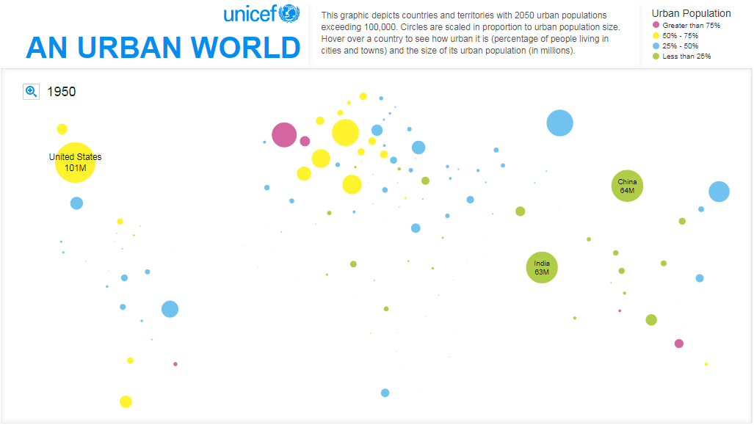
1950

Slide 5
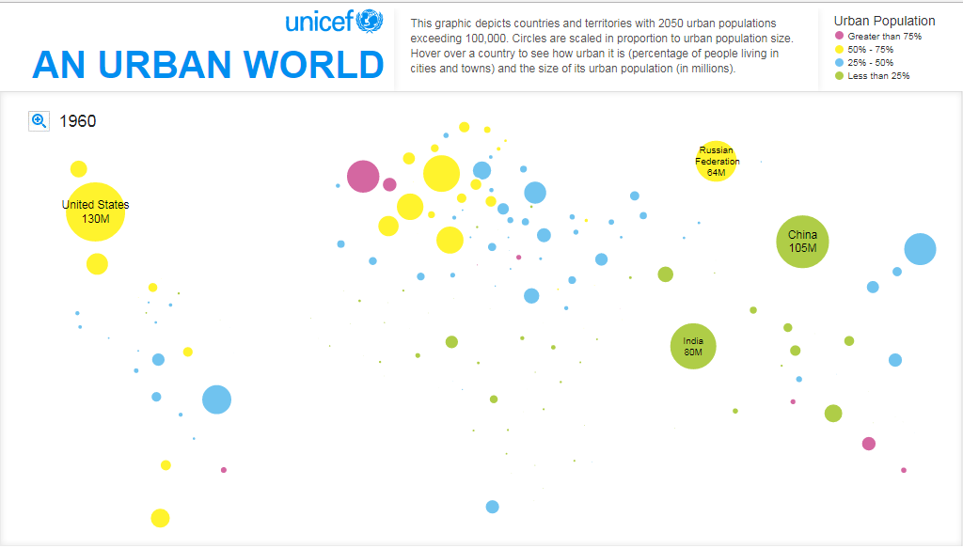
1960

Slide 6
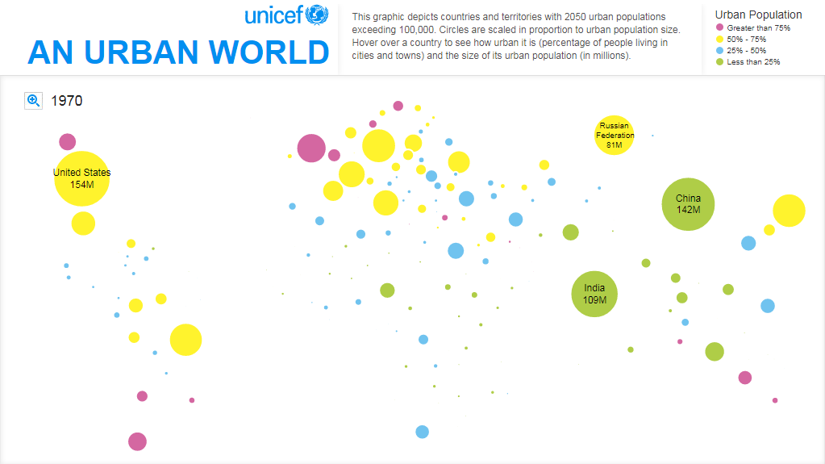
1970

Slide 7
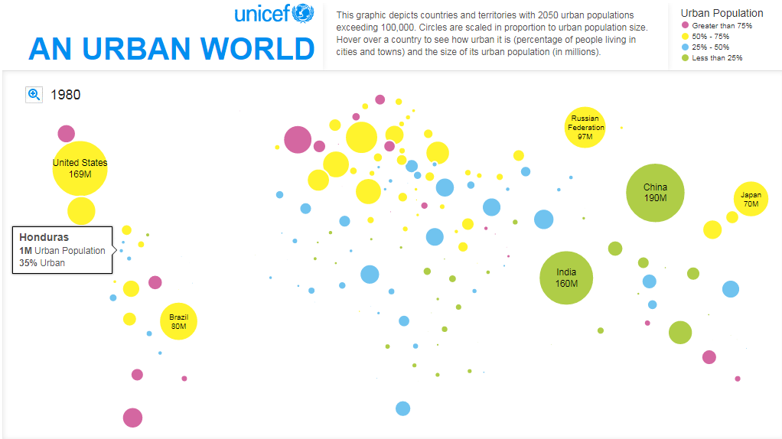
1980

Slide 8
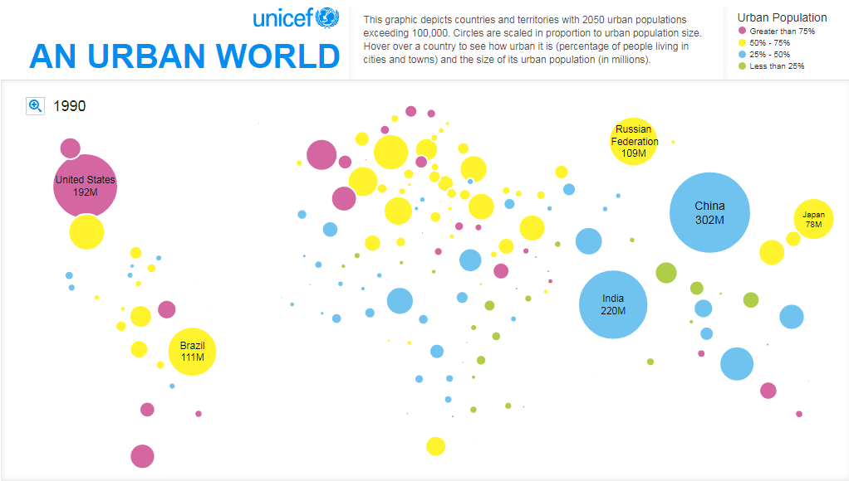
1990

Slide 9
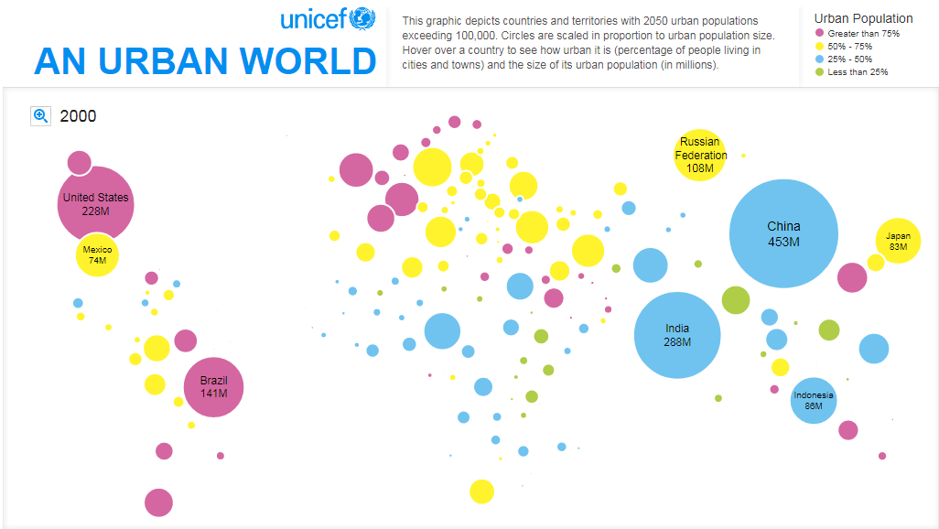
2000

Slide 10
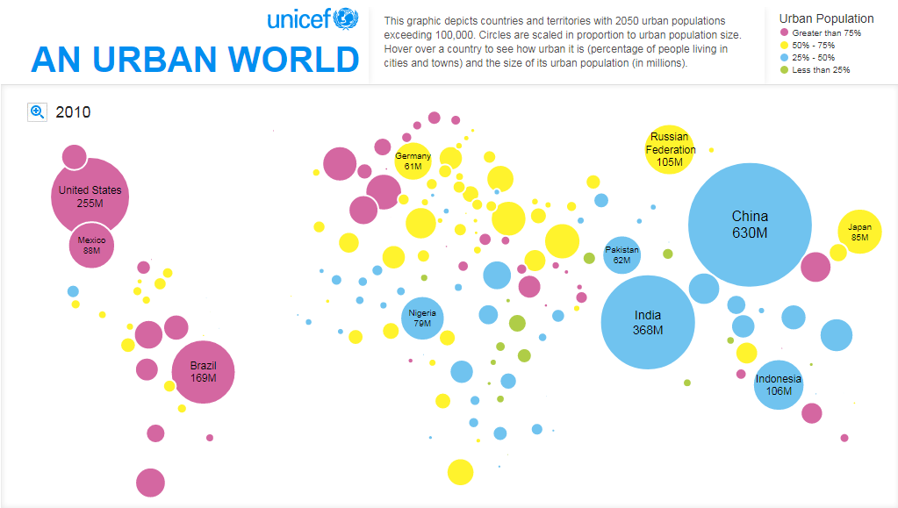
2010

Slide 11
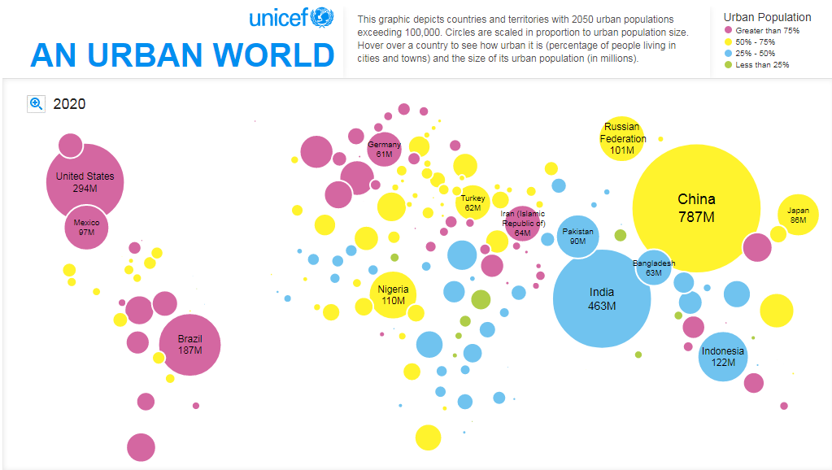
2020

Slide 12
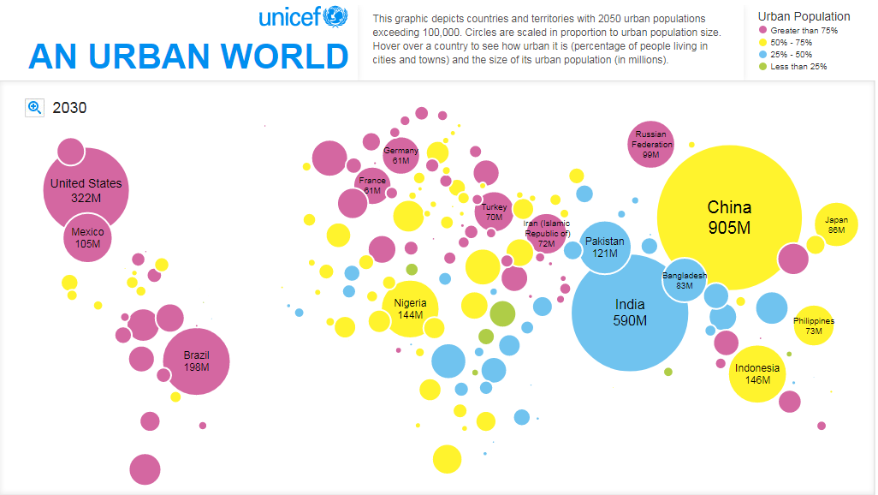
2030

Slide 13
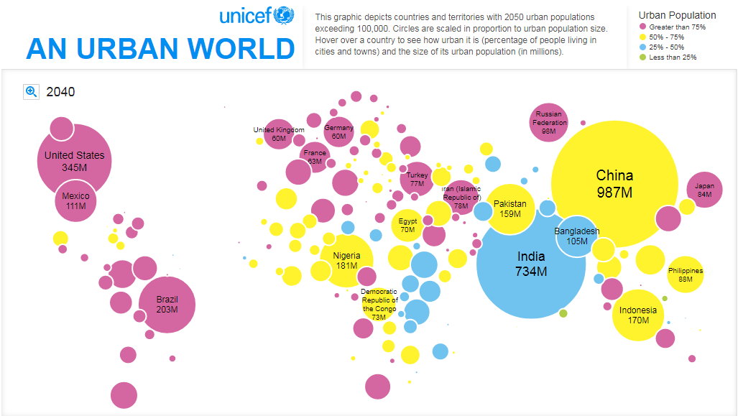
2040

Slide 14
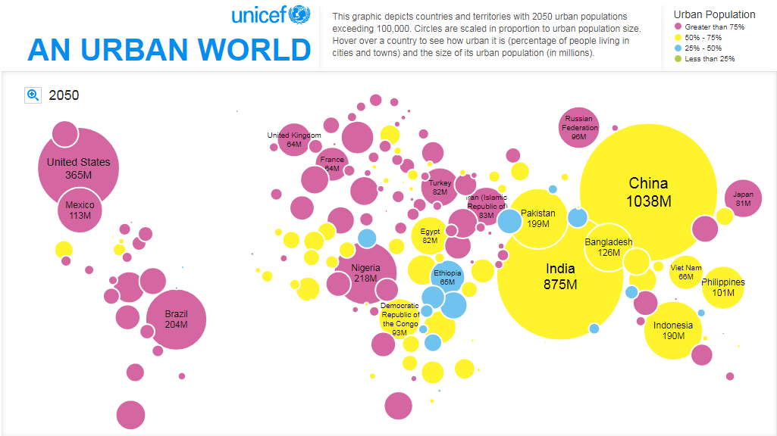
2050

Slide 15
Urbanization
Stages
Cities, a difficult definition
Urban functions
Urban structures

Slide 16
Stages of Urbanization
Initial Stage
Transition Stage
Terminal Stage
100
Demographic transition
Rural to urban migration
Developed countries
80
Rural
Society
Developing
countries
Urban
Society
60
Urban Population
40
Least developed
countries
20
Urbanization
0
Time
Notes:
Source: Adapted from Peters and Larkin, 1999.
**

Slide 17
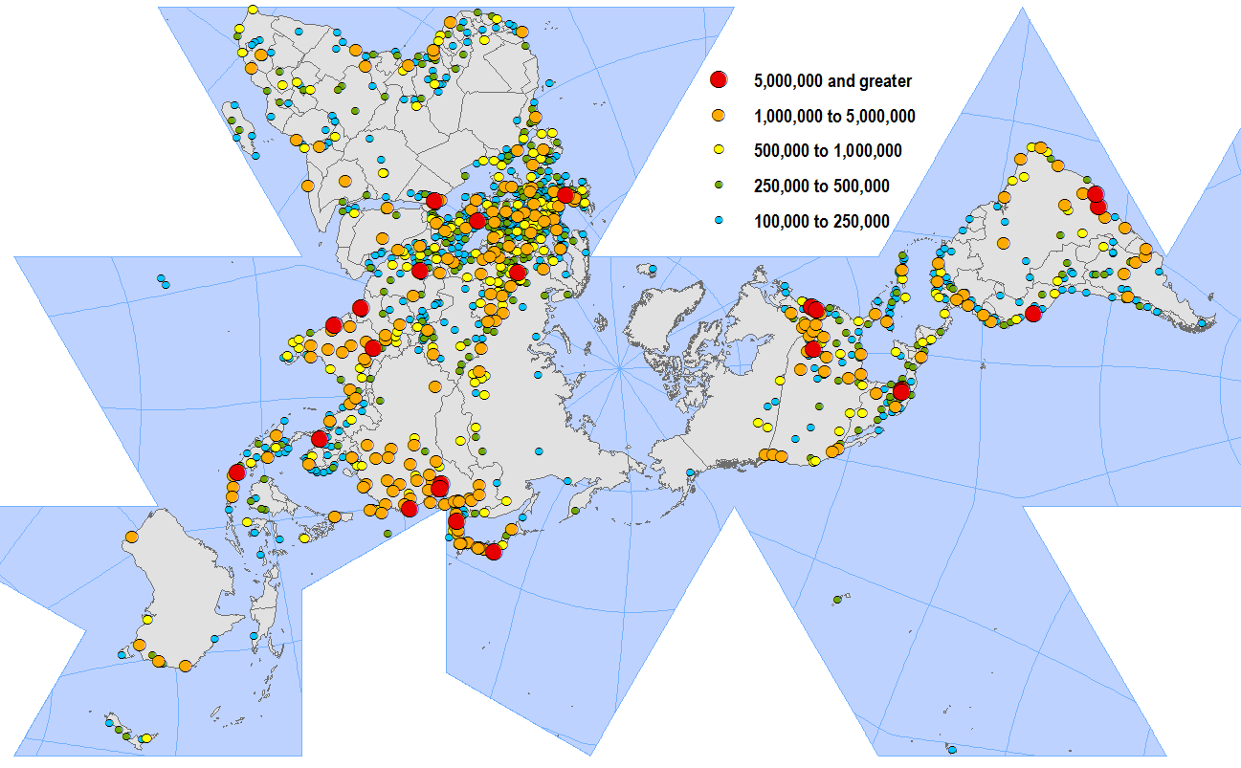
World’s Largest Cities
Copyright © 1998-2010, Dr. Jean-Paul Rodrigue, Dept. of Global Studies & Geography, Hofstra University. For personal or classroom use ONLY. This material (including graphics) is not public domain and cannot be published, in whole or in part, in ANY form (printed or electronic) and on any media without consent. This includes conference presentations. Permission MUST be requested prior to use.
Notes:
**
17

Slide 18
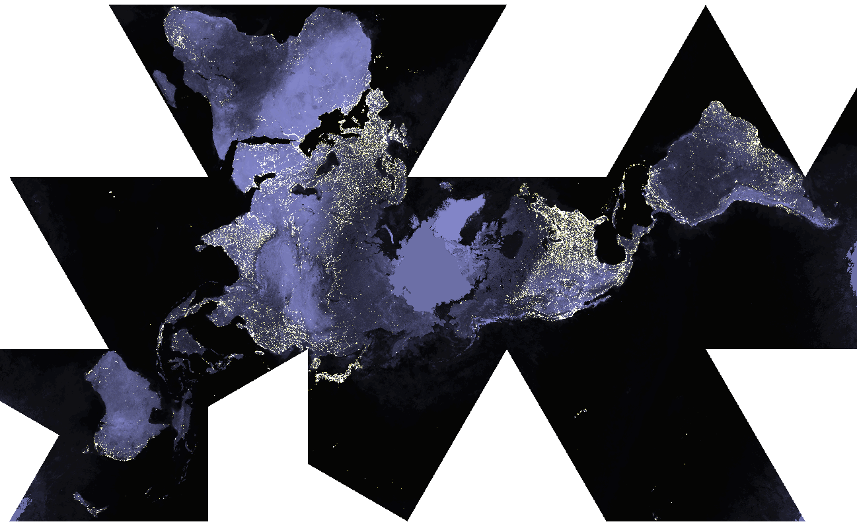
World at Night
Copyright © 1998-2010, Dr. Jean-Paul Rodrigue, Dept. of Global Studies & Geography, Hofstra University. For personal or classroom use ONLY. This material (including graphics) is not public domain and cannot be published, in whole or in part, in ANY form (printed or electronic) and on any media without consent. This includes conference presentations. Permission MUST be requested prior to use.
Notes:
**
18

Slide 19
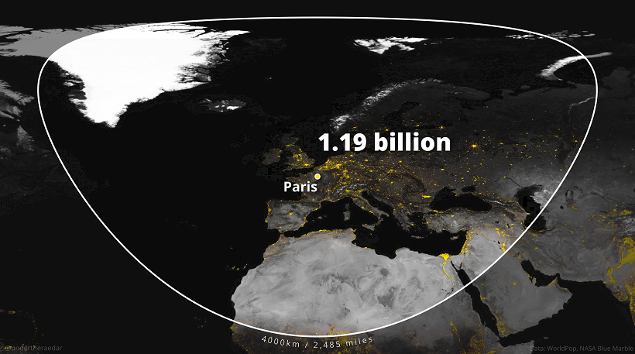
World’s most populated areas
https://www.visualcapitalist.com/cp/the-yuxi-circle-the-worlds-most-densely-populated-area/
Notes:
**
19

Slide 20
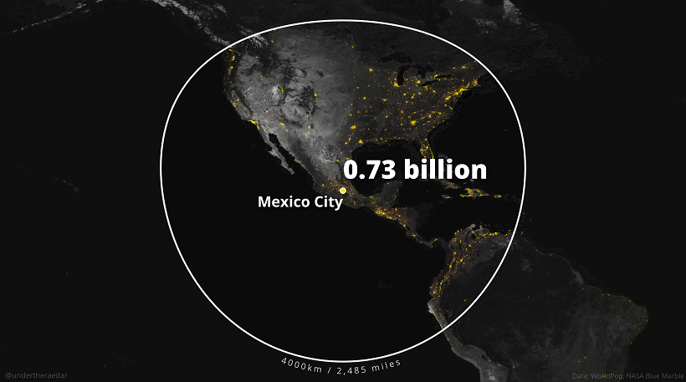
World’s most populated areas
https://www.visualcapitalist.com/cp/the-yuxi-circle-the-worlds-most-densely-populated-area/
Notes:
**
20

Slide 21
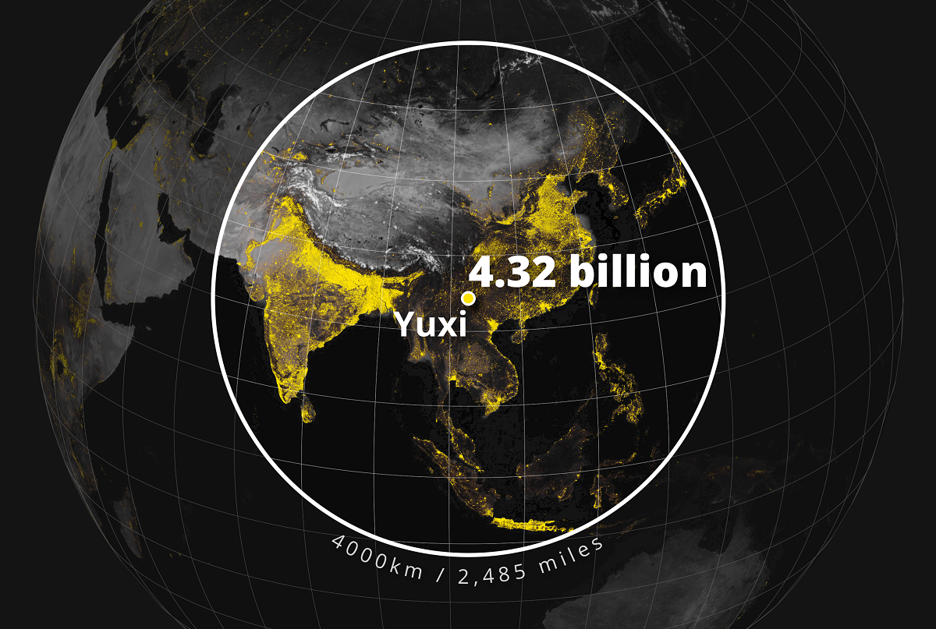
World’s most populated areas
https://www.visualcapitalist.com/cp/the-yuxi-circle-the-worlds-most-densely-populated-area/
Notes:
**
21

Slide 22
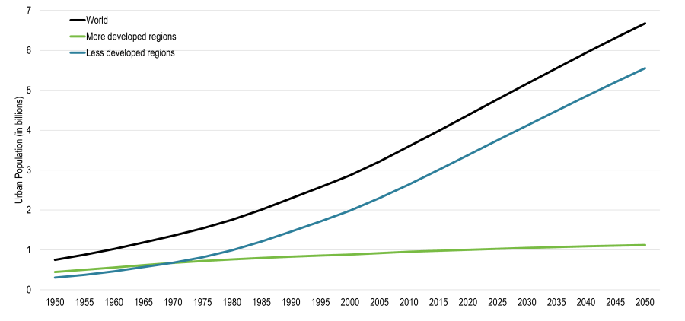
World Urban Population, 1950-2015 with Projections to 2050 (in billions)
https://transportgeography.org/contents/chapter8/transportation-urban-form/world-urban-population/
Copyright © 1998-2010, Dr. Jean-Paul Rodrigue, Dept. of Global Studies & Geography, Hofstra University. For personal or classroom use ONLY. This material (including graphics) is not public domain and cannot be published, in whole or in part, in ANY form (printed or electronic) and on any media without consent. This includes conference presentations. Permission MUST be requested prior to use.
Notes:
22
Source: United Nations, Department of Economic and Social Affairs, Population Division (2006). World Urbanization Prospects: The 2005 Revision. New York: United Nations.
**

Slide 23
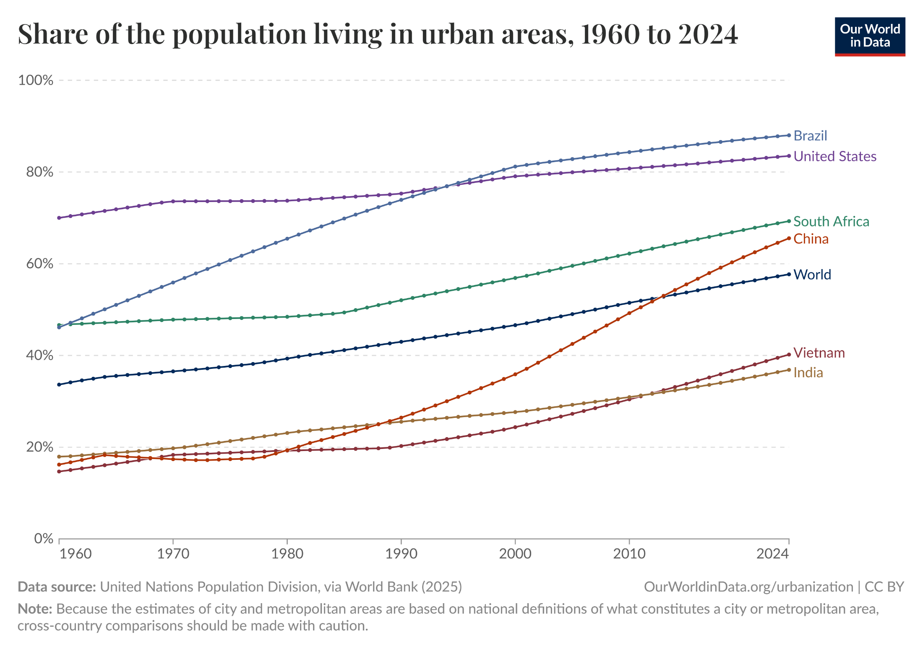
World Urban Population, 1950-2005 with Projections to 2020 (in billions)
https://ourworldindata.org/grapher/share-of-population-urban?tab=line
Notes:
23
Source: United Nations, Department of Economic and Social Affairs, Population Division (2006). World Urbanization Prospects: The 2005 Revision. New York: United Nations.
**

Slide 24
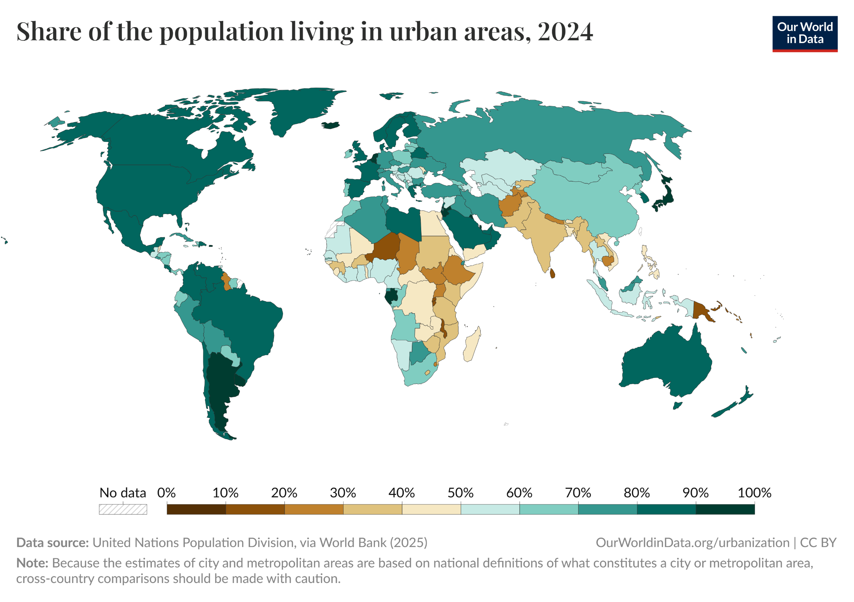
World Urban Population, 1950-2005 with Projections to 2020 (in billions)
https://ourworldindata.org/grapher/share-of-population-urban
Notes:
24
Source: United Nations, Department of Economic and Social Affairs, Population Division (2006). World Urbanization Prospects: The 2005 Revision. New York: United Nations.
**

Slide 25
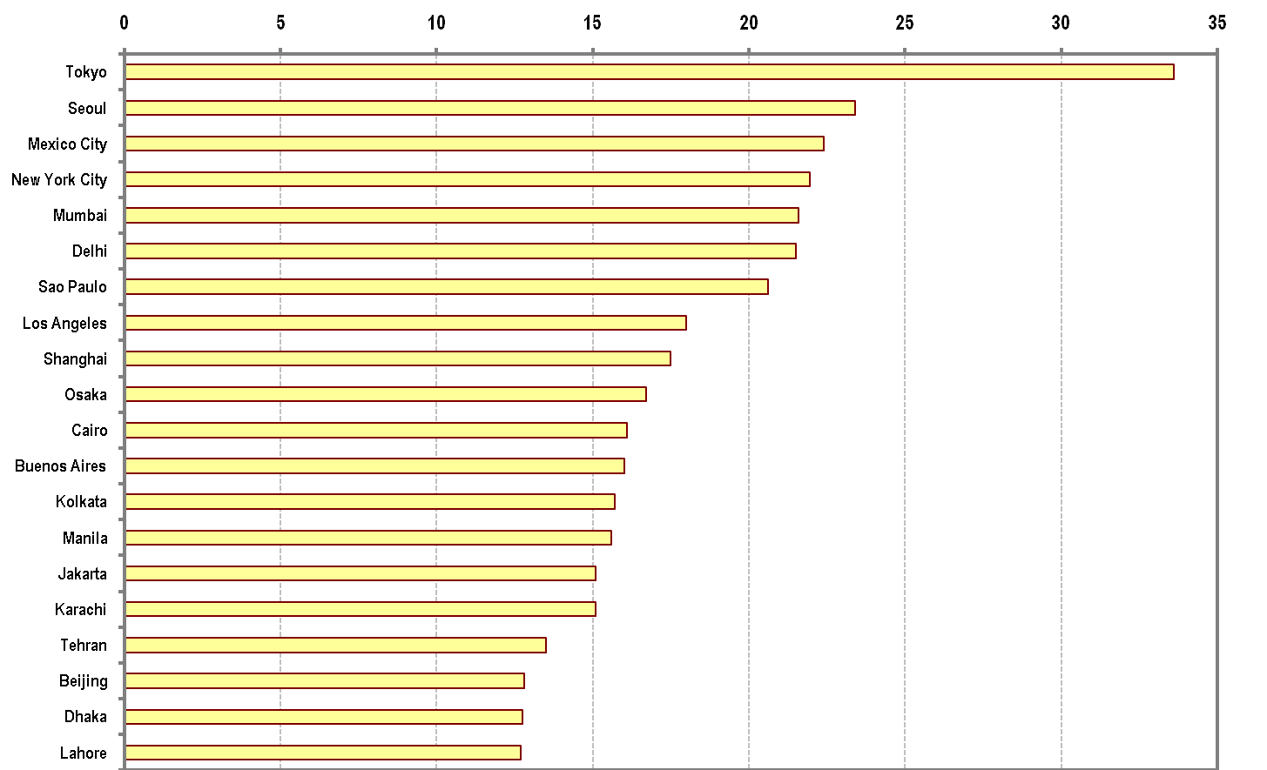
World’s Largest Metropolitan Areas, 2006 (in millions)
Copyright © 1998-2010, Dr. Jean-Paul Rodrigue, Dept. of Global Studies & Geography, Hofstra University. For personal or classroom use ONLY. This material (including graphics) is not public domain and cannot be published, in whole or in part, in ANY form (printed or electronic) and on any media without consent. This includes conference presentations. Permission MUST be requested prior to use.
Notes:
Source: United Nations, Department of Economic and Social Affairs, Population Division (2006). World Urbanization Prospects: The 2005 Revision. New York: United Nations.
**
25

Slide 26
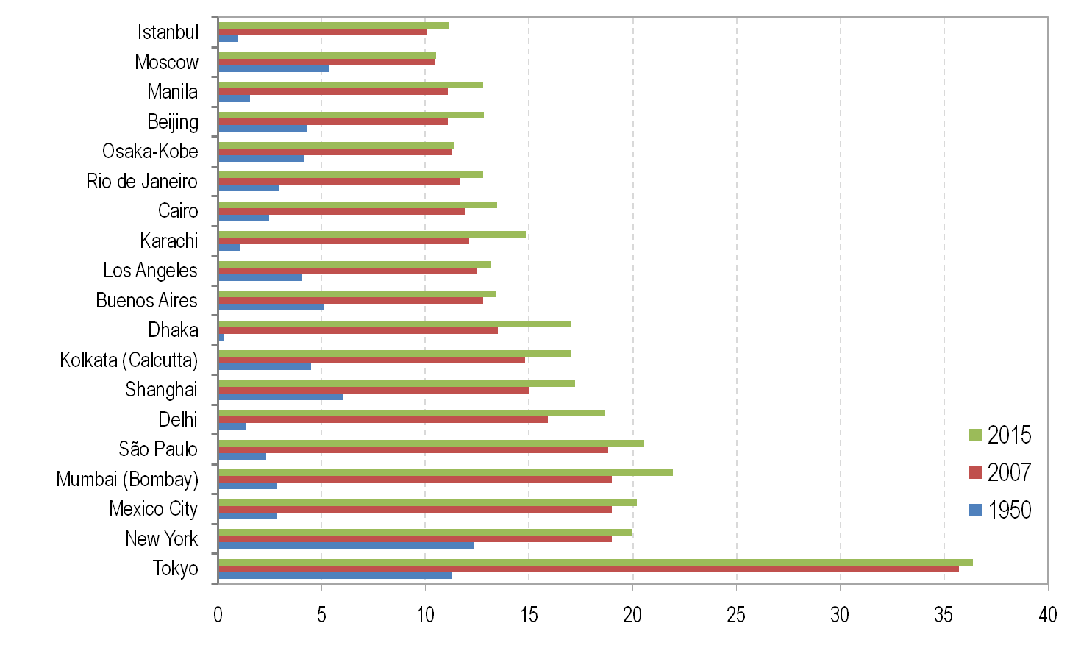
Cities of More than 10 Million Inhabitants, 2007
Copyright © 1998-2010, Dr. Jean-Paul Rodrigue, Dept. of Global Studies & Geography, Hofstra University. For personal or classroom use ONLY. This material (including graphics) is not public domain and cannot be published, in whole or in part, in ANY form (printed or electronic) and on any media without consent. This includes conference presentations. Permission MUST be requested prior to use.
Notes:
Source: Compiled by Earth Policy Institute.
**
26

Slide 27
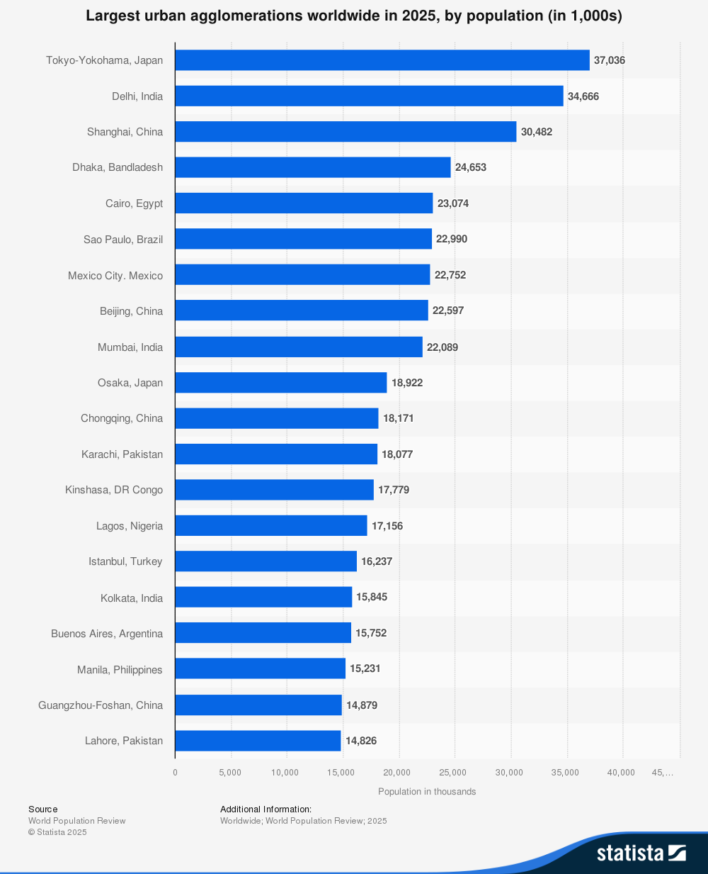
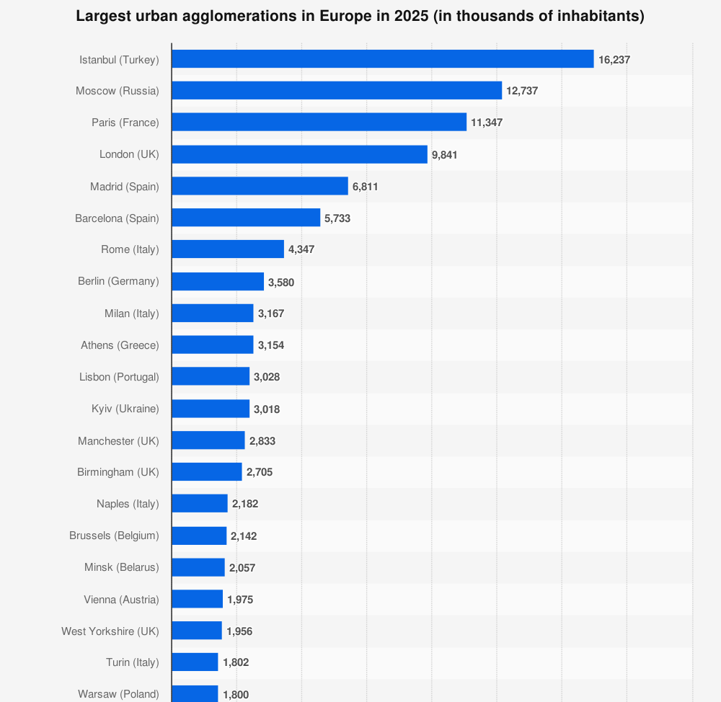
Largest Cities in the world e in Europe, 2025
https://www.statista.com/statistics/912263/population-of-urban-agglomerations-worldwide/; https://www.statista.com/statistics/1101883/largest-european-cities/
Notes:
Source: Compiled by Earth Policy Institute.
**
27

Slide 28
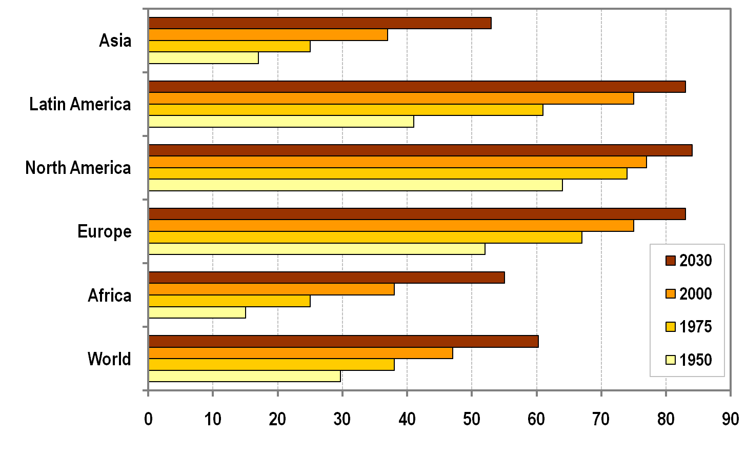
Percentage of Urban Population by Region, 1950-2030 (forecast)
Copyright © 1998-2010, Dr. Jean-Paul Rodrigue, Dept. of Global Studies & Geography, Hofstra University. For personal or classroom use ONLY. This material (including graphics) is not public domain and cannot be published, in whole or in part, in ANY form (printed or electronic) and on any media without consent. This includes conference presentations. Permission MUST be requested prior to use.
Notes:
28
Source: United Nations Population Program.
**

Slide 29
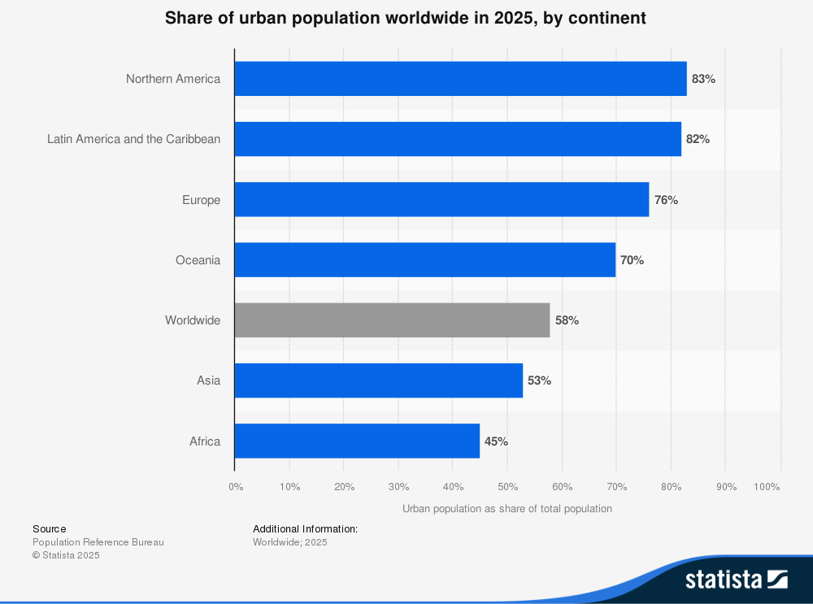
https://www.statista.com/statistics/270860/urbanization-by-continent/
Notes:
29
Source: United Nations Population Program.
**

Slide 30
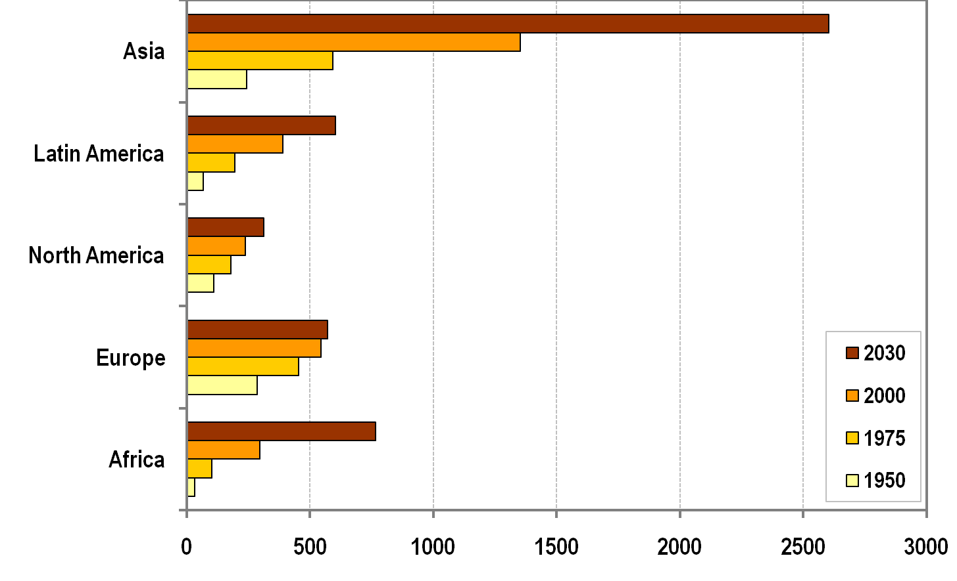
Urban Population by Region, 1950-2030 (in millions)
Copyright © 1998-2010, Dr. Jean-Paul Rodrigue, Dept. of Global Studies & Geography, Hofstra University. For personal or classroom use ONLY. This material (including graphics) is not public domain and cannot be published, in whole or in part, in ANY form (printed or electronic) and on any media without consent. This includes conference presentations. Permission MUST be requested prior to use.
Notes:
30
Source: United Nations Population Program.
**

Slide 31
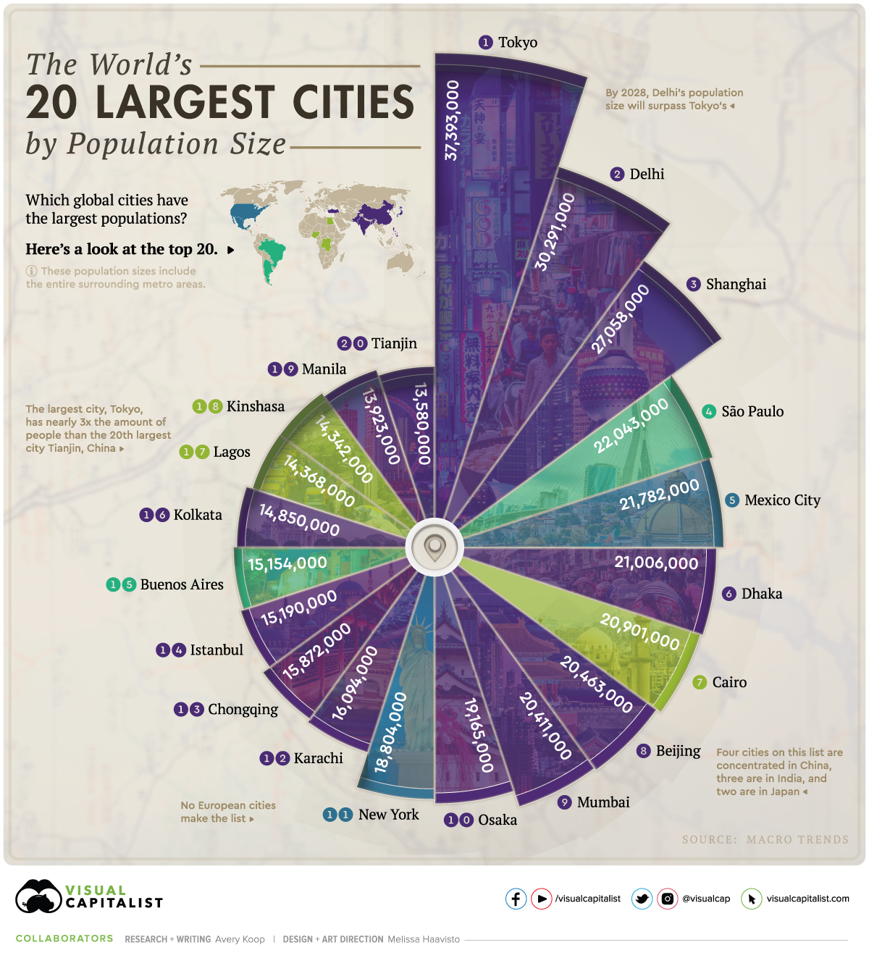
https://www.visualcapitalist.com/most-populous-cities-in-the-world/
Notes:
31
Source: United Nations Population Program.
**

Slide 32
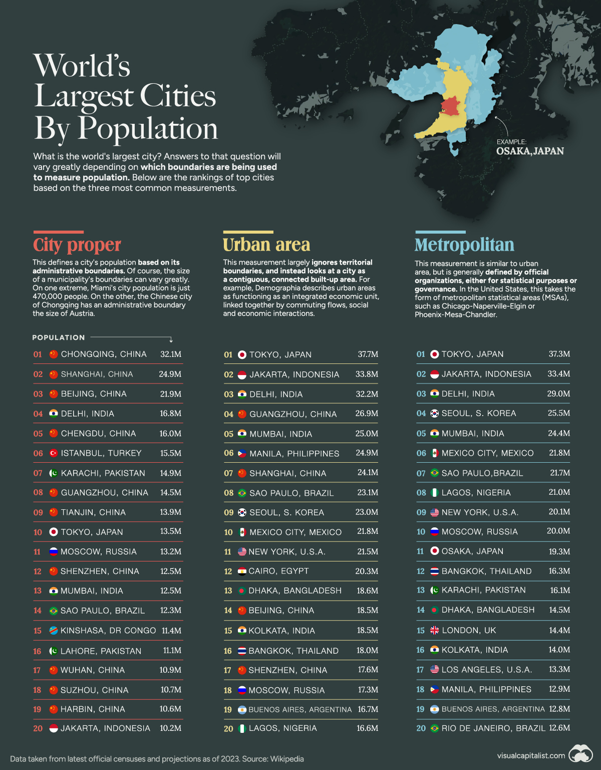
https://www.visualcapitalist.com/ranked-the-worlds-largest-cities-by-population/
Notes:
32
Source: United Nations Population Program.
**

Slide 33
Cities
The city: a difficult definition. Criteria:
Topographic – construction (= concentration of buildings)
Demographic (= concentration of inhabitants)
I.e., urban population in centres > 2.000 inhabitants
Economic (= concentration of activities)
Quantity and quality of concentration: different activities and different from agriculture, extra-urban demand
=>
Functional definition:
Aggregation of people to better realise some activities (activity = a function of the city);
Cities as rare, ,non ubiquitous in the geographical space produce functions over a service area

Slide 34
Cities
Empirical evidence: positive correlation between demographic dimension and functional rule of a city:
FU = f (P)
FU = set of urban function’s activities
P = number of inhabitants

Slide 35
Urban functions and gravitation
Urban functions:
city serving
Activities that depend on the existence of the city itself;
Aimed at satisfying inhabitants’ needs (i.e., retail, schools, etc.)
city forming
Essence of the city: i.e., specialized medical services, university and research centres, specialized banks, etc.
Sectors of activity or single companies can work both for the internal urban market and for a wider area
=>
Analysis on gravitation towards cities to identify the borders of such area

Slide 36
Key Concepts on Urban Functions: City Forming and City Serving
City Forming Functions: These are the fundamental or base functions essential to the city's existence. They serve external markets beyond the local population, such as industries and economic activities generating income from outside the city itself. They shape the city's economic base and attract external demand.
City Serving Functions: These are service functions oriented towards fulfilling the needs of the local urban population. They include retail, local services, administration, education, and daily necessities that support the internal functioning and quality of life within the city.

Slide 37
Key Concepts on Urban Functions: City Forming and City Serving - Foundational Authors and Theories
The distinction originates from early works by W. Sombart, who distinguished between foundational (city forming) and service functions.
Walter Christaller's Central Place Theory theorized the hierarchical organization of urban functions into a spatial system serving local needs (city serving).
Modern urban geography and planning literature continually develop this framework to analyze the complexity of urban economic and social functions.

Slide 38
Example Summary from Academic Literature
Urban functions describe different uses of urban spaces including industrial, commercial, administrative, and residential activities.
City forming functions tend to be those that place the city in the wider economic system, often involving trade, manufacturing, and specialized services drawing customers from beyond local boundaries.
City serving functions provide support and services oriented to resident populations, such as local retail, education, health, and public administration.
These distinctions help explain urban structure and planning decisions and are fundamental in understanding the organization and growth of cities.

Slide 39
Urban functions and gravitation
Reilly’s law (1929) on the forming of retail areas
Interaction of a city and its service area can be expressed as :
F = a * D ^{– b}
a = mass of the city (population or other indexes of ‘centrality’)
D = distance of places out and around the city
b = parameter to indicate the slope (=> extension of the gravitating area)
Notes:
Diparimento di Scienze Geografiche e Storiche - Introduzione ai GIS
39
1 ora

Slide 40
Urban areas and dimensions. FUAs
A Functional Urban Area (FUA) is defined as a city and its surrounding commuting zone, representing an economically integrated territory where the city's labor market significantly influences the adjacent less densely populated areas. The FUA includes a dense urban core and a commuting zone where a substantial portion of the employed residents work within the city.
Key components of a Functional Urban Area:
City:
An administrative unit with a majority of its population residing in an urban center of at least 50,000 inhabitants.
Commuting Zone:
The surrounding area where a significant number of residents commute to the central city to work. This integration creates a functional economic unit that extends beyond administrative boundaries.
https://ec.europa.eu/eurostat/statistics-explained/index.php?title=Glossary:Functional_urban_area#:~:text=Short%20definition:%20a%20functional%20urban,city%20(OECD%2C%202012).
https://www.istat.it/statistiche-per-temi/focus/informazioni-territoriali-e-cartografiche/statistiche-sul-territorio/cities-functional-urban-areas/
Notes:
Diparimento di Scienze Geografiche e Storiche - Introduzione ai GIS
40
1 ora

Slide 41
Urban areas and dimensions. FUAs
Purpose and application:
Economic Integration:
FUAs provide a framework for understanding the economic and social interconnections between a central city and its surrounding hinterland.
Policy Making:
The concept helps in developing more effective policies by considering areas that function as a single unit, especially in domains like environmental management and regional planning.
Statistical Analysis:
FUAs are used in European and global statistical frameworks, such as those by Eurostat and the OECD, to provide a comparable basis for analyzing urban areas across different regions.
https://www.oecd.org/en/data/datasets/oecd-definition-of-cities-and-functional-urban-areas.html
Notes:
Diparimento di Scienze Geografiche e Storiche - Introduzione ai GIS
41
1 ora

Slide 42
References
Berry B. J. L., Urbanization and Counterurbanization, SAGE, Beverly Hills, 1976
Brunet R., Les ville “européenne” Datar-Reclus-Documentation Francaise, Montpellier, 1989
Brunet R., Lignes de force de l’espace européen, Mappemonde, 66 (2) 2002, pp. 14-19
Camagni R., Economia e pianificazione della città sostenibile, Il Mulino, Bologna, 1996.
De Blij H. J. e Murphy A. B., Geografia umana. Cultura. Cultura, società, spazio, Zanichelli, Bologna, 2002
Dematteis G., Lanza C., Nano F. e Vanolo A., Geografia dell’economia mondiale, quarta edizione, UTET, Torino, 2010 (cap. 3, cap. 10)
Diappi L. e Campeol A., “Sostenibilità urbana: lo sviluppo di un approccio sistemico”, in Diappi L. (a cura di), Sostenibilità Urbana. Dai princìpi ai metodi di analisi - Forma urbana, energia e ambiente , Paravia, Torino, 2000
European Environmental Agency (EEA), Urban sprawl in Europe. The ignored challenge, European Commission, European Environmental Agency (EEA), Luxemburg, 2006. (http://eea.europe.eu)
Gottmann, J. Megalopolis revisited: 25 years later. University of Maryland Institute for Urban Studies, Baltimore, 1987
Gottmann, J., Megalopolis: The urbanized northeastern seaboard of the United States. Twentieth Century Fund, New York, 1961.
Gottmann, J., Megalopolitan systems around the world. Ekistics 243, 1976, pp. 109–13.
Haggett P., Geografia – Volume 1: Geografia umana, Zanichelli, Bologna, 2004 (cap. 5, cap. 11, cap. 12)
Lloyd P. E., DICKEN P., Location in space. A theoretical approach to economic geography, Harper International, New York, 1972.
Haggett P., Geography. A global synthesis, Pearson Education Limited, 2001
Morelli P., Geografia economica, McGraw-Hill, Milano, 2010 (cap. 7, cap. 9)
Morrill R., Classic Map Revisited: The Growth of Megalopolis, The Professional Geographer, 58(2) 2006, pp. 155–160
UN-HABITAT, Annual Report 2009, UNITED NATIONS HUMAN SETTLEMENTS PROGRAMME, Nairobi, 2010 (http://www.unhabitat.org)
Rodrigue J. P., Comtois C., Slack B., Geography of Transport Systems, Second Edition, Routdledge, 2010

Slide 43
An Urban World
Links
UNICEF – An Urban World https://www.youtube.com/watch?v=Yi-rEL8i46Y
https://www.ted.com/talks/parag_khanna_how_megacities_are_changing_the_map_of_the_world?language=en
Notes:
**

