Slide 1

Sustainable Cities
2 – Urban form and urban structure
659EC
A.Y. 2025/2026
Dr. Giuseppe Borruso
Department of Economics, Business, Mathematics and Statistics
University of Trieste
E-mail. giuseppe.borruso@deams.units.it
Ph. +39 040 558 7008
Notes:
Slides with (*) in footnotes have been modified by Jean-Paul Rodrigue materials concerning “Transportation Geography”. Slides with (*) in footnotes are referred to “Transport and the Urban Environment” materials (see copyright). I have modified and elaborated materials in order to be suitable for the current course.
For references visit http://people.hofstra.edu/geotrans
Copyright © 1998-2010, Dr. Jean-Paul Rodrigue, Dept. of Global Studies & Geography, Hofstra University. For personal or classroom use ONLY.

Slide 2
Topics
World urban population
Cities: a definition
Transport, urban form and spatial structure
The analysis of urban structure
  The global models
  The urban density
  The bid rent and the models of urban structure
The urban crisis and the urban lifecycle
Case study: the Megalopolis

Slide 3
Transportation, Urban Form and Spatial Structure

Slide 4
Transportation, Urban Form and Spatial Structure
Spatial
imprint
Infrastructures
Modes
Users
Transportation
Urban Form
Spatial
interaction
Urban Spatial Structure
Copyright © 1998-2010, Dr. Jean-Paul Rodrigue, Dept. of Global Studies & Geography, Hofstra University. For personal or classroom use ONLY. This material (including graphics) is not public domain and cannot be published, in whole or in part, in ANY form (printed or electronic) and on any media without consent. This includes conference presentations. Permission MUST be requested prior to use.
Notes:
4
**

Slide 5
One Hour Commuting According to Different Urban Transportation Modes
Streetcar line
Freeway
Walking
10 km
Streetcar
Cycling
Automobile
Automobile with
freeways
Copyright © 1998-2010, Dr. Jean-Paul Rodrigue, Dept. of Global Studies & Geography, Hofstra University. For personal or classroom use ONLY. This material (including graphics) is not public domain and cannot be published, in whole or in part, in ANY form (printed or electronic) and on any media without consent. This includes conference presentations. Permission MUST be requested prior to use.
Notes:
5
Source: adapted from P. Hugill, (1995), p. 213.
**

Slide 6
Evolution of the Spatial Structure of a City
A
B
C
Core activities
Peripheral activities
Major transport axis
Central activities
Central area
Copyright © 1998-2010, Dr. Jean-Paul Rodrigue, Dept. of Global Studies & Geography, Hofstra University. For personal or classroom use ONLY. This material (including graphics) is not public domain and cannot be published, in whole or in part, in ANY form (printed or electronic) and on any media without consent. This includes conference presentations. Permission MUST be requested prior to use.
Notes:
6
**

Slide 7
Evolution of Transportation and Urban Form in North American and European Cities
IV
II
I
I
II
III
IV
III
North America
Europe
I - Walking-horsecar era (1800-1890)
III - Automobile era (1920-1945)
Streetcar line
II - Streetcar era (1890-1920)
IV - Highway era (1945-)
Highway
Copyright © 1998-2010, Dr. Jean-Paul Rodrigue, Dept. of Global Studies & Geography, Hofstra University. For personal or classroom use ONLY. This material (including graphics) is not public domain and cannot be published, in whole or in part, in ANY form (printed or electronic) and on any media without consent. This includes conference presentations. Permission MUST be requested prior to use.
Notes:
7
*

Slide 8
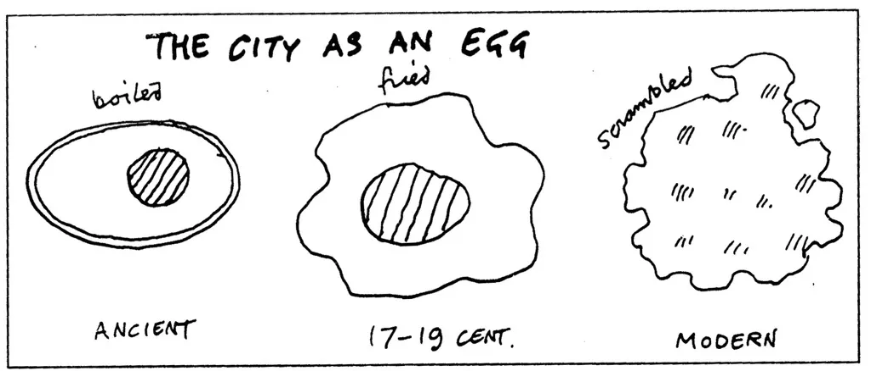
The city as an egg
https://bigthink.com/strange-maps/534-the-eggs-of-price-an-ovo-urban-analogy/

Slide 9
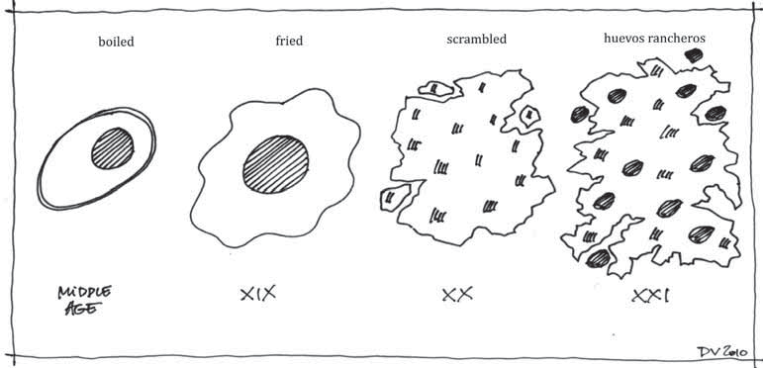
The city as an egg
https://www.researchgate.net/figure/The-Form-of-the-City-Vancutsem-2010-adapted-from-The-City-as-an-Egg-Source-Price_fig2_255717111

Slide 10
The analysis of urban structure
The global model
The urban density
The bid rent and the models of urban structure

Slide 11
The analysis of urban structure
Partial models – concern the location of specific sectors of activity;
Global models – concern the location of all residential and production forms of an urban area
Role of transport in shaping the distribution of types of land use:
  in terms of transport costs;
  in terms of accessibility and urban land value

Slide 12
Global models
Effort to highlight an order within the topographical and functional structure of a city
Different models used to represent and study such ‘order’ :
  Circular Models i (Burgess, 1967)
    Urban values decrease regularly from city centre
  Sectors Models (Hoyt, 1932)
    elaboration: inner city’s structure is influenced by radial road, pre-existing nuclei, geomorphology, etc.
  Multi-centre Models (Harris and Ullman, 1945)
    Development of no single centres but in a number of centres within urban area:
      Specialized request for soil;
      Concentration of activities;
      Conflict between different activities in land use;
      Bid-rent differences

Slide 13
Bugess’ model of land use
Model
Chicago, years ‘20
Single Family Dwellings
Second Immigrant
Settlement
Little
Sicily
Ghetto
LOOP
Two Plan
Area
Apartment Houses
Black Belt
Residential District
Bungalow
Section
I - Loop (downtown; CBD)
IV – working class area
II – industries
V – residential area
III – transition area
VI – suburban area
Notes:
Diparimento di Scienze Geografiche e Storiche - Introduzione ai GIS
13
(*)

Slide 14
Models: ‘sectors’ (Hoyt) and
‘nuclei’ (Harris and Ullman)
Sector
Nuclei
2
3
3
4
2
1
3
3
4
5
3
1
3
5
3
7
3
6
2
3
4
9
8
1 CBD
2 Wholesale and light manufacturing
3 Low-class residential
4 Middle-class residential
5 High-class residential
6 Heavy manufacturing
7 Sub business district
8 Residential suburb
9 Industrial suburb
Notes:
Diparimento di Scienze Geografiche e Storiche - Introduzione ai GIS
14
(*)

Slide 15
Urban density
Topographic and functional structures: different characteristics for different cities
The distribution of urban density maintains similar characteristics for all cities
Density decreases following a negative exponential function of distance from urban centre.
P_{d} = P₀ * e ^{– gd}
  P_{d} = population density at distance d from the centre (CBD)
  – g = factor of negative slope of the density function
  P₀ = density of the central area

Slide 16
Profiles of urban density
Density
a) P_{d} = P₀ * e ^{– gd}
b) P_{d} = P₀ * e ^{– gd2}
c) ‘volcano’
CBD
Distance
Density
CBD
Distance
Density
CBD
Distance

Slide 17
Evolution of urban densities in North America and Europe
North America
Europe
r(NA)
r(E)
Density
Density
IV
II
III
I
II
III
I
IV
Distance
Distance
I – Before mechanized transport
II – first forms of mechanized transport (tram)
III – Motorization (bus, private cars)
IV - Suburbanization
Notes:
Diparimento di Scienze Geografiche e Storiche - Introduzione ai GIS
17
(*)

Slide 18
The bid-rent (I)
Pattern of land uses depend on a variety of settlements’ decisions
Decisions guided by economic process operating gin the system. The distribution of urban areas’ use represent a visual and structured phenomenon.
Basic aspects:
  Each activity derives utility from every site of the urban area;
  Utility is measured by the rent an activity is willing to pay for the use;
  Among the different rents from the utility of the site, the maximum one will determine the market value

Slide 19
The bid-rent (II)
In the long run the market competition in urban areas will result in the optimal use of each site
The rent is influenced by elements as the evaluation of the exchange between the major rent paid for the use of a site with higher accessibility and the transport costs’ savings compared to a less accessible site
The competition for land use minimizes the effects of distance on the urban area
The spatial distribution of urban rent is function of the transport cost.

Slide 20
The bid-rent (III)
Savings in transport costs can lead to payments of extra-rents;
More accessible sites in urban areas are NOT occupied by activities that pay more BUT by those that can gain the higher advantage from that part of urban land;
Bid rent become land values and depend on different accessibilities of sites within the urban area

Slide 21
The bid-rent (IV)
Land values are important to comprehend the internal geographical economic structure of a city :
Different motivations for residential uses;
Production is affected by land value as an expression of accessibility:
  Land value is maximum in the city centre and decreases when moving gto peripheries;
  Higher land values close to main radial road than in the space between them;
  Higher land values, with respect to the distance from the city centre, can be found at intersection between major radial roads and ring roads
Accessibility has different meanings for different activities:
  Retail – closeness to potential market;
  Services – closeness to places of supply of complimentary services;
  Industry – availability of suited soils; Transport; public services, closeness to other industries;
  Residential – closeness to working places, shopping centres; also environmental and social qualities

Slide 22
Von Thunen’s model of land use
Replay
The isolated state
Modified conditions
Secondary market
Central market
River
dairy & vegetables
forestry
Intensive crop rotation
Arable and pastures
Three-field crop rotation system
Extensive stock grazing
Notes:
Diparimento di Scienze Geografiche e Storiche - Introduzione ai GIS
22
(*)

Slide 23
Bid rent and land use
1 – bid rent lines
2 – Overlay of rents
rent
B- Industry and retail
A- Retail
Distance
City borders
C - Apartments
D – Detached
houses
Notes:
Diparimento di Scienze Geografiche e Storiche - Introduzione ai GIS
23
(*)

Slide 24
Bid-rent
A
rent
Area A: commercial land use
Area B: industrial land use
Area C: residential land use
B
C
C’
A
B
P
A’
Q
B’
distance
C
Curve AA’: commercial activities’ rent
Curve BB’: industrial activities rent
Curve CC’: residential activities rent
Notes:
Diparimento di Scienze Geografiche e Storiche - Introduzione ai GIS
24

Slide 25
Bid rent
Rent
1/S
S = π D²
ΔD
S = 3.14
Δ1/S
S = 75.40
1 km
5 km
10 km
S = 235.62
Notes:
Diparimento di Scienze Geografiche e Storiche - Introduzione ai GIS
25
(*)

Slide 26
Variations to bid-rent theory
A – CBD
B – Commerce / industry
C – residential high– medium density
D – sub-centres
E – Suburbia
rent
A
B
C
D
E
Notes:
Diparimento di Scienze Geografiche e Storiche - Introduzione ai GIS
26
(*)

Slide 27
Land use value for activity sector according to the distance from the CBD
Retail
Residential (several components families)
Land use value
Residential (single families)
Distance from the centre
Notes:
Diparimento di Scienze Geografiche e Storiche - Introduzione ai GIS
27
(*)

