Slide 1
Pangenomics: theoretical and practical takes
Amaro Saco – Institute of Marine Research, Vigo, Galicia, Spain
Marco Gerdol – University of Trieste, Trieste, Italy
31/10/2025 and 04/11/2025

Slide 2
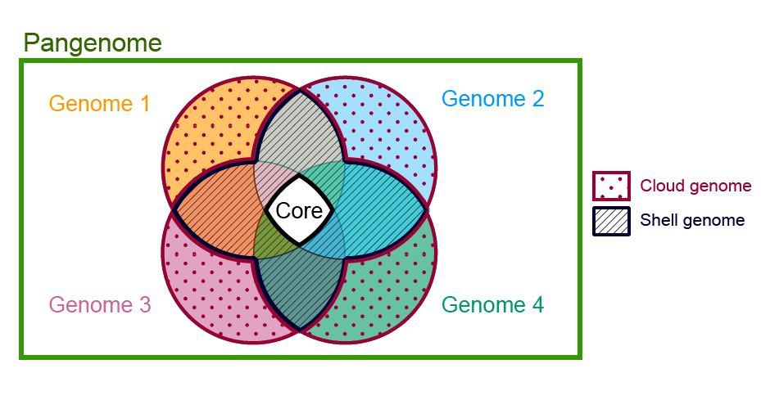
The pangenome concept
Breaking the rule of one species = one genome
Discovered in 2005 when sequencing 8 strains of Streptococcus agalactiae:
  Only 80% of genes encoded in a single genome was shared by the others -> core pangenome
  Other genes were dispensable, shared by some but not all of the genomes -> shell pangenome
  Each genome contributed unique dispensable strainspecific genes not present in any of the other genomes sequenced -> cloud pangenome
After this discovery, pangenomes continued to be discovered in all sort of Bacteria and Archea species
The genetic repertoire of a bacterial species is much larger than the gene content of an individual/strain
The thresholds defined above are not universal. Usually:
  Core genes > 95% individuals (in other cases only when 100% individuals)
  Shell genes > 10% and < 95% individuals
  Cloud genes < 10% individuals (in other cases only when present in just one individual/strain)

Slide 3
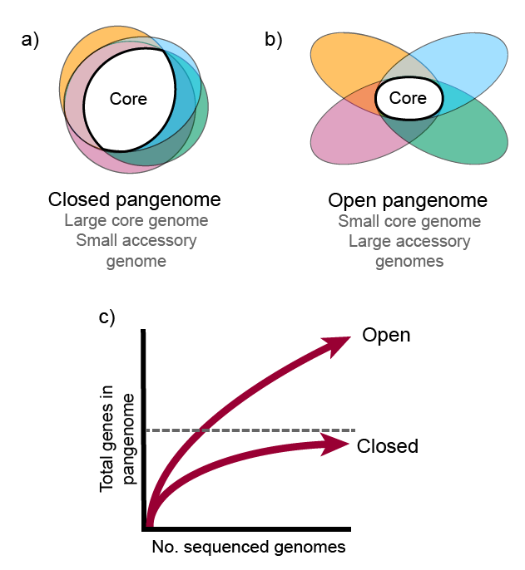
The pangenome concept
A specific species can present two different types of pangenomes:
  Closed pangenome: very few genes are added per sequenced genome and the size of the full pangenome can be theoretically predicted.
  Open pangenome: new genes are constantly added per each additional sequenced genome. The pangenome size keeps increasing regardless how many new genomes are added.
This usually depends of population size and niche versatility. Parasitism and species that are specialists in some ecological niche tend to have closed pangenomes.
  Any E. coli genome size is in the range of 4000–5000 genes and the pangenome size estimated for this species with approximately 2000 genomes is composed by 89,000 different gene families (open pangenome)
  Streptococcus pneumoniae bacteria showed few new genes discovered with each new genome sequenced. In fact, the predicted number of new genes dropped to zero when the number of genomes exceeds 50 (close pangenome)

Slide 4
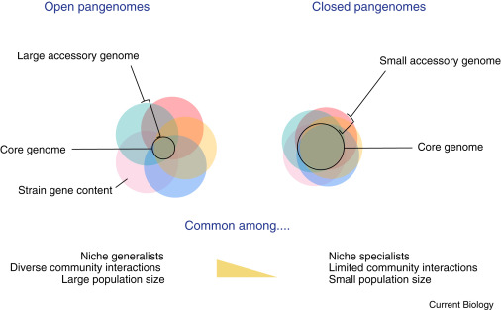
The pangenome concept

Slide 5

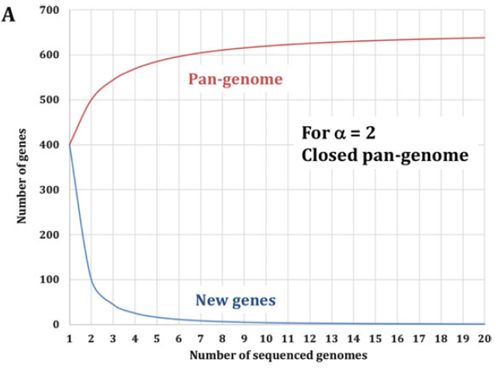
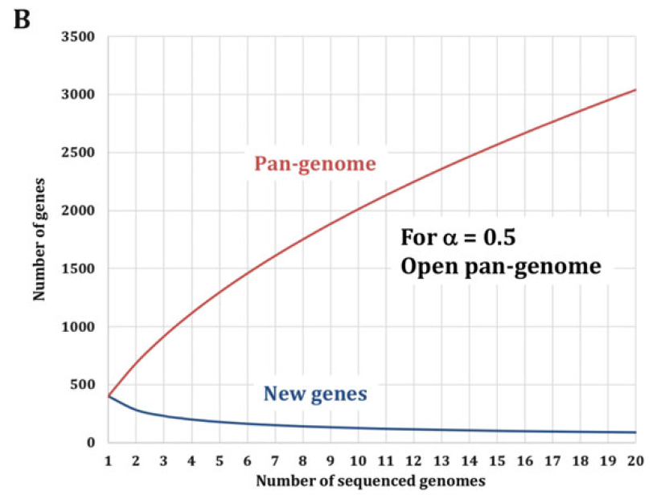
The pangenome concept
Based on the idea that the more genomes from a species are sequenced and added to the study, the number of new genes added to the pangenome will be smaller. The number of new genes discovered after each new genome will be:
- κ is a constant, N is the number of genomes sequenced, and α > 0.
- For α > 1 pangenome is “closed”. For 0 < α 1, the pangenome is “open”
We will study:
The distribution of pangenomes:
Open pangenomes are very common in prokaryotes and also quite abundant in some eukaryotes such as plants. However, in recent years pangenomes with sticking openness have been described in metazoans, which were thought to possess closed pangenomes with very low variation.
The basis and evolution of pangenomes:
Pangenome evolves due to: gene duplication, gene gain and loss dynamics and interaction of the genome with mobile elements that are shaped by selection and drift

Slide 6
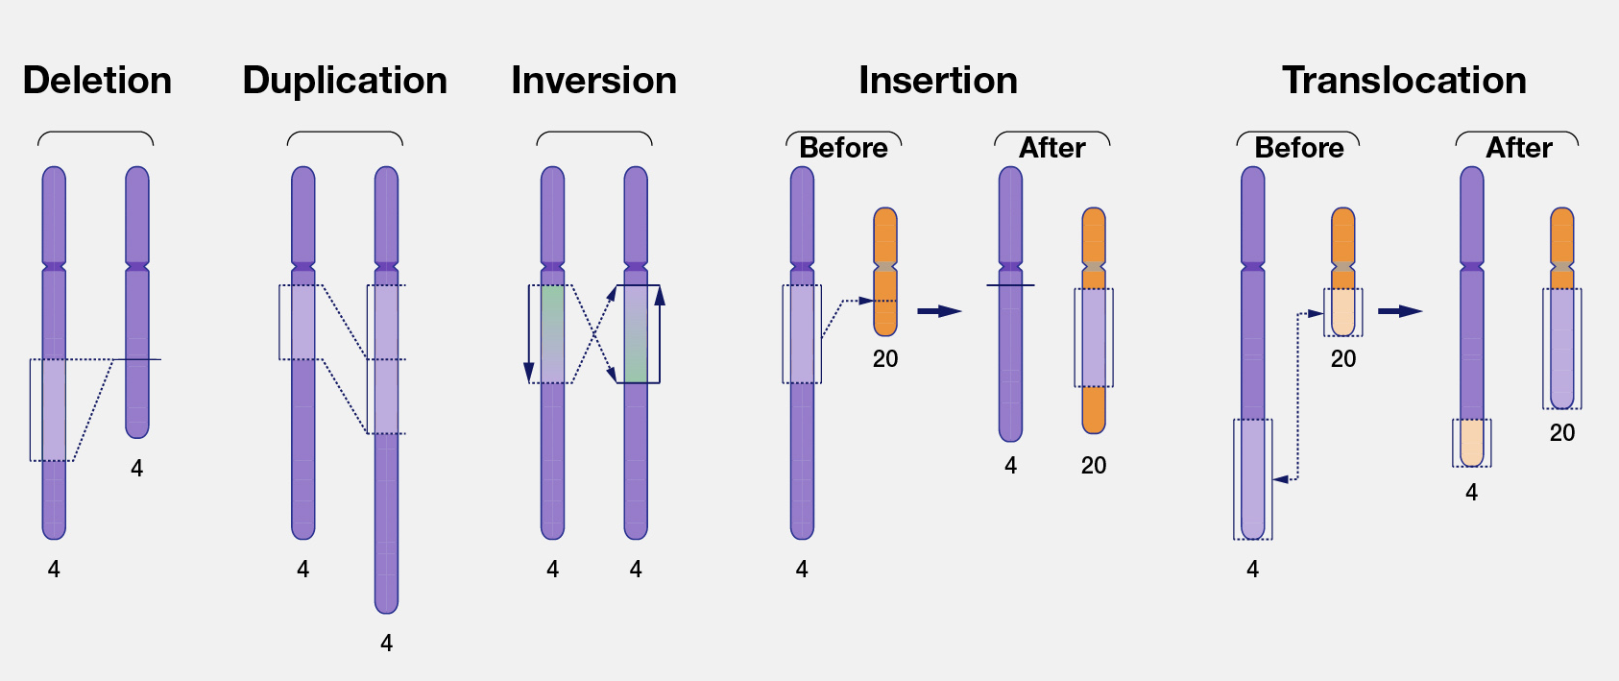
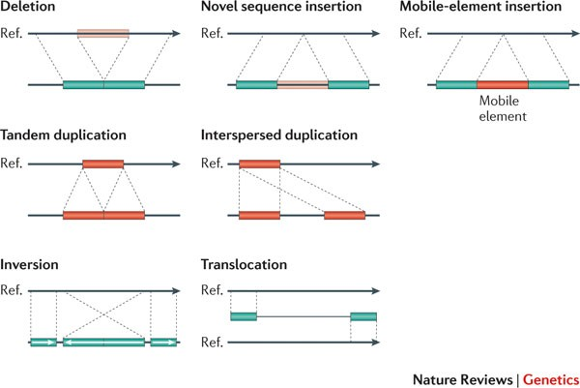
The pangenome concept
Even if pangenome studies are often focused on the coding gene fraction, the genomic variation behind does not occur at the gene level.
Structural variation
Large-scale differences in DNA segments between individual genomes or between haplotypes of the same individual, including deletions, insertions, duplications, inversions, and translocations. These variations are a significant source of genetic diversity. The genes encoded in these large structural variations are the accessory genes subjected to presence/absence variation in a pangenome
Between haplotypes of a diploid organism. Depending of the haplotype inherited by the offspring, different gene content will be inherited due to these structural variations between haplotypes (source of genetic diversity in the population).
Between two individual genomes of the same species. When aligning two different individual genomes, the structural variants identified with respect to the reference encode the dispensable/accessory genes that differ in that individual with respect to the reference

Slide 7
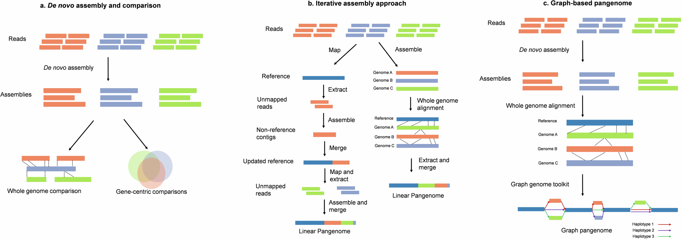
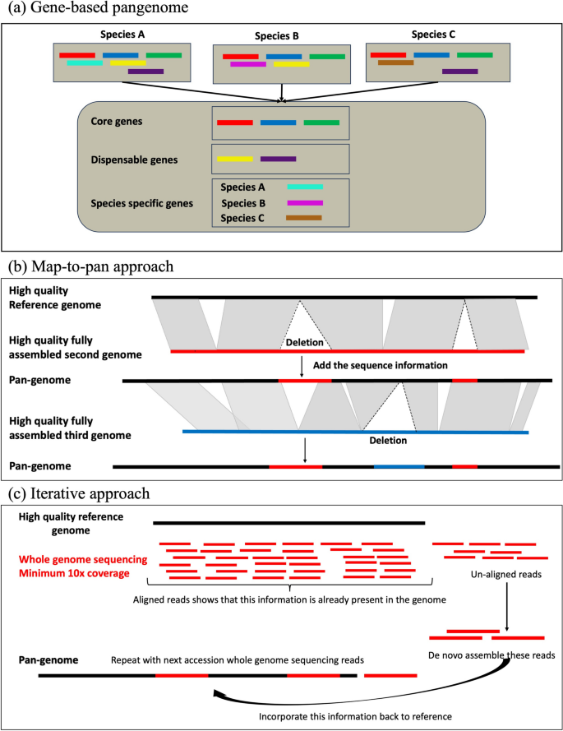
The pangenome concept
Approaches for studying pangenomes:
Coding-fraction approach
Structural / full genome approach
Reads from different individuals
Genes encoded in the different individuals
Mapped against the reference genome
Structural variations that contain the dispensable/
accesory genes
Study of the presence/absence variation of the reference genes based on mapping
Reads from individuals that dont map in the reference genome encode new genes for the pangenome
Strain/individual specific genes

Slide 8
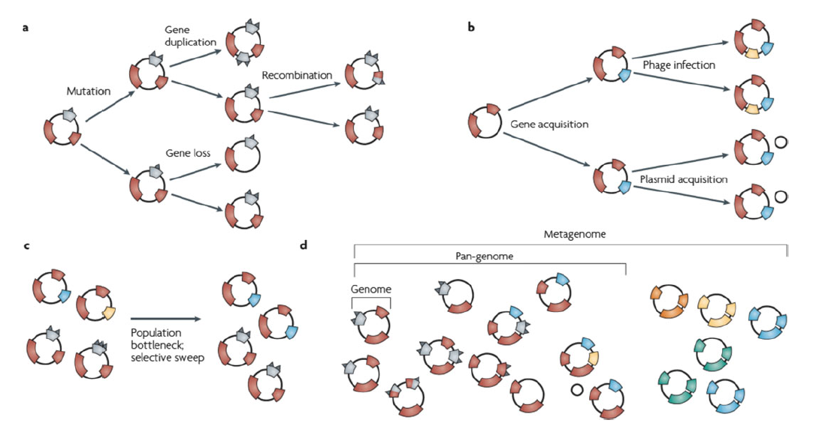
Prokaryote pangenomes
High abundance of open pangenomes
  High rate of horizontal gene transfer (HGT): Prokaryotes can exchange genes through conjugation, transformation, or transduction, even between different species. This continuously introduces new genes into their populations.
  Ecological diversity and rapid adaptation: Bacteria occupy a wide variety of niches (from intestines to hydrothermal vents), and different environments favor the acquisition of adaptive genes (resistance, metabolism of new substrates, stress tolerance, etc.).
  Large populations and frequent mutations: Their large population size and rapid replication cycles increase genetic variability.
Molecular evolutionary mechanisms that manipulate the genomic diversity of bacterial species.
Intra-species (a)
Inter-species (b)
Population dynamics (c)
Pangenome and Metagenome (d)
Multiple genome sequences are needed to describe the pangenome, which represents, with the best approximation, the genetic information of a bacterial species.
Metagenomics embraces the community as the unit of study and, in a specific environmental niche, defines the metagenome of the whole microbial population.

Slide 9
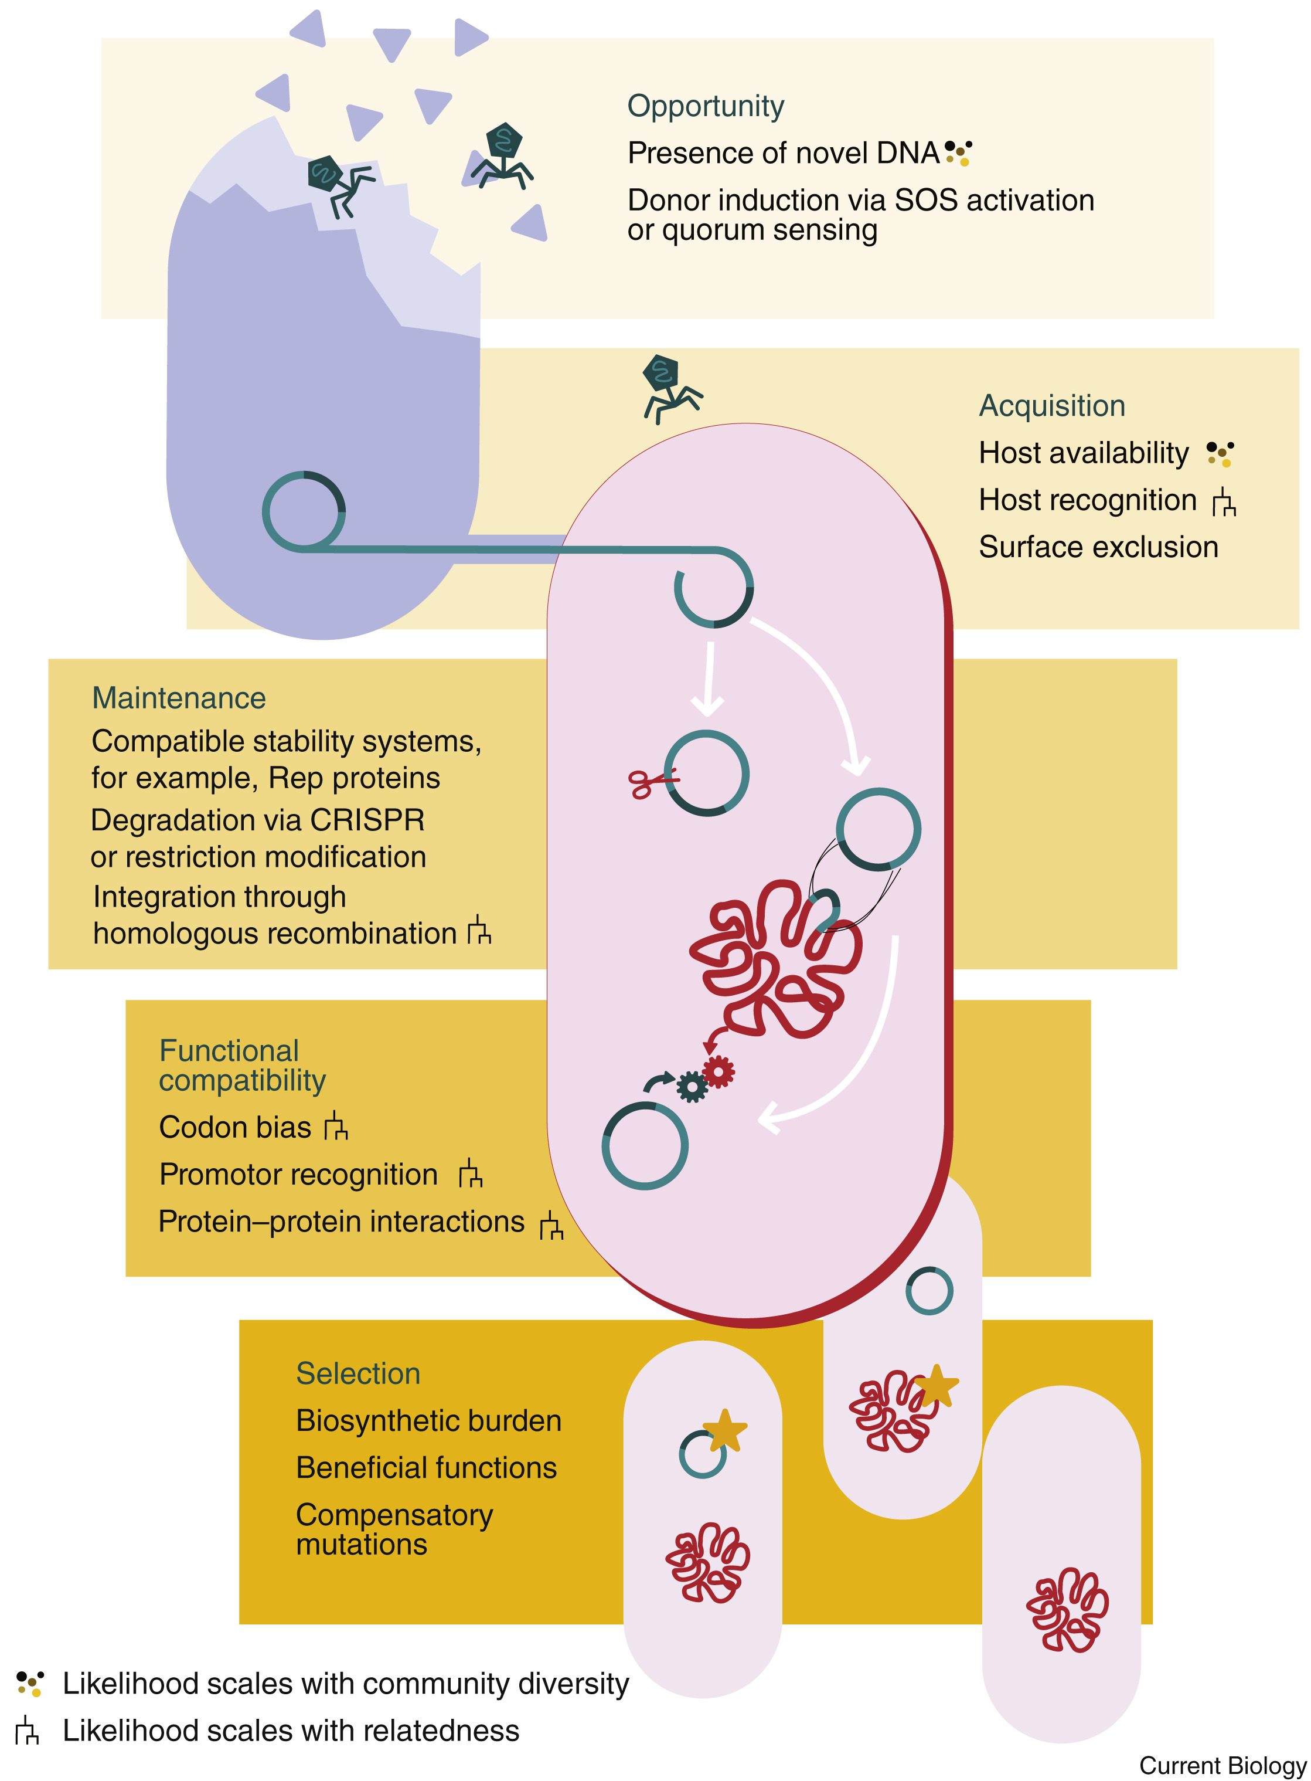
Prokaryote pangenomes
The High rate of horizontal gene transfer (HGT) is the main source of new genes in the pangenomes of some bacteria. For example, the main source of new genes in S. pneumoniae was Streptococcus mitis from which genes were transferred horizontally.
This compromises the definition of species
In animals and plants, a species can be associated with the genetic cohesion (shared history, traits, and ecology) characterized by sexual compatibility and population structure
In contrast, building a biologically relevant species definition remains a challenging
endeavor in prokaryotes. Prokaryotic species are definable and diagnosable as genetically cohesive as evidenced by the existence of a core-genome.
Once the core genome of a species is defined, strains can be assigned, or not assigned, to a species based on the extent to which they share the same core genome
The extent of genomic plasticity is regulated by restriction modification systems, phage-defense systems, and Clustered Regularly Interspaced Short Palindromic Repeats (CRISPR)
Genomic plasticity is the key for prokaryote adaptation capacity
Ecological flexibility: strains can adapt to different environments thanks to accessory genes (one strain contains only a subset of genes available at the population level)
Rapid evolution: they facilitate ecological diversification and bacterial speciation.
Adaptation due to the functions of accesory genes:
- Resistance and survival: genes for resistance to antibiotics, heavy metals, or phages - Metabolic innovation: incorporation of new metabolic pathways (new energy sources)

Slide 10
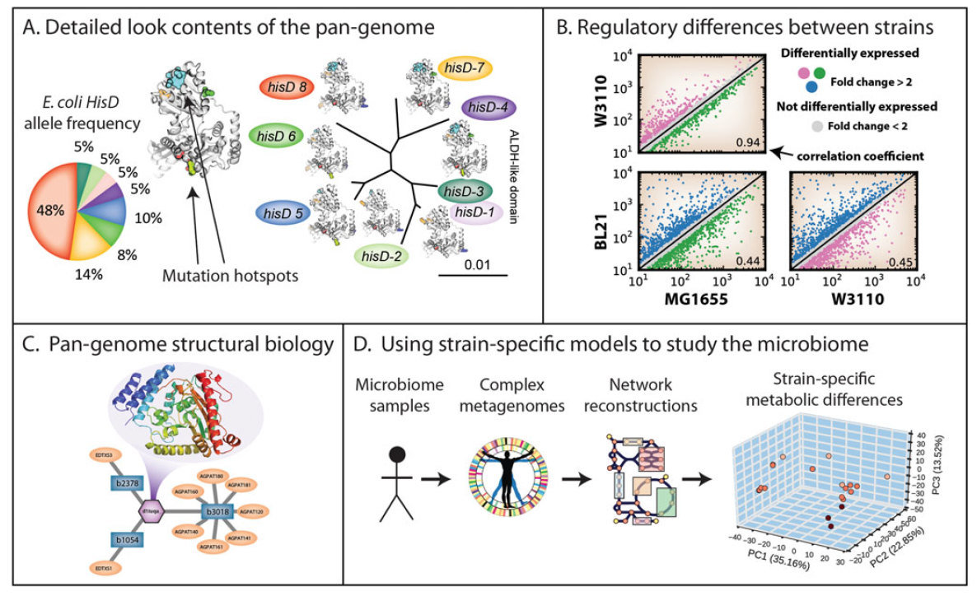
Prokaryote pangenomes
Genomic plasticity is the key for prokaryote adaptation capacity
The target now is in stablishing relation bewteen specific accesory genes in the pangenomes (usually working with different strains of the species) and the phenotypic charactersitic that these genes support in order to achieve the adaptation

Slide 11
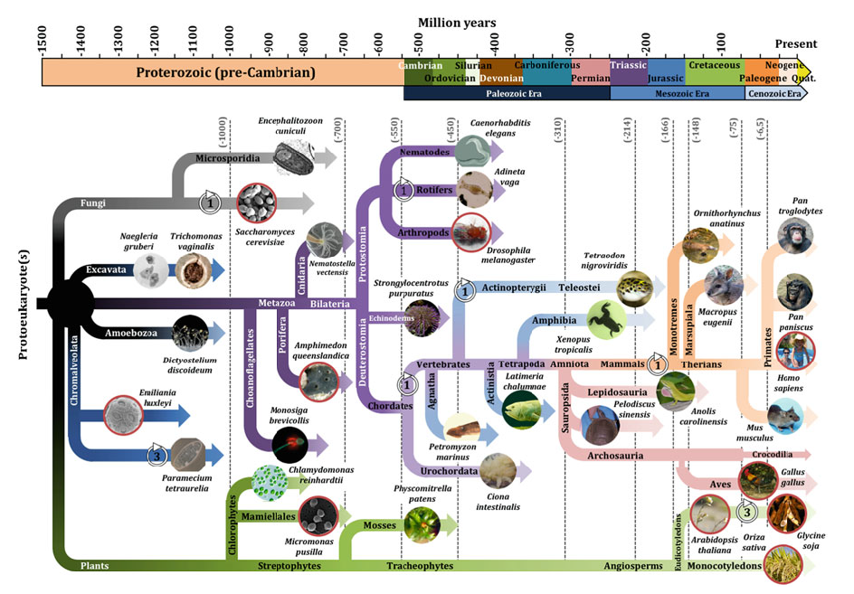
Eukaryote pangenomes
The first eukaryotes emerged from their prokaryotic ancestors more than 1.5 billion years ago and, same as prokaryotes, colonized all environments.
Taking advantage of an expanding genome complexity and flexibility, they adapted their body plan, physiology, and metabolism to new environments.
The increase of genome complexity is related with an increase in gene repertoire, mainly from molecular reassortment of existing protein domains, but sometimes from the capture of a piece of viral genome or of a transposon sequence.
Among the mechanisms generating genetic diversity in eukaryotes we find: interspecific hybridization, whole-genome duplications, segmental duplications, horizontal gene transfer, and single-gene duplication
Of course, pangenomes both open and closed are found among eukaryotes as well.
One genome is not sufficient to describe the whole species:
1,011 Saccharomyces cerevisiae genomes
1,135 Arabidopsis thaliana genomes
10,545 human genomes
1,483 rice genomes

Slide 12
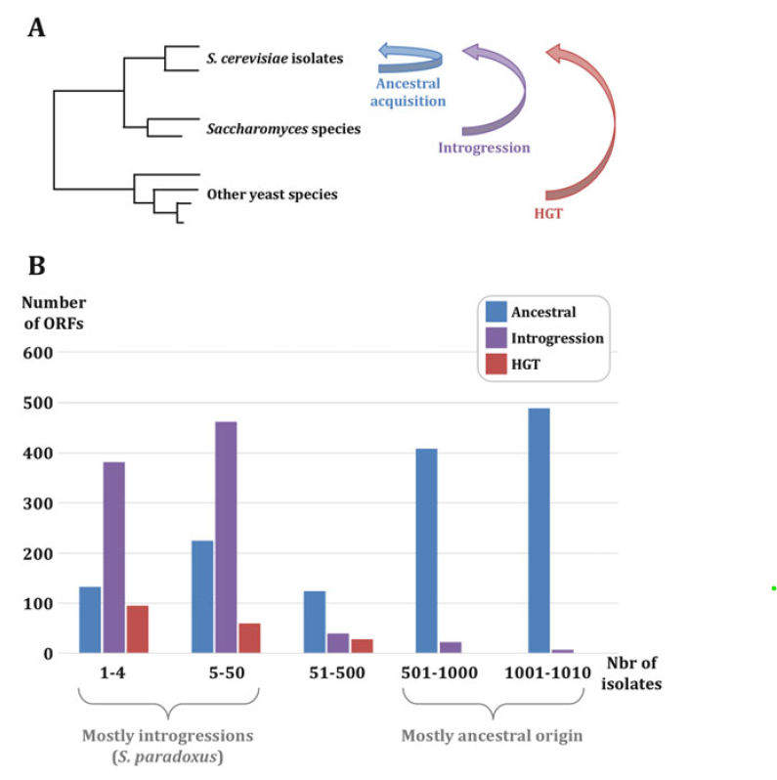
Eukaryote pangenomes: Yeast
Yeast pangenomes: Saccharomyces cerevisae
1011 sequenced S. cerevisiae isolates, collected worldwide, from domesticated, wild, or human origin
Chinese strains were closer to the root of Saccharomyces than strains from any other origin, strongly supporting a single outof-China origin for S. cerevisiae, that subsequently spread all over the planet. It could be determined that the yeast core-genome contained 4940 Open Reading Frames (ORFs) whereas 2856 ORFs were variable within the population, for a total of 7796 ORFs constituting the pangenome.
Core ORFs were mostly found in one copy per haploid genome, while ca. 20% of variable ORFs were absent or present in more than one copy. The authors subsequently looked at the origin of these variable ORFs and classified them in three different groups, based on their phylogeny:
ORFs with their closest ortholog in another S. cerevisiae strain and consistent with genome phylogeny were considered as being ancestral acquisitions
ORFs with their best ortholog in another Saccharomyces species were considered to be introgressions
ORFs more related to another yeast species outside the Saccharomyces complex were treated as horizontal gene transfers (HGT)
Variable ORFs had functions strongly enriched for cell-wall and membrane components, cell–cell
interactions, and secondary metabolism (adaptation). Enriched in subtelomeric regions, which have
been known for a long time to be highly polymorphic among yeast strains and species
Core-genome ORFs were found to exhibit lower levels of loss-of-function mutations and lower ratio
of nonsynonymous over synonymous substitutions, showing that these genes are more conserved.

Slide 13
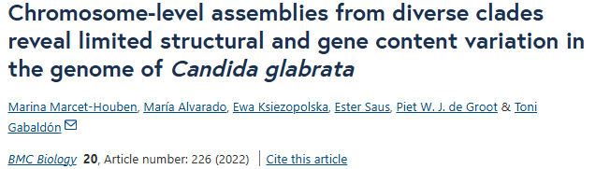
Eukaryote pangenomes: Yeast
Yeast pangenomes: Candida glabrata
C. glabrata is an opportunistic pathogen responsible for candidiasis and bloodstream infections in immunocompromised patients. Despite its genus name, its genome is closer to S. cerevisiae than to C. albicans.
C. glabrata exhibits frequent chromosome polymorphisms among different isolates, due to translocations, copy number variations (CNV), gene tandem amplifications, formation of neo-chromosomes, and the presence of many large tandem repeats known as megasatellites.
33 isolates of C. glabrata of different geographical origins were fully sequenced and compared to the reference strain.
108 genes were deleted or duplicated in these strains, half of them encoding glycosylphosphatidylinositol-anchored adhesin homologues, showing the extensive variability of this gene family within this clade.
The core-genome contained 3603 proteins, significantly less than for S. cerevisiae
The number of variable ORFs was higher than S.cerevisiae yeast. 302–580 predicted genes
(mean: 342) were found to be unique of each isolate, for a total of 9915 strain-specific genes.
Therefore, the genome of a Candida yeast individual is smaller than S.cerevisiae,
but the pangenome is much larger.

Slide 14
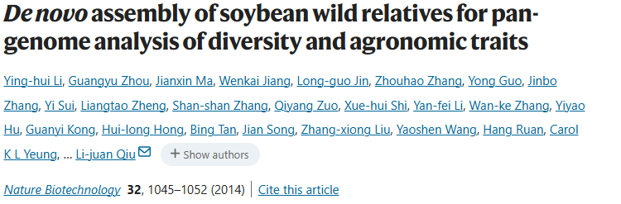
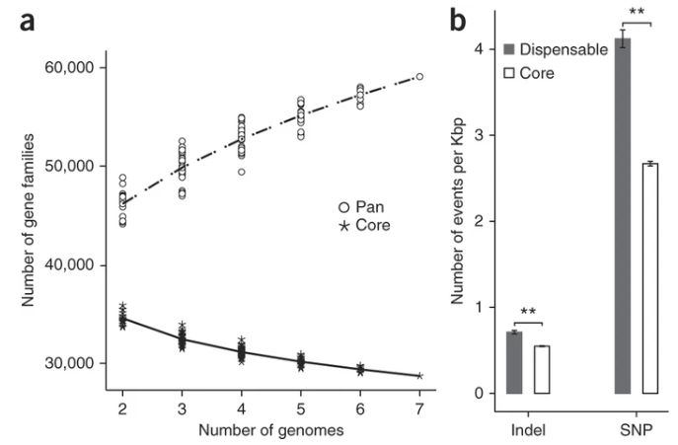
Eukaryote pangenomes: Plants
Plant pangenomes: open pangenomes are quite common in plants
Soybean:
Glycine max is the cultivated soybean variety, diverged from the wild variety, Glycine soja, 800,000 years ago, by means of natural selection, way before domestication and human selection
The genome of 7 strains of Glycine soja were sequenced. Gene number ranged from 54,256 to 57,631, depending on the isolate and hundreds of genes were identified as gained or lost as compared to domesticated soybean.
The G. soja core-genome contained 28,716 genes, while 30,364 variable genes were identified. Most of them (58%) were shared by two to six out of seven samples, whereas 12,916 (42%) were uniquely found in one of the seven isolates. The pangenome therefore contained 50,080 genes.
Open pangenome in which adding new isolates would increase pangenome size. G. soja pangenome twice as large as its coregenome.
Dispensable genes exhibited more sequence variability and were less conserved than core genes (more SNP rate). They were enriched in biological functions including metabolic processes, antioxidant activity, and structural molecule activity. Lineage-specific genes included genes implicated in effector-triggered immunity, acting as pathogen detectors, reflecting adaptation to various biotic stresses.
The domesticated soybean genome contains 1794 genes involved in acyl lipid metabolism, illustrating the effect of its intense selection for oil and fatty acid production.

Slide 15
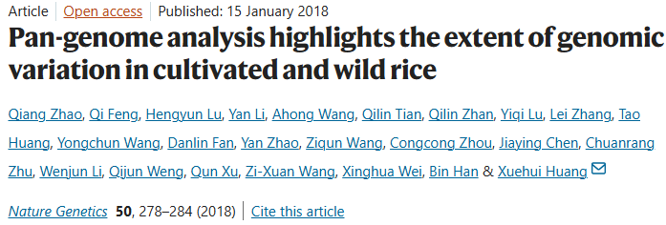
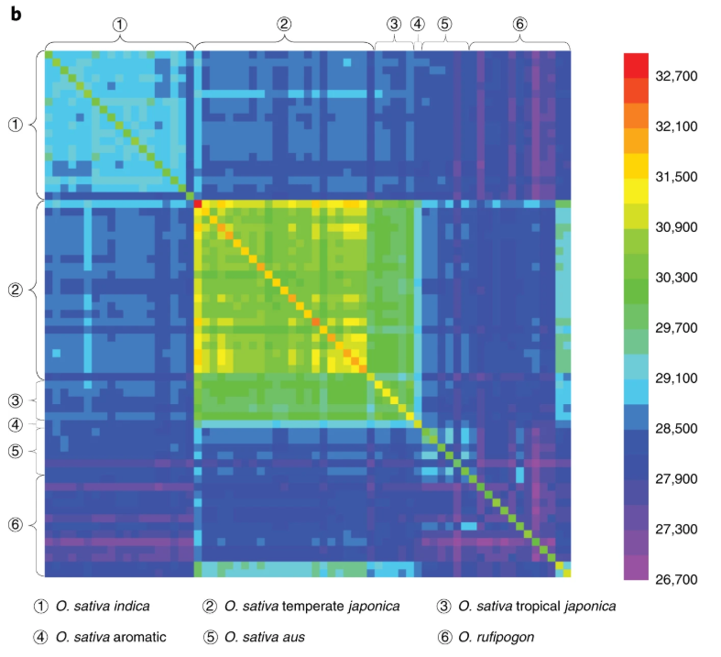
Eukaryote pangenomes: Plants
Rice (Oryza sativa):
Domesticated rice comprises two subspecies/strains: indica and japonica. The reference genome (Nipponbare) is a japonica subspecies and contains 37,544 protein-coding genes, among which 2859 (8%) seemed to be uniquely found in rice.
The sequencing and assembly of 66 cultivated and wild (Oriza rufipogon) rice isolates gave a definitive picture of their large pangenomic variations:
Large structural variations were detected: Chromosomal introgressions from indica were detected in 16% of japonica genomes. Also insertions and deletions cause 10k genes to be partially absent from the reference genome due to large indels.
A total of 26,372 genes were found to be common to more than 60 rice isolates and were therefore considered to constitute the rice core genome
Dispensable genes found in less than 60 genomes accounted for 16,208 genes, elevating the total number of genes of the pangenome to 42,580 genes. Dispensable genes were enriched in functions related to abiotic and biotic response genes, controlling disease resistance in rice.
Already with 66 individuals a plateau was reached, indicating that the pangenome is almost closed and that further sequencing of rice isolates will not prove to be very useful in identifying new dispensable genes

Slide 16
Eukaryote pangenomes: Plants
Cabbage (Brassica oleracea) is a diploid eudicotyledon, comprising remarkably morphologically diverse crops, including cabbage, cauliflower, broccoli, Brussels sprout, kohlrabi, and kale.
After sequencing 9 isolates, the assembled pangenome covers 587 Mb and represents 61,379 genes, after removal of transposable elements. The core-genome constitutes the majority of the pangenome, representing 49,895 genes (81%), whereas 11,484 genes (19%) are variable.
Dispensable genes were enriched for functions predicted to be involved in disease resistance, defense response, water homeostasis, amino acid phosphorylation, and signal transduction. Lineage-specific variable genes comprised biotic and abiotic stress response genes, similar to what was observed in rice and soybean.
B. oleracea underwent a whole-genome triplication specific to this lineage, in which gene families involved in morphological variations were amplified, contributing to the wide morphology diversity observed in this species. Specific gene involved in a flowering loci, FLC were identified, its absence in a rapid cycler strain demonstrated as responsible for the early flowering.
Poplar (Populus trichocarpa)
N=1011
N=33 N=66 N=7 N=9 N=7
After analyzing 6 isolates with respect to the reference genome, 34k core genes (74%) and 12k accesory ones (26%) were identified. The pangenome was closed.
Genome comparisons identified 7,889 deletions and 10,586 insertions as big structural variations causing the genetic diversity. A large majority of these were due to transposons and retrotransposable elements (62% of deletions and 84% of insertions), a feature shared by all plant pangenomes sequenced so far.

Slide 17
Eukaryote pangenomes: Animals
In animals, until recent years, it was not expected to find high genetic diversity or not the open pangenomes found in other eukaryotes.
In humans for example, the most studied and sequenced species -> Human Pangenome Project (HPRC)
  After several projects sequencing very large numbers of human genomes, the variation of human pangenome is around the 1%
  The last release of the Human Pangenoma Project (HPRC) only added 119 megabases (Mb) of sequence not present in the previous reference, about ~90 Mb of it due to Structural variation (out of the 3,000 Mb size of the genome) (3-4% variation).
  Around 240 genes (~1.17 %) could be “putatively dispensable” in human. Most of the structural variation found is intergenic and without clear functional implications.
In other animals, the metrics were similar:
  In pigs, after sequencing 12 genomes, 72.5 Mb of nonredundant sequences (~3% of the genome) were found to be absent from the reference genome
  In sheep, after sequencing 14 genomes, it was found ~130.3 Mb of non‐reference sequences and annotated 588 genes in the non‐reference portion (3%).
  In cattle, after sequencing 898 cattle representing 57 breeds, the pangenome identified 83 Mb of sequence not found in the cattle reference genome, representing 3.1% novel sequence.
    3.3 million deletions, 0.12 million inversions, and 0.18 million duplications. SVs can affect biological functions even if there are not big differences in terms of large dispensable gene sets.
    In the cattle example, some insertion falls within a segment overlapping predicted enhancer and promoter regions of genes that could affect important traits such as immune response, olfactory functions, cell proliferation, and glucose metabolism in muscle.

Slide 18
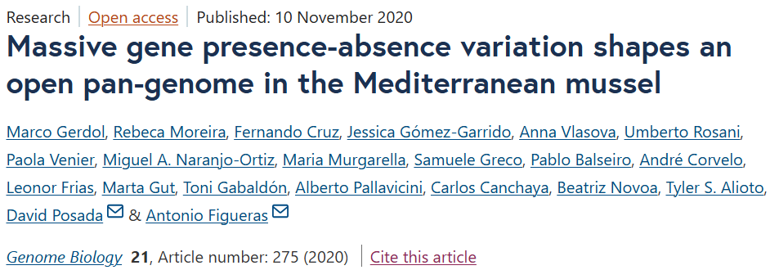
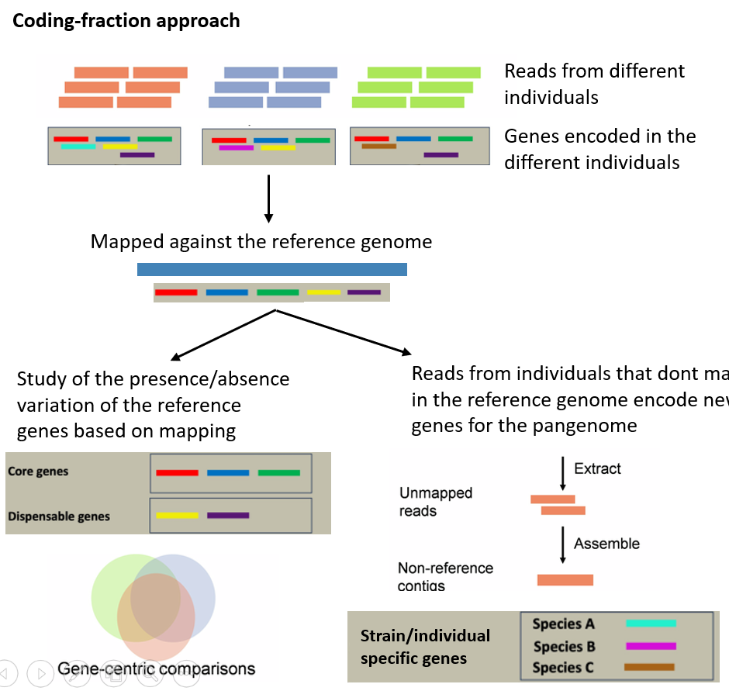
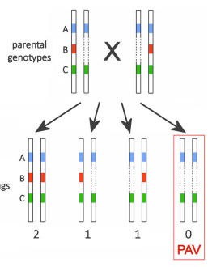
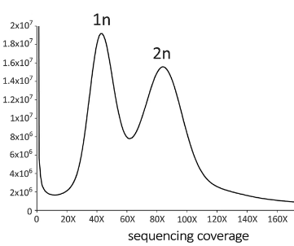
Eukaryote pangenomes: Mussels, the first open pangenome in a metazoan
Revealed in 2020 in Trieste and Galicia. The first pangenome with high interindividual variation in a metazoan
The story for its discovery is analogous as in prokaryotes. After sequencing the genome, and compare it with a previous draft assembly, massive genetic differences were evidenced, even by PCRs.
14 additional invidiuals were sequenced from Galicia and Italy and the short reads mapped to the new reference genome to identify dispensable genes and also retrieve additional genes not present in the reference.
Even if the approach was coding-based, it was evidenced that large structural variations associated with a very high hemizygous fraction of the genome was the responsible for such pangenomic variation

Slide 19
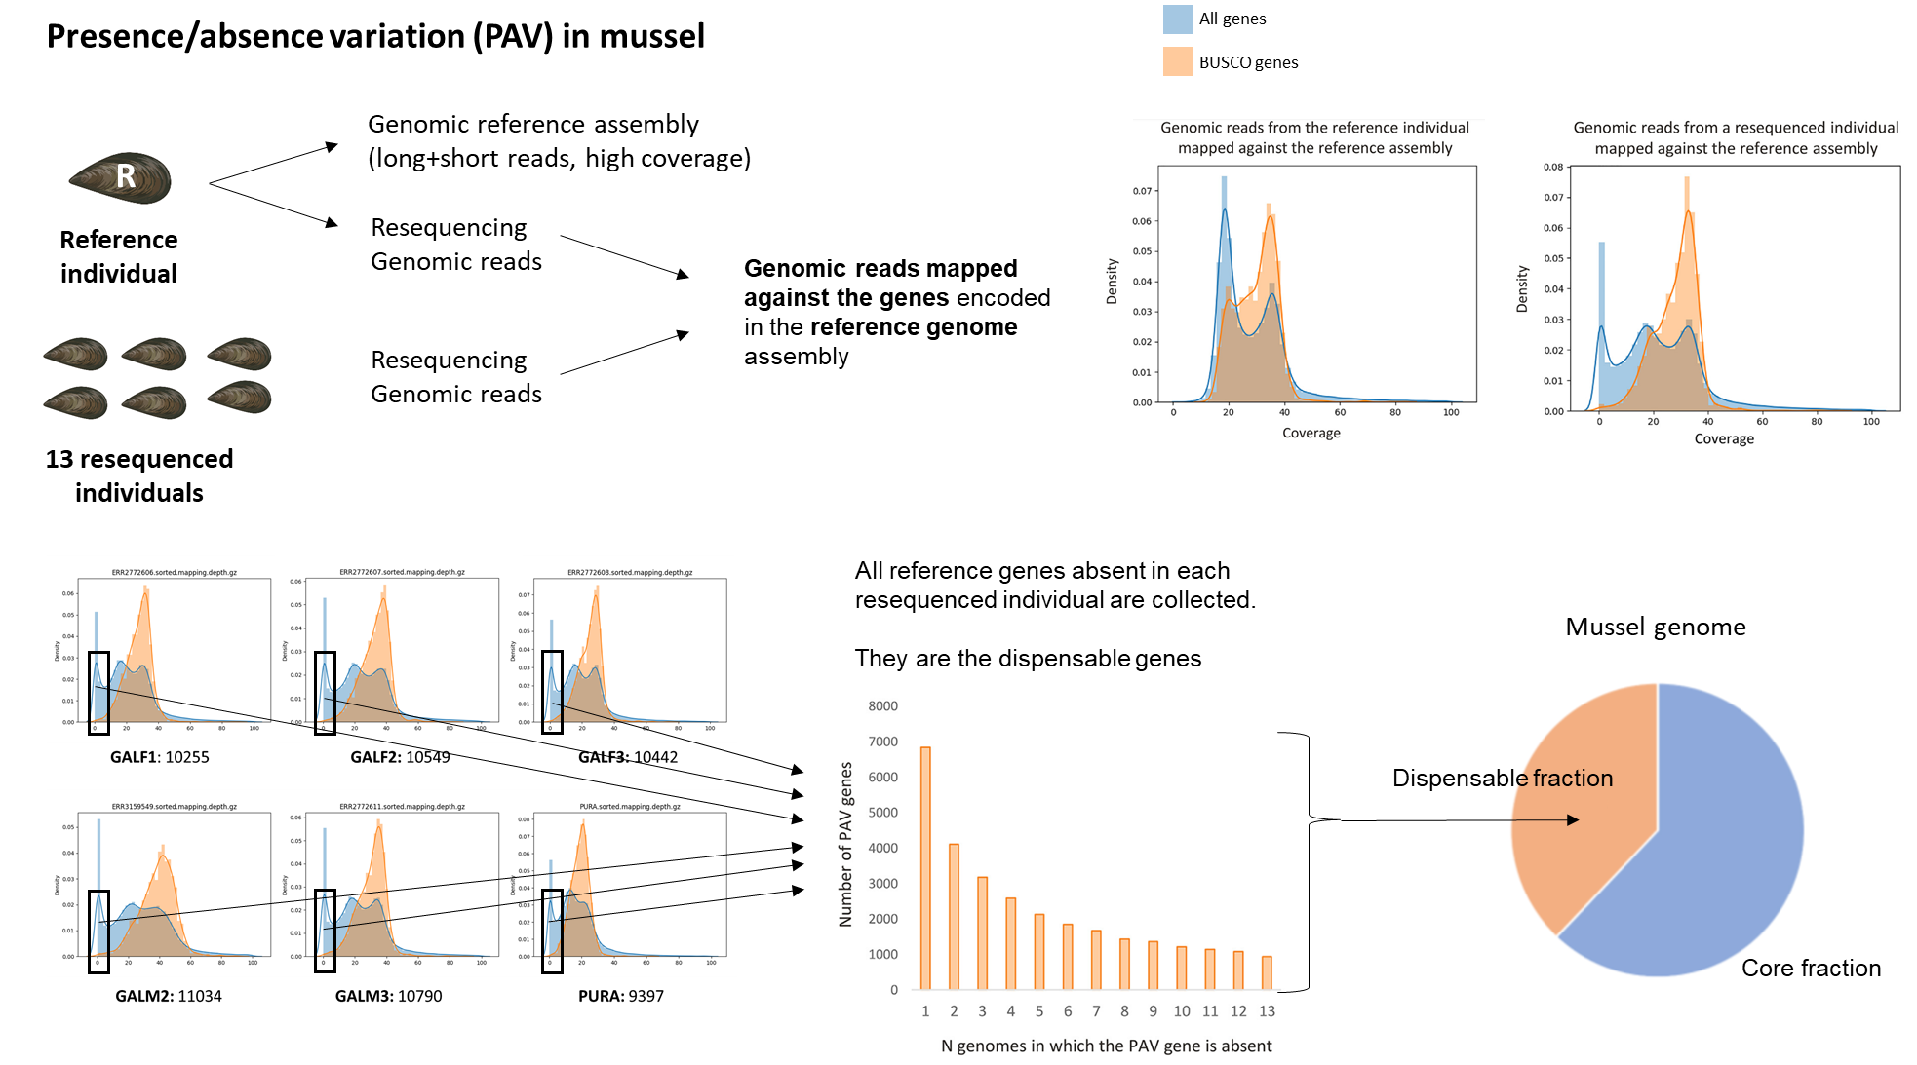
Eukaryote pangenomes: Mussels, the first open pangenome in a metazoan

Slide 20
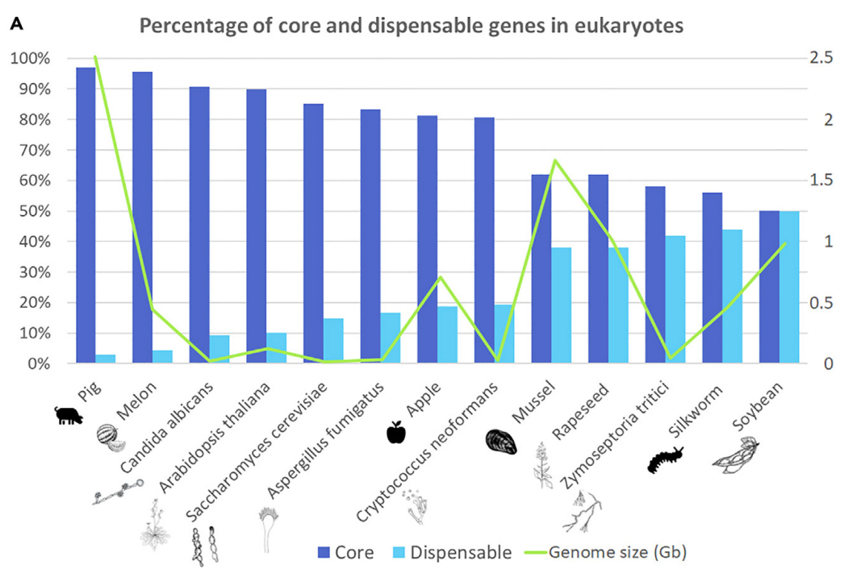
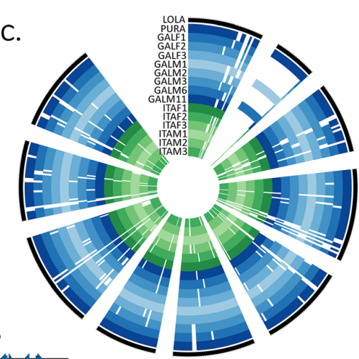
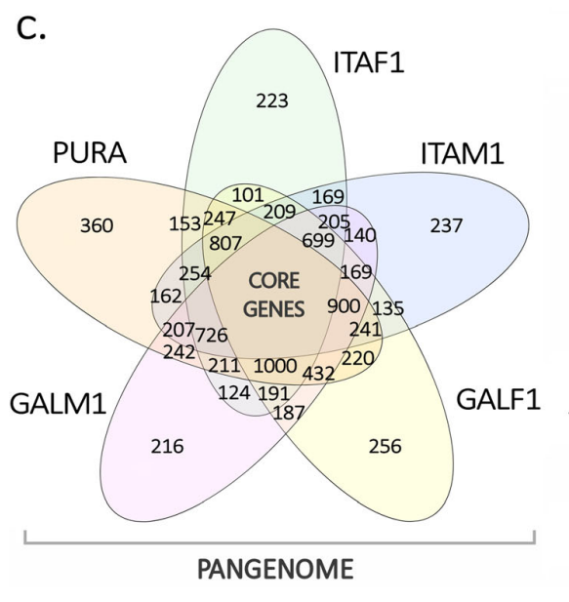
Eukaryote pangenomes: Mussels, the first open pangenome in a metazoan
First open pangenome in a metazoan: aprox. 45,000 core genes and 20,000 dispensable
  Genomic structural variations (SV) are large-scale differences within the genome of a species. SV can affect intergenic and also gene-encoding regions, resulting in gene presence-absence variation (PAV), basis of pangenomes
  Close pangenomes are common in the animal kingdom (humans and pigs with variations in the order of 1-10% in gene content)
  Open pangenomes with variation as found in mussel were only common in prokaryotes, plants, microalgae and fungi. Recently they are being reported also in invertebrates as bivalves (38% gene variation in mussels; 14 individuals) and arthropods (44% gene variation in silkworm; 1078 individuals)

Slide 21
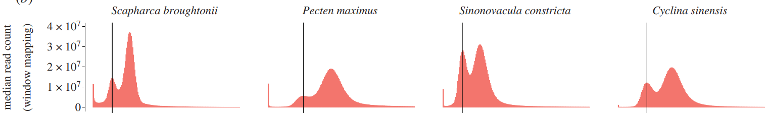
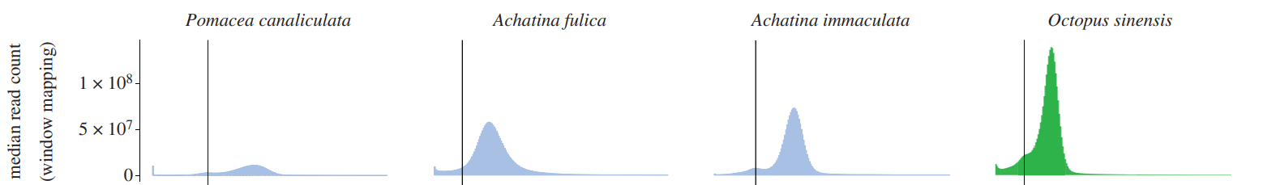
Eukaryote pangenomes: Mussels, the first open pangenome in a metazoan
Gerdol et al., 2020. Genome Biology
In diploid organisms, PAV occurs between homologous chromosomes within an individual, resulting in hemizygous genomic regions (present in only one of the two homologous chromosomes)
Due to mendelian inheritance, genes encoded in hemizygous regions of a single individual are subjected to PAV at population level.
Bivalves are characterized by great hemizygosity rates (in other molluscs is not important)
Detected when genes present half the expected genomic coverage (mapping genomic reads to the genomic assembly)
Calcino et al., 2021. Philosophical Transactions

Slide 22
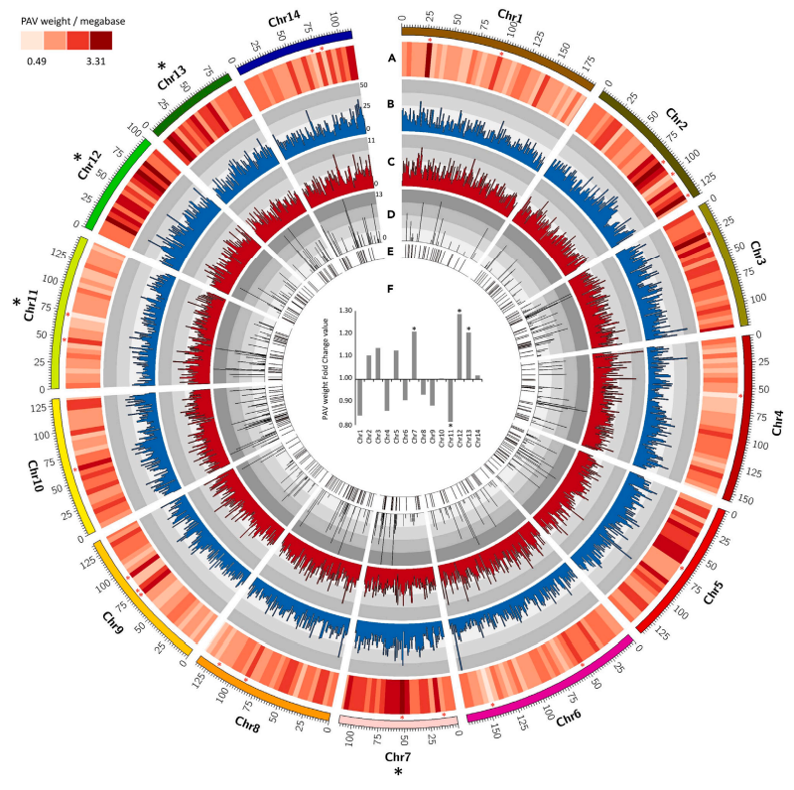
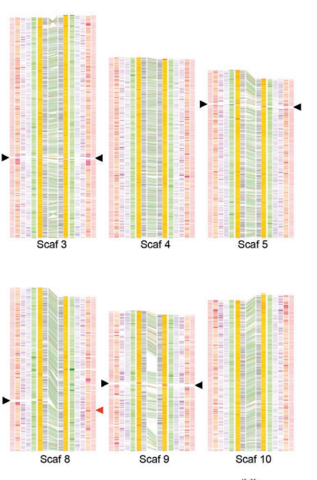
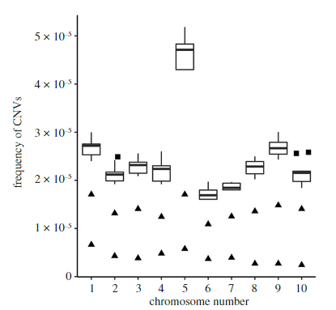
Eukaryote pangenomes: Mussels, the first open pangenome in a metazoan
The large hemizygous fractions in other bivalves could be related with a widespread distribution of pangenomes in these species
Some studies started to point towards PAV in other bivalves, focused in the chromosomic distribution of SV.
Chromosomic distribution of duplications (gene copy variations between individuals) in Crassostrea virginica
Gene variation between haplotypes (hemizygous regions) in Pinctada fucata
Chromosomic distribution of PAV in Mytilus galloprovincialis
(Takeuchi et al., 2022)
Modak et al., 2021.
Saco et al., 2023. Iscience

Slide 23
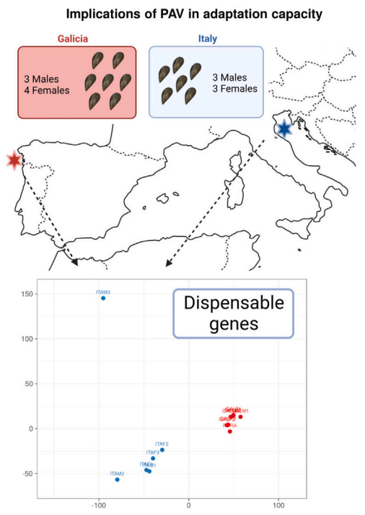
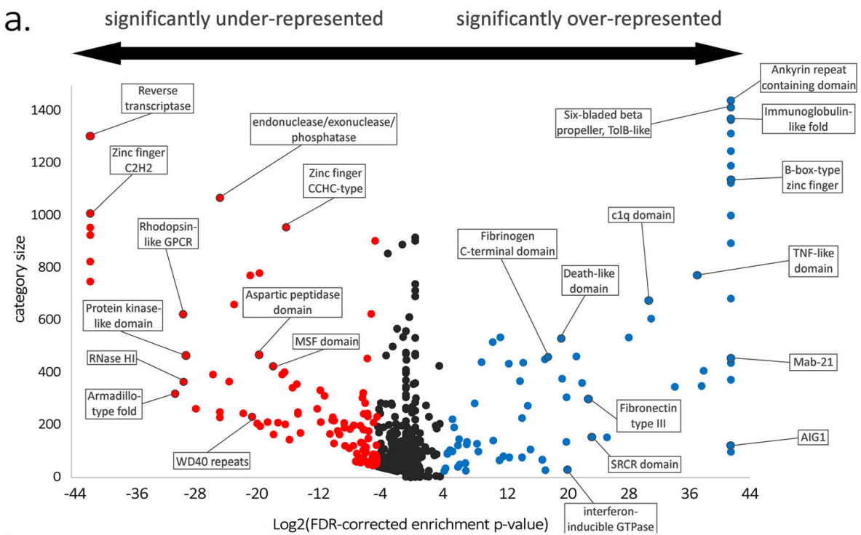
Eukaryote pangenomes: Mussels, the first open pangenome in a metazoan
The large dispensable fraction of the mussel genome could be related with adaptation (as usually described for pangenomes in other species)
The dispensable fraction in mussels is enriched in gene families with immune functions (same in hemizigous fractions in other bivalves)
In addition, resequenced mussels from two different populations show differences in their dispensable repertoire

Slide 24
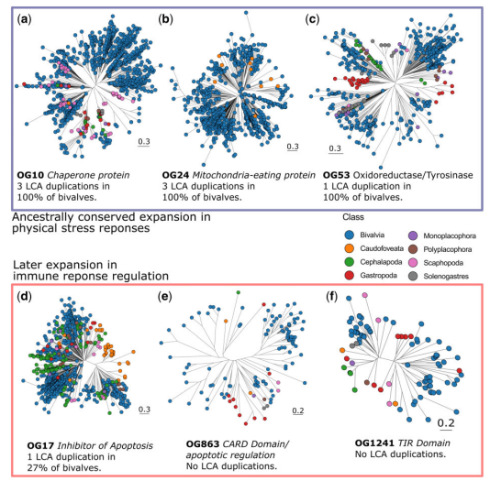
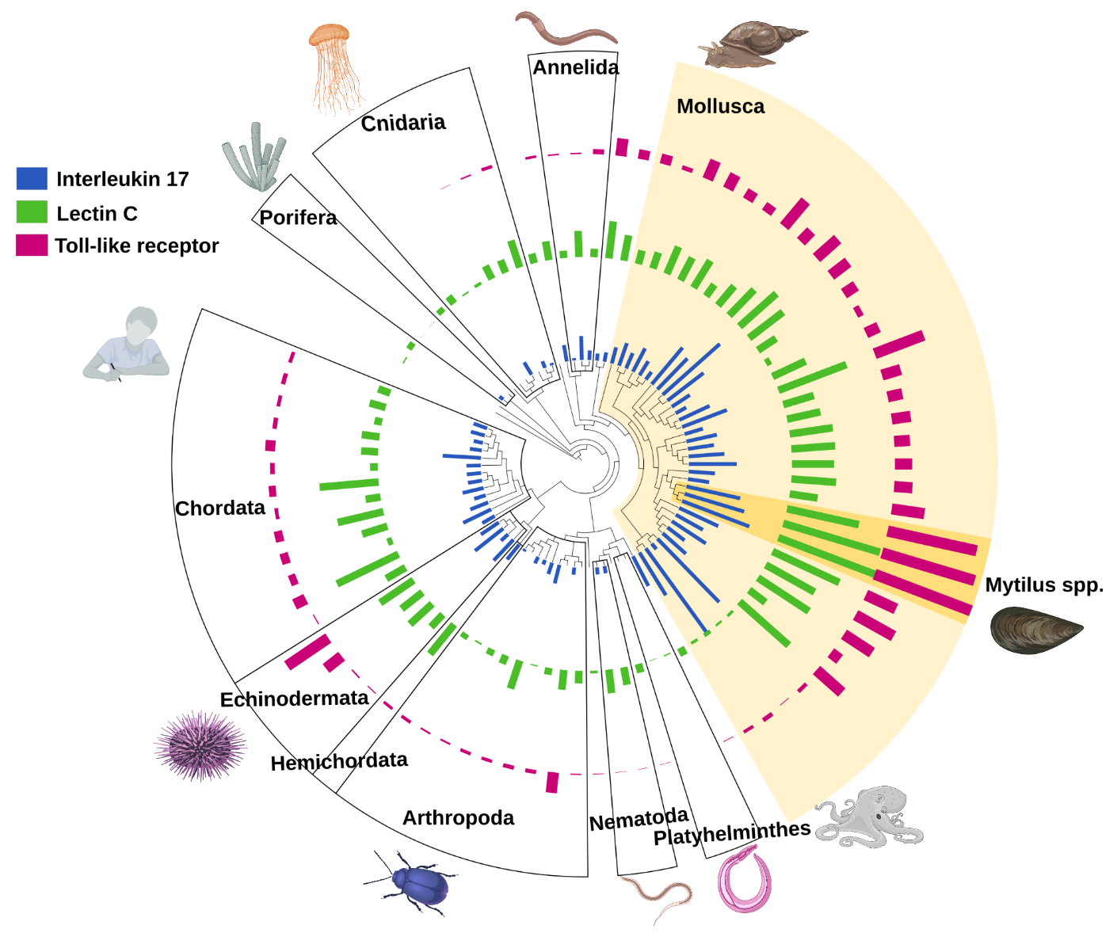
Eukaryote pangenomes: Mussels, the first open pangenome in a metazoan
The same immune gene families enriched in the dispensable fraction in mussels are usually largely expanded and diversified in mussels and other bivalves

Slide 25
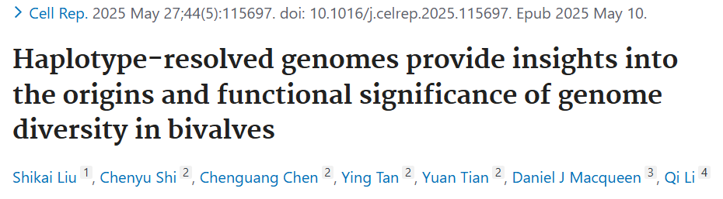
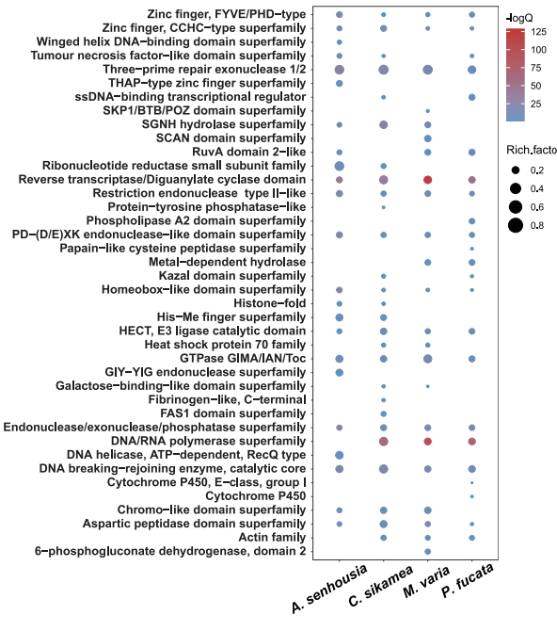
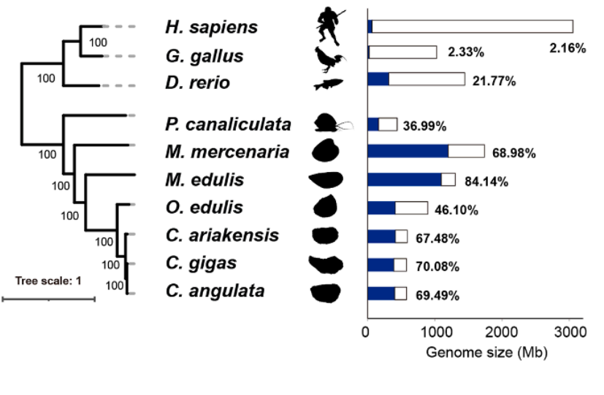
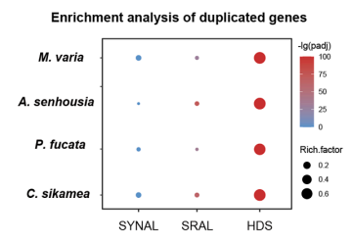
Eukaryote pangenomes: Another bivalve
Crassostrea sikamea: haplotype-resolved genome
Identification of widespread haplotype divergent sequences (HDSs), representing genomic regions unique to each haplotype. These regions are the hemizgyous regions containing genes that will be susceptible to be dispensable. In the study they are compared with other SVs such as syntenic region alignments (SYNAL) and structural rearrangement alignments (SRAL).
HDSs are driven by transposable elements (65-70% of HDS present complete intact TEs
inserted into the regions).
Percentage of divergent sequences between individual genomes in representative species
More duplicated genes in the HDS regions
Domains enriched in the genes encoded in HDS regions

Slide 26

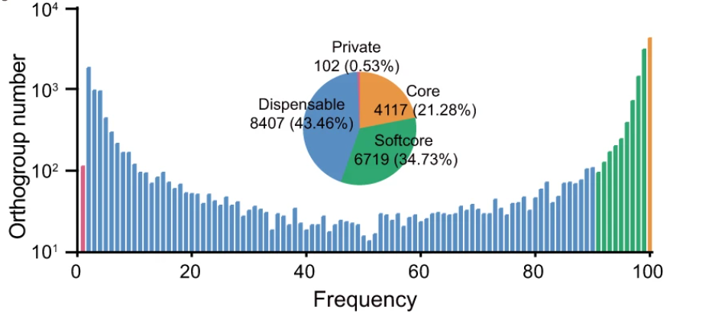
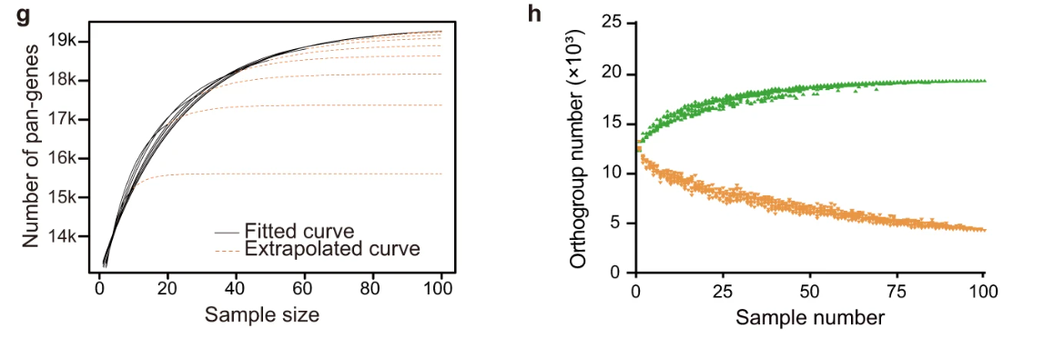
Eukaryote pangenomes: Report in arthropod
The silkworm Bombyx mori was another stricking report of a quite open pangenome in an invertebrate,
in this case an arthropod
After re-sequencing of 1,078 silkworms and assemble long-read genomes for 545 representatives, 7308 new genes
were identified , 4260 (22%) core genes, and 3,432,266 non-redundant structure variations (SVs).
Hundreds of genes and SVs could contribute to the artificial selection (domestication and breeding) of silkworm, including genes responsibly for economic (silk yield and silk fineness) and ecologically adaptive traits (egg diapause and aposematic coloration).
Transposable elements constituted the largest component (67%) of SV sequences in silkworm genomes. Also particularly high number of TEs
Out of the massive number of SVs identified, ~7% of SVs affect coding sequences (CDSs) directly. 48% in regulatory + intron/flanking regions of genes. The rest an majority, in intergenic regions far away from the encoded genes.

Slide 27
Next session: 04/11/2025
Methodological insights
Practical case

Slide 28
Practical case
The problem
Imagine a sunflower population highly resistant to ionizing radiation in comparisson with other sunflowers that die under the same conditions
The goal is to identify if there are dispensable genes or structural variants associated with this biological property.

Slide 30
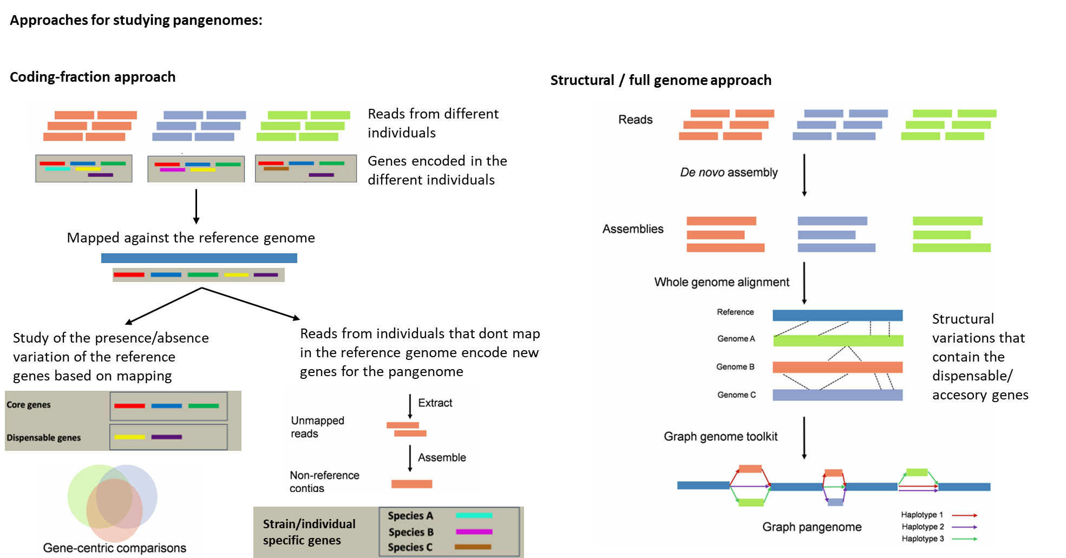
The problem
Imagine a sunflower population highly resistant to ionizing radiation in comparisson with other sunflowers that die under the same conditions
The goal is to identify if there are dispensable genes or structural variants associated with this biological property.

Slide 31
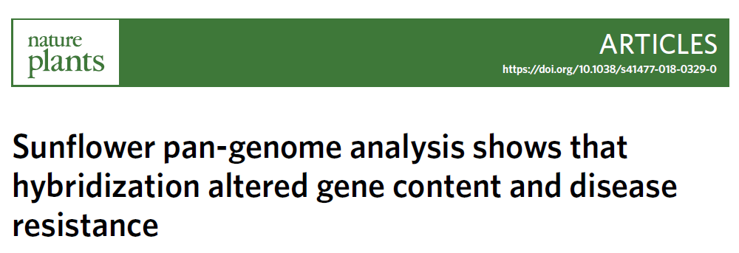
A similar paper
Sunflower (Helianthus annuus L.) exhibits typical domestication syndrome, including dramatic morphological and ecological differences from its wild ancestor. Many crop plants exhibit a strong reduction in genetic variation relative to their wild progenitors due to population bottlenecks and strong artificial selection during domestication. Genetic variation has been eroded further over the past century with the transition from traditional varieties adapted to
their local environment to uniform elite lines.
The transition from a wild progenitor (also H. annuus) to the cultivated form about 4,000 years ago in North America and later to elite lines during the nineteenth and twentieth centuries, progressively narrowed the available genetic variation for breeding. Fortunately, sunflower is crosscompatible with many of its wild relatives, which has permitted the introgression of beneficial traits from the wild.
Despite domestication, cultivated sunflower remains highly variable genetically, mainly due to hybridization with wild relatives. This genetic diversity is essential to give the species the necessary response capacity to selection caused by different stress factors.
In the paper, the goal is not to find particular genes that can give advantage under a certain stress factor.
To characterize genetic diversity in the sunflower and to quantify contributions from wild relatives
We sequenced 287 cultivated lines (SAM), 17 Native American landraces and 189 wild accessions representing 11 compatible wild species.
Test whether introgression from wild relatives has significantly expanded the gene repertoire of cultivated sunflower.
Analyzing if these introgressions have contributed to enhanced disease resistance, as predicted by breeding records, and identify candidate genes contributing to downy mildew resistance.

Slide 32
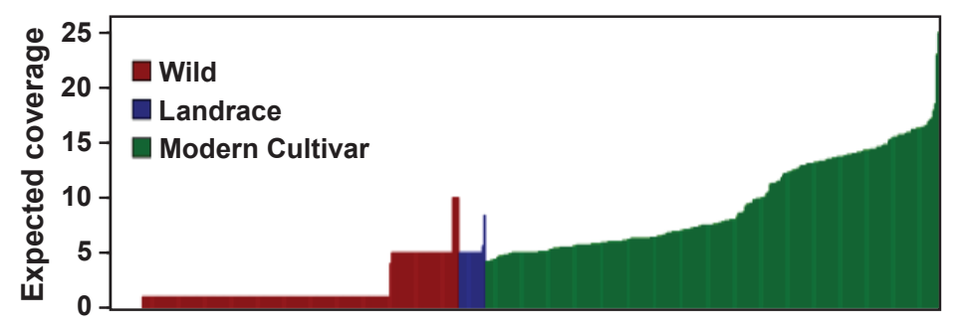
Methods
Resequencing the SAM population and wild relatives.
  287 samples from the SAM population. It captures ~90% of the allelic diversity in the cultivated sunflower gene pool and is mainly comprised of modern oil and confectionary (non-oil) cultivars, which were released after the transition to hybrid breeding in the early 1970s.
  17 Native American landraces (landrace is a domesticated, locally adapted,often traditional variety of a species of animal or plant that has developed over time, through adaptation to its natural and cultural environment of agriculture and pastoralism, and due to isolation from other populations of the species).
  189 genotypes representing 11 annual and perennial congeners—including species representing the primary (no crossing barriers), secondary (some barriers) and tertiary (special techniques required for breeding) gene pools:
    H. annuus from the primary gene pool; H. petiolaris, H. neglectus, H. argophyllus, H. anomalus, H. debilis, H. paradoxus and H. praecox from the secondary gene pool; and H. divaricatus, H. grosseserratus and H. giganteus representing the tertiary gene pool.
Genomic DNA was extracted from each sample, libraries were prepared following Illumina’s TruSeq protocol and sequencing was conducted on the Illumina HiSeq platform with 100-bp paired-end reads. Sequence coverage varied between accessions, in which cultivated accessions (modern cultivars and landraces) were sequenced to a coverage of 5–25× and wild accessions were sequenced to 1–5× .

Slide 33
Methods
Pangenomic analysis
The HA412-HO.v1.1 reference genome and annotations were used to guide the assembly of the cultivated sunflower pan-genome.
Following the alignment of reads from each accession to the reference (SAP SE), unmapped and poorly mapped reads (defined as an edit distance of ≥ 8 for a read pair) were extracted.
These reads were assembled de novo (separately) for 270 accessions that were well classified and characterized from the SAM population and an additional 17 landraces independently using the Ray assembler with a range of k-mers between 13 and 51 to enable the assembly of contigs from low-coverage data.
All sequences were blasted against the UniVec database to remove potential contaminants. Assembled contigs shorter than 200 bp were removed from further analysis. Remaining contigs were aligned to the reference genome to identify sequences that were reassembled and are already present in
the reference. Contigs with > 75% similarity along > 75% of the alignment length were considered as represented in the reference genome and were excluded from further analysis (very conservative approach).
Next, all new contigs from all accessions were pooled into one data set that represents all dispensable sequences not found in the reference genome. To cluster overlapping sequences and avoid redundancy, the pooled data set was processed using the software CD-HIT with a similarity threshold of 95%, keeping the longest contig at each cluster. Remaining sequences were searched against the NCBI nr database to look for potential assembled contaminants. A total of 526 sequences were identified as potential contaminants and excluded from further analysis.
To annotate the non-redundant sequences from the pooled data set, annotations of the HA412-HO reference genome were integrated with the plant
protein database to create a more complete annotation database. Annotations for the non-redundant de novo-assembled sequences were determined using blastx with a minimum bit-score threshold of 200 to ensure a high quality of annotations. Only the best hit was kept while giving priority to the HA412-HO hits associated with each query. The final outcome of this process was a set of annotated genes that corresponded to the cultivated sunflower pan-genome, including core and dispensable genes.

Slide 34
Methods
Introgression from wild populations
Comparisons with the wild samples were conducted following the same procedure described for the pan-genome in the cultivated gene pool.
Raw reads from wild accessions were cleaned, trimmed and aligned to the cultivated sunflower pan-genome. A consensus sequence was called for each wild accession alignment separately. A comprehensive comparison of sequences from all wild accessions to all cultivated accessions was performed with blastn and results were filtered using a minimum bit-score of 200, a minimum alignment length of 150 bp and a minimum of 75% identity. Of the remaining hits, only the best hit was kept as a potential source of introgression.
The pairwise identity matrix was further filtered to remove wild introgressions supported by only one cultivated accession. To distinguish gene sequences brought into the cultivated gene pool by domestication versus those that were introgressed during improvement, landrace accessions were used as a reference. All gene sequences found in landraces were considered as derived from domestication and were removed from downstream analyses.
Results
Cultivar sequences failing to map to the sunflower reference were assembled de novo for each genotype to determine the gene repertoire, or ‘pan-genome’, of the cultivated sunflower. Assembled genes were then compared to the wild species to estimate origins.
Results indicate that the cultivated sunflower pan-genome comprises 61,205 genes, of which 27% vary across genotypes. Approximately 10% of the cultivated sunflower pan-genome is derived through introgression from wild sunflower species, and 1.5% of genes originated solely through introgression. Gene ontology functional analyses further indicate that genes associated with biotic resistance are over-represented among introgressed regions, an observation consistent with breeding records. Analyses of allelic variation associated with downy mildew resistance provide an example in which such introgressions have contributed to resistance to a globally challenging disease.

Slide 35
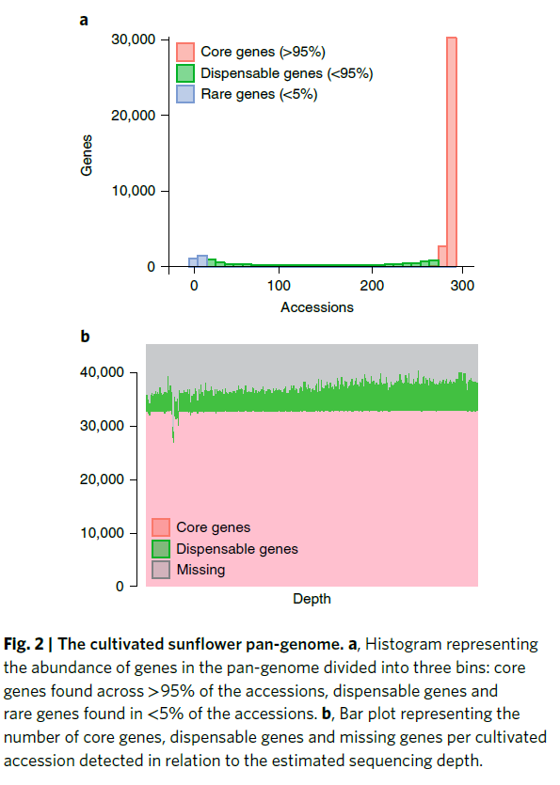
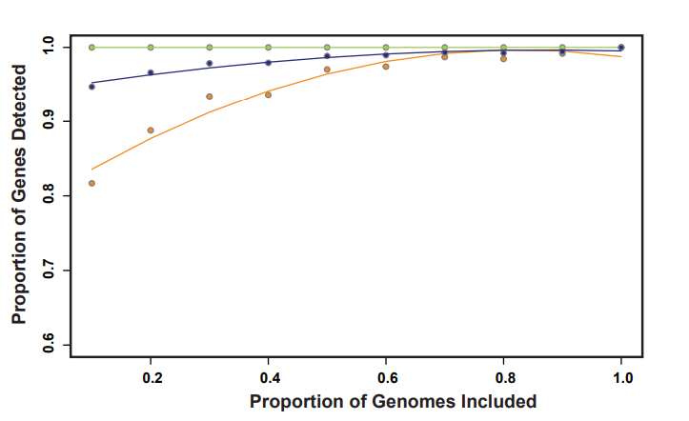
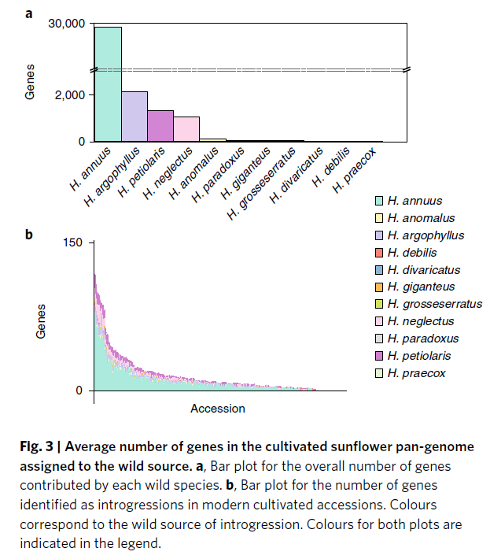
A similar paper
Results
dispensable genes (orange), core genes (green) and the total number of genes (blue)

Slide 36
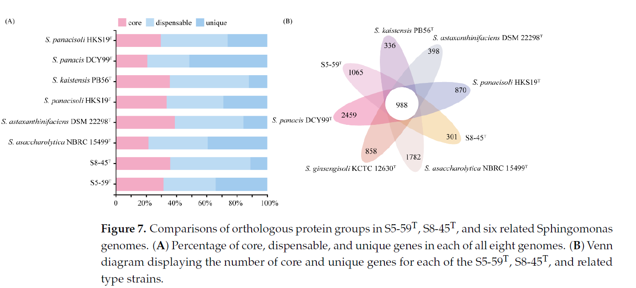
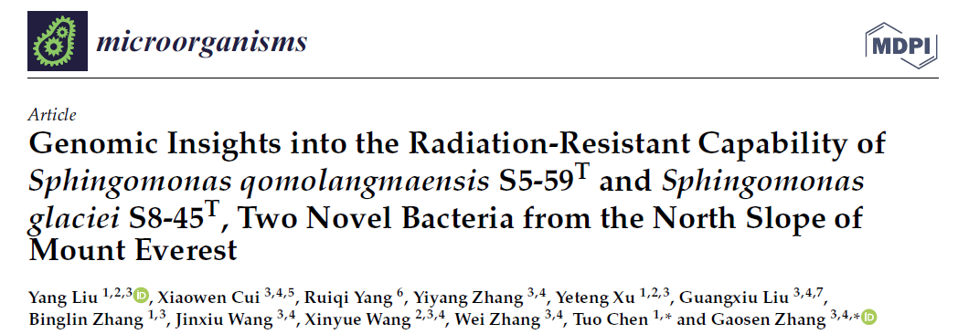

Examples of identification of radiation-resistant genes
Bacterial pangenomes have their own tools (not comparable)
Genome assembly with just illumina 100X sequencing
Pangenome analysis with the Bacterial Pan Genome Analysis (BPGA) software
Two bacterial strains, designated S5-59T and S8-45T, were isolated from moraine samples collected from the north slope of Mount Everest at altitudes of 5700m and 5100m above sea level. The present study investigated the polyphasic features and genomic characteristics of S5-59T and S8-45T.
Strains S5-59T and S8-45T harbored great radiation resistance. The genomic analyses showed that DNA damage repair genes, such as mutL, mutS, radA, radC, recF, recN, etc., were present in the S5-59T and S8-45T strains. Additionally, strain S5-59T possessed more genes related to DNA protection proteins. The pan-genome analysis and horizontal gene transfers revealed that strains of Sphingomonas had a consistently homologous genetic evolutionary radiation resistance. Moreover, enzymatic antioxidative proteins also served critical roles in converting ROS into harmless molecules
that resulted in resistance to radiation. Further, pigments and carotenoids such as zeaxanthin and alkylresorcinols of the non-enzymatic antioxidative system were also predicted to protect them from radiation.

Slide 37
What could we do?
Include some samples from populations resistant to the ionic radiation and some that aren’t
Focus on the absent genes in those populations, as it could also give functional clues
Assemble and retrieve the genes specific from those populations and relate them with the functional properties they could have to support the observed adaptation

Slide 38
Number of samples and coverage? Never a definitive answer
Resequencing costs
Genome of 1.4 Gb at 35X.
Sunflower is 3 Gb genome
1,5 Gb 35× ≈ €450-900
3 Gb 35× ≈ €900-1.800

Slide 39
For the ideal approach, both approaches should be combined
Current mussel project

Slide 40
Examples of methods: coding-focused approach
Illumina resequencing -> trimming (fastp)
Mapping against the reference genome (bwa mem)
Its made against each position of the genome
Sorting of alignments (sorting the mapping by the bases in the reference sequence)
Calculation of mapping coverage/depth in each position of the reference sequence -> samtools depth
Then we take into consideration the coordinates of the exons to calculate the average coverage in the coding regions of each gene
At the end, each gene will have a average sequencing coverage in each of the resequenced samples
We supplement a python script with the exon coordinates, the busco conserved genes and the coverage/position for each resequenced sample -> absent genes

Slide 41

Examples of methods: coding-focused approach
The threshold to call a gene absent will be a gene presenting less than 1/8 coverage of the busco genes (1/8 coverage of the expected sequencing coverage)

Slide 42

Examples of methods: for structural variation
We need to build high quality genome assemblies: sequencing with Pacbio Hifi longreads and Illumina Hi-C (much most costly, not results guaranteed)
Once we obtain the genome assemblies we can study structural variants between haplotypes or bewteen genomes
Chromosome alignment with minimap2
Syriri for detecting structural variants and snps -> quantification
Plotting with plotsr
CPG | Copy gain in non-reference genome | 25
CPL | Copy loss in non-reference genome | 11
DEL | Deletion in non-reference genome | 13568
DUP | Duplication | 256
DUPAL | Duplication alignment | 266
HDR | Highly diverged regions | 976
INS | Insertion in non-reference genome | 13515
INV | Inversion | 27
INVAL | Inversion alignment | 208
INVDP | Inverted Duplication | 237
INVDPAL | Inverted Duplication alignment | 254
INVTR | Inverted Translocation | 537
INVTRAL | Inverted Translocation alignment | 567
NOTAL | Not Aligned region | 3522
SNP | Single nucleotide polymorphism | 178196
SYN | Syntenic region | 439
SYNAL | Syntenic alignment | 1317
TDM | Tandem repeat | 0
TRANS | Translocation | 585
TRANSAL | Translocation alignment | 609

Slide 43





Examples of methods: for structural variation
Dotplots and multiple chromosome alignments

Slide 44


Examples of methods: for structural variation
Associate chromosomic regions with structural variation with the dispensable genes
In a reference genome, we can locate the genes of that reference that were in the accesory part of the pangenome (subjected to presence/absence variation across the individiual resequenced samples). Of course, we can not locate in that reference the extra genes reassembled from a resequenced individual’s reads that were not present in such reference.

