Slide 1
MACROECONOMICS
Financial Crisis
University of Trieste
Dr Enrico Vanino - School of Economics, University of Sheffield

Slide 2
Lecture Plan
What’s a Financial Crisis
The Great Financial Crisis
Financial Crisis Contagion
Policy Response

Slide 3
What’s a Financial Crisis?
Financial crisis occurs when there is a particularly large disruption to information flows in financial markets.
Result in financial frictions increasing sharply and financial markets stop functioning.
Given centrality of financial markets in our economy, financial crisis usually spread to rest of economy.
Systematic risks and economic recession.

Slide 4
Dynamics of Financial Crisis
Stage One: Initiation of a Financial Crisis:
  Mismanagement of financial liberalization/innovation
  Asset-price Boom and Bust
  Increase in uncertainty
Stage two: Banking Crisis
  Drop in trust
  Decrease in lending
  Increase in Non-Performing Loans
Stage three: Debt Increase
  Private debt due to NPL
  Public debt due to policy interventions

Slide 5
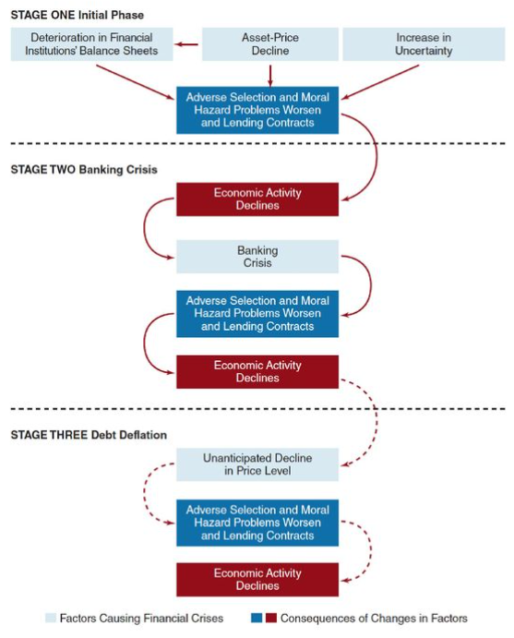

Slide 6
Brief History of Financial Crisis
1930s US Great Depression
  Stock prices inflation and interest rates
1970s Energy Crisis
  Oil prices and stagflations
1990s Asian Tigers
  Lost decade of Japanese asset price bubble
  Hot money and exchange rates
2000s Dot-com bubble
  Technology-inspired bubble and low interest rates.
2008 Great Financial Crisis
  Financial innovation and housing bubble

Slide 7
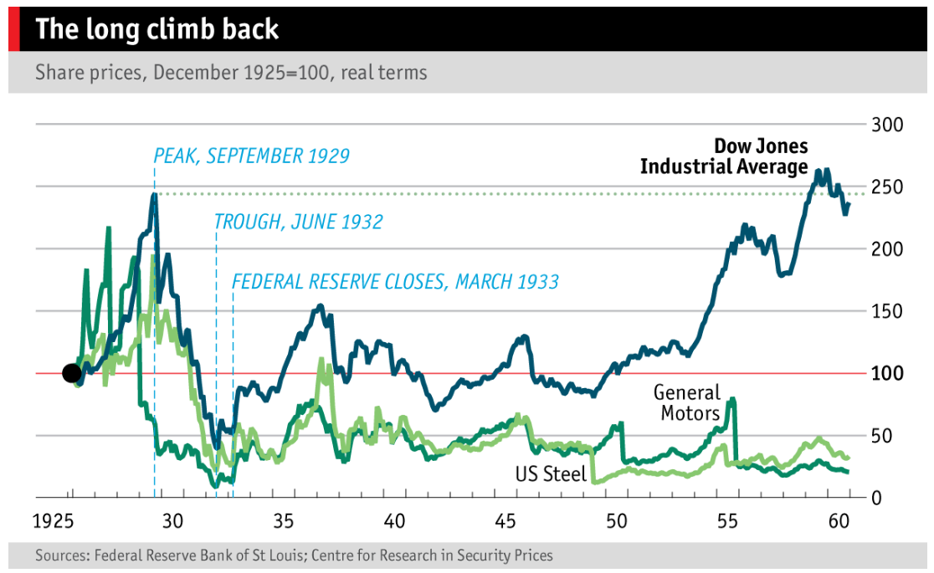
Consequences of Financial Crisis

Slide 8


Slide 9
Great Financial Crisis
From a housing problem to a financial crisis.
2000s period of unusually low interest rates, which stimulated housing demand.
Mortgage lenders was increasingly willing to make loans to risky borrowers with subprime mortgages.
From 2006 on, with slowdown in property prices, many home mortgages went underwater (value of the mortgage exceeded value of the house).
Lenders faced large losses as many borrowers defaulted.

Slide 10
Great Financial Crisis
Causes of the Financial Crisis:
Financial innovations emerge in the mortgage markets
  Subprime mortgage
  Mortgage-backed securities
  Collateralized debt obligations (CDOs)
Housing price bubble forms
  Increase in liquidity from cash flows surging to the United States
  Development of subprime mortgage market fuelled housing demand and housing prices

Slide 11
CDOs & Great Financial Crisis
Creation of Collateralized Debt Obligations (CDOs) by corporate entities (special purpose vehicle - SPV) that buys a collection of assets (corporate bonds and loans, commercial real estate bonds, and mortgage-backed securities).
The SPV separates the payment streams (cash flows) from these assets, and repackages them into tranches that are sold to investors:
  High-rated tranches, referred to as super senior tranches, are the ones that are paid off first and so have the least risk, higher rating and low returns.
  Lowest tranches are equity tranches and these are the first set of cash flows not paid out if underlying assets go into default. These tranches have highest risk, lower rating and high returns.
CDOs developed to spread risk and create new investment opportunities.

Slide 12
CDOs & Great Financial Crisis
CDOs transform a collection of individual loans into a structured product redistributing risk and return.
Different types based on underlying assets: mortgage-backed securities (mortgage loans), and asset-backed securities (corporate debt, auto loans, or credit card debt).
Agents involved: securities firms, CDO managers, rating agencies, financial guarantors, investors (pension funds, hedge funds, banks).
Niche market until early 2000s, when SPVs began to use subprime mortgages as collateral: from $30 billion in 2003 to $225 billion in 2006 ($27.5 billion in 2023).

Slide 13
CDOs & Great Financial Crisis
Subprime mortgages required very low down-payments, no proof of income with adjustable-rate mortgages increasing over time.
Little government regulation, with ratings agencies making mortgage-backed securities look low-risk to investors.
CDOs increased the demand for mortgage-backed securities, which increased the number of subprime mortgages that lenders were willing and able to sell.
General consensus was that real estate prices would continue to go up, with low subprime mortgages delinquency rates.
Prices did not continue to rise, subprime borrowers found themselves underwater on homes worth less than what they owed on their mortgages -> a high rate of defaults.
This triggered implosion in the CDO market, causing losses for hundreds of billions of dollars for some of the largest financial services institutions, resulting in investment banks going bankrupt or being bailed out.

Slide 14
CDOs & Great Financial Crisis
Causes of the Financial Crisis:
  Agency problems arise
  “Originate-to-distribute” model is subject to principal-(investor) agent (mortgage broker) problem
  Borrowers had little incentive to disclose information about their ability to pay
  Commercial and investment banks (as well as rating agencies) had weak incentives to assess the quality of securities
  Information problems surface
  Housing price bubble bursts

Slide 15
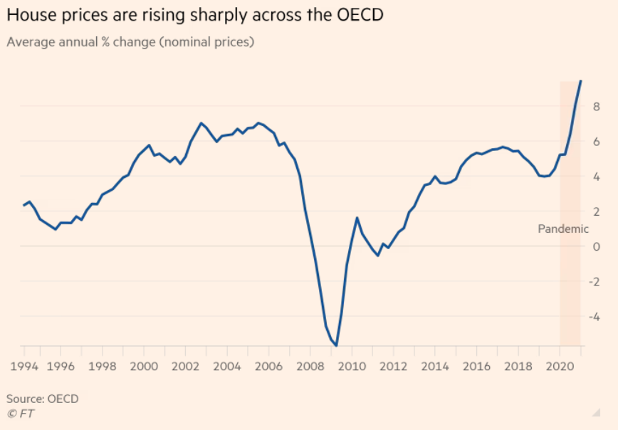
Housing Market Bubble

