Slide 1
MACROECONOMICS
Financial Crisis
University of Trieste
Dr Enrico Vanino - School of Economics, University of Sheffield

Slide 2
Lecture Plan
What’s a Financial Crisis
The Great Financial Crisis
Financial Crisis Contagion
Policy Response

Slide 3
What’s a Financial Crisis?
Financial crisis occurs when there is a particularly large disruption to information flows in financial markets.
Result in financial frictions increasing sharply and financial markets stop functioning.
Given centrality of financial markets in our economy, financial crisis usually spread to rest of economy.
Systematic risks and economic recession.

Slide 4
Dynamics of Financial Crisis
Stage One: Initiation of a Financial Crisis:
  Mismanagement of financial liberalization/innovation
  Asset-price Boom and Bust
  Increase in uncertainty
Stage two: Banking Crisis
  Drop in trust
  Decrease in lending
  Increase in Non-Performing Loans
Stage three: Debt Increase
  Private debt due to NPL
  Public debt due to policy interventions

Slide 5
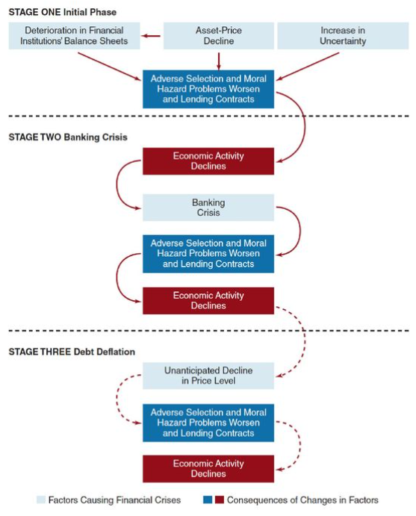

Slide 6
Brief History of Financial Crisis
1930s US Great Depression
  Stock prices inflation and interest rates
1970s Energy Crisis
  Oil prices and stagflations
1990s Asian Tigers
  Lost decade of Japanese asset price bubble
  Hot money and exchange rates
2000s Dot-com bubble
  Technology-inspired bubble and low interest rates.
2008 Great Financial Crisis
  Financial innovation and housing bubble

Slide 7
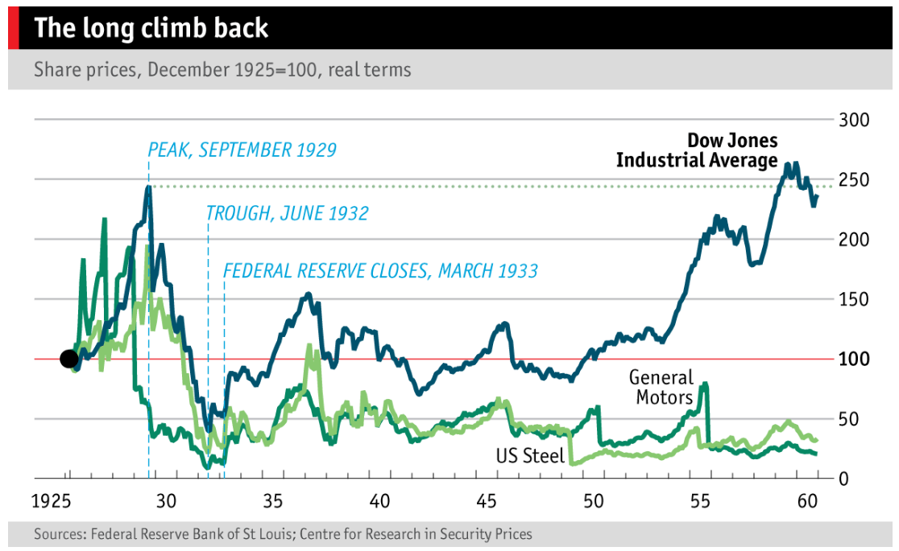
Consequences of Financial Crisis

Slide 8


Slide 9
Great Financial Crisis
From a housing problem to a financial crisis.
2000s period of unusually low interest rates, which stimulated housing demand.
Mortgage lenders was increasingly willing to make loans to risky borrowers with subprime mortgages.
From 2006 on, with slowdown in property prices, many home mortgages went underwater (value of the mortgage exceeded value of the house).
Lenders faced large losses as many borrowers defaulted.

Slide 10
Great Financial Crisis
Causes of the Financial Crisis:
Financial innovations emerge in the mortgage markets
  Subprime mortgage
  Mortgage-backed securities
  Collateralized debt obligations (CDOs)
Housing price bubble forms
  Increase in liquidity from cash flows surging to the United States
  Development of subprime mortgage market fuelled housing demand and housing prices

Slide 11
CDOs & Great Financial Crisis
Creation of Collateralized Debt Obligations (CDOs) by corporate entities (special purpose vehicle - SPV) that buys a collection of assets (corporate bonds and loans, commercial real estate bonds, and mortgage-backed securities).
The SPV separates the payment streams (cash flows) from these assets, and repackages them into tranches that are sold to investors:
  High-rated tranches, referred to as super senior tranches, are the ones that are paid off first and so have the least risk, higher rating and low returns.
  Lowest tranches are equity tranches and these are the first set of cash flows not paid out if underlying assets go into default. These tranches have highest risk, lower rating and high returns.
CDOs developed to spread risk and create new investment opportunities.

Slide 12
CDOs & Great Financial Crisis
CDOs transform a collection of individual loans into a structured product redistributing risk and return.
Different types based on underlying assets: mortgage-backed securities (mortgage loans), and asset-backed securities (corporate debt, auto loans, or credit card debt).
Agents involved: securities firms, CDO managers, rating agencies, financial guarantors, investors (pension funds, hedge funds, banks).
Niche market until early 2000s, when SPVs began to use subprime mortgages as collateral: from $30 billion in 2003 to $225 billion in 2006 ($27.5 billion in 2023).

Slide 13
CDOs & Great Financial Crisis
Subprime mortgages required very low down-payments, no proof of income with adjustable-rate mortgages increasing over time.
Little government regulation, with ratings agencies making mortgage-backed securities look low-risk to investors.
CDOs increased the demand for mortgage-backed securities, which increased the number of subprime mortgages that lenders were willing and able to sell.
General consensus was that real estate prices would continue to go up, with low subprime mortgages delinquency rates.
Prices did not continue to rise, subprime borrowers found themselves underwater on homes worth less than what they owed on their mortgages -> a high rate of defaults.
This triggered implosion in the CDO market, causing losses for hundreds of billions of dollars for some of the largest financial services institutions, resulting in investment banks going bankrupt or being bailed out.

Slide 14
CDOs & Great Financial Crisis
Causes of the Financial Crisis:
  Agency problems arise
  “Originate-to-distribute” model is subject to principal-(investor) agent (mortgage broker) problem
  Borrowers had little incentive to disclose information about their ability to pay
  Commercial and investment banks (as well as rating agencies) had weak incentives to assess the quality of securities
  Information problems surface
  Housing price bubble bursts

Slide 15
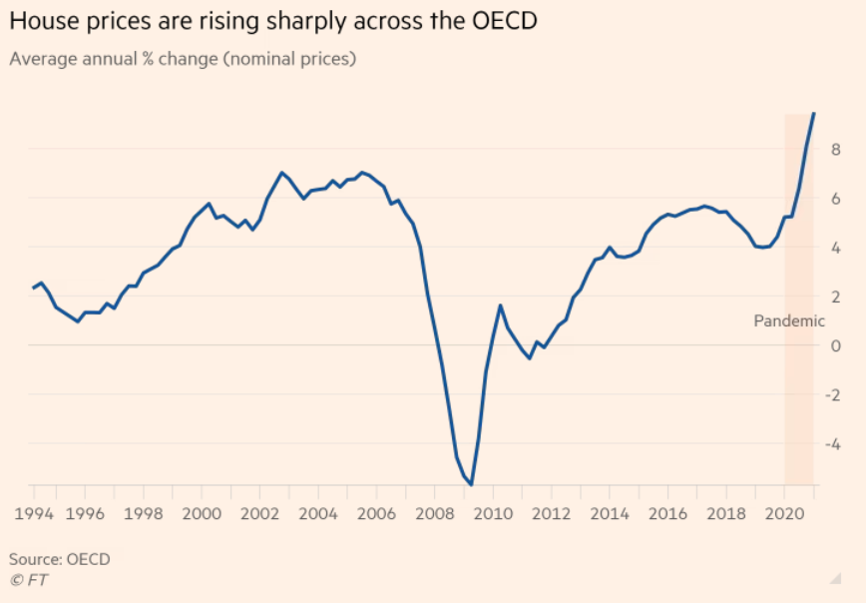
Housing Market Bubble

Slide 16


Slide 17
Consequences of House Bubble
Deterioration of financial institutions’ balance sheets:
  Write downs
  Sell of assets and credit restriction
High-profile firms fail:
  Bear Stearns (March 2008)
  Fannie Mae and Freddie Mac (July 2008)
  Lehman Brothers, Merrill Lynch, AIG, Reserve Primary Fund (mutual fund) and Washington Mutual (September 2008)
  Federal intervention and bail-outs.

Slide 18
Spread of the Financial Crisis
Financial crisis quickly spread to real economy.
Perceived credit risk (TED spread) increased from 40 basis points to almost 240 in August 2007.
Housing markets suffered, resulting in evictions and foreclosures.
US Household wealth fell $11 trillion by the beginning of 2009 (squeezing middle class in particular), resulting in a decline in consumption, and business investment.
Several businesses failed, with 8.4% decline in real GDP, and with US unemployment peaking at 11% at the end of 2009.

Slide 19
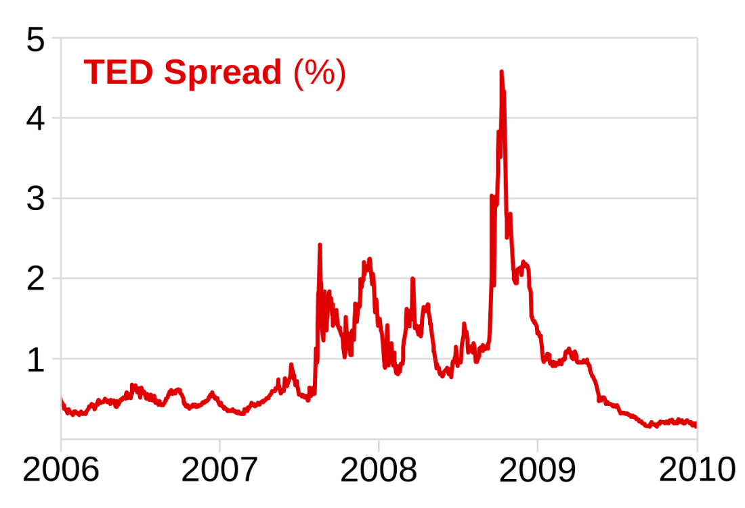
TED Credit Risk

Slide 20
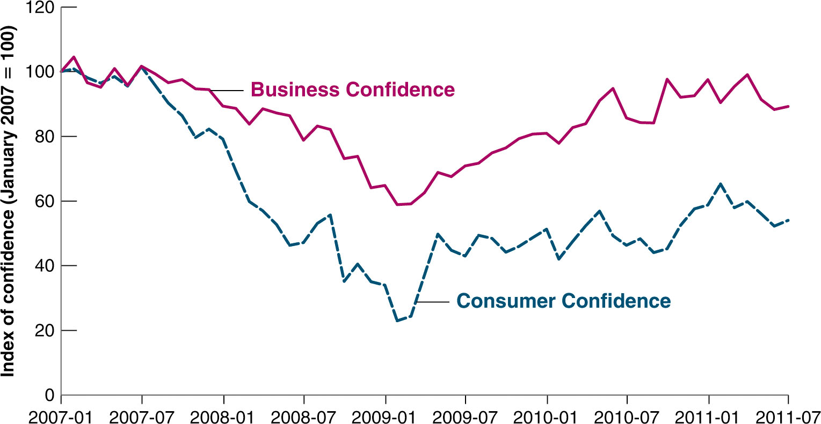
US Consumer and Business Confidence

Slide 21
Spread of the Financial Crisis
Financial crisis spreads globally very quickly:
  Sign of the globalization of financial markets;
  Toxic securities were owned by corporate and institutional investors globally;
  Northern Rock (UK), DB (Germany), BNP (France), etc.
Also economic crisis spread to the rest of the world:
  US consumption accounted for more than 1/3 growth in global consumption;
  Frozen credit markets accelerated solvency crisis;
  All of these resulted in sharp decrease in international trade;
  Impact on commodity prices, investment and unemployment.

Slide 22
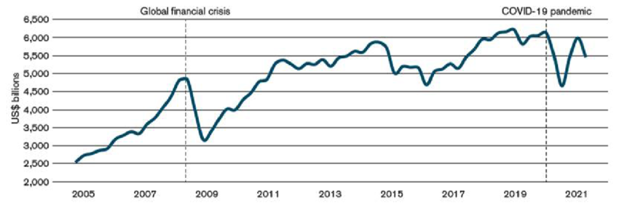
International Trade

Slide 23
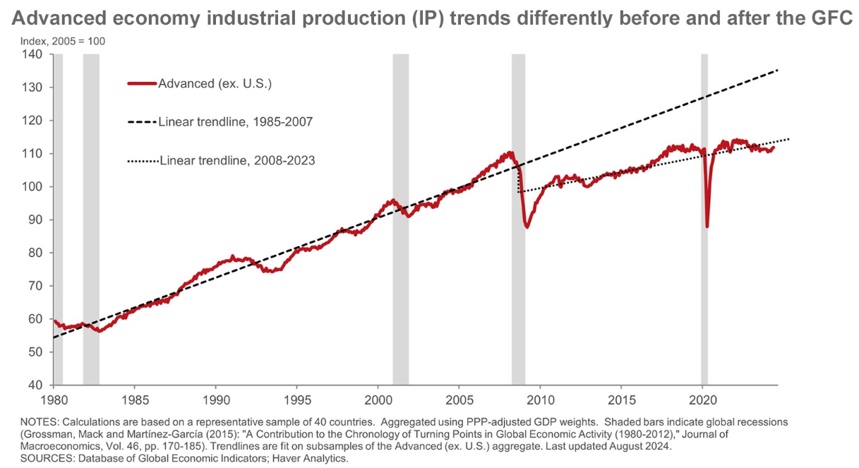
Industrial Production

Slide 24
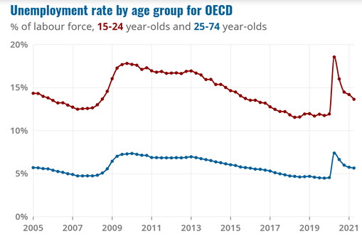
Unemployment Rate

Slide 25
Policy Response - Regulation
From macroprudential to microprudential supervision.
Approaches to solving the too-big-to-fail problem:
  Break up large financial institutions
  Higher capital requirements
Dodd-Frank Wall Street Reform and Consumer Protection Act of 2010:
  Consumer protection
  Resolution authority
  Systemic risk regulation
  Volcker Rule
  Derivatives
Basel III regulations for banks in EU: increased capital ratios, limits on leverage, liquidity requirements.
Remaining issues to tackle:
  Compensation in the financial sector
  Government-sponsored enterprises (GSEs)
  Reform of credit-rating agencies

Slide 26
Policy Response - Fiscal
Due to governments and central banks intervention, the Great Recession was far smaller in magnitude than the Great Depression.
In the short run, several bailout packages debated.
House of Representatives voted down the $700 billion bailout package on September 29, 2008: it passed on October 3, 2008.
The Troubled Asset Relief Program (TARP) authorized the Treasury to purchase subprime mortgage assets from troubled financial institutions and inject capital.
Medium term congress approved a $787 billion economic stimulus plan (5.7% GDP) on February 13, 2009.
Similar fiscal measures in the EU, accounting from 0.2% GDP in Italy to 5.5% in Portugal.

Slide 27
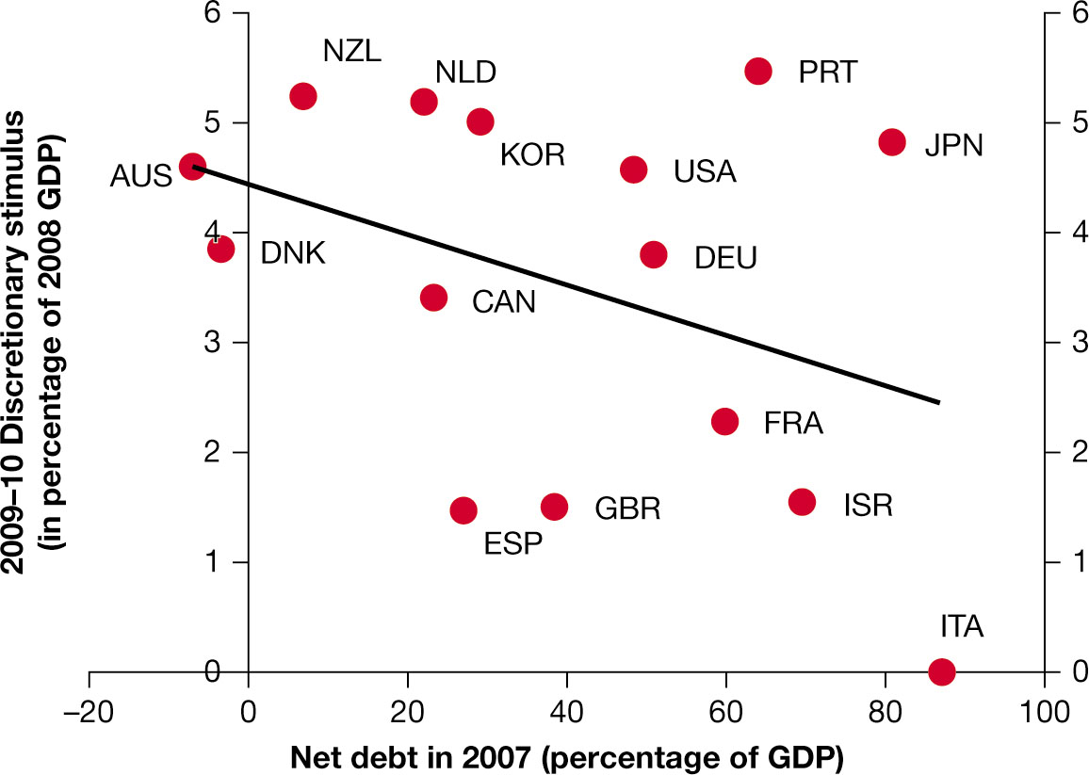
Policy Response - Fiscal

Slide 28
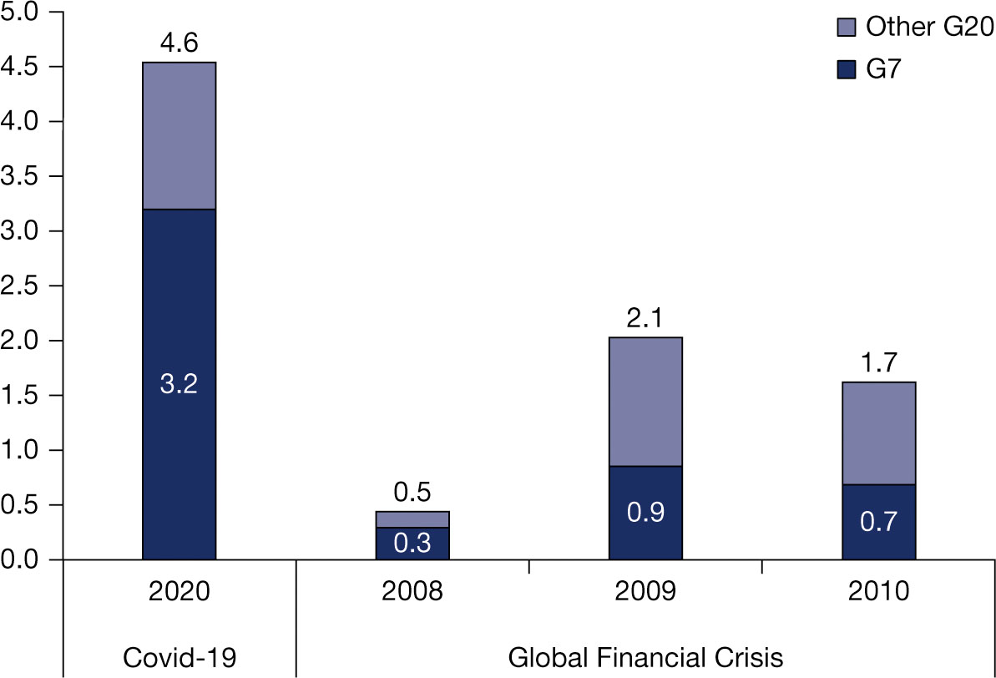
Policy Response - Fiscal

Slide 29
Policy Response - Monetary
Monetary policy aimed at stabilizing financial system, restoring liquidity, and promoting economic recovery.
Conventional Monetary Policy
  Interest Rates: US Federal Reserve (and other central banks) interest rate from 5.25% in mid-2007 to a range of 0% to 0.25% by December 2008 to stimulate economic activity.
Unconventional Monetary Policy
  Quantitative Easing (QE): purchasing of large quantities of government bonds and mortgage-backed securities (MBS) to increase money supply and lower long-term interest rates.
  Forward Guidance: assure markets and investors to stabilize expectations and provided businesses and households with a clearer outlook (e.g. Draghi’s “Whatever it takes”).
  Lending Facilities and Liquidity Support: emergency lending facilities to provide liquidity to financial institutions.
  Global Coordination: in particular regarding changes in interest rates and stabilizing exchange rates.

Slide 30
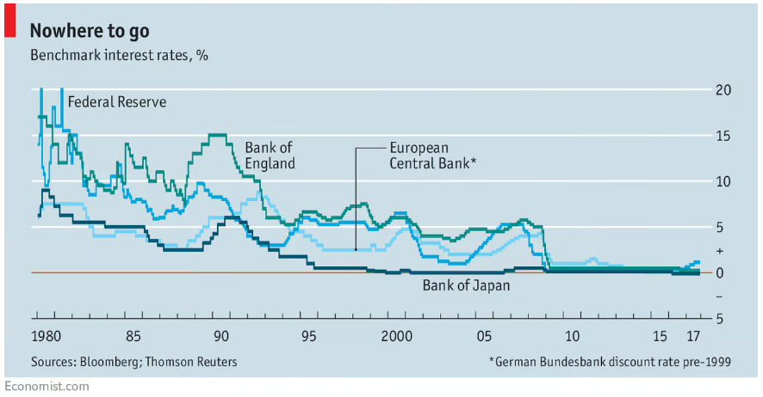
Policy Response - Monetary

Slide 31
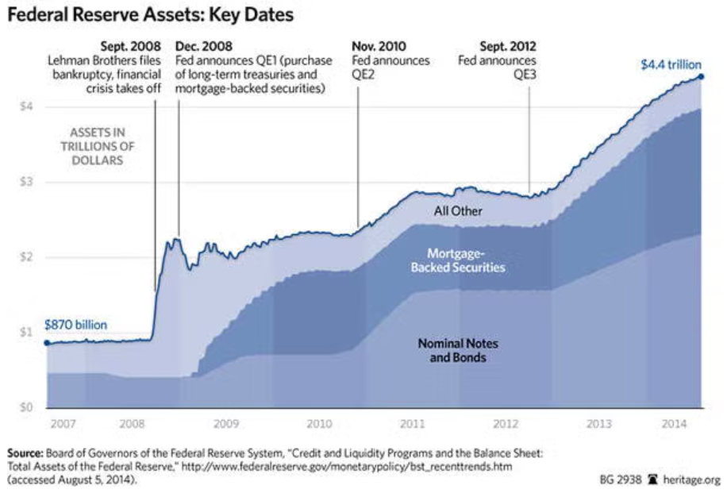
Policy Response - Monetary

Slide 32
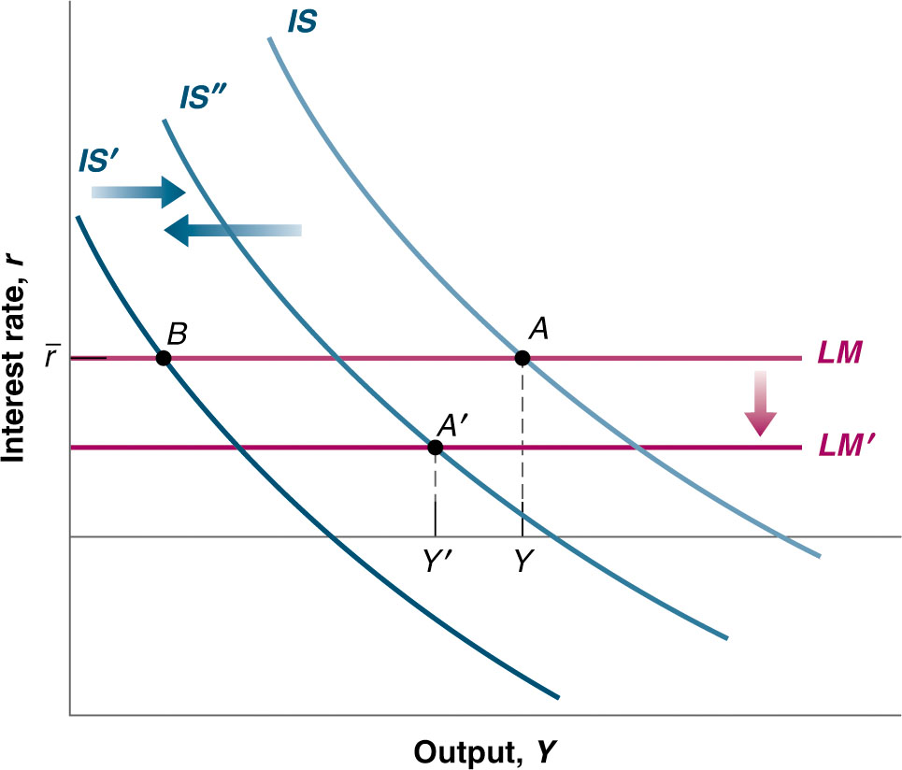
Financial Crisis in IS-LM model
0

Slide 33
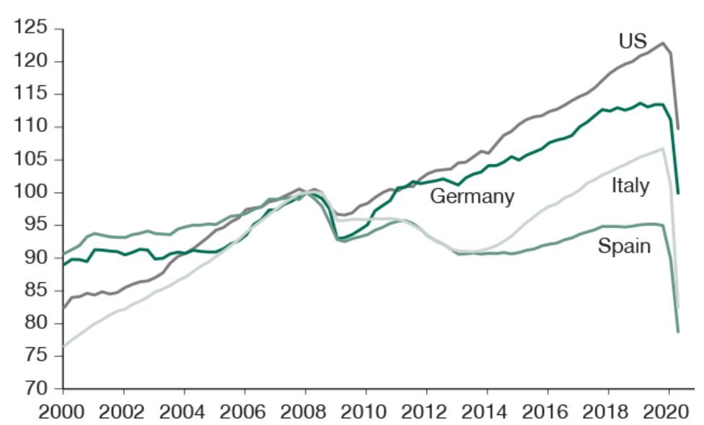
Economic Recovery post Financial Crisis

Slide 34
European Sovereign Debt Crisis
Increase in budget deficits and lower output following the financial crash put under pressure many EU countries.
Particularly those with high debt-to-GDP ratios and weak financial systems (Greece, Italy, Portugal, Ireland, and Spain).
Exacerbated by Eurozone structural issues: same monetary policy, different fiscal policies.
Originated before financial crisis, with over-borrowing thanks to low interest rates due to being part of Eurozone -> increase in spending without corresponding economic growth.
Key Events:
  Greece’s Debt Revelation (2009-2010) and contagion effect.
  EU and IMF Bailouts conditional on Austerity Measures.
  ECB intervention with massive QE and forward guidance.

Slide 35
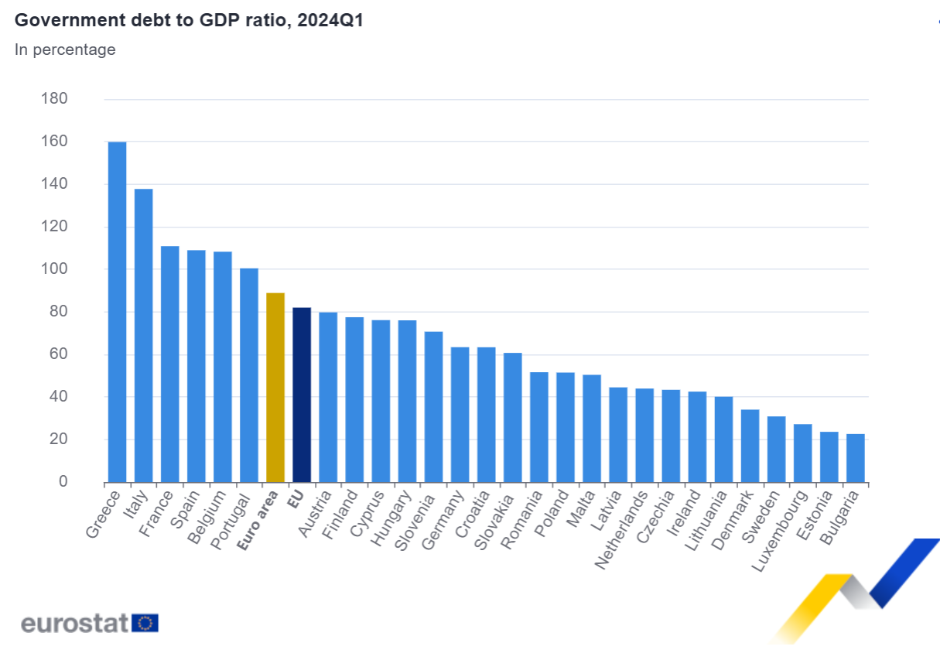
European Sovereign Debt Crisis

Slide 36
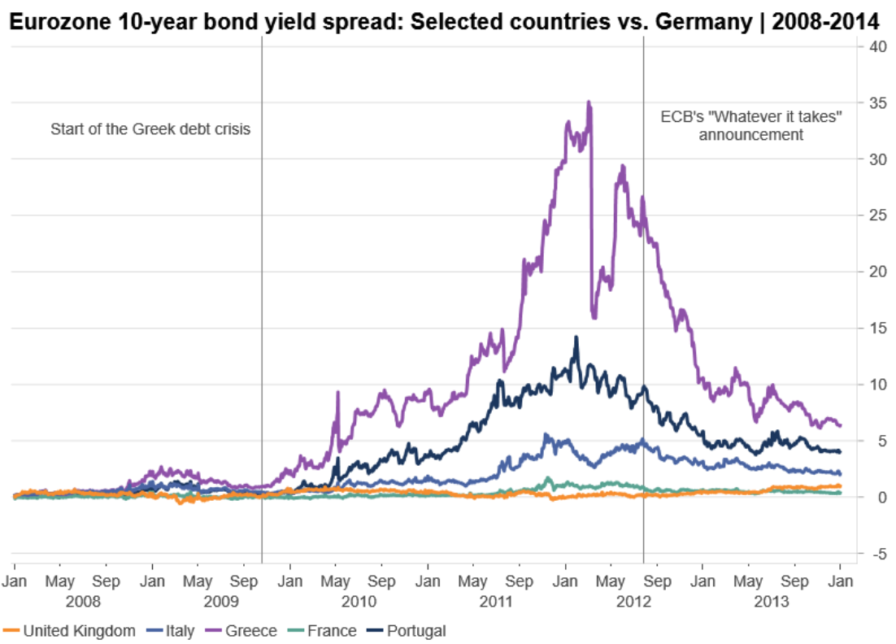
European Sovereign Debt Crisis

Slide 37
European Sovereign Debt Crisis
Economic contraction and high unemployment particularly among the youth (more than 50% in Greece and Spain).
Austerity measures sparked protests leading to the rise of populist and Eurosceptic parties.
Changes in Eurozone Policy: European Stability Mechanism (ESM), Fiscal Compact, better fiscal coordination.
Slow and uneven recovery, still with lower levels of households wealth in some countries and high legacy debt.
Different fiscal policy approach for COVID-19 crisis.

