Slide 1

Economic Geography
5 – Industry in a globalized World
121EC
A.Y. 2025/2026
Dr. Giuseppe Borruso
Department of Economics, Business, Mathematics and Statistics
University of Trieste
E-mail. giuseppe.borruso@econ.units.it
Ph. +39 040 558 7008
Skype: giuseppe.borruso
Notes:
Slides with (*) in footnotes have been modified by Jean-Paul Rodrigue materials. (see copyright). I have modified and elaborated materials in order to be suitable for the current course.
Copyright © 1998-2010, Dr. Jean-Paul Rodrigue, Dept. of Global Studies & Geography, Hofstra University. For personal or classroom use ONLY.

Slide 2
Learning Objectives
In this lesson we will:
  Introduce Wallerstein’s World System Theory;
  Present the maps of Core, Semi-periphery, Periphery;
  Introduce Dicken’s Global Production Networks;
  ‘Globalizing’ regional development: a global production networks perspective

Slide 3
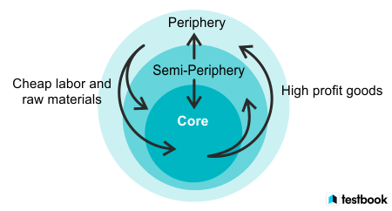
Wallerstein’s World System Theory
A multidisciplinary approach to world history and social change which emphasizes the world-system (and not nation states) as the primary (but not exclusive) unit of social analysis.
The "world-system" refers to the inter-regional and transnational division of labor, which divides the world into core countries, semi-periphery countries, and periphery countries.
Wallerstein's world systems theory categorizes countries into a global hierarchy of three zones: the core, periphery, and semi-periphery.
  The core countries are dominant, wealthy, and technologically advanced,
  Core countries have higher-skill, capital-intensive industries,
  and the rest of the world has low-skill, labor-intensive industries and extraction of raw materials:
    while the periphery countries are dependent, less industrialized, and provide raw materials and labor;
    the semi-periphery countries are
    in a middle position,
    exploiting the periphery while being exploited by the core.

Slide 4
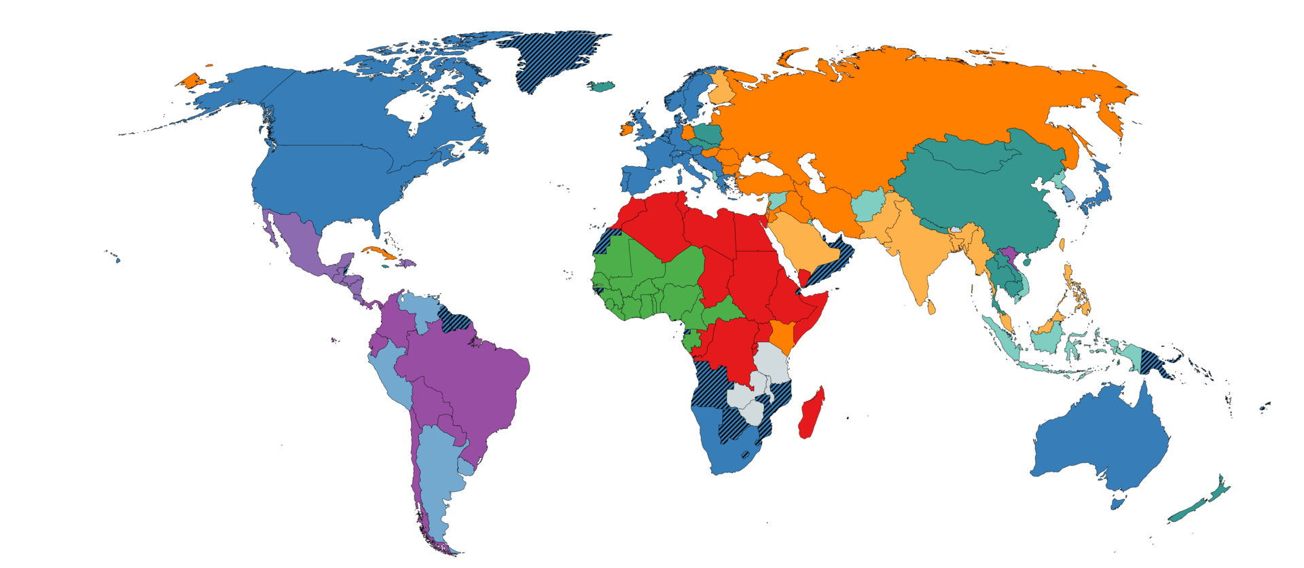
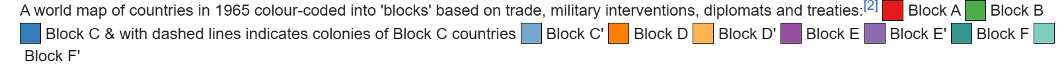
A world map of countries in 1965 colour-coded into 'blocks' based on trade, military interventions, diplomats and treaties
https://en.wikipedia.org/wiki/World-systems_theory#/media/File:World_trade_map_1965.png

Slide 5
Core
Characteristics: Dominant capitalist countries with high levels of industrialization, high wages, and advanced technology.
Role: Exploit peripheral countries for labor and raw materials, controlling capital and trade.
Examples: The United States, Japan, and Germany

Slide 6
Periphery
Characteristics: Dependent on core countries for capital, less industrialized, often agrarian, and have lower literacy rates.
Role: Provide cheap labor and raw materials to the core countries.
Examples: Many African countries and low-income countries in South America.

Slide 7
Semi-periphery
Characteristics: Share characteristics of both core and peripheral countries; they have some industrialization but are less developed than core nations.
Role: Act as a buffer zone between the core and periphery. They exploit peripheral countries while also being exploited by core countries.
Examples: South Korea, Taiwan, Mexico, Brazil, India, and South Africa.

Slide 8
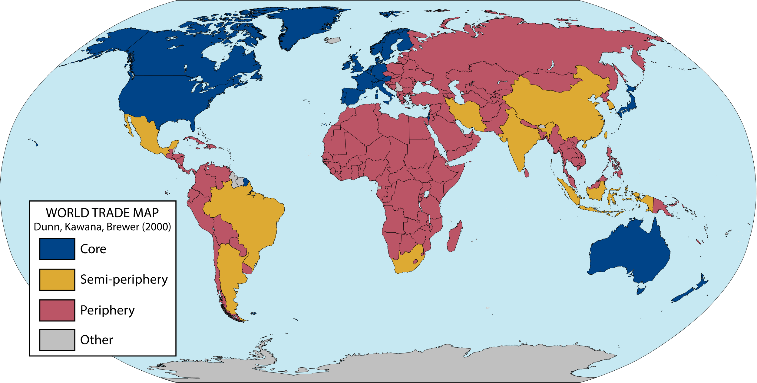
Core / Periphery Division of the World
https://transportgeography.org/contents/chapter2/transport-and-spatial-organization/world-core-periphery/
By Vladusty - Own work, CC0, https://commons.wikimedia.org/w/index.php?curid=141896621

Slide 9
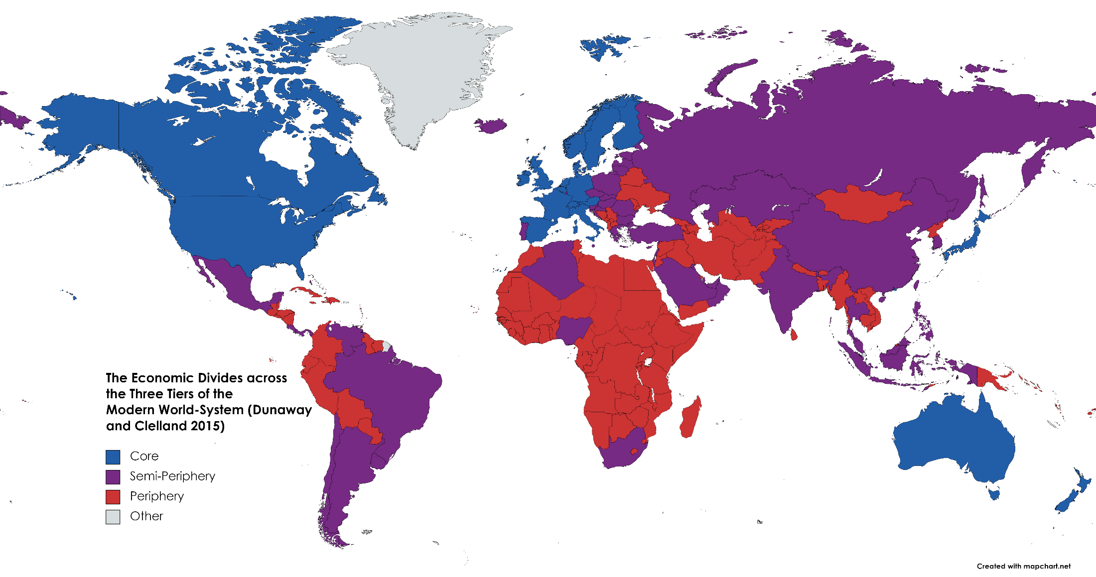

Slide 10
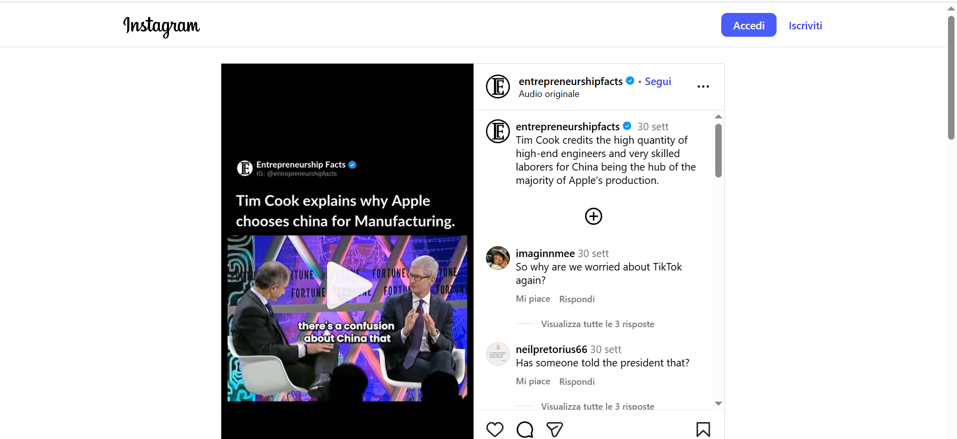
Tim Cook credits the high quantity of high-end engineers and very skilled laborers for China being the hub of the majority of Apple’s production.
https://www.instagram.com/reel/DIRX-YRuFtC/

Slide 11
Dicken’s Global Production Networks
Dicken extends Wallerstein’s concepts with a more detailed firm-level analysis.
Focuses on multinational and transnational corporations, decentralizing manufacturing and coordinating global value chains.
Production activities are frequently delocalized to the Semiperiphery and Periphery, while headquarters and strategic functions remain in the Core.
Emphasizes the networks and relationships (juridical, business, and labor flows) that connect firm activities across zones.

Slide 12
Main Actors of Global Production Networks
Lead Firms: Large multinational enterprises or brands that design, coordinate, and control the production network; they orchestrate the system and capture the most value.
Tiered Suppliers:
  Tier 1 (Strategic partners): Provide full-package services and close collaboration.
  Tier 2 (Specialized suppliers): Offer specialized components or services.
  Tier 3 (Generic suppliers): Provide basic, widely available parts or services.
Intermediaries: Firms or organizations overseeing finance, logistics, or industry standards and certifications.
Customers: Buyers, retailers, or end-users of the final products.
Non-firm Actors: Governments, international organizations, NGOs, labor unions, and consumer associations, influencing regulation, labor conditions, and standards.

Slide 13
‘Globalizing’ regional development: a global production networks perspective
Coe, N.M., Hess, M., Yeung, H.W., Dicken, P., & Henderson, J.W. (2004). ‘Globalizing’ regional development: a global production networks perspective. Transactions of the Institute of British Geographers, 29, 468-484.
Recent literature concerning regional development has placed significant emphasis on local institutional structures and their capacity to ‘hold down’ the global. Conversely, work on inter-firm networks – such as the global commodity chain approach – has highlighted the significance of the organizational structures of global firms’ production systems and their relation to industrial upgrading. In this paper, drawing upon a global production networks perspective, we conceptualize the connections between ‘globalizing’ processes, as embodied in the production networks of transnational corporations, and regional development in specific territorial formations. We delimit the ‘strategic coupling’ of the global production networks of firms and regional economies which ultimately drives regional development through the processes of value creation, enhancement and capture. In doing so, we stress the multi-scalarity of the forces and processes underlying regional development, and thus do not privilege one particular geographical scale. By way of illustration, we introduce an example drawn from recent research into global production networks in East Asia and Europe. The example profiles the investments of car manufacturer BMW in Eastern Bavaria, Germany and Rayong, Thailand, and considers their implications for regional development.
https://doi.org/10.1111/J.0020-2754.2004.00142.X

Slide 14
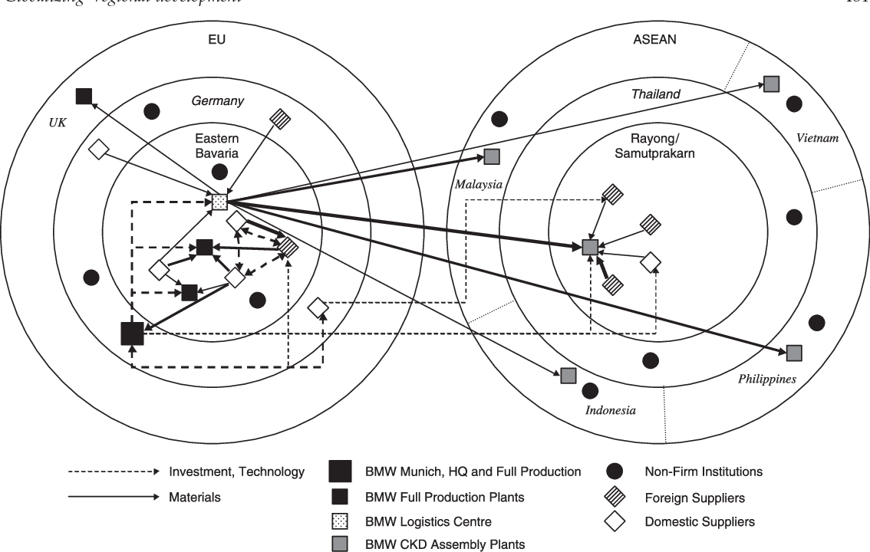
Figure 3 BMW’s GPN and regions in the EU and ASEAN
Coe, N.M., Hess, M., Yeung, H.W., Dicken, P., & Henderson, J.W. (2004). ‘Globalizing’ regional development: a global production networks perspective. Transactions of the Institute of British Geographers, 29, 468-484.

