Slide 1

Sustainable Cities 3 – The urban lifecycle and the urban crisis
659EC
A.Y. 2025/2026
Dr. Giuseppe Borruso
Department of Economics, Business, Mathematics and Statistics
University of Trieste
E-mail. giuseppe.borruso@deams.units.it
Ph. +39 040 558 7008
Notes:
Slides with (*) in footnotes have been modified by Jean-Paul Rodrigue materials concerning “Transportation Geography”. Slides with (*) in footnotes are referred to “Transport and the Urban Environment” materials (see copyright). I have modified and elaborated materials in order to be suitable for the current course.
For references visit http://people.hofstra.edu/geotrans
Copyright © 1998-2010, Dr. Jean-Paul Rodrigue, Dept. of Global Studies & Geography, Hofstra University. For personal or classroom use ONLY.

Slide 2
Topics
World urban population
Cities: a definition
Transport, urban form and spatial structure
The analysis of urban structure
The bid rent and the models of urban structure
The global model
The urban density
The urban crisis and the urban lifecycle
Case study: the Megalopolis

Slide 3
The urban crisis and the urban lifecycle

Slide 4
The urban crisis (?)
Urban and urbanization
Urban: city = way of living, thinking, working, building the environment, etc.
Urban: concentration and high density
Urbanization = spreading of urban life model to those parts of the geographical space that do not present the physical characters of urban (concentration and high density)
Urbanization => ‘trivialization’ of some urban functions, extended to the entire population
New urbanized geographical spaces : periurban or rururban

Slide 5
The urban crisis (?)
Counter-urbanization (Berry): “a process of de-concentration of urban population implying the passage from a higher concentration state to a minor concentration one”
End of ’60 – end of ’80
Fielding (1989): counter-urbanization = ratio of inverse proportion between index of migration variation and urban demographic dimension

Slide 6
The urban crisis (?)
Core ring agglomeration
+ +- -
- + +
- - -
+ - +-
Cities’ life cicle
Core (central city; inner city)
Ring (surrounding suburban municipalities)
Stages:
Urbanization
Suburbanization
Deurbanization
Reurbanization

Slide 7
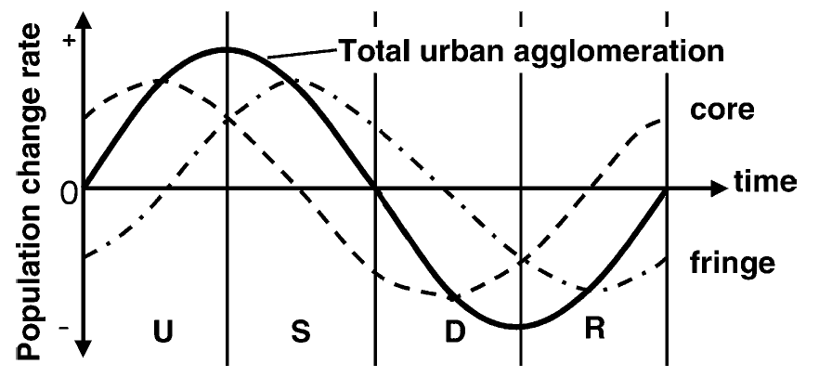
Urban life cycle (Van den Berg et al., 1982; Paddison, 2001)
Urbanization
Sub - urbanization
dis - urbanization
re - urbanization
Stages of development

Slide 8
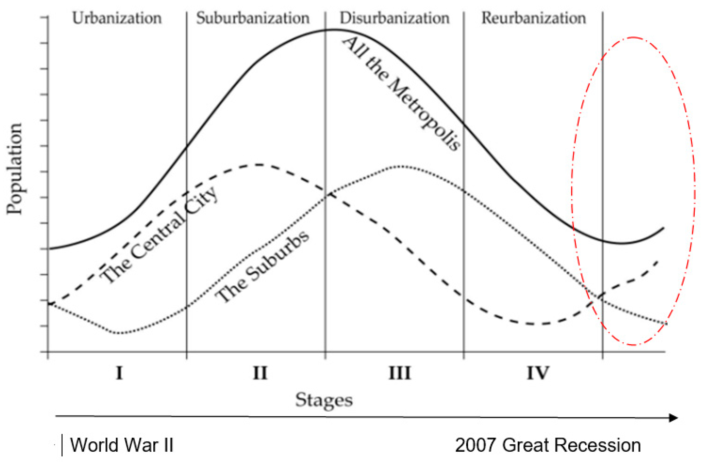
Figure 1. A general scheme of the ‘City Life Cycle’ covering the time interval between World War II and nowadays: the ellipse indicates the most recent urban dynamics; the arrow indicates time. Cividino, S.; Halbac-Cotoara-Zamfir, R.; Salvati, L. Revisiting the “City Life Cycle”: Global Urbanization and Implications for Regional Development. Sustainability 2020, 12, 1151. https://doi.org/10.3390/su12031151 https://www.mdpi.com/2071-1050/12/3/1151

Slide 9
Cities as innovation poles in the digital transition. The Italian case
Giuseppe Borruso ¹ and Ginevra Balletto ^{2,}*
¹ University of Trieste, DEAMS - Department of Economics, Business, Mathematics and Statistics “Bruno de Finetti”, via A. Valerio 4/1, 34127, Trieste, Italy
² University of Cagliari, DICAAR - Department of Civil, Environmental Engineering and Architecture, Via Marengo 2, 09123, Cagliari, Italy
https://www.aimspress.com/article/doi/10.3934/geosci.2024043

Slide 10
Cities as innovation poles in the digital transition. The Italian case
The research aimed to analyze recent urban population dynamics in Italy's main metropolitan and mid-sized innovative cities, focusing on the period 2019–2023.
It explored the impact of depopulation, population aging, and urban sprawl on Italian cities, particularly through the lens of metropolitan and functional urban areas.
The study examined innovation in cities using the 2019 Italian ICity Rank index, linking innovation levels with population trends to assess how innovation might counteract demographic decline.
The research sought to understand urban dynamics within the framework of the urban life cycle model and Florida’s "New Urban Crisis," applying spatial analytical methods such as LISA (Local Moran's I).
It aimed to identify urban "champions," cities that effectively attract people and expertise, contributing to population stability or growth in suburban and some core areas.
The findings intend to support the development of targeted urban policies to address demographic challenges through investments in innovation and population support.aimspress​

Slide 11
Figure 2. a) Administrative divisions: regions and metropolitan cities and provinces; b) regions, metropolitan cities, and their capital municipalities. Source: our elaborations from ISTAT (2023).

Slide 12
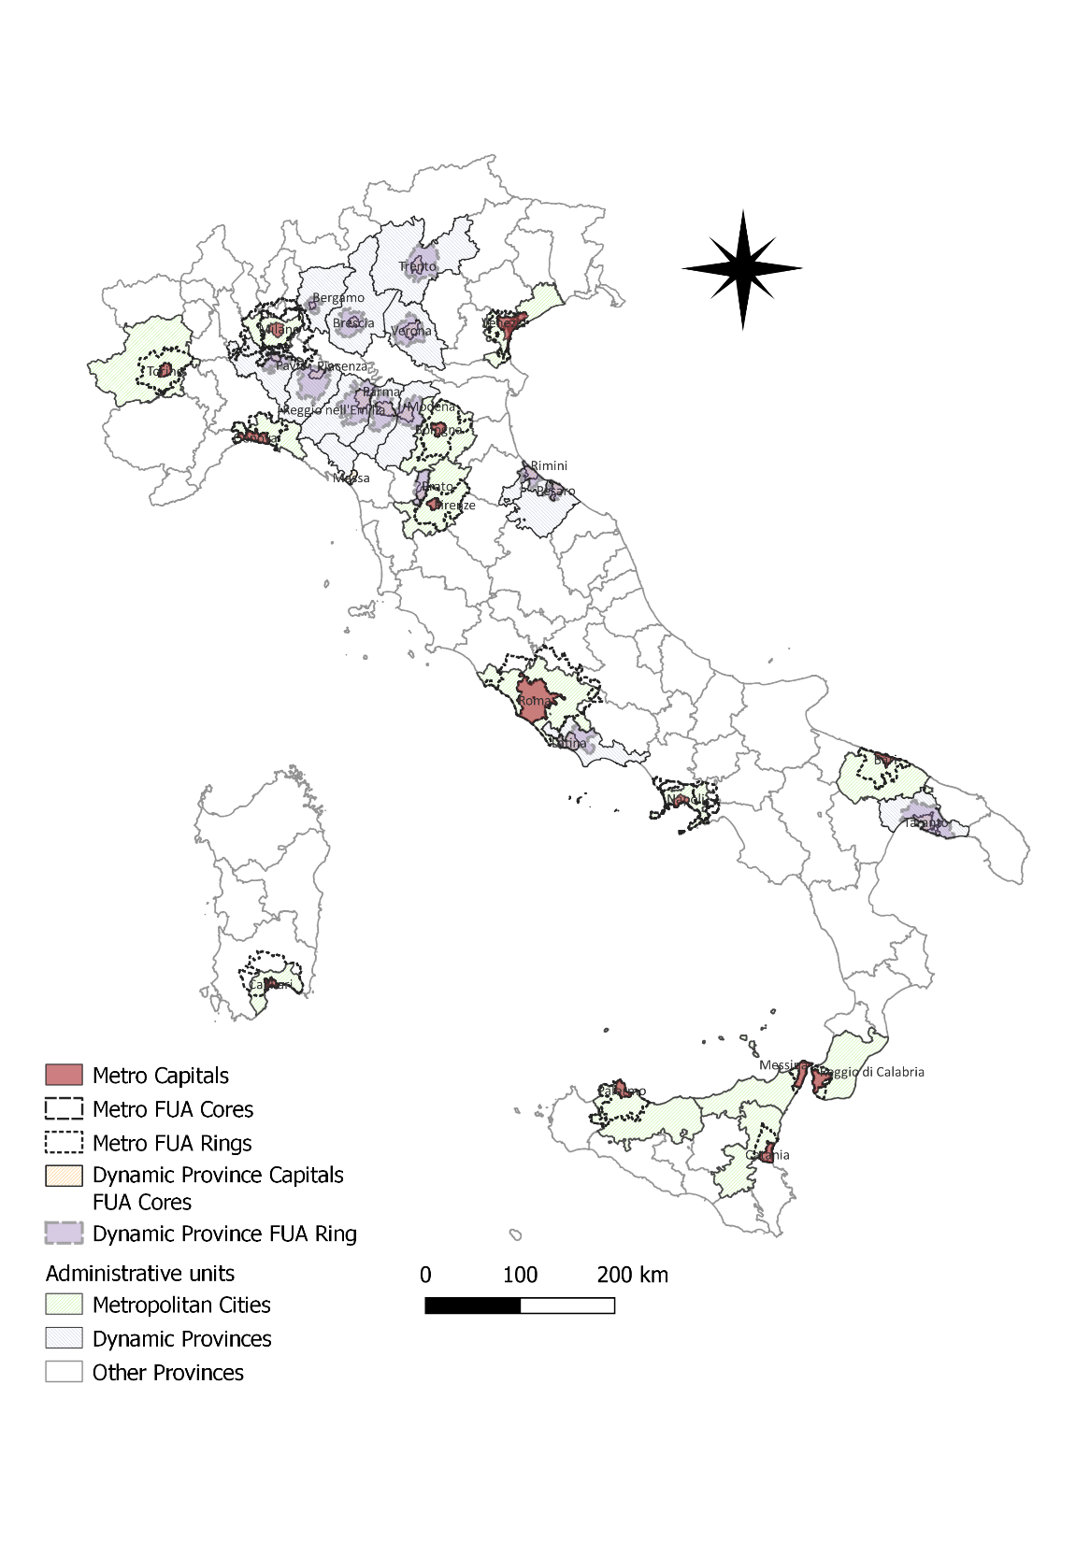
Figure 3. a) FUAs: metropolitan cities and their FUAs; b) metropolitan cities’ FUAs and their municipalities. Source: our elaborations from ISTAT, OECD (2023), and Copernicus Data.

Slide 13
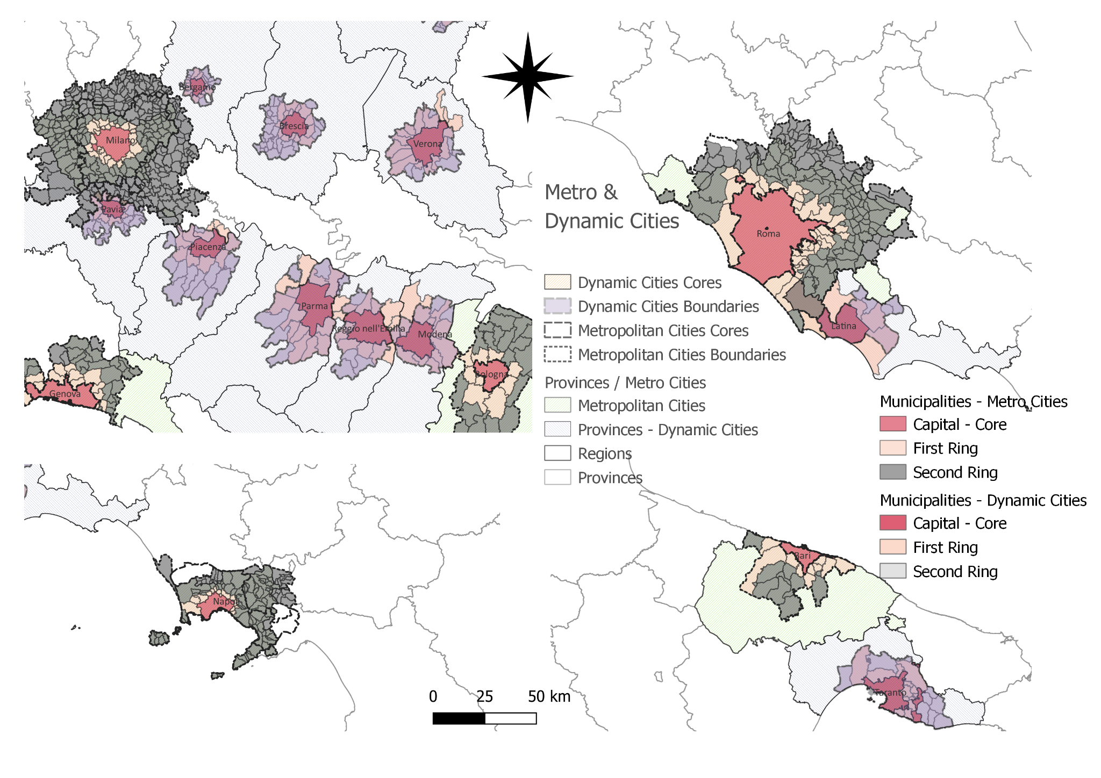
Figure 4. Overview of a selected set of metropolitan cities and their FUAs. From left to right, upper corner to lower corner: Milan, Po Valley Megalopolis; Rome, Latina; Naples, Bari-Taranto. Source: our elaboration on ISTAT, OECD, and Copernicus data.

Slide 14
Table 4. Metropolitan cities and areas. Population changes from 2019 to 2023 (based on municipalities data; positive values in green).
Metro city name | Metro city | Capital city | 1st ring | 2nd ring | FUA core | FUA ring | FUA total
Torino | −1.52 | −1.56 | −1.75 | −0.77 | −1.56 | −1.23 | −1.39
Genova | −1.75 | −1.40 | −3.17 | −3.41 | −1.40 | −3.29 | −1.74
Milano | −0.68 | −2.69 | 0.66 | 0.74 | −0.66 | 0.62 | −0.20
Venezia | −1.78 | −3.48 | −0.38 | −1.23 | −3.48 | −0.61 | −2.08
Bologna | −0.34 | −1.03 | 0.46 | 0.93 | −1.03 | 0.70 | −0.20
Firenze | −1.08 | −1.93 | −0.24 | −0.84 | −1.93 | −0.53 | −1.22
Roma | −0.86 | −2.30 | 2.79 | 1.42 | −2.30 | 2.08 | −0.77
Napoli | −2.23 | −3.86 | −1.42 | −1.20 | −2.25 | −1.27 | −1.99
Bari | −0.81 | 0.08 | −1.33 | −1.16 | 0.08 | −1.26 | −0.68
Reggio di Calabria | −3.32 | −2.90 | −4.71 | −6.14 | −2.90 | −4.78 | −3.22
Palermo | −2.23 | −3.10 | 1.48 | 0.21 | −3.10 | 0.68 | −1.77
Messina | −3.00 | −4.31 | −2.67 | −3.51 | −4.31 | −2.97 | −4.14
Catania | −0.26 | 0.66 | 0.62 | 2.43 | 0.66 | 1.30 | 1.00
Cagliari | −0.88 | −2.12 | −0.40 | −1.14 | −2.12 | −0.67 | −1.12
Source: our elaborations from ISTAT Data (2024) and OECD Data (2022).

Slide 15
Table 5. Dynamic cities and areas. Population changes from 2019 to 2023 (based on municipalities data; positive values in green). Source: our elaborations from ISTAT Data (2024) and OECD Data (2022).
Province city name | Province | Capital city/FUA core | 1st ring | 2nd ring | Total capital + rings | FUA ring | FUA total
Bergamo | -0.08 | −0.63 | 0.39 | -0.29 | -0.17 | 0.12 | -0.17
Brescia | 0.23 | 0.56 | -0.14 | 0.79 | 0.43 | 0.33 | 0.43
Pavia | -0.98 | -1.44 | 0.61 | 0.05 | -0.55 | 0.34 | -0.56
Trento | -0.13 | -1.12 | 1.07 | 1.33 | 0.05 | 1.2 | 0.05
Verona | 0.3 | -0.98 | 0.52 | 2.24 | -0.05 | 0.85 | -0.05
Piacenza | -0.71 | −1.13 | -0.21 | −0.4 | -0.72 | -0.3 | -0.72
Parma | -0.18 | −0.8 | 1.44 | -0.94 | -0.05 | 0.91 | -0.05
Reggio Emilia | -0.56 | -0.26 | -0.32 | 1.17 | -0.19 | -0.13 | -0.19
Modena | -0.34 | -2.21 | 0.16 | 1.82 | -0.83 | 0.25 | -0.84
Pesaro | -1.72 | −0.96 | -0.94 | -0.31 | -0.92 | -0.87 | -0.93
Prato | 1.06 | 1.34 | 1.31 | -0.25 | 0.99 | 0.2 | 0.9
Latina | 0.66 | 0.6 | 1.46 | -3.71 | 0.98 | 1.22 | 0.96
Taranto | -2.04 | -2.32 | -2.19 | -1.64 | -2.14 | -1.99 | -2.19
Rimini | -0.03 | 0.47 | -0.19 | -0.69 | 0.17 | -0.22 | 0.17

Slide 16
Table 6. Urbanization, urban life cycle, and Italian metropolitan cities and areas (2019–2023). Source: our elaborations from ISTAT Data (2024) and OECD Data (2022) and [7].
Stage | Sub-stage | Core | Ring | Agglomeration | City (Metro in capital letters)
Urbanization | 1) absolute concentration | ++ | - | +
 | 2) relative concentration | ++ | + | +++
Suburbanization | 3) relative deconcentration | + | ++ | +++
 | 4) absolute deconcentration | - | ++ | + | MILAN, BOLOGNA, Trento, Prato
Disurbanization | 5) absolute deconcentration | - - | + | - | ROME, PALERMO, Bergamo, Pavia, Verona, Parma, Modena
 | 6) relative deconcentration | - - | - | - - - | TURIN, VENICE, GENOA, FLORENCE, REGGIO DI CALABRIA, MESSINA, CAGLIARI, Piacenza, Reggio Emilia, Rimini
Reurbanization | 7) relative concentration | - | - - | - - - | Latina
 | 8) absolute concentration | + | - - | - | BARI, CATANIA, Brescia, Taranto

Slide 17
Case study: Megalopolis and Megacities

Slide 18
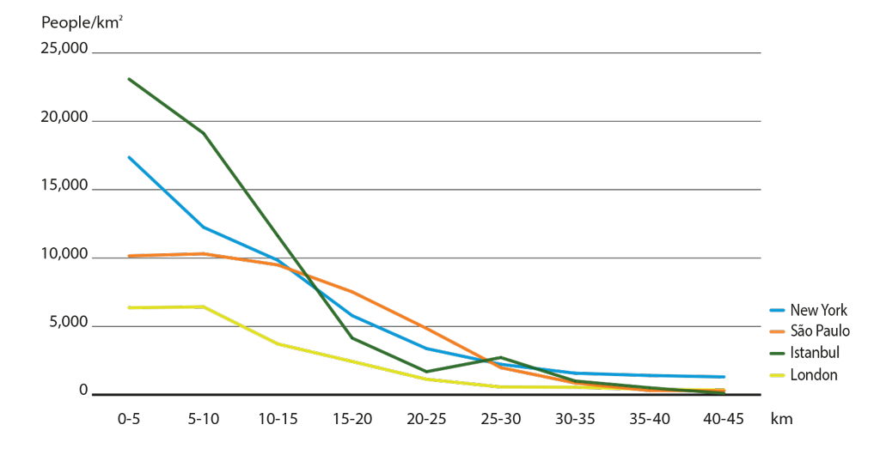
Density levels from the city centre
https://urbanage.lsecities.net/data/density-levels-from-the-city-centre-2009

Slide 19
Evolution of Megalopolis
Megalopolis: conurbation of two or more metropolis (already realized or in formation) originating an urban un continuum, particularly along major transport routes
Gottmann’s term megalopolis to refer to a string of closely interconnected metropolises was logical and inspired and has become part of the language;
BoWash (Boston – Washington) – studied by Gottmann (1961): coastal conurbation showing a trend to full conurbation – although characterized by interstitial areas
Stages:
1950-1970: growth of suburbs: suburbanization;
1970-1990: slowed suburban growth; edge cities, out of town industrial and retail parks; new growth in central areas;
1990-2000: back to the core. Gentrification; preferences (residential, service) for central locations; creative class; immigration, economic restructuring and gentrification => higher level of social and economical inequity. Movement of poor and immigrants towards old suburban internal areas. Growth of suburbs for specialized functions (smart growth), once separated by cities, now incorporated in megalopolis. Suburbs: industry and retail (mall etc.); Centre: selected services and financial activities
It is reasonable to conclude, with Gottmann, that Megalopolis remains the Main street of America, despite the much faster rate and amount of growth in the metropolitan South and West.
Megalopolis (see. map): 42.400.000 people in 2000.
Extra urban area around Megalopolis (commuting area) + 8 millions

Slide 20
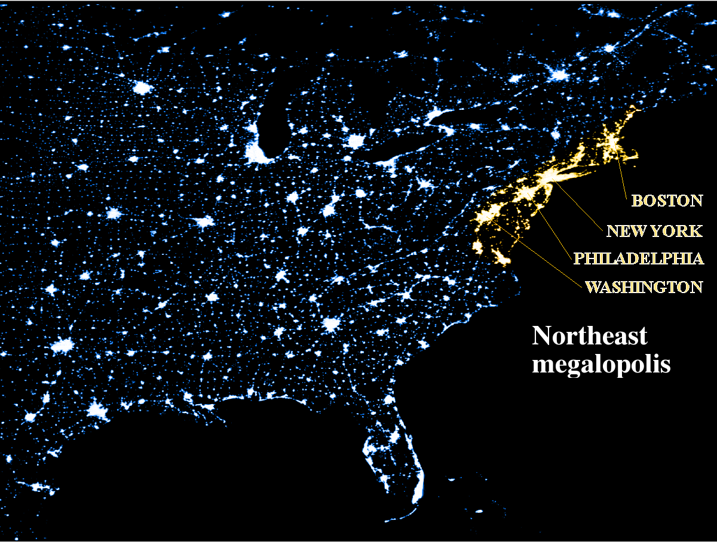

Slide 21
Population and growth of the urbanized area in the Megalopolis (1950 – 2000)
Morrill R., Classic Map Revisited: The Growth of Megalopolis, The Professional Geographer, 58(2) 2006, pages 155–160

Slide 22
Population and growth of the urbanized area in the Megalopolis (1950 – 2000)
Year | Population (millions) | Surface (km2) | Density (Inhabitants/ km2)
1950 | 24,5 | 8.499 | 2.883
1960 | 29,4 | 13.845 | 2.123
1970 | 34 | 18.137 | 1.875
1980 | 34,4 | 21.720 | 1.584
1990 | 36,6 | 26.367 | 1.388
2000 | 42,4 | 34.924 | 1.214
Morrill R., Classic Map Revisited: The Growth of Megalopolis, The Professional Geographer, 58(2) 2006, pages 155–160

Slide 23
Megalopolis
USA:
Chicago – Pittsburg
Santa Barbara – San Diego (30 millions inhab.)
includes Los Angeles, low-density, horizontal metropolis
Japan:
Tokio - Osaka (25 millions inhab.)
Tokio Bay (50 millions inhab.)
China:
Bejing – Tientsin (northern megalopolis)
Hangzhou
With Shangai
Europe:
London – Milan:
Renan Megalopolis; Blue Banana
The “Pentagon”

Slide 24
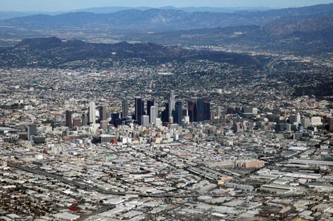
Los Angeles, low-density, horizontal metropolis

Slide 25
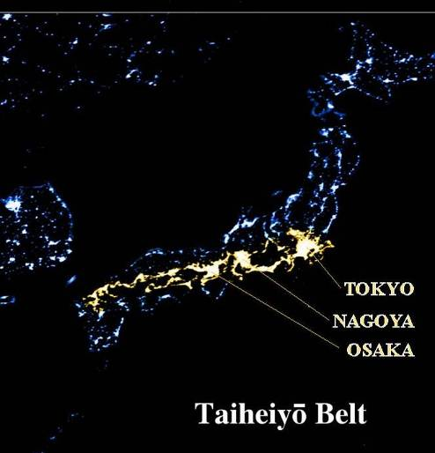
Tokio – Osaka Megalopolis

Slide 26
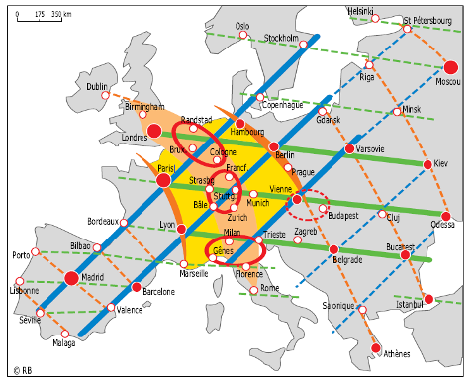
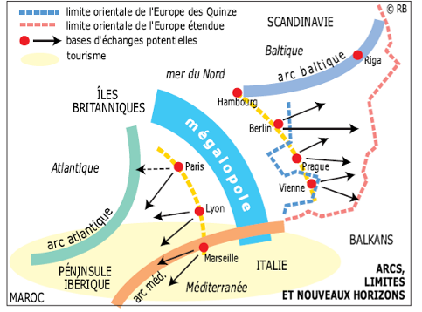
European Treillage and Renan Megalopolis
Brunet R., Lignes de force de l’espace européen, Mappemonde, 66 (2) 2002, pp. 14-19

Slide 27
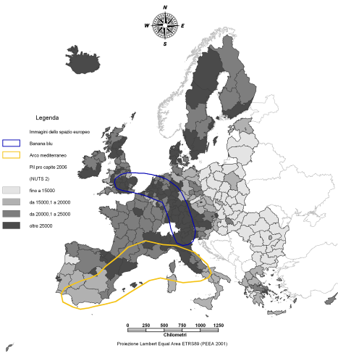
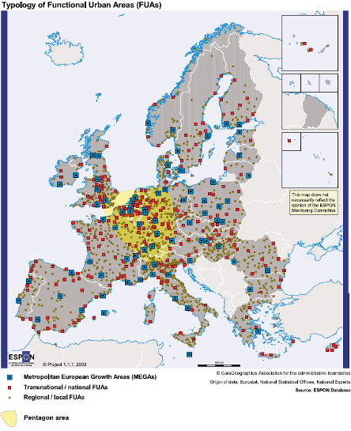
Images of the European space: the “blue banana” and the “pentagon” of cities
https://www.youtube.com/watch?v=Yi-rEL8i46Y
Mediterranean Arch and Blue Banana
Pentagon: London, Paris, Milan, Munchen, Hamburg
14% of Europe - 27 space 32% of urban population 46,5% of EU GDP.

Slide 28
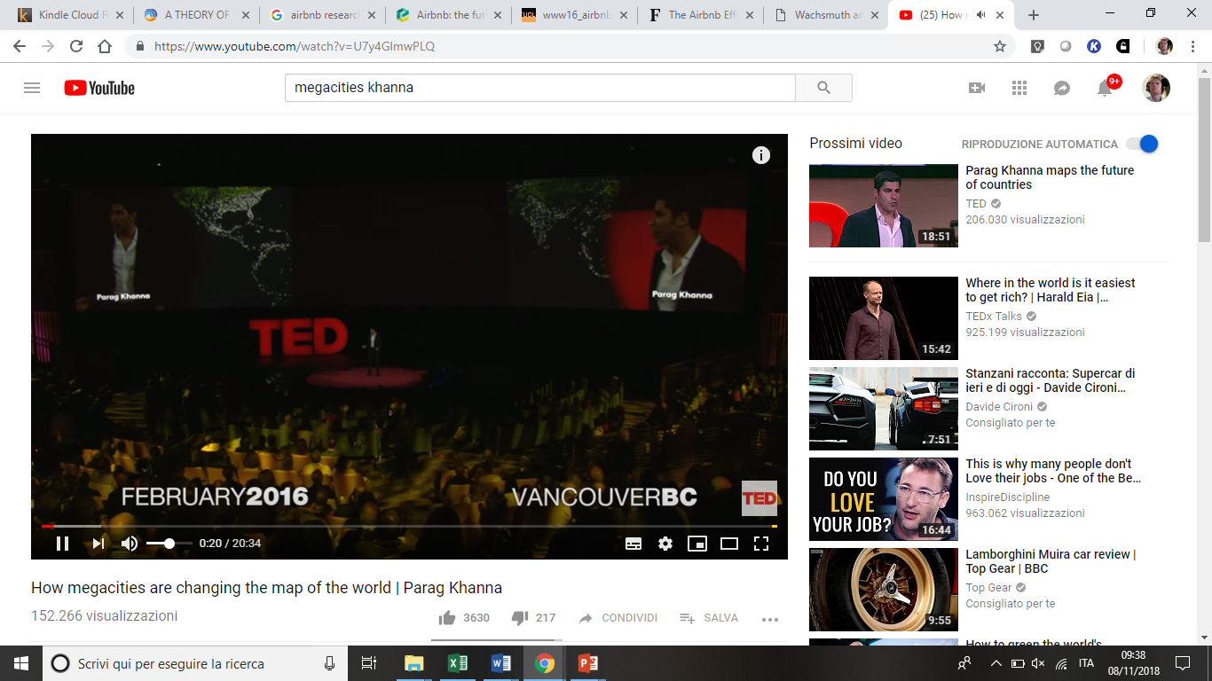
How Megacities are changing the map of the World
https://www.youtube.com/watch?v=U7y4GlmwPLQ

Slide 29
References
Berry B. J. L., Urbanization and Counterurbanization, SAGE, Beverly Hills, 1976
Brunet R., Les ville “européenne” Datar-Reclus-Documentation Francaise, Montpellier, 1989
Brunet R., Lignes de force de l’espace européen, Mappemonde, 66 (2) 2002, pp. 14-19
Camagni R., Economia e pianificazione della città sostenibile, Il Mulino, Bologna, 1996.
De Blij H. J. e Murphy A. B., Geografia umana. Cultura. Cultura, società, spazio, Zanichelli, Bologna, 2002
Dematteis G., Lanza C., Nano F. e Vanolo A., Geografia dell’economia mondiale, quarta edizione, UTET, Torino, 2010 (cap. 3, cap. 10)
Diappi L. e Campeol A., “Sostenibilità urbana: lo sviluppo di un approccio sistemico”, in Diappi L. (a cura di), Sostenibilità Urbana. Dai princìpi ai metodi di analisi - Forma urbana, energia e ambiente , Paravia, Torino, 2000
European Environmental Agency (EEA), Urban sprawl in Europe. The ignored challenge, European Commission, European Environmental Agency (EEA), Luxemburg, 2006. (http://eea.europe.eu)
Gottmann, J. Megalopolis revisited: 25 years later. University of Maryland Institute for Urban Studies, Baltimore, 1987
Gottmann, J., Megalopolis: The urbanized northeastern seaboard of the United States. Twentieth Century Fund, New York, 1961.
Gottmann, J., Megalopolitan systems around the world. Ekistics 243, 1976, pp. 109–13.
Haggett P., Geografia – Volume 1: Geografia umana, Zanichelli, Bologna, 2004 (cap. 5, cap. 11, cap. 12)
Lloyd P. E., DICKEN P., Location in space. A theoretical approach to economic geography, Harper International, New York, 1972.
Haggett P., Geography. A global synthesis, Pearson Education Limited, 2001
Morelli P., Geografia economica, McGraw-Hill, Milano, 2010 (cap. 7, cap. 9)
Morrill R., Classic Map Revisited: The Growth of Megalopolis, The Professional Geographer, 58(2) 2006, pp. 155–160
UN-HABITAT, Annual Report 2009, UNITED NATIONS HUMAN SETTLEMENTS PROGRAMME, Nairobi, 2010 (http://www.unhabitat.org)
Rodrigue J. P., Comtois C., Slack B., Geography of Transport Systems, Second Edition, Routdledge, 2010

Slide 30
https://www.facebook.com/events/495804477473216/
https://www.ted.com/talks/parag_khanna_how_megacities_are_changing_the_map_of_the_world?language=en

