Slide 1
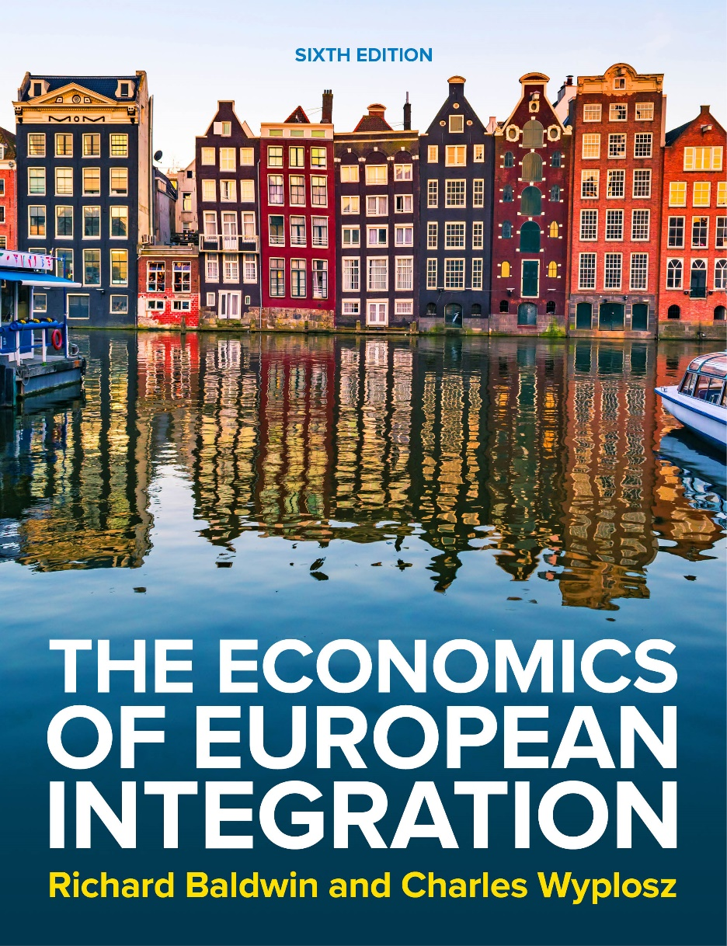
Chapter 15
Optimum currency areas
The Economics of European Integration, Sixth Edition

Slide 2
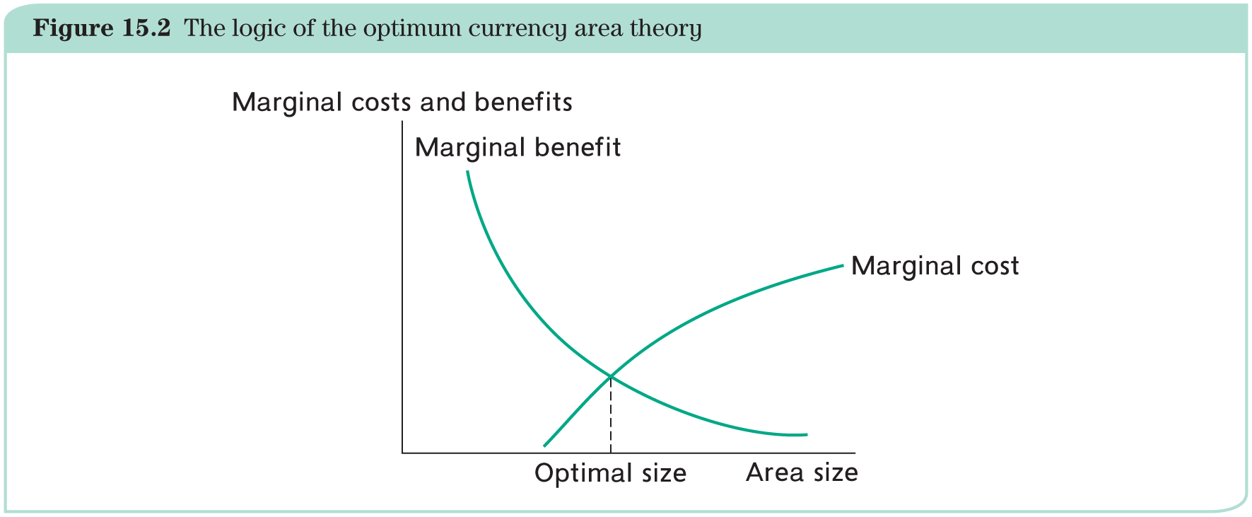
The question, the problem and the short answer
Should currency area borders coincide with national borders?
Money makes transactions immensely easier: the more people accept a currency, the more useful it is;
as a currency area grows larger, it becomes more diverse, which means more costly.
The solution has to involve trading off these costs and benefits (at the margin):

Slide 3
Benefits of a currency area
(1) Elimination of transaction costs:
  If you started with one EU currency and exchanged it successively in all the currencies of the EU (before the Euro) and then exchanged it back into the initial currency, you would get less than 50% of the initial amount!
Price transparency
  Prices become directly comparable across countries and intensified competition;
  transparency and competition also affect wage-setting.
(3) Uncertainty
  Elimination of exchange rate risk (for trade transactions and FDI) = less uncertainty.
Intensified trade
Common currency eliminates a number of barriers (thanks to increased competition)
(5) Quality of monetary policy
More independent central bank and better quality of monetary policy.

Slide 4
Costs of a currency area
Diversity in a currency area is costly because a common currency makes it impossible to react to each and every local particularity.
The theory of optimum currency areas (OCA) aims at identifying these costs more precisely.
We proceed in four steps:
1. provide some theory background;
2. define and examine the effects of asymmetric shocks;
3. study the problems of asymmetric shocks in a currency area;
4. examine how the effects of asymmetric shocks can be mitigated when national exchange rates are no longer available.

Slide 5
Shocks and the exchange rate
Consider an adverse (external) demand shock:
Starting from point A, the decline in the foreign demand for our goods is captured by the leftward shift of the demand curve from D₁ to D₂. (see next slide)
Eventually, the economy will move to point B.
This will be the case if
  the nominal exchange rate were allowed to depreciate to enhance competitiveness through a real depreciation (EP/P* declines with E);
  or if prices were flexible (EP/P* declines with P).
But the latter adjustment through declining prices (and wages) is likely to be the outcome of a painful and protracted process, in contrast to a rapid exchange rate depreciation option (if prices do not float, the economy will stay for some time at point C, where there is greater supply than demand and inventories will have to be sold eventually at the lower price P₂).

Slide 6
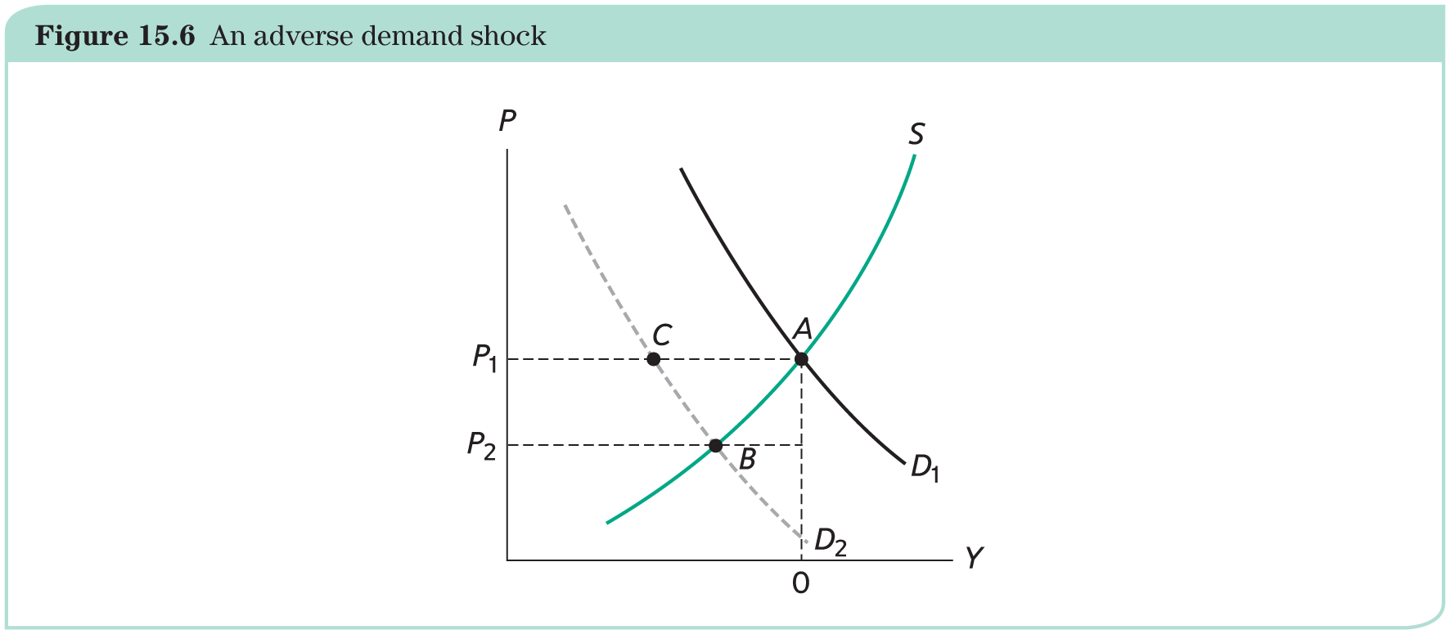
Shocks and the exchange rate
Adverse (external) demand shock:

Slide 7
Asymmetric shock in a monetary union
Consider a currency area with two member countries A and B.
Within the monetary union, there is no exchange rate, but both countries share the same exchange rate vis-à-vis the rest of the world.
If countries A and B are hit by the same (= symmetric) adverse shock, both have to undergo a real depreciation vis-à-vis the rest of the world (see before).
  If they are similar enough, there is no need for their bilateral exchange rate to change.
  The union will simply adjust its common exchange rate vis-à-vis the rest of the world and its member countries are as well off as if they had each independently changed their own exchange rates.
The situation is very different in the presence of an asymmetric shock.
  Assume, for instance, that country A is hit by an adverse shock, but not country B.

Slide 8
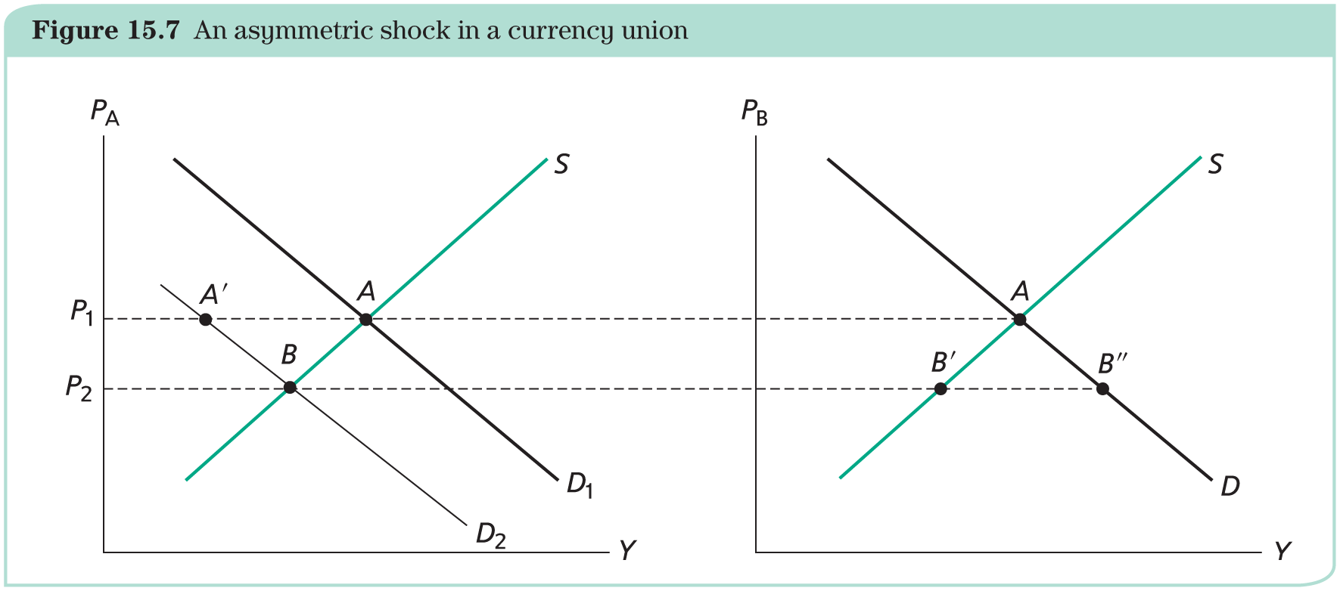
Asymmetric shock in a monetary union
Reduction in demand – from outside the monetary union – affects only country A (not country B):
The left-hand chart shows a leftward shift of the demand schedule from D₁ to D₂.
With flexible prices, the price level would decline to P₂ and the economy would land at point B, like in the previous section.
With the price level stuck at P₁, if country A were not part of a monetary union, the same situation could be reached through a depreciation, which would mimic the flexible price outcome.
The foreign country B would have no reason to change its exchange rate and would remain at point A.

Slide 9
Asymmetric shock in a monetary union
The now-common central bank must make a choice on their behalf.
  If it cares only about country A, it could cut the interest rate and let the common exchange rate depreciate to boost demand back to D₁. This would not suit country B, because the depreciation would shift its demand curve to the right and create excess demand (not shown).
  If the central bank instead favours country B, it will keep the common exchange rate unchanged as this country does not face any disturbance and would rather stay at point A.
Country A, however, is in a most uncomfortable position. At price P₁, supply is represented by point A but demand is represented by point A′. This means excess supply in country A: the distance A′A represents the inventories of unsold goods that firms accumulate.
Clearly, in the presence of an asymmetric shock, what suits one country hurts the other.

Slide 10
Asymmetric shock in a monetary union
Problem: no good outcome simultaneously for both countries
Fundamental and unavoidable cost of forming a monetary union.
With sticky prices, the nominal exchange rate is the only way of adjusting a country’s competitiveness to changing conditions. Within a monetary union, the common exchange rate cannot protect simultaneously all member countries.
Over time, prices become flexible. Prices will fall in country A until point B is reached while country B remains at point A. Yet, this price adjustment may take a few years of misery.

Slide 11
The optimum currency area criteria: overview
The optimum currency area (OCA) theory brings together the benefits and the costs to derive practical criteria to understand which countries should share the same currency.
It derives criteria that make a common currency acceptable, not optimal (!); and the criteria are never black or white, they are more or less fulfilled.
Three classic (economic) criteria:
Labour mobility (Mundell): Since prices and wages are sticky, one solution is for production facilities to move from the country that faces an adverse shock to the unaffected countries. Equipment is relatively easy to move, but what about people?
Diversification (Kenen): Strong asymmetric shocks are bound to be rare if all countries produce a wide and similar range of goods.
Openness (McKinnon): Goods prices in countries that are very open to trade cannot be that rigid.

Slide 12
The optimum currency area criteria: overview
Three criteria with more political flavour:
(Fiscal) transfers: Shocks are avoidable but their occurrence is a near-certainty. Are there insurance mechanisms that mitigate, or even eliminate, their consequences?
Homogeneous preferences: Even in the presence of symmetric shocks, countries may disagree on the remedy. In the opposite, like-minded countries can promptly agree on policy responses.
Degree of solidarity: When one country suffers from a serious shock and cannot respond with an exchange rate change, it often is in the collective interest for the other members to rescue it in various ways.

Slide 13
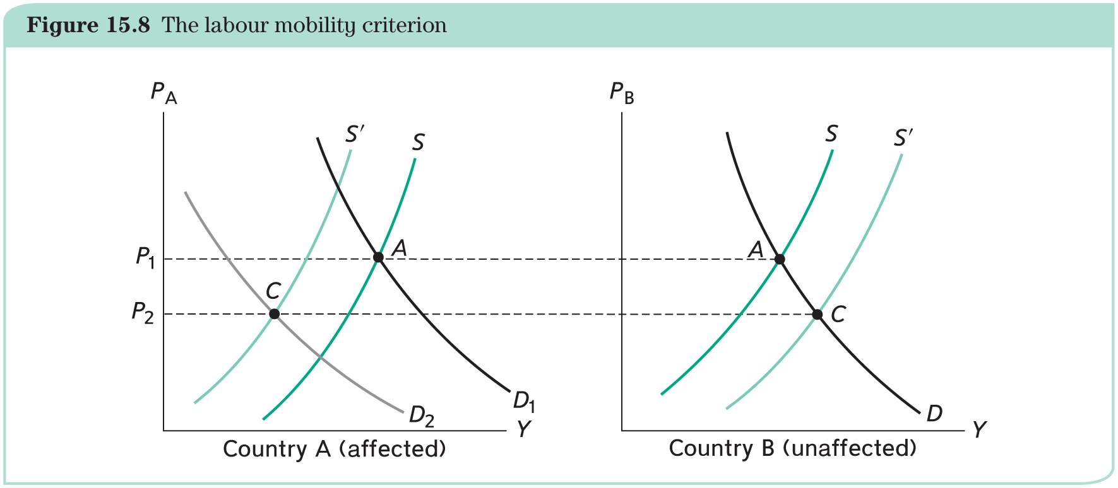
Criterion 1 (Mundell): Labour mobility
Optimum currency areas are those within which people move easily:
Unemployment in A and inflationary pressures in B could be solved by moving production factors from A to B.
Caveats and criticism:
Labour mobility is easier within national borders (culture, language, legislation, welfare, etc.) than across countries.
The goods produced in country A may differ from those produced in country B. In presence of country specialization, skills also matter.
Labour needs equipment: physical (installed) capital also immobile.

Slide 14
Criterion 2 (Kenen): Production diversification
Countries whose production and exports are widely diversified and of similar structure form an optimum currency area:
Severe shocks are more likely to occur in countries that specialize in the production of a narrow range of goods.
Conversely, a country that produces a wide range of products will be little affected by shocks that concern any particular good because that good weighs relatively little in total production.
Caveat and criticism:
A very broad statement: How much diversification and production similarity is enough?

Slide 15
Criterion 3 (McKinnon): Openness
Countries that are very open to trade and trade heavily with each other form an optimum currency area:
If all goods are traded, domestic good prices must be flexible and the exchange rate does not matter for competitiveness.
In addition, modern trade takes the form of value chains whereby finished products incorporate many parts produced literally all over the world. It becomes increasingly difficult to talk about national goods.
Losing the exchange rate is of little consequence and the two countries can form a currency area without suffering much hardship in the presence of asymmetric shocks.
Caveat and criticism:
Exchange rate can affect profits for exporters (both upwards and downwards, but this is less relevant if firms are integrated in global value chains, because some times they will gain and some other times they will lose)

Slide 16
Criterion 4: Insurance through transfers
Countries that agree to compensate each other for adverse shocks form an optimum currency area:
Transfers can act as an insurance that mitigates the costs of an asymmetric shocks.
Transfers exist within national borders (the welfare system and explicit regional arrangements).
Transfers can be achieved publicly or privately.
Caveats and criticism:
Insurance inevitably raises the issue of moral hazard; the Eurozone debt crisis has brought forward the issue of transfers.
The insurance mechanism is somehow linked to financial markets (through borrowing and repayment): governments may loose access to financial markets and/or banking system collapses.

Slide 17
Criterion 5: Homogeneous preferences
A high degree of homogeneity of national preferences is required in a currency union:
Member countries must therefore agree on a common monetary policy and a host of other features.
Currency union member countries must be able to routinely reach consensus on the best way to manage the economy, which is possible only if national preferences are not too different.
Caveats and criticism:
Source of disagreement amount European countries.
  Inflation: hawks and doves in central banks.
  Labor markets policies and institutions: differences result in different costs of adopting a common currency.
  Public deficits and Debt: government may be tempted to let its debt grow.

Slide 18
Criterion 6: Degree of solidarity
When the common monetary policy gives rise to conflicts of national interest, the countries that form a currency area need to accept some costs in the name of a common destiny:
It is unavoidable that there will be times when there will be disagreements and that these disagreements may follow national lines: people must accept that they will be living together and extend their sense of solidarity to the whole union.
Common destiny needs to outweigh the nationalist tendencies.
This argument is sometimes used to show that a monetary union can only come about after a political union.
Caveats and criticism:
A currency union is not a free ride and costs are bound to arise now and then, when asymmetric shocks occur.

Slide 19
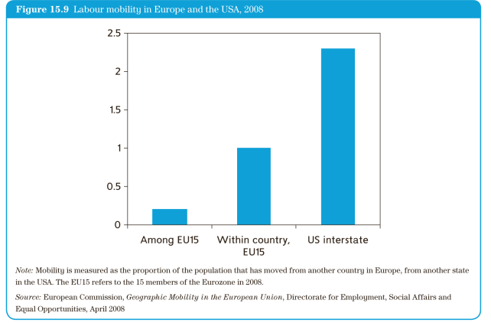
Is Europe an optimum currency area?
Labour mobility: Europeans move little.

Slide 20
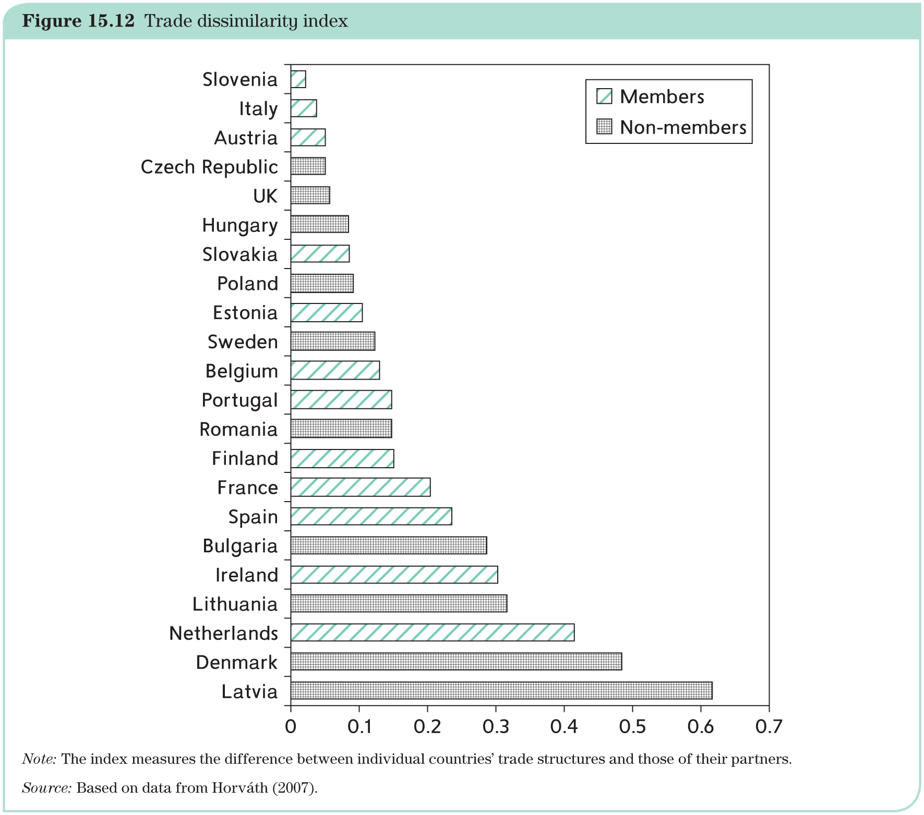
Is Europe an optimum currency area?
Diversification and trade dissimilarity = trade dissimilarity index:

Slide 21
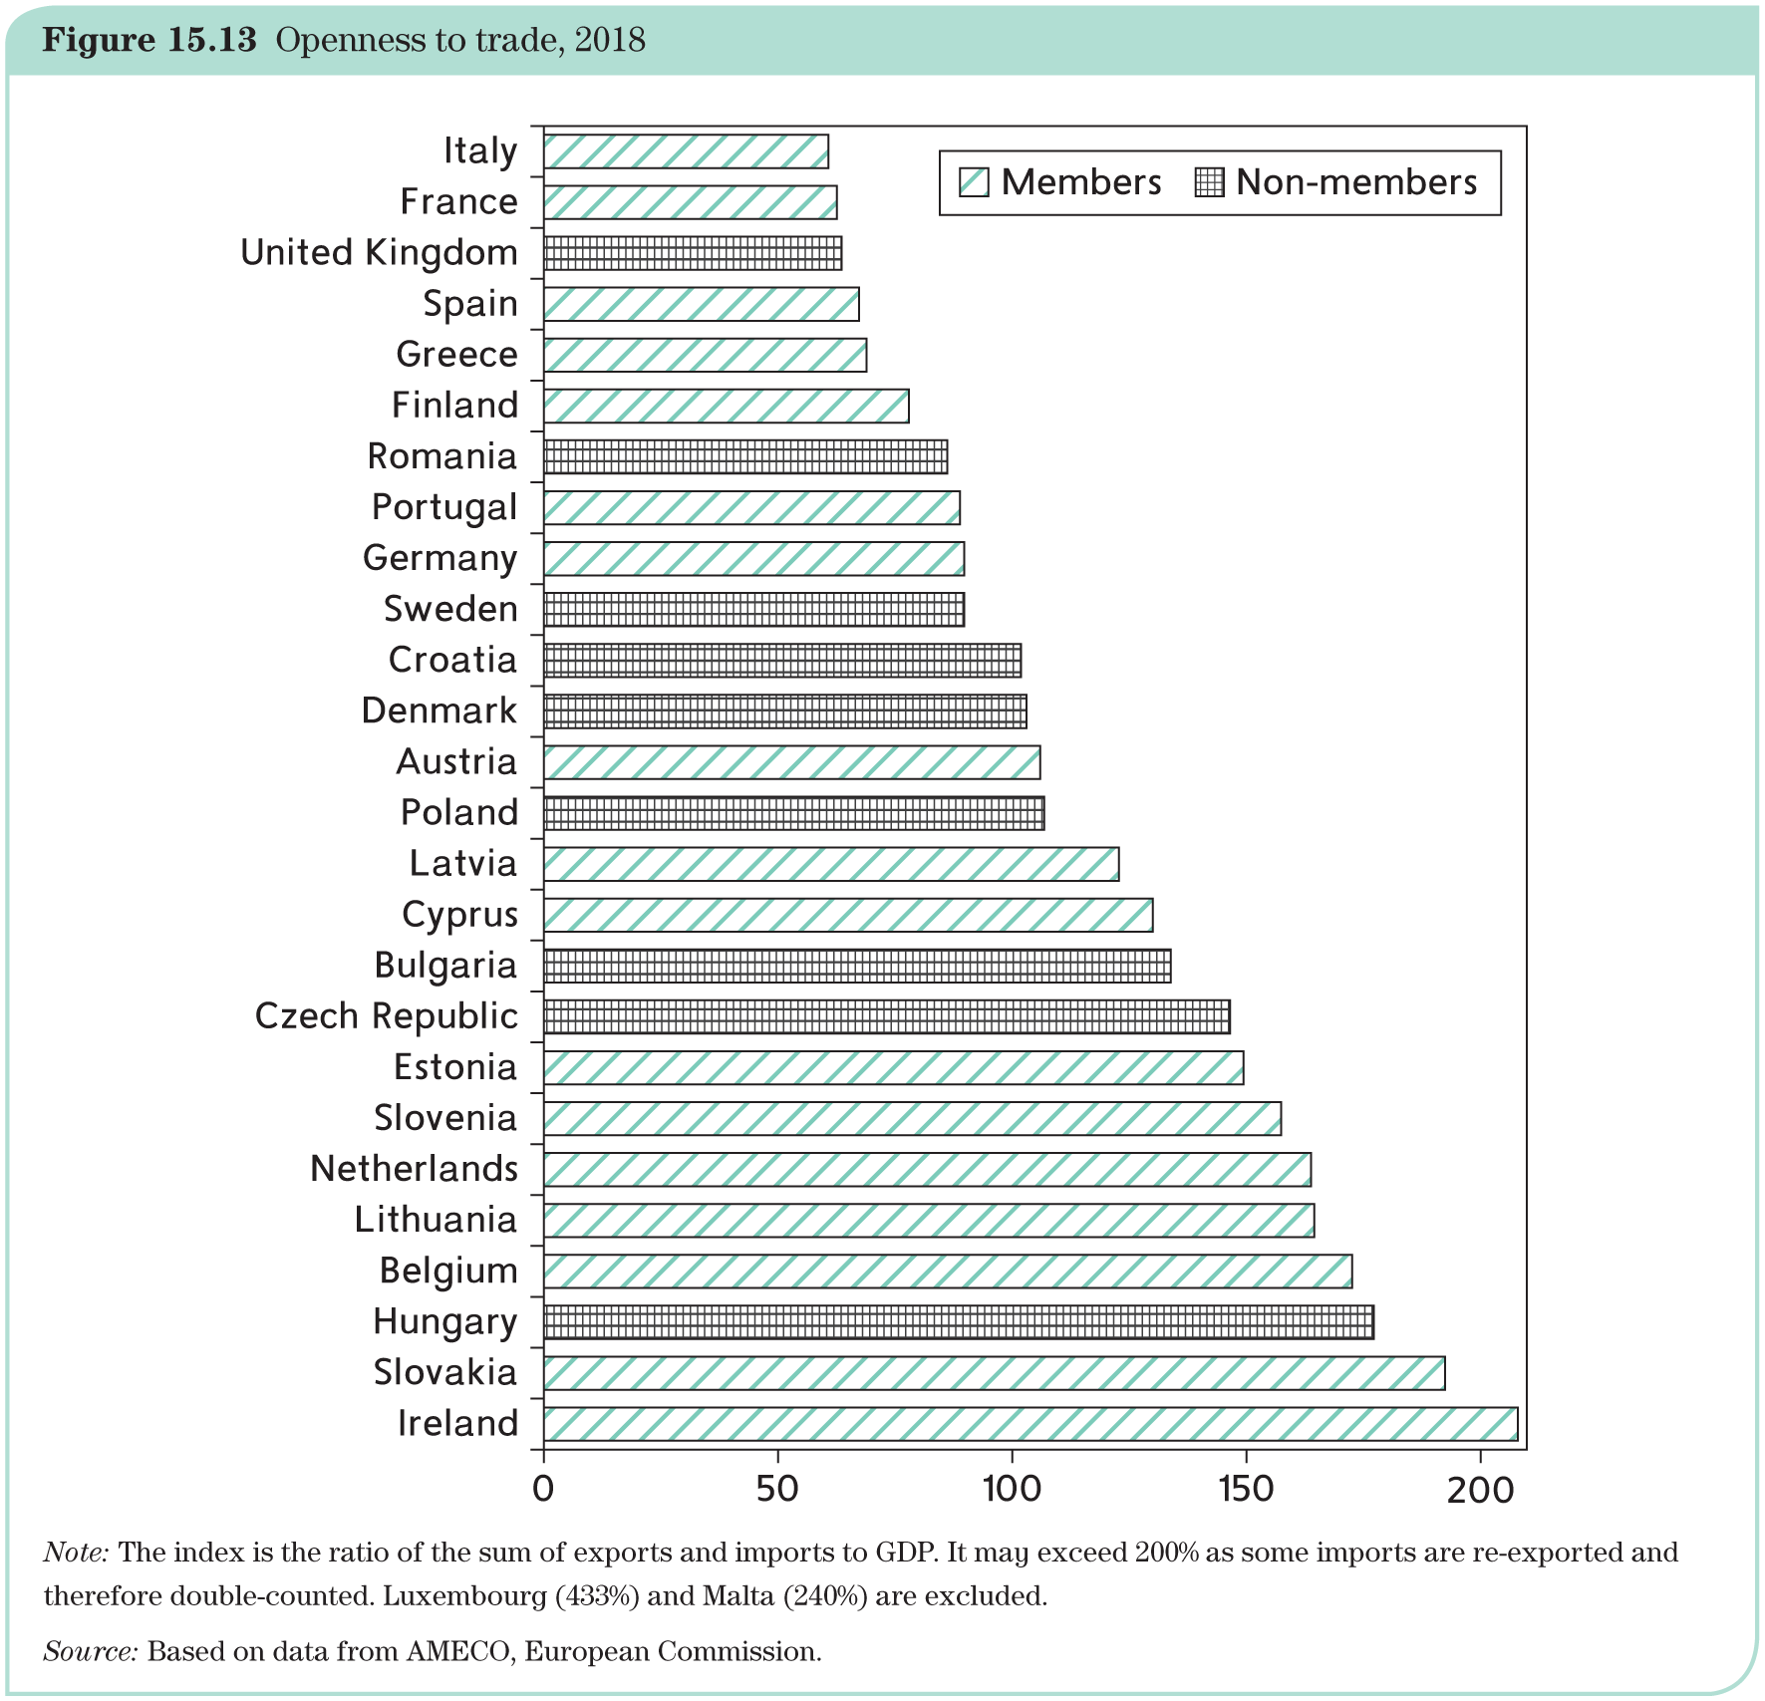
Is Europe an optimum currency area?
Openness = openness to trade:

Slide 22
Is Europe an optimum currency area?
Fiscal transfers:
up until the debt crisis, there was no transfer system in the EU;
EU budget is small (slightly above 1% of GDP) and almost entirely spent on operating expenses, CAP, and Structural Funds;
crisis led to the creation of the European Financial Stability Fund (EFSF), transformed into the European Stability Mechanism (ESM).
Now, the NextGenerationEU and the issuance of green bonds (more related to solidarity)
Homogeneous preferences:
based on past inflation rates, it does not seem that country share similar views on monetary policy;
similar story when looking at public debts;
there remains some heterogeneity among national preferences.

Slide 23
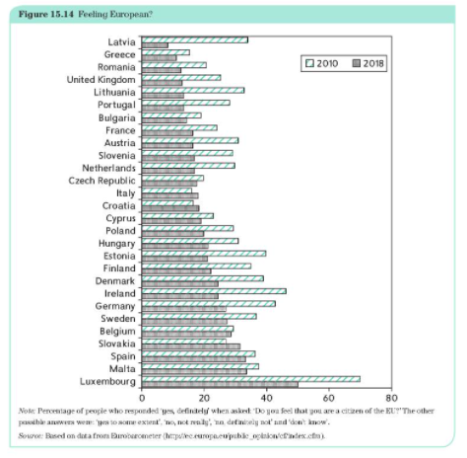
Is Europe an optimum currency area?
Solidarity vs. nationalism = feeling European? (2018)

Slide 24
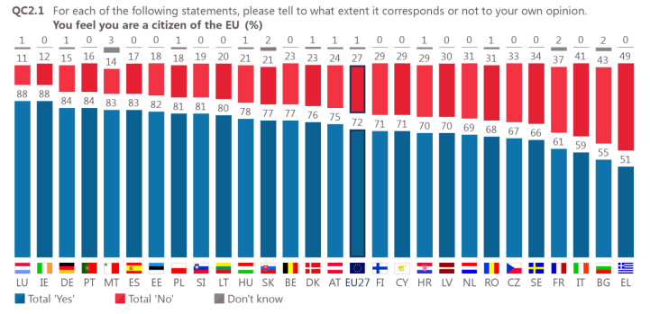
Is Europe an optimum currency area? (2)
Eurobarometer (Spring 2021)

Slide 25
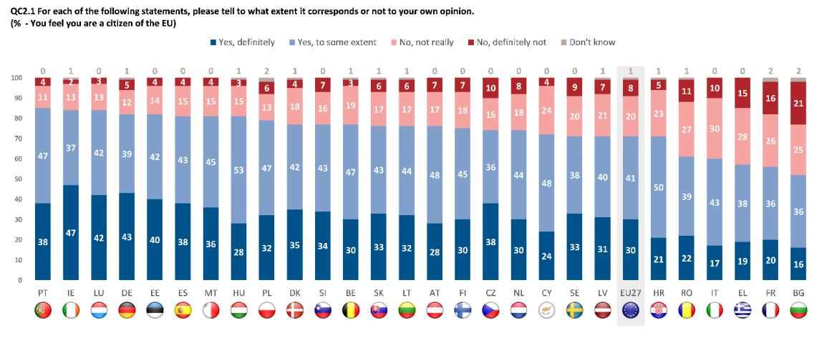
Is Europe an optimum currency area? (3)
Eurobarometer (Winter 2021-2022)

Slide 26
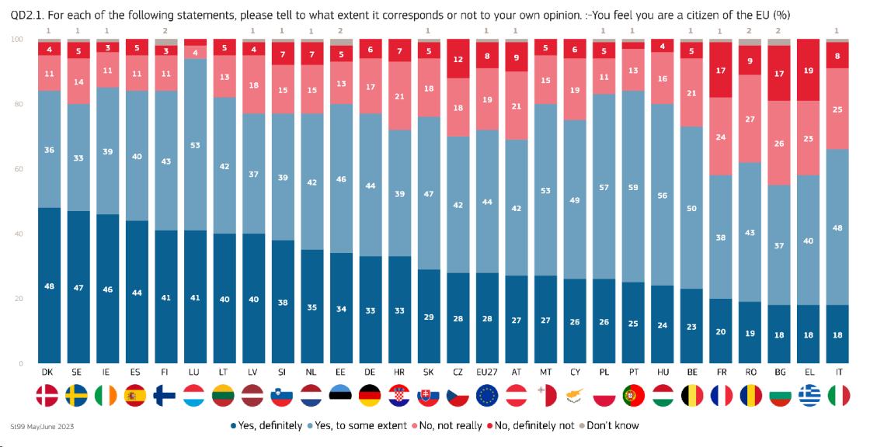
Is Europe an optimum currency area? (4)
Eurobarometer (Spring 2023)

Slide 27
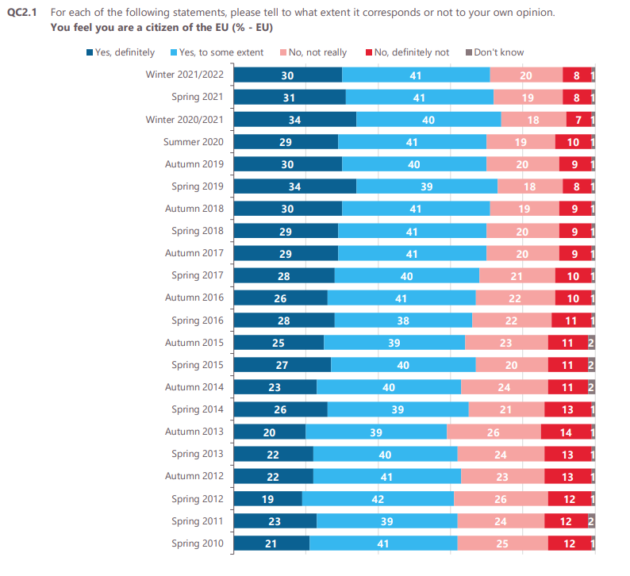
Is Europe an optimum currency area? (5)

Slide 28
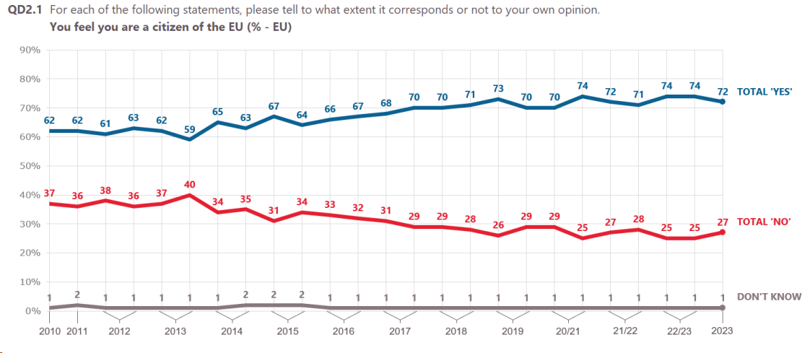
Is Europe an optimum currency area? (6)

Slide 29
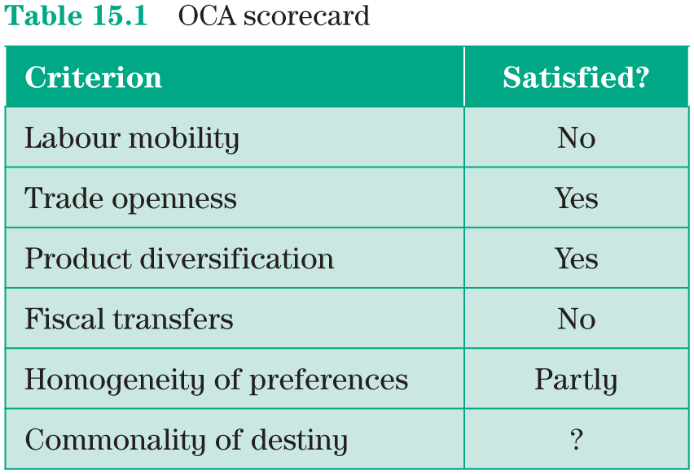
Is Europe an optimum currency area?
So, is Europe an optimum currency area? Mixed performance:
COVID-19?
→ The OCA criteria themselves are not clear-cut. They are unlikely to be entirely satisfied or entirely violated.
→ Ultimately, the economic case is undecided, and the decision to create the monetary union must rest on political considerations.
→ The sovereign crises reminds that asymmetric shocks do happen and that they can be painful.

Slide 30
Is Europe becoming an optimum currency area?
The degree of fulfilment of the six OCA criteria is not a given, it may change over time.
This possibility is called the endogeneity of the OCA criteria:
  effects on labour markets and mobility;
  effects on trade and specialization;
  fiscal transfers.
  Politics: preferences and common destiny.
  Political considerations have been paramount in launching the euro; political leaders agreed on the monetary union without thinking in terms of the OCA theory. They were largely focusing on the symbolic nature of the undertaking. Their intention was to move one step further in the direction of an ‘ever-closer union’.

Slide 31
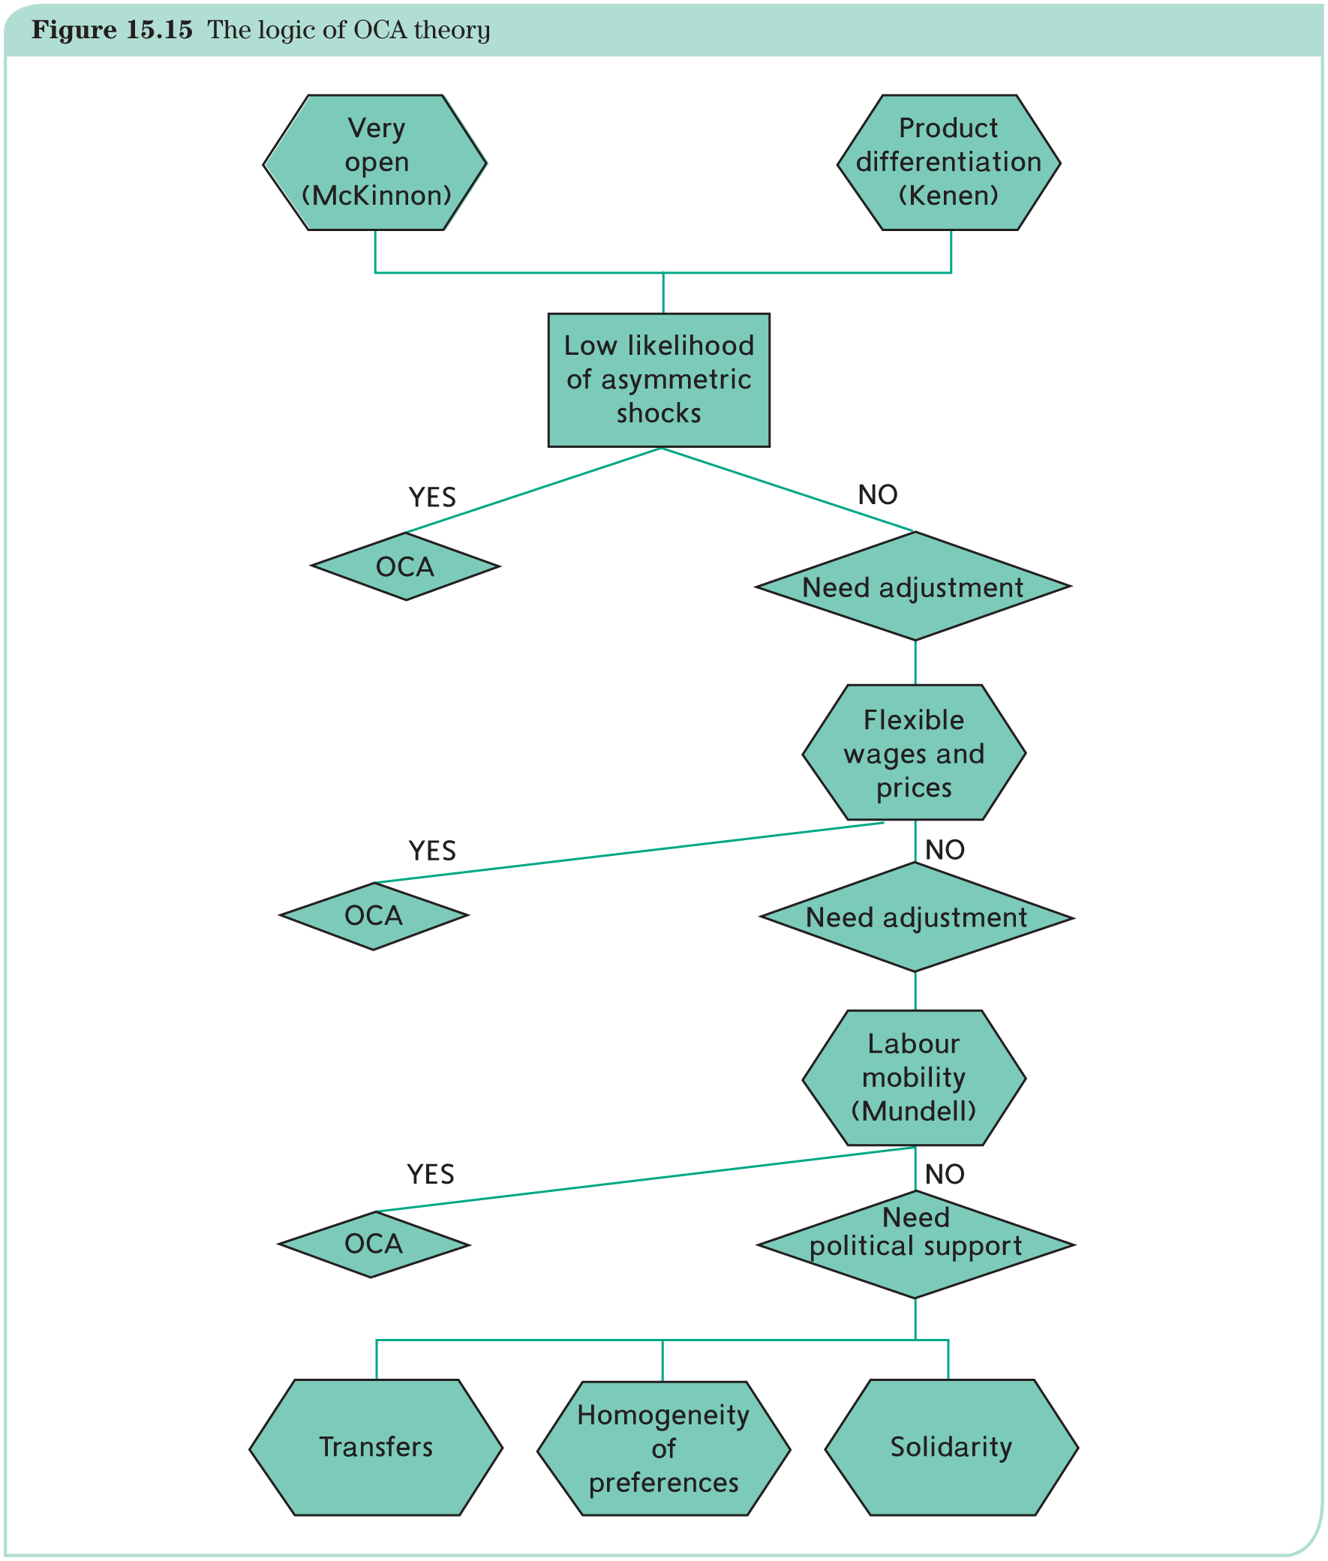
The logic of the optimum currency area criteria

