Slide 1
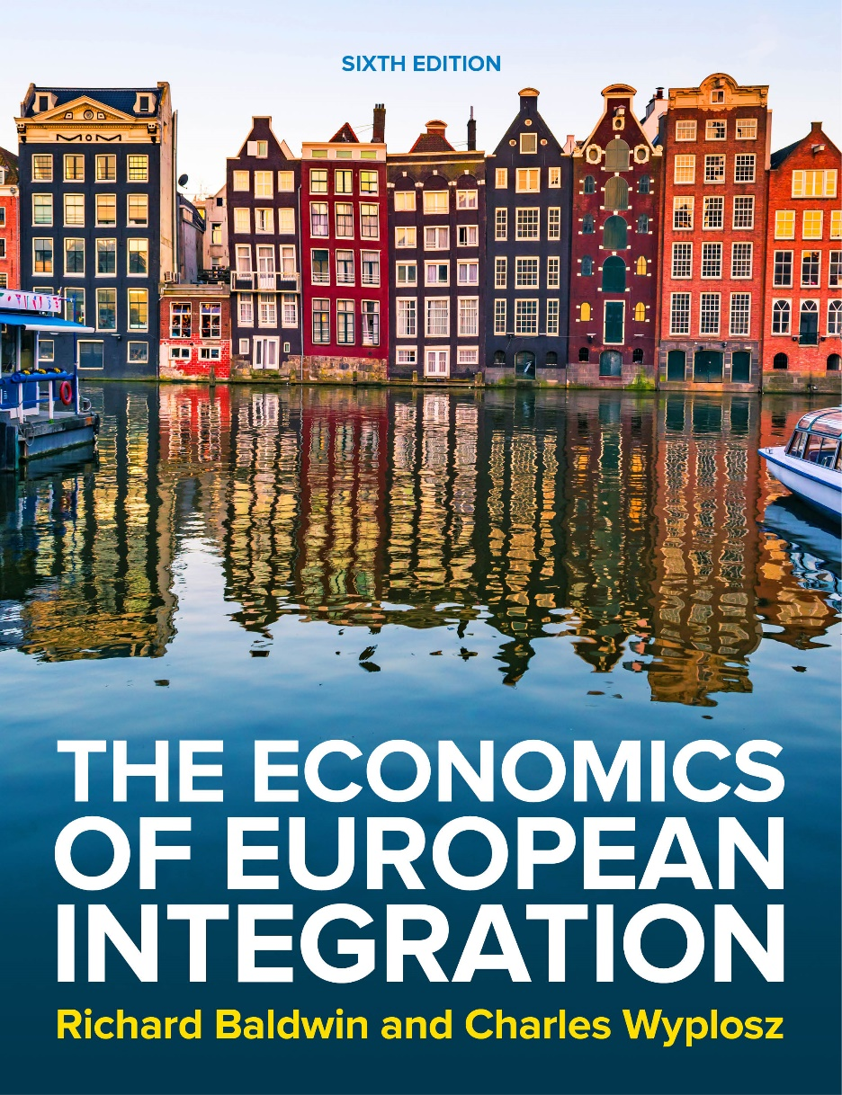
Chapter 16
The European monetary union
The Economics of European Integration, Sixth Edition

Slide 2
The Maastricht Treaty
European Monetary Union is the outcome of a deal between sovereign European countries.
Principles (mainly on German requests):
  price stability;
  central bank independence;
  fiscal discipline.
The Maastricht Treaty included:
a firm commitment to launch the single currency by January 1999 at the latest;
five explicit criteria for admission to the monetary union;
a precise specification of central banking institutions;
additional conditions mentioned (e.g. the excessive deficit procedure).

Slide 3
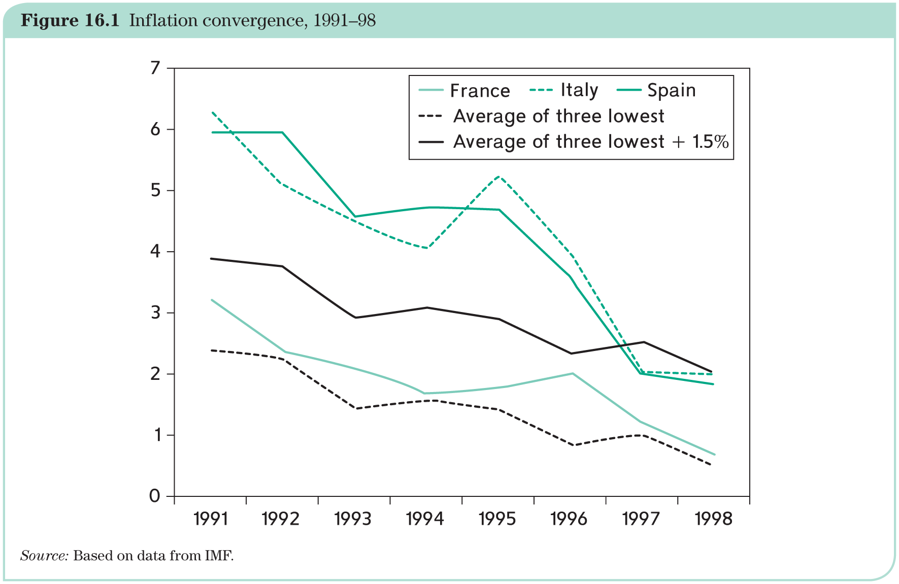
The Maastricht Treaty: five entry conditions
Purpose: A selection process to certify which countries have adopted a ‘culture of price stability’ (i.e., German-style low inflation); countries have to fulfill five convergence criteria.
1. Inflation: Not to exceed by more than 1.5 percentage points the average of the 3 lowest inflation rates among EU countries.

Slide 4
The Maastricht Treaty: five entry conditions
2. Long-term nominal interest rate: Not to exceed the average interest rate in the 3 lowest inflation countries by more than 2 percentage points (→ long-term interest rates mostly reflect markets’ assessment of long-term inflation).
3. ERM membership: At least 2 years in ERM without being forced to devalue (https://en.wikipedia.org/wiki/European_Exchange_Rate_Mechanism)
4. Budget deficit: Deficit less than 3% of GDP.
5. Public debt: Debt less than 60% of GDP (= average of countries at that time).
Maastricht Treaty specifies that all countries are expected to join as soon as they fulfill the criteria.
Only Denmark and UK were given an exemption (opt out clause).
Sweden does not have an exemption, but acts as if it is not member of the ERM II.

Slide 5
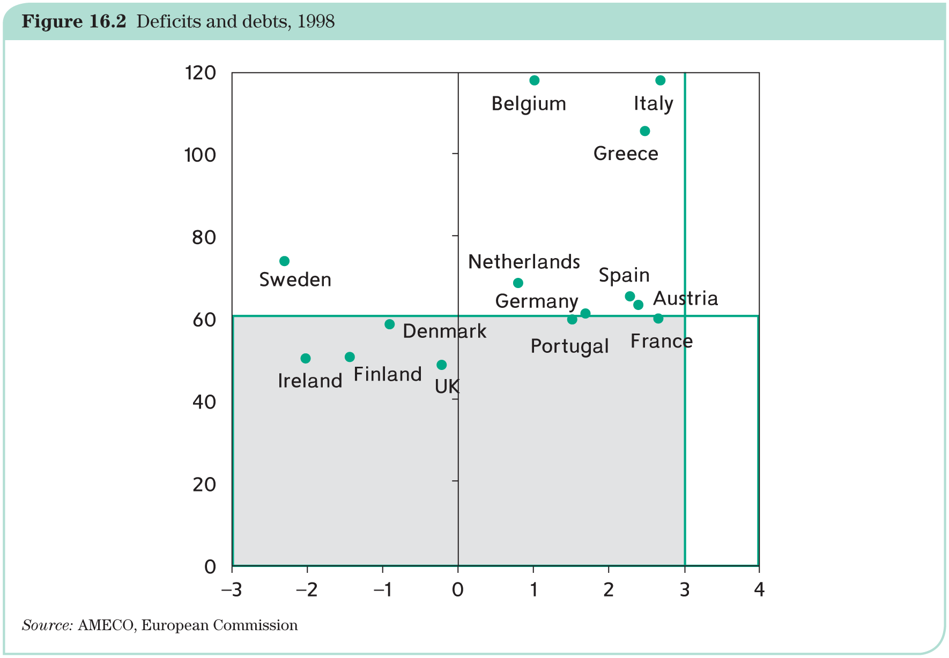
The Maastricht Treaty: five entry conditions

Slide 6
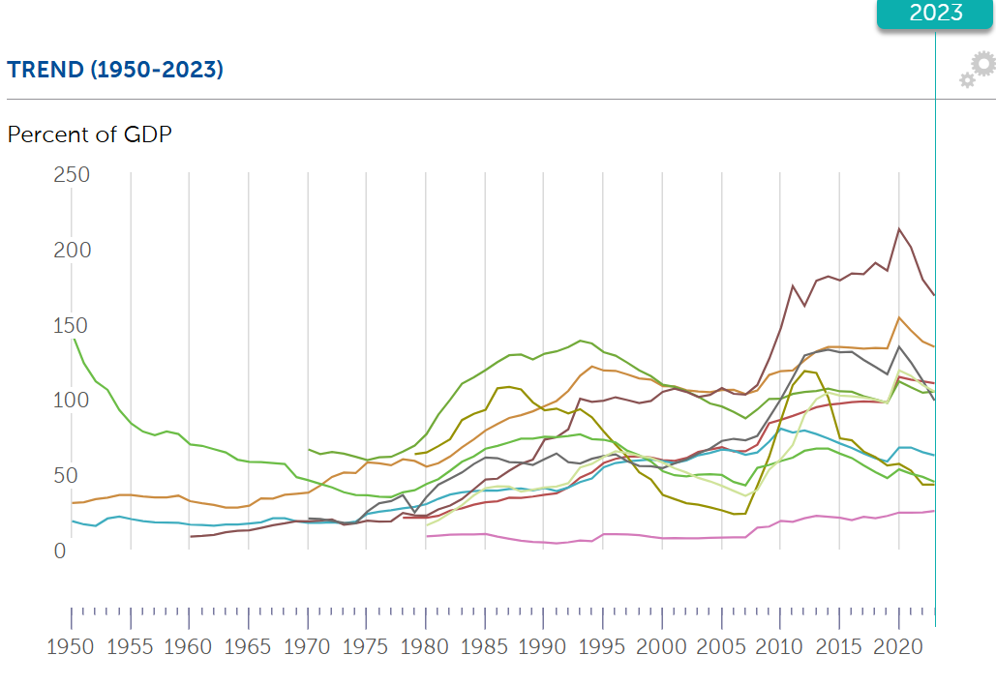
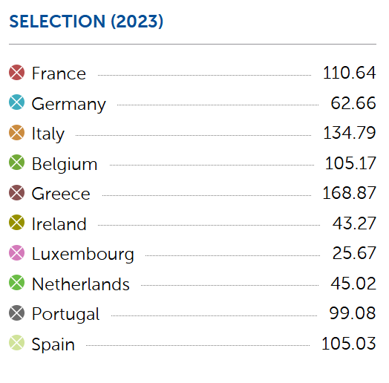
The debt situation over time
https://www.imf.org/external/datamapper/GG_DEBT_GDP@GDD/FRA/DEU/ITA/BEL/BGR/HRV/EST/FIN/GRC/IRL/LVA/LTU/LUX/NLD/POL/PRT/ROU/SVK/SVN/ESP

Slide 7
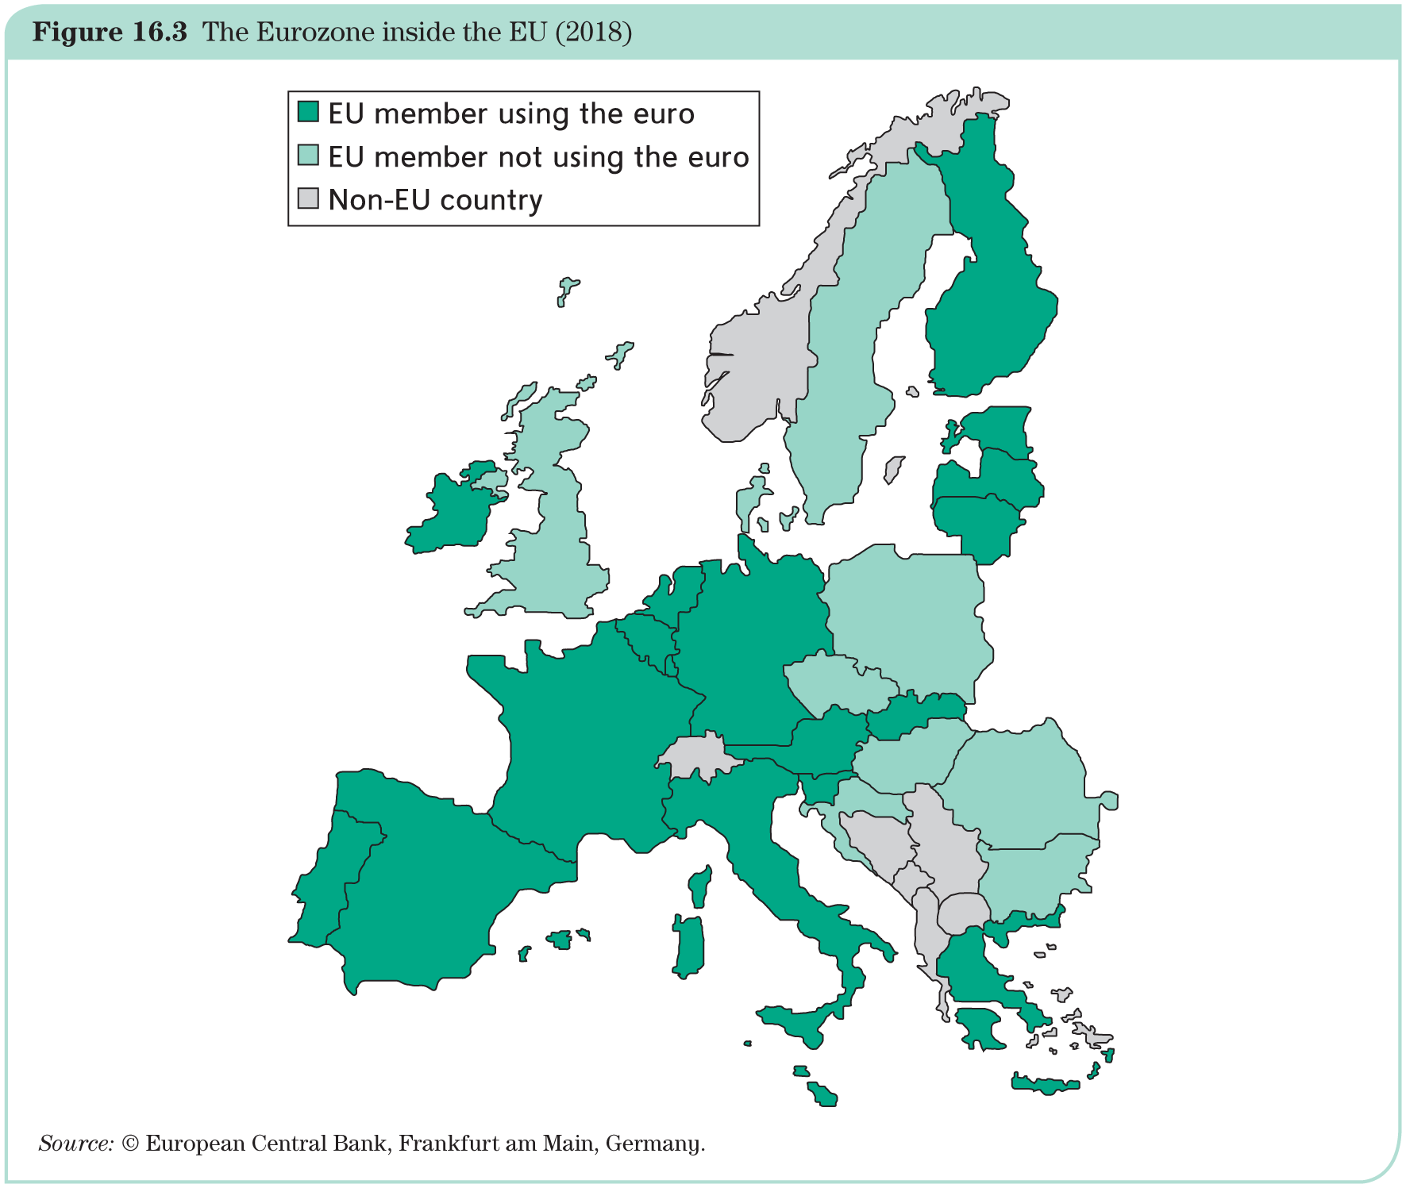
Two-speed Europe
The ‘two-speed’ arrangement is not without problems: the endogeneity of the OCA criteria suggests that the Eurozone countries are becoming increasingly cohesive.

Slide 8
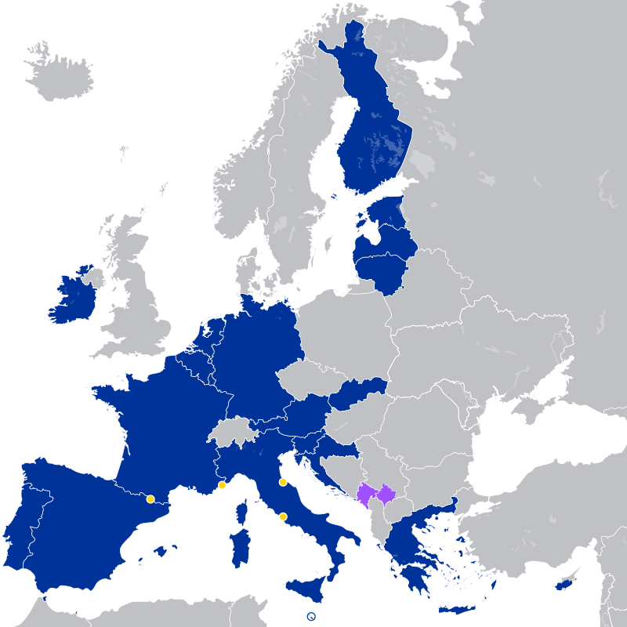
Two-speed Europe
The 20 eurozone members are:
Austria, Belgium, Croatia, Cyprus, Estonia, Finland, France, Germany, Greece, Ireland, Italy, Latvia, Lithuania, Luxembourg, Malta, the Netherlands, Portugal, Slovakia, Slovenia, and Spain.
The seven non-eurozone members of the EU are Bulgaria, the Czechia, Denmark, Hungary, Poland, Romania, and Sweden. They continue to use their own national currencies, although all but Denmark are obliged to join once they meet the euro convergence criteria.
Among non-EU member states, Andorra, Monaco, San Marino, and Vatican City have formal agreements with the EU to use the euro as their official currency and issue their own coins.^{[10][11][12]} In addition, Kosovo and Montenegro have adopted the euro unilaterally, relying on euros already in circulation rather than minting currencies of their own.^{[13]} These six countries, however, have no representation in any eurozone institution.

Slide 9
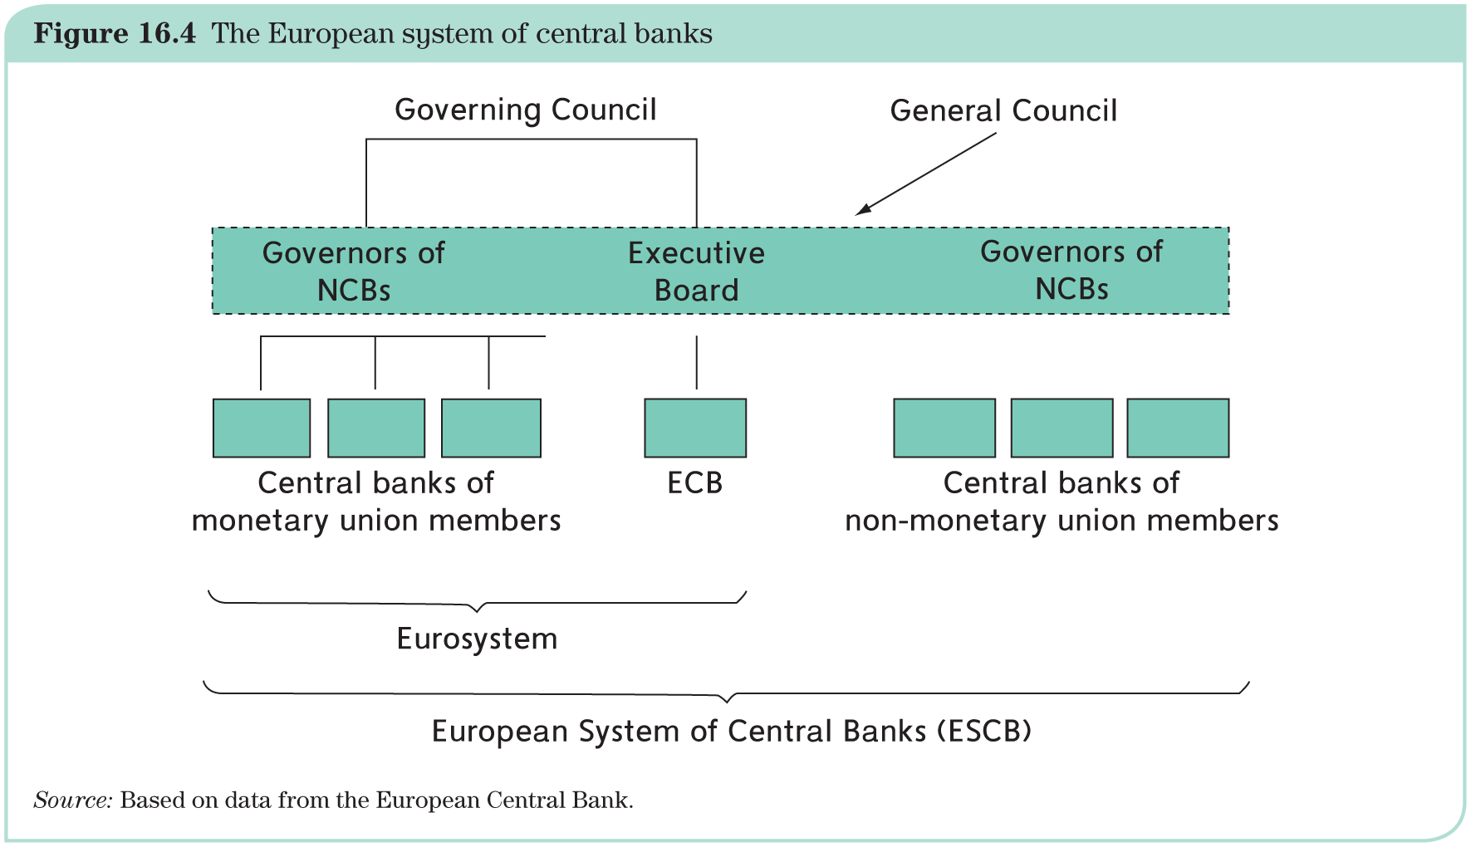
The Eurosystem
N countries with N National Central Banks (NCBs) and a new central bank at the center: the European Central Bank (ECB).
The European System of Central Banks (ESCB): the ECB and all EU NCBs.
The Eurosystem: the ECB and the NCBs of euro area member countries.

Slide 10
The Eurosystem
The ECB is run by an executive board of six members.
They are individually appointed by the heads of state or governments of the countries that have joined the monetary union, following consultation with the European Parliament.
The Eurosystem is run by the Governing Council of the ESCB. It comprises the six members of the Executive Board and the governors of the NCBs of monetary union member states.
The Governing Council is the key authority deciding on monetary policy.
Formally, the members of the Executive Board of the ECB are not representing their countries: they are appointed as individuals, even though the large countries (France, Germany, Italy and Spain) all had a national sitting on the first Executive Board appointed, and still have.

Slide 11
The rotating voting system for Governing Council
Reason for rotation (in place since 2015): Even with potentially all EU countries in the EMU, the votes should be limited to 21 (follows from Maastricht logic with EU15 at that time and 6 ECB board members).
An index is computed for each country:
  based on its GDP (5/6 of the weight);
  and the size of its financial sector (remaining 1/6).
The resulting ranking classifies all countries into two groups:
  The five largest countries (Germany, France, Italy, Spain, and the Netherlands) form the first group, with four voting rights.
  The remaining countries make up the second group, with 11 voting rights.
    Currently this second group is a merger of the second and the third group in the chart below (as well as Figure 16.6 in the textbook).
    The third group will split up one point in the future, when the size of the EMU increases further.

Slide 12
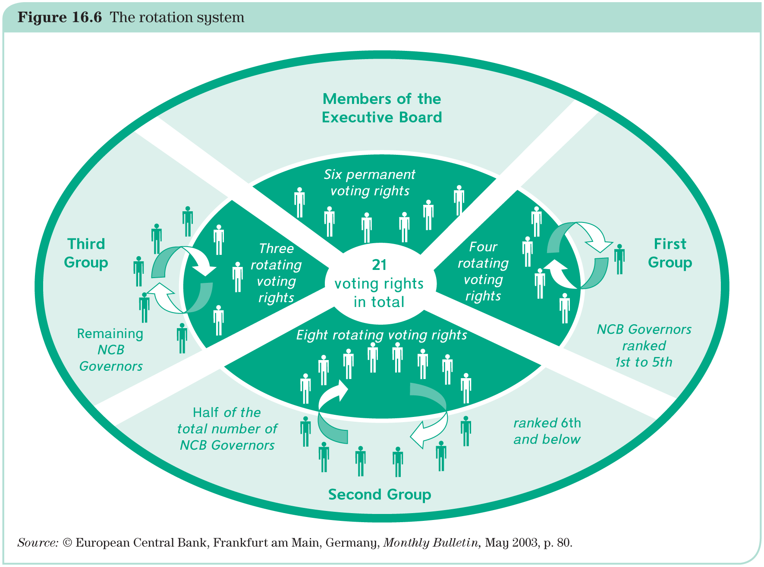
The rotating voting system (since 2015)

Slide 13
ECB‘s monetary policy strategy: objectives
Treaty:
‘The primary objective of the ESCB shall be to maintain price stability. Without prejudice to that objective, it shall support the general economic policies in the Union in order to contribute to the achievement of the latter’s objectives.’
→ Eurosystem has chosen to interpret it as follows: ‘Price stability is defined as a year-on-year increase in the Harmonized Index of Consumer Prices (HICP) for the Eurozone of below but close to two per cent.’
→ Price stability is to be maintained over the medium term.
→ This is commonly understood as inflation between 1.5 and 2% and to refer to a 2–3 year horizon.

Slide 14
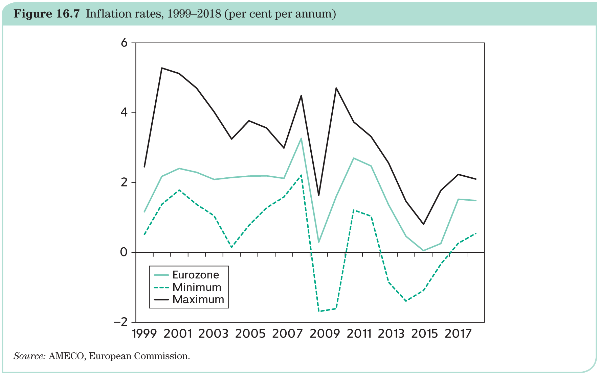
ECB‘s inflation performance
On average, Eurozone inflation has been 1.7 per cent (which is less than with Deutschmark in Germany before). Really?

Slide 15
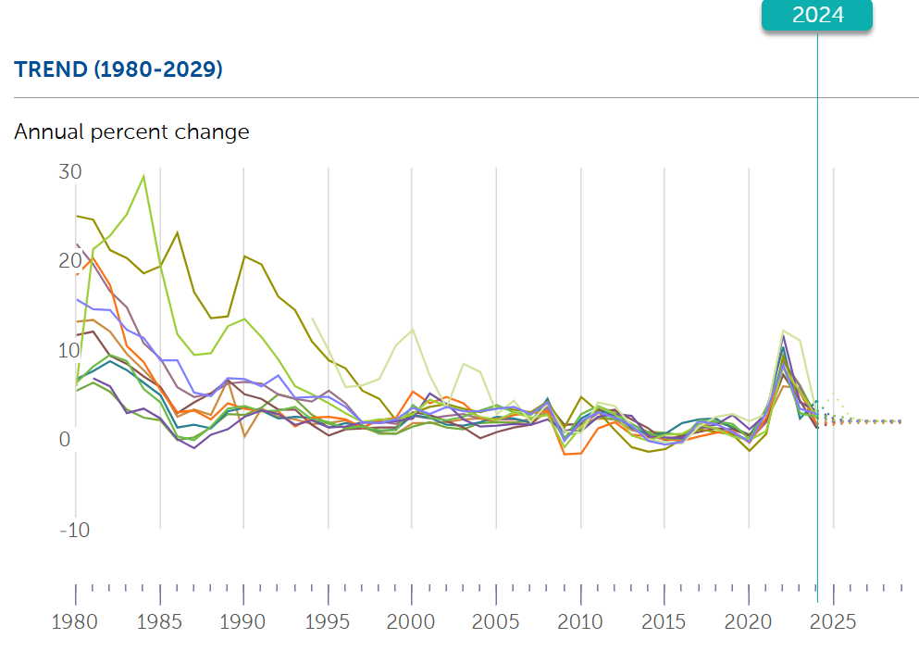
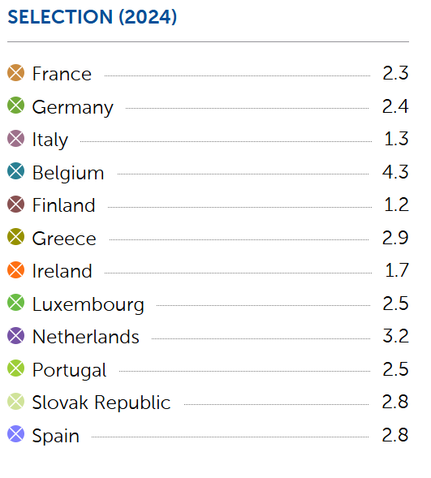
ECB‘s inflation performance
https://www.imf.org/external/datamapper/PCPIPCH@WEO/FRA/DEU/ITA/BEL/FIN/GRC/IRL/LUX/NLD/PRT/SVK/ESP

Slide 16
ECB‘s monetary policy strategy
Strategy relies on three main elements:
Definition of price stability as the primary goal: ‘change in HICP below but close to two per cent’;
and two ‘pillars’ to identify risks to price stability:
First pillar = ‘economic analysis’ (short- to medium-term perspective):
It consists of a broad review of recent evolution and likely prospects of economic conditions (e.g., growth, employment, prices, exchange rates, foreign conditions etc.).
Second pillar = ‘monetary analysis’ (medium- to long-term perspective):
It studies the evolution of monetary aggregates and credit.

Slide 17
ECB and the Taylor Rule
Inflation-targeting central banks set the short-term interest rate with one eye on inflation forecasts and the other on the expected activity level, measured by the output gap, i.e. the deviation of the actual GDP from its ‘normal’ level.
This approach is formalized as the Taylor rule.
This rule posits that the central bank chooses the actual interest rate as a function of
The deviation of inflation from its target; and
The output gap, which is the difference between actual and potential GDP, measured as a percentage of potential GDP.
Formally this is written as:
i_{t} = a(π_{t} − π*) + b(y_{t} −y_{t}*)
where i_{t} is the interest rate at time t, π_{t} is the inflation rate, π* is the inflation target, y_{t} = GDP, y_{t}* is the potential GDP. The parameters a and b are weights that reflect the relative importance attached by central banks to it two objectives.

Slide 18
Independence
A central bank must be free to operate without outside interference, but delegation to unelected officials needs to be counterbalanced by democratic accountability.
Dimensions of independence:
  institutional independence;
  personal independence;
  independence with respect to policy objectives and instruments;
  financial independence.
Eurosystem is characterized by a great degree of independence (probably the world’s most independent central bank).
  ‘When exercising the powers and carrying out the tasks and duties conferred upon them by this Treaty and the Statute of the ESCB, neither the ECB, nor a national central bank, nor any member of their decision-making bodies shall seek or take instructions from Community institutions or bodies, from any government of a Member State or from any other body. The Community institutions and bodies and the governments of the Member States undertake to respect this principle and not to seek to influence the members of the decision-making bodies of the ECB or of the national central banks in the performance of their tasks.’ (Treaty, Art. 130)

Slide 19
Accountability
In a democratic society, delegation to unelected officials (like ECB Governing Council members are) must be counterbalanced by democratic accountability.
ECB accountability is exercised in two ways—reporting and transparency:
  Formally, the Eurosystem operates under the control of the European Parliament.
  ECB is required to send an annual report to the Parliament, as well as to the Council and the Commission.
  The report is debated by the Parliament.
  The Parliament may request that the President of the ECB and the other members of the Executive Board testify to the Parliament’s Economic and Monetary Affairs Committee (so-called ‘Monetary Dialogue’).
  In addition, the President of the EU Council and a member of the European Commission may participate in the meetings of the Governing Council, but without voting rights.

Slide 20
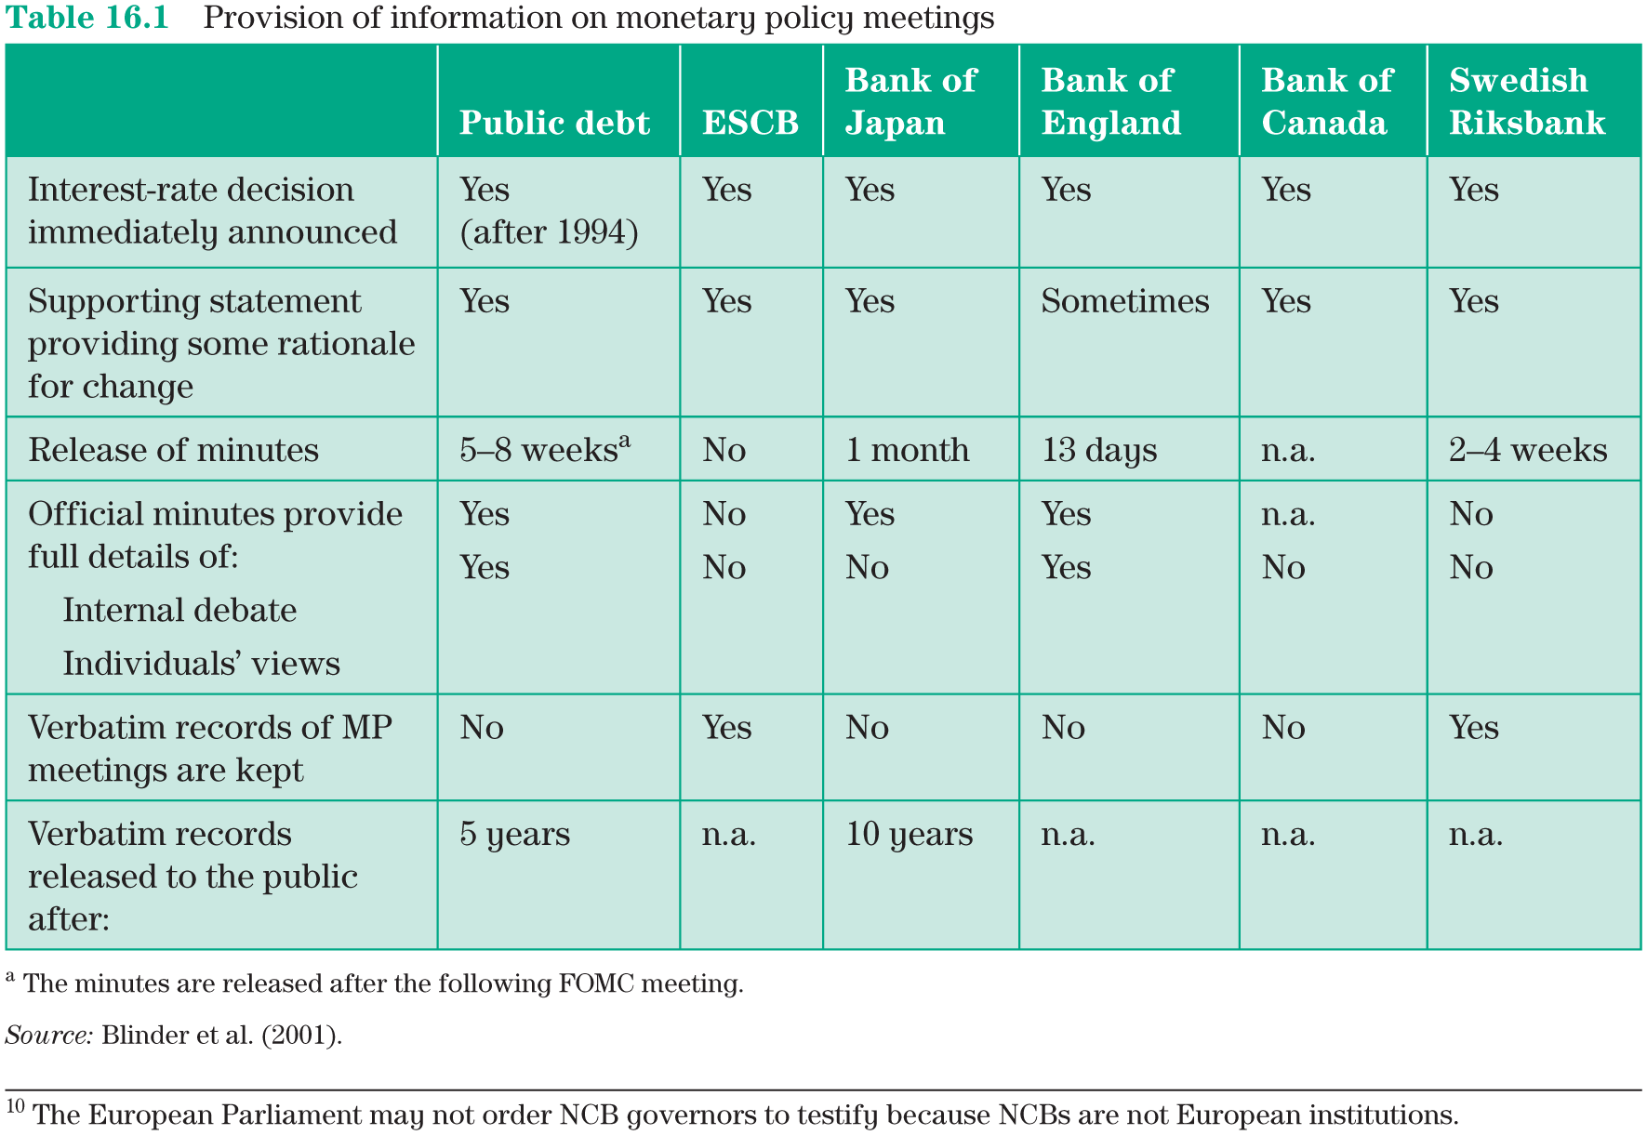
Transparency
By revealing the contents of its deliberations, a central bank conveys the rationale behind and difficulties faced by its decisions to the public (the media, the financial markets and independent observers).
Federal Reserve

Slide 21
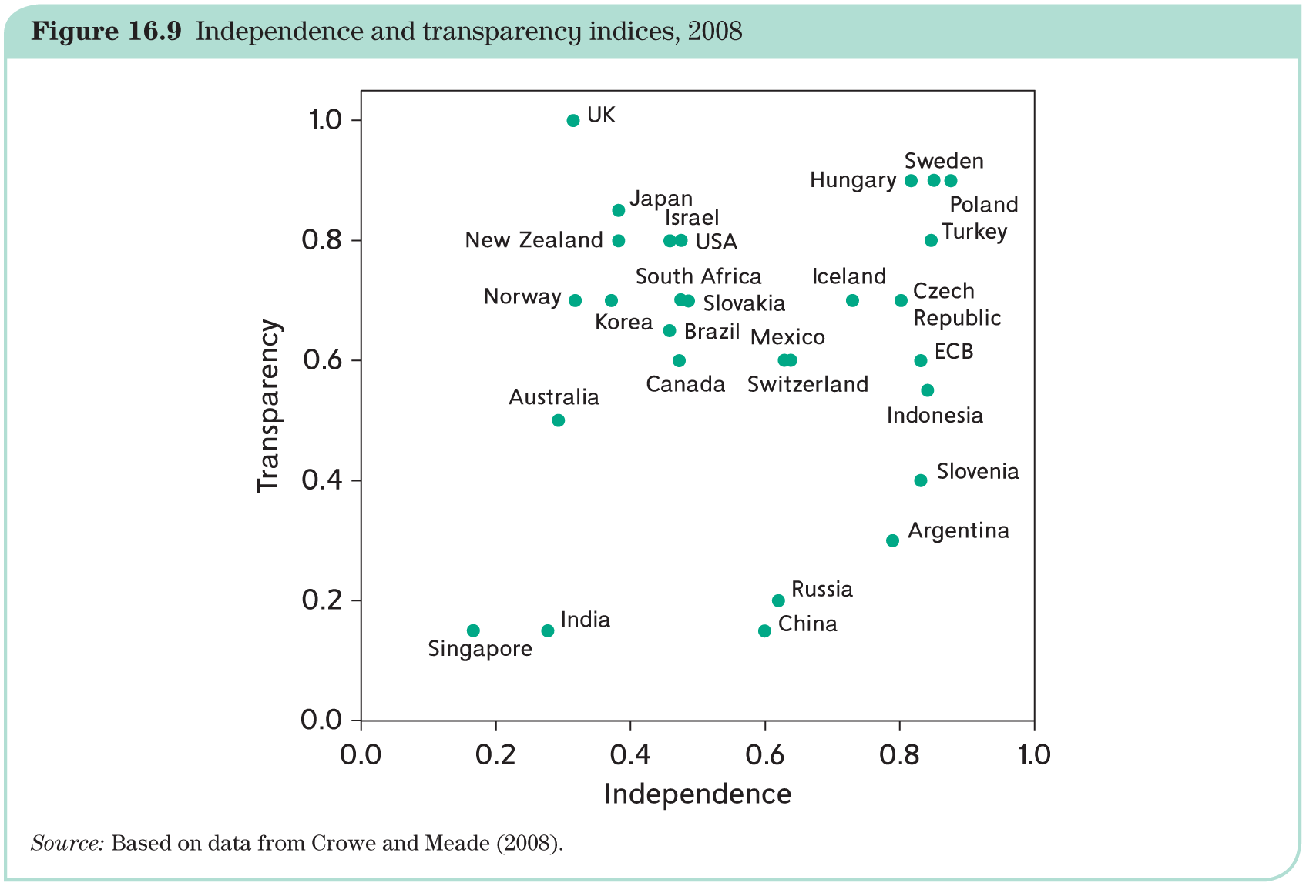
Independence and accountability
Independence and transparency indices:

Slide 22
Instruments
Eurosystem uses the short-term interest rate: Its changes have a knock-on effect on longer-term interest rates (and thus on the cost of credit), on asset prices (and thus on capital costs of firms), and on the exchange rate (and thus on foreign demand for domestic goods and services).
The Eurosystem focuses on the overnight rate EONIA (European Over Night Index Average, a weighted average of overnight lending transactions in the Eurozone’s interbank market) (see next slide)

Slide 23
Instruments
The Eurosystem creates a ceiling and a floor for EONIA by maintaining open lending and deposit facilities at pre-announced interest rates.
  The marginal lending facility allows banks to borrow directly from the Eurosystem at the corresponding rate. It is a ceiling because no bank would want to pay a higher rate on the overnight market.
  Similarly, the Eurosystem accepts deposits at its pre-announced deposit rate. This is a floor since no bank would ever agree to lend at a lower rate. The figure in the next slide shows that, indeed, EONIA, has moved within the corridor thus established at least up until 2012.
The Eurosystem conducts, usually weekly, auctions at a rate that it chooses, thus providing liquidity to the banking system and the chosen interest rate serves as a precise guide for EONIA.
  Each NCB collects bids from its commercial banks and passes the information to the ECB. The ECB then decides which proportion of bids will be accepted and instructs the NCBs accordingly.
  As the interbank market dried up in autumn 2008, and banks could no longer rely on borrowing from each other, the ECB amended its approach and provided unlimited credit to banks at a fixed interest rate. The amended approach came to be known as fixed-rate full allotment.

Slide 24
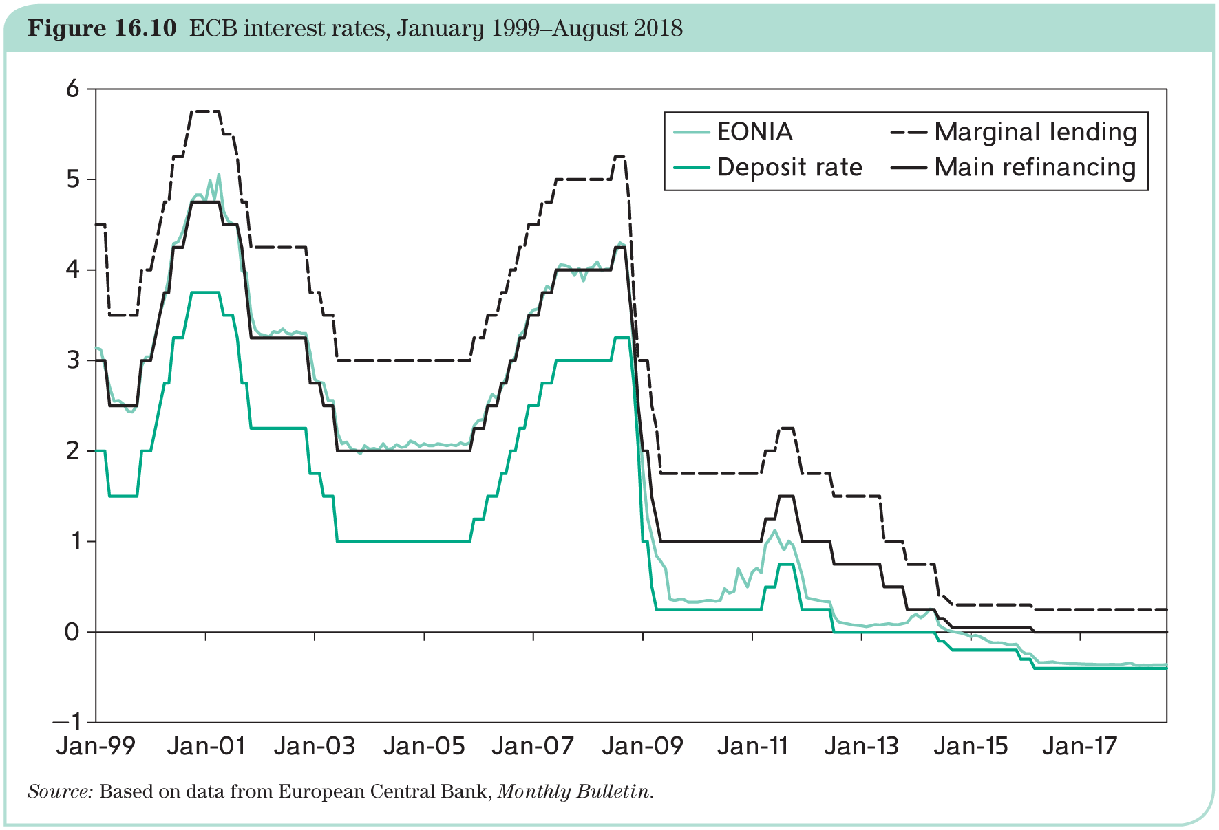
The ECB‘s policy rates

Slide 25
The first years (until the Great Crisis)
A difficult period:
oil shock in 2000;
September, 11 in 2001;
oil prices rose to record level
US financial crisis started mid-2007.
Result: Inflation rate has remained quite close to 2% until late 2007, then showed spikes and a prolonged period of digits below target. Most recently the inflation has been lower than 2%, especially during the peak of the pandemic. The pandemic lead to a temporary deflation and the post pandemic period saw an unprecedented rise in inflation.
Growth has been generally slow in the Eurozone, prompting criticism of the ECB, including by some member governments.

Slide 26
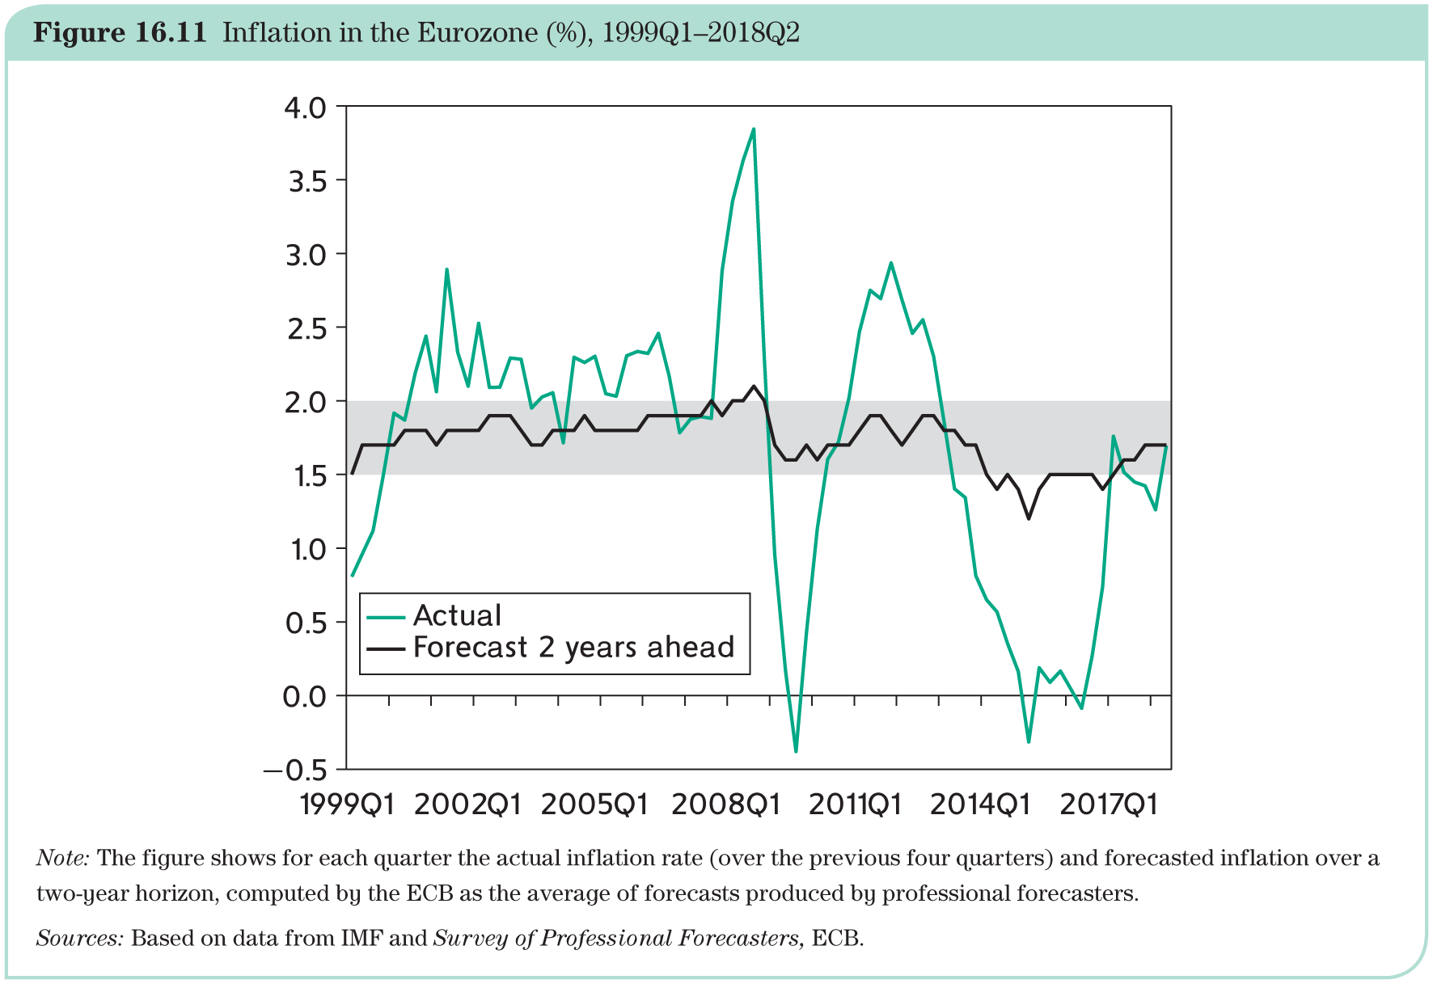
The first years (until the Great Crisis): inflation

Slide 27
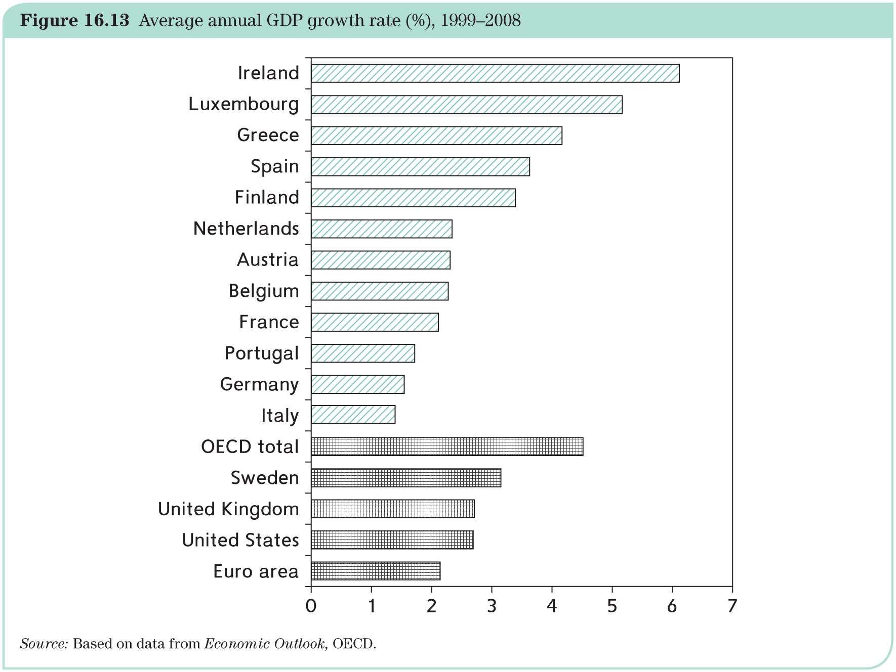
The first years (until the Great Crisis): growth

Slide 28
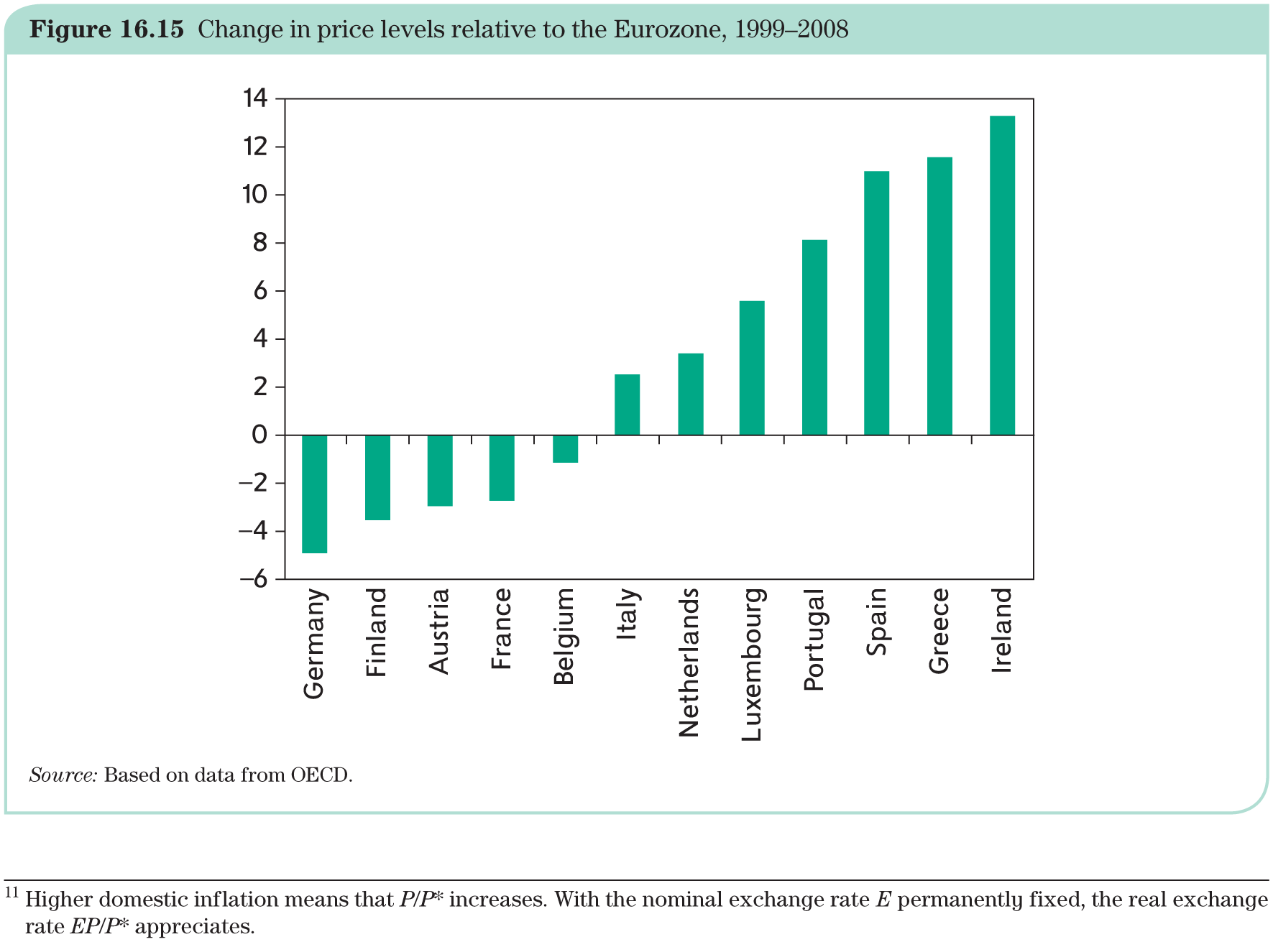
The first years (until the Great Crisis): lasting differences in inflation

Slide 29
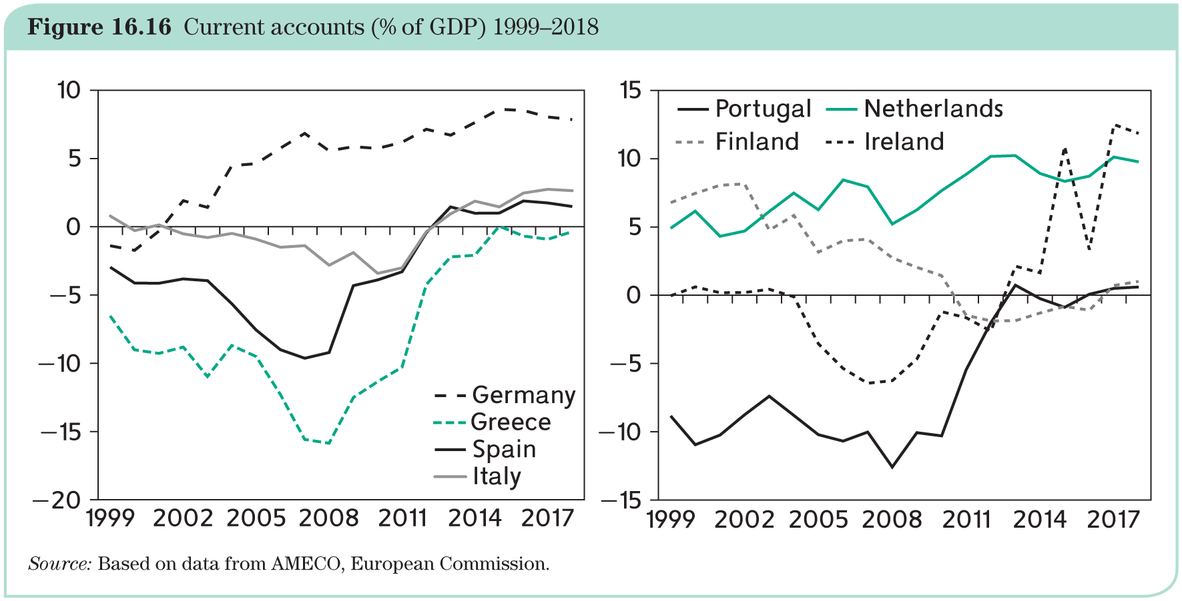
The first years (until the Great Crisis): diverging current account

Slide 30
The first years (until the Great Crisis): growth, inflation, and current account
Growth:
https://www.imf.org/external/datamapper/NGDP_RPCH@WEO/FRA/DEU/ITA/BEL/FIN/GRC/IRL/LUX/NLD/PRT/SVK/ESP
Inflation:
https://www.imf.org/external/datamapper/PCPIPCH@WEO/FRA/DEU/ITA/BEL/FIN/GRC/IRL/LUX/NLD/PRT/SVK/ESP
Current account)
https://www.imf.org/external/datamapper/BCA_NGDPD@WEO/FRA/DEU/ITA/BEL/FIN/GRC/IRL/LUX/NLD/PRT/SVK/ESP

Slide 31
The first years (until the Great Crisis): lasting differences in inflation
Still, large inflation differentials have occurred:
lower than average: Germany, France and Finland;
higher than average: Ireland, Spain, Portugal, Netherlands and Italy.
Possible causes:
catching up in productivity levels (Balassa–Samuelson effect, i.e. laggard economies upgrade their products, adopting better technologies. These countries climb up the product quality ladder and produce increasingly more sophisticated products that they can sell at higher prices, which allows their workers to earn higher wages);
wrong initial conversion rates;
autonomous wage and price setting (e.g. wage increases in excess of labour productivity gains eat into competitiveness)
policy mistakes, such as fiscal expansion (once prices are up, it is difficult to bring them down)
asymmetric shocks, such as oil price effects.
More recently: post-pandemic effects, such as supply bottlenecks, the war in Ukraine and the rise in the price of gas and the alleged role played by excess savings.

