Slide 1

Chapter 18
The financial markets and the euro
The Economics of European Integration, Sixth Edition

Slide 2
The macroeconomic role of financial markets: behind the IS and MP schedules
Financial markets are subsumed in the MP schedule: the central bank sets the interest rate, which affects spending decisions by households and firms.
In chapter 13, we implicitly add up the IS and MP curves of millions of households and firms to derive the aggregate IS and MP curves.
The individual MP schedules do not always respond mechanically to what the central bank does.
Banks constantly assess the prevailing economic conditions and their own situations to decide on how much they lend and at what interest rates.
This assessment may change:
  the interest rate that they charge may change even if the central bank keeps its policy rate unchanged;
  changes in the policy rate stand to affect the assessment.

Slide 3
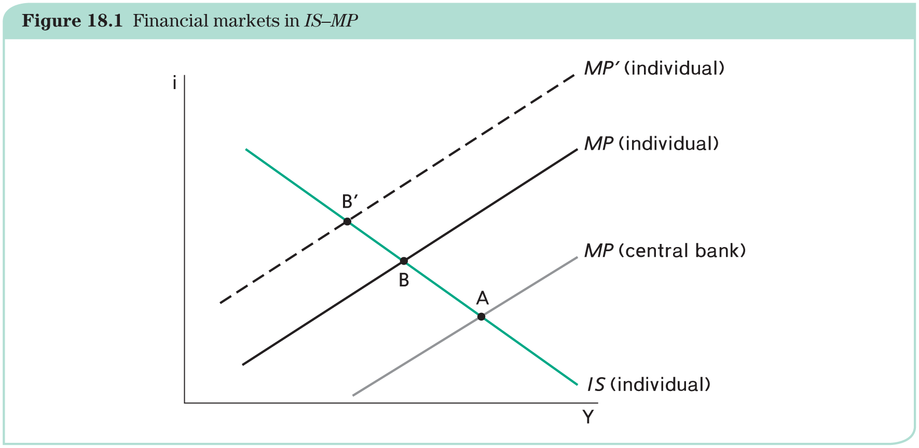
The macroeconomic role of financial markets: behind the IS and MP schedules
The individual MP schedule lies above the central bank’s MP because the individual does not borrow at the policy rate, but at a higher rate.
  The individual’s spending is captured by point B, not point A: less spending because of the higher borrowing rate.
  With higher risk premia, B‘ becomes relevant.

Slide 4
What are financial institutions and markets?
Capital markets collect savings and provide producers with the financial means to invest in productive equipment. They perform three main functions:
1. they transform maturity;
2. they perform intermediation;
3. they deal with inherent risk.
Best-known types financial institutions and markets are:
banks, funds and insurance companies—financial institutions come in all shapes and sizes;
bond and stock markets.

Slide 5
What do financial markets do?
Matching lending and borrowing needs: maturity
Current accounts versus term deposits, with interest differentials since time has a value and the market set its price.
Matching lending and borrowing needs: risk
Investors want high returns and no risk.
Basic trade-off between risk and return: rate of return is adjusted by incorporating a risk premium.
Diversification:
Pooling together assets with negative risk correlation reduce overall risk.
Financial markets can offer almost unbounded possibilities for diversification, the more so the bigger they are.

Slide 6
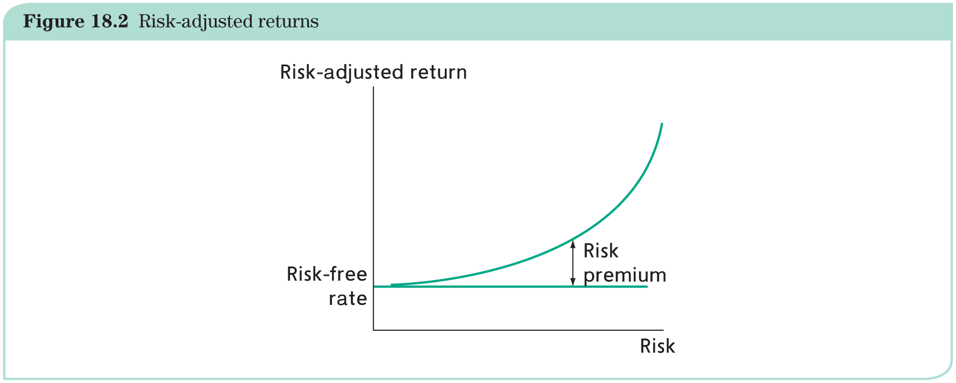
What do financial markets do?

Slide 7
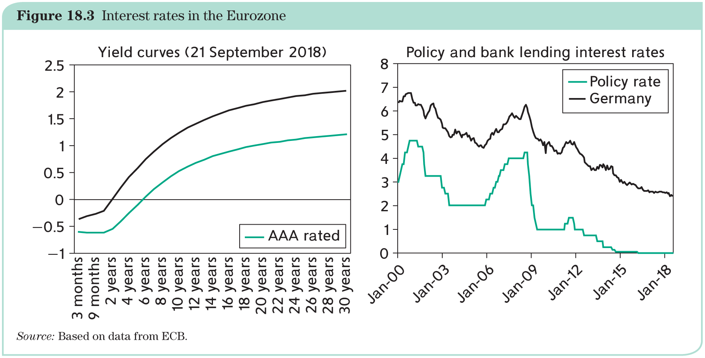
What do financial markets do?

Slide 8
Characteristics of financial markets
Scale economies:
  Matching and risk is easier with many players.
Networks:
  Networks of borrowers and lenders exploiting network externalities (the larger the network, the better it works).
Asymmetric information:
  Borrowers have incentives to conceal risks.
  Lenders are aware and may overprice risk and/or refuse to lend.
  Inherent danger of adverse selection and moral hazard.
→ Implies a need of careful regulation of financial markets.

Slide 9
Effects of a single currency for banks
In principle, banks should compete throughout the euro area. In practice, many limits to this scenario:
good to be known by your banker (information asymmetry);
large costs of switching banks;
importance of wide branch networks.
Banks merge, but mostly within countries:
regulations remain local in spite of harmonization efforts;
cultural differences;
tax considerations.
Early effect:
more concentration and less competition;
banks could establish branches abroad.

Slide 10
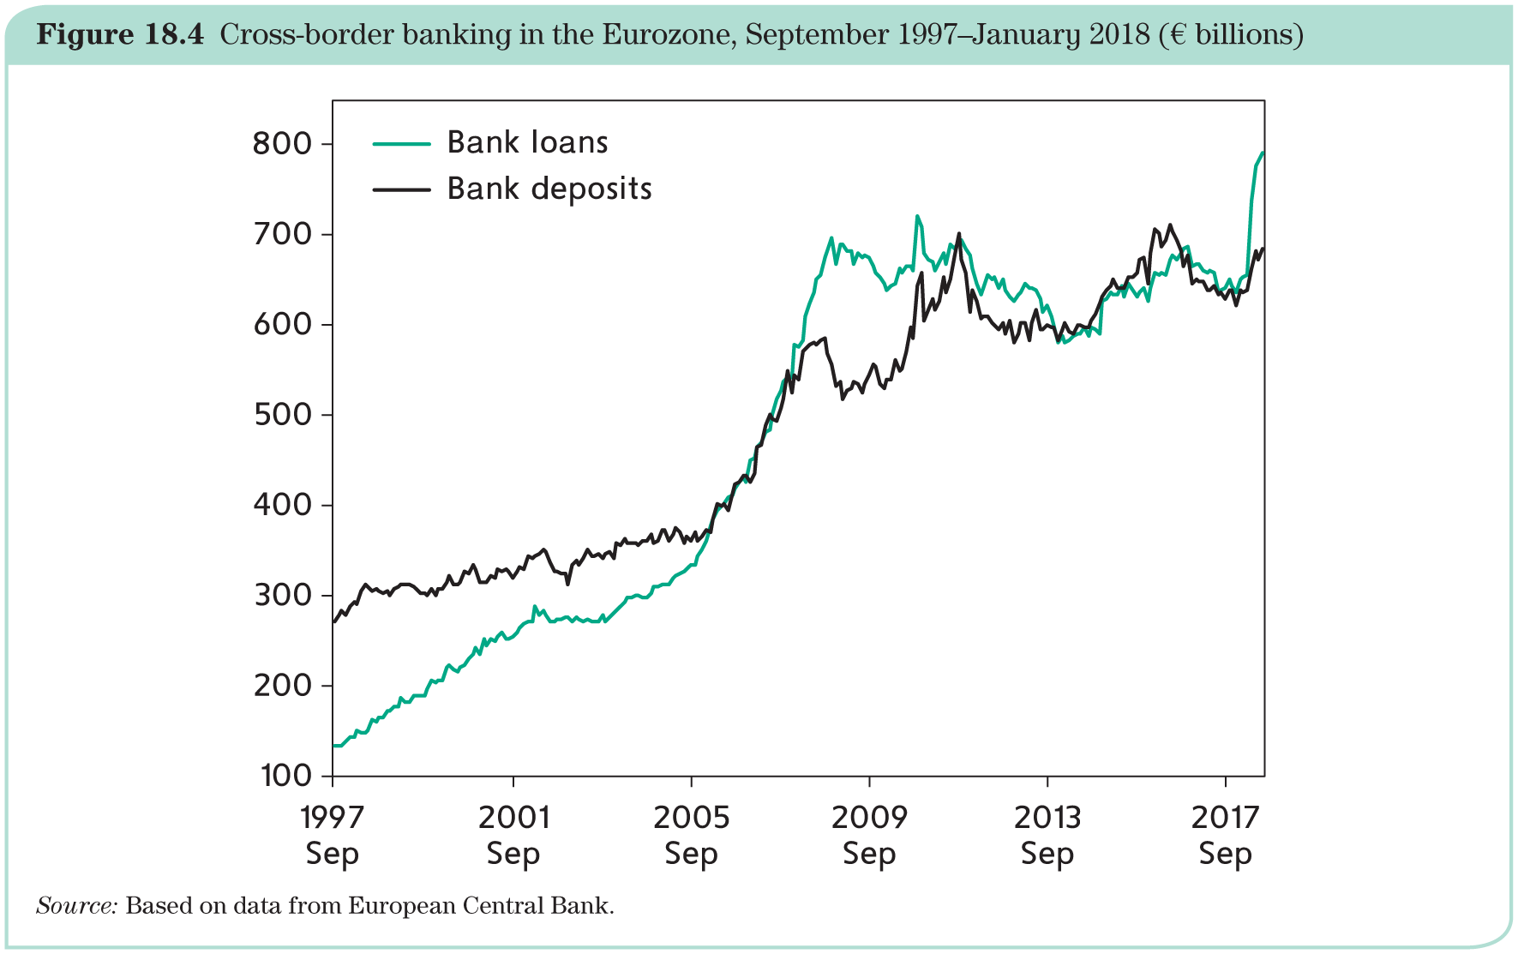
Effects of a single currency for banks

Slide 11
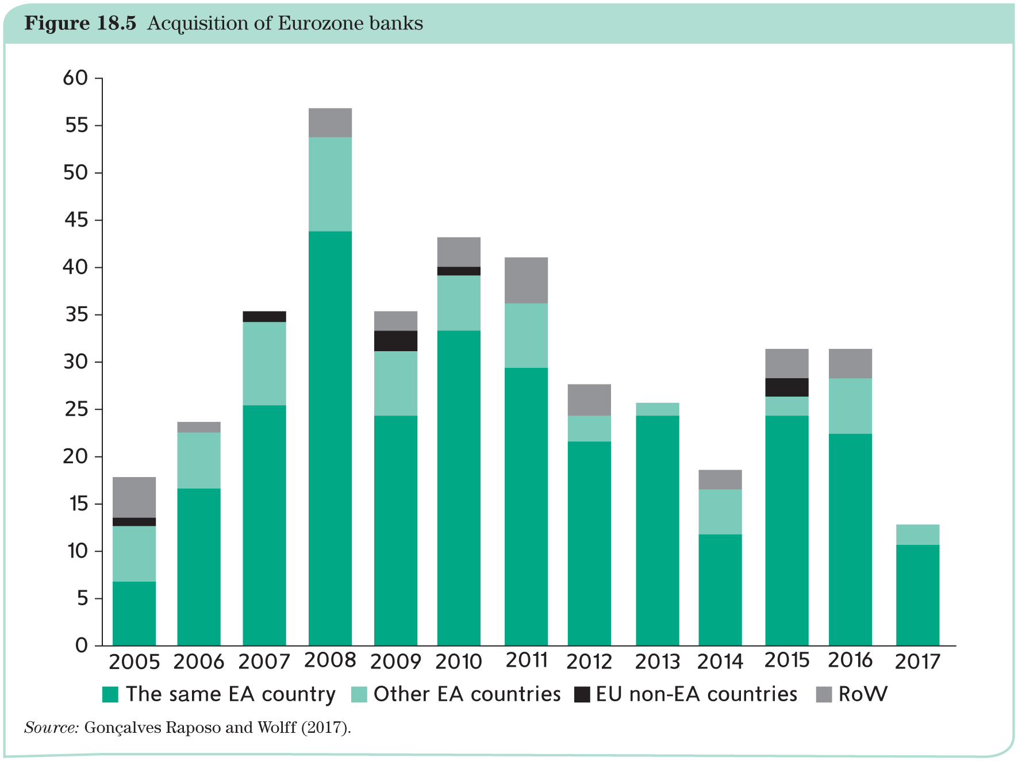
Effects of a single currency for banks

Slide 12
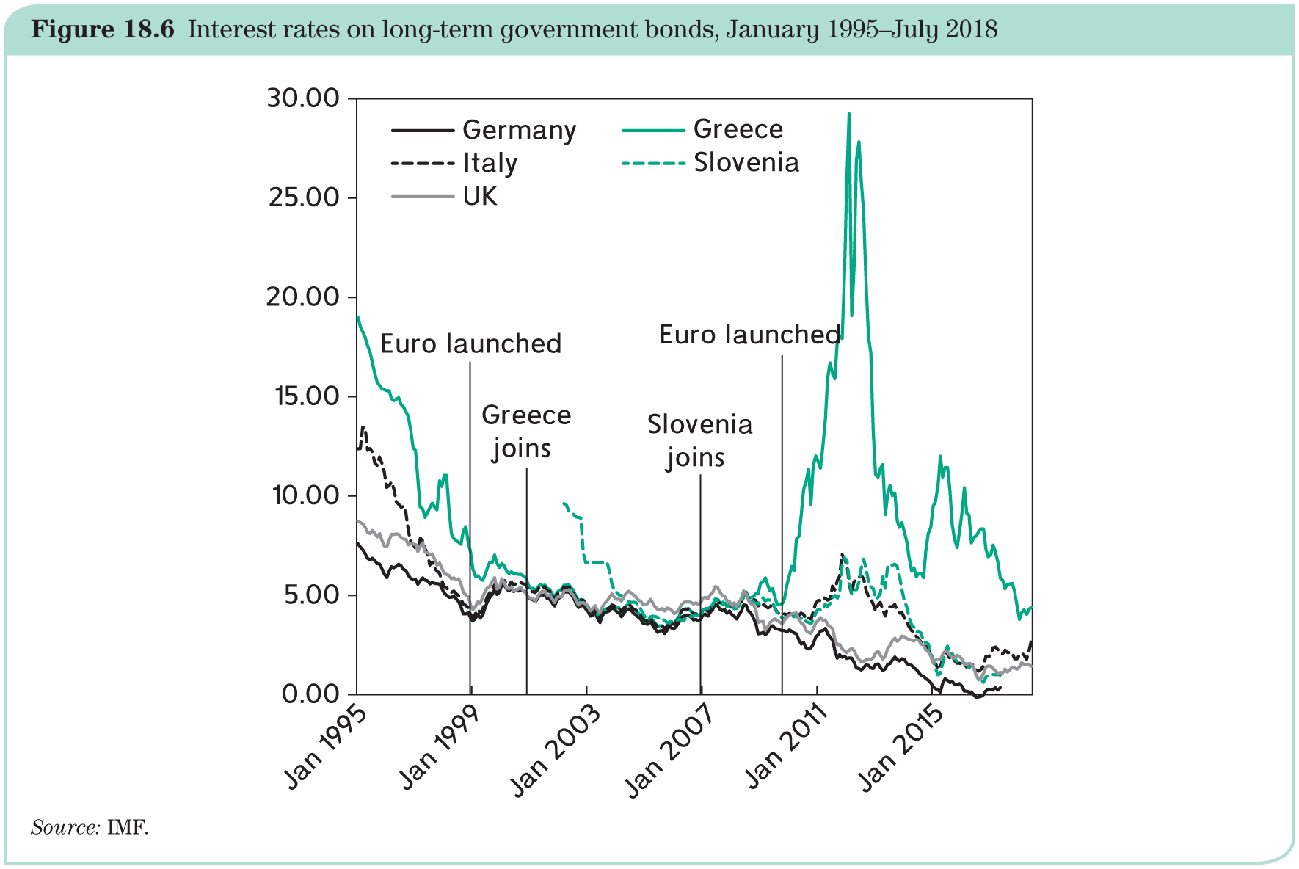
Effects of a single currency for bond markets
Convergence has happened but is not complete; interest rates on long-term government bonds.
The financial crisis changes reversed the convergence extremely.

Slide 13
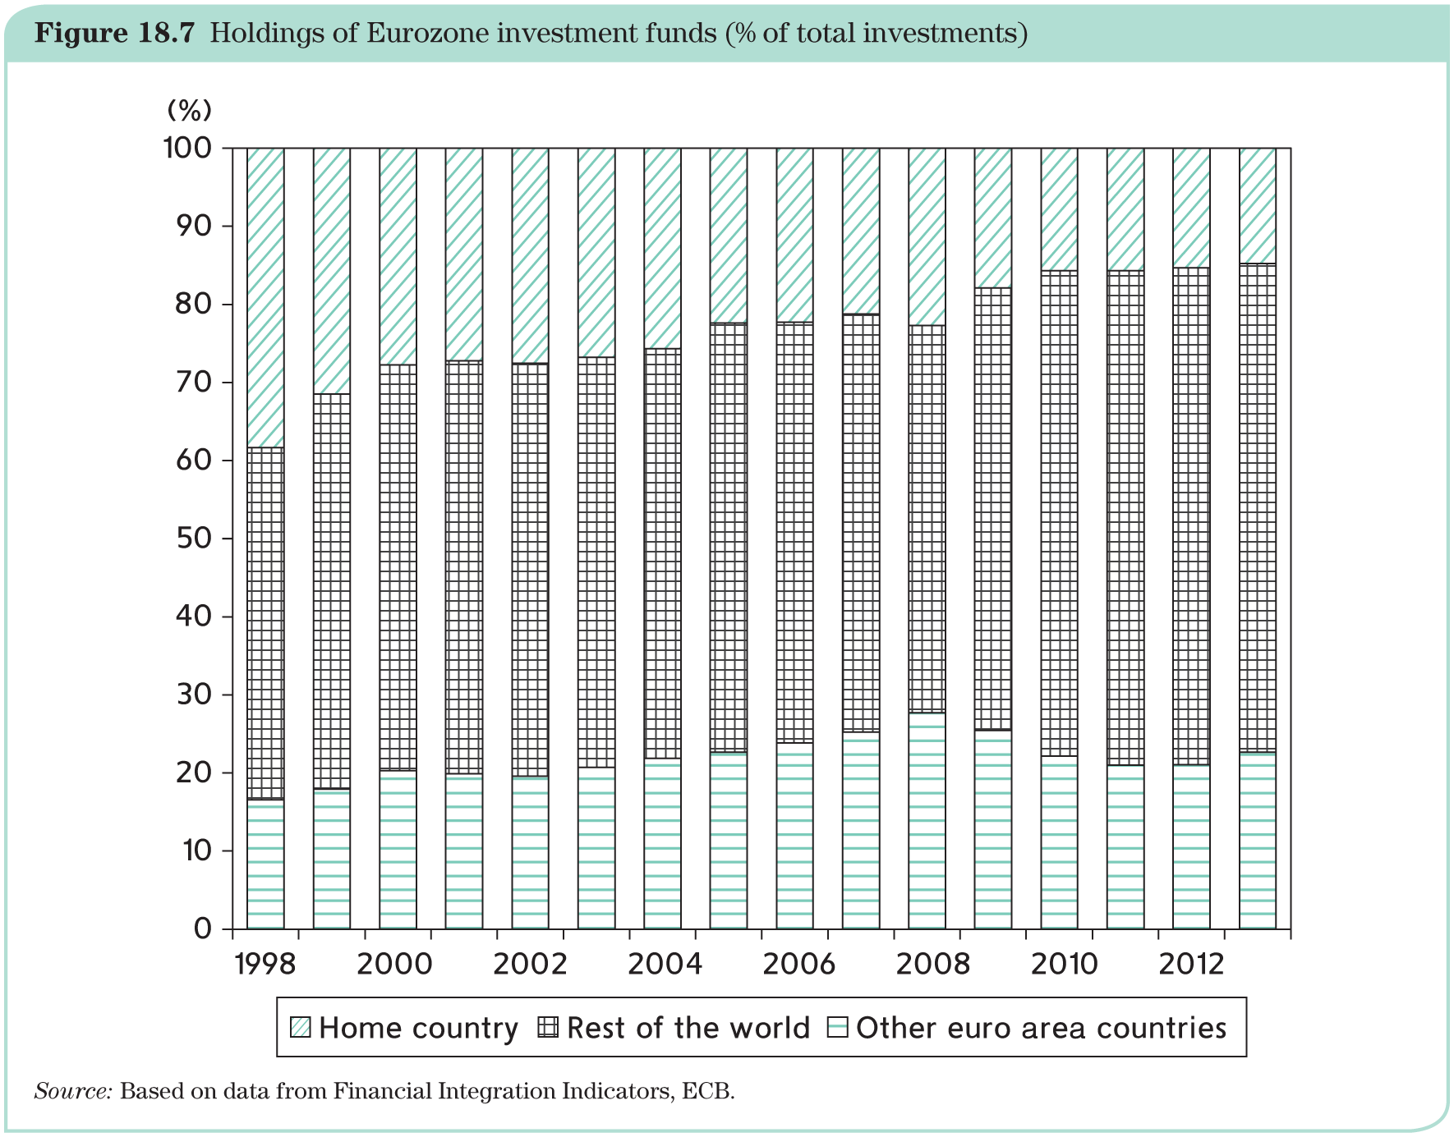
Effects of a single currency for stock market
Worldwide stock markets are surprisingly national (home bias), due to:
information asymmetries;
currency risk → euro area stock markets should be less subject to home bias.
Holdings of Eurozone investment funds (as % of total investment):

Slide 14
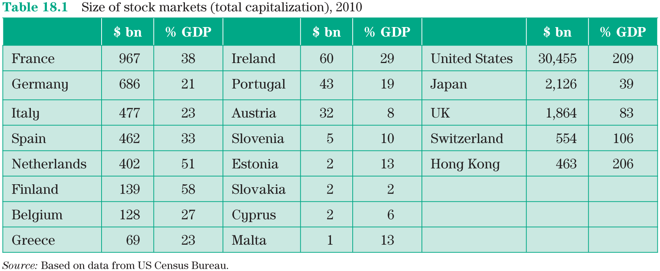
Effects of a single currency for stock markets

Slide 15
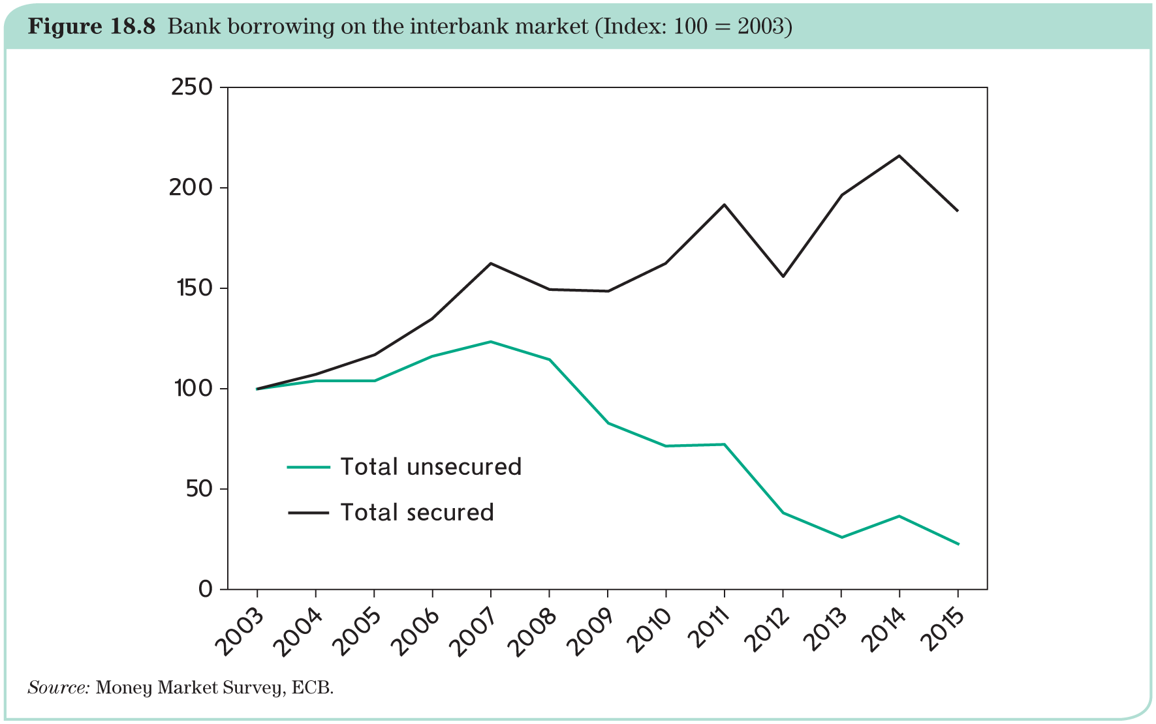
Fragmentation during the crisis: banks and the interbank market
Unsecured lending (i.e. without collateral guarantee) in the Euro money market declined markedly.

Slide 16
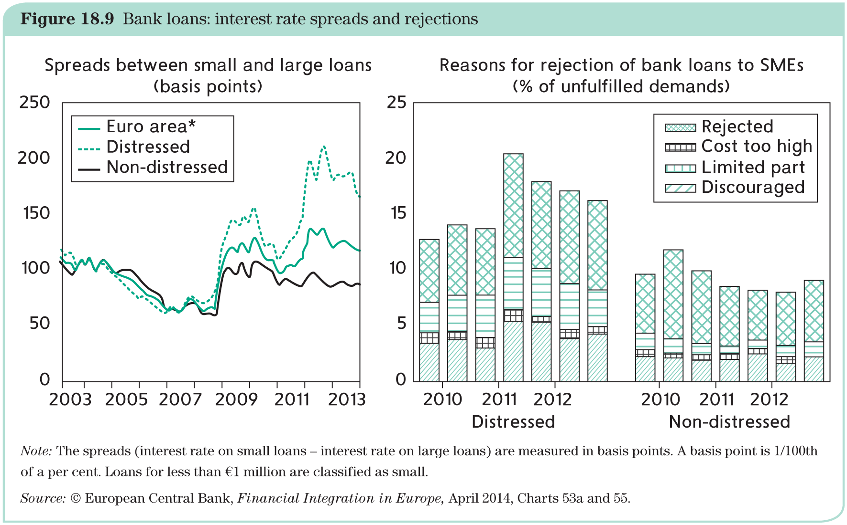
Fragmentation during the crisis: banks and the interbank market
Consequently, banks have become increasingly unable to fulfill their key task of lending to firms and households:

Slide 17
Fragmentation during the crisis: bond markets
Interest rates on several Eurozone government debts started to diverge.
The result was a total fragmentation of the markets for private bonds.
The divergence between public bond rates reflects two risks:
  First, the fear that some governments could default, introducing a risk premium;
  Second, the fear that some countries could leave the Eurozone and restore their own currencies: the redenomination risk.

Slide 18
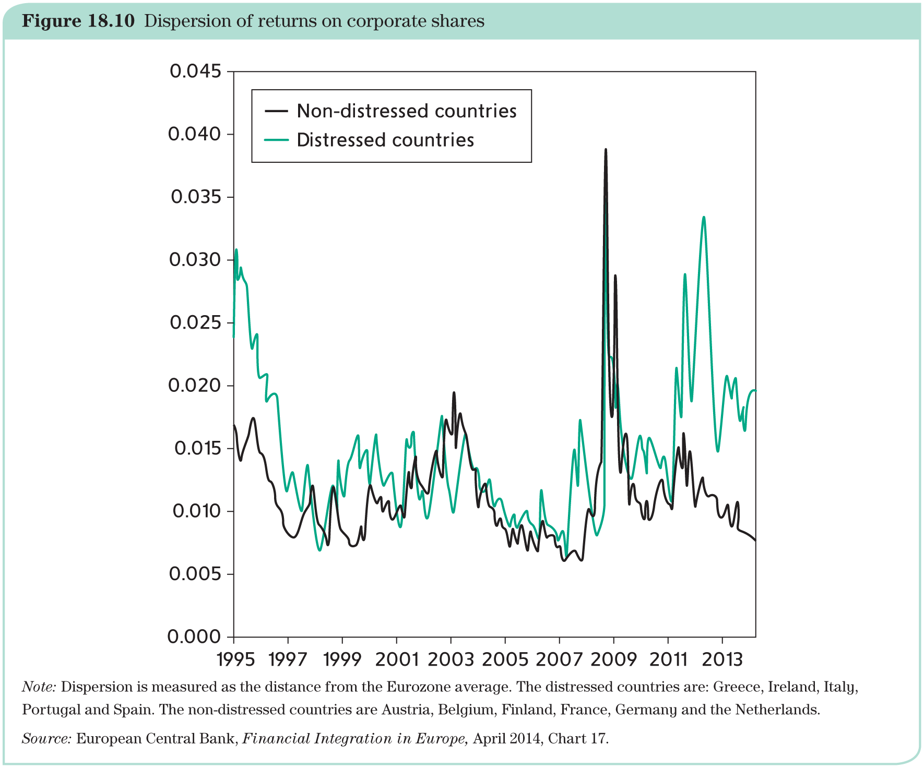
Fragmentation during the crisis: stock markets
Stock Markets displayed a increased dispersion:

Slide 19
Regulation and supervision in the Eurozone
Because of ‘market failures’
financial markets are regulated;
and financial institutions are supervised;
and if necessary a bank resolution has to take place.
Core principles of regulation are agreed within the ‘Basel Committee for Bank Supervision’, which brings together regulators from countries with significant banking systems.
A new institution that examines all financial institutions was created in 2009: the Financial Stability Board (also in Basel): issues recommendations.
In Europe: should regulation, supervision and resolution be carried out at the EU or the national level?

Slide 20
Regulation and supervision in the Eurozone
When the Euro was created, the solution was to combine common regulation with decentralized supervision and national resolution authorities.
The financial crisis that hit Europe in 2008 showed that this system was not adequate. For example: decision by Ireland in 2008 to offer full guarantee to deposits and liabilities of six Irish banks forced other countries, which offered limited guarantees, to offer unlimited guarantees to deposits at their own banks in order not to be at disadvantage.
Crisis led to a task force. The de Larosière Report (2009) showed that:
National supervisors did not share information with one another;
ECB, tasked with the function of lender of last resort, was not any better informed of the true situation of stressed banks.

Slide 21
Regulation and supervision in the Eurozone
Following the proposals of the de Larosière Report, the European System of Financial Supervision (ESFS) has been created, which includes five new institutions:
1. European Banking Authority (EBA), which is charged with collecting detailed information on all EU banks;
2. European Securities Market Authority (ESMA), which brings together all EU bond and stock market regulators and supervisors;
3. European Systemic Risk Board (ESRB), which looks at the overall picture and can issue binding recommendations;
4. European Insurance and Occupational Pensions Authority (EIOPA), focusing on insurance companies and pension funds;
5. Joint Committee of the European Supervisory Authorities (ESA), which brings national supervisors together to improve transparency.
A second step was the creation of the European Banking Union which became effective at the end of 2014.

Slide 22
European Banking Union
Membership to the Banking Union is compulsory for all Eurozone member states and open to the EU countries.
Three building blocks:
  the Single Rule Book, that is, common regulations;
  the Single Supervision Mechanism (SSM);
  the Single Resolution Mechanism (SRM).

Slide 23
European Banking Union: regulation (I)
Own version of the Basel III measures with key requirements are:
Bank capital
  Banks must have an amount of capital equal to 8% of ‘risk weighted assets’;
  Capital is the amount of shares issued by the bank and represents the value of the bank to its owners;
  The bank itself assesses the quality of its assets.
Leverage ratio
  The leverage ratio relates borrowing to capital;
  It will be closely monitored and the authorities can require that it be reduced.
Liquidity ratio
  Ratio of assets that can be promptly and safely sold to obtain cash as a proportion of payments that a bank expects to make over the next 30 days;
  This ratio will have to be progressively raised to 100 per cent.

Slide 24
European Banking Union: regulation (II)
Systemically important banks
  Because they are large, they cannot be allowed to fail, and are extremely costly to rescue or resolve;
  They are subject to higher requirements for the above ratios.
Macro-prudential policies
  When banks face large losses, their capital can be depleted;
  This is the reason for a minimum capital ratio;
  In order to prevent the ratio from falling under the minimum, banks can be required to raise the capital ratio above the minimum in good times to accumulate an additional buffer.

Slide 25
European Banking Union: supervision
Single Supervisory Mechanism (SSM): supervision of the 119 largest banks of the Eurozone is centralized and under the authority of the ECB.
  Because systemically important banks potentially are the source of massive spillovers;
  SSM operates independently of the monetary policy wing, behind a ‘Chinese wall’.
The smaller banks remain subject to national supervision.
Non-Eurozone countries may choose to join the SSM. The SSM is managed by a Supervisory Board, which is part of the ECB.
ECB periodically conducts a Comprehensive Assessment of the banks that it supervises:
  Asset Quality Review (AQR);
  stress tests that simulate hypothetical financial and economic shocks.

Slide 26
European Banking Union: resolution
Second pillar of the Banking Union is the Supervisory Resolution Mechanism (SRM).
Single Resolution Board (SRB) is responsible for all large (systemically important) banks. Its mission involves the following principles:
  Resolution of a bank is decided by the SRB and carried out by the relevant national resolution authority;
  Funding for any cash injection is provided by a new resolution fund;
  The SSM (supervision) and SRM (resolution) are independent institutions to avoid a conflict of interest between these two functions;
  Bank losses are to be borne by the stakeholders in a predetermined order, the so-called ‘pecking order’: first the shareholders, then owners of junior bonds ranked from more to less liquid;
  All bank deposits by households and SMEs are fully protected up to 100,000 euros: European Deposit Insurance Scheme (EDIS, details of its financing are not finally decided yet).

Slide 27
The Capital Markets Union Initiative
In Europe, banks play a much larger role than the financial markets in financing the needs of households and firms.
Capital markets exist in every European country, but they are relatively small.
Key advantage of capital markets over banks is that bank crises are more lethal as governments must protect small depositors.
Investors in capital markets understand that they take risks and, presumably, are set to bear losses when they occur.
Another advantage of capital markets is that it is sometimes easier for startup firms to find resources in capital markets.
Therefore, European Commission is sponsoring the Capital Markets Union Initiative, with the aim of increasing the role of capital markets. So far very little progress has been achieved.

Slide 28
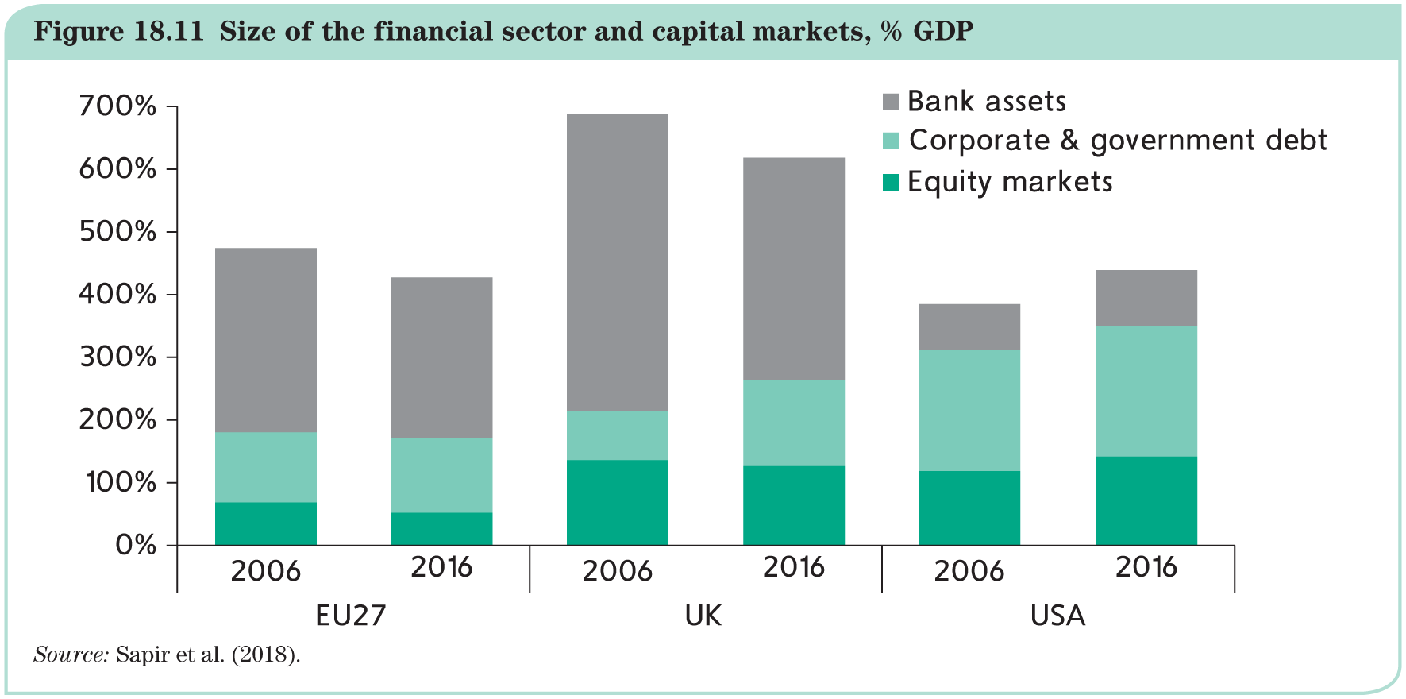
The Capital Markets Union Initiative

Slide 29
The international role of the euro
An international currency must fulfil the same conditions as a national currency. The classic attributes of money are:
  medium of exchange used for commercial transactions;
  unit of account;
  store of value.
Externally, a currency can be:
an international unit of account: trade invoicing;
an international medium of exchange: a vehicle currency;
an international store of value: bond market, foreign exchange reserves, individual hoarding.
Internally, these functions are established by law.
Externally, they have to be earned over time.

Slide 30
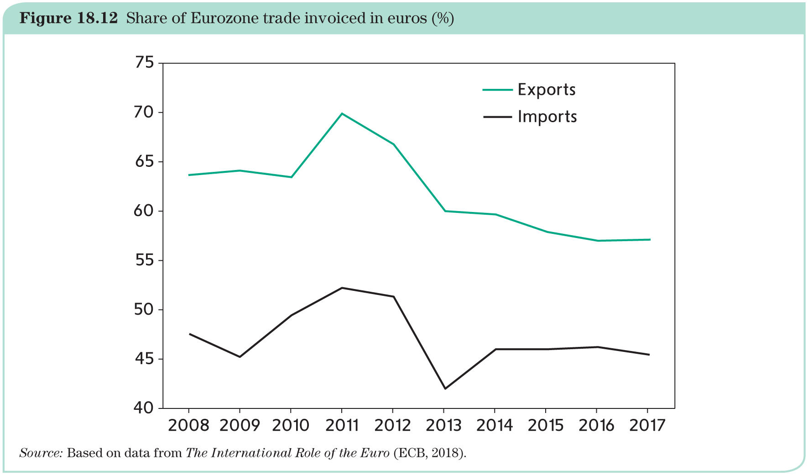
The international role of the euro
Medium of Exchange: trade invoicing

Slide 31
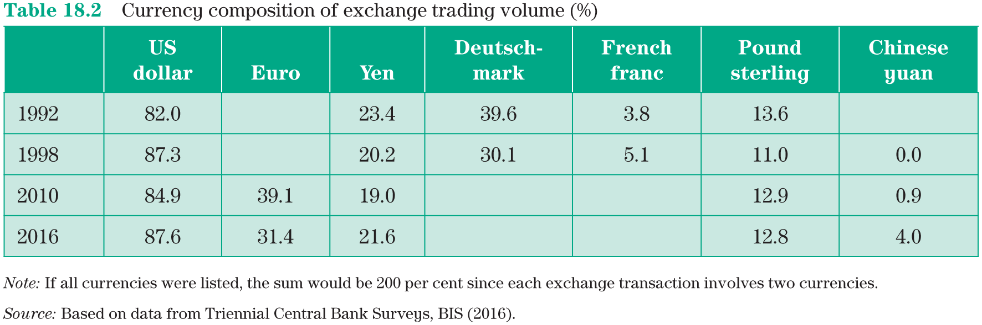
The international role of the euro
Unit of account: vehicle currencies on foreign exchange markets

Slide 32
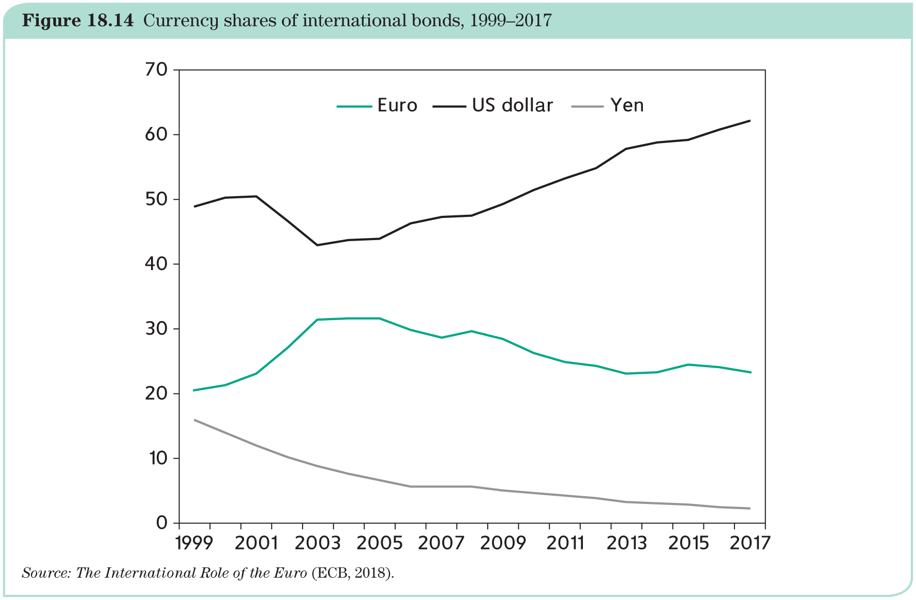
The international role of the euro
Store of value: bond markets

Slide 33
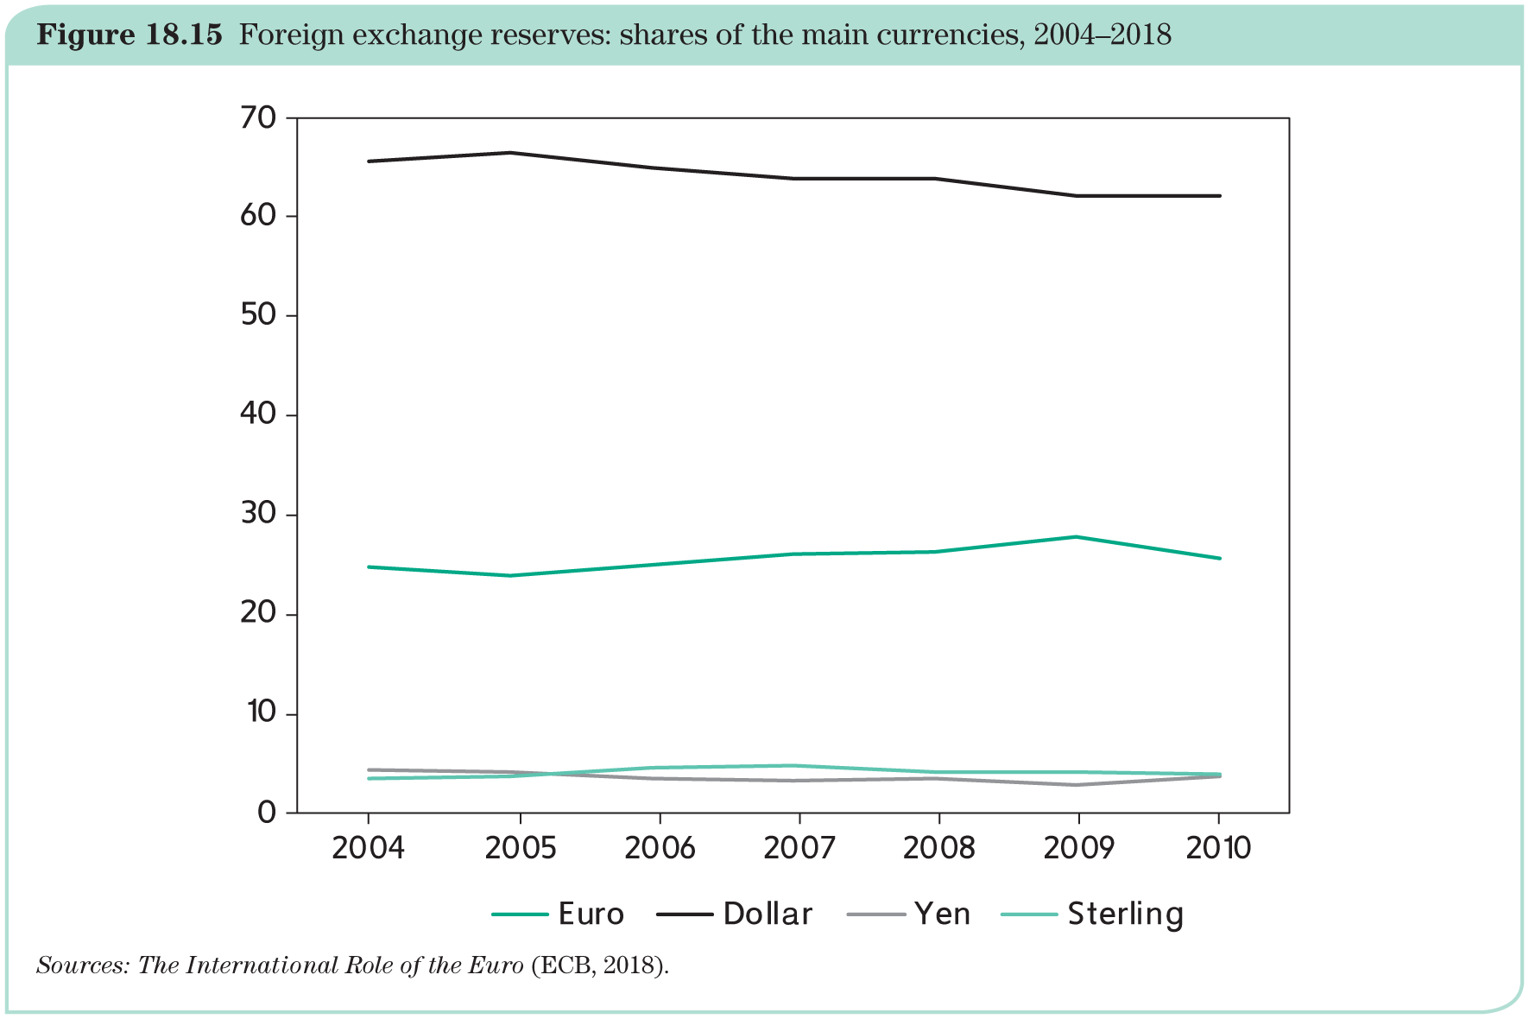
The international role of the euro
Store of value: international reserves

