Slide 1

Chapter 19
The Eurozone in crisis
The Economics of European Integration, Sixth Edition

Slide 2
Stage one: the global financial crisis
Following Great Depression, strict regulation was designed to limit risk-taking by banks and financial institutions.
The deregulation phase started in the 1980s, followed by a rapid expansion of financial sectors in the USA and Europe.
Banks became active investors:
maturity mismatch;
currency mismatch.
Banks took major risks, implicitly borne by their governments.
House mortgages in the US to risky people: subprime mortgages, which relied on ever increasing house prices. And these loans were sold to banks, which sold them to other banks (i.e., securitization).

Slide 3
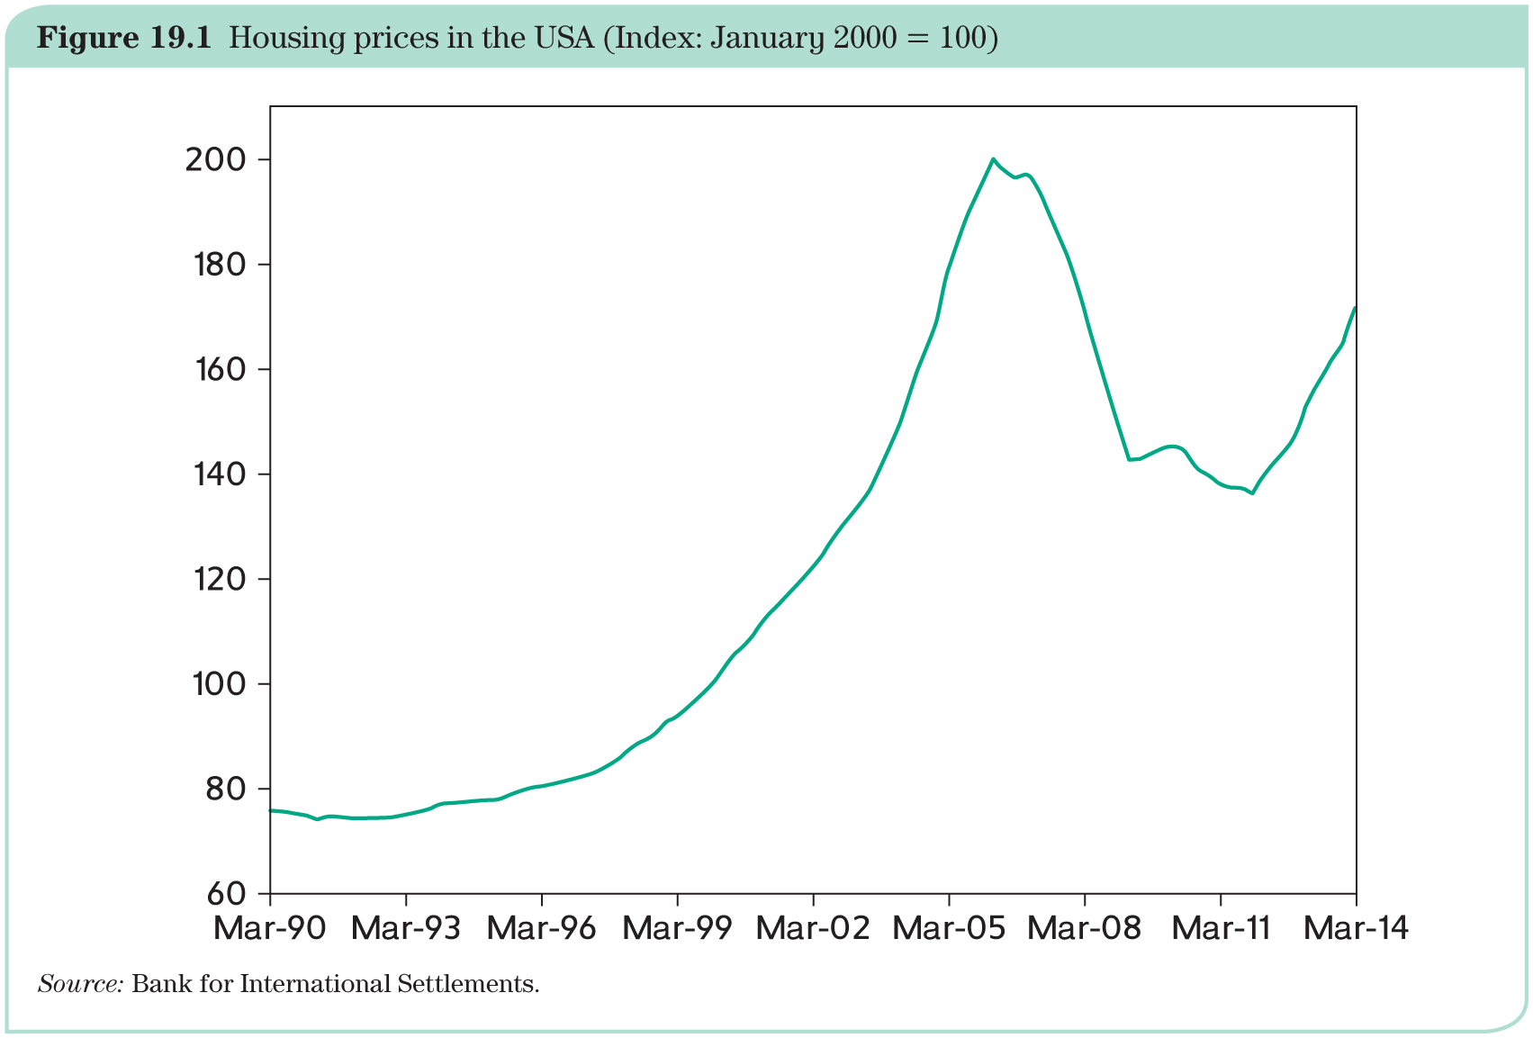
Stage one: the global financial crisis

Slide 4
Stage one: the global financial crisis
When house prices stopped rising, securities lost their ratings, and many of the world’s largest banks (especially in US, UK, France, Germany) faced heavy losses.
April 2007: New Century Financial Corporation (one of the largest US mortgage lenders) declared bankruptcy.
July 2007: Bank Bears Stearns announced that it would stop honouring the commitments of one of its SPVs.
→ Banks grew suspicious of one another and stopped their mutual lending that makes up the interbank market.
→ Central banks provided liquidity directly to their banks.
September 2007 – spring of 2008: Several major banks failed.
15 September 2008: Failure of Lehman Brothers triggered the worst financial crisis since 1929.

Slide 5
Stage one: the global financial crisis
Policy makers (governments and central banks) followed the lessons learned from the Great Depression:
rescue large financial institutions;
deep distress in the financial system is soon followed by a profound and long-lasting recession;
central banks must provide liquidity to the financial system and adopt sharply expansionary policies;
governments must bail out banks and other financial institutions;
governments must use fiscal policy to prevent a vicious cycle of recession and large budget deficits.
The London G20 Summit in 2009 called upon all governments to urgently adopt expansionary policies.

Slide 6
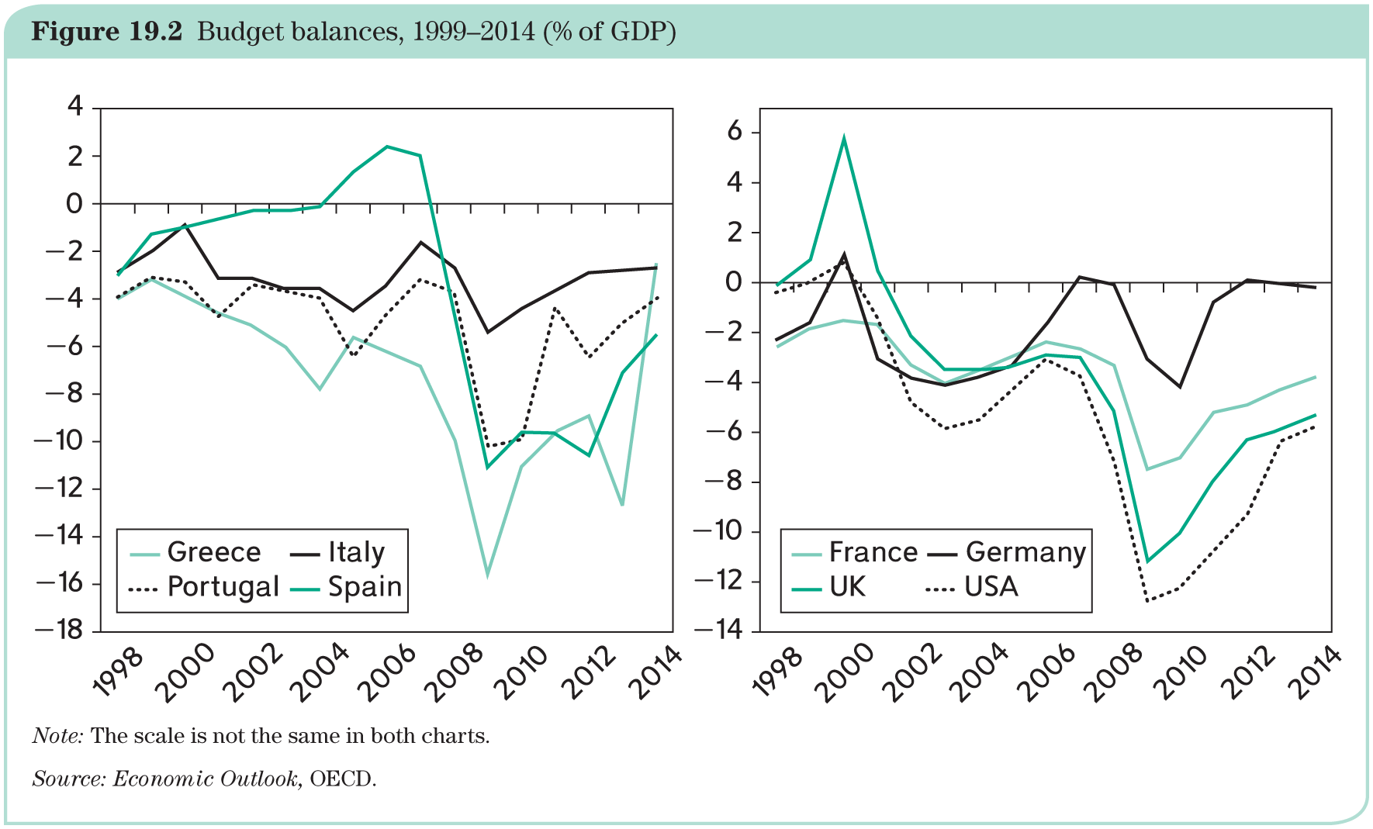
Stage two: the public debt crisis in the Eurozone
These actions had dramatic impacts on budget deficits (e.g., in 2010, Irish government spent almost 30% of its GDP on bank bailouts).

Slide 7
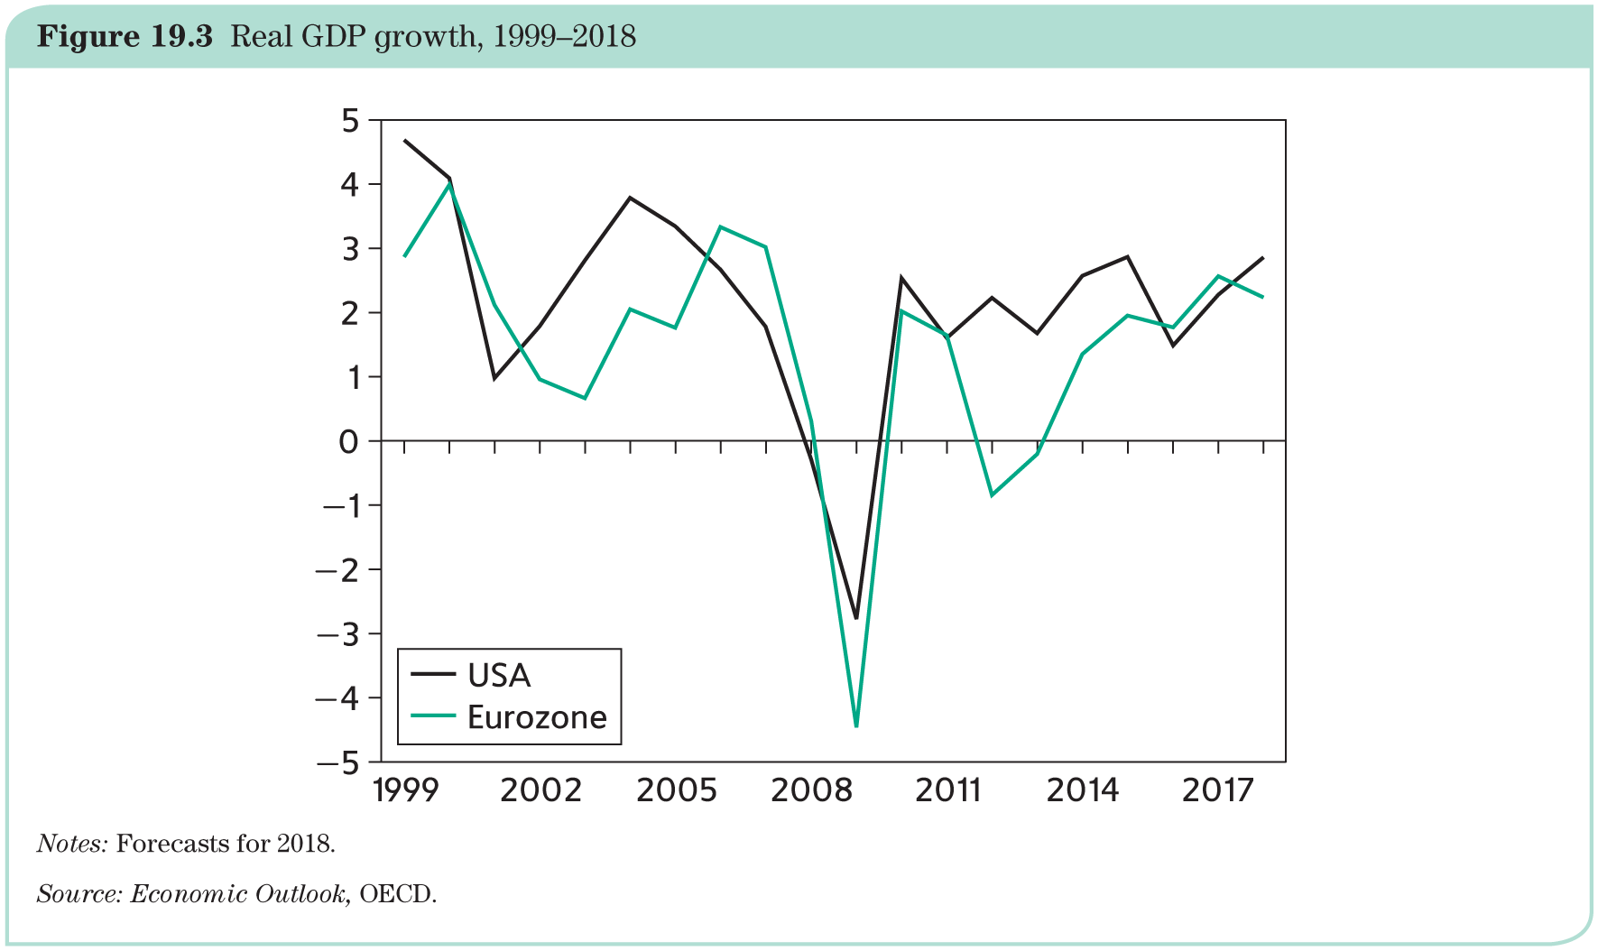
Stage two: the public debt crisis in the Eurozone
The recession has been deep but relatively short-lived.

Slide 8
Stage two: the public debt crisis in the Eurozone
However, negative growth and large budget deficits have led to a fast increase in public debts.
Greece:
Late 2007: public debt at 105% of GDP / late 2009: at 127%.
Early 2010: Greek government in desperate situation.
May 2010: IMF–EU–ECB (called Troika) rescue operation and creation of European Financial Stability Facility (EFSF).
2011: new package from the Troika (conditional loans).
In 2012, the Troika declared itself disappointed and requested stronger measures in exchange for a new €100 billion loan.
In early 2015, a new government was elected after promising to reject the conditions imposed by the Troika: interest rate on Greek bonds jumped.
In July 2015, new loan of €86 billion and a long (up to 30 years) grace period on its debt and the government accepted the conditions it had rejected earlier.
In August 2018, this new programme was completed and both sides declared victory.
Yet, at 180 per cent of GDP, the debt is now much higher than it was in 2009.

Slide 9
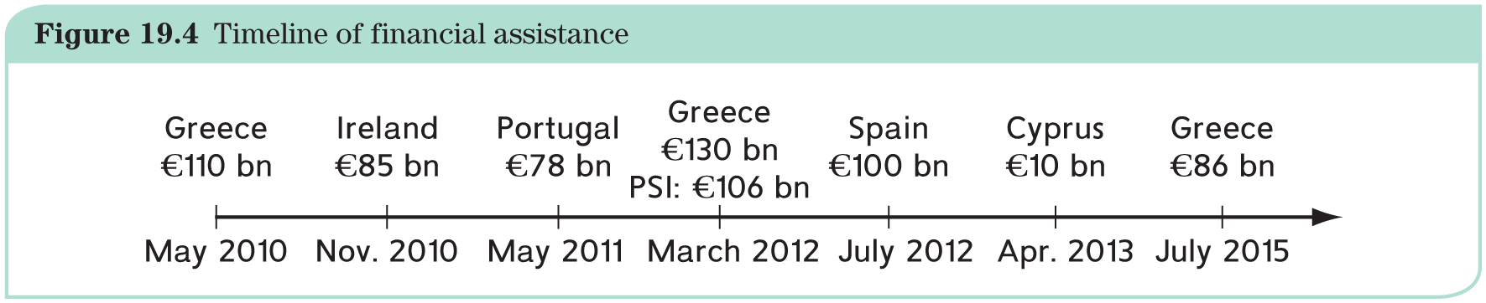
Stage two: the public debt crisis in the Eurozone

Slide 10
Stage two: the public debt crisis in the Eurozone
Bailout of Greece in May 2010 was motivated as a way to avoid highly dangerous contagious effects but this goal proved elusive:
Ireland received a loan in November 2010;
Portugal followed suit with a loan in May 2011.
Contagion within the Eurozone is highly troubling since public indebtedness is not enough to explain why these countries, and not others, have faced the wrath of the financial markets.
Possible additional explanations:
indebtedness;
no lender of last resort;
competiveness issue;
policy mistakes.

Slide 11
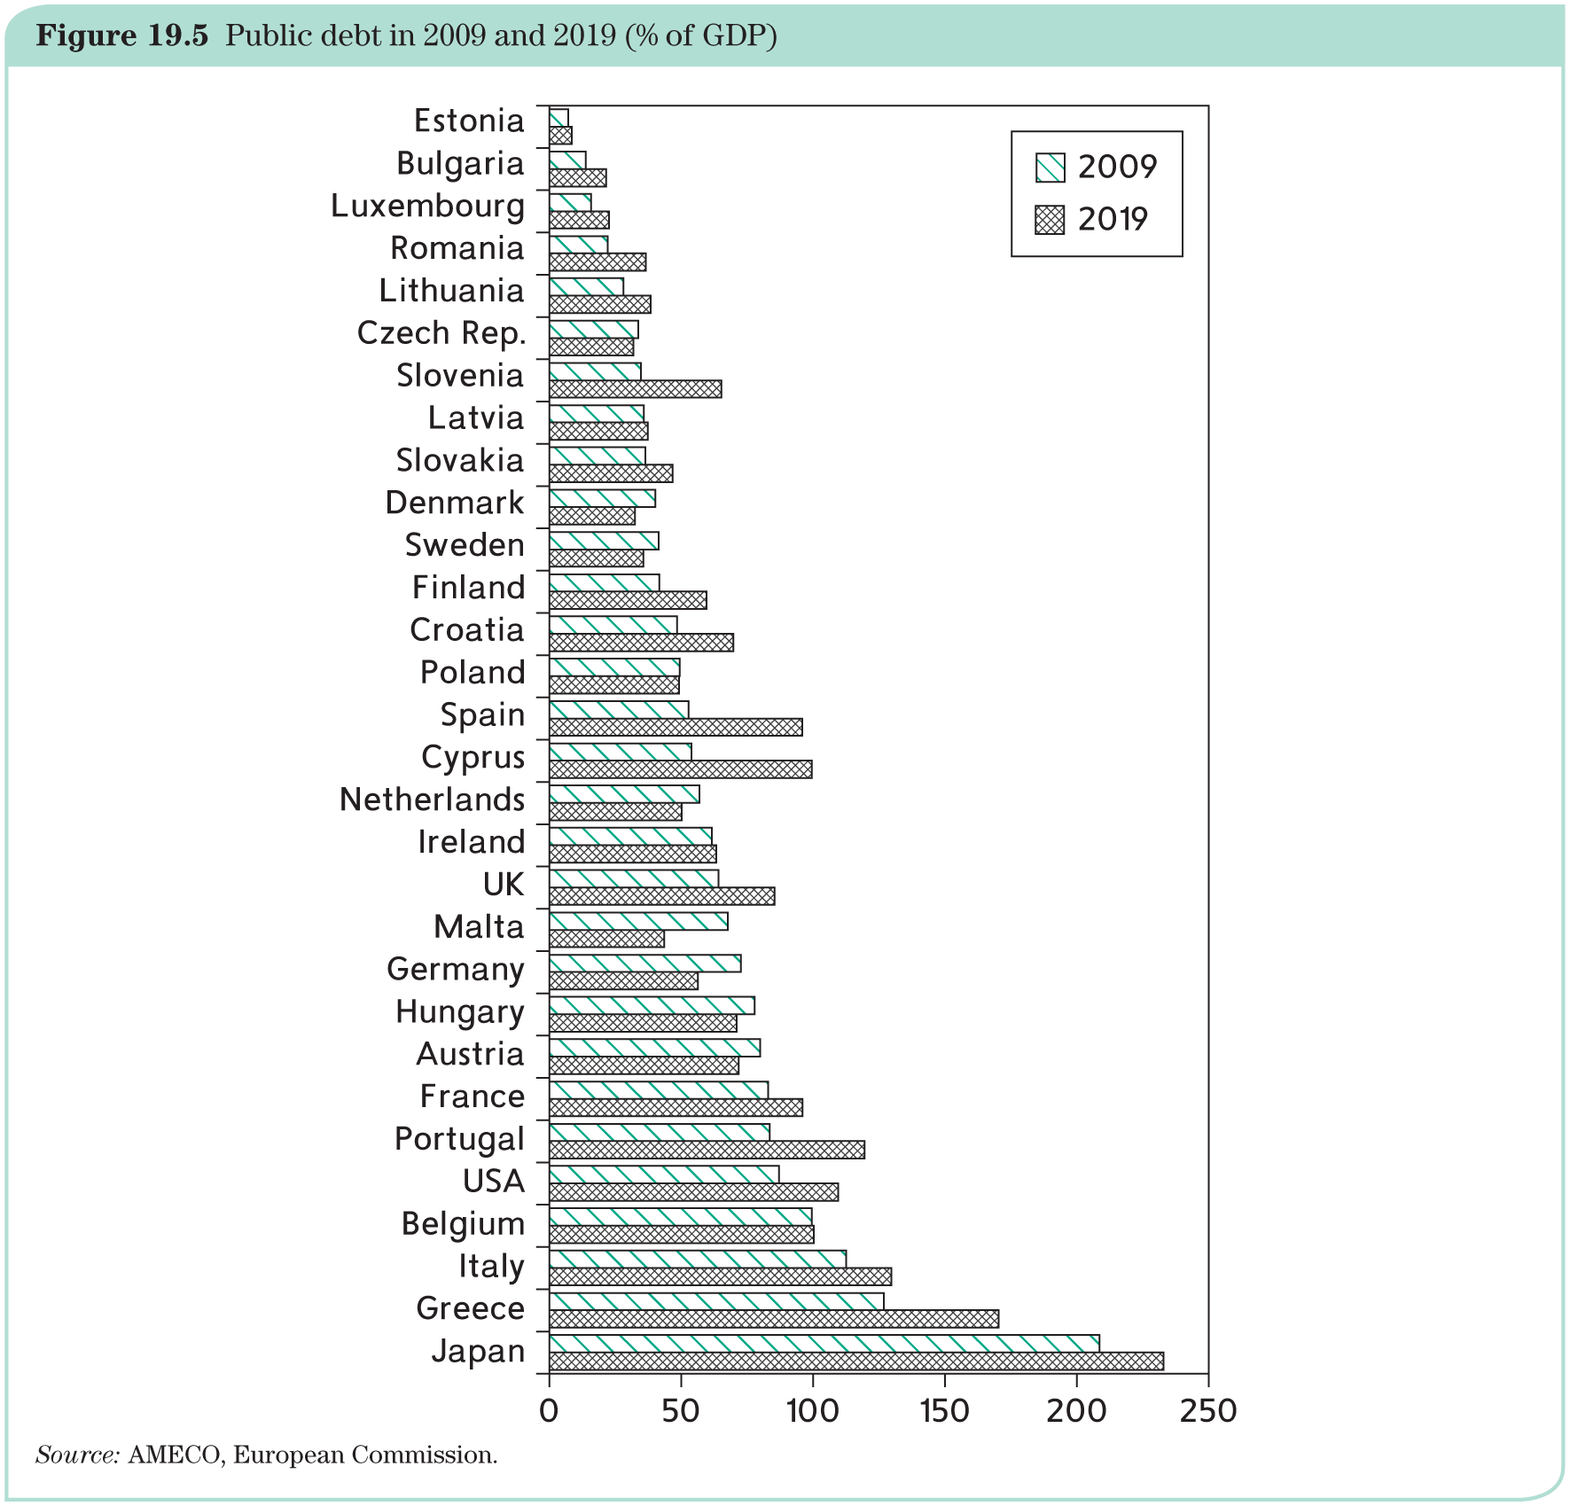
Stage two: the public debt crisis in the Eurozone

Slide 12
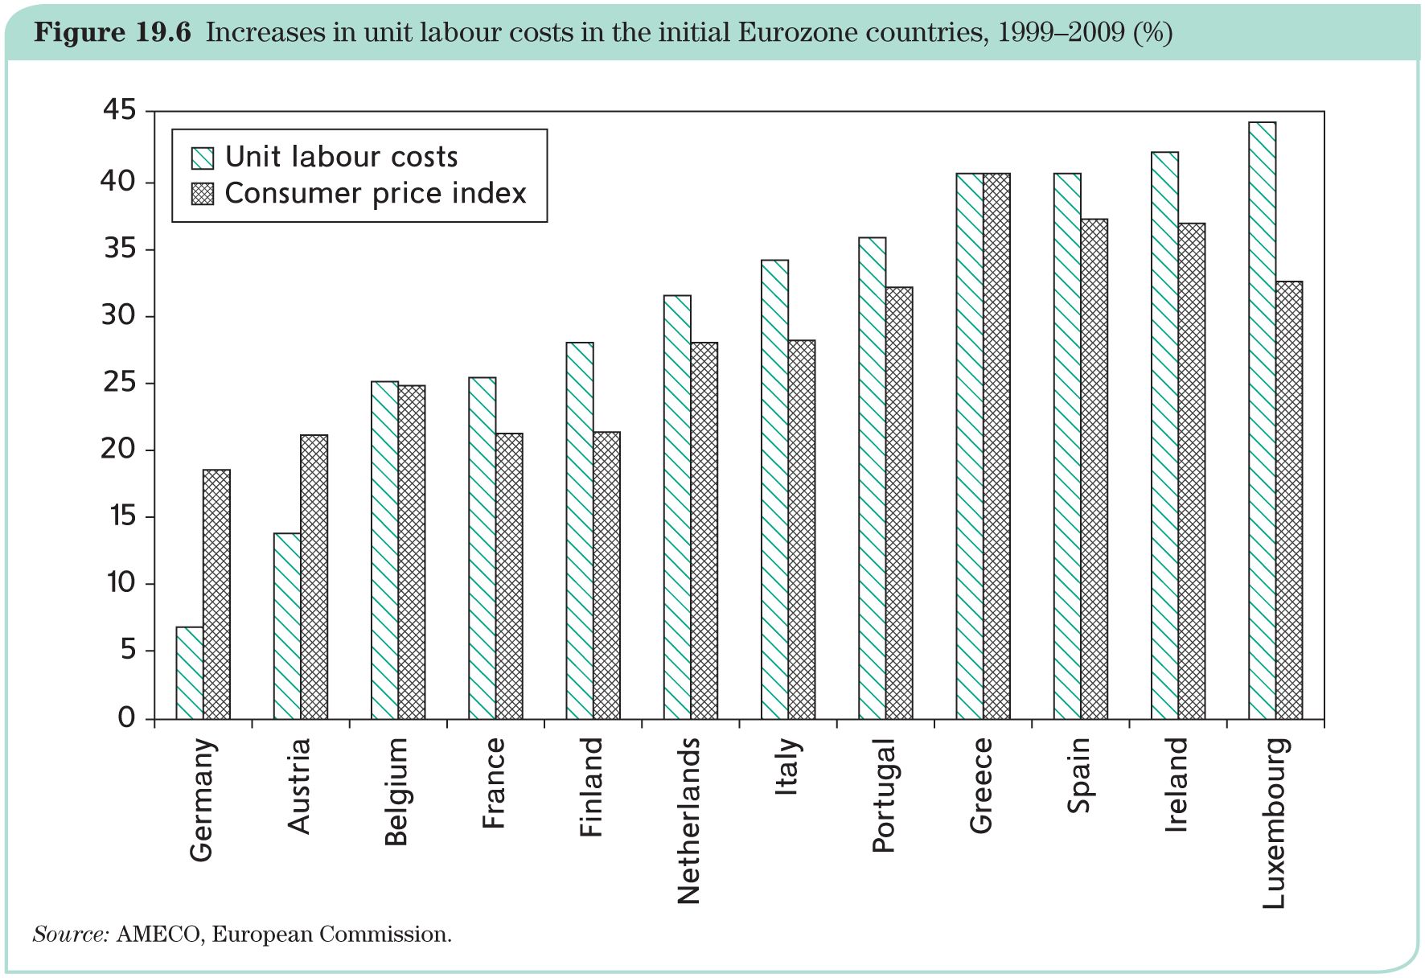
Stage two: the public debt crisis in the Eurozone

Slide 13
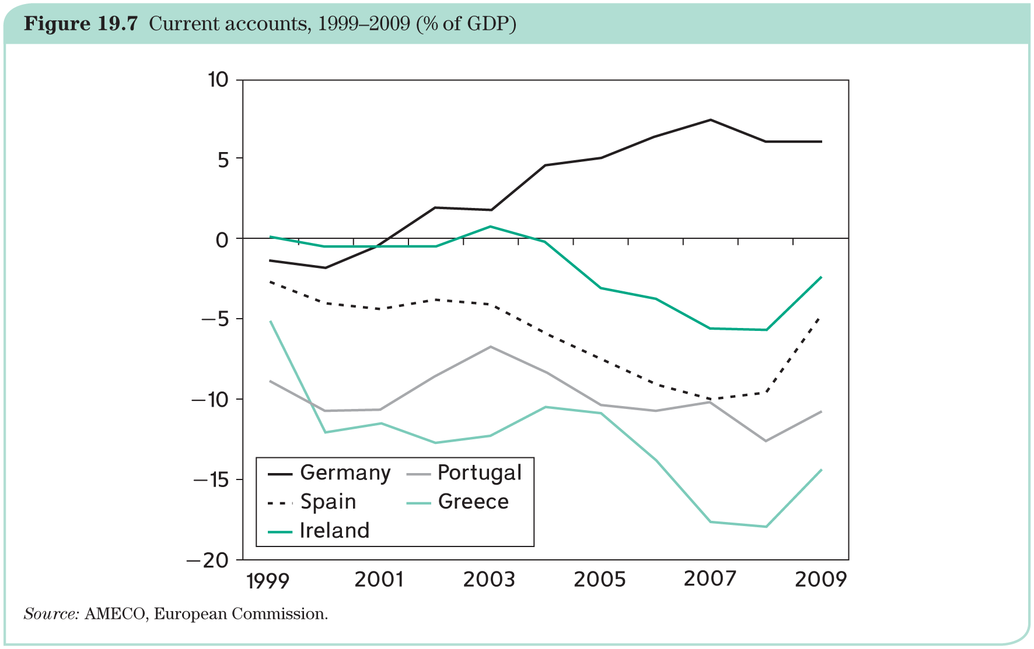
Stage two: the public debt crisis in the Eurozone

Slide 14
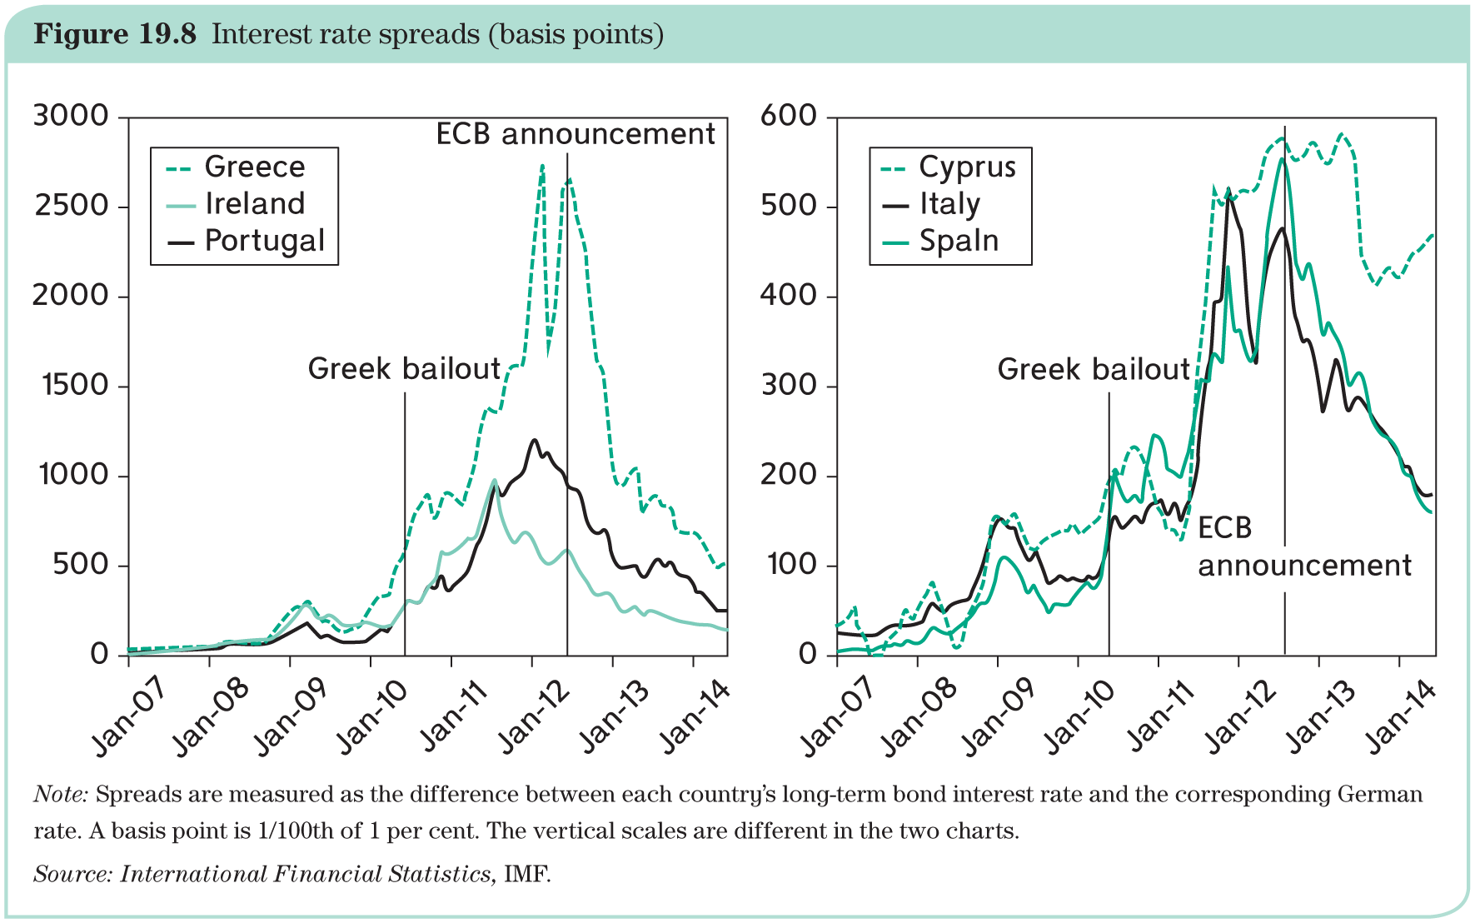
Policy mistakes
Step increases in interest spreads (below) are due to policy decisions that markets perceived as ‘too little, too late’ (e.g., EFSF).

Slide 15
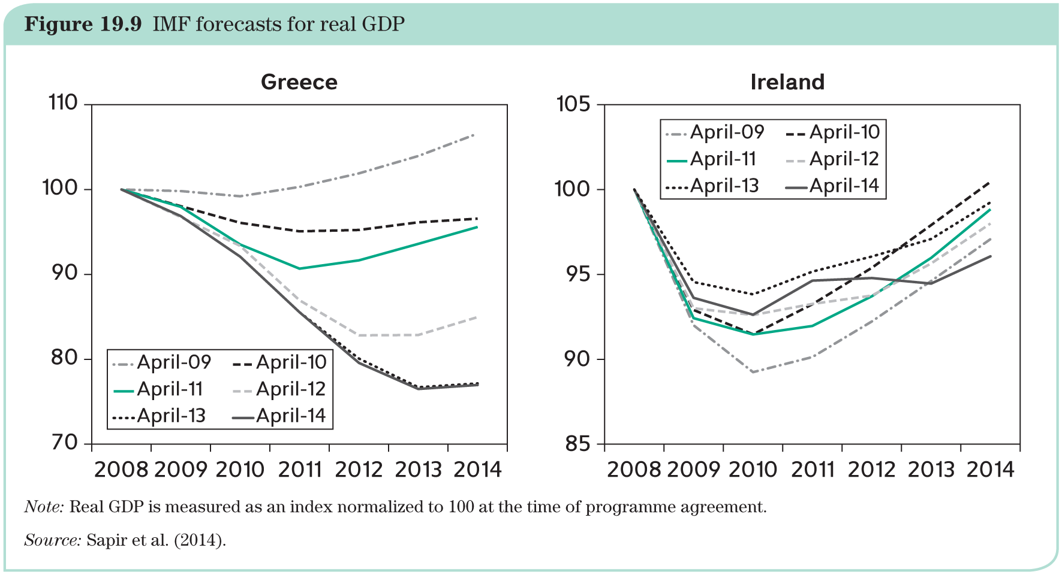
Policy responses
Fiscal policy strategy: fiscal austerity as a mean to return to economic growth.

Slide 16
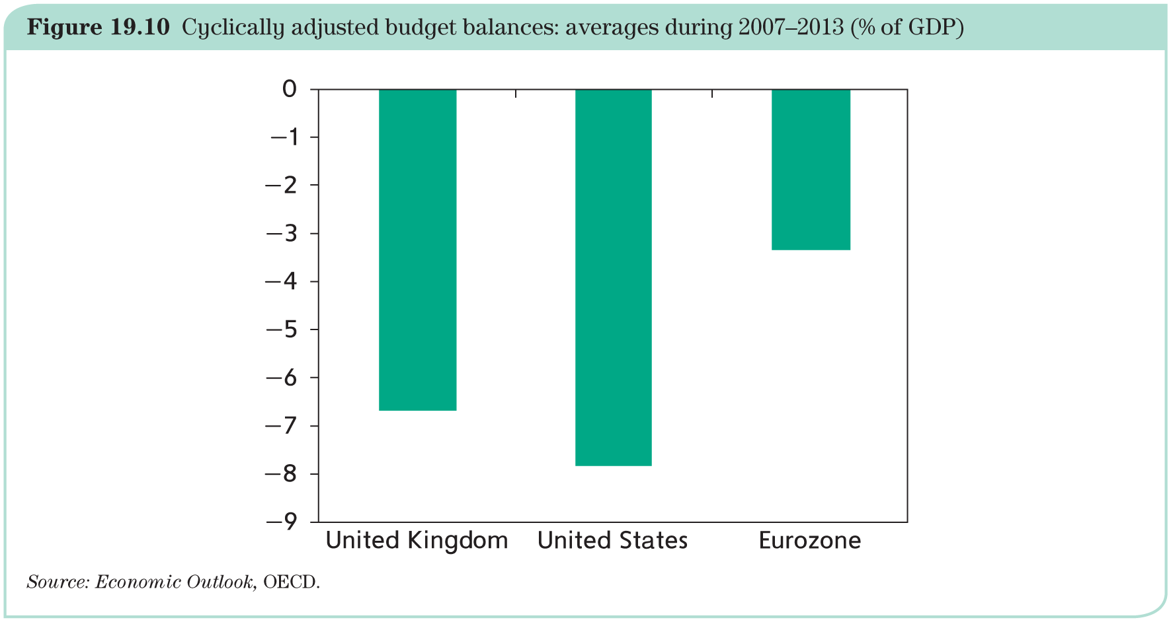
Policy responses
Fiscal policy was much less expansionary in the Eurozone.

Slide 17
Policy responses
‘Bailout Institutions’
Creation of the European Financial Stability Fund (EFSF) for availability of financial resources in case of contagion.
Replacement with the European Stability Fund (ESM) in 2012:
based in Luxembourg;
lending capacity of 500 billion Euro;
capital can be increased up to 700 billion Euro.
ESM is allowed to lend money for bank rescues under a lighter programme called Precautionary Financial Assistance.

Slide 18
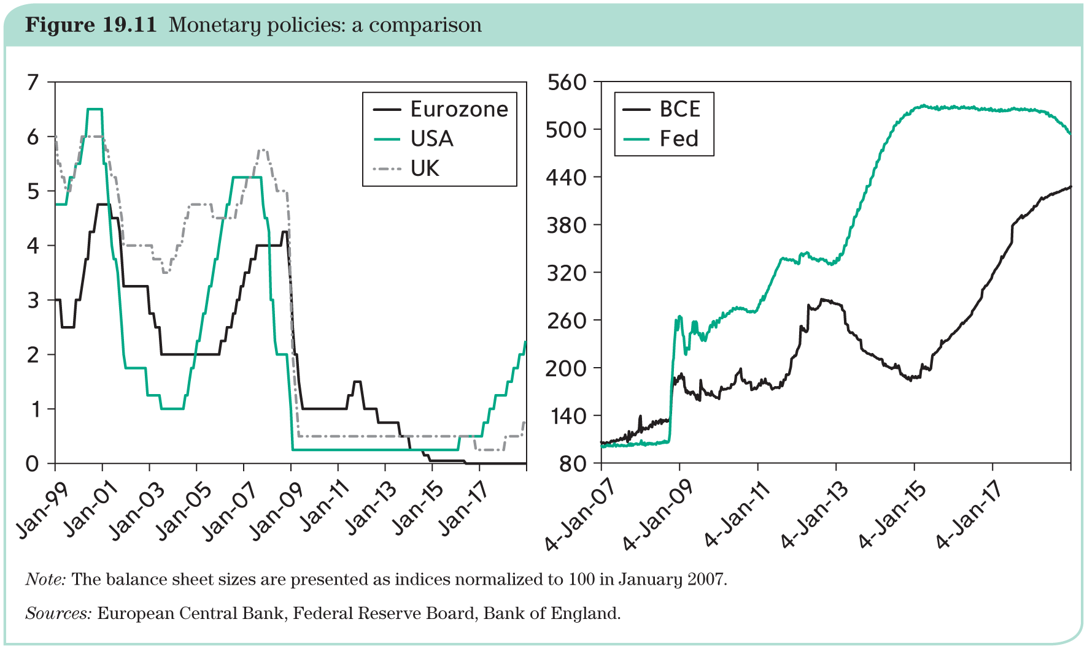
Policy responses: monetary policy

Slide 19
Policy responses: monetary policy
Like the Federal Reserve and the Bank of England, the Eurosystem reduced its interest rate to zero.
Critics have accused the Eurosystem of being ‘behind the curve’, reacting slowly to the turn of events rather than being proactive.
Within a few weeks, the size of ECB balance sheet–which measures the total amount of its loans–increased by an unprecedented 40%.
With Quantitative Easing (QE), the ECB was also slower to react: it first allowed its loans to banks to decline. Then, two years after its counterparts, it also adopted QE.
The ECB was very concerned to give the impression that its independence was being eroded.

Slide 20
Policy responses: monetary policy
In July 2012, its president Mario Draghi announced that ‘the ECB is ready to do whatever it takes to preserve the euro’.
This announcement was understood as a promise to buy as many crisis countries’ public bonds as necessary.
In September 2012, this announcement was formalized with the Open Market Transactions (OMT) programme. This was a drastic step because it could be construed as financing deficits.
Even though the ECB did not actually make any purchases under the OMT programme, the spreads still declined quite dramatically.
OMT programme was legally challenged to be not ‘within the mandate’ of the ECB.
The European Court of Justice finally ruled in favour of the ECB.

Slide 21
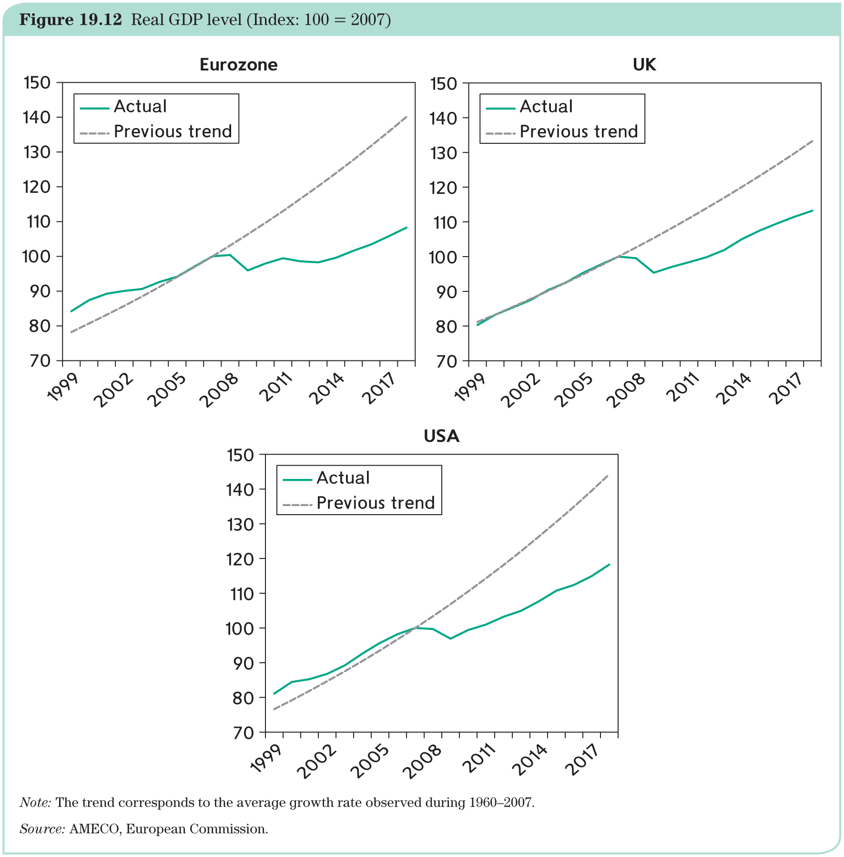
The outcome
Eurozone differs from comparable countries:

Slide 22
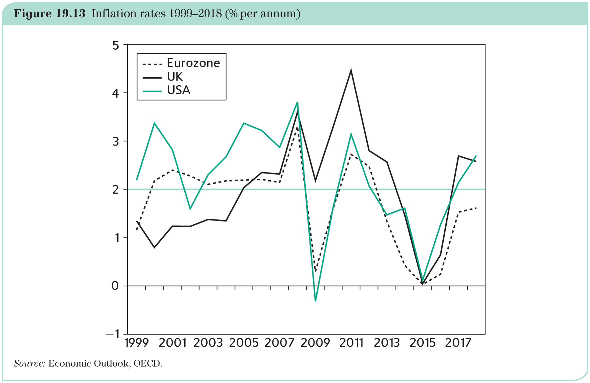
The outcome
Missing the inflation target from below:

Slide 23
Banks and public debt
Multiple equilibria as the most serious threat of crisis.
The ‘doom loop’
  Banks were ‘encouraged’ to buy public bonds as a means of upholding their value.
  As the crisis deepened, the share of public national debt in the portfolios of banks continuously increased.
  The doom loop thus locked governments and their banks in a dangerous embrace:
    Banks depended on forgiving government supervision, but also on their countries’ public debt reputation;
    Governments needed banks to support their bonds and were highly motivated to help them.

Slide 24
What have we learned from the crisis?
Very high debt creates serious difficulties
Limits countercyclical fiscal policy
Possibly challenges monetary policy independence
Possibly limits growth
Eurobonds may have appealing features
Element of solidarity
Single Eurobond market might challenge US Treasury Bonds (as international reserves)
Considered to be safe
End fragmentation of Eurozone financial market
But, politically unfeasible (What about now?)
Debate on debt restructuring
Bank fragility
Governance

Slide 25
Survival of the euro
Some observers argue that the Eurozone is doomed because:
Europe is not an optimum currency area.
Lack of fiscal discipline:
  Countries with high debts need to grow fast to generate tax revenues. If that is not possible, debt restructuring is unavoidable.
  However, defaulting countries typically undergo a sharp exchange rate depreciation, which provides the demand boost that they need to recover and grow.
  But there is no room for depreciation in a monetary union.
Gap between well-functioning North and badly wounded South plus solidarity has been strained (what about now?), thus undermining one of the OCA criteria.
Many international investors do not believe that the euro can survive (self-fulfilling process).

Slide 26
Survival of the euro
Others argue that the euro will survive:
Breakup would have catastrophic implications and this ties countries together.
A new currency would have to be printed and reintroduced. Unclear how to manage this in short time.
It may well be that some countries will have to default, but that does not require an exit from the Eurozone.
No legal procedure for a country to leave the Eurozone exists.
The crisis has made it clear that the euro architecture needs to be improved, and solutions do exist.
The Eurozone may not be an optimum currency area, but neither is it hugely ill-suited to operate with a common currency. The bigger problem has been the mishandling/political mismanagement of the crisis.

