Slide 1
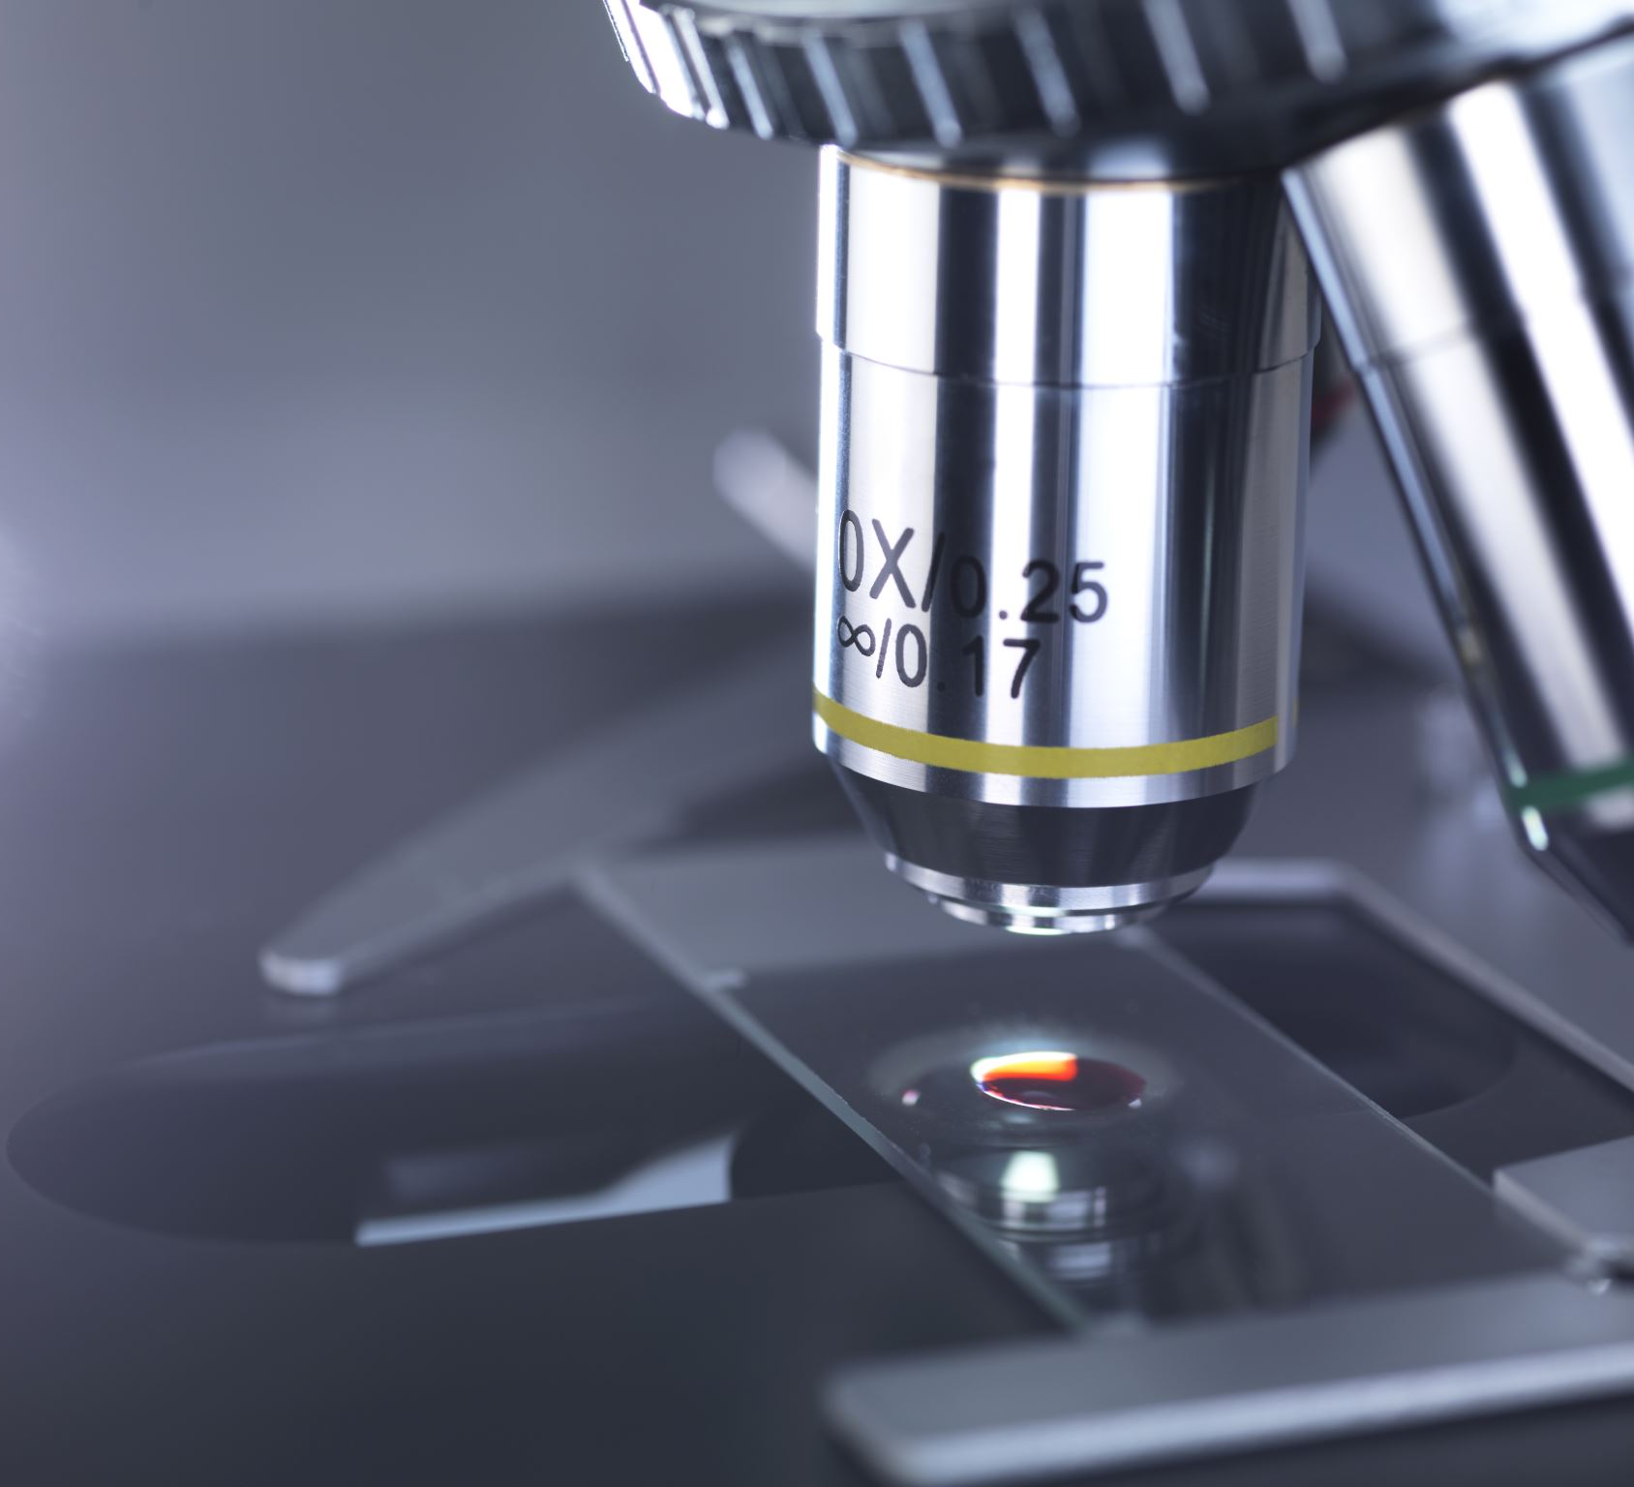
Quantitative optical microscopy
Gabriele Baj
gbaj@units.it

Slide 2
What is quantitative microscopy ?

Slide 3
Deriving quantitative information from images of biological samples

Slide 4
Measurements should be objective, not influenced by human interpretation

Slide 5
Algorithms must be reliable. Visualization helps gaining trust in methods

Slide 6
Quantitative microscopy is supposed to be:

Slide 7
few small “memento”….
In light microscopy :
Magnifying is not seeing
Seeing is not science (numbers)
Image analysis is part of the experiment

Slide 8
Image analysis is part of the experiment
Think about how to analyze your images before starting the experiment.
Consider adapting your experiment so that quantitative image analysis can be performed easily.
Think about controls, counter-proves, an easy to falsify null-hypothesis.
Be a lazy scientist. Do simple experiments.
How can you exclude yourself from the experiment?
Think of blinding yourself or fully automate analysis.
One experiment usually answers just one or less questions.

Slide 9
Common questions in quantitative microscopy
Must have characteristics of the image
Numbers (particles, spots, nuclei. etc)
Morphometry (length, Feret diameters, roundness, etc)
Densitometry (intensity base analysis on fluorophores)
Colocalization
Live imaging & tracking

Slide 34
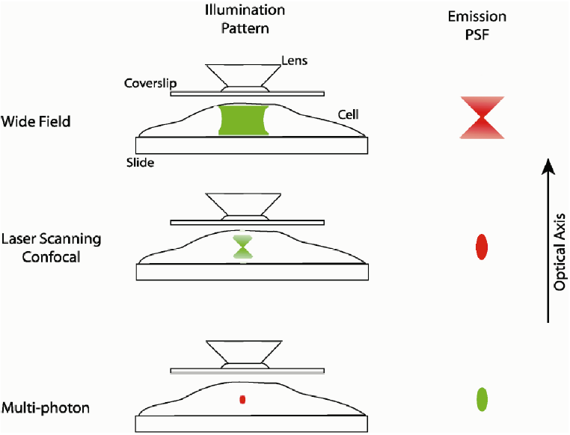
Wide-field vs. confocal vs. 2-photon
Drawing by P. D. Andrews, I. S. Harper and J. R. Swedlow

Slide 35
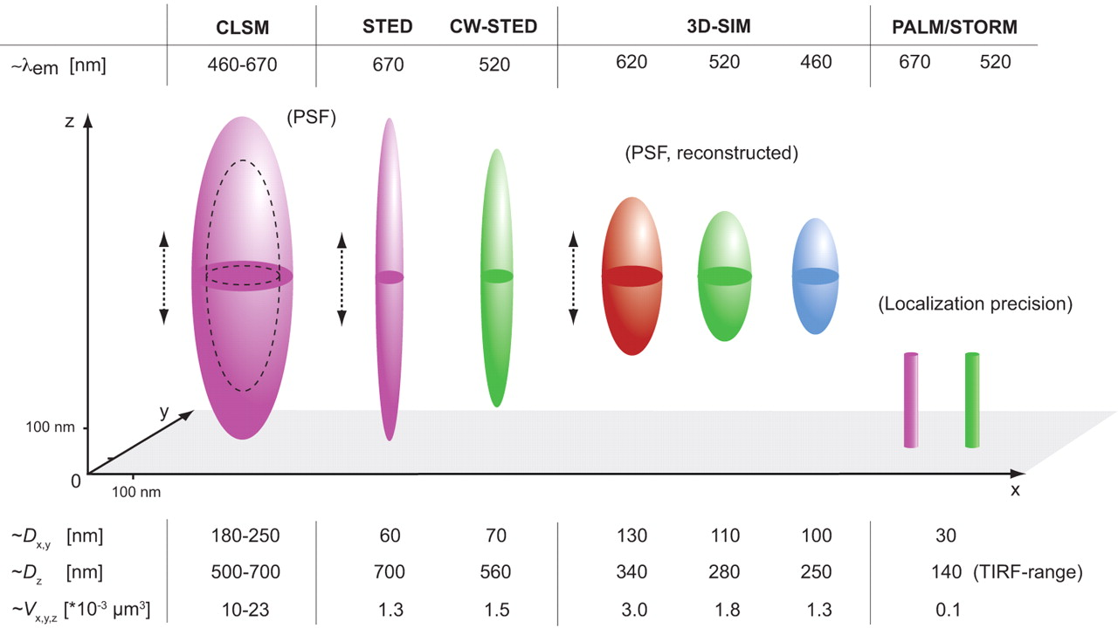
Resolvable volumes obtained with current commercial super-resolution microscopes.
Schermelleh, Lothar, Rainer Heintzmann, and Heinrich Leonhardt. 2010. “A guide to super-resolution fluorescence microscopy.” The Journal of Cell Biology 190 (2) (July 26): 165 -175. doi:10.1083/jcb.201002021.
Notes:
Resolvable volumes obtained with current commercial super-resolution microscopes. A schematic 3D representation of focal volumes is shown for the indicated emission maxima. The approximate lateral (x,y) and axial (z) resolution and resolvable volumes are listed. Note that STED/CW-STED and 3D-SIM can reach up to 20 µm into the sample, whereas PALM/STORM is usually confined to the evanescent wave field near the sample bottom. It should be noted that deconvolution approaches can further improve STED resolution. For comparison the “focal volume” for PALM/STORM was estimated based on the localization precision in combination with the z-range of TIRF. These indications do not necessarily constitute actual resolution as many other effects (e.g., fluorophore orientation, local refractive index variations, flatfield quality of the camera, local aberrations, and statistical selection bias) influence image quality and final resolution.

Slide 36
Which imaging technique should I use?
1-5 μm
TIRF (for samples at the coverslip)
Wide-field (+deconvolution)
1-20 μm
Fast
Spinning Disk Confocal
Sample Thickness
Sensitivity
10-100 μm
Line-scanning confocal
>20 μm
Point scanning Confocal
Slow
>50-100 μm
2-photon confocal

Slide 37
SAMPLE
colored
(i.e. histological staining)
Transparent
Fluorescent
live
fixed
live
fixed
Brightfield
phase
contrast
DIC
Nomarsky
polarization

Slide 38
SAMPLE fluorescent
live
fixed
“Slim”
“Thick”
“Slim”
“Thick”
Confocal
Spinning disk/LSM
Confocal
Spinning disk/LSM
Confocal
2 photon
/LSM
epifluo
epifluo
TIRF
Structured illumination
/Light sheet
STED
Structured illumination
/Light sheet
STORM
/ PALM
Structured illumination
/Light sheet
STED
Please consider the single techniques limitations!

Slide 39
Quantitative microscopy : terminology
Images and pixels
•An image is just a matrix of numbers
•Pixel: “picture element”
•The edges between pixels are an artefact. In reality, they don’t exist!

Slide 40
Pixel size versus resolution
• Resolution is a property of your imaging system.
• The measure of how close object can be in an image while still being differentiable, is called spatial resolution..

Slide 41
Lookup tables
• The lookup table decides how the image is displayed on screen.
• Applying a different lookup table doesn’t change the image.
All pixel values stay the same, they just appear differently

Slide 45
few small “memento”….about fluorescence

Slide 46
Key Stages in Digital Image Processing
Image Restoration
Morphological Processing
Image Enhancement
Segmentation
Image Acquisition
Object Recognition
Representation & Description
Problem Domain
Colour Image Processing
Image Compression

Slide 47
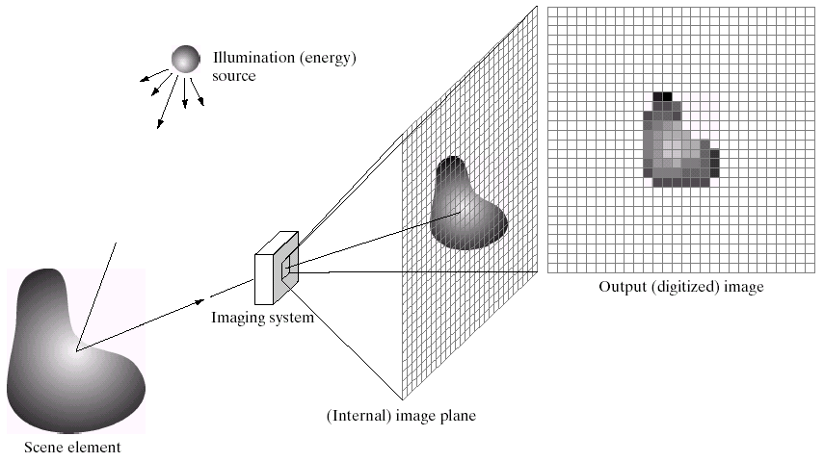
Key Stages in Digital Image Processing: Image Aquisition
Image Restoration
Morphological Processing
Image Enhancement
Segmentation
Image Acquisition
Object Recognition
Representation & Description
Problem Domain
Colour Image Processing
Image Compression

Slide 48
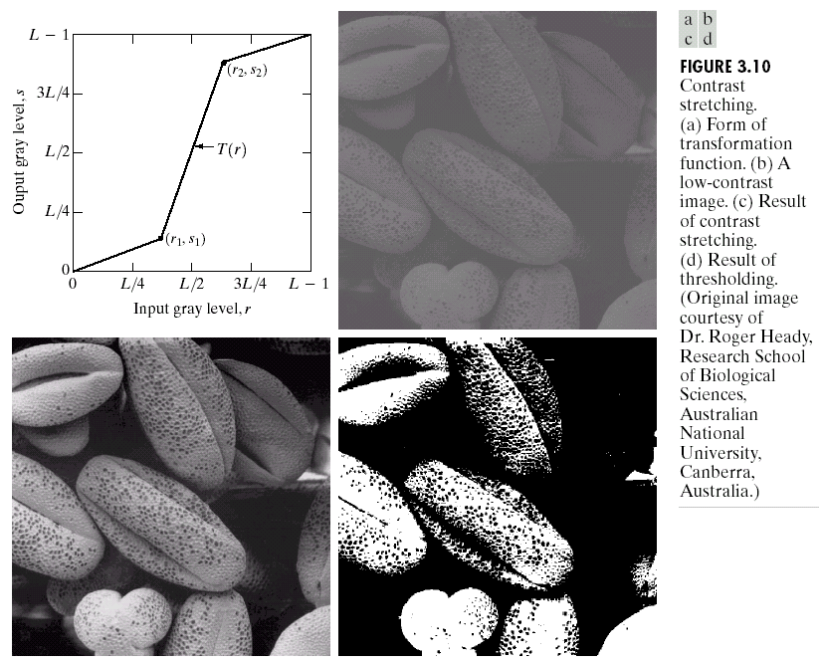
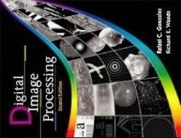
Key Stages in Digital Image Processing: Image Enhancement
Image Restoration
Morphological Processing
Image Enhancement
Segmentation
Image Acquisition
Object Recognition
Representation & Description
Problem Domain
Colour Image Processing
Image Compression

Slide 49
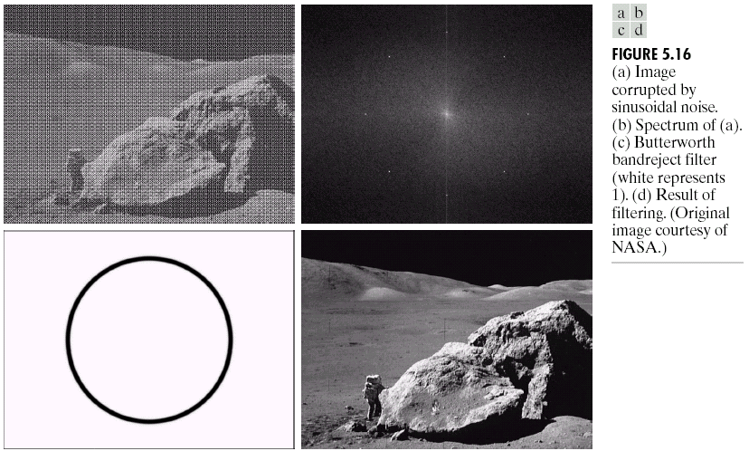
Key Stages in Digital Image Processing: Image Restoration
Image Restoration
Morphological Processing
Image Enhancement
Segmentation
Image Acquisition
Object Recognition
Representation & Description
Problem Domain
Colour Image Processing
Image Compression

Slide 50
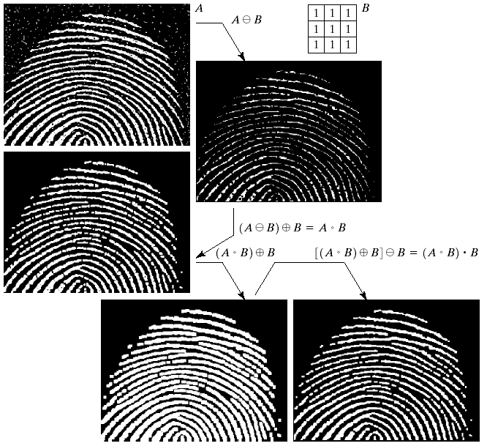
Key Stages in Digital Image Processing: Morphological Processing
Image Restoration
Morphological Processing
Image Enhancement
Segmentation
Image Acquisition
Object Recognition
Representation & Description
Problem Domain
Colour Image Processing
Image Compression

Slide 51
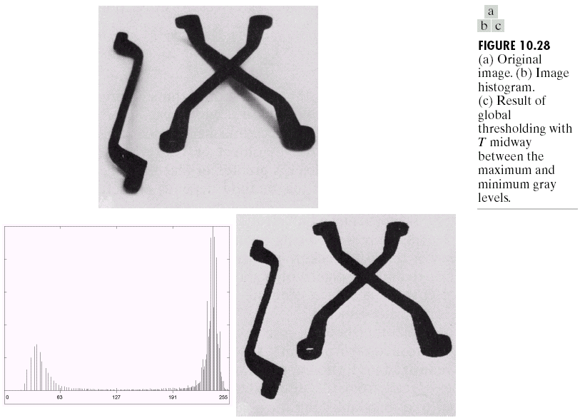
Key Stages in Digital Image Processing: Segmentation
Image Restoration
Morphological Processing
Image Enhancement
Segmentation
Image Acquisition
Object Recognition
Representation & Description
Problem Domain
Colour Image Processing
Image Compression

Slide 52
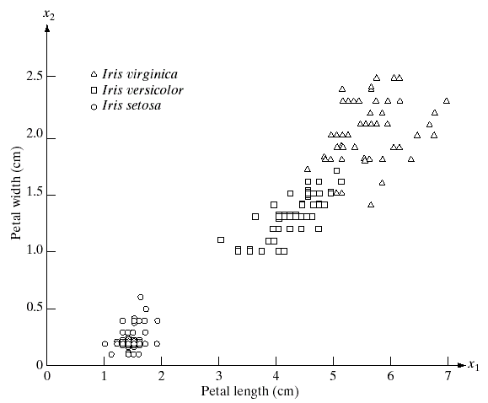
Key Stages in Digital Image Processing: Object Recognition
Image Restoration
Morphological Processing
Image Enhancement
Segmentation
Image Acquisition
Object Recognition
Representation & Description
Problem Domain
Colour Image Processing
Image Compression

Slide 53
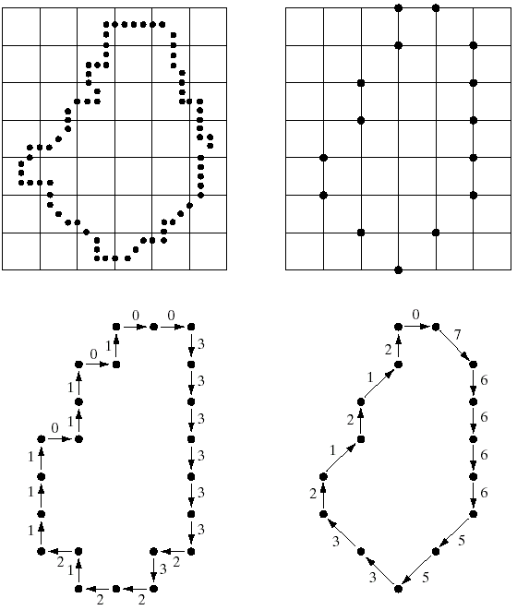
Key Stages in Digital Image Processing: Representation & Description
Image Restoration
Morphological Processing
Image Enhancement
Segmentation
Image Acquisition
Object Recognition
Representation & Description
Problem Domain
Colour Image Processing
Image Compression

Slide 54
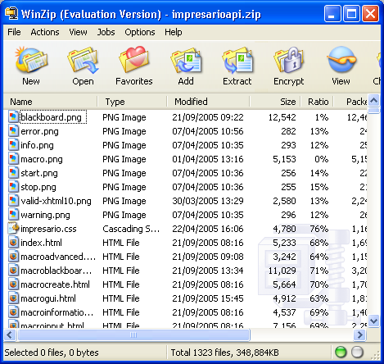
Key Stages in Digital Image Processing: Image Compression
Image Restoration
Morphological Processing
Image Enhancement
Segmentation
Image Acquisition
Object Recognition
Representation & Description
Problem Domain
Colour Image Processing
Image Compression

Slide 55
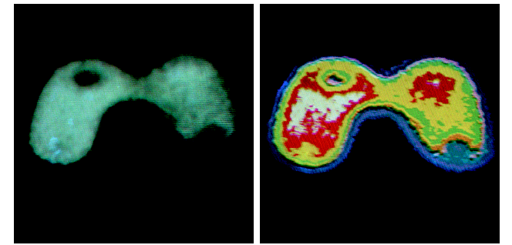
Key Stages in Digital Image Processing: Colour Image Processing
Image Restoration
Morphological Processing
Image Enhancement
Segmentation
Image Acquisition
Object Recognition
Representation & Description
Problem Domain
Colour Image Processing
Image Compression

Slide 56
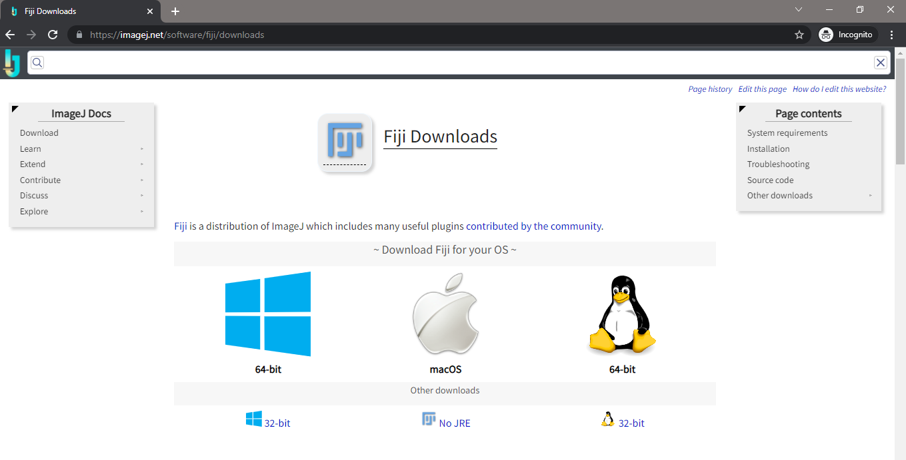
NEXT LECTURE
https://imagej.net/software/fiji/downloads

Slide 57
2021 - Light microscopy in Cellular Biology
Further Information
Websites:
Molecular Expresssions: Exploring the World of Optics and Microscopy: http://microscopy.fsu.edu/
Confocal Microscope Company Websites:
Education in Microscopy and Digital Imaging, Carl Zeiss MicroImaging, LLC: http://zeiss-campus.magnet.fsu.edu/
Microscopy Resource Center, Olympus America Inc.: http://www.olympusmicro.com/
Microscopy U, Nikon Instruments, Inc.: http://www.microscopyu.com/
Leica Microsystems Inc.: http://www.leica-microsystems.com/
Other Company Websites:
Fluorescence Labels: www.probes.com
Fluorescent proteins: www.clontech.com
Living cell microscopy supplies: www.ibidi.com
Non Commercial Websites:
The Cell, An Image Library: http://cellimagelibrary.org/
Cell Migration Gateway: http://www.cellmigration.org/
Non-profit plasmid repository: http://www.addgene.org/
List Servers:
Confocal Microscopy: http://lists.umn.edu/cgi-bin/wa?A0=confocalmicroscopy
Multi-Photon Laser Scanning Microscopy: http://tech.groups.yahoo.com/group/mplsm-users/
Image Processing and Analysis in Java (ImageJ): http://rsbweb.nih.gov/ij/index.html
Contact the author: Stephen Lockett, locketts@mail.nih.gov

Slide 59
Image filtering

Slide 60
Filters

Slide 61
Effects harming image quality

Slide 62
Noise

Slide 63
Image correction / noise removal

Slide 64
Image correction / noise removal

Slide 65
Linear Filters

Slide 66
Linear Filters

Slide 67
Linear Filters

Slide 68
Background removal

Slide 69
Background removal

Slide 70
Background removal

Slide 71
Background removal

Slide 72
Mathematical operations on images

Slide 73
Mathematical operations on images

Slide 74
Mathematical operations on images

Slide 75
Difference-of-Gaussian (DoG)

Slide 76
Difference-of-Gaussian (DoG)

Slide 77
NON Linear Filters

Slide 78
NON Linear Filters

Slide 79
Laplace-filter

Slide 80
Laplacian-of-Gaussian (LoG)

Slide 81
Image Segmentation

Slide 82
Segmentation and labelling

Slide 83
Pre-processing

Slide 84
Thresholding

Slide 85
Low-pass filtering to improve thresholding results

Slide 86
Refining masks

Slide 88
Refining masks

Slide 89
Refining masks

Slide 90
Refining masks

Slide 91
The particle analyzer

Slide 92
Colocalization http://fiji.sc/Colocalization_- _hardware_setup_and_image_acquisition

Slide 93
Colocalisation/Correlation?
Think about the biology!
What is the biological/biochemical question?
Are you looking for Co-Compartmentalisation?
Are you looking for exclusion / anti correlation?
Are you looking for interacting molecules?
Then you must also do biochemsitry
(Immuno Co-precip, Fluo Correlation Spectroscopy)
FRET / FLIM might be very informative

Slide 94
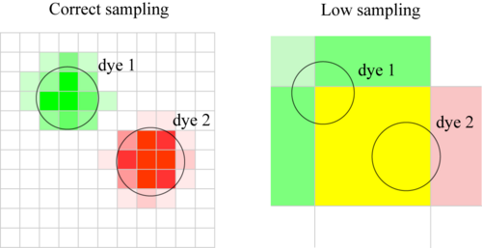
Colocalization

Slide 95

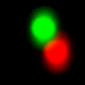
Colocalization
BLUR
Background and NOISE

Slide 96
“Colocalisation” covers two qualitatively different conditions:
1) that objects have both
fluorophores present
(Object Based Coloc)
Segmentation needed.
Biology?
2) there is some relationship
between the intensities of
the fluorophores in a pixel.
(Pixel Intensity Based Coloc)
Interaction - BioChemistry?

Slide 97
2 fluorophores are there in a pixel
Binary information
Is it Random?
Is it Real?
Little or no biological meaning?
…unless you are confident about how to segment objects out from the background.

Slide 98
Definition of Terms
“Concurrence” = “co-presence” “there is red and green”
“Colocalisation” = Relationship between channel intensities
Eg. “Red is only found with Green”
Special case - “Correlation”
Intensity Correlation over Space

Slide 99
Colocalisation is #1
2 objects overlap
Binary information
No intensity information
Concurrence?
Image Segmentation!
Biological Meaning?

Slide 100
Colocalisation is #2
Some objects appear to
overlap
with another object
Binary information
No intensity information
Colocalisation?
Biological Meaning?

Slide 101
Colocalisation is: #3
Intensity profiles overlap
Image “Correlation”
Biological Meaning?
Co-compartmentalisation?
Physical interaction?

Slide 102
Colocalisation/Correlation -Think about:
Are your “objects” smaller than optical resolution?
Vesicles? Small Organelles?
Check channel overlap with sub resolution beads!
Are your objects large?
Large single homogenous blobs?
Large reticular networks / membranes
Resolution required?
Complementary “correlation” methods
Fluorescence correlation spectroscopy (FCS in live cells)
Flow Cytometry? Multiple markers in a cell. Good stats.

Slide 103
Colour Merge Images = Bad
… so what should I do instead?
“Colocalisation Analysis”
Statistical Significance of Colocalisation
Single image - random / insignificant.
Statistical P value (significance), Manders coefficients, and
Scatter Plot. (ImageJ, BioImageXD, Huygens and others)
But remember…
Don’t merge projections of stacks (you lose 3D info, false coloc)
Don’t believe your eyes, they lie.

