Slide 1

Valence Thesis
Defense
Prof. Silvano Geremia
Lorenzato Mattia
Ottanà Gabriele
Sterni Paolo
Zadra Fabio

Slide 2
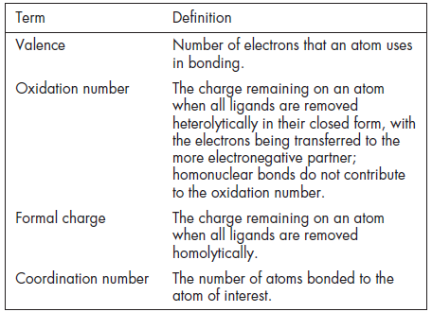
Simple Definitions of Common Terms
Gerard Parkin - Journal of Chemical Education 2006 83 (5), 791

Slide 3
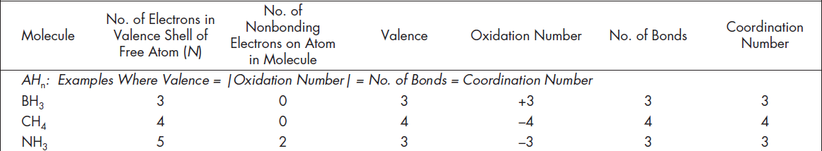
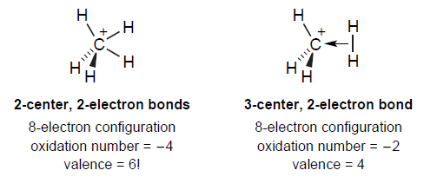
Problems’ Origin
Gerard Parkin - Journal of Chemical Education 2006 83 (5), 791

Slide 4

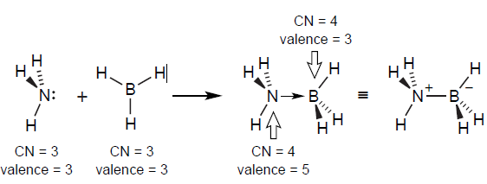
Valence vs. n° bonds
Gerard Parkin - Journal of Chemical Education 2006 83 (5), 791

Slide 5

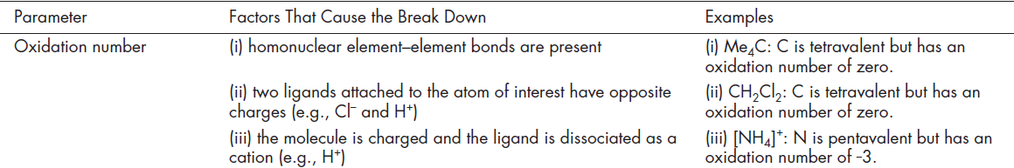
Valence vs. n° ox
Gerard Parkin - Journal of Chemical Education 2006 83 (5), 791

Slide 6
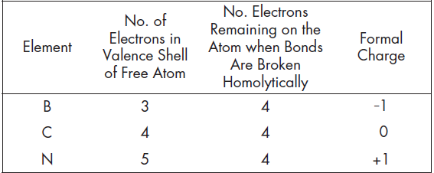
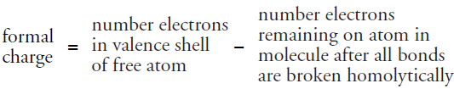
N° ox
Formal Charge
HETEROLYTIC BREAK
HOMOLYTIC BREAK
Ionic character exaggerated
Covalent character exaggerated
Gerard Parkin - Journal of Chemical Education 2006 83 (5), 791

Slide 7
Conclusions
Wrong usage
Why and when to use
Gerard Parkin - Journal of Chemical Education 2006 83 (5), 791

