Slide 1

Valence Thesis
Defense
Prof. Silvano Geremia
Ottanà Gabriele
Sterni Paolo
Zadra Fabio

Slide 2

The need of an article
Crucial points of scientific subjects:
Continuous debate and disagreement
Long lasting discussion ≠ failure of a concept
Terminology matters: similar concepts are not interchangeable
Necessity to use a precise language
Gerard Parkin - Journal of Chemical Education 2006 83 (5), 791
Notes:
The defense has both times stated that the fact that the 150 years of disagreement and the existence of this paper are the sign of a failed concept. However the scientific research is DRIVEN by continuous debate and people questioning each other: it doesn’t mean that something has failed, but rather that it may not be as simple as it was thought to be.
The aim of Parkin’s paper was to explain in more detail the key differences between concepts that, for someone approaching chemistry for the first time, may be misleading and confusing.

Slide 3
The mix usage of the term valence
The term valence is used in many different theories. Should we address this problem to the term valence?
Is this a problem of the term itself or rather a non-curance of renovating it’s meaning?
Use a language with grammatic rules that are not present in native language.
Valence Electrons
Valence Bond Theory
VSEPR
Theory
Bond Valence Model
G. A. Deluga et al. ,Renewable Hydrogen from Ethanol by Autothermal Reforming.Science303,993-997(2004)
Gerard Parkin - Journal of Chemical Education 2006 83 (5), 791
Notes:
The term valence was firstly used before QM was a thing.
Also, valence first of all is the outermost energetic region of a atom or even molecule. This region characterizes the reactivity of the system.
However, all these theories share a common ground: they all rely on the outer shell electrons (valence electrons).
In the common English a lot of terms are made of two separate word that can have different specific meanings but have the same base (phrasal verbs, such as:Get on/ in/ out/ along/ ecc..
Also terms like time sheet/ limit/ zone/ ecc.

Slide 4
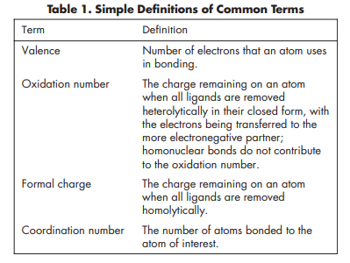
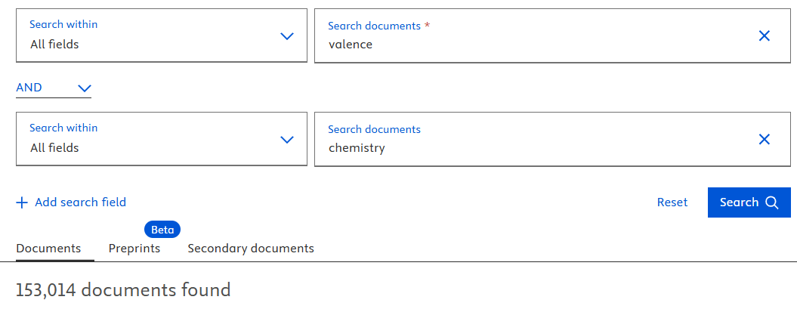
Valence blurred meaning
Important points to clarify:
This case is based on the wrong use of the term valence, not for it’s meaning
It’s a powerful concept that if applied correctly can describe even the most difficult systems
Gerard Parkin - Journal of Chemical Education 2006 83 (5), 791
Notes:
As it was previously explained in the first trial. The usage of valence is not wrong, it’s just misunderstood by most.
In the article the valence is described as the number that gives insights about how many electrons of the outer shell an atom has used upon binding.
So, the valence of an atom gives insight about the reactivity of the single atom and not the “specie” in which the atom is found (molecule, …).
The term valence was invented before the knowledge on how are built the molecules, nonetheless was useful
to understand the reactivity and to discriminate the different sistems, such as…

Slide 5

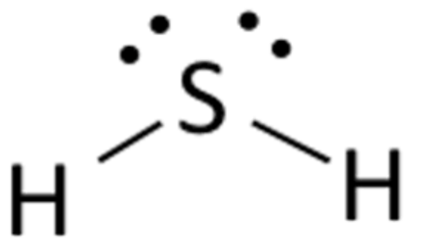

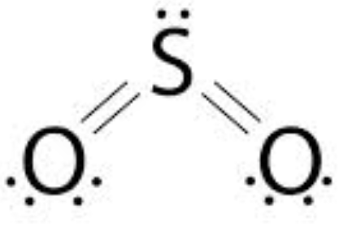

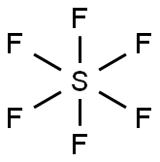
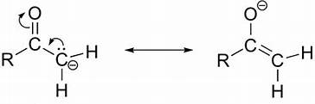
About Counterexamples
Valence in the two species is the same → it’s what we expect
3 different Sulfur compounds, all having different valence
Depending on the resonance structure the 𝛂 carbon has a different valence
Gerard Parkin - Journal of Chemical Education 2006 83 (5), 791

Slide 6

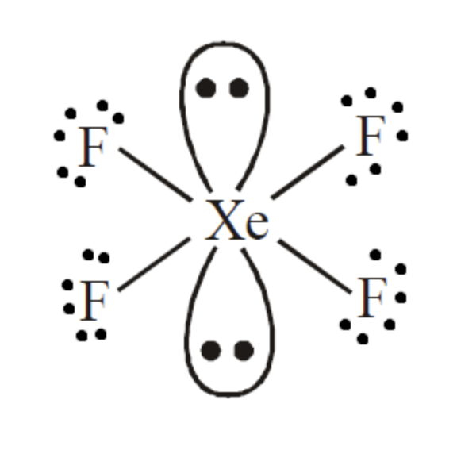
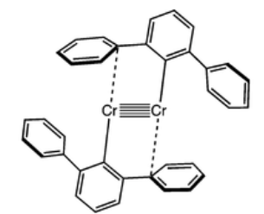
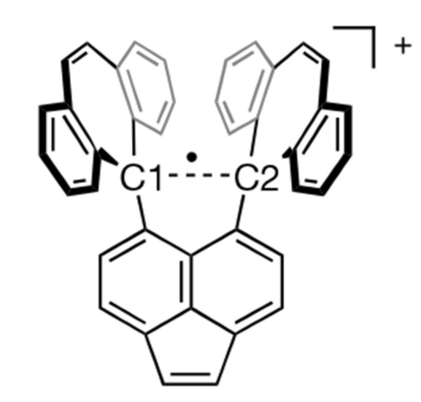
Nickelocene, XeF4 Cr(I) compounds
a)
b)
c)
d)
Ni(II): [Ar]3d8
Cr(I): [Ar]3d5
Gerard Parkin - Journal of Chemical Education 2006 83 (5), 791

Slide 7
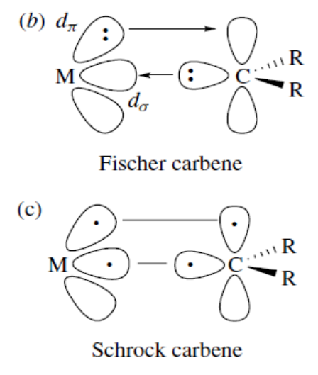
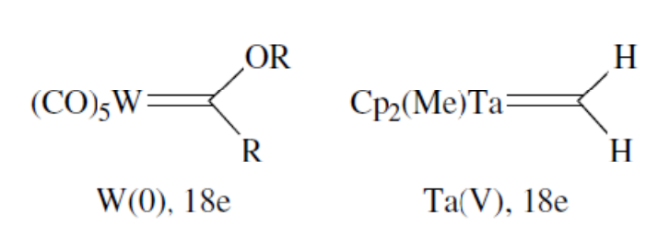
Metal carbenes
Gerard Parkin - Journal of Chemical Education 2006 83 (5), 791

Slide 8
Exceptions
«Valence fails because it has exceptions»
Implicit assumption: a valid concept must be unique with no exceptions
Oxidation number has exceptions as well (e.g. Oxygen)
Context-dependent as valence
Can be regarded as a confirmation tool, rather than a predicting one
Exceptions do not make a concept less valid
Gerard Parkin - Journal of Chemical Education 2006 83 (5), 791
Notes:
To strengthen the defense of the valence concept, we’d like to introduce new evidence about the misconceptions that other common concepts, like the oxidation number can cause.
Commonly, the oxidation number of oxygen is -2. However there are compounds like the peroxides and superoxides.
This is not to say that the oxidation number isn’t a great tool in certain fields of chemistry, but we’d like to focus on the «commonly» word. Everything in nature has its own exception and if we try to stick to them and find a rule that fits everything, we wouldn’t be able to explain anything.

Slide 9
Final Conclusions
Valence does not fail where chemistry becomes complex, it simply reveals that chemistry was never simple to begin with!
Gerard Parkin - Journal of Chemical Education 2006 83 (5), 791

Slide 10
Citations
Gerard Parkin - Journal of Chemical Education 2006 83 (5), 791
G. A. Deluga et al. ,Renewable Hydrogen from Ethanol by Autothermal Reforming.Science303,993-997 (2004) Morgenstern, D. A.; Fornango, J. P. Low-temperature reforming of ethanol over copper-plated raney nickel: a new route to sustainable hydrogen for transportation. Energy Fuels 2005, 19 (4), 1708– 1716
Jordi Llorca, Pilar Ramírez de la Piscina*, Joaquim Sales and Narcís Homs*; Direct production of hydrogen from ethanolic aqueous solutions over oxide catalysts; Chem. Commun., 2001, 641-642, M. Benito, J.L. Sanz, R. Isabel, R. Padilla, R. Arjona, L. Daza,
Bio-ethanol steam reforming: Insights on the mechanism for hydrogen production, Journal of Power Sources, Volume 151,2005,Pages 11-17

