Slide 1
OUR STRATEGY THIS ROUND
STAGE 2
We won the opening on argument. Now we win on evidence.
For each of our four counts, we present real molecular examples that expose valence as ambiguous, misleading, and inconsistent — drawn directly from the chemical record.
COUNTER-
ARGUMENTS
& DEBATE
COUNT I
COUNT II
Definition Chaos
Built-In Confusion
e.g. ethane, CCl₄, [NH₄]⁺
e.g. [NH₄]⁺, [BH₄]⁻, CH₂Cl₂
For the Prosecution
COUNT III
COUNT IV
Structure-Dependent
Circular Reasoning
e.g. OsO₄, Hg₂X₂, Ga–Ga
e.g. (CH₅)⁺, alcohols series
Parkin, J. Chem. Educ. 2006, 83, 791

Slide 2
COUNT I — EVIDENCE: A CENTURY OF DEFINITIONAL CHAOS
DEFENSE LIKELY CLAIMS:
"Sidgwick (1927) gave a clear, workable definition that chemists have used ever since."
PROSECUTION EVIDENCE
1852
Frankland introduces "atomicity" — combining power relative to hydrogen
1865
Hofmann renames it "quantivalenz" — already a disagreement about terminology
1927
Sidgwick defines valence as electrons "engaged" in bonding — but this is contested
1948
Glasstone: "valence number" replaced by "oxidation number" due to misleading association
2006
Parkin publishes a full article just to clarify what "valence" means — the debate is still alive
VERDICT: 154 years of renaming, redefining, and re-explaining is not a sign of a healthy concept — it is a symptom of a broken one.
PROSECUTION | COUNTERARGUMENTS & DEBATE | VALENCE ON TRIAL

Slide 3
COUNT I — THE SAME WORD, FOUR DIFFERENT MEANINGS
DEFENSE LIKELY CLAIMS:
"Context makes the meaning clear — chemists know which definition applies."
If context alone made the meaning clear, why does the same word appear in four unrelated theoretical frameworks with no cross-compatibility?
Valence Electrons
ATOMIC STRUCTURE
Valence Bond Theory
QUANTUM MECHANICS
Refers to ALL outer-shell electrons — including lone pairs that are NOT used in bonding. Contradicts Sidgwick's definition directly.
Describes orbital overlap — has no direct relationship to the integer counting definition. A different concept entirely.
VSEPR Theory
MOLECULAR GEOMETRY
Bond-Valence Model
CRYSTALLOGRAPHY
Uses "valence shell" loosely to mean electron pairs — including lone pairs. Geometry predictions ignore the bonding-electron count.
Calculated from bond lengths using empirical equations — a continuous variable, not an integer. Unrelated to Sidgwick's definition.
VERDICT: A term that means four different things across four frameworks is not versatile — it is undefined.
PROSECUTION | COUNTERARGUMENTS & DEBATE | VALENCE ON TRIAL

Slide 4
COUNT II — EVIDENCE: [NH₄]⁺, THE BUILT-IN CONFUSION EXPOSED
DEFENSE LIKELY CLAIMS:
"The equivalence in AHn molecules is a feature, not a bug — it makes teaching simpler."
Making teaching "simpler" by hiding a fundamental distinction is not a feature — it is a pedagogical trap. The ammonium ion [NH₄]⁺ is the proof.
VALENCE
5
[NH₄]⁺
OXIDATION NO.
−3
N used ALL 5 valence electrons
(including the lone pair
to bond the 4th H via H⁺)
Bonds broken heterolytically:
4 H leave as H⁺, giving N a
charge of −3
4 DIFFERENT
ANSWERS
for 1 molecule
# OF BONDS
4
COORD. NUMBER
4
Four 2-centre 2-electron
covalent bonds to
hydrogen atoms
Four hydrogen atoms
are directly bonded
to nitrogen
VERDICT: [NH₄]⁺ gives valence=5, oxidation no.=−3, bonds=4, coord. no.=4. These are NOT the same concept dressed up differently.
PROSECUTION | COUNTERARGUMENTS & DEBATE | VALENCE ON TRIAL

Slide 5
COUNT II — EVIDENCE: ISOELECTRONIC MOLECULES, WILDLY DIFFERENT OXIDATION NUMBERS
DEFENSE LIKELY CLAIMS:
"Oxidation number and valence only differ for complex or unusual molecules."
Wrong. Even simple, everyday organic molecules expose the divergence. Consider the isoelectronic series (BH₄)⁻, CH₄, (NH₄)⁺ — all have four bonds to hydrogen, yet valences are 3, 4, and 5 respectively.
Molecule
# Bonds to H
Valence
Oxidation No.
Formal Charge
[BH₄]⁻
4
3 ← trivalent!
+3
−1
CH₄
4
4
−4
0
[NH₄]⁺
4
5 ← pentavalent!
−3
+1
WHY THIS MATTERS:
All three molecules are isoelectronic — same number of electrons. Yet valence spans 3–5 and oxidation numbers span −4 to +3. If the concepts tracked the same chemical reality, they would give consistent results for structurally equivalent species. They do not.
VERDICT: Three isoelectronic molecules, three different valences, and completely uncorrelated oxidation numbers. This is not an edge case — it is the rule.
PROSECUTION | COUNTERARGUMENTS & DEBATE | VALENCE ON TRIAL

Slide 6
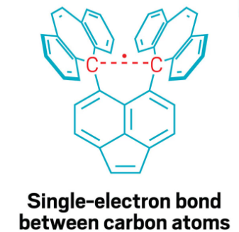


COUNT III — VALENCE IS NOT A GOOD PREDICTOR
Using BOTH definitions provided by the article, this molecule is totally equivalent to the reduced species with a regular covalent bond in terms of valence. However, as it can be easily seen, they are completely different.
Single electron covalent bond
PROSECUTION | COUNTERARGUMENTS & DEBATE | VALENCE ON TRIAL

Slide 7
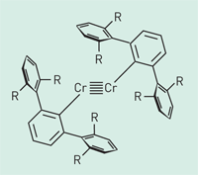
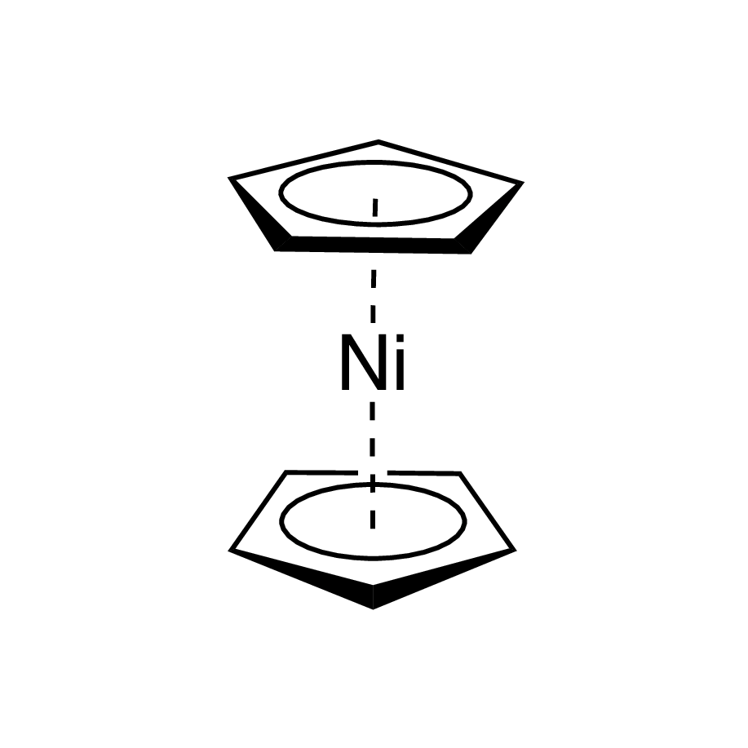
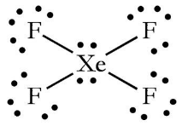
COUNT III— EXCEPTIONAL MOLECULES
TRIVALENT (misleading!)
Xenon tetrafluoride
Nickelocene
Multiple bond coordination compounds
PROSECUTION | COUNTERARGUMENTS & DEBATE | VALENCE ON TRIAL

Slide 8
COUNT IV — EVIDENCE: THE ALCOHOL SERIES AND AD HOC RULE CHANGES
DEFENSE LIKELY CLAIMS:
"The oxidation number series for alcohols correctly tracks the oxidation state of carbon."
The oxidation numbers of the α-carbon in a simple homologous series of alcohols vary by 3 units — yet the carbon chemistry is essentially unchanged. Even defenders of oxidation number admitted this was unreasonable.
Alcohol
Molecule
Ox. No. of C
Valence of C
Same chemistry?
Methanol
CH₃OH
−2
4
✔ YES
Ethanol
MeCH₂OH
−1
4
✔ YES
Isopropanol
Me₂C(H)OH
0
4
✔ YES
tert-Butanol
Me₃COH
+1
4
✔ YES
▲ varies
by 3 units!
Defenders of oxidation number proposed "assigning zero charge to C-H hydrogens" to fix this — inventing new rules ad hoc rather than admitting the concept fails.
VERDICT: Valence = 4 for all four alcohols. Oxidation number varies wildly, reflecting nothing real about their chemistry. The fix proposed was to bend the rules — which is an admission of failure.
PROSECUTION | COUNTERARGUMENTS & DEBATE | VALENCE ON TRIAL

Slide 9
COUNT IV — EVIDENCE: (CH₅)⁺ AND THE LIMITS OF VALENCE’S PREDICTIVE POWER
DEFENSE LIKELY CLAIMS:
"Valence uniquely predicts that (CH₅)⁺ is impossible, proving its superiority over oxidation number."
The defense claims this as valence's great triumph. The prosecution will show it is actually its greatest circular argument.
STEP 1
What the defense claims
Valence of C in (CH₅)⁺ = 6 (from eq. 3: valence = bonds + formal charge = 5 + 1). Carbon only has 4 valence electrons. Therefore, valence "predicts" an impossible molecule.
STEP 2
What the logic actually requires
The conclusion "valence of 6 is impossible" only follows because you already know carbon has 4 valence electrons. You needed that prior knowledge BEFORE applying the valence formula. Valence did not generate the insight — you did.
STEP 3
The deeper problem: even valence cannot explain (CH₅)⁺
Parkin resolves (CH₅)⁺ by reinterpreting it as [H₃C(η²-H₂)]⁺ — a 3-centre 2-electron bond. But this required abandoning the standard valence formula entirely and invoking a different bonding model. Valence did not solve the problem; a new model did.
VERDICT: Valence's "prediction" about (CH₅)⁺ is borrowed knowledge, not independent insight. And when it failed, chemists abandoned valence and used a better model anyway.
PROSECUTION | COUNTERARGUMENTS & DEBATE | VALENCE ON TRIAL

Slide 10
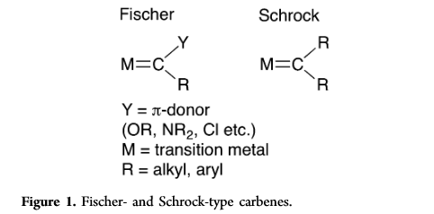
COUNT V— EXCEPTIONAL MOLECULES
TRIVALENT (misleading!)
Metal carbenes
PROSECUTION | COUNTERARGUMENTS & DEBATE | VALENCE ON TRIAL

Slide 11
THE EVIDENCE IS IN
Every Count: Proven by Example
COUNT I: GUILTY
COUNT II: GUILTY
Frankland (1852) → Parkin (2006)
[NH₄]⁺, [BH₄]⁻, (isoelectronic series)
154 years of disagreement. No definition has ever achieved consensus.
Valence, oxidation no., bonds, and coord. no. all diverge. Four answers for one molecule.
COUNT III: GUILTY
COUNT IV: GUILTY
Hg₂X₂, R₂Ga–GaR₂, [Tp]Ga→GaI₃
Alcohol series, (CH₅)⁺
Oxidation number misleads about lone pair availability and actual bonding in metal–metal compounds.
Oxidation number varies without chemical meaning; valence's predictions require prior knowledge to interpret.
"The terms valence, oxidation number, coordination number, and number of bonds each have individual meanings
and it is neither wise nor appropriate to use them interchangeably." — Parkin, 2006 (the defense's own witness)

