Slide 1
Crystallographic Lattice Planes
Three non-collinear lattice nodes define a crystallographic plane.
Because all nodes are equivalent, each lattice node lies on this plane
or on an equivalent plane by translation.
The set of equivalent planes forms a family of crystallographic planes.
They are parallel and equally spaced by a constant distance d (spacing).
Lattice Planes in 2 D
b
γ
a
Unit cell
Crystal lattice
Nodes

Slide 2
The lattice planes are identified by integer triplets:
Miller Indices
2
Considering three non-collinear points of the lattice
a plane passing through these nodes is representative of the parallel family planes
In all lattice nodes passes one plane of this family
b
1
a
c
1
1
2
Tacking one lattice node as the origin
one plane of the hkl family passes through it.
The successive parallel plane of the family cuts the crystallographic axes at a/h, b/k, c/l at a distance d_{hkl} from the origin
2
b
1
d₂₁₁
a
c
1/2
1
1
hkl are three integers that identify the family planes
2

Slide 3
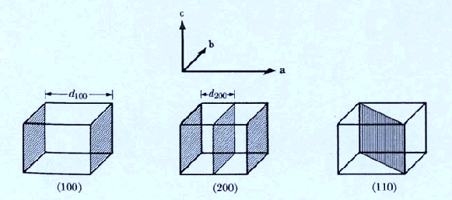
Families of Planes and Miller Indices
A family of planes parallel to an axis has index 0 for that axis (intercept at ∞)
True lattice planes
True lattice planes
True lattice planes have Miller indices that are coprime integers
It is convenient to extend Miller indices to all positive and negative integers (negative indicated with a bar)
In this way, one also accounts for families of planes that are not lattice planes in the strict sense (passing through nodes), but are parallel to lattice planes and have spacings that are integer submultiples of those of true lattice planes
Two families differing only by sign represent the same planes viewed in opposite directions

Slide 4
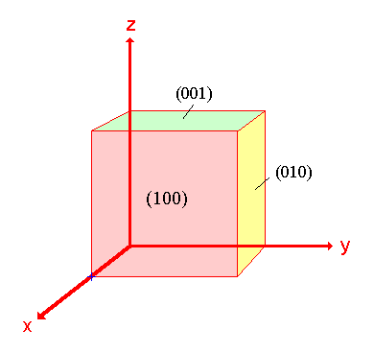
Family of planes, crystal faces and crystal direction
The Miller indices hkl are used to indicate:
Indices of reflection from a family of planes: hkl without brackets
Family of planes or Crystal face: (hkl) with round brackets
All symmetrically equivalent faces or planes: {hkl} with curly brackets
Crystal direction: [uvw] with square brackets (direction passing through the origin and the lattice node uvw)
[001]
(010)
[010]
(001)
[100]

Slide 5
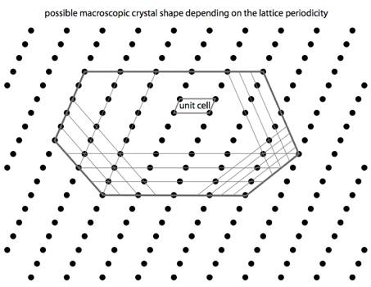
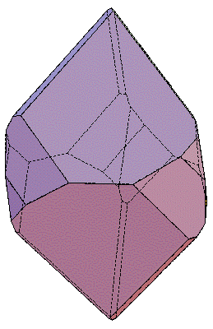
Crystal Morphology – Bravais Law
Crystal faces are parallel to lattice planes with high node density.
Flat faces and sharp edges

Slide 6
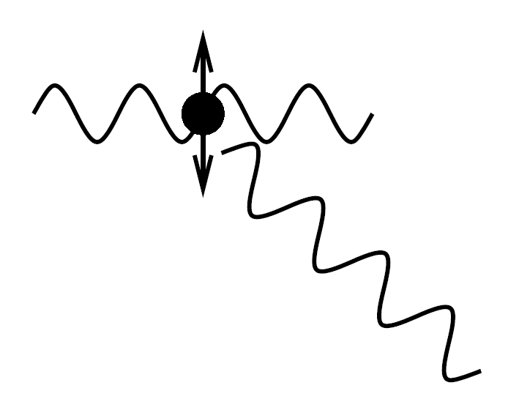
Scattering of Light
Charged particles are accelerated by electric fields.
A charged particle generates an electric field.
The acceleration of a charged particle perturbs the electric field.
The acceleration of electrons generates photons!
When an electron interacts with an electromagnetic wave, it can oscillate at the same frequency and become a source of radiation.
This process is called scattering.
From the analysis of scattering, one can determine the position of the scatterers.

Slide 7
3°
5°
Distance Between Sources
3 wavelengths
Distance Between Sources
5 wavelengths
4°
2°
3°
2°
1°
1°

Slide 8
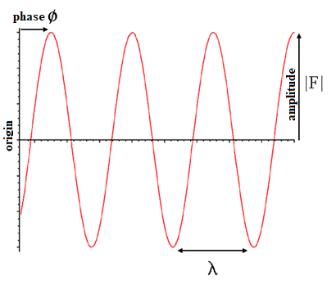
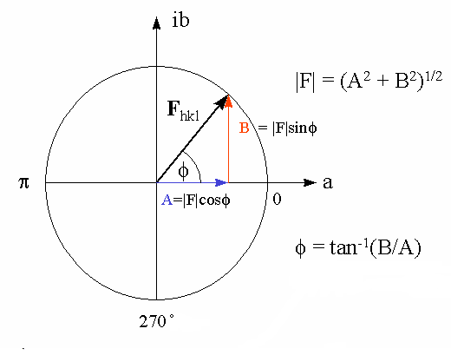
Waves in the Argand Diagram
Waves F are characterized by an amplitude |F| and a phase φ
F = |F| exp(iφ) = |F| (cosφ+isenφ)
Monochromatic radiation
Waves can be represented as complex numbers

Slide 9
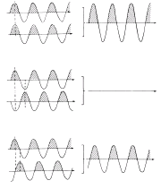
Interference of Electromagnetic Waves
The result of the sum of two coherent waves (same frequency) depends on the phase difference (Interference).
In phase
(constructive interference)
In opposite phase
(destructive interference)
Partially out of phase

Slide 10
Sum of Waves in the Argand Diagram
Two waves in phase
constructive interference
total amplitude |F|_{t} = 2|F|
Two waves not in phase
partially destructive interference
total amplitude |F|_{t} < 2|F|
Two waves in opposite phase
destructive interference
total amplitude |F|_{t} = 0

Slide 11
The Crystal Lattice
N atoms per unit cell
N equivalent interpenetrating lattices,
each with corresponding atoms at the vertices

Slide 12
Reflection
Constructive interference of waves scattered by a crystal plane
θ₁’
θ₂
O
P
Constructive interference when optical paths are equal
optical path = optical path
θ₁ = θ₂ reflection condition

Slide 13
Bragg Law
Constructive interference of waves scattered by a family of crystallographic planes
O
θ
d
θ
θ
P
Constructive interference 2dsenθ = nλ

Slide 14
Bragg Law and Miller indices
Constructive interference 2d_{hkl}senθ_{n(hkl)} = nλ
true lattice planes (coprime integers)
n = reflection order
2d_{n(hkl)}senθ_{n(hkl)} = λ
2d_{hkl}senθ_{hkl} = λ
Miller indices with any integer
2d₁₀₂senθ_{2°(102)} = 2λ
2d₂₀₄senθ₂₀₄ = λ
θ₂₀₄
θ₂₀₄
d₂₀₄
d₁₀₂

Slide 15
Real lattice
Reciprocal lattice
Reflection 1 0
Reflection -1 0
Reflection 2 0
Reflection -2 0
Reflection 0 -1
Reflection 0 1
Reflection 0 -2
Reflection 0 2
Reflection 1 -1
Reflection -1 1
Reflection 1 1
Family planes1 0
Reflection -1 -1
Family planes2 0
Family planes-1 0
Family planes-2 0
Family planes0 -1
Family planes0 1
Family planes0 -2
Family planes0 2
Family planes1 -1
Family planes-1 1
Family planes1 1
Family planes-1 -1

Slide 16
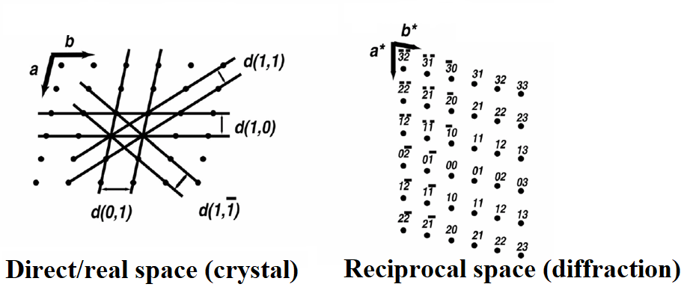
Direct and Reciprocal lattice
^
a*·a = 1
a*·b = 0
a*·c = 0
a*=1/a·cos(a*a)=A_{bc}/V_{abc}
^
b*·a = 0
b*·b = 1
b*·c = 0
b*=1/b·cos(b*b)=A_{ac}/V_{abc}
^
c*·a = 0
c*·b = 0
c*·c = 1
c*=1/c·cos(c*c)=A_{ab}/V_{abc}
a*┴ b
a*┴ c
b*┴ a
b*┴ c
c*┴ a
c*┴ b

Slide 17
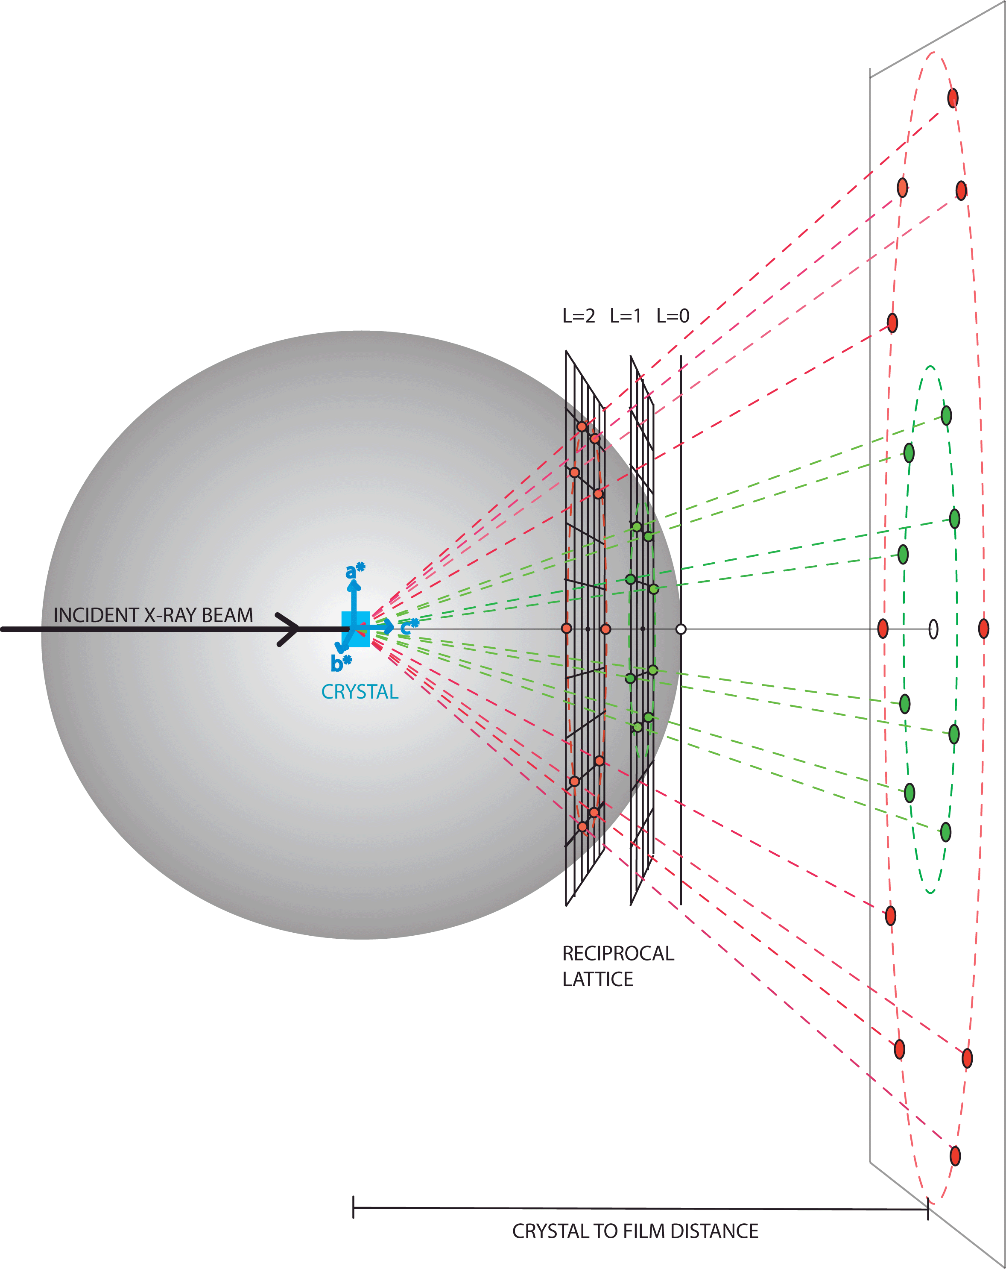
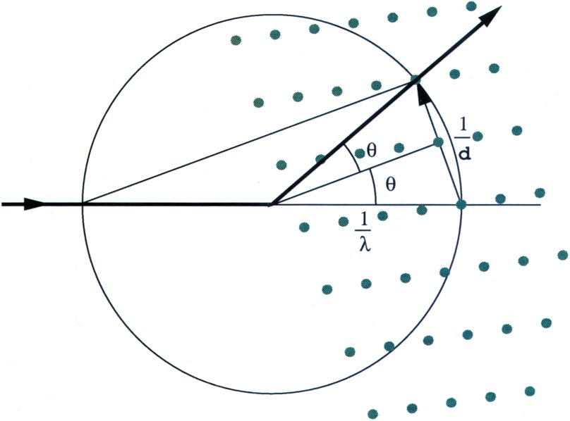
Ewald sphere
The diffraction pattern is a 2D projection of the 3D reciprocal lattice.
d
2 senθ/λ = 1/d_{hkl}
Each time a reciprocal lattice point hkl intersects the Ewald sphere, a diffracted beam hkl is produced.

Slide 18
Diffraction experiment
X-ray source
Detector

