Slide 1
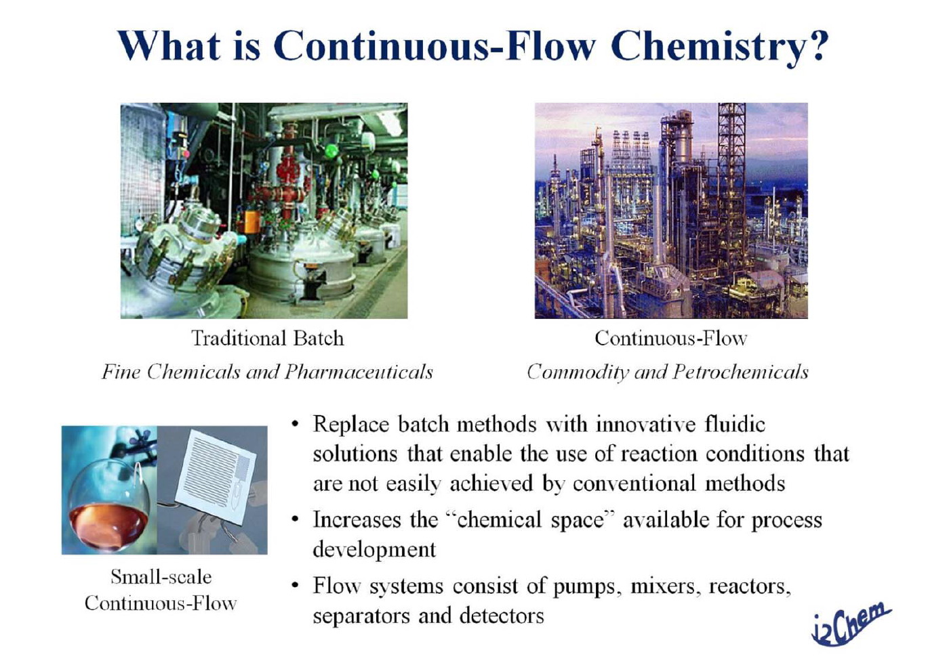
Flow Chemistry

Slide 2
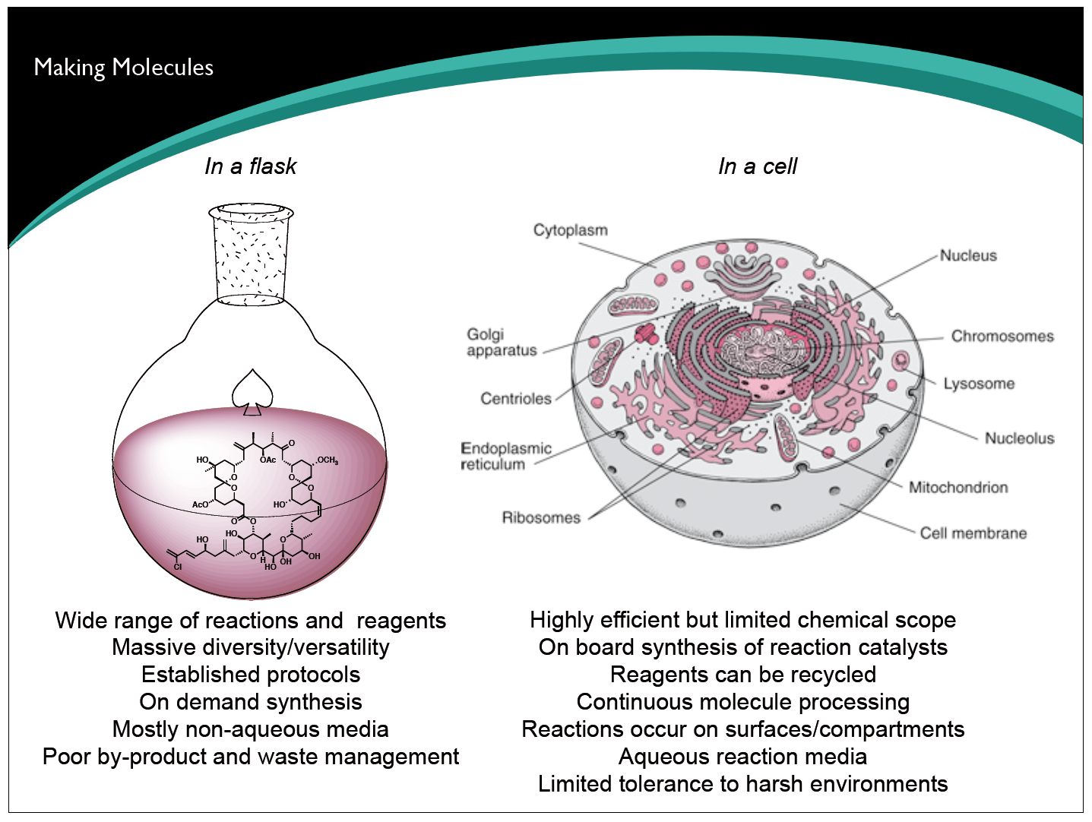
Flow Chemistry

Slide 3
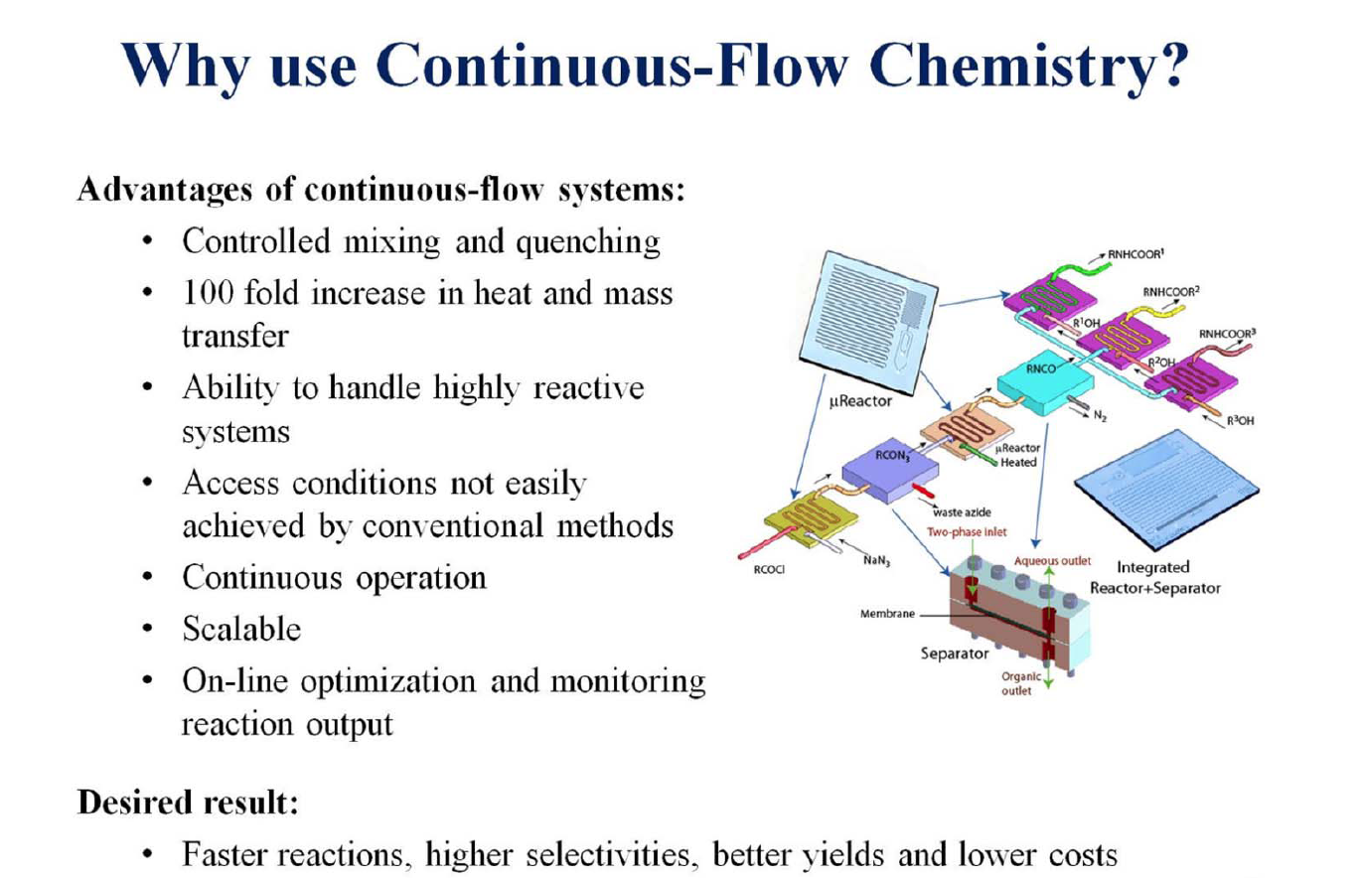
Flow Chemistry

Slide 4
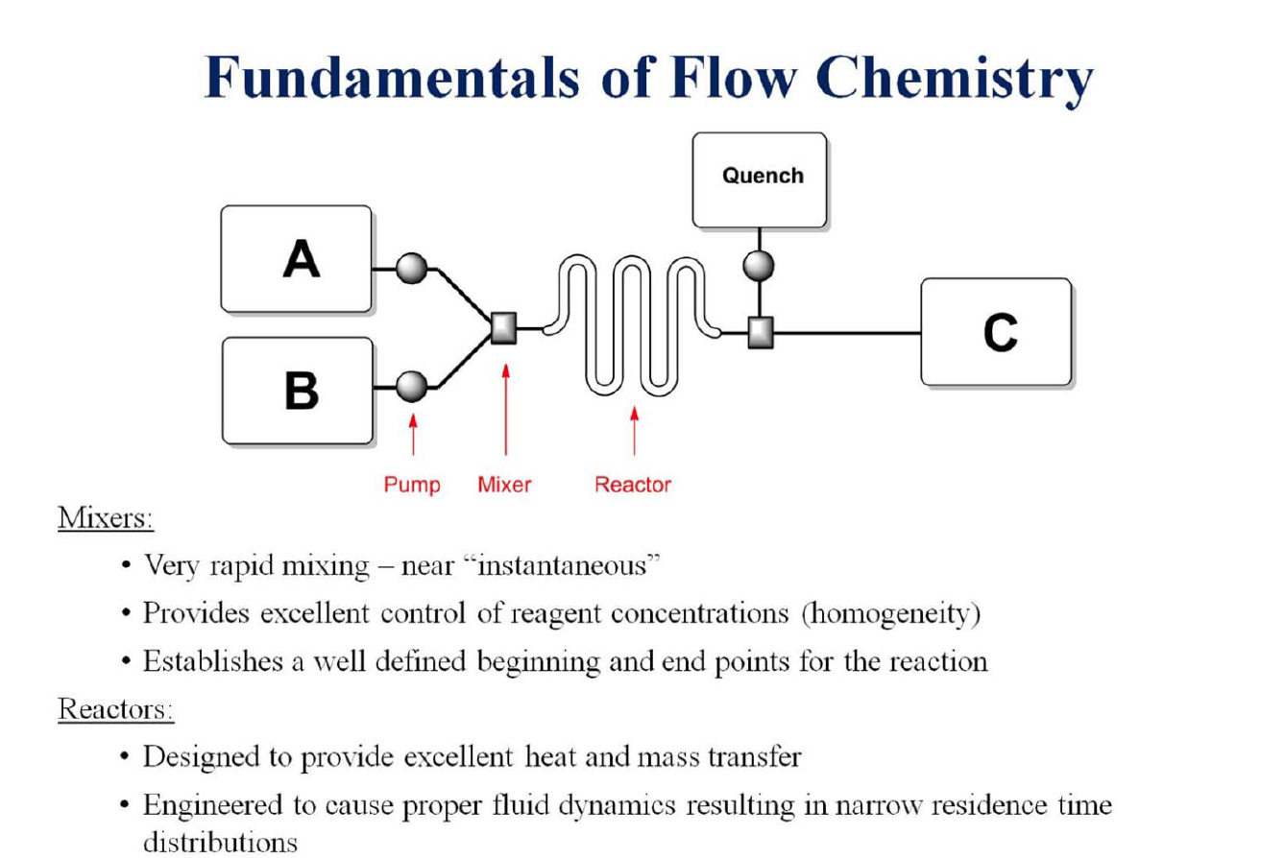
Flow Chemistry

Slide 5
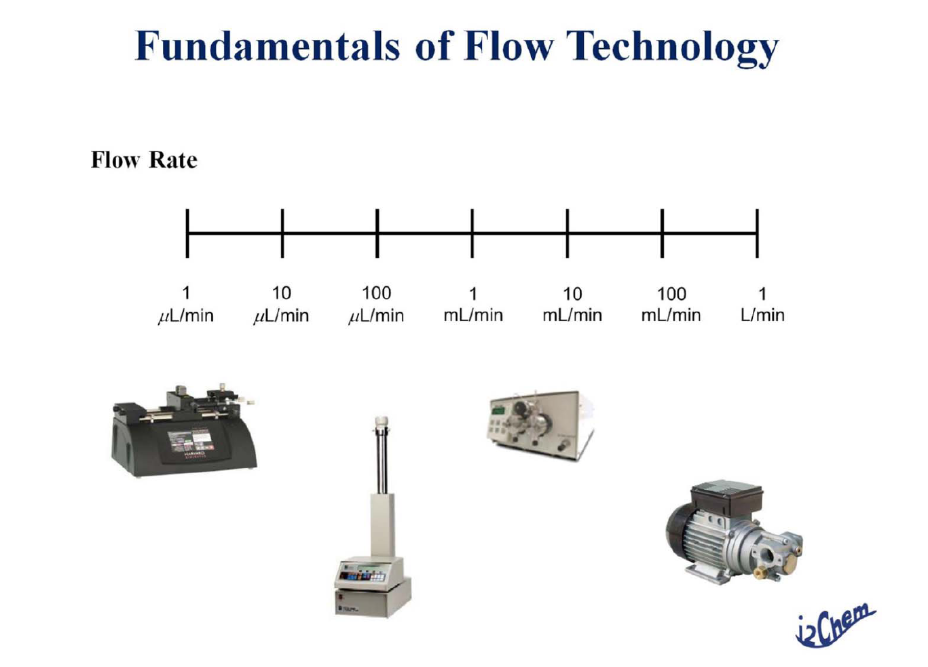
Flow Chemistry

Slide 6
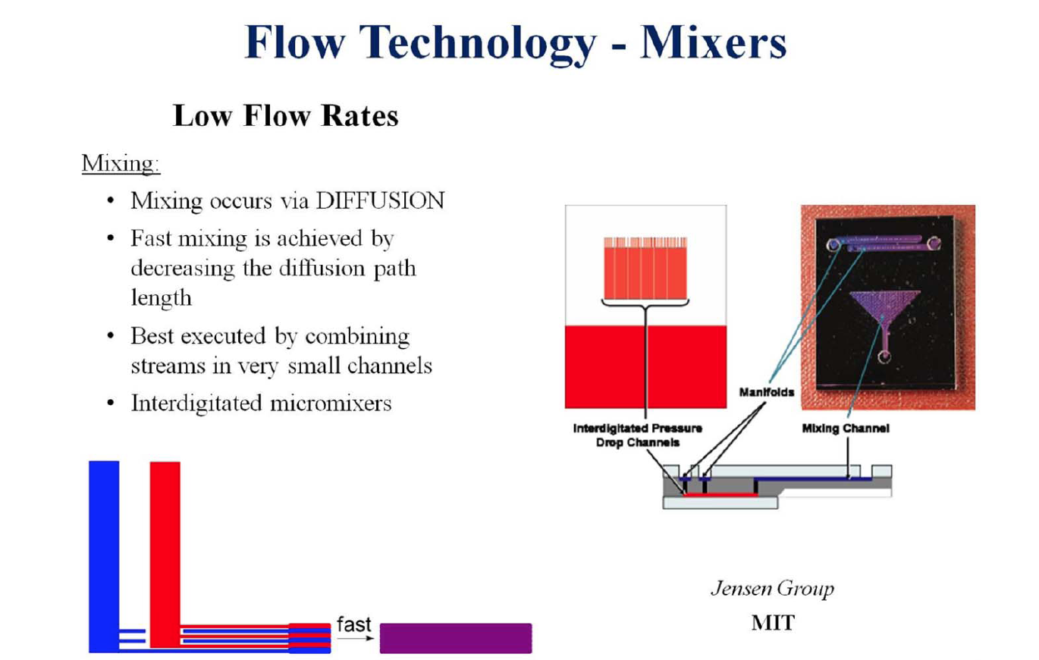
Flow Chemistry

Slide 7
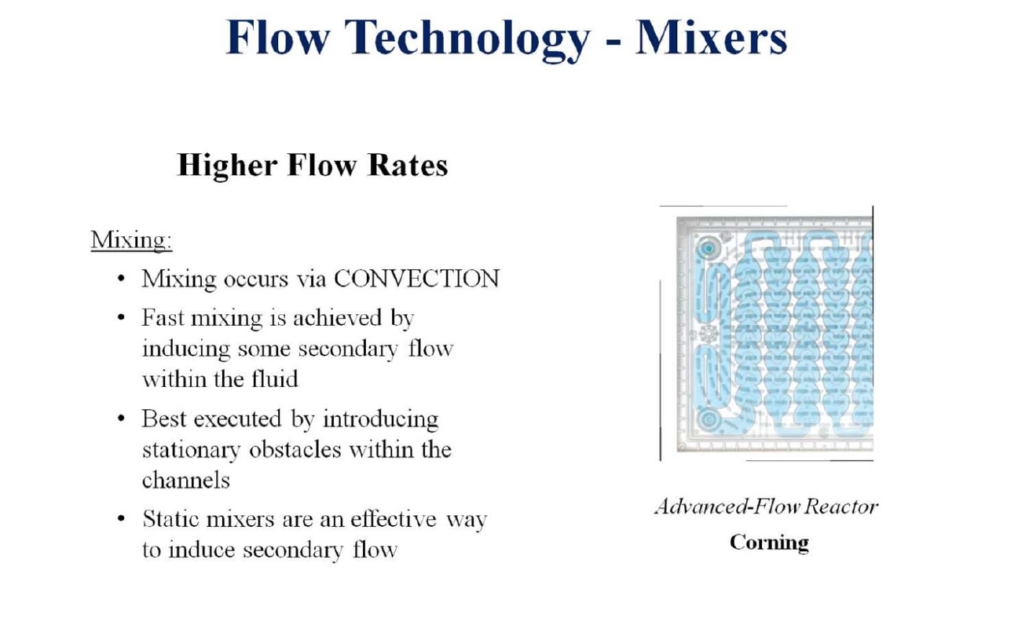
Flow Chemistry

Slide 8
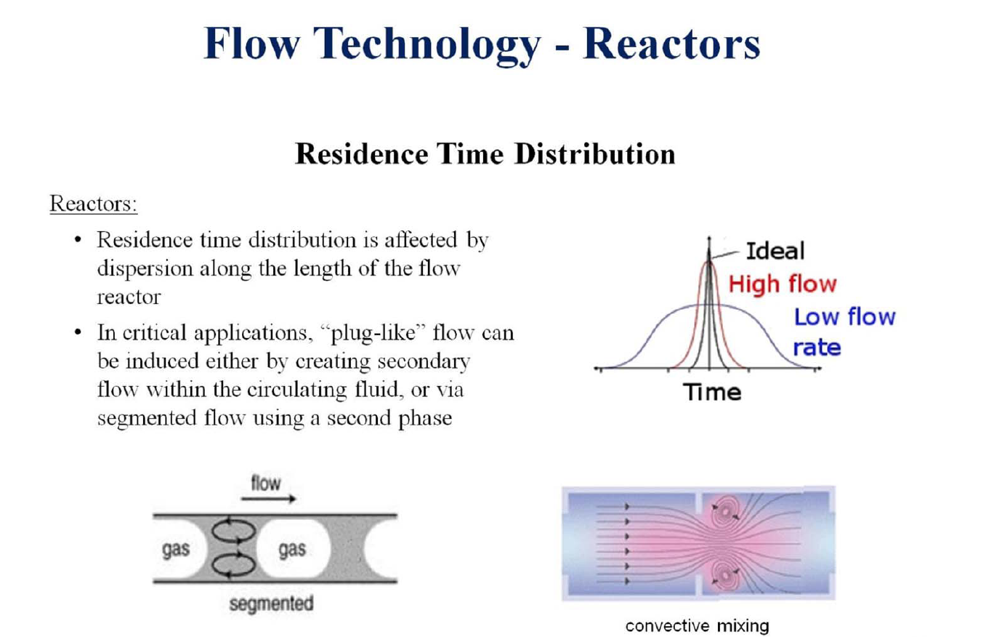
Flow Chemistry

Slide 9
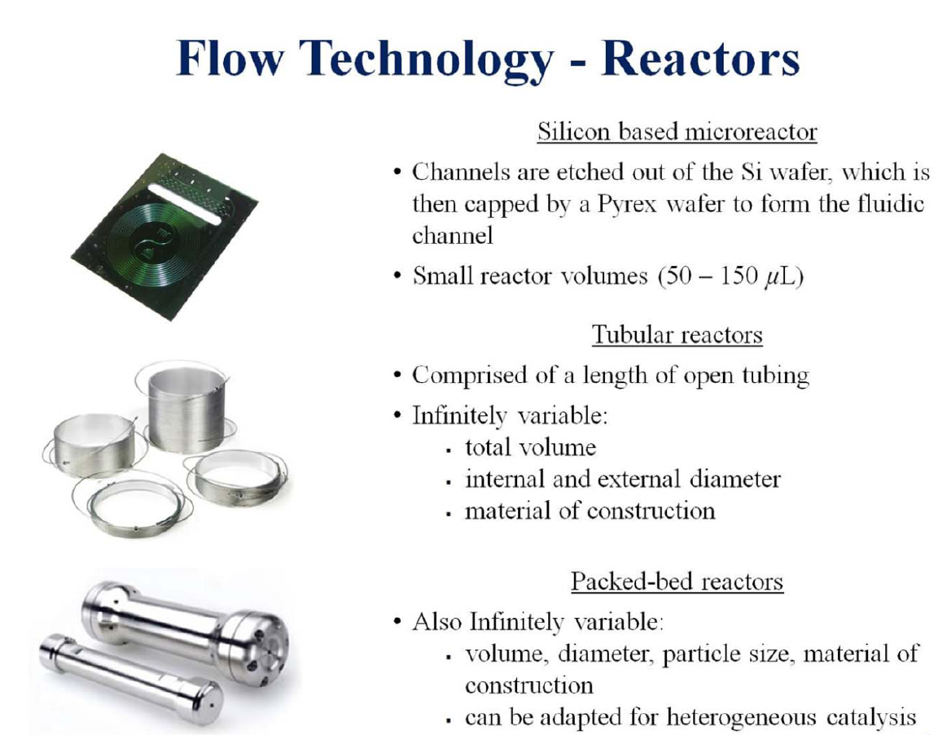
Flow Chemistry

Slide 10
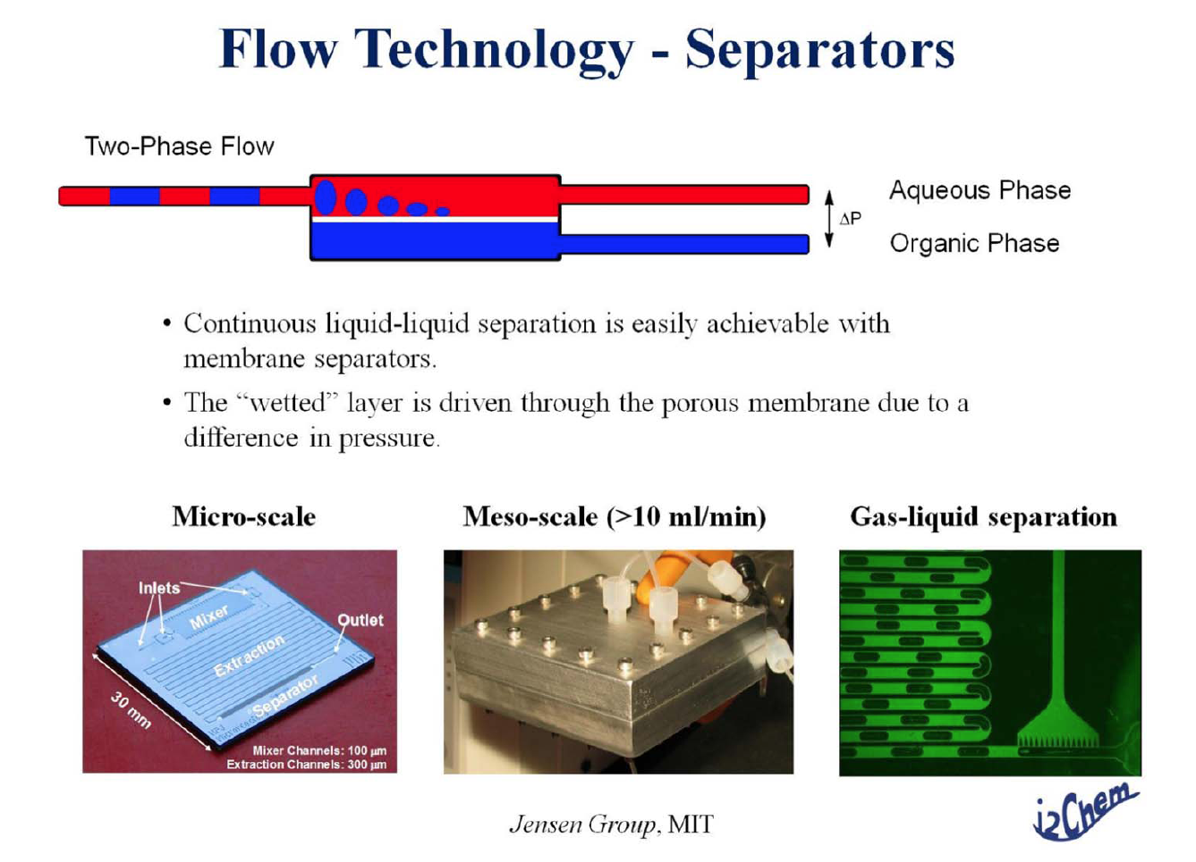
Flow Chemistry

Slide 11
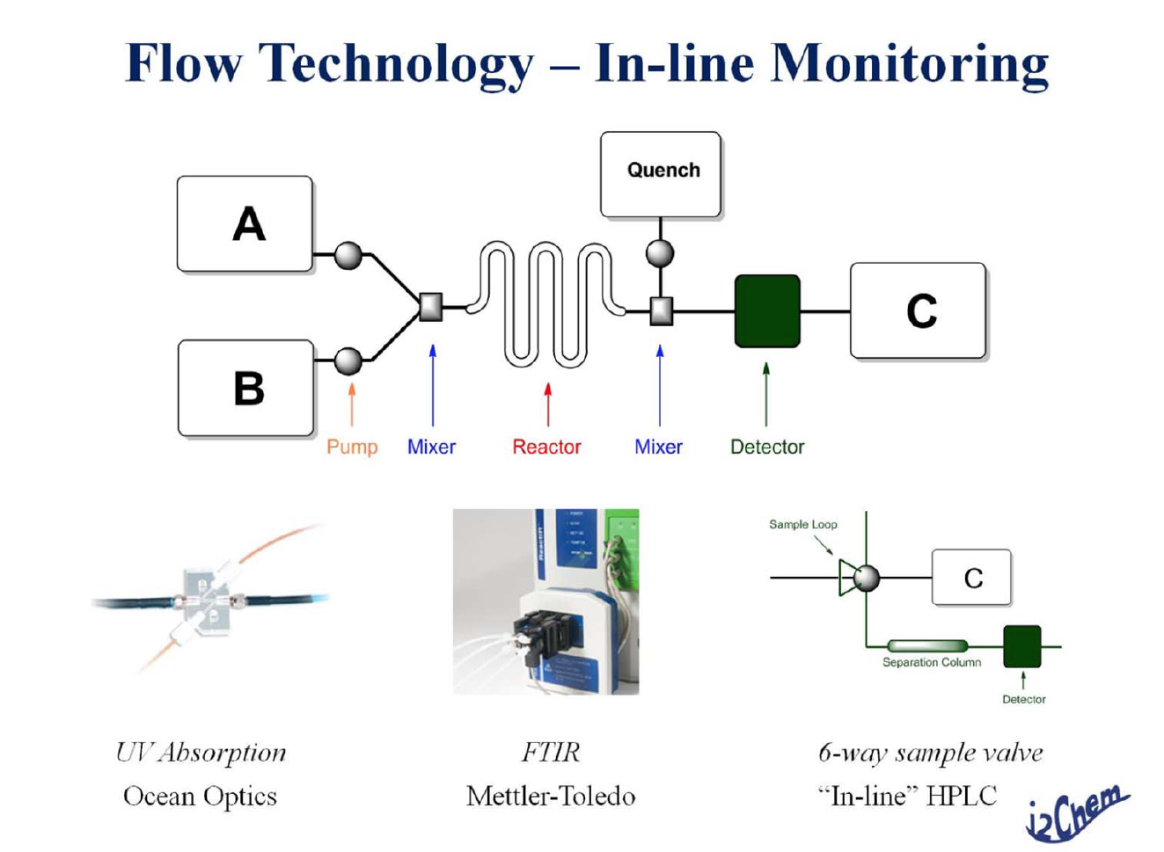
Flow Chemistry

Slide 12
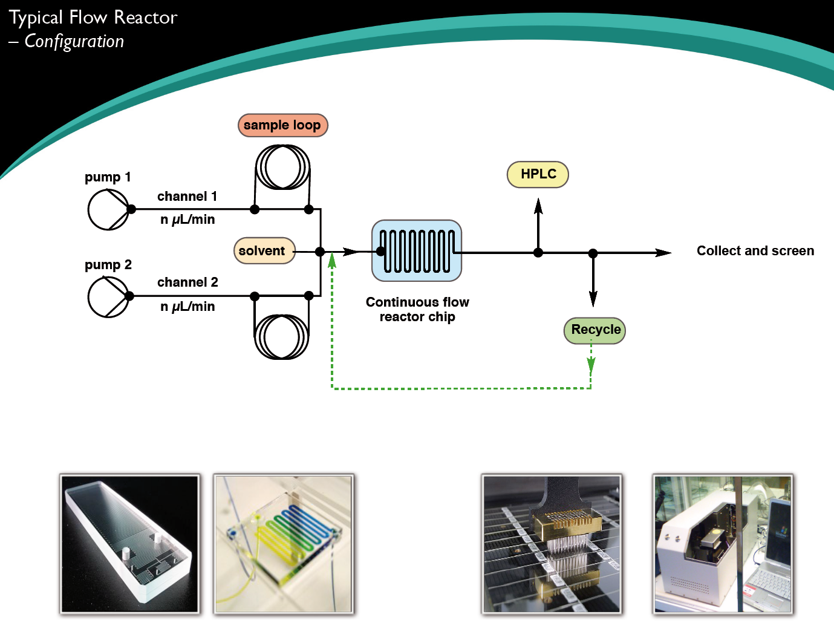
Flow Chemistry

Slide 13
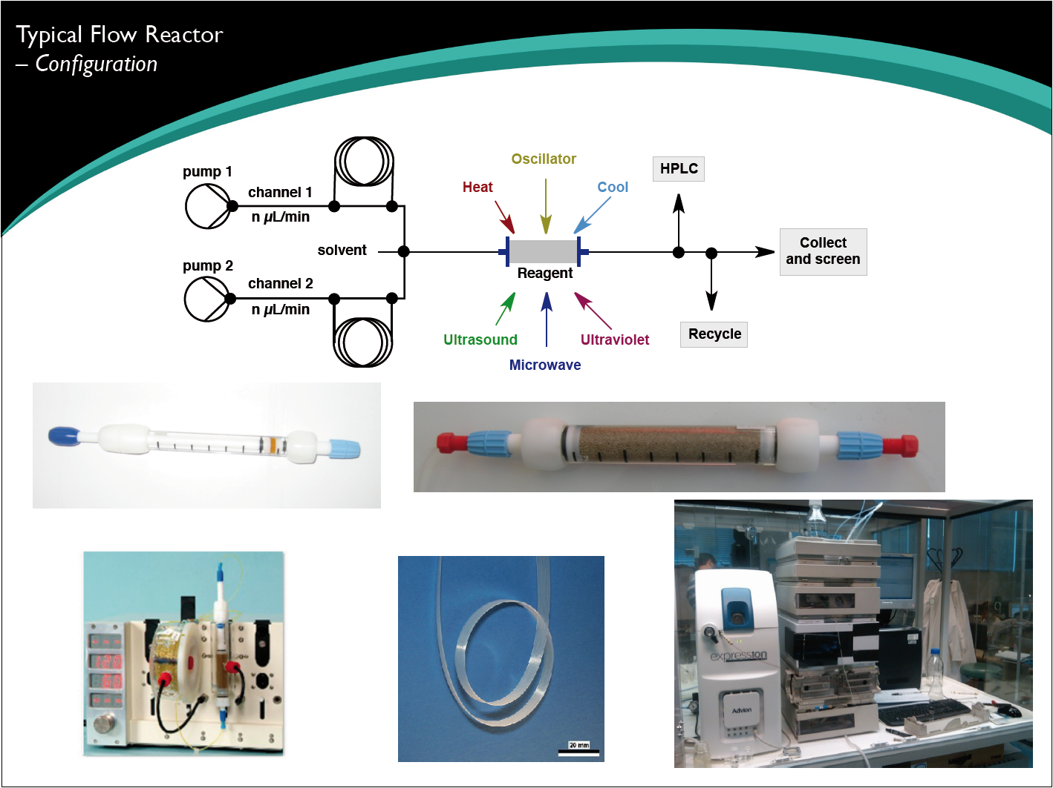
Flow Chemistry

Slide 14
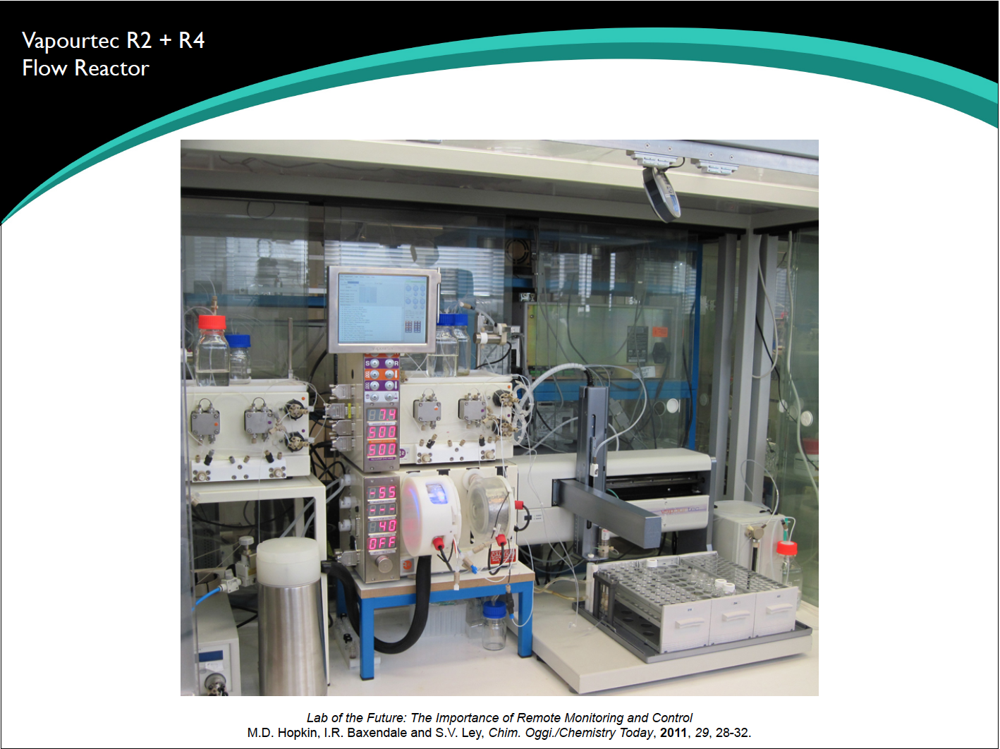
Flow Chemistry

Slide 15
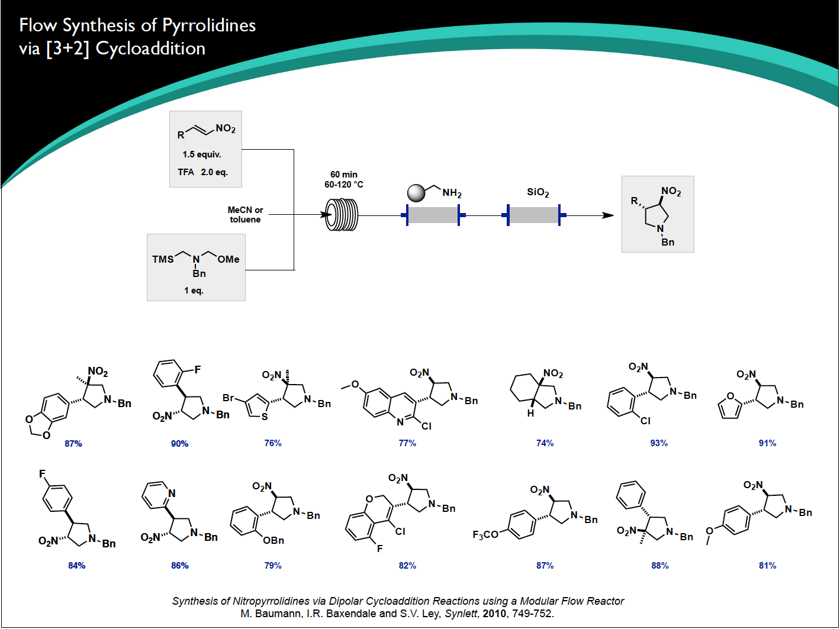
Flow Chemistry

Slide 16
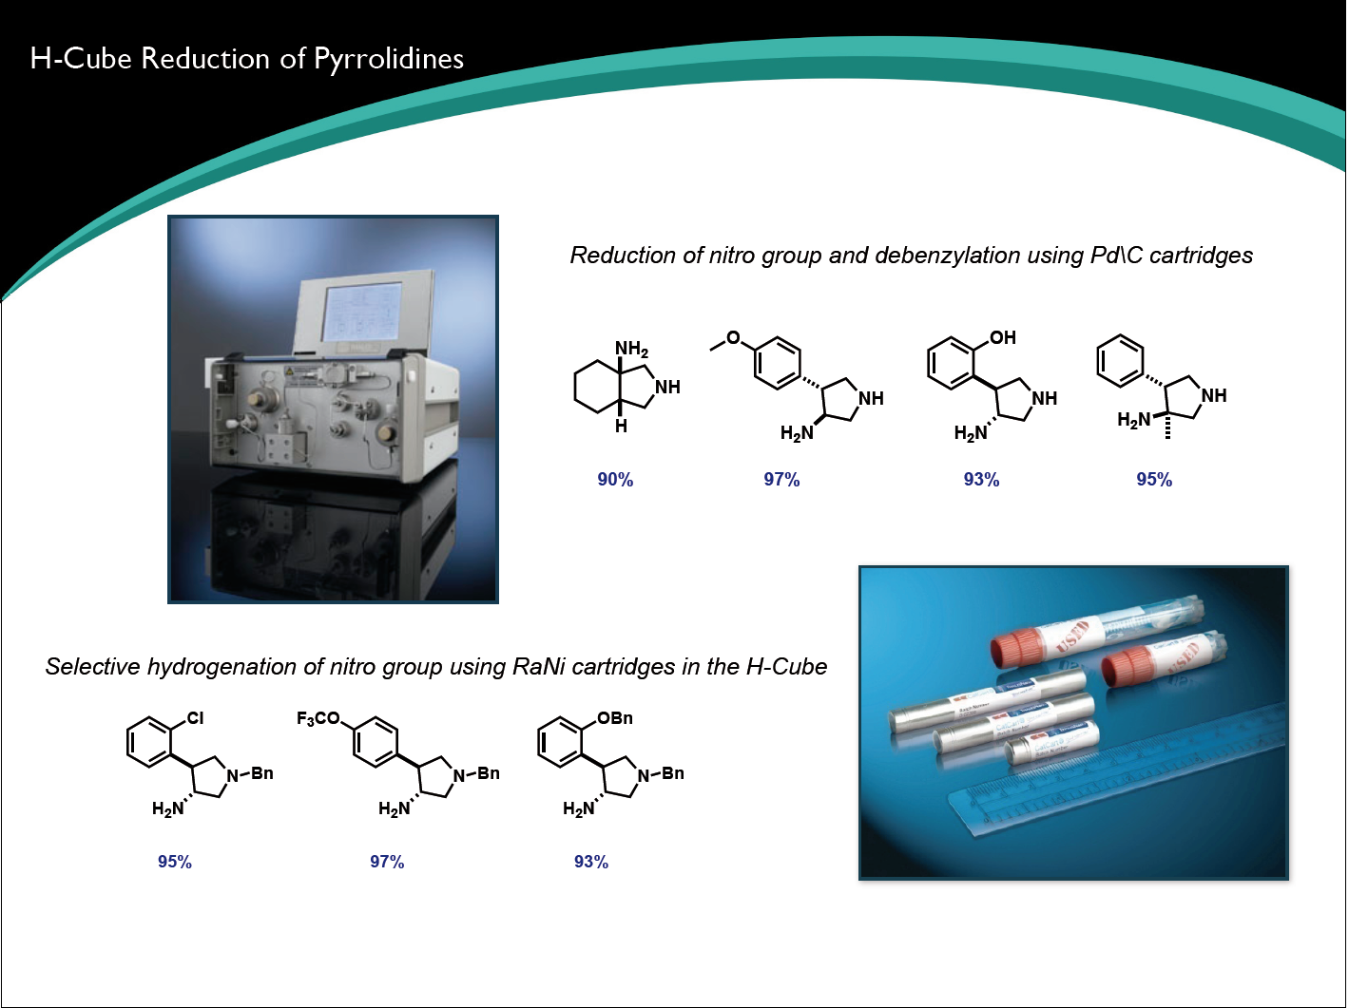
Flow Chemistry

Slide 17
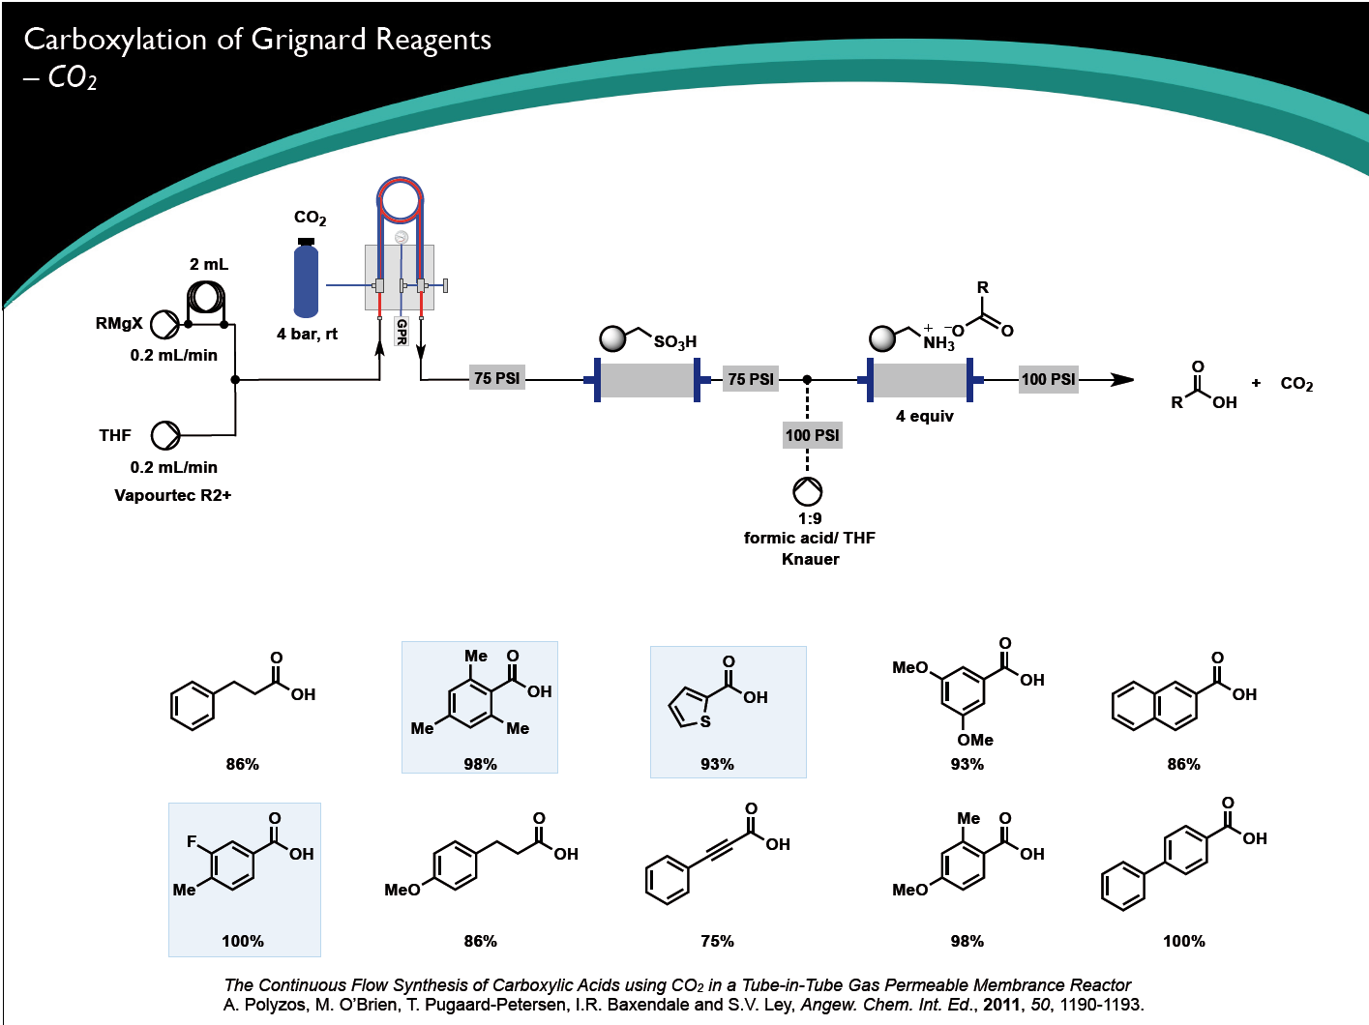
Flow Chemistry

Slide 18
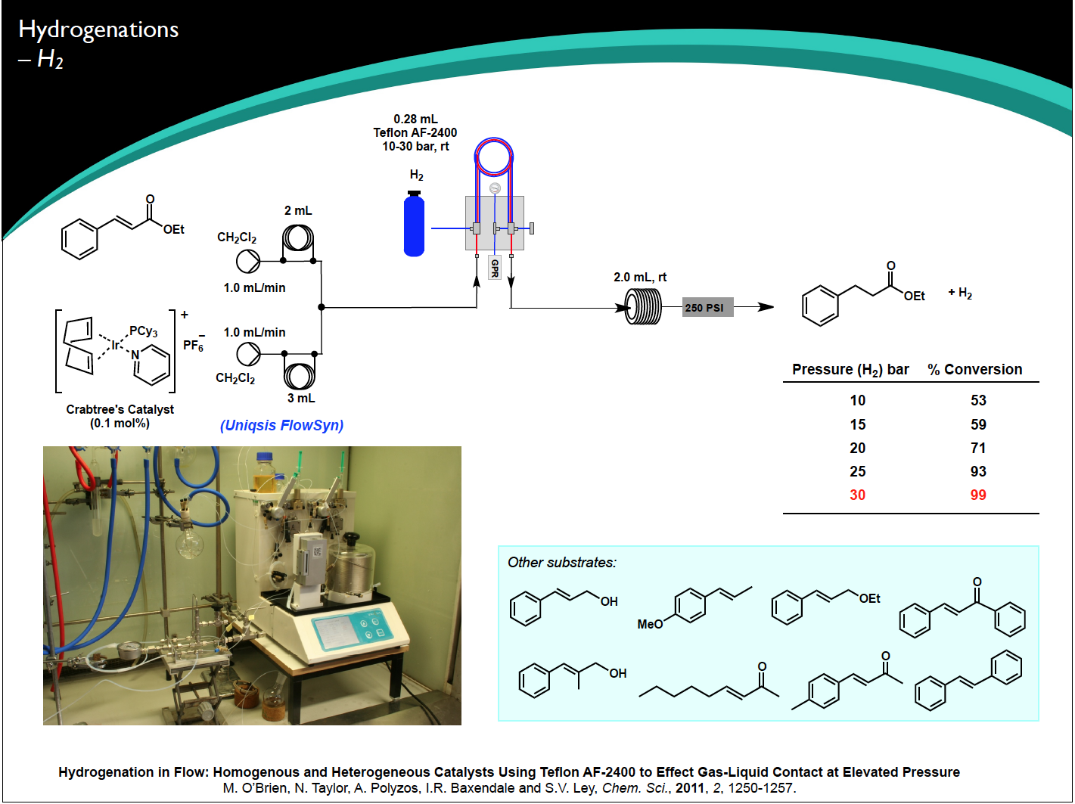
Flow Chemistry

Slide 19
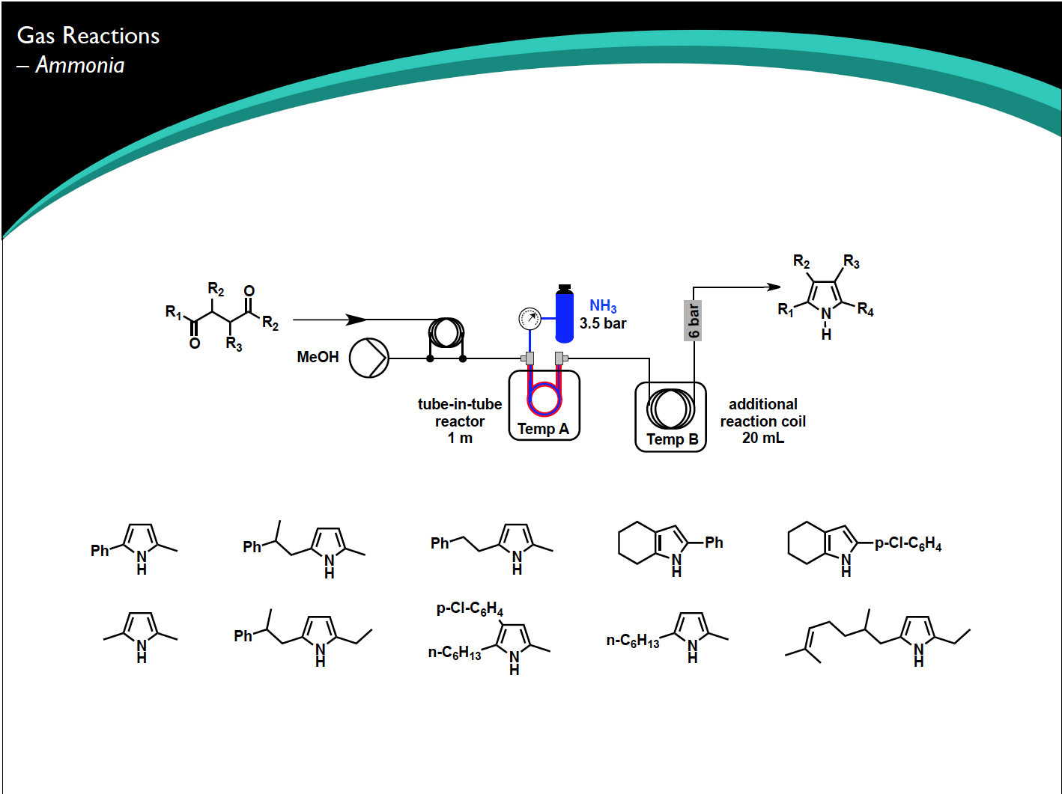
Flow Chemistry

Slide 20
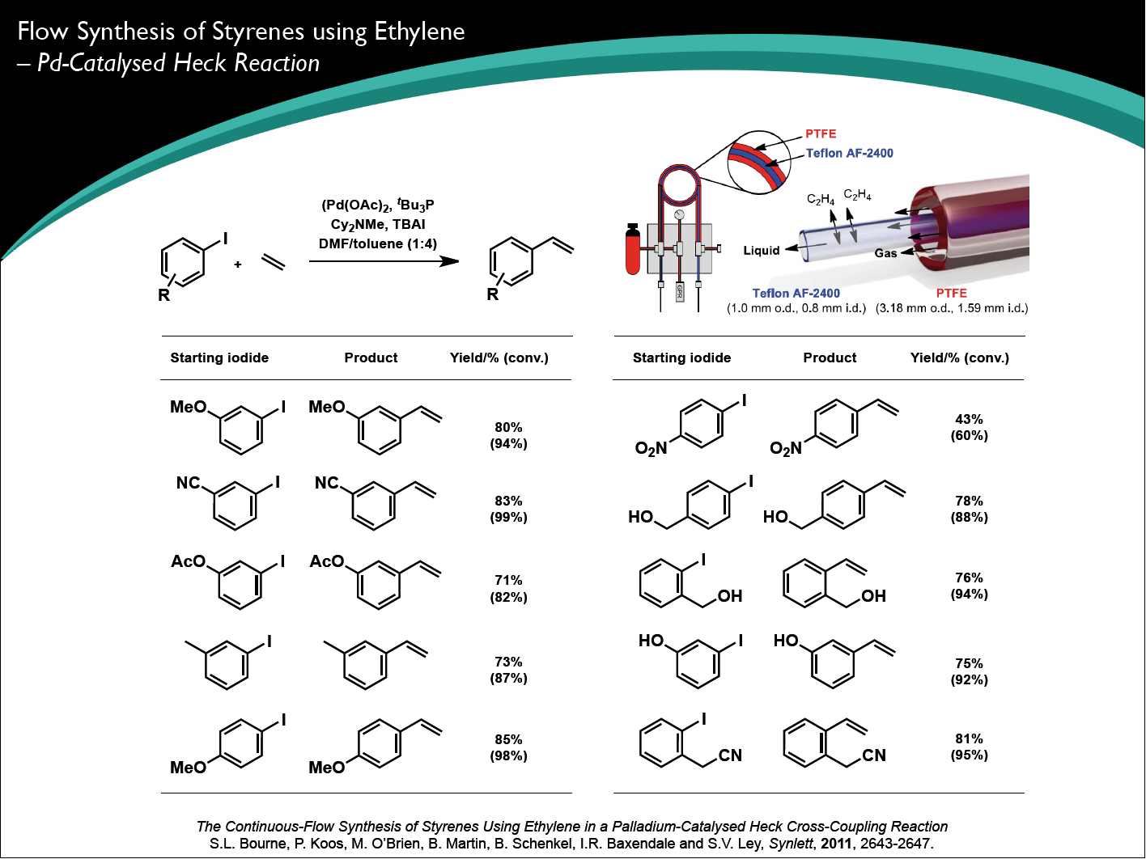
Flow Chemistry

Slide 21
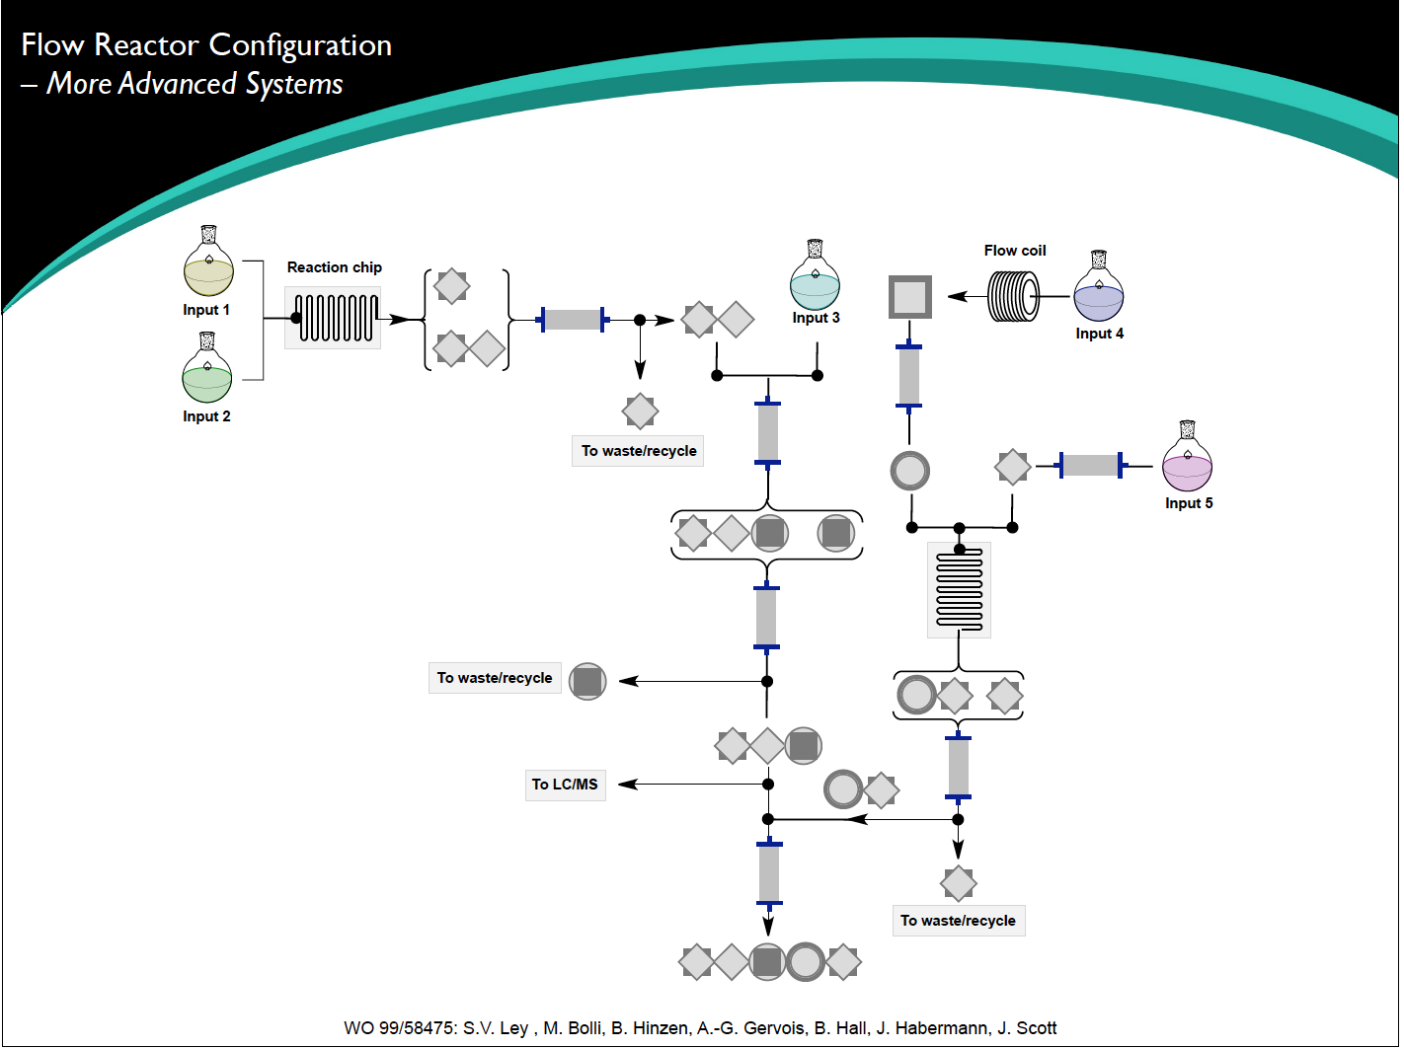
Flow Chemistry

Slide 22
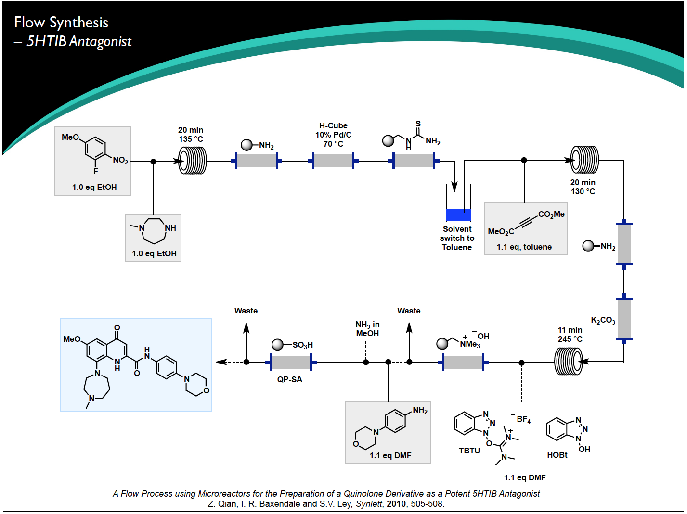
Flow Chemistry

Slide 23
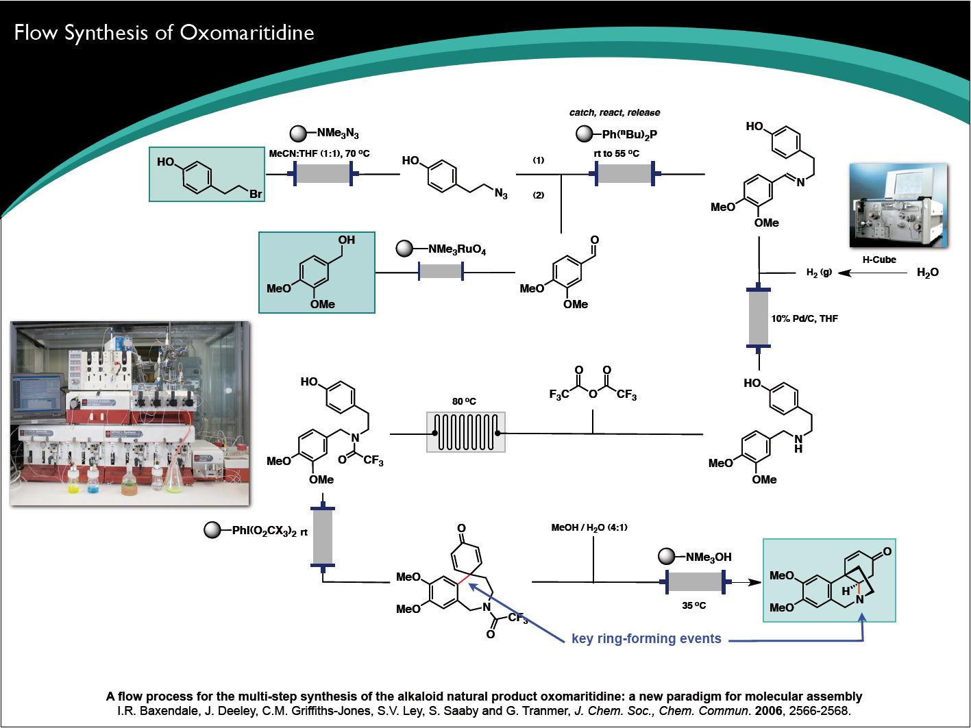
Flow Chemistry

Slide 24
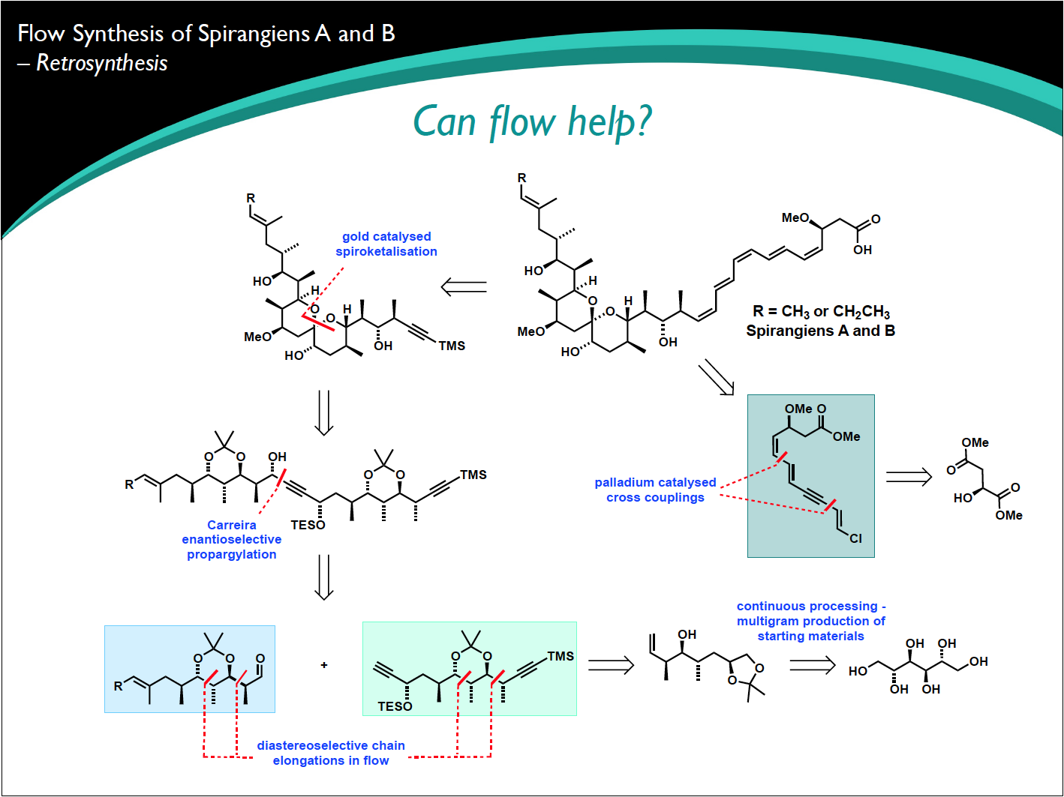
Flow Chemistry

Slide 25
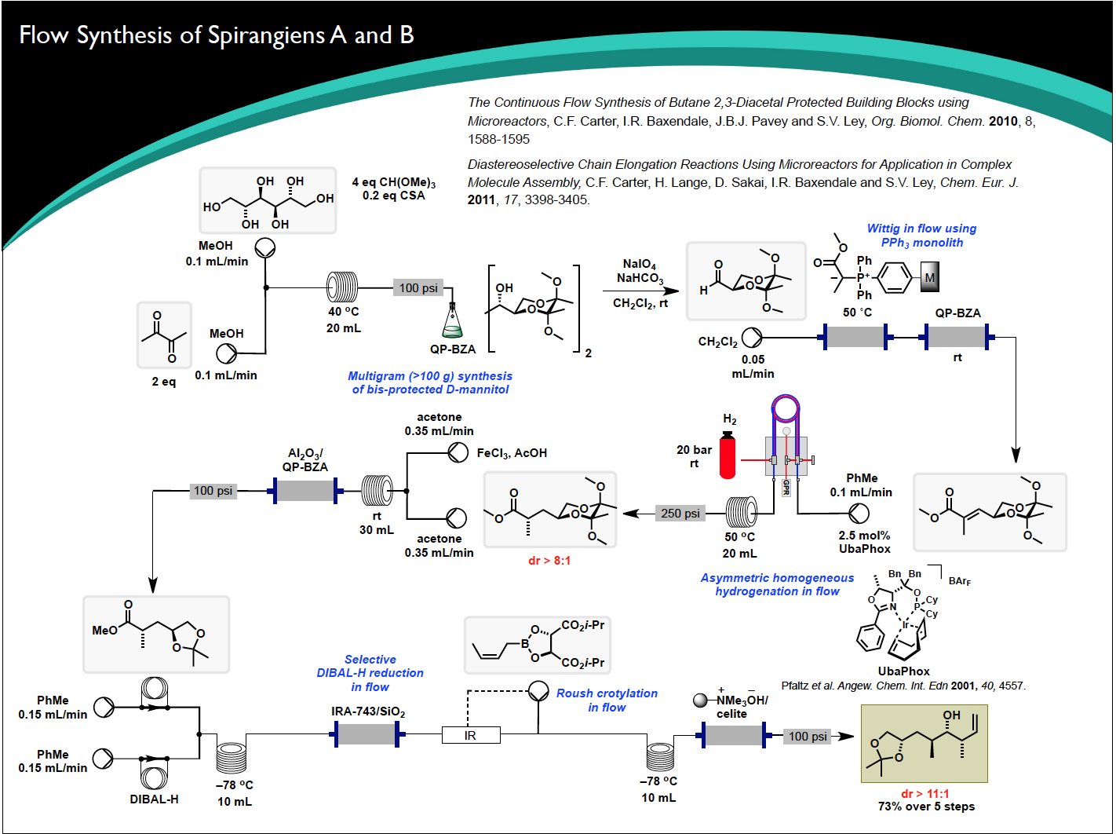
Flow Chemistry

