Slide 1

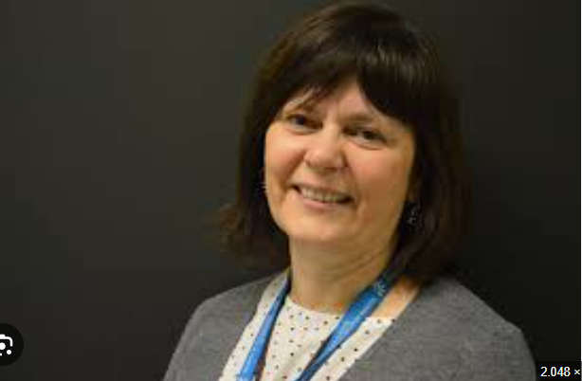
Prof. Germana Meroni
Associate professor of Genetics at University of Trieste, Department of Life Sciences
Coordinator of PhD in Molecular Biomedicine
Her research topics focus on human genetics with the identification of genes responsible for genetic diseases and the functional characterisation of these genes in order to identify their pathogenic mechanisms
Several of her research projects have been financed by AIRC, Fondazione Telethon, Fondation Jérome Lejeune, PRIN 2015, European Commission (Horizon 2020 Program)
Participant and Italian Representative of the Management Committee of a COST Action
Author of 66 publications on international scientific journals
Associate professor of genetics at University of Trieste and Coordinator of PhD in Molecular Biomedicine

