Slide 1
X-ray tubes
Small size
Economic
Lab-scale instruments
Small size
Economic
Lab-scale instruments
X-ray sources
Used to investage the structure of materials
Synchrotron
Tunable
Multi-technique experiments
Large Scale Facility
Limited access for experiments

Slide 2
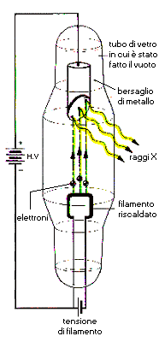
X-ray tubes
Vacuum tube
K_{α}
Anode
Characteristic
radiation
HV
X-rays
Intensity (a. u.)
K_{β}
Bremsstrahlung
radiation
Electrons
Cathode
λ_{min}
0.02
0.04
0.06
0.08
0.10
Wavelength (nm)
Filament supply
The spectrum from an X-ray tube has discrete fluorescent lines superimposed on
the continuous bremsstrahlung radiation

Slide 3
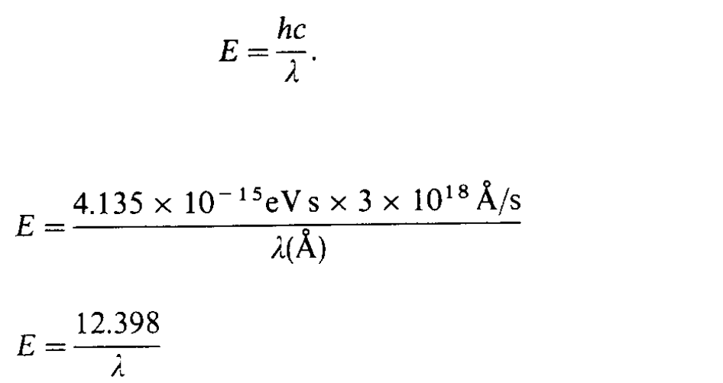
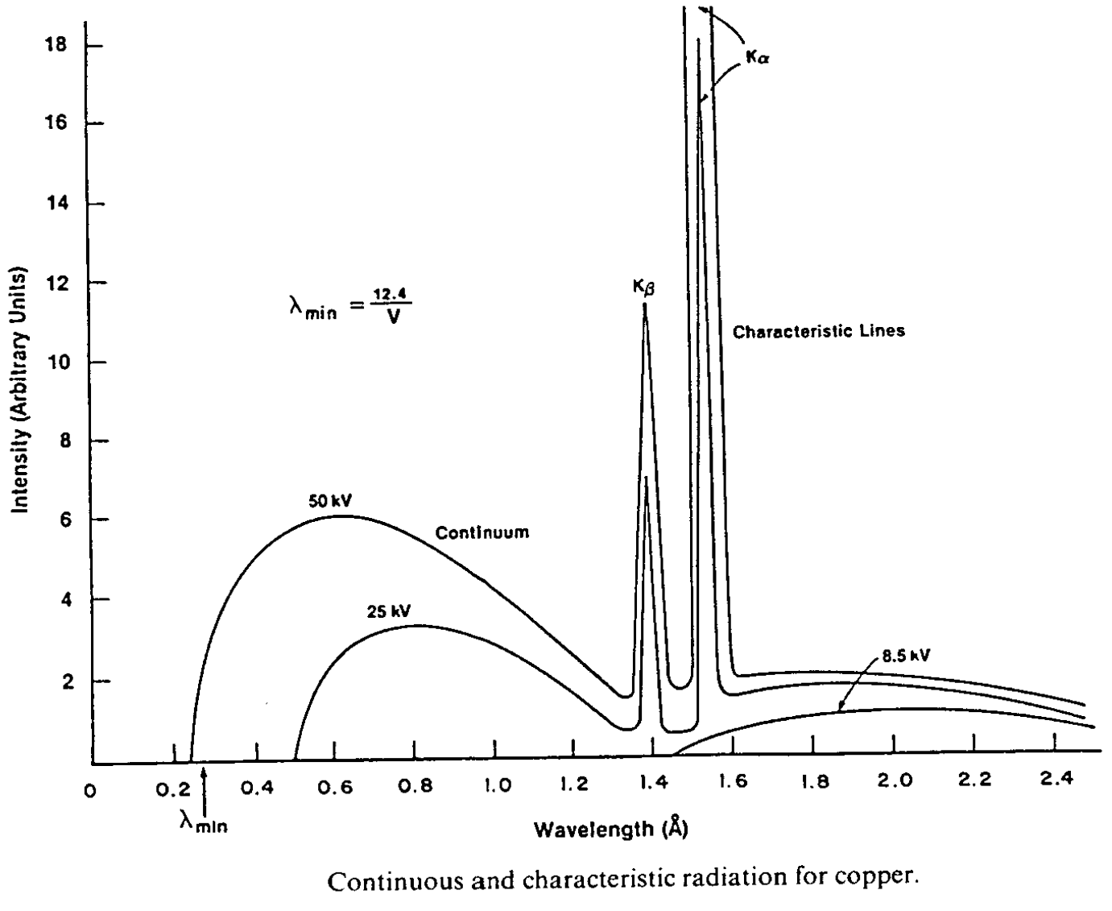
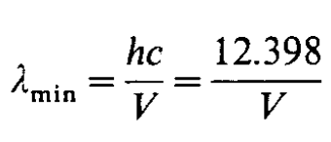
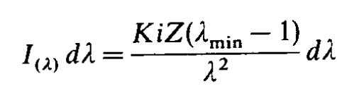
X-ray tubes
λ in Å ; E in keV ; V in kV

Slide 4
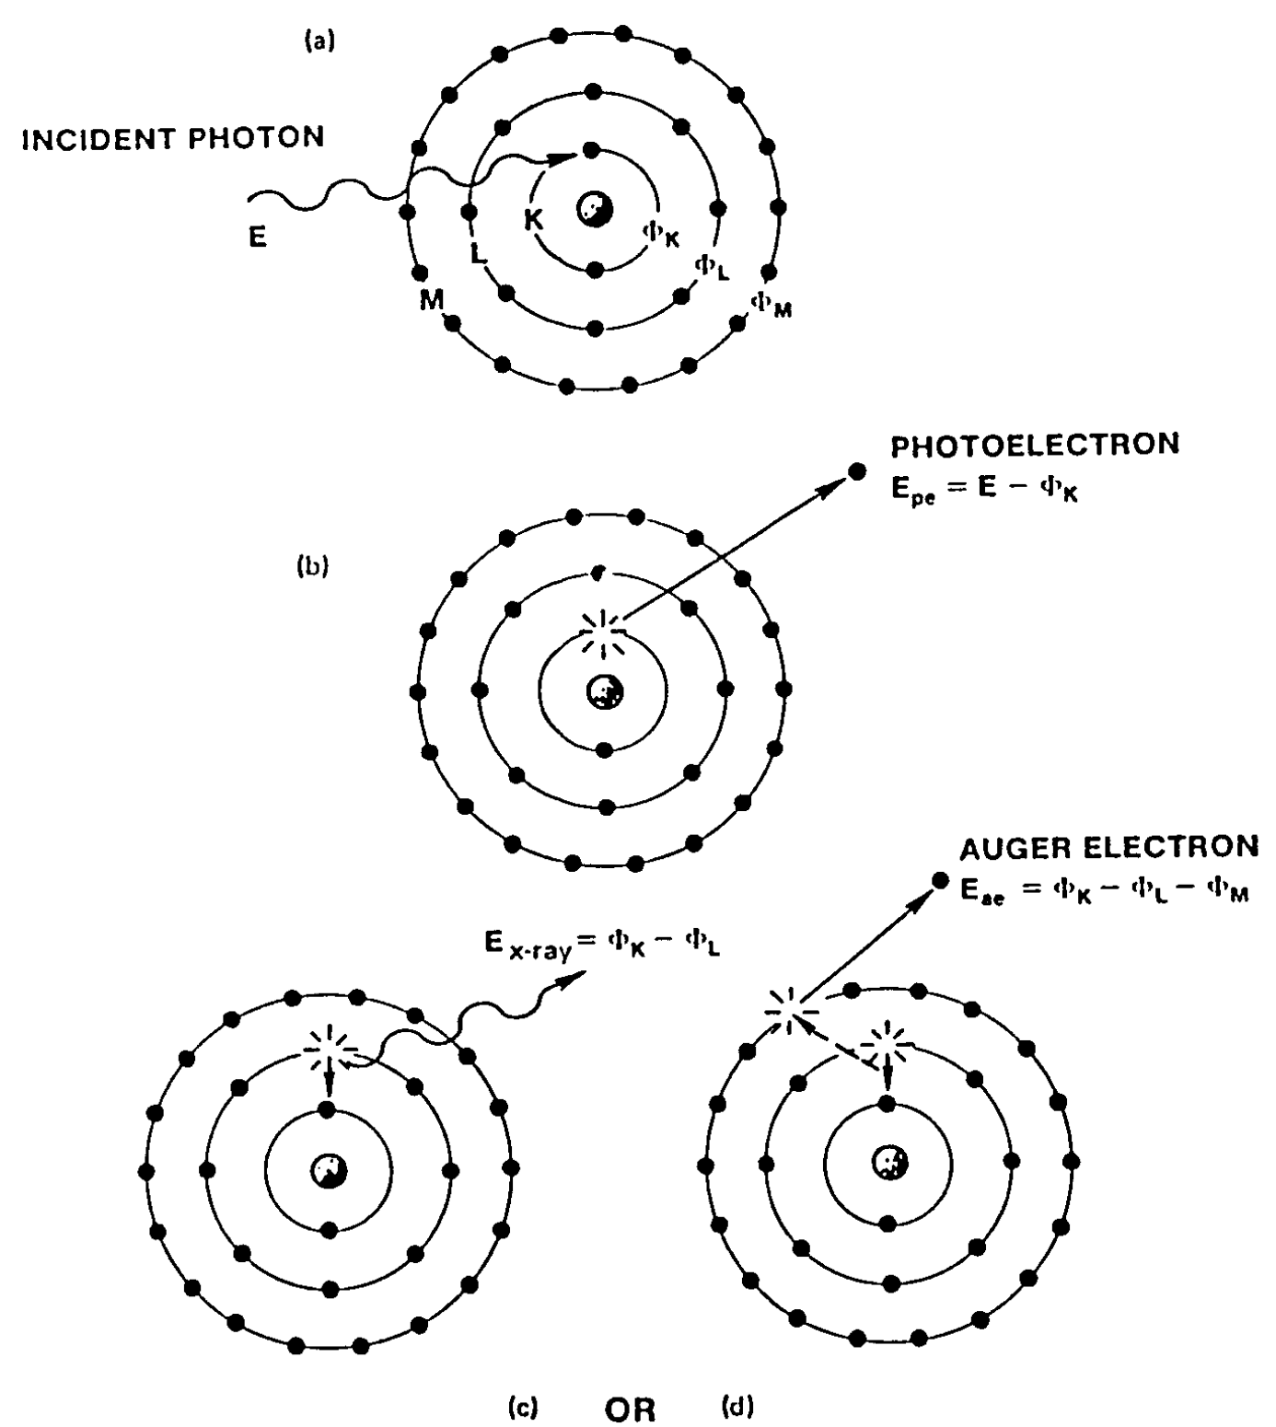
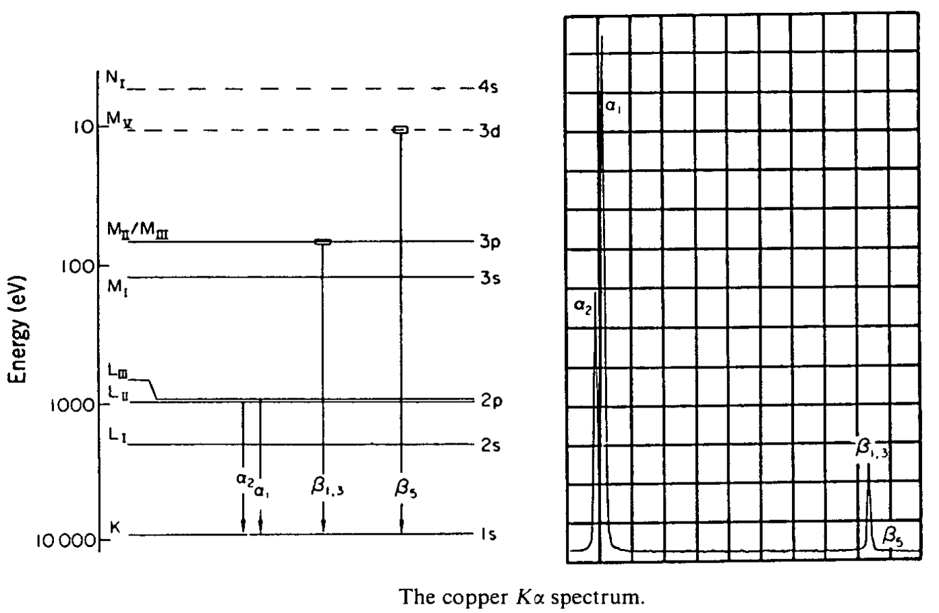
X-ray tubes

Slide 5

Energy Dissipation

Slide 6
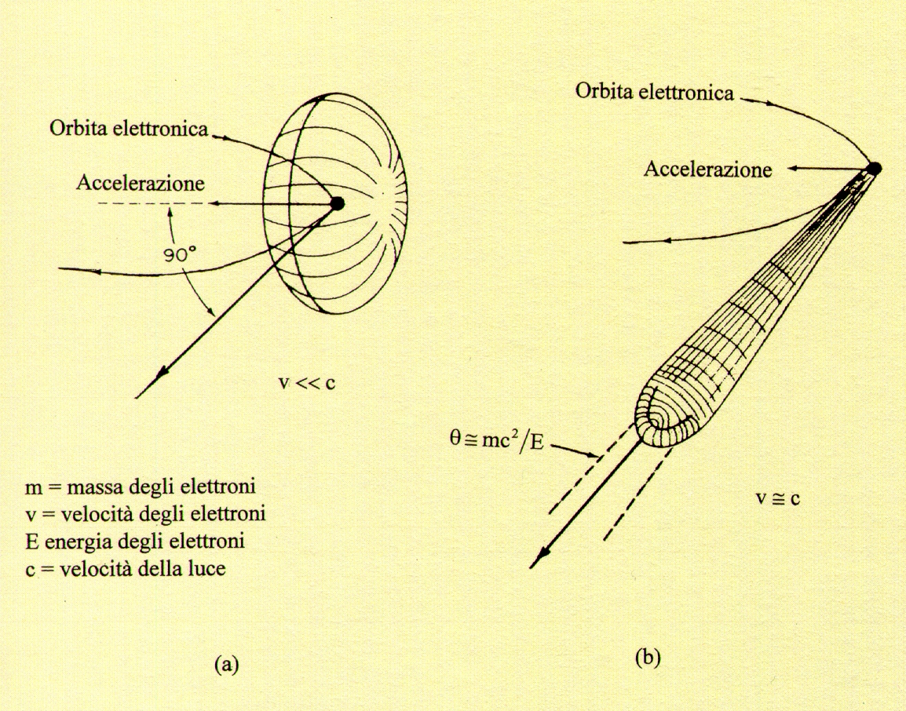
Synchrotron radiation angular distribution
Electron orbit
Electron orbit
e⁻
e⁻
Acceleration
Acceleration
v
v << c
Θ ≅ m₀c²/E
= 1/γ rad
m₀ = electron mass
v = electron velocity
E = electron energy
c = velocity of light
v ≅ c
v
Radiation angular distribution (a) electrons travelling at low speed and
(b) electrons travelling at relativistic speed (γ = (1-v²/c²)^{-1/2} ≅ 10000 at ESRF)

Slide 7
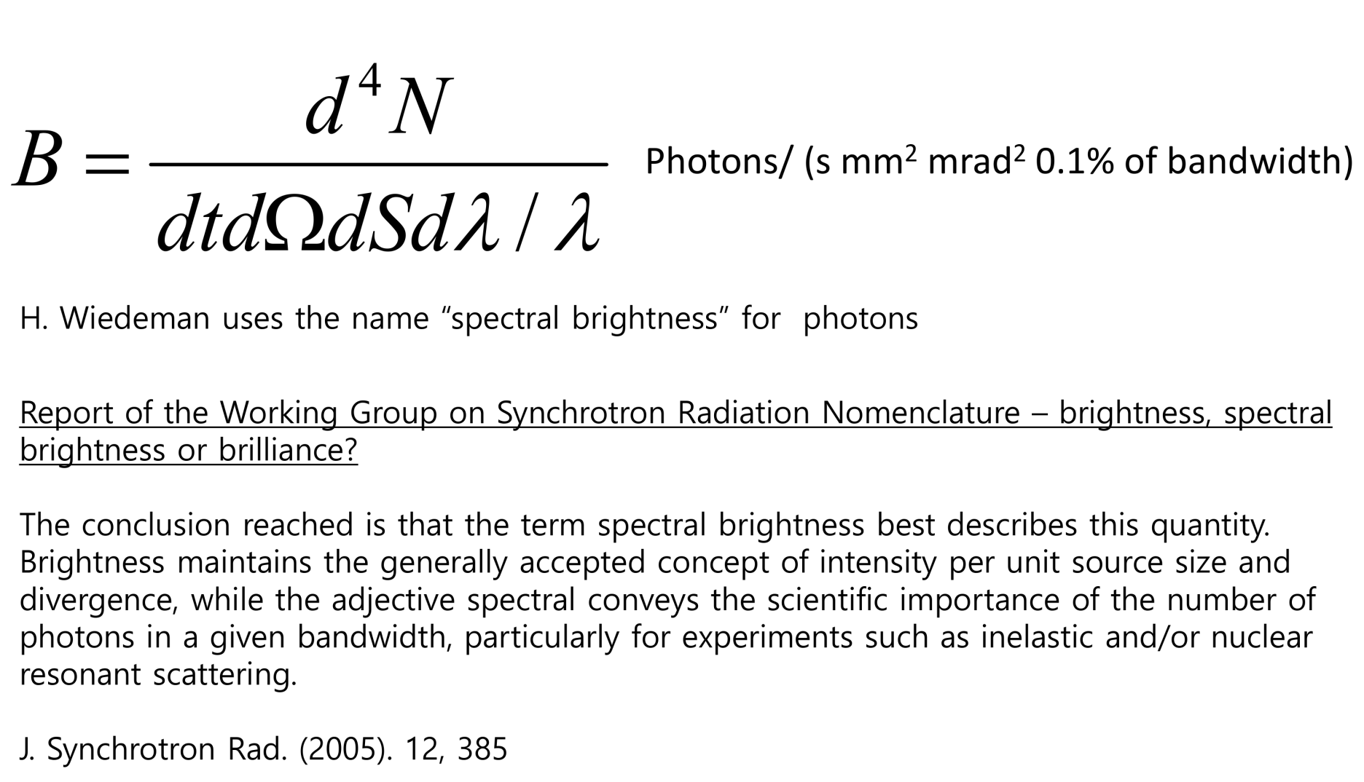
Synchrotron radiation – Spectral brightness

Slide 8
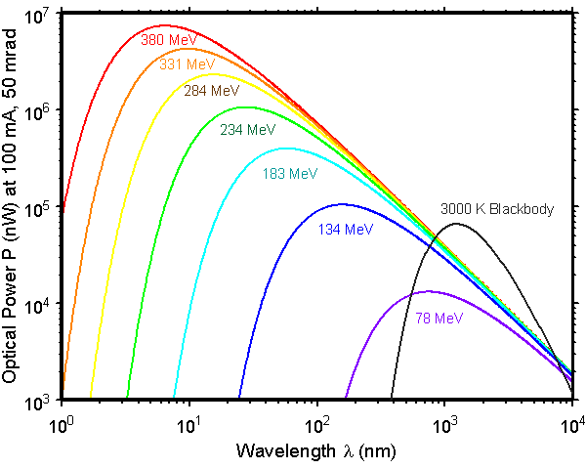
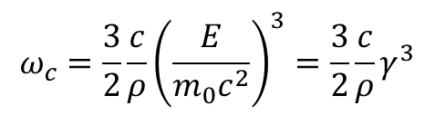

$$ω_{c}=\frac{3}{2}\frac{c}{ρ}{\left(\frac{E}{m_{0}c^{2}}\right)}^{3}=\frac{3}{2}\frac{c}{ρ}γ^{3}$$
$ρ$ = radius of curvature

Slide 9
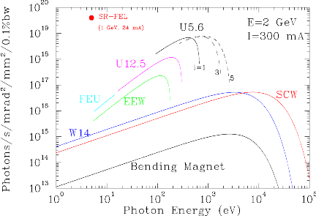
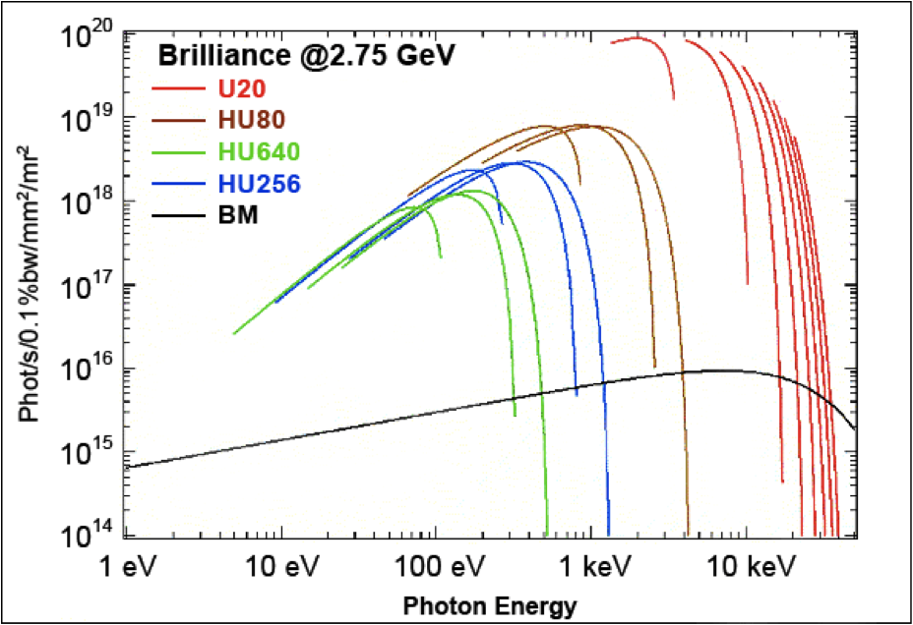
Elettra
SOLEIL

Slide 10
How a Storage Ring Works
Front-end
Optical hutch
Booster
Experimental
hutch
Electron source
LINAC

Slide 11
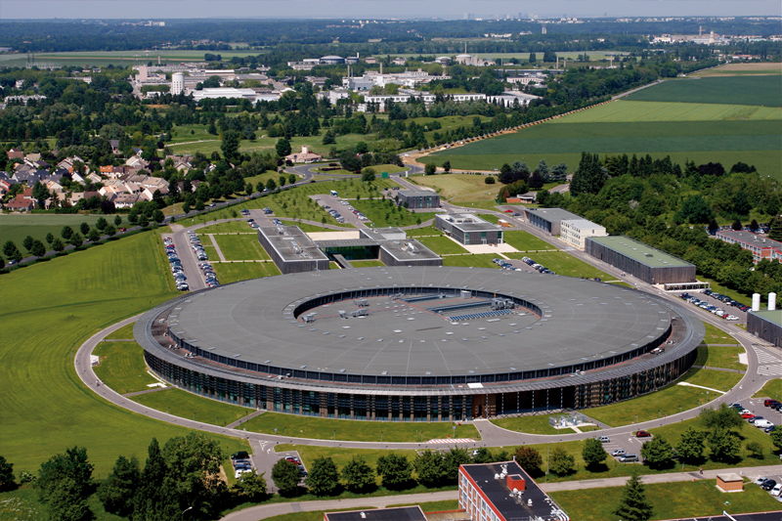
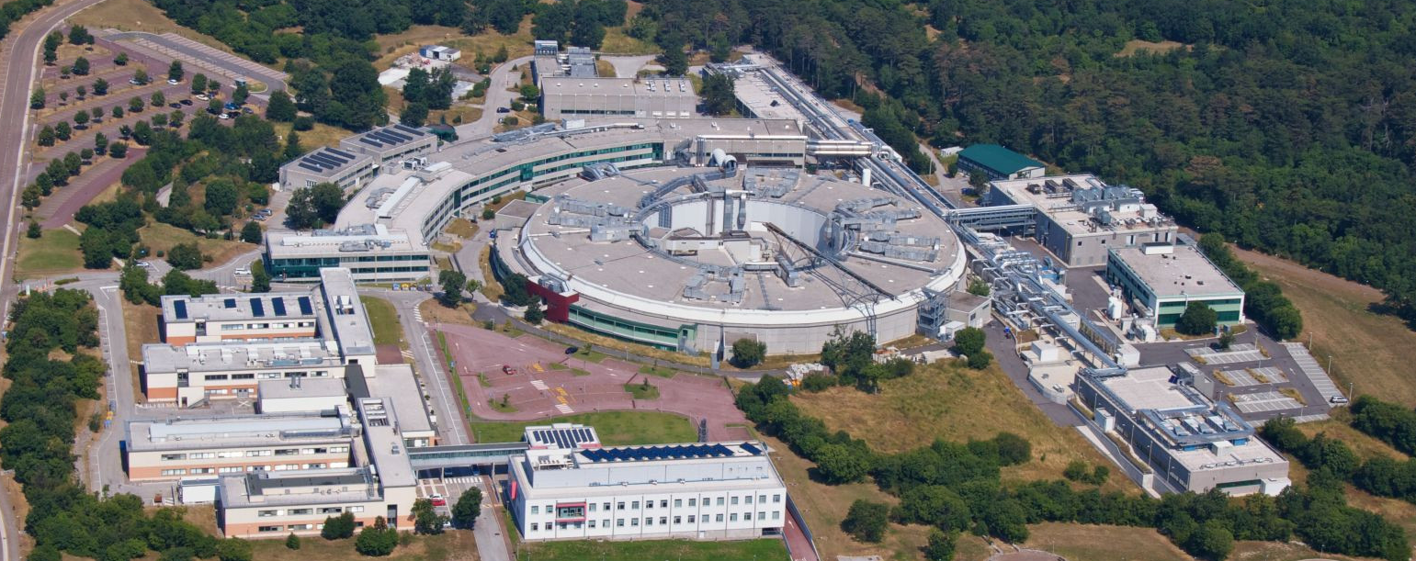
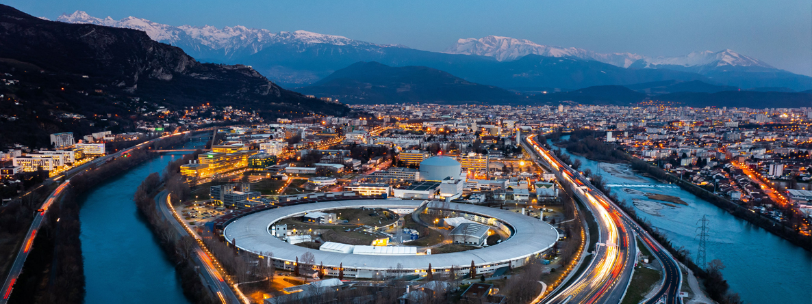
Storage ring
Elettra: 260m
SOLEIL: 354m
ESRF: 844m

Slide 12
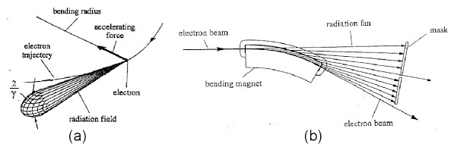
Emission from a bending magnet

Slide 13
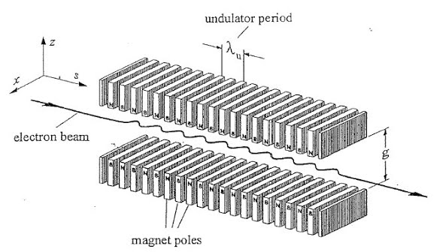
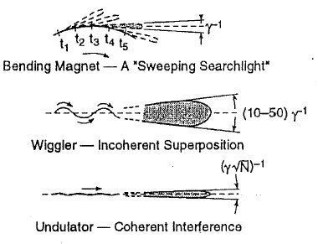
Insertion devices

Slide 14
Time structure
Light pulses
e⁻
e⁻
I
e⁻
e⁻
100 ps
t
1μs
Time pulsed emission is interesting for studying rapid reactions

Slide 15
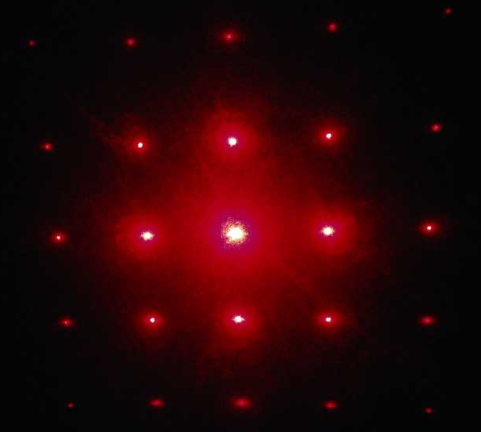
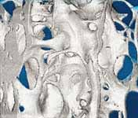
Types of experiments
Fluorescence
Elemental analysis
I
Detector
X-rays
Sample
wavelength
Diffraction
Detector
X-rays
Absorption
Sample
μ
2.0
1.0
X-rays
Sample
Detector
0.0
8800
8800
9000
9000
9200
9200
9400
9400
9600
9600
9800
9800
10000
10000
Energy
E (eV)
Imaging
X-rays
Detector

