Slide 1
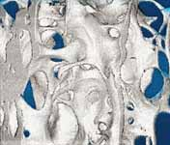
Fluorescence
Elemental analysis
I
Detector
X-rays
Sample
wavelength
Absorption
μ
2.0
1.0
X-rays
Sample
Detector
0.0
8800
8800
9000
9000
9200
9200
9400
9400
9600
9600
9800
9800
10000
Energy
10000
E (eV)
Imaging
X-rays
Detector

Slide 2
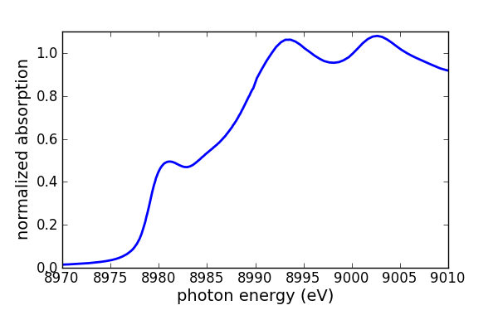
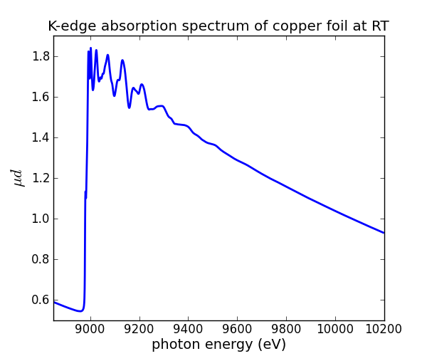
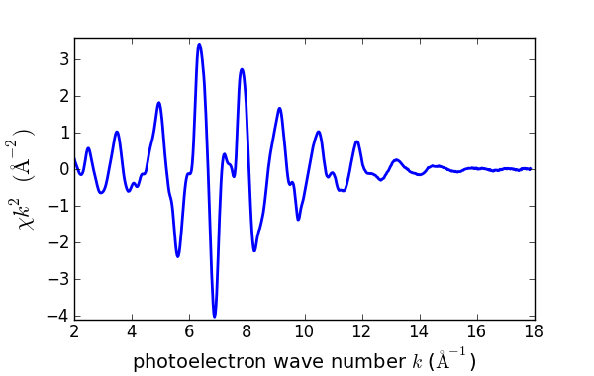
XAFS: X-ray Absorption Fine Structure
transmission experiment
I₀
I₁
x-rays
sample
XANES
X-ray Absorption Near Edge Structure
EXAFS Extended X-ray Absorption Fine Structure
measured at Alba/CLÆSS

Slide 3
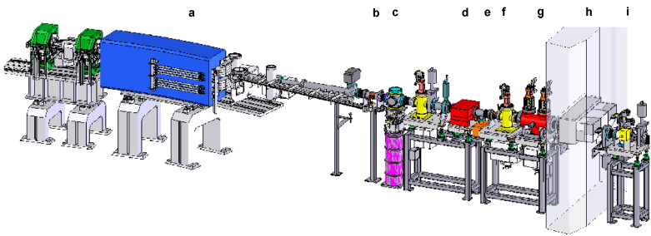
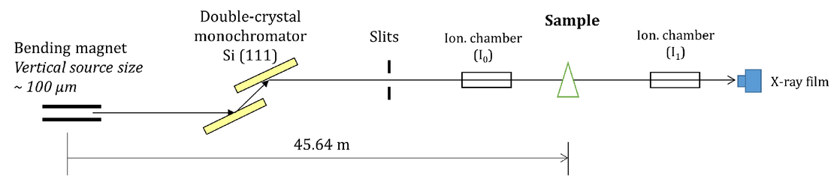
Beamline structure
Front-end
Optical hutch
Experimental hutch

Slide 4
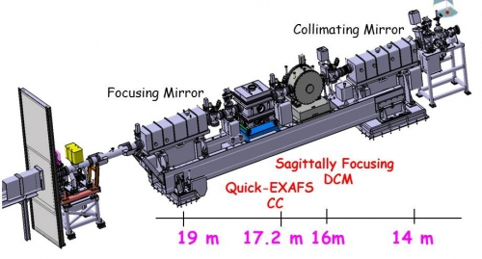
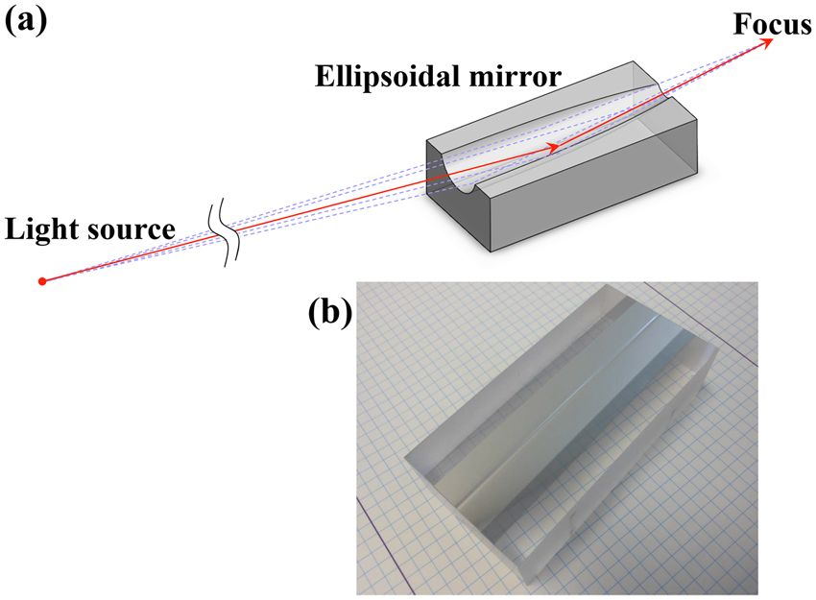
Beamline structure
Optical hutch
Mirrors
Metal thin film on substrate
Bended by piezoelectric devices

Slide 5
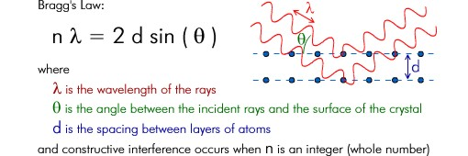
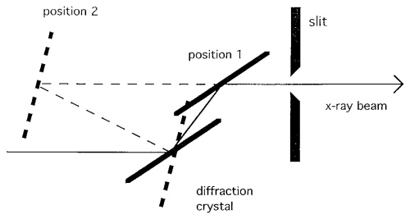
Beamline structure
Monochromator:
Si single crystals
(111)
(220)
(311)
Monochromator
Double-crystal
monochromator

Slide 6
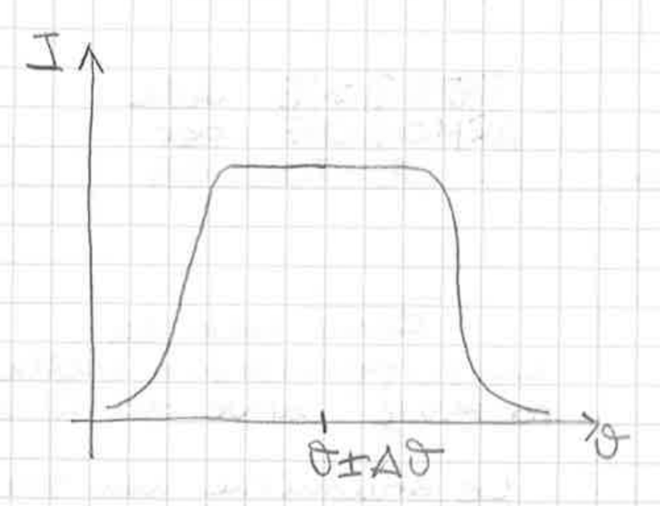
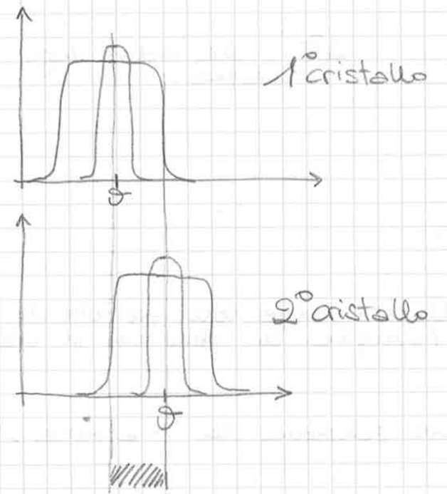
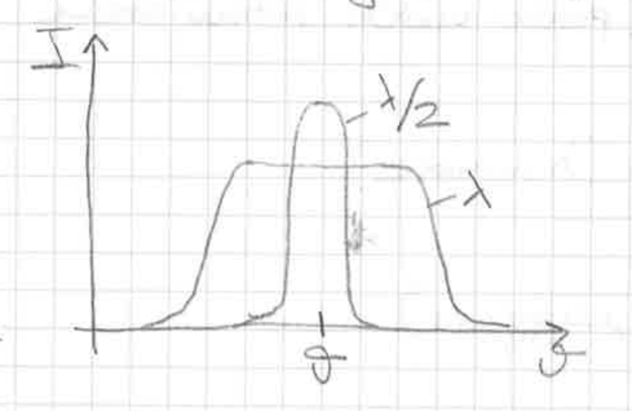
Monochromator – harmonic rejection by detuning
Rocking curve
Detuning
λ is diffracted by both the crystals and exits the monochromator.
λ/2 is eliminated from the beam.
Depends on λ

Slide 7
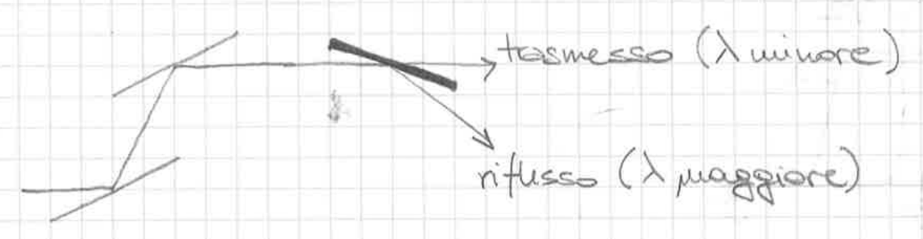
Monochromator – harmonic rejection by mirrors
Mirrors work under gracing incidence
Transmitted (higher frequency)
Reflected (lower frequency)

Slide 8
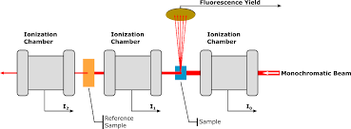
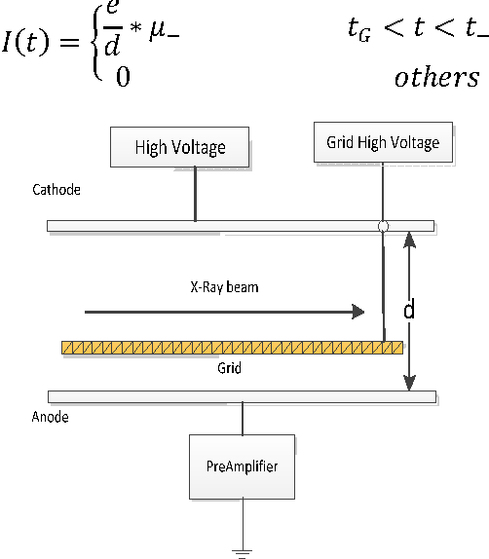
Experimental hutch
Ionization
chamber

Slide 9
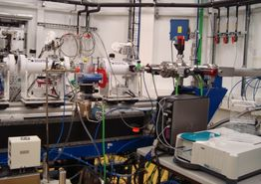
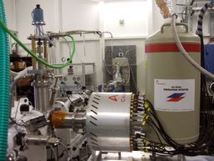
Experimental hutch
Ionization chamber
Fluo detector

Slide 10
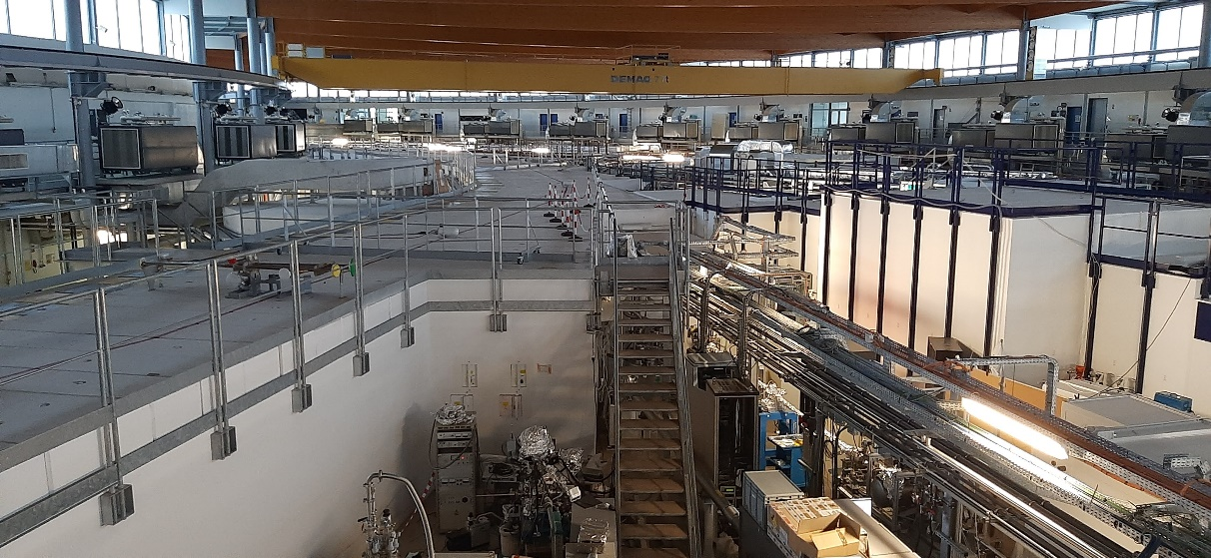
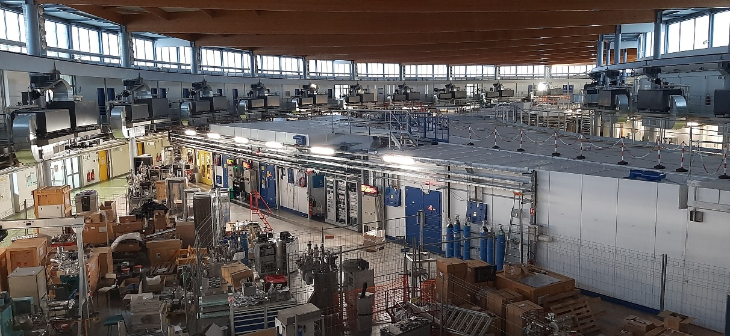

Slide 11
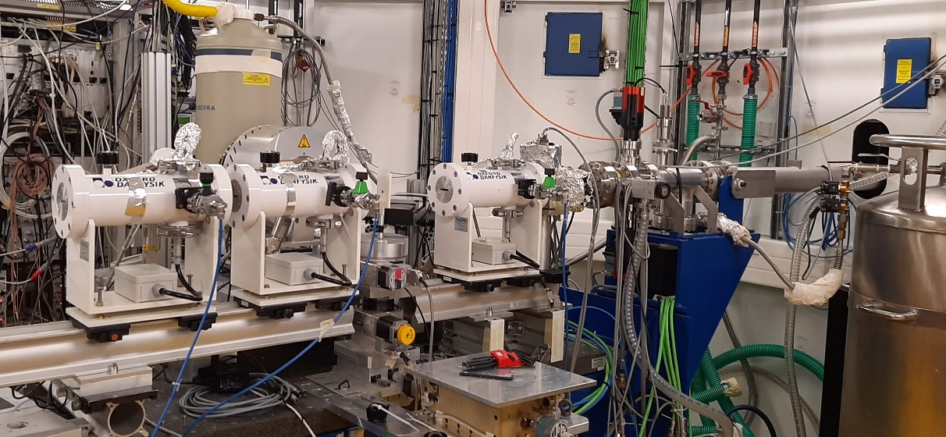
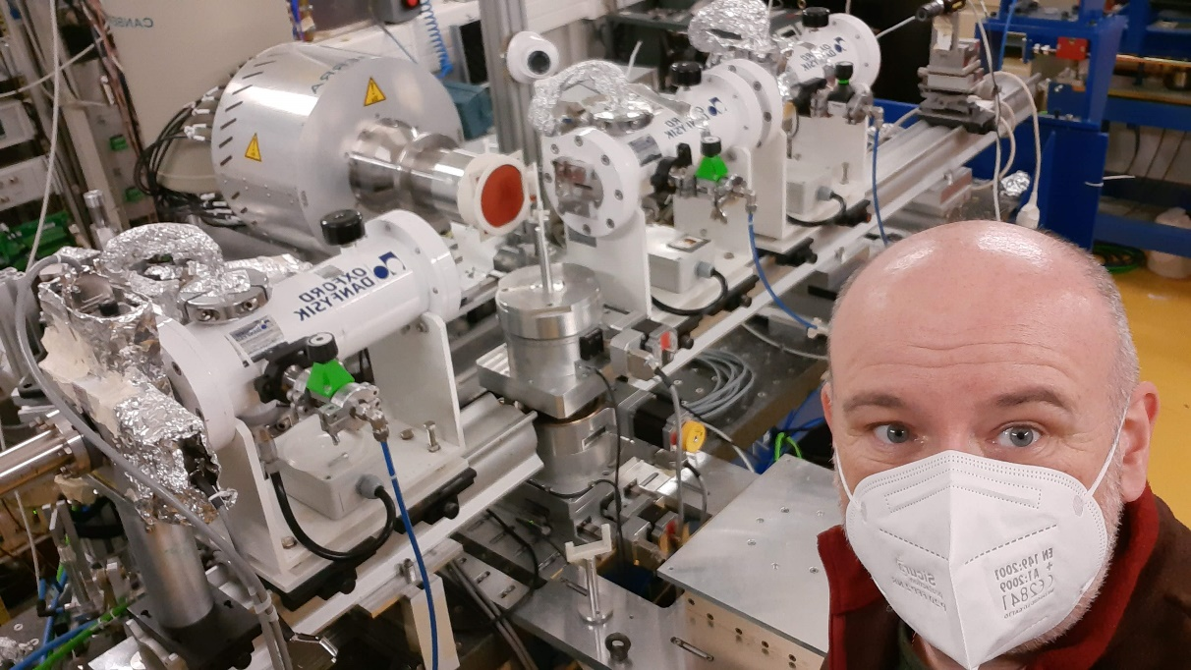

Slide 12
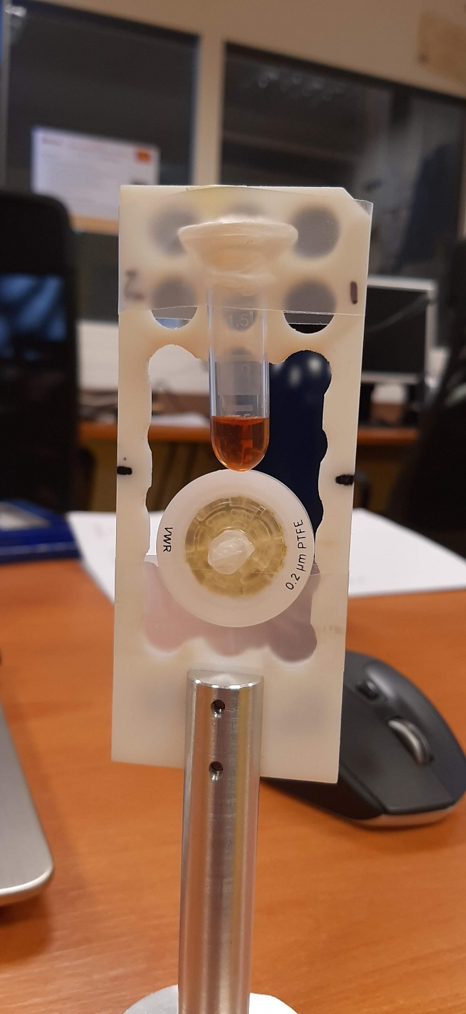
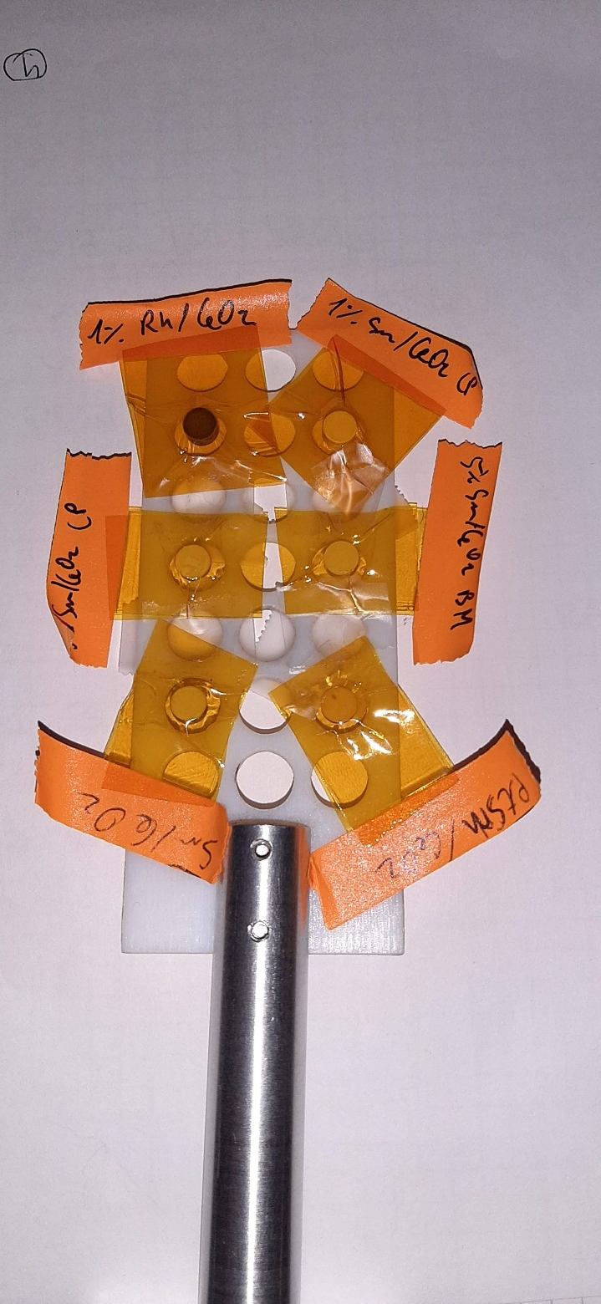

Slide 13



Qualitative Picture of XAFS
x-ray
Isolated atom
X
E _{photoelectron}
continuum
M₁–M₅
E_{F}
L₃ 2p_{3/2}
The outgoing wave is scattered by neighbors
L₂ 2p_{1/2}
L₁ 2s
X
E_{x-ray}
E_{x-ray}
Single
Scattering
K 1s

Slide 14



Qualitative Picture of XAFS
constructive interference –
absorption maximum
Here is where the interference is important!
destructive interference –
absorption minimum
X
Multiple
Scattering

Slide 15
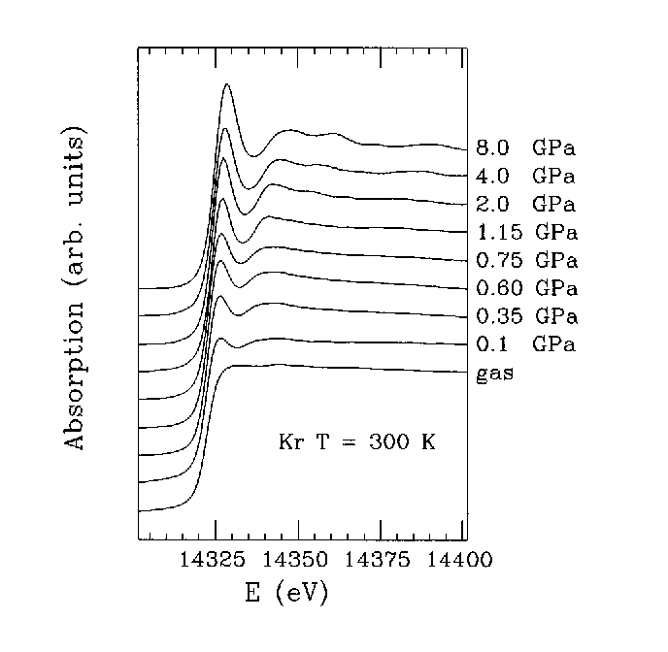
High-pressure EXAFS of solid and liquid Kr
Solid
Liquid
Gas
A. Di Cicco, A. Filipponi, J. P. Itié and A. Polian, Phys. Rev. B 54 (1996) 9086-9098

Slide 16
XANES vs EXAFS
Inelastic mean free path

Slide 17
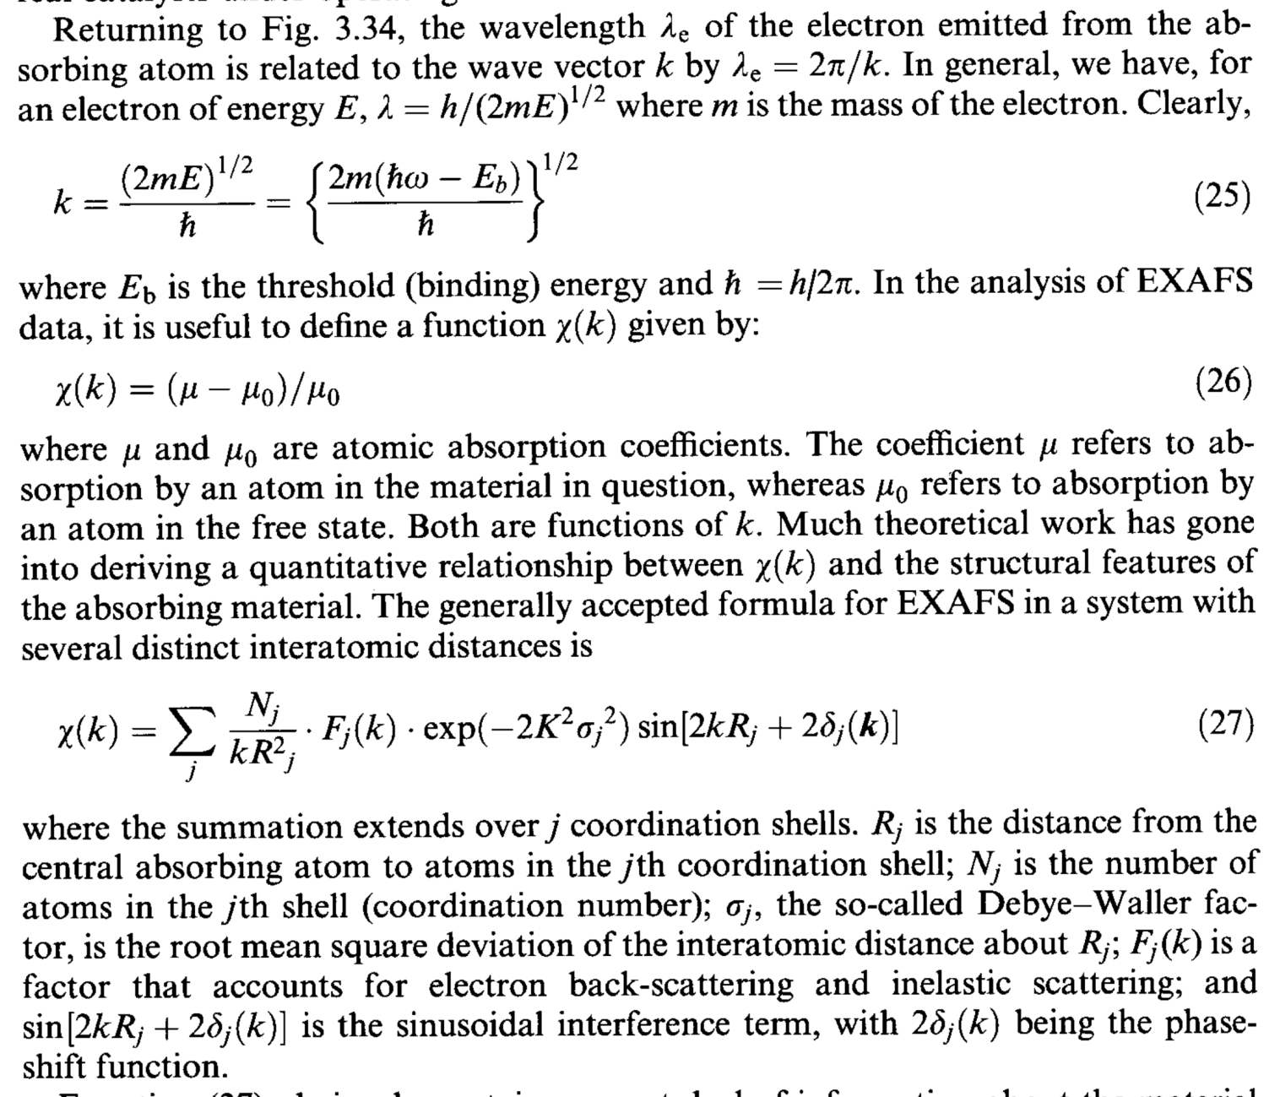
EXAFS standard formula

Slide 18
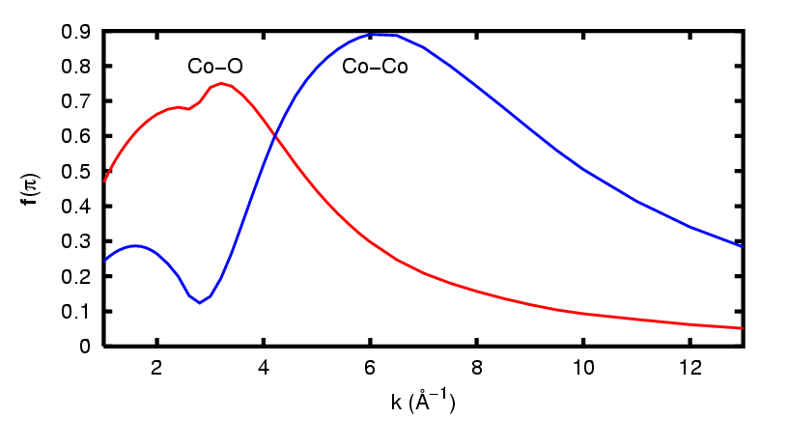
EXAFS standard formula
R_{i}
A
S_{j}
absorber-scatterer distance: R_{i}
coordination numbers: N_{i}
disorder along the absorber – scatterer distance: σ²
passive electron relaxation: S₀²
finite photo-electron mean free path: λ_{(k)}
function of scattering amplitude: f_{i(k)}
phase function: φ_{i(k)}
Notes:
mettere colori secondo che si voglia conoscere o si conoscano i parametri

Slide 19
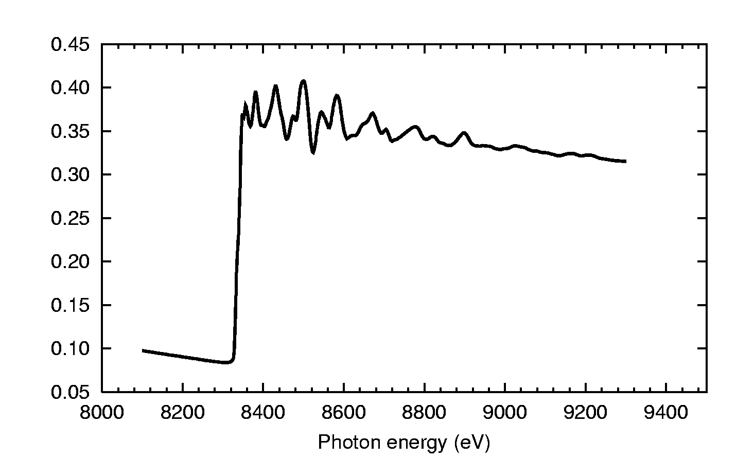

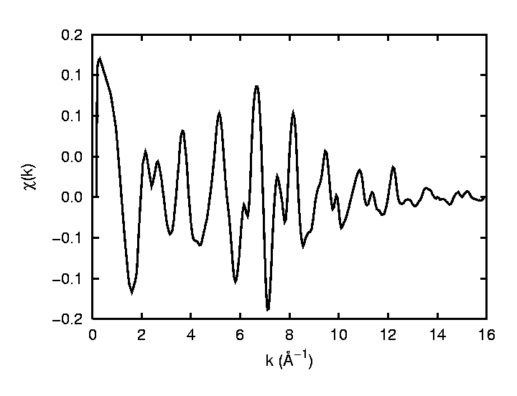
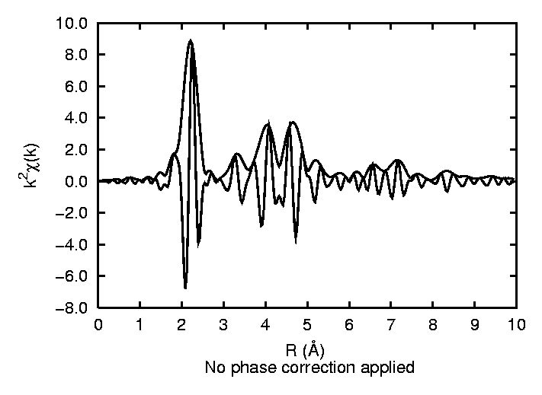
Ni K-edge
μ₀
Outline of EXAFS analysis
E₀
Δμ
1
Background subtraction
2
Fourier Transform
1
]
FT[
2

Slide 20
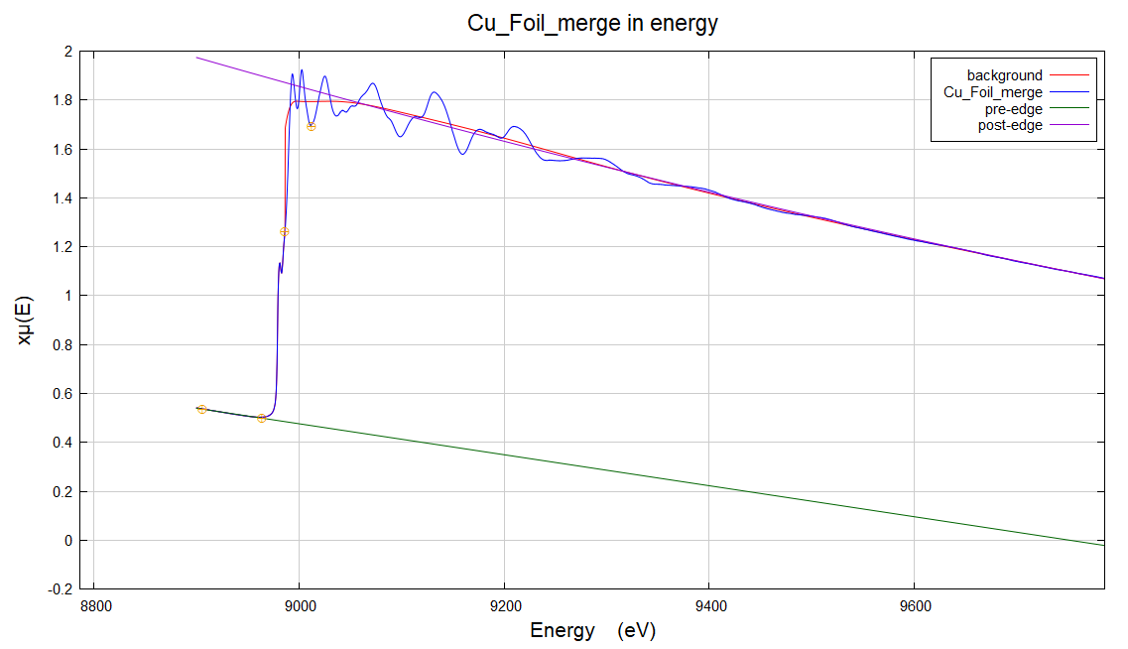
Subtraction of atomic background and normalization

Slide 21
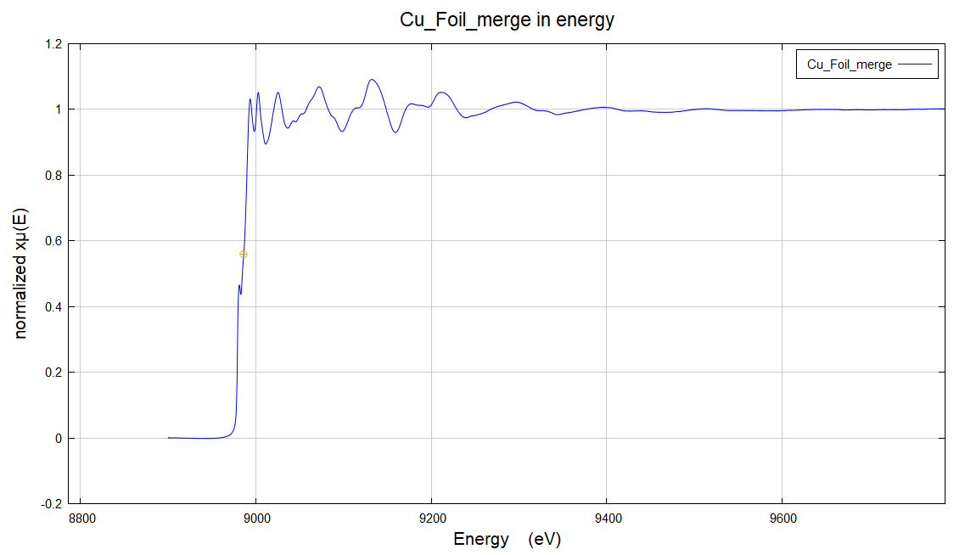
Subtraction of atomic background and normalization

Slide 22
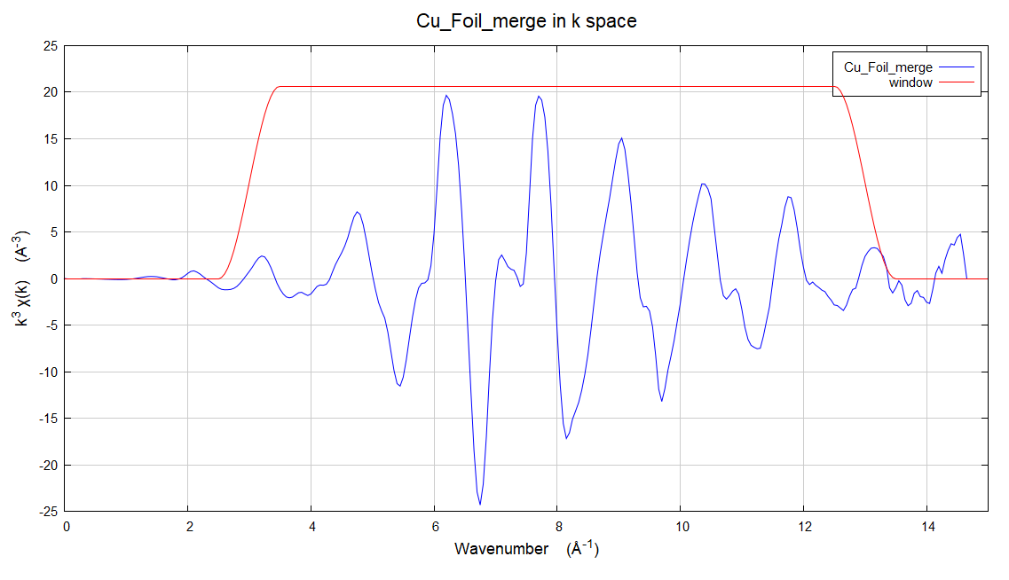
Extraction of EXAFS signal

Slide 23
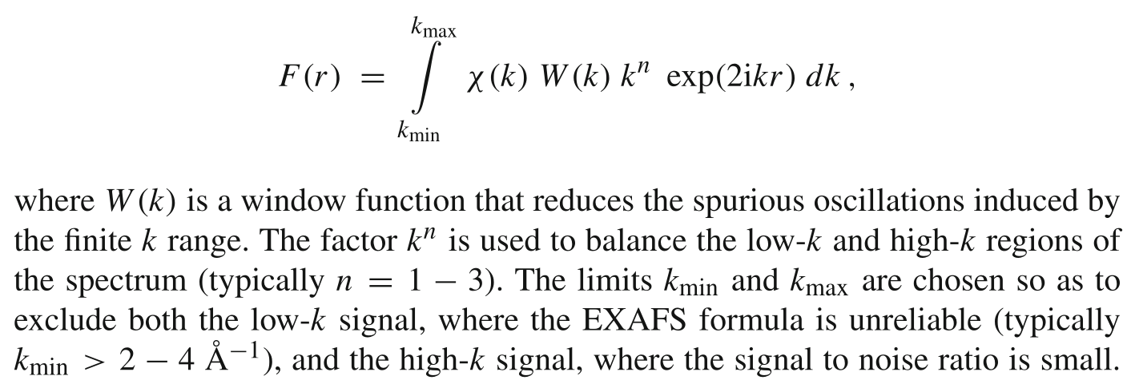

The FT-χ(k)

Slide 24
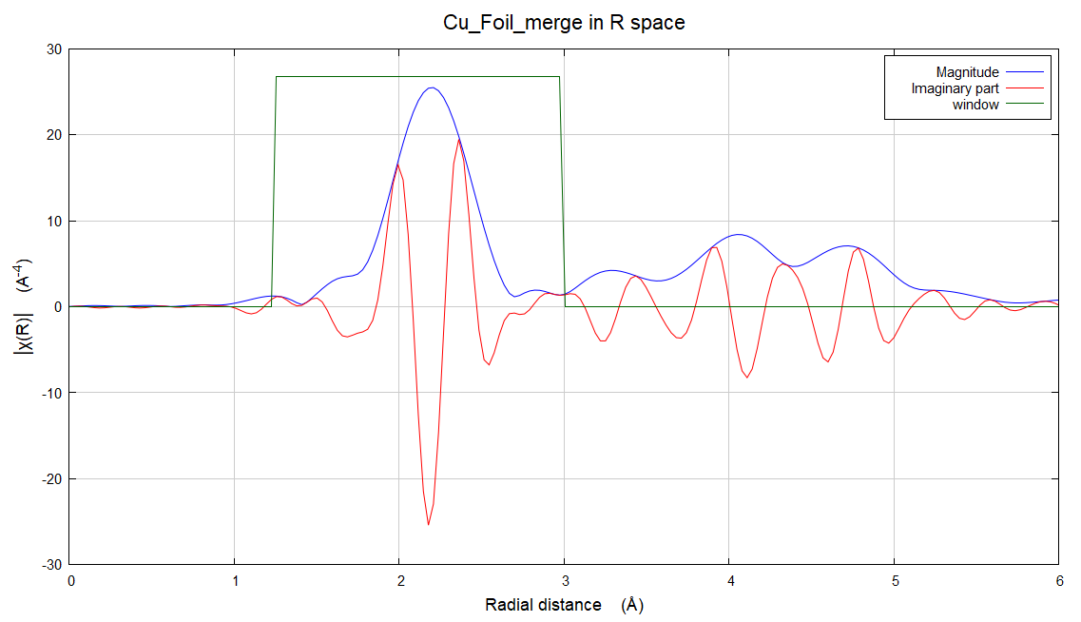
The FT-χ(k)
Unpleasant thing about EXAFS: FT positions are shifted towards small distances. More unpleasant: Each FT peak has its own shift.
Because of the phase shifts, extracting the
structural information from EXAFS requires curve fitting with assumed (calculated) phase shifts.

Slide 25
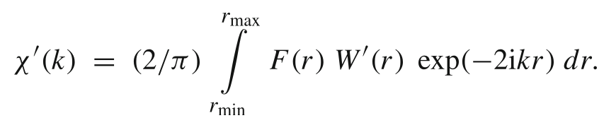
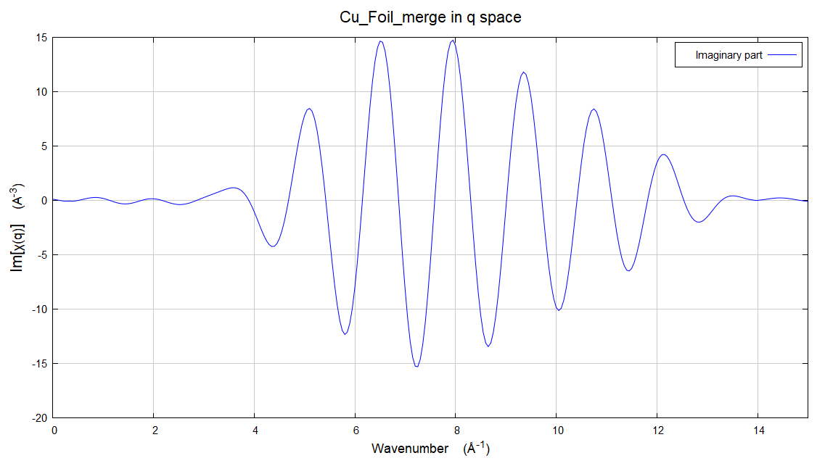
The back-trasformed χ(k)

Slide 26
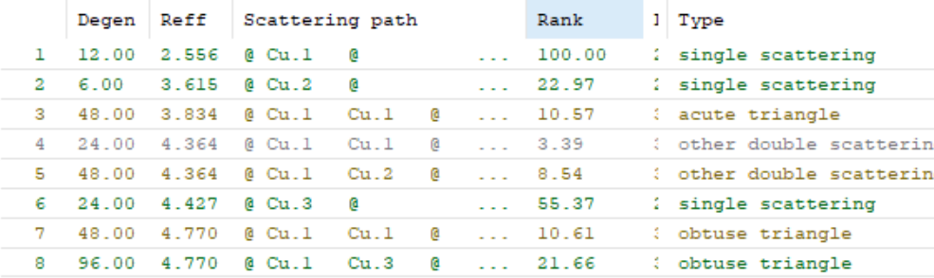
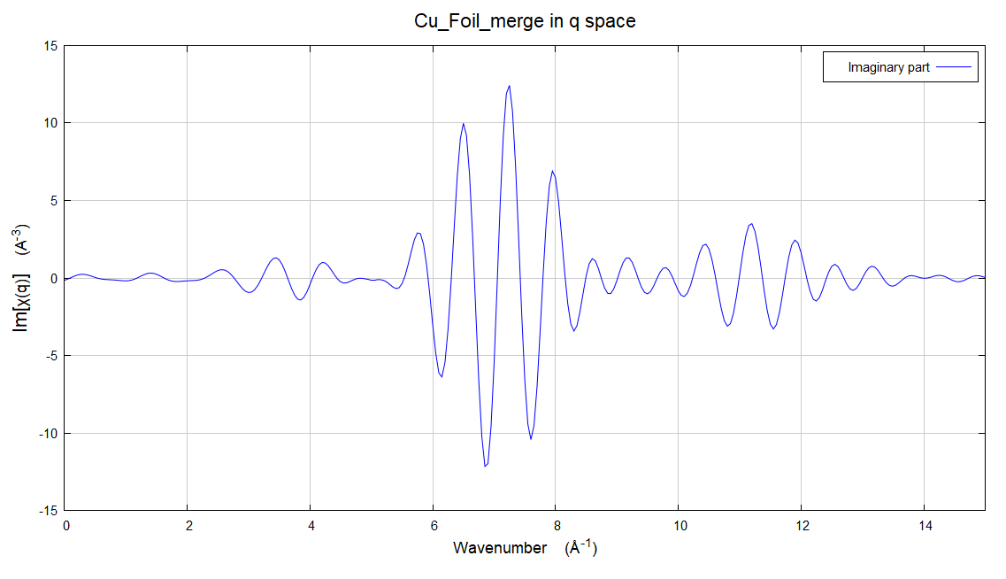
The back-trasformed χ(k)
R = 1.25 – 3.0
R = 3.0 – 5.5

Slide 27
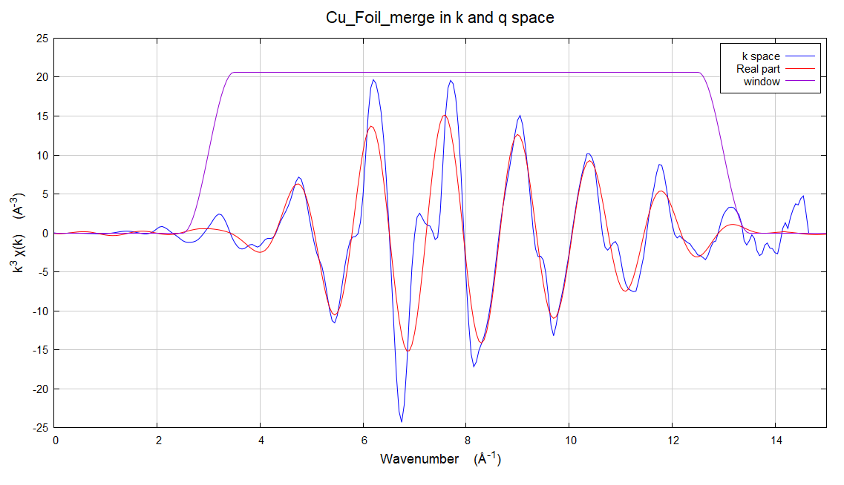
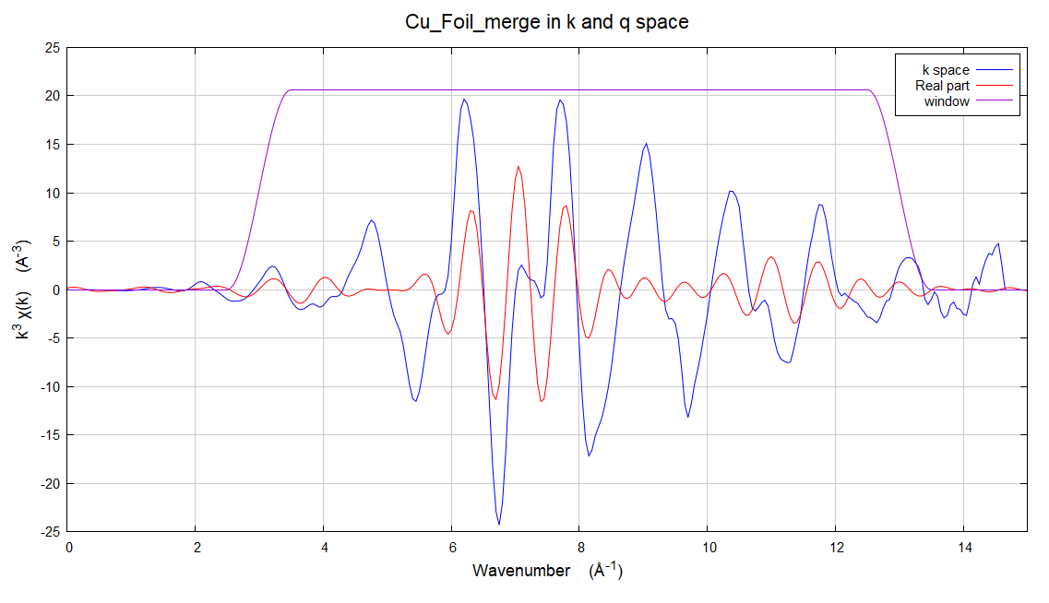
The back-trasformed χ(k)
R = 1.25 – 3.0
R = 3.0 – 5.5

Slide 28
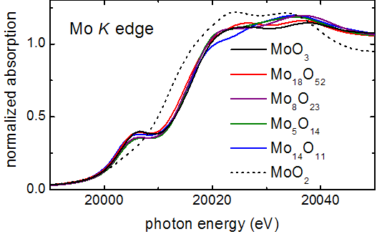
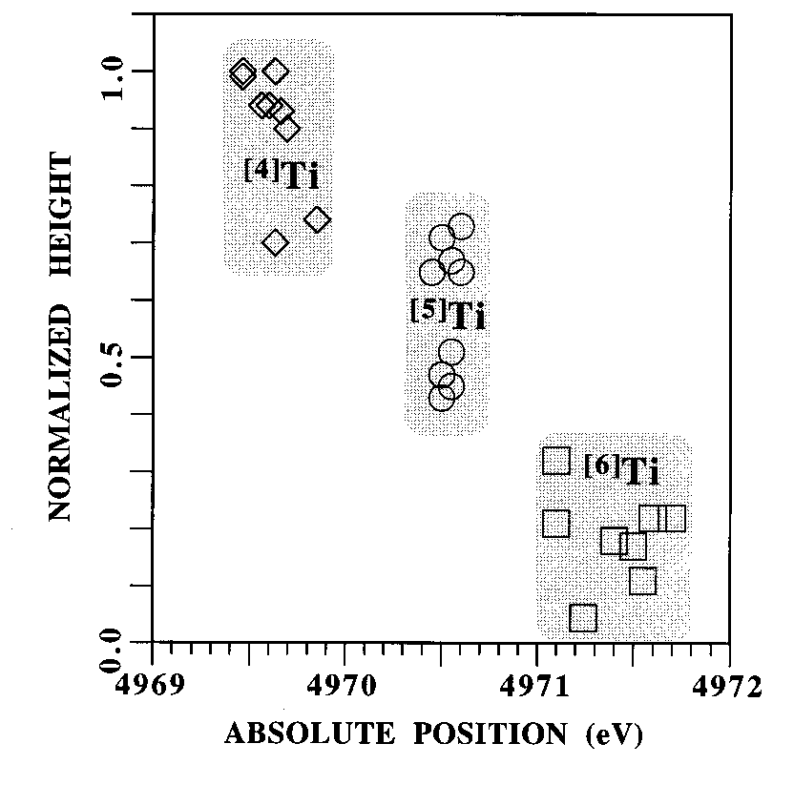
What we can learn from XANES: a) Pre-edge Peak
Dipole selection rule (only in central-symmetric case!): Δl = ±1
Consider K-absorption for transition metals:
initial state = 1s (l=0)
states near E_{F} are formed by nd electrons (l=2)
central-symmetry | non-central symmetry
no resonance | resonance (pre-edge peak)
T. Ressler et al. J. Phys. Chem. B 104, 27 (2000) 6360-6370
from [F. Farges, G. E. Brown, J. J. Rehr,
Phys. Rev. B 56 (1997) 1809]

Slide 29
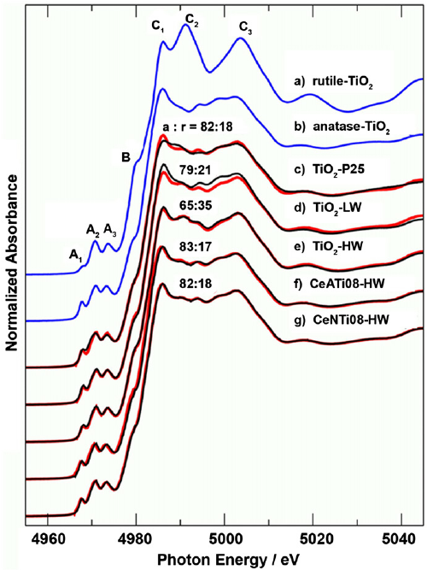
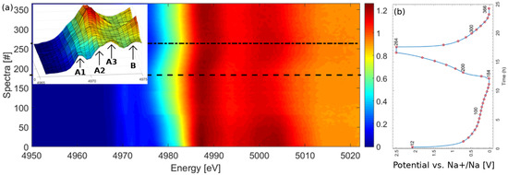
What we can learn from XANES: a) Pre-edge Peak

Slide 30
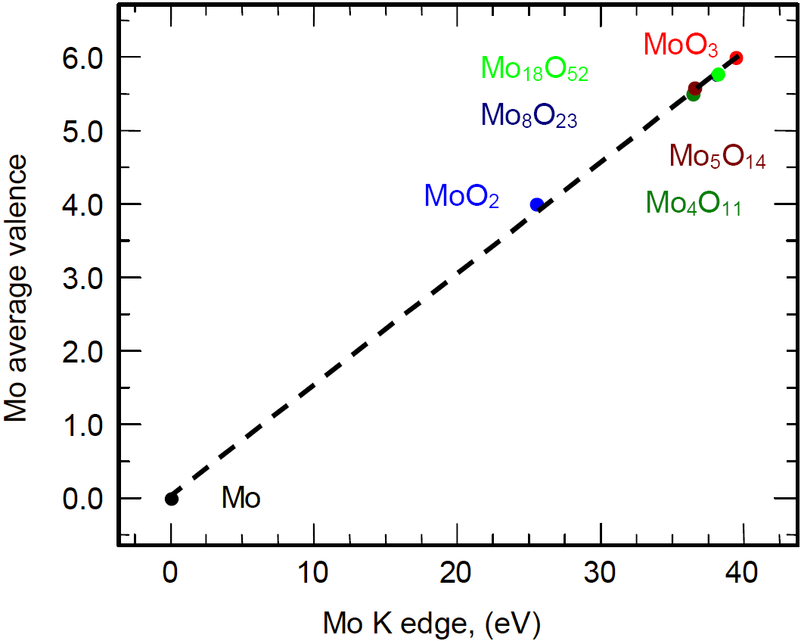
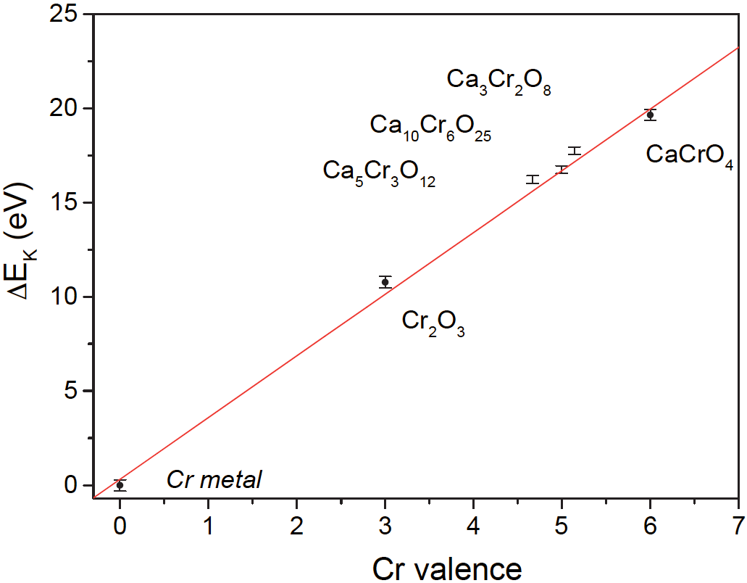
What we can learn from XANES: b) Edge Shift
T. Ressler, R. E. Jentoft, J. Wienold, M. M. Günter and O. Timpe:
J. Phys. Chem. B 104, 27 (2000) 6360-6370
I. Arčon, B. Mirtič, A. Kodre, J. Am. Ceram. Soc. 81 (1998) 222–224
Why does it shift?
1) Electrostatic: it is harder for the photoelectron to leave a positive (oxidized) atom
2) Shorter bonds at higher oxidation states ⇒ Fermi energy is higher

Slide 31
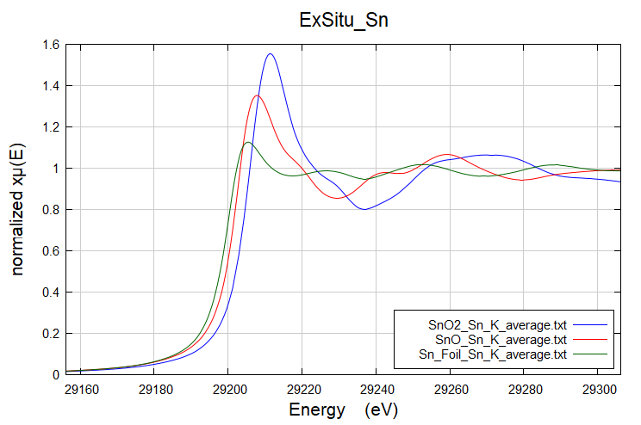
What we can learn from XANES: b) Edge Shift
Why does it shift?
1) Electrostatic: it is harder for the photoelectron to leave a positive (oxidized) atom
2) Shorter bonds at higher oxidation states ⇒ Fermi energy is higher

Slide 32
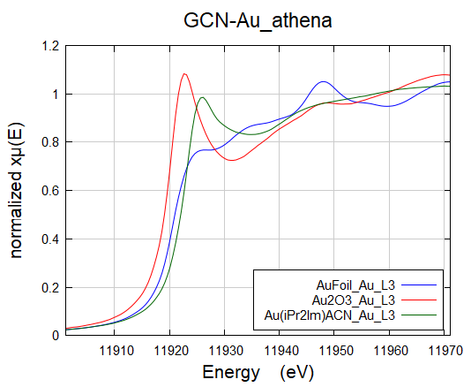
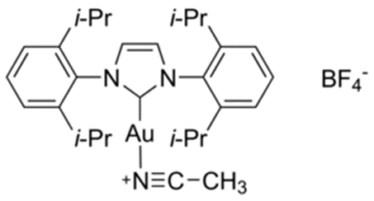
What we can learn from XANES: b) Edge Shift
Au(iPr₂Im)ACN
Why does it shift?
1) Electrostatic: it is harder for the photoelectron to leave a positive (oxidized) atom
2) Shorter bonds at higher oxidation states ⇒ Fermi energy is higher

Slide 33


What we can learn from XANES: c) White Line
L₃ absorption edges for 5d metals:
(transition 2p_{3/2} → 5d)
…white line also depends on particle size and morphology:
G. Meitzner, G. H. Via, F. W. Lytle, and J. H. Sinfelt, J. Phys. Chem. 96 (1992) 4960
a) Pt₃ triangle (dashes), Pt₄ tetrahedron (solid), Pt₅ triangular bipyramid (dash-dot), and Pt₆ octahedron (dash-dot-dot);
(b) Pt₇ and Pt₄ clusters of different shape: planar ‘‘honeycomb,(dashes), D5h bipyramid (solid) , single-capped
octahedron (long dashdot), Pt₄ tetrahedron (dots), and Pt₄ planar rhombus (dash-dot).
from A. L. Ankudinov, J. J. Rehr, J. J. Low, and S. R. Bare, J. Chem. Phys. 116 (2002) 1911
Intensity is proportional to the number of free 5d states and also depends on valence state. But…

Slide 34

What we can learn from XANES: c) White Line

Slide 35


What we can learn from XANES: d) Speciation
By Linear Combination Analysis

Slide 36

What we can learn from XANES: d) Speciation
By Linear Combination Analysis
G(CN)-Au sample is composed by 48.6 mol% of Au(0) and 51.4 mol% of Au(I).

Slide 37


XAS and small objects: coordination numbers
A common subject: bulk metal versus metal clusters.
All atoms are both absorber and scattering centers.
Bulk: any atom is equivalent to the others;
Cluster: surface atoms have a diminished coordination number.
The average first coordination number depends on the size, i.e. surface to bulk ratio.
Infinite lattice
Small cluster
The EXAFS coordination number
is the weighted average
of the coordination numbers of all absorbers.

Slide 38



Example: Ag/CeO₂

Slide 39
Example: Application of EXAFS to Pd,Pt/C Catalysts (b)
Reduction treatment: in 5%H₂/He atmosphere, stepwise with ΔT=50°C.
Measurements at LN₂ temperature in order not to have interference of two effects: (i) due to different temperature vibrations and (ii) due to different particle sizes.

Slide 40
Example: Application of EXAFS to Pd,Pt/C Catalysts (c)
Reference compound: metallic Pd foil
Checking your amplitudes and phases with reference spectra must be always the first step in every EXAFS study!
The difference between a simply reduced Pd/C sample (hydrided) and one subsequently blown out by He flow (dehydrided)

Slide 41


Metallic nanoparticle size determination by EXAFS
Zastita Materijala 57 (2016), 101 – 109
doi:10.5937/ZasMat1601101M

Slide 42



Slide 43



Mean coordination number for concentric shells

Slide 44

Size determination by EXAFS

Slide 45
Determination of shape by EXAFS
J. Catal. 190 (2000), 182–190

Slide 46
Determination of shape by EXAFS
J. Catal. 190 (2000), 182–190
Ridotto a 773 K
Cubottaedro
FFT (k³ χ)
R (Å)
Ridotto a 773 K
Ridotto a 773 K
Icosaedro
Decaedro
FFT (k³ χ)
FFT (k³ χ)
R (Å)
R (Å)

Slide 47

Oxide nanoparticle size determination by EXAFS
Nanosized NiO
IUCrJ 1 (2014), 571–589
doi:10.1107/S2052252514021101

Slide 48

Oxide nanoparticle size determination by EXAFS
Nanosized NiO
IUCrJ 1 (2014), 571–589
doi:10.1107/S2052252514021101

Slide 49

Oxide nanoparticle size determination by EXAFS
Nanosized NiO
IUCrJ 1 (2014), 571–589
doi:10.1107/S2052252514021101

Slide 50

Pt(ML)/Pd/C electrocatalyst for ORR
J. Electrochem. Soc., 165 (2018) J3222-J3230
From Pt L₃ edge
From Pd K edge
N(PtPt) = 5.8 ± 0.8
The total coordination
number for Pd atom,
N(PdM) = 11 ± 0.7
Estimated Particle size: 5.0 nm
N(PtPd) = 2.7 ± 0.7

