Slide 1
Debye-Scherrer camera
Au (cubic)
ZrSiO₄ (tetragonal)

Slide 2
Powder XRD instruments

Slide 3
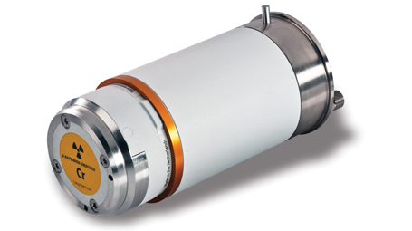
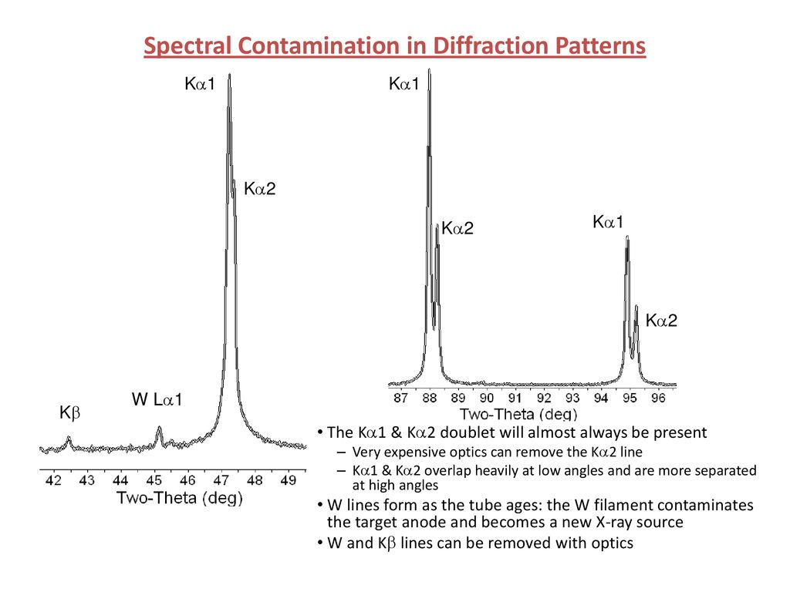
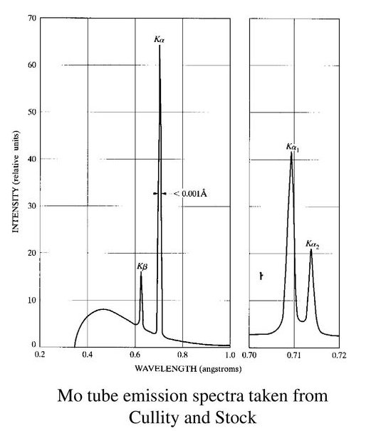
X-ray sources
X-Ray tubes

Slide 4
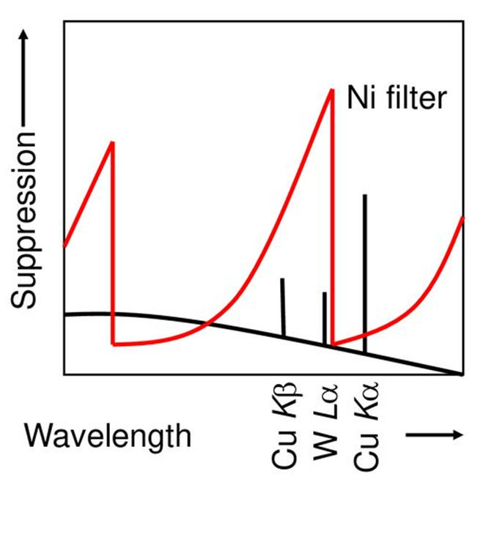
X-ray sources
X-Ray tubes & optics
A material with an absorption edge between the Kα and Kβ wavelengths can be used as a beta filter
This is often the element just below the target material on the periodic table
For example, when using Cu radiation
Cu Kα = 1.541 Å (8048 – 8028 eV)
Cu Kβ = 1.387 Å (8905 eV)
Ni absorption edge = 1.488 Å (8333 eV)
The Ni absorption of Cu radiation is:
50% of Cu Kα
99% of Cu Kβ

Slide 5
X-ray sources
X-Ray tubes & optics
Monochromators remove unwanted wavelengths of radiation from the incident or diffracted X-ray beam.
Diffraction from a monochromator crystal can be used to select one wavelength of radiation and provide energy discrimination.
Most powder diffractometer monochromators only remove Kβ, W-contamination, and Brehmstralung radiation
Only HR-XRD monochromators or specialized powder monochromators remove Kα2 radiation as well.
A monochromator can be mounted between the tube and sample (incident-beam) or between the sample and detector (diffracted-beam)
An incident-beam monochromator only filters out unwanted wavelengths of radiation from the X-ray source
A diffracted-beam monochromator will also remove fluoresced photons.
A monochromator may eliminate 99% of Kβ and similar unwanted wavelengths of radiation.

Slide 6
X-ray sources
X-Ray tubes & optics
Diffracted-beam monochromator
Best signal-to-noise ratio
Data collection will take a longer time
Expensive optical element
Realignment required after changing X-ray source
Beta-filter
Cheap optical element
Specific for each X-ray tube
Kα2 contributes to X-ray pattern (must be taken into account during profile fitting)
Synchrotron radiation
Monochromatic radiation
High intensity
Possibility of anomalous scattering
Limited access to SR facilities

Slide 7
Goniometer & sample stage
Schematic of the notation used for the angles and degrees of freedom in a typical diffractometer.

Slide 8
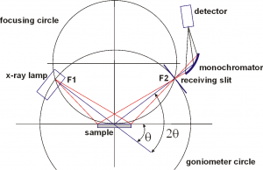
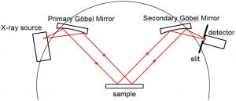
Goniometer & sample stage
Bragg-Brentano (BB) Geometry
Parallel Beam (PB) Geometry
Most of powder diffractometers use Bragg-Brentano parafocusing geometry, offering high-resolution and high beam-intensity analysis at the cost of very precise alignment requirements and carefully prepared samples.
The PB optics provides accurate measurement of diffracted X-ray positions unaffected by sample shape. It is generally used to analyze powder sample profiles, the degree of preferred orientation and thin films.
Optics on incident and difraccted beams depend on the goniometer geometry

Slide 9
Bragg-Brentano (BB) Geometry
Para-focusing optics

Slide 10
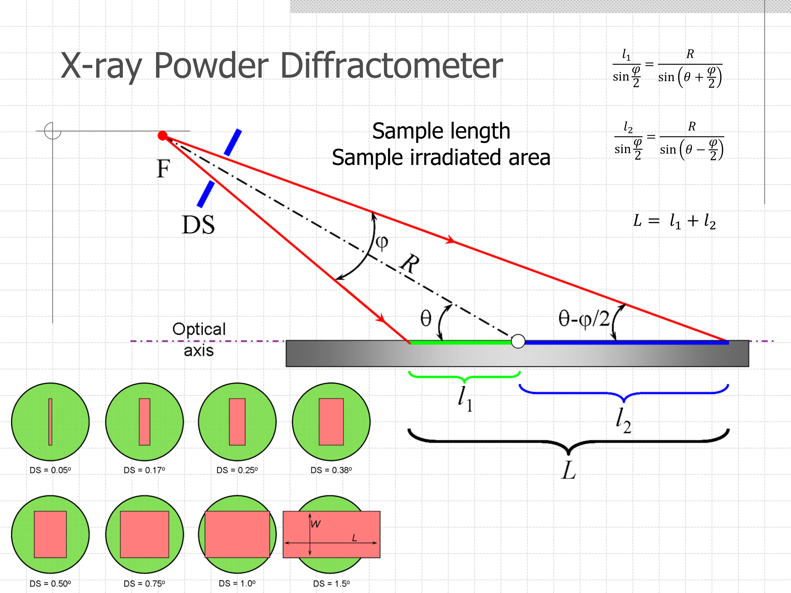
Bragg-Brentano (BB) Geometry
Divergence slits
Reduce equatorial divergence and define lenght of irradiated area

Slide 11
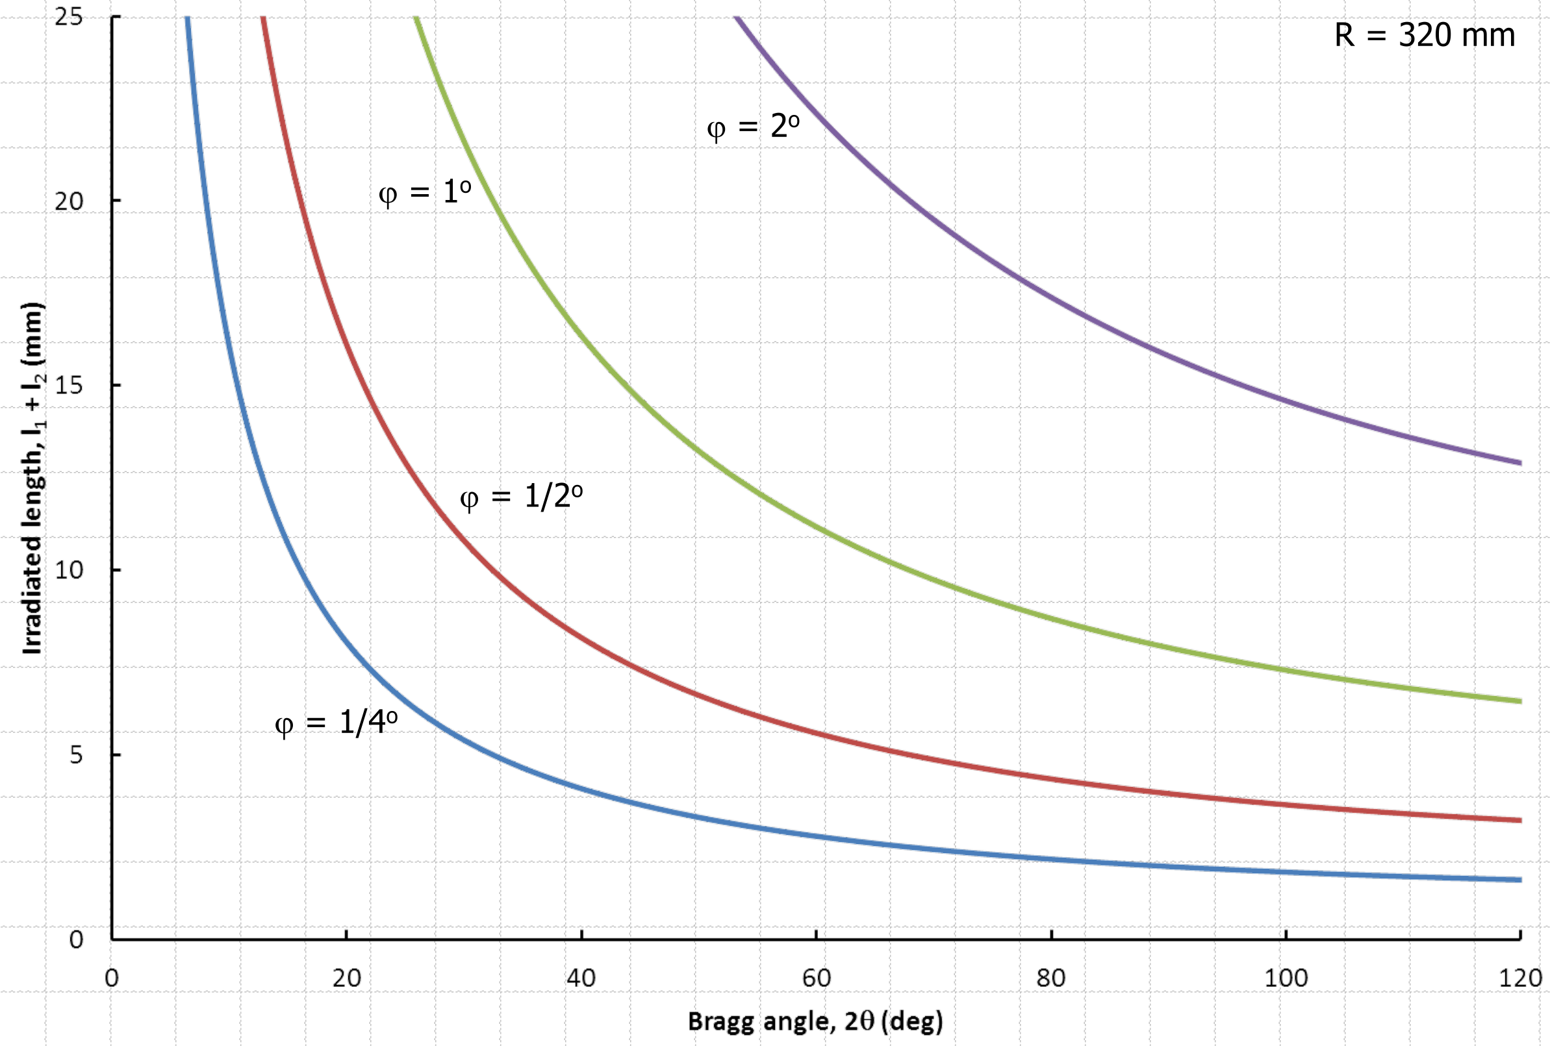
Bragg-Brentano (BB) Geometry
Divergence slits
Reduce equatorial divergence and define irradiated area

Slide 12
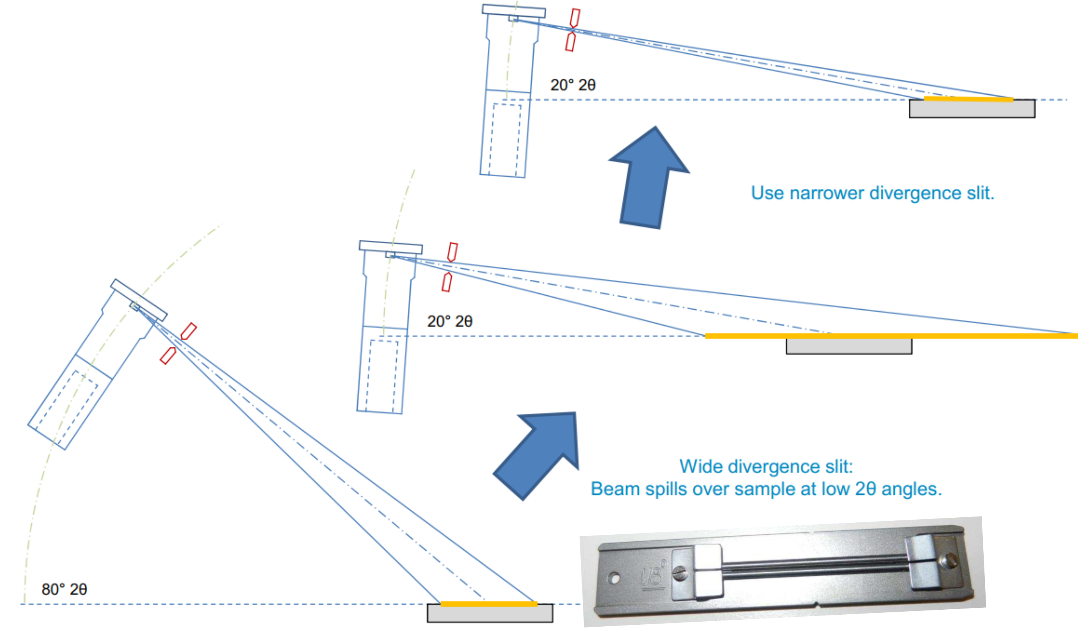
Bragg-Brentano (BB) Geometry
Divergence slits
Reduce equatorial divergence and define irradiated area

Slide 13
Bragg-Brentano (BB) Geometry
Divergence slits
Slits also used as:
Receiving slit on diffracted beam
Antiscattering slits (on both beams)

Slide 14
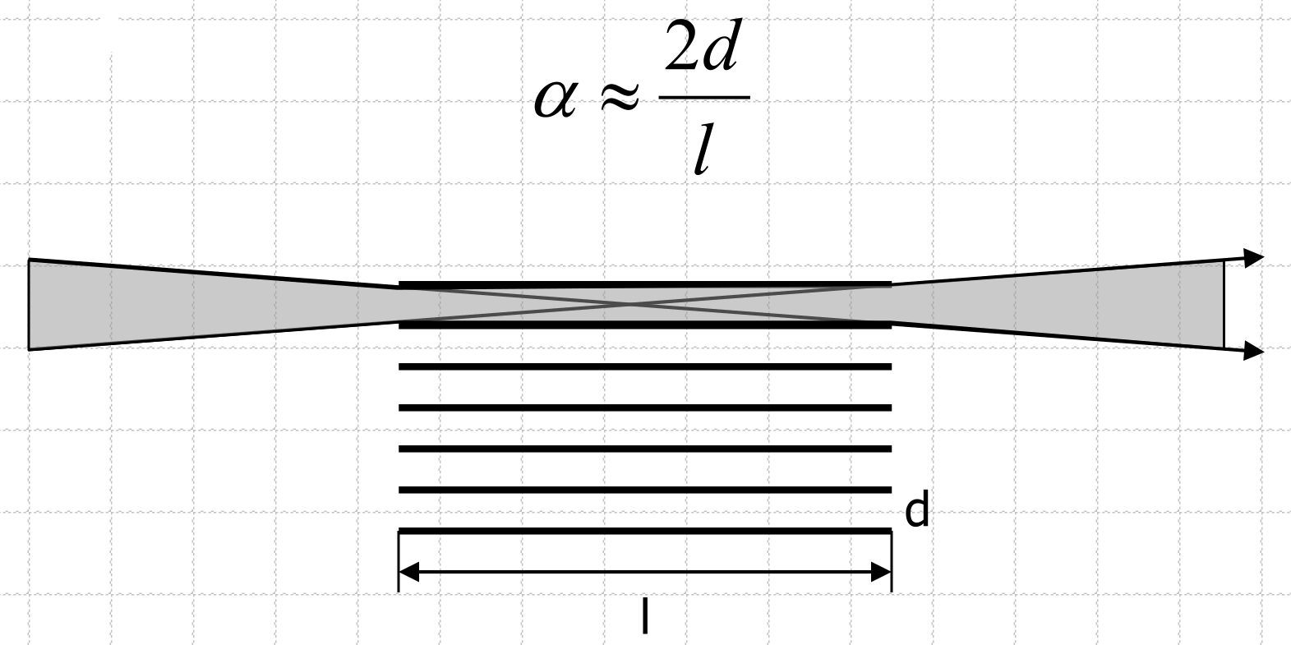
Bragg-Brentano (BB) Geometry
Soller slit
Reduce axial divergence (on incident beam) and increase resolution (on diffracted beam).
Resolution vs Intensity

Slide 15
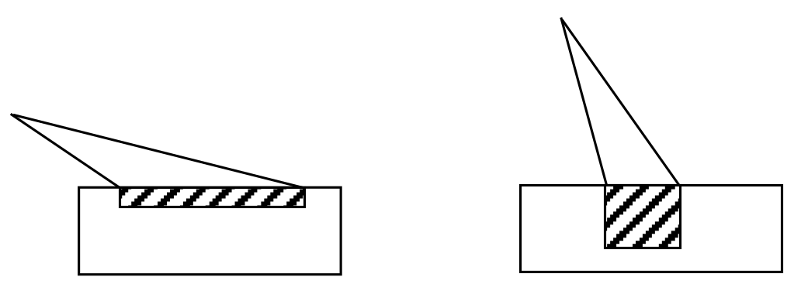
Bragg-Brentano (BB) Geometry
Mask
Define the width of irradiated area
Divergence slit and mask must be optimized to control irradiated area at the initial angle of the measure.
Constant volume irradiated

Slide 16
Detectors
Point detectors (0D)
Observe one point of space at a time.
Slow, but compatible with most/all optics
scintillation and gas proportional detectors count all photons, within an energy window, that hit them
Si(Li) detectors can electronically analyze or filter wavelengths
Position Sensitive Detectors (PSD)
Linear PSDs (1D) observe all photons scattered along a line
Area detectors (2D) observe all photons scattered along a conic section
gas proportional (gas on wire; microgap anodes): limited resolution, issues with deadtime and saturation
CCD: limited in size, expensive
Solid state real-time multiple semiconductor strips: high speed with high resolution, robust

Slide 17
Detectors
Quantum counting efficiency
Number of photons detected by the detector to the number of photons entering the detector.
Linearity
The ability of the detector to provide an output that is in direct proportion to the intensity of the x-ray beam (number of x-ray photons entering the detector).
Sensitivity
The ability of the detector to detect low intensity levels.

Slide 18
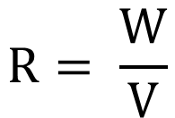
Detectors
Energy resolution
The ability of the detector to distinguish between energies.
Resolution = input photon of energy E produces an output pulse of height V ± dV
$$R= \frac{W}{V}$$
Smaller R, better resolution

Slide 19
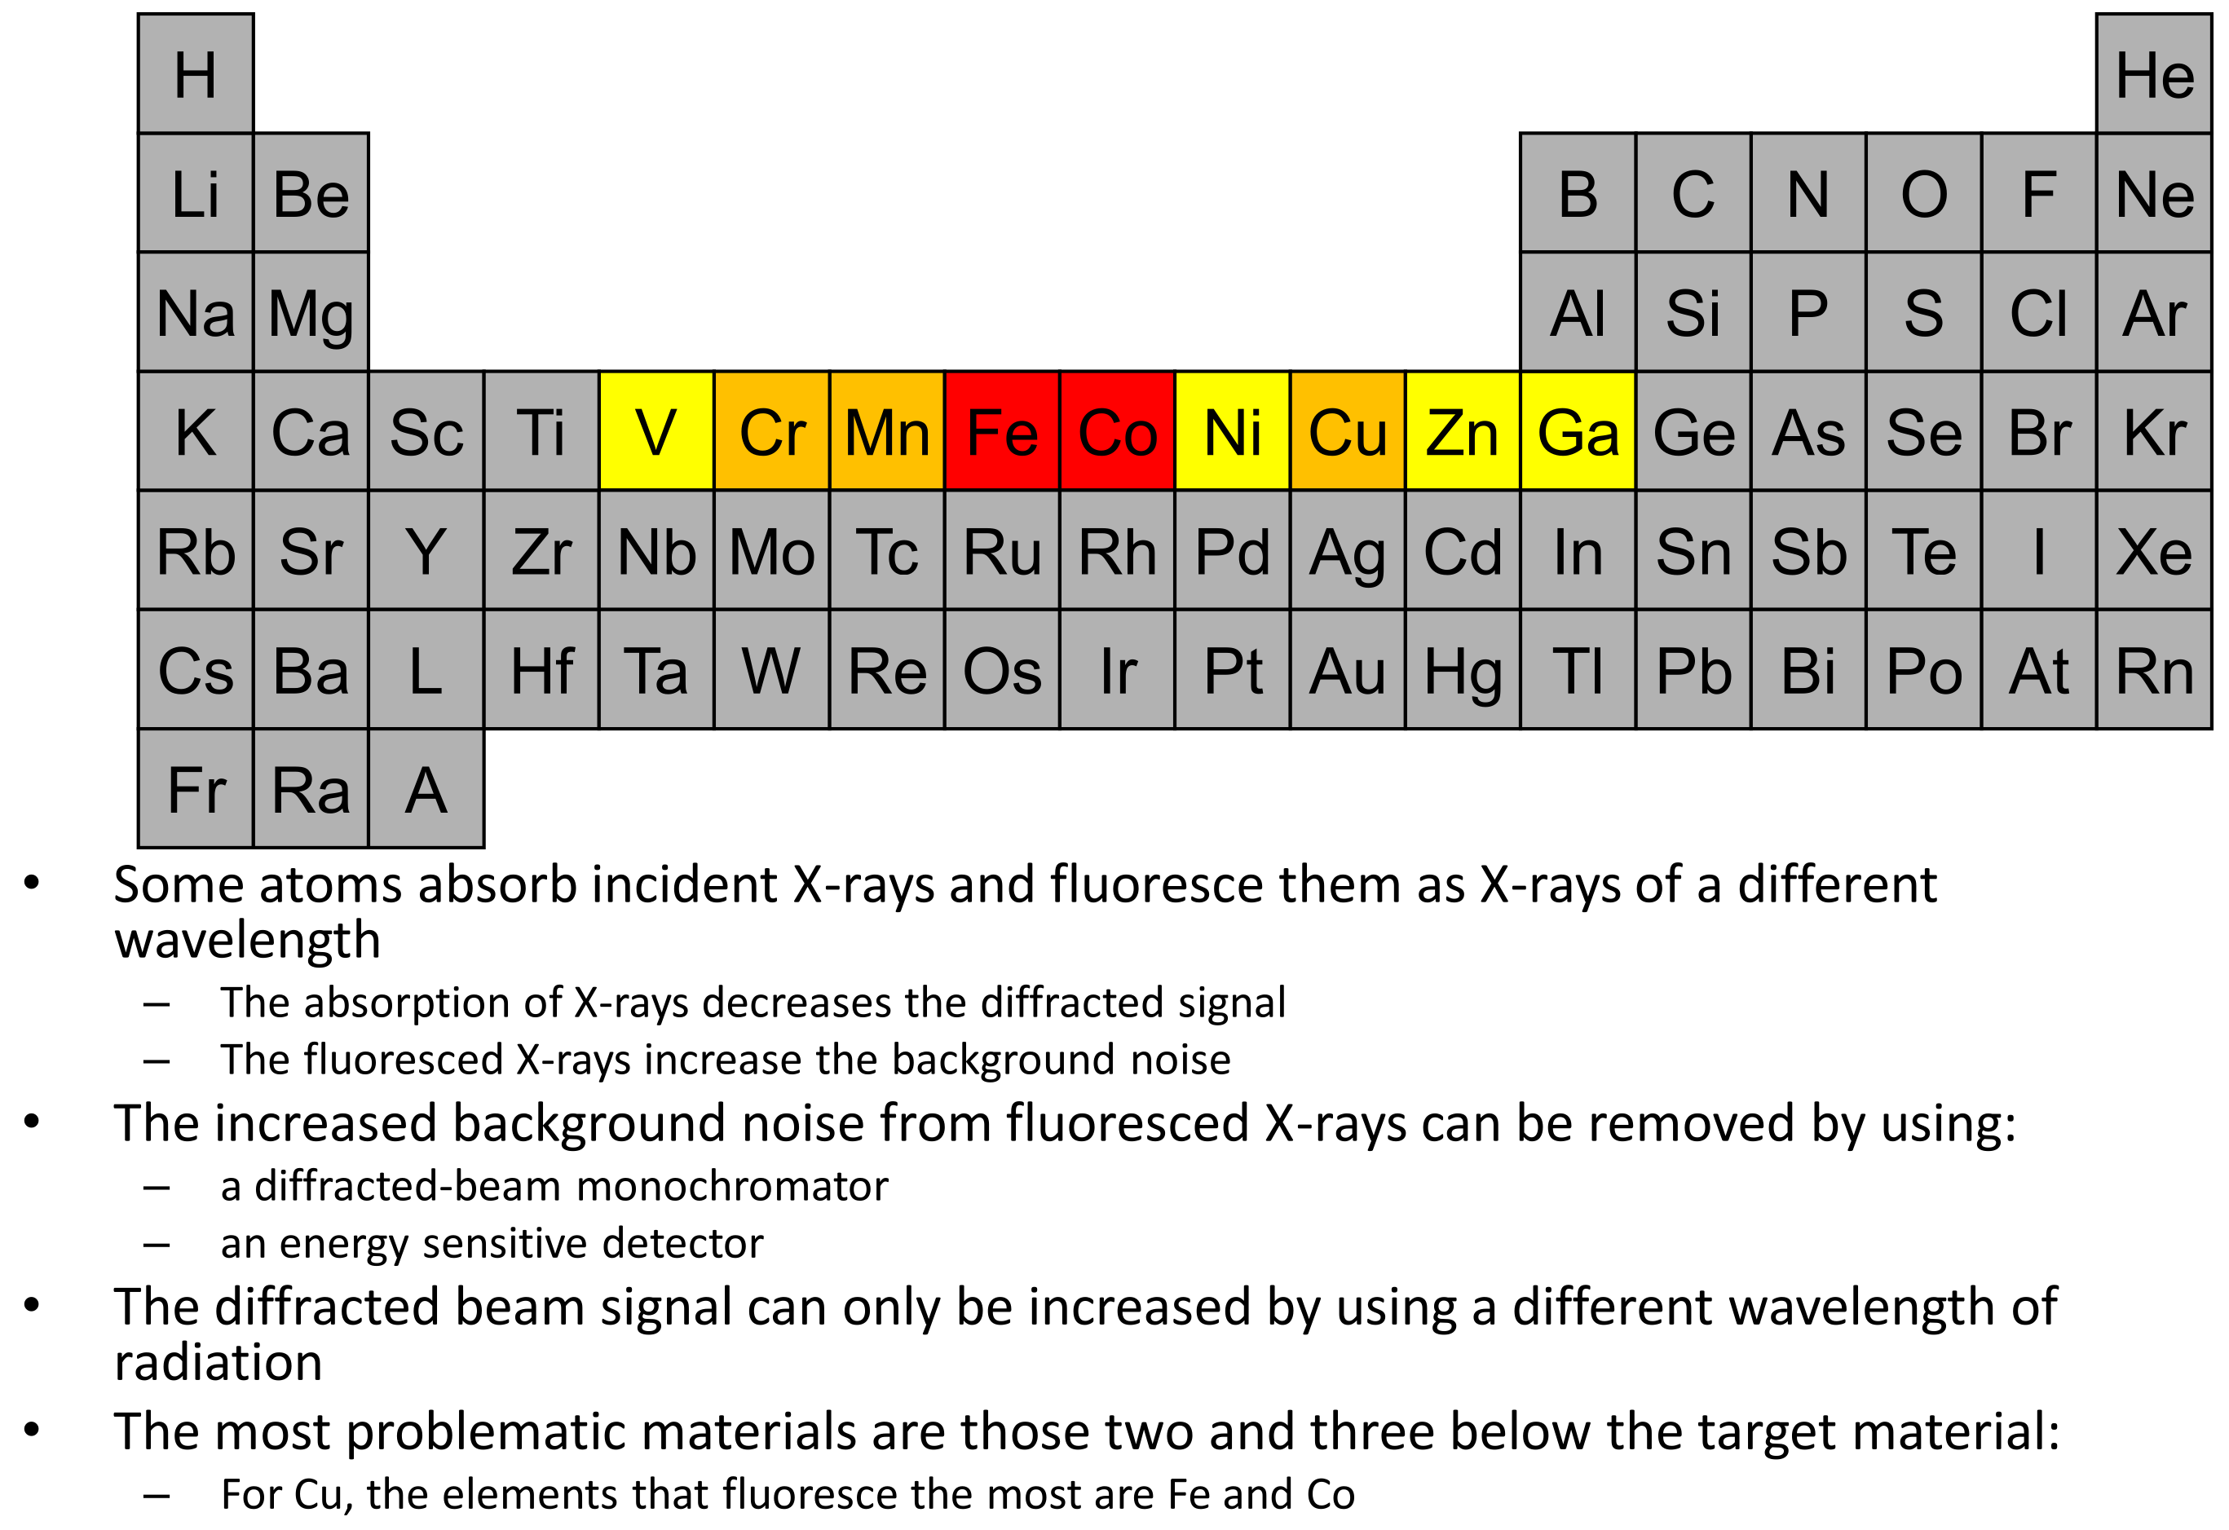
Fluorescence

Slide 20
Fluorescence
Fe₃O₄

Slide 21
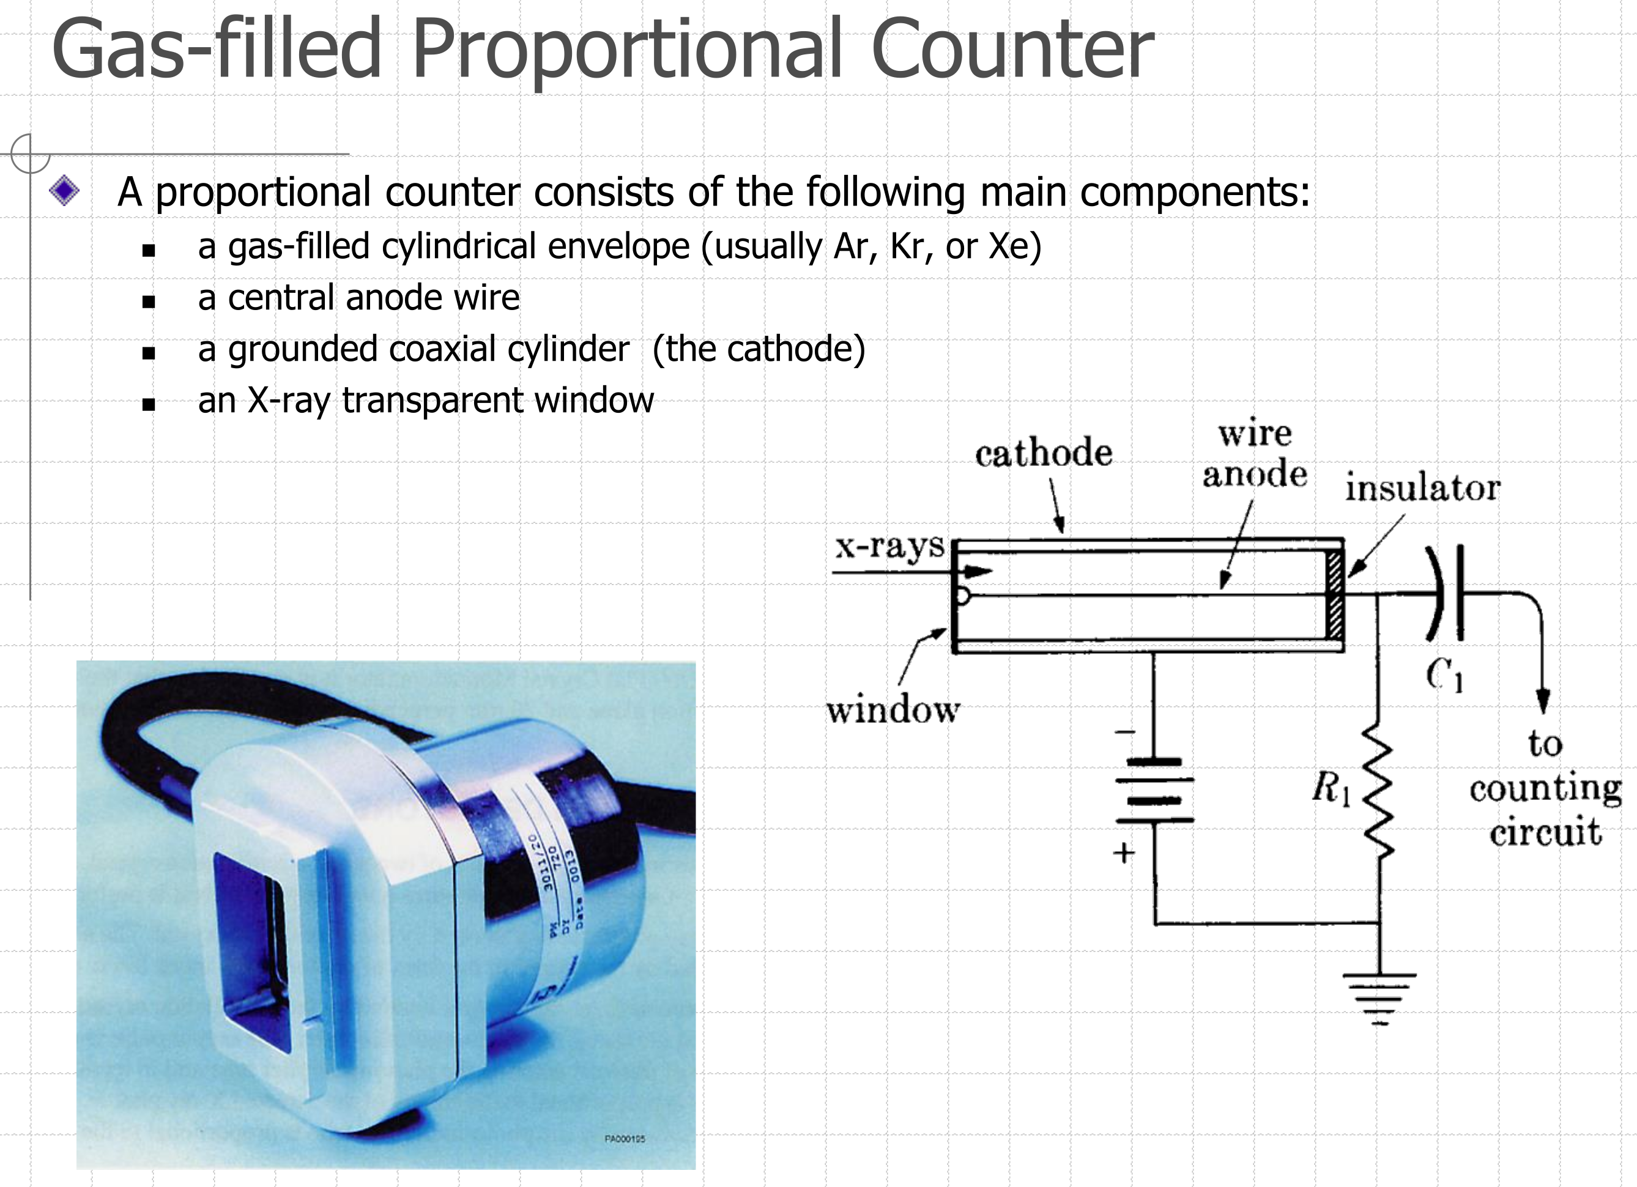
Detectors

Slide 22
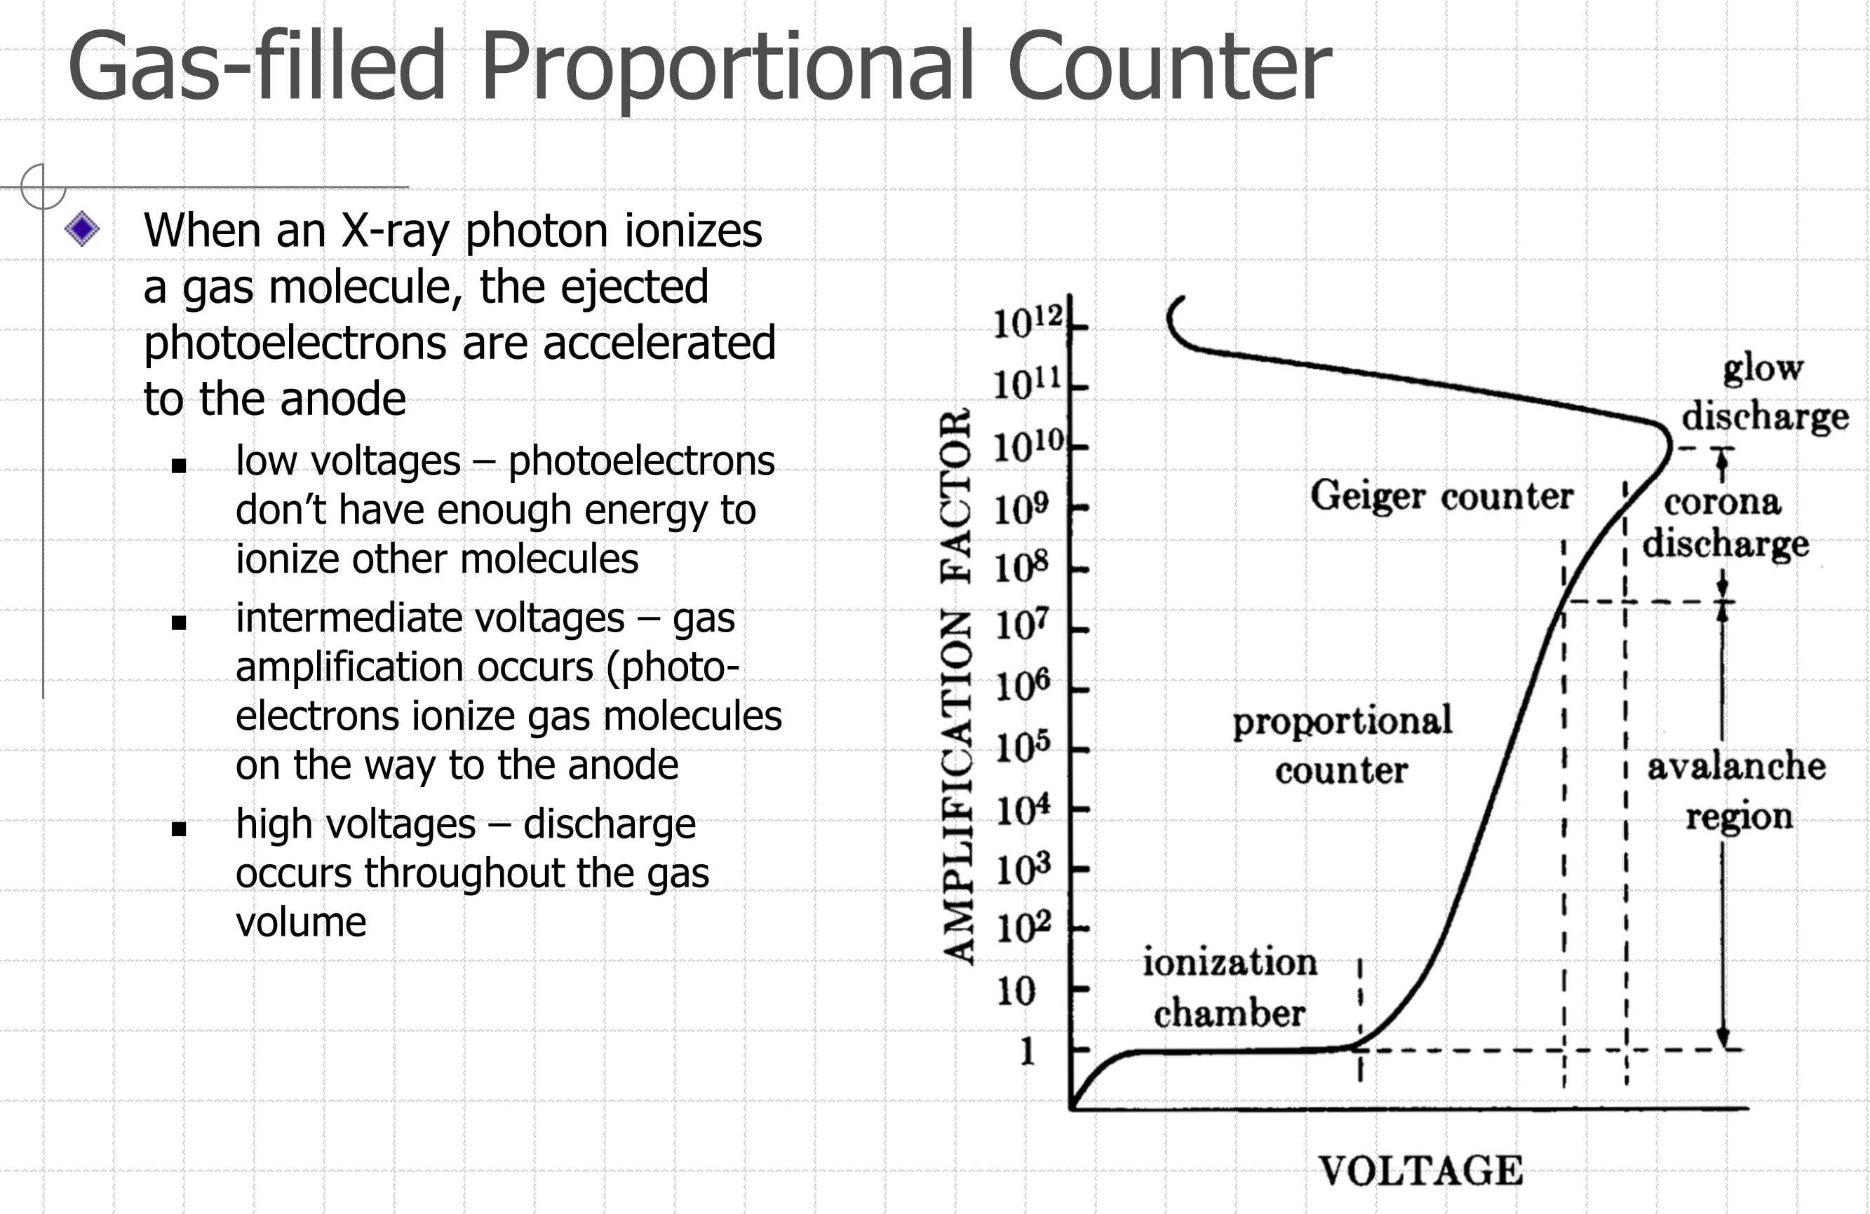
Detectors

Slide 23
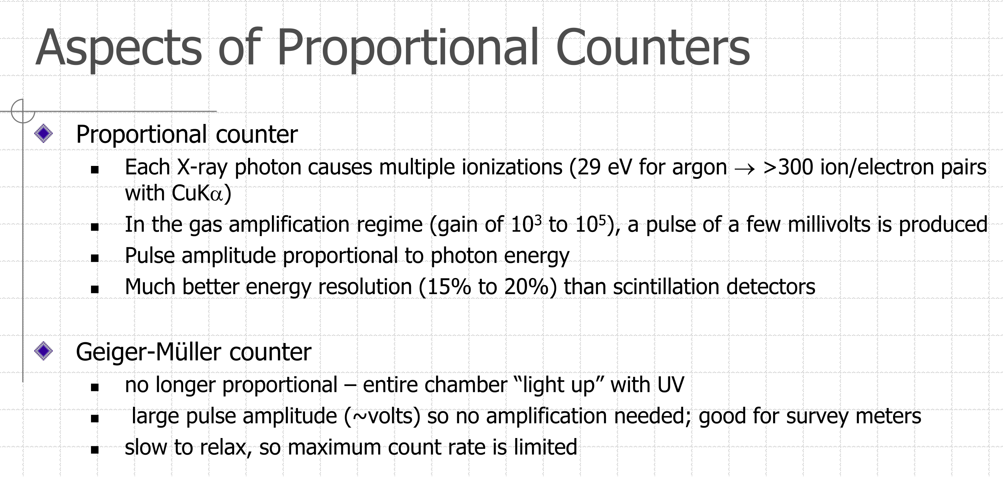
Detectors

Slide 24
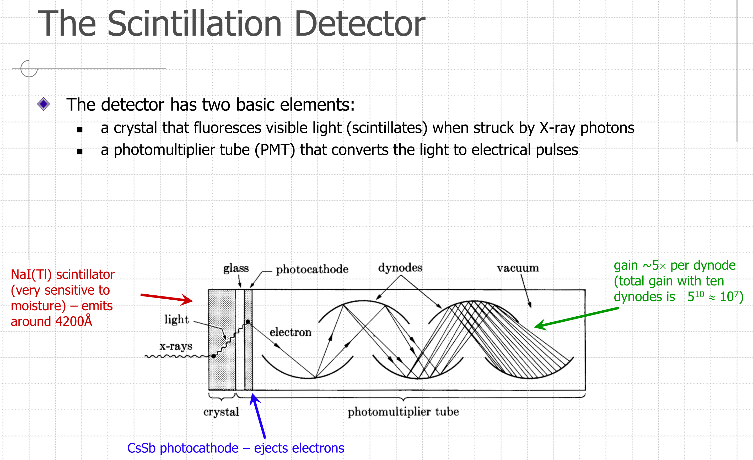
Detectors

Slide 25
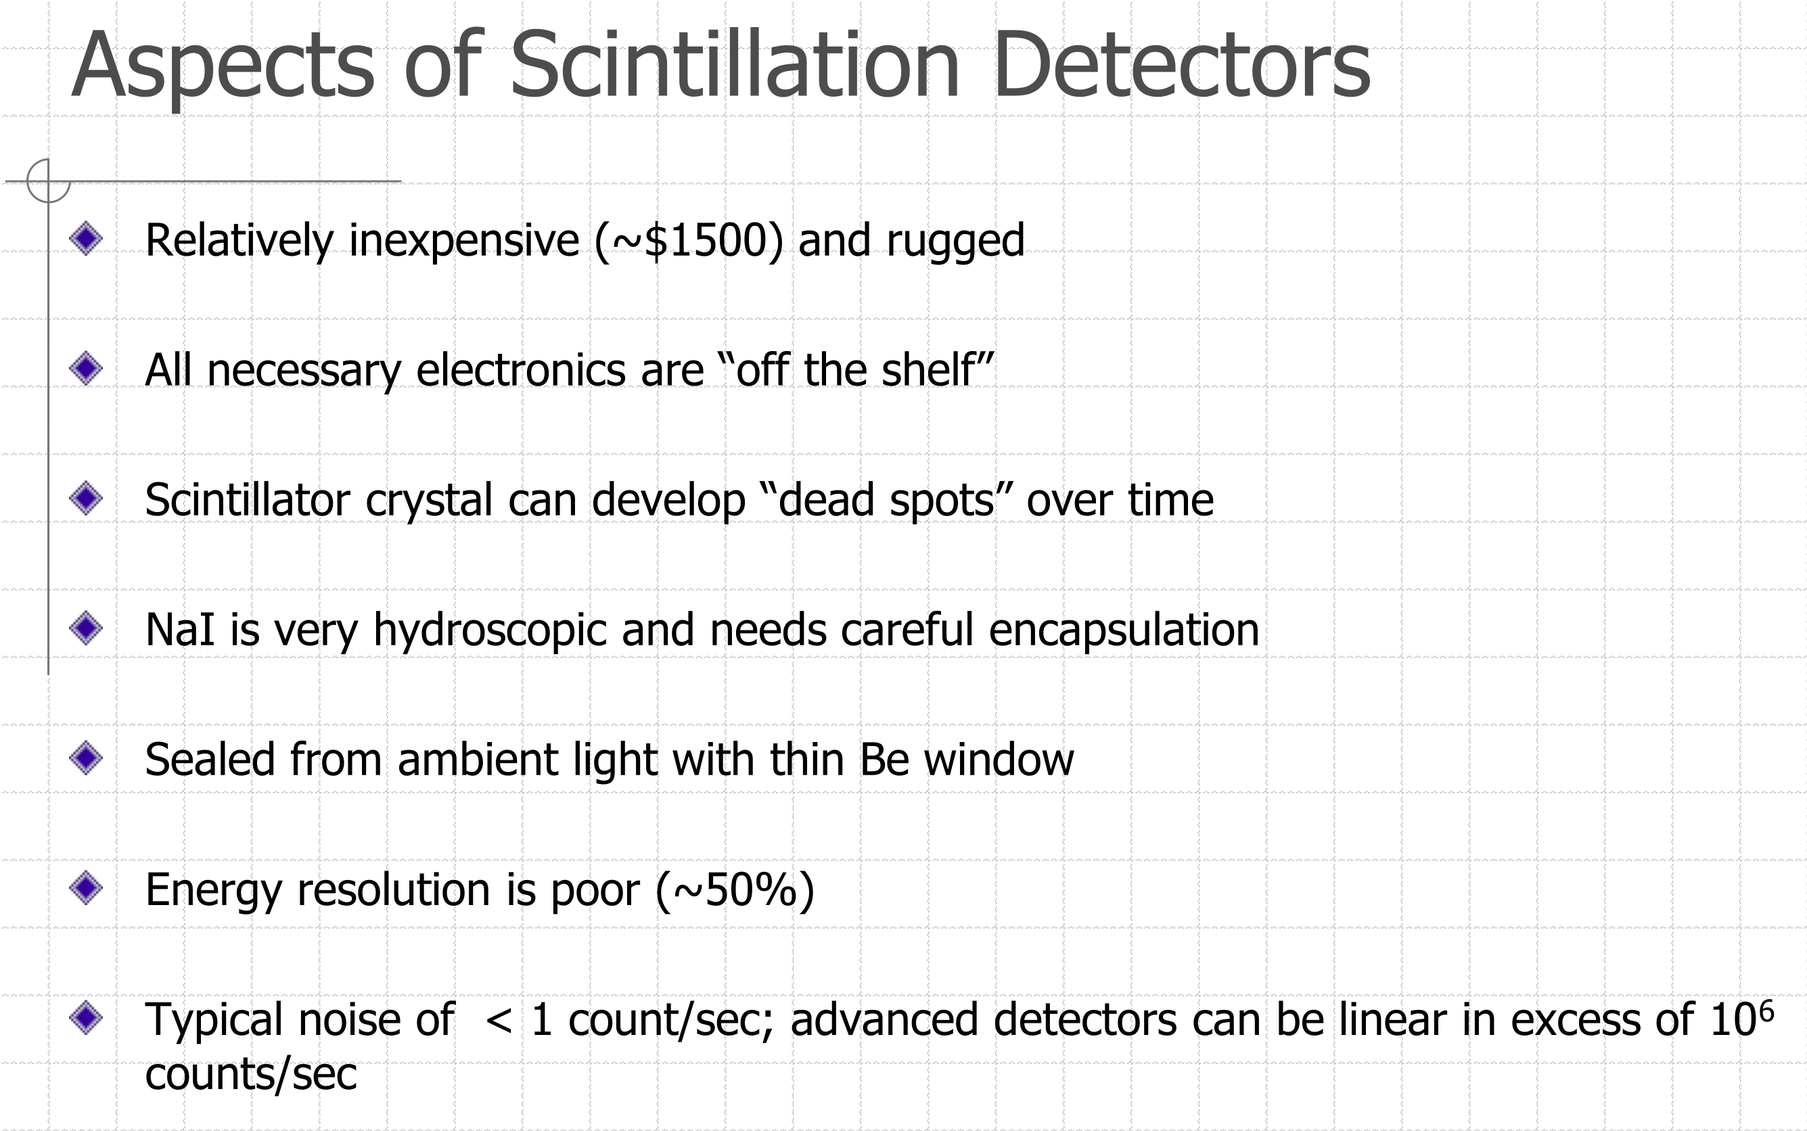
Detectors

Slide 26
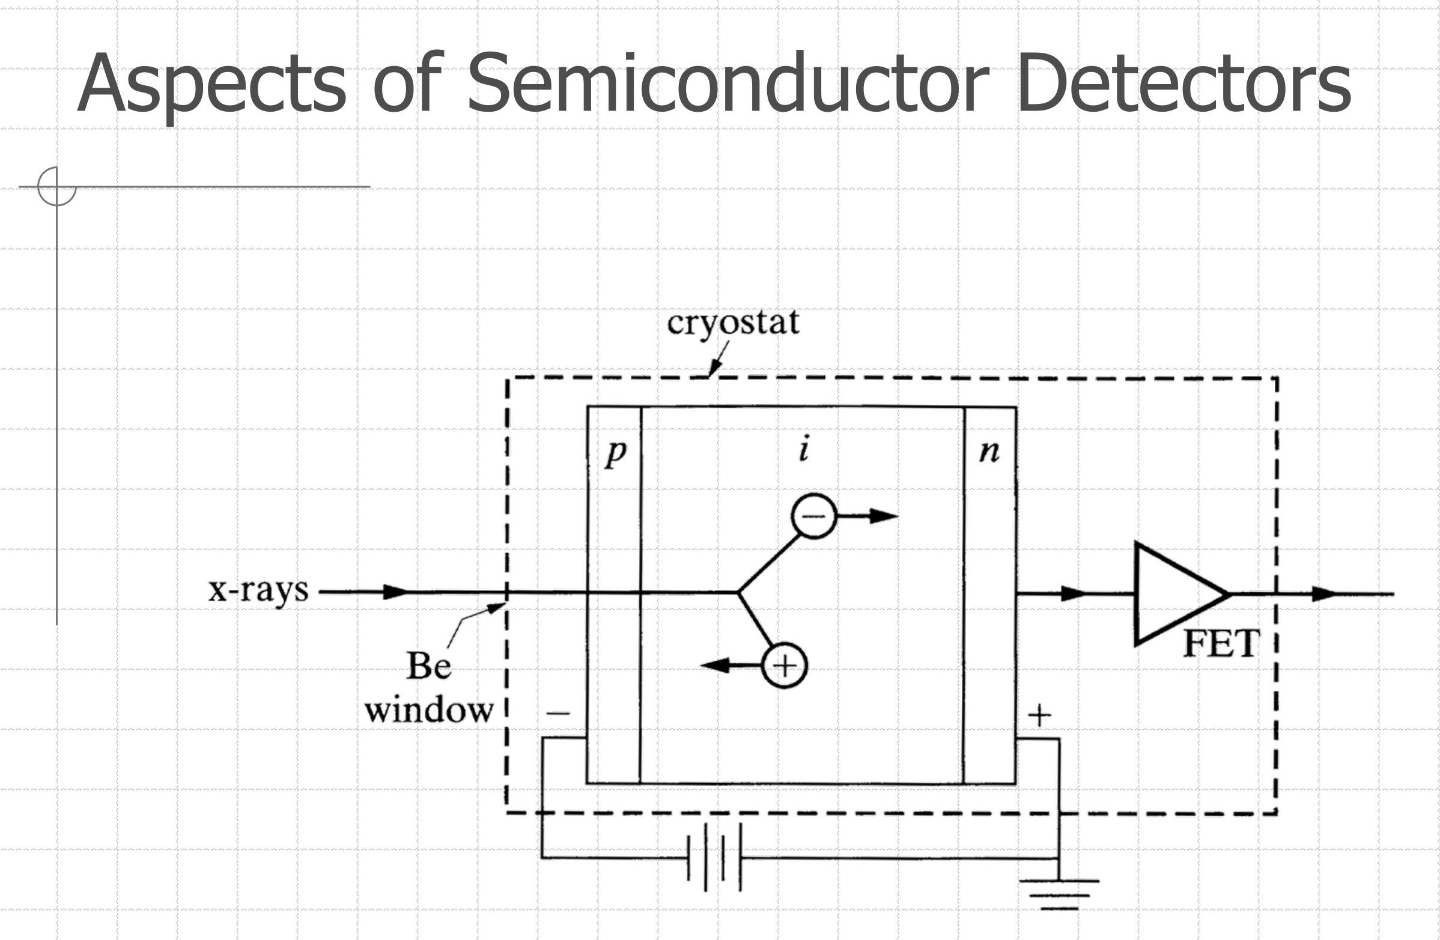
Detectors

Slide 27
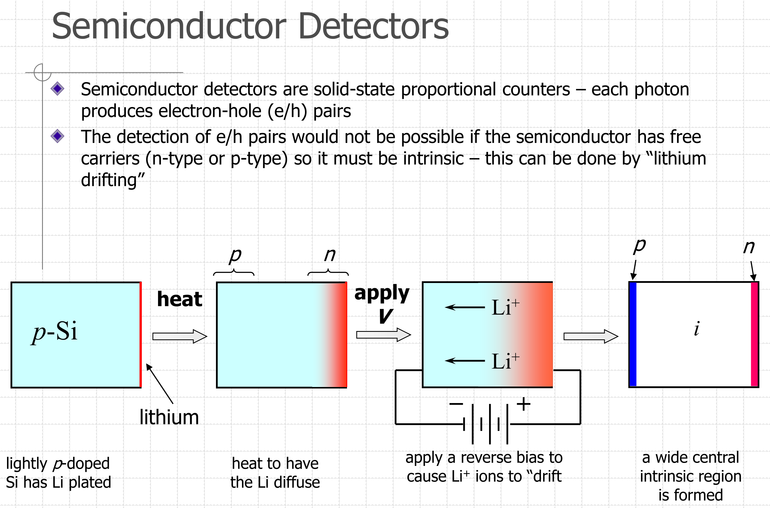
Detectors

Slide 28
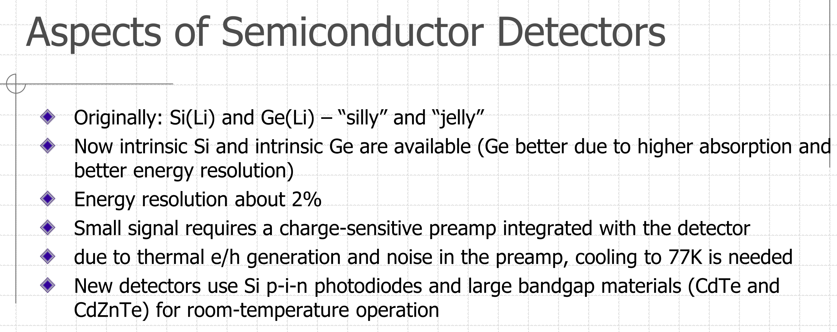
Detectors

Slide 29
Detectors
Energy resolution of different detectors

Slide 30
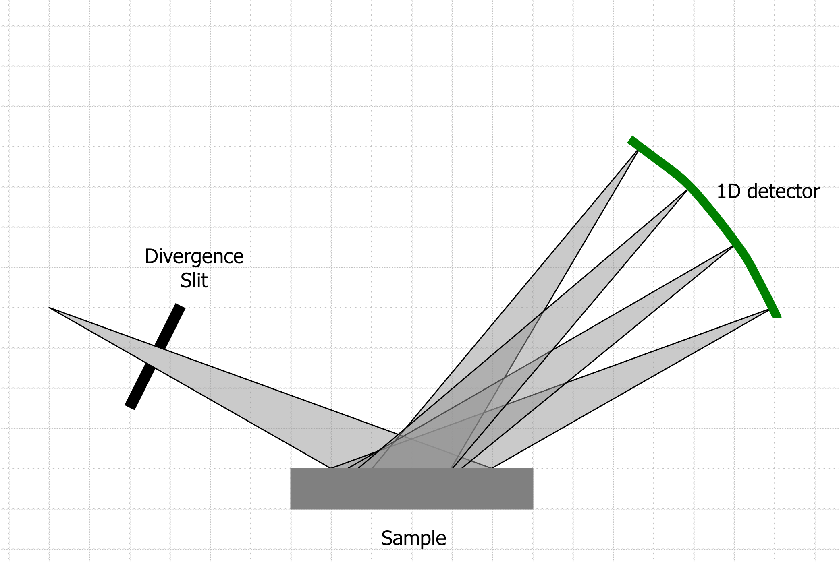
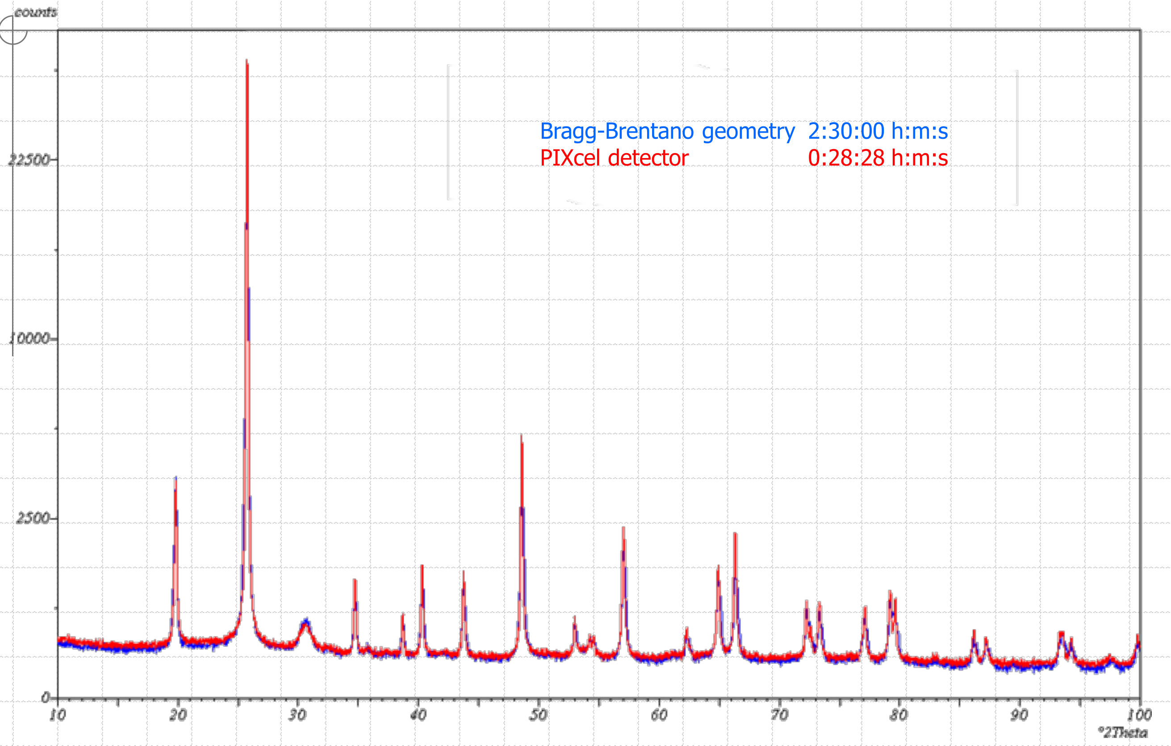
Detectors
Position Sensitive Detectors (PSD)
Higher counts for each angular position
Faster acquisition
Lower instrumental width

Slide 31
Bragg-Brentano (BB) Geometry

Slide 32
Bragg-Brentano (BB) Geometry

Slide 33
https://ywcmatsci.yale.edu/principle-0
https://slideplayer.com/slide/12857449/
https://slideplayer.com/slide/15366466/

