Slide 1
Powder XRD data analysis
General view of the XRD data
Phase identification – qualitative information
Crystallite size / strain analysis
Rietveld analysis – quantitative information

Slide 2
Phase identification
General list of available databases
https://www.iucr.org/resources/data/databases
COD: Crystallography Open Database
ICDS : Inorganic Crystal Structure Database
ICDD: Powder Diffraction File of the International Centre for Diffraction Data
The Materials Project
Freely accessible on-line database
https://www.crystallography.net/cod/
https://next-gen.materialsproject.org/
An Open option
Altomare, A., Corriero, N., Cuocci, C., Falcicchio, A., Moliterni, A., Rizzi, R.
QUALX2.0: a qualitative phase analysis software using the freely available database POW_COD,
J. Appl. Cryst. (2015). 48, 598-603.
Qualx2 software + POW_COD database

Slide 3
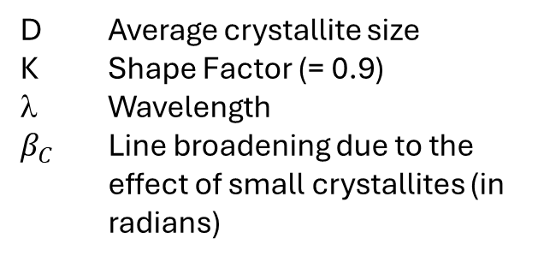
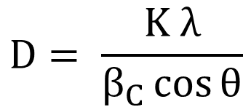

Crystallite size / Strain analysis
Scherrer’s equation
Microstrain
$$D= \frac{K λ}{β_{C}\cos{θ}}$$
$$β_{S}^{}=4ε\tan{θ}$$
D Average crystallite size
K Shape Factor (= 0.9)
λ Wavelength
$β_{C}$ Line broadening due to the effect of small crystallites (in radians)

Slide 4
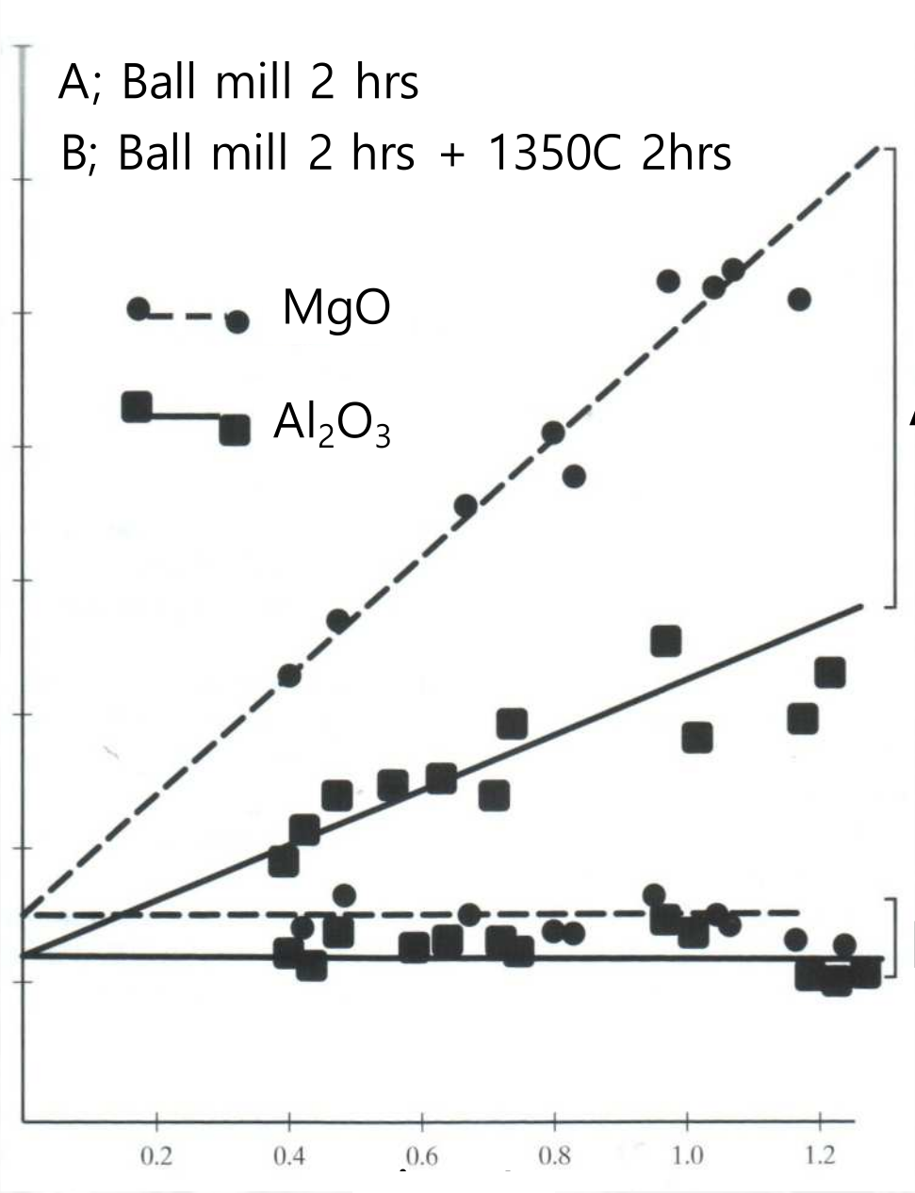
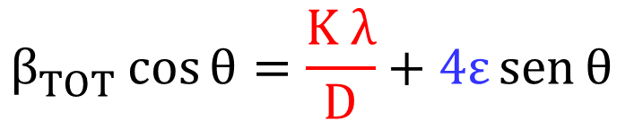



Crystallite size / Strain analysis
Williamson-Hall plot
$β_{TOT}^{2}=$ $β_{Exp}^{2} −$ $β_{Inst}^{2}$
A
$$β_{TOT}^{}\cos{θ}=\frac{K λ}{D}+4ε\operatorname{sen}{θ}$$
$$β_{TOT}^{}\cos{θ}$$
Both methods (SE or WH) require to fit reflections to determine FWHM.
B
Fit have to be done on original data
A peak for each reflection present in the XRD pattern of each phase must be included
$$\operatorname{sen}{θ}$$

Slide 5
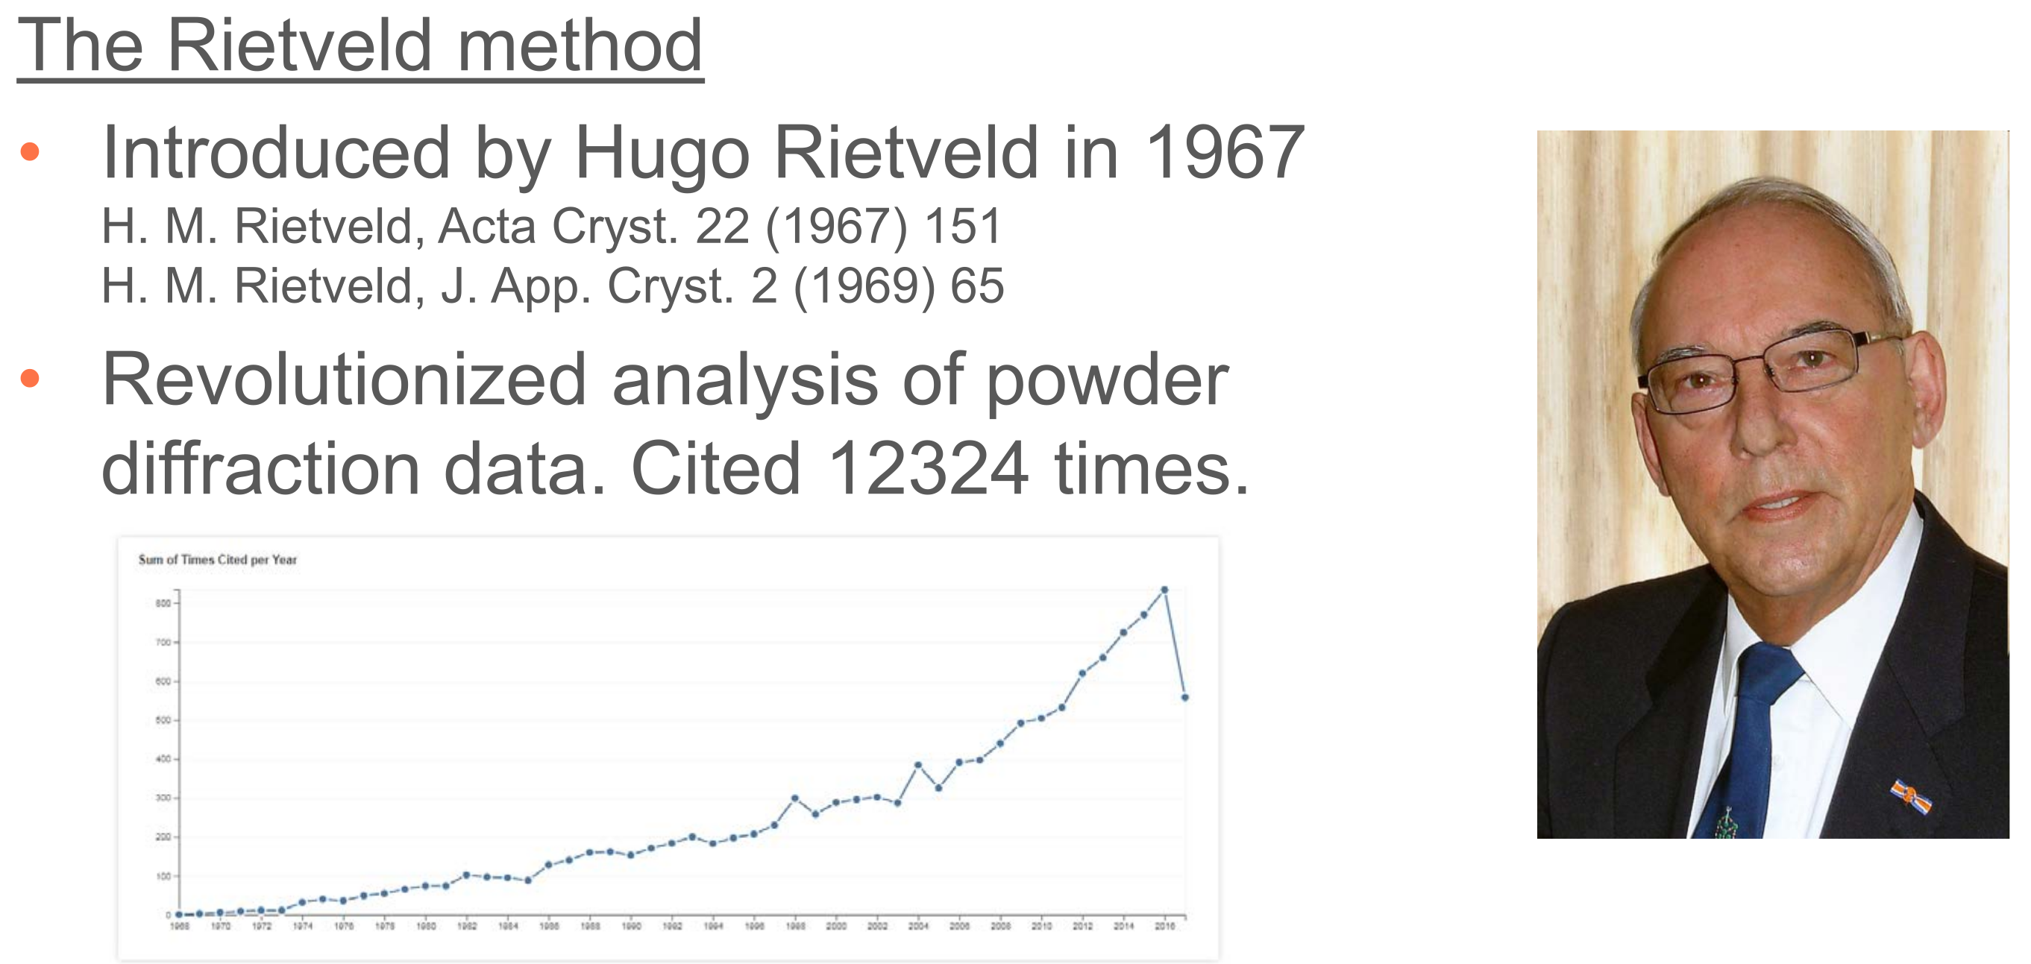
Rietveld analysis – quantitative information
Developed as a method for structural refinement but allowing also quantitative determination of phase composition.

Slide 6
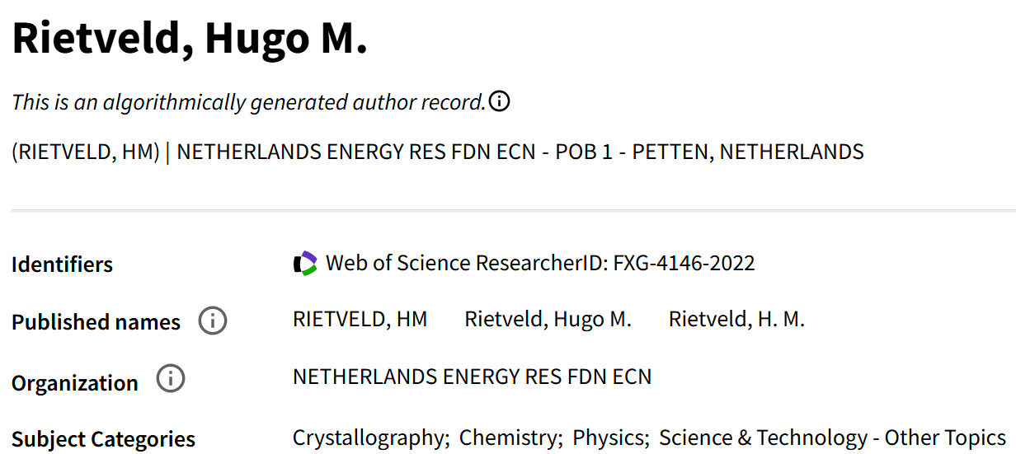
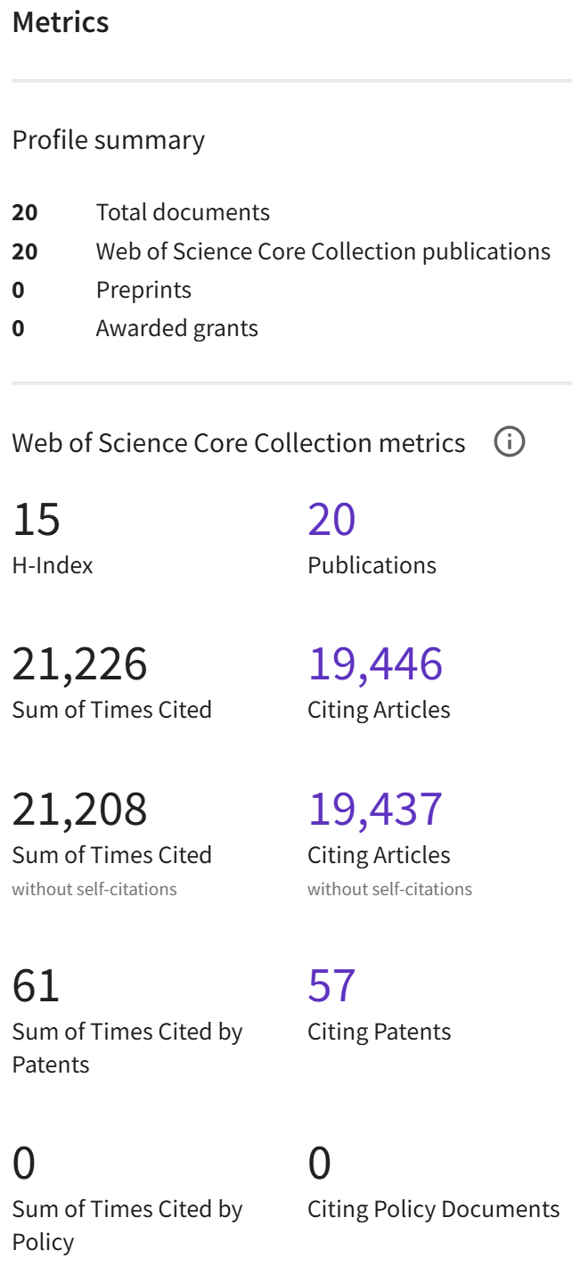

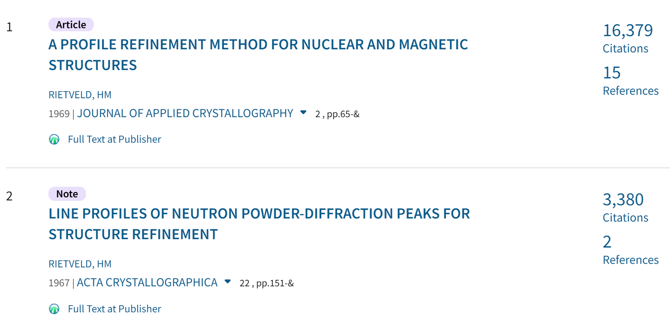
Rietveld analysis – quantitative information
19759 citations with 2 papers !!!!

Slide 7
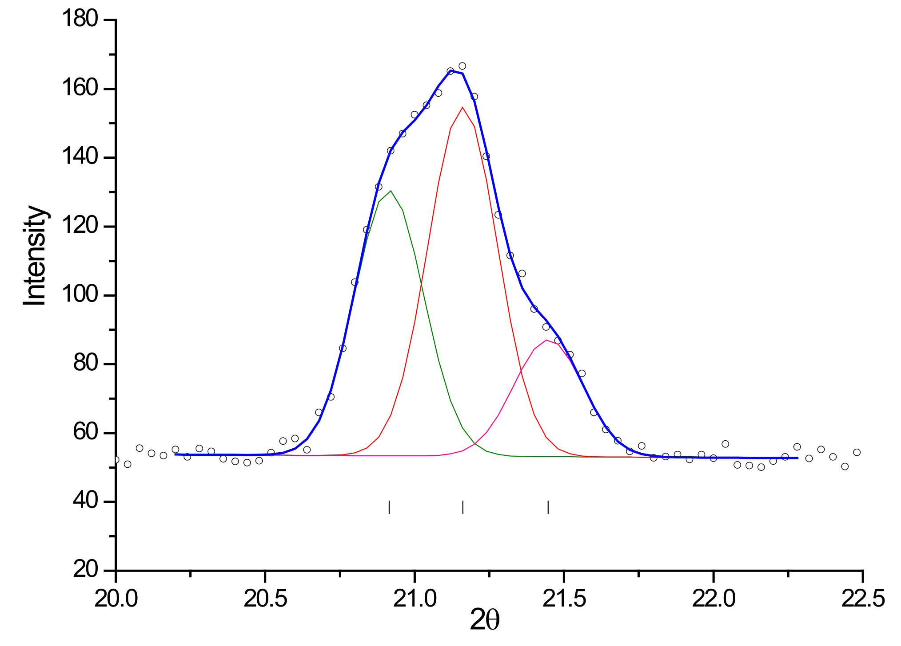
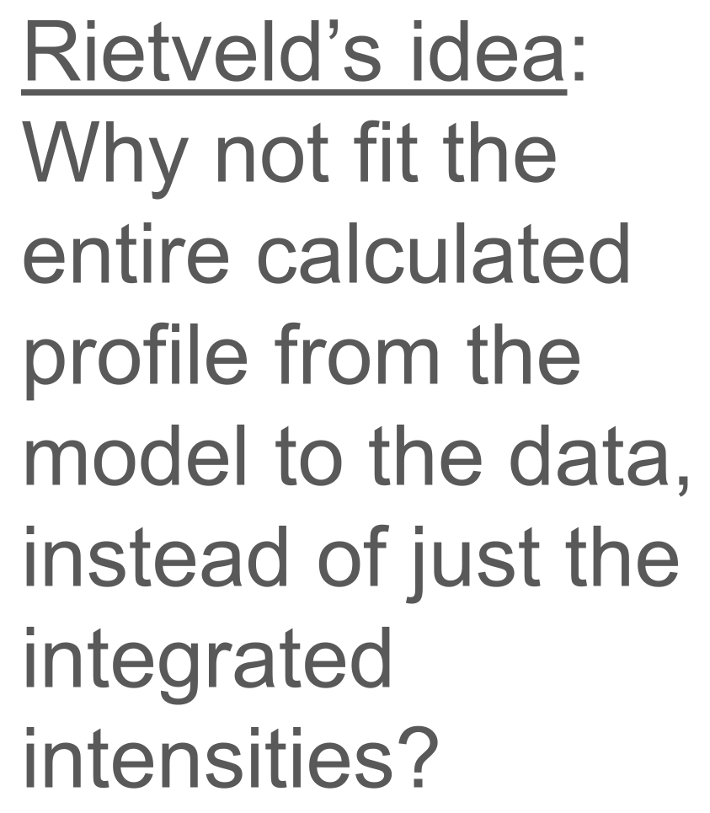
Rietveld analysis – quantitative information
Before Rietveld, quantification was made on the basis of integrated intensities
BUT
Reflections appear as peaks and more reflections can overlap and contribute to intensity in the same point of XRD pattern

Slide 8
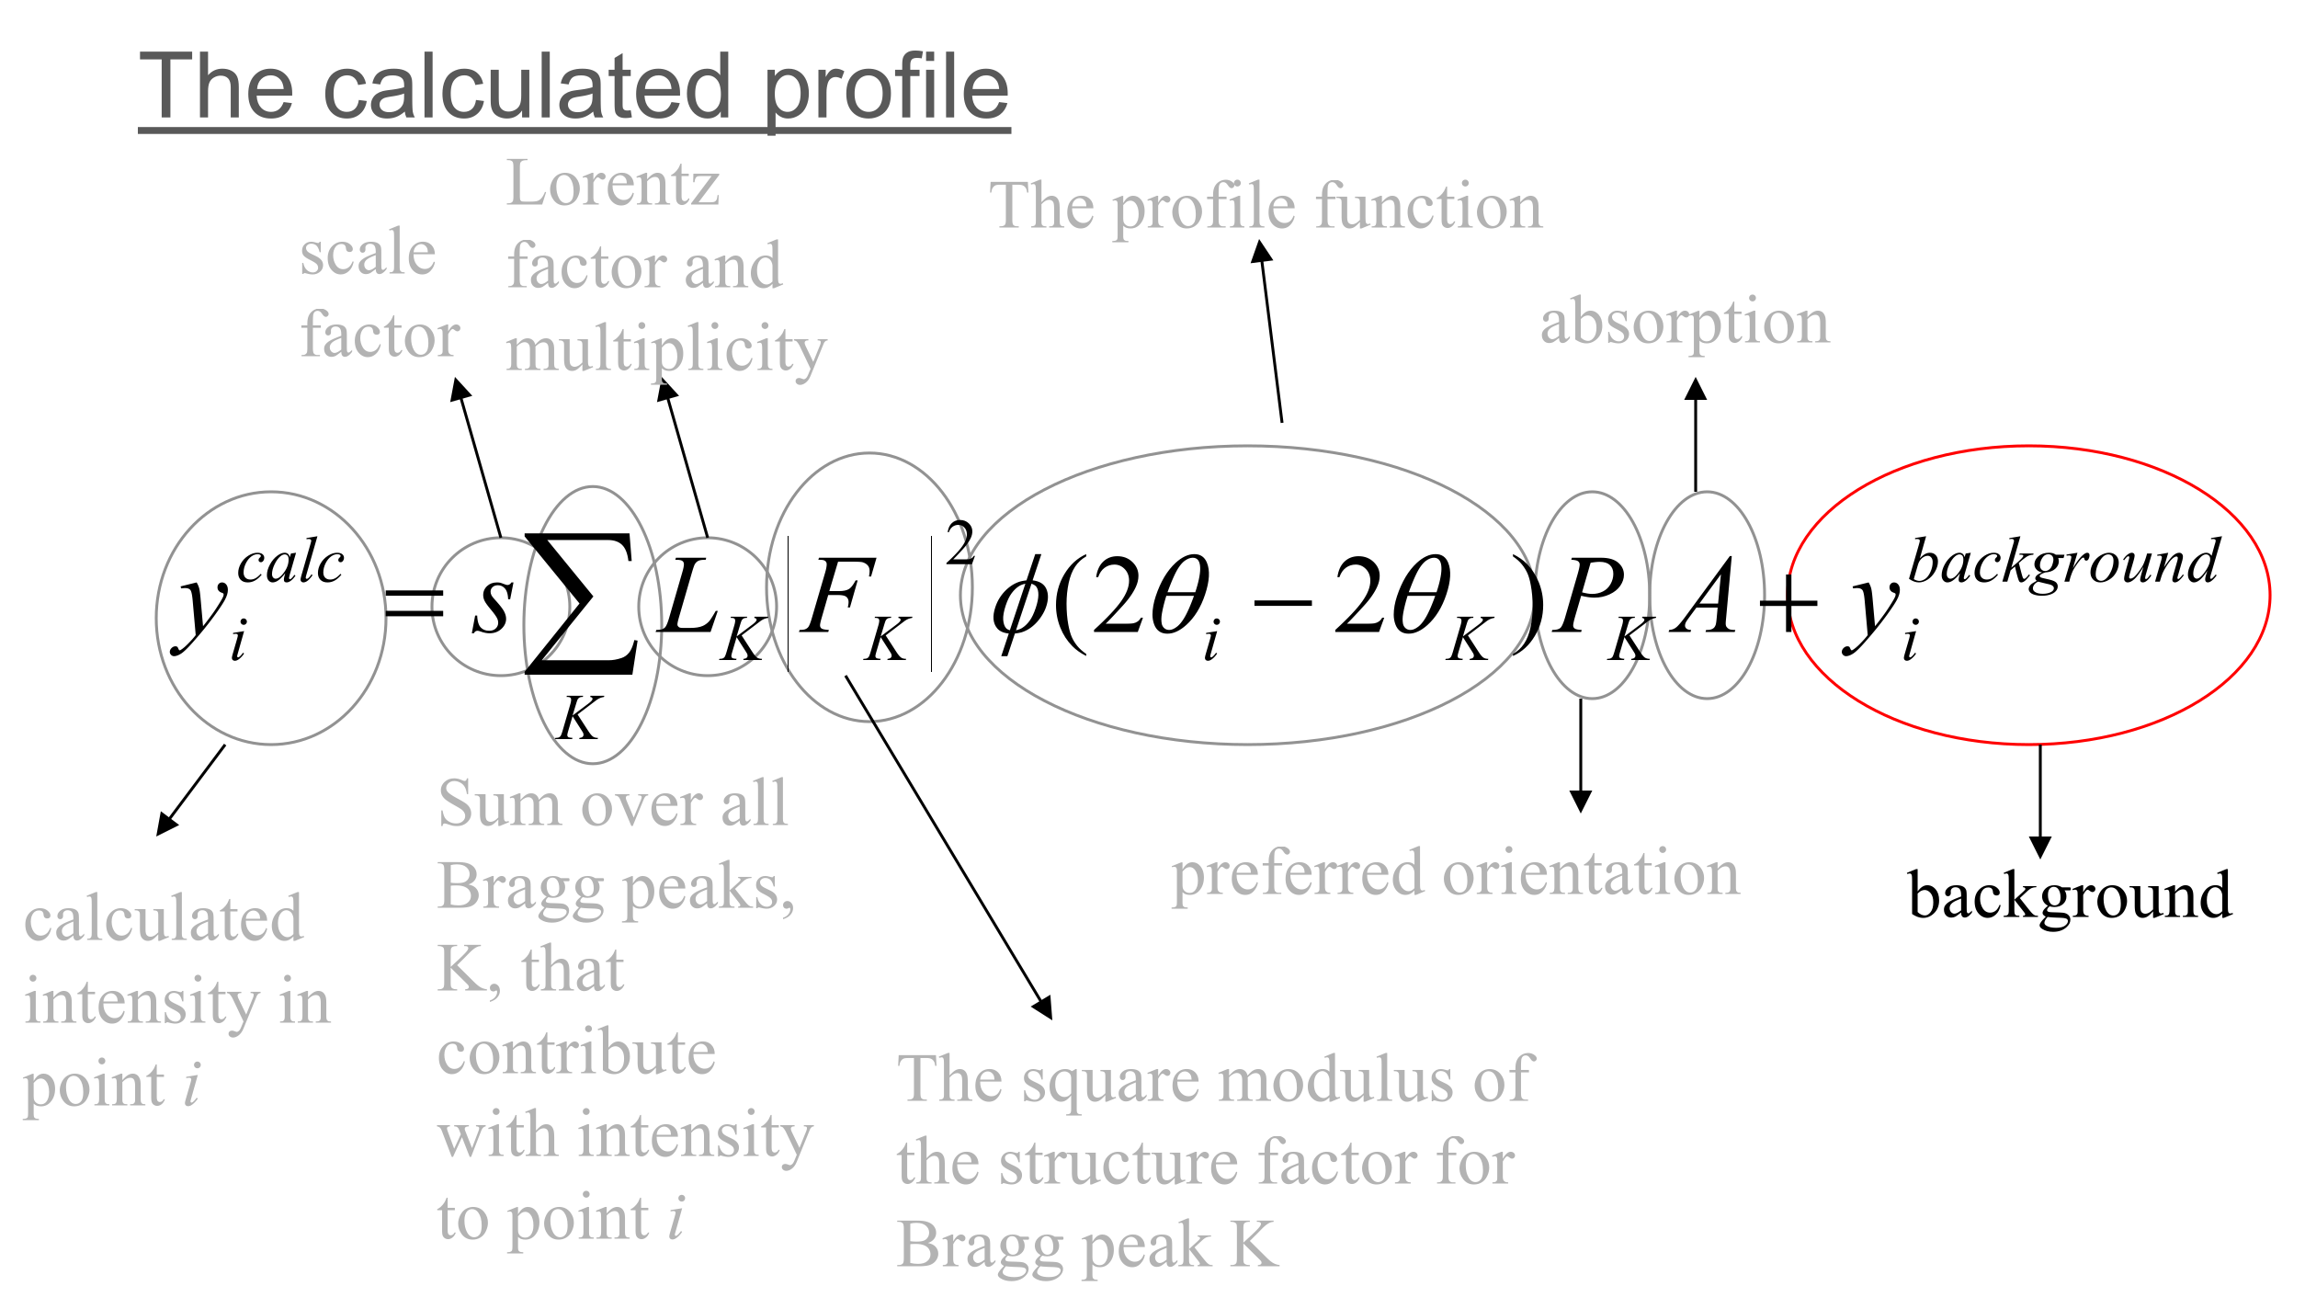
Rietveld analysis – quantitative information

Slide 9
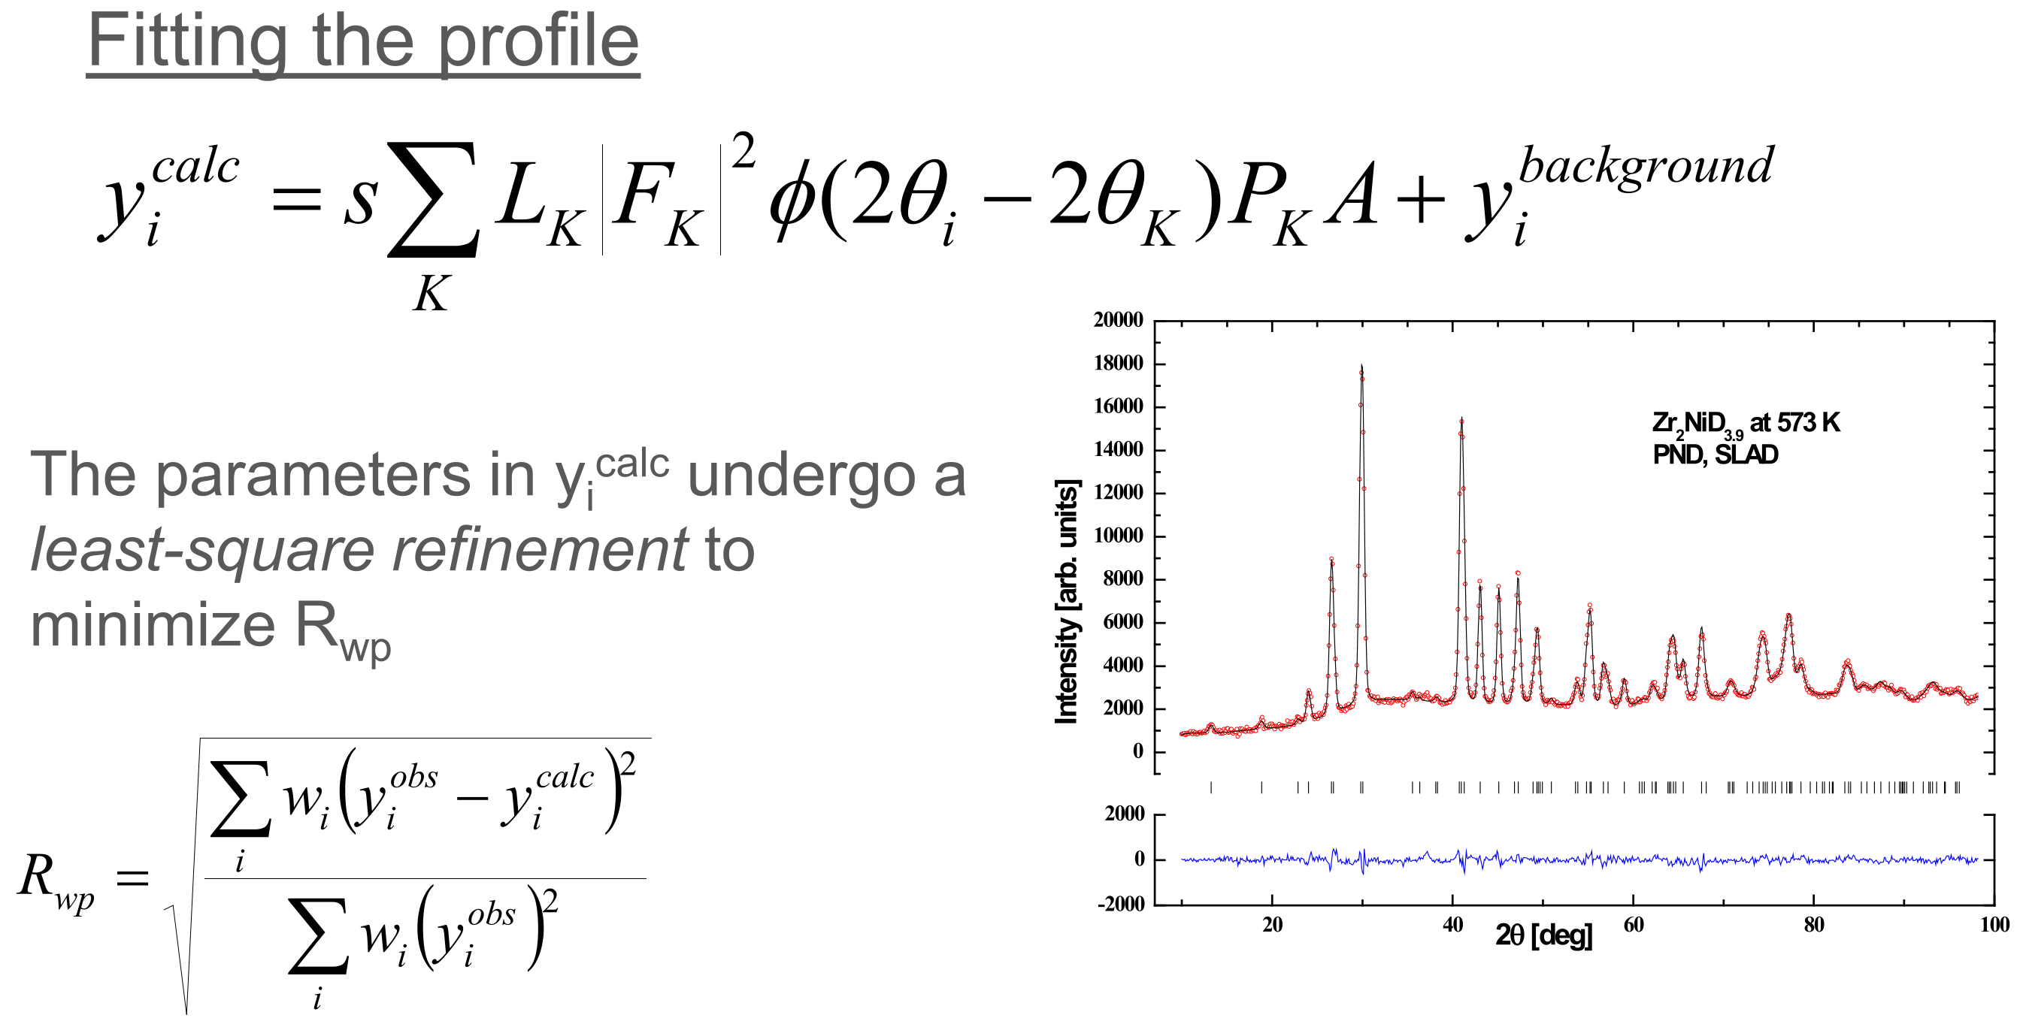
Rietveld analysis – quantitative information

Slide 10
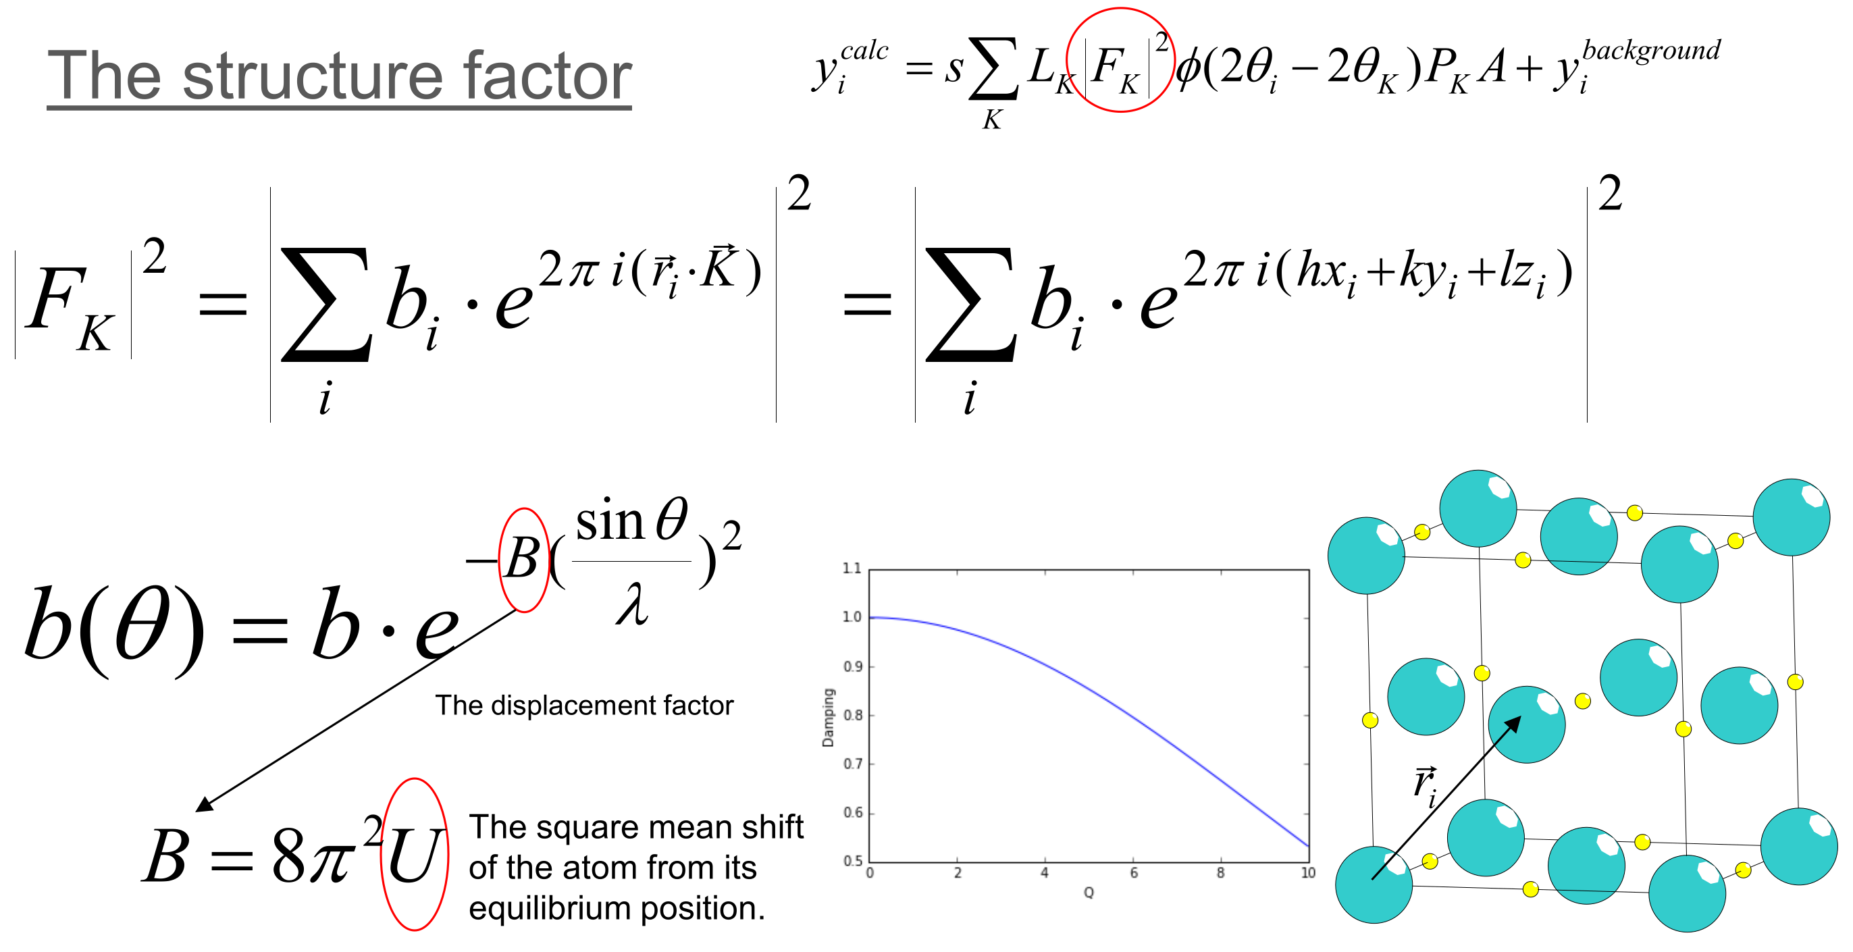
Rietveld analysis – quantitative information
B depends on temperature of the sample

Slide 11
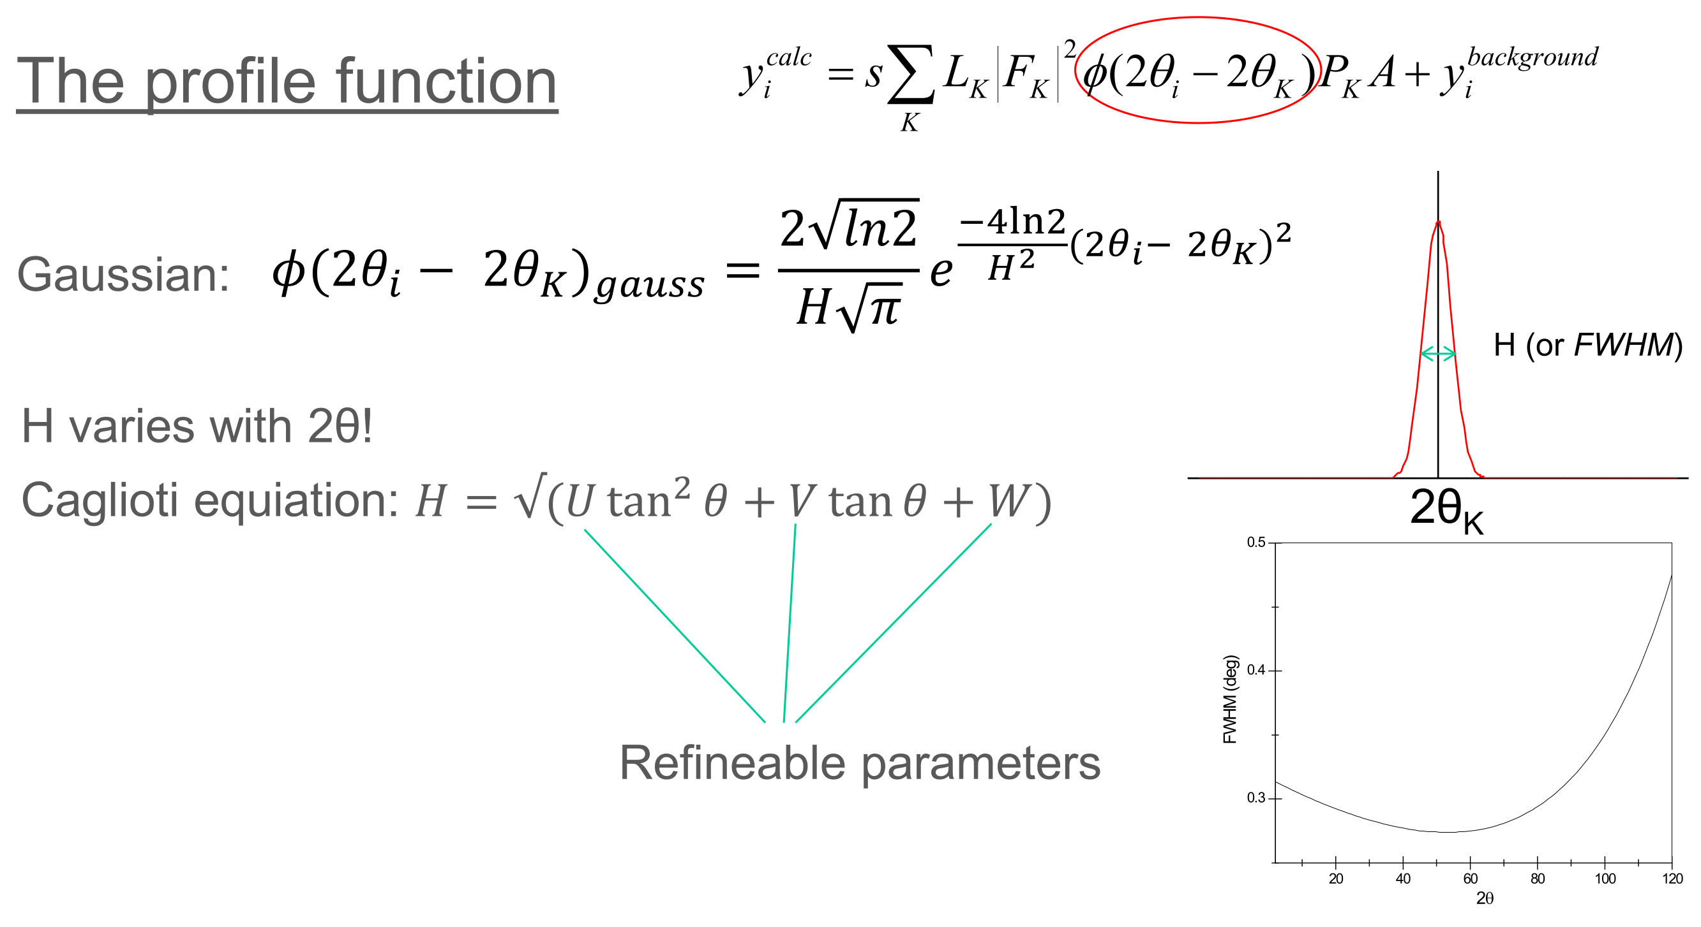
Rietveld analysis – quantitative information
Cagliotti equation

Slide 12
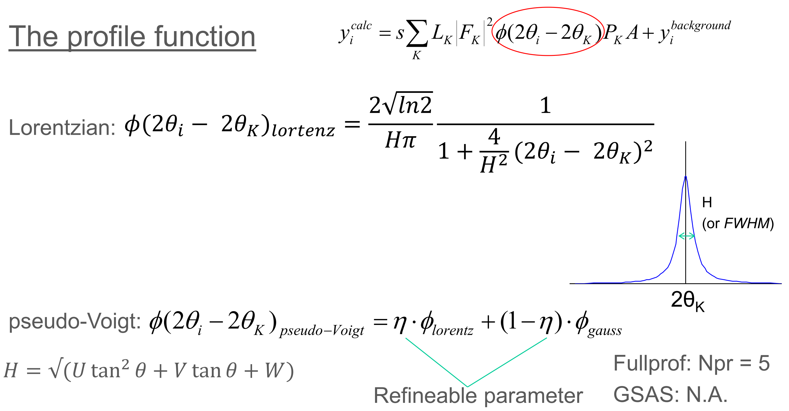
Rietveld analysis – quantitative information

Slide 13
Rietveld analysis – quantitative information
Parameters to be fitted for each phase included:
S: Scale factor
B: Thermal factor
Sample displacement
U, V, W, η: Peak shape (pseudo-Voigt)
Background (Polynomial)
If required:
Cell parameters (up to 6 variables)
Atomic position and occupancy ((up to 4 variables)

Slide 14
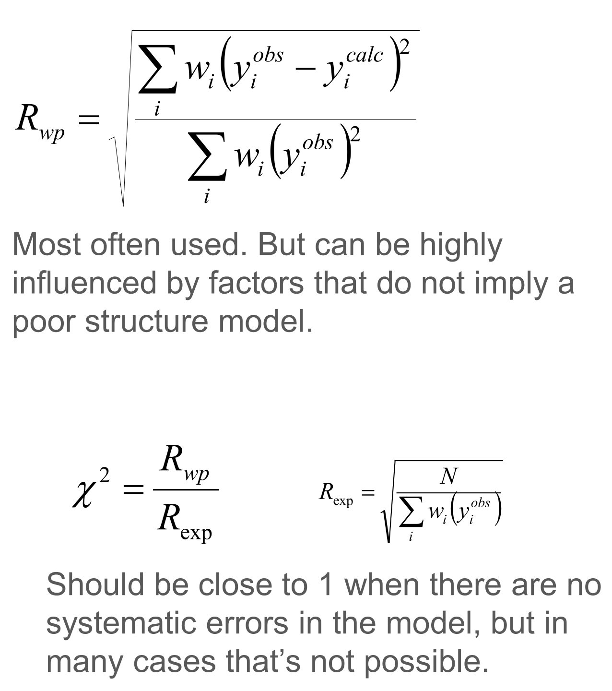
Rietveld analysis – quantitative information
Evaluating the fit

Slide 15
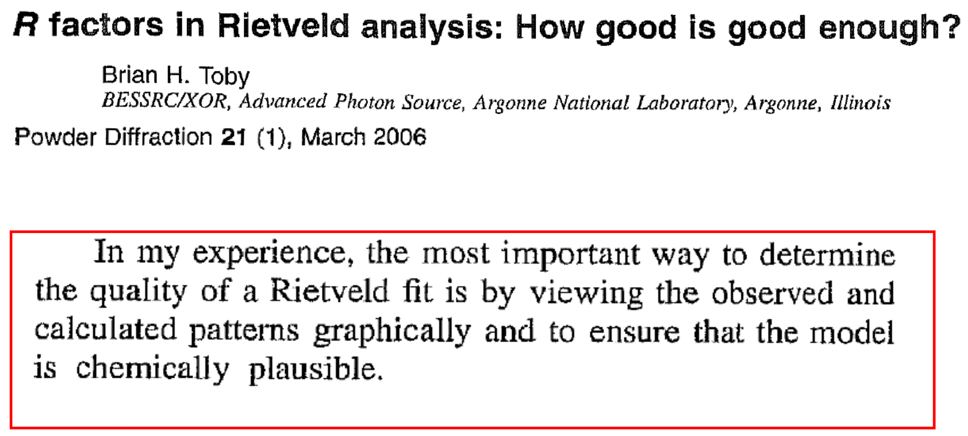
Rietveld analysis – quantitative information
Evaluating the fit

