Slide 1
Synthesis
Nanosized material: CdS quantum dots
Nanocomposite materials: TiO₂ by sol-gel
Nanostructured materials: Ti-MCM-41

Slide 2
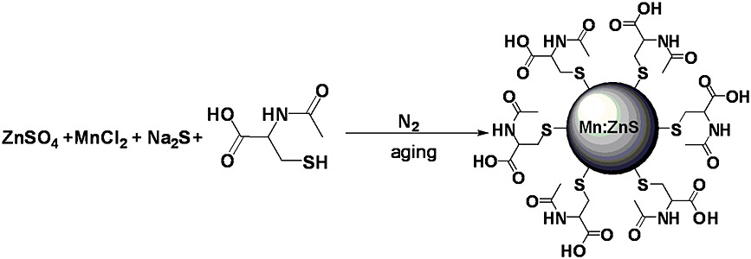
Nanosized material: CdS quantum dots
Colloidal synthesis
CdCl₂ + Na₂S +
The NAC capped CdS QDs were synthesized directly in aqueous solution. Briefly, 51.3 mg NAC were dissolved in 55 mL of bidistilled water and 5.00 mL of solution of CdCl₂ · 2 H₂O 57.4 mM. The pH value was adjusted to 8.0–9.0 by titrating NaOH solution (2.0 M) under constant stirring. When the reaction went through 0.5 h, 5.00 mL 57.4 mM of Na₂S · 9 H₂O solution was added drop by drop into it under the same conditions. After 0.5 h, the NAC capped CdS QDs were obtained. The procedure was carried out at different temperatures in order to investigate the influence of temperature on the size of the quantum dots.

Slide 3
Nanosized material: CdS quantum dots
Student | V NAC | V Cd²⁺ | V S²⁻ | Temperature (°C)
1 | 55 | 5.00 | 5.00 | 0
2 | 55 | 5.00 | 5.00 | 10
3 | 55 | 5.00 | 5.00 | 20
4 | 55 | 5.00 | 5.00 | 30
5 | 55 | 5.00 | 5.00 | 50
Prepare the NAC solution
Correct pH to 8.0-9.0 using NaOH 2.0 M (use indicator paper)
Stir for 30 min
Add solution with S²⁻ and stir 30 min
Separate the suspension in 3 vials
Precipitate CdS-NAC QDs adding 25 mL of acetone in 2 vials; save third vails for characterization in solution.
Centrifuge 5000 rpm, 10 min
Wash the precipitate with 10 mL of acetone
Centrifuge and dry the product in air overnight
Characterization
XRD
UV-vis
Fluorescence
DLS

Slide 4
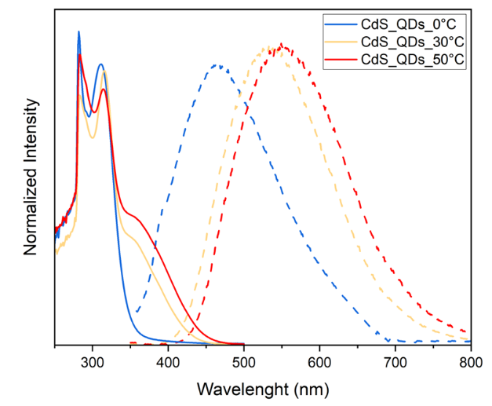

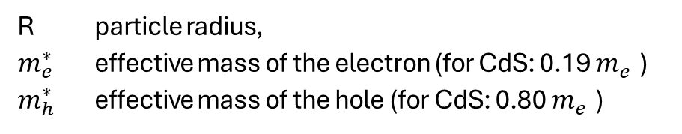
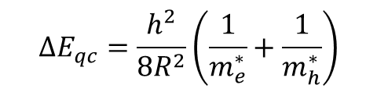
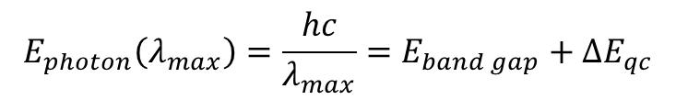
Nanosized material: CdS quantum dots
Record UV-vis spectra (300 – 500 nm) and fluorescence spectra (λ_{exc} = 350 nm; λ_{em} = 350 – 800 nm)
Calculate CdS QDs size from fluorescence maximum (λ_{max}).
Characterization
XRD
UV-vis
Fluorescence
DLS
$$E_{photon}\left(λ_{max}\right)=\frac{hc}{λ_{max}}=E_{band gap}+ΔE_{qc}$$
$$ΔE_{qc}=\frac{h^{2}}{8R^{2}}\left(\frac{1}{m_{e}^{∗}}+\frac{1}{m_{h}^{∗}}\right)$$
E_{band gap} = 2.42 eV (bulk CdS)
ΔE_{qc} = extra gap due to quantum confinement
R particle radius,
$m_{e}^{∗}$ effective mass of the electron (for CdS: 0.19 $m_{e}^{}$)
$m_{h}^{∗}$ effective mass of the hole (for CdS: 0.80 $m_{e}^{}$)

Slide 5
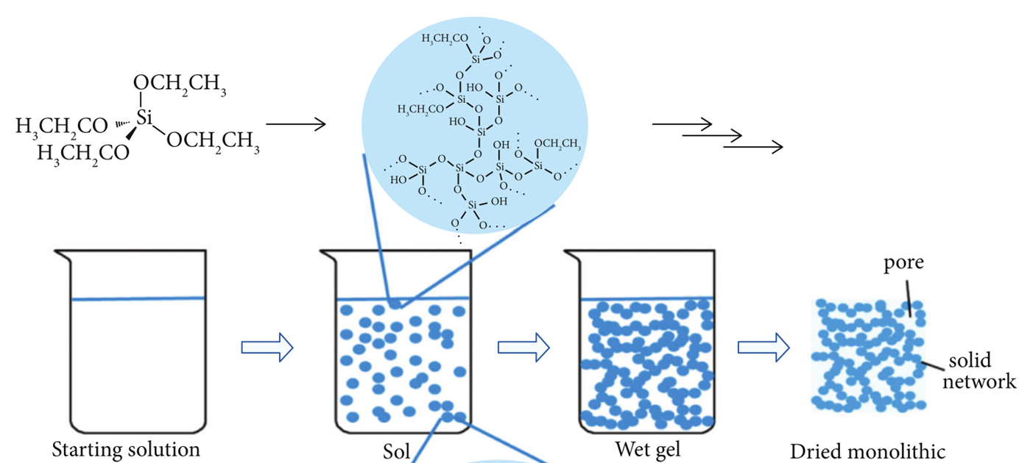
Nanocomposite materials: TiO₂ by sol-gel
TiO₂ samples were prepared by a sol–gel method as follows. Typically, 17.0 g of Ti(OBu)₄ were dissolved at 25 °C in 40.0 mL of anhydrous ethanol to form the solution 1. Meanwhile, 3.0 mL of concentrated HNO₃ were mixed with 35.0 mL of anhydrous ethanol and 15.0 mL of water to prepare the solution 2. Then the solution 1 was added drop-wise into the solution 2 within 20 min under vigorous stirring. The solution was continuously stirred for 30–60 min until the formation of TiO₂ gel. After aging for at least 24 h at room temperature, the as-prepared TiO₂ gel was dried at 120 °C for 12 h. The obtained solid was ground and annealed at 450 °C for 6 h with a heating rate of 3 °C/min.

Slide 6
Nanocomposite materials: TiO₂ by sol-gel
Student | Solution 1 |  | Solution 2
 | m Ti(OBu)₄ | V EtOH | V H₂O | V EtOH | V HNO₃
1 | 8.5 g | 15 + 5 mL | 7.5 mL | 17.5 mL | 0.5 mL
2 & 3 | 8.5 g | 15 + 5 mL | 7.5 mL | 17.5 mL | 1.0 mL
4 & 5 | 8.5 g | 15 + 5 mL | 7.5 mL | 17.5 mL | 1.5 mL
Prepare Solution 1 in a plastic vial. Close carefully the vial to avoid hydrolysis
Prepare Solution 2 into a 100 mL flask with magnetic stirrer
Withdraw Solution 1 with a 20 mL plastic syringe and drop it slowly into Solution 2 under stirring.
Rinse the vial with 5 mL of EtOH and add it into the flask
Start a timer on your smartphone
Continue stirring gently: when the gel will be formed, the magnetic bar will stop!
Stop the timer and record the time required to form the gel
Leave the gel standing for at least 24 h
Dry the material at 120 °C overnight
Grind the solid product into a mortar and calcine at 450 °C for 6 hours (heating rate of 3 °C/min)
Characterization
XRD
Physisorption

Slide 7
Nanostructured materials: Ti-MCM-41
Pore-expanded titanium-containing mesoporous catalysts were directly synthesized under a microwave irradiation condition, using organic water-insoluble agent as a pore expander. Detailed synthetic procedure was carried out as follows:
CTAB (3.64 g) and a certain amount of SA were dissolved in 90 mL of deionized water under vigorous stirring at 313 K, and then TEOS (15.32 g) was added dropwise to the surfactant solution followed by an adjustment of pH value to 11.0 through gradual addition of a NaOH solution. After 10 min, TBOT (0.50 g) dissolved in i-PrOH was dropped into the mixture. The stirring was maintained for 40 min for the sufficient hydrolysis of TEOS and TBOT. Molar composition of final gel was 1:7.35:0.147:1.5:500:7.35 CTAB:TEOS:TBOT:NaOH:H₂O:i-PrOH. The SA/CTAB molar ratio was 1. The resultant suspension was transferred into Teflon vessels and heated via nonpulsed microwave irradiation in a Multiwave 3000 microwave reaction system (Anton Paar) that is equipped with an 8-rotor tray. Combined with a temperature sensor, a pressure sensor, and an adjustable power output (maximum 1200 W), the microwave system provides an efficient way for rapid and uniform heating. Crystallization was performed in the temperature controlled mode where the temperature was ramped for 5 min and hold 393 K for 40 min. After cooling to room temperature, the solid products were isolated by filtering, washed with deionized water, and dried in air at 373 K for 12 h. Subsequently, the dried samples were calcined at 823 K for 6 h in air with a heating rate of 2 K/min.

Slide 8
Nanostructured materials: Ti-MCM-41
Student | CTAB | H₂O | TEOS | TBOT | 2-PrOH | NaOH 2.0M | SA
1 | 1.213 g | 27.5 mL | 5.43 mL | 0.167 mL | 1.82 mL | 2.5 mL | ----
2 | 1.213 g | 27.5 mL | 5.43 mL | 0.167 mL | 1.82 mL | 2.5 mL | n-heptane 0.488 mL
3 | 1.213 g | 27.5 mL | 5.43 mL | 0.167 mL | 1.82 mL | 2.5 mL | Dodecylamine 0.766 mL
4 | 1.213 g | 27.5 mL | 5.43 mL | ----- | 1.82 mL | 2.5 mL | n-heptane 0.488 mL
4 | 1.213 g | 27.5 mL | 5.43 mL | ----- | 1.82 mL | 2.5 mL | Dodecylamine 0.766 mL
In a 100 mL flask, mix CTAB and H2O and heat the system under stirring at 40°C
Add SA (if required) and let the system gently stirring overnight
Add TEOS dropwise and NaOH 2.0 M
After 10 min, add dropwise the solution of TBOT in 2-PrOH
Stir gently for 10 minutes
Transfer the gel into 2 Teflon vessel
Perform hydrothermal aging at 120°C for 40 minutes under microwave irradiation
Prepare the washing solution mixign 100 mL of H₂O with 50 mL of EtOH
After cooling, wash the precipitate with 30 mL of the washing solution, shake for 30 sec and centrifuge (5000 rpm for 10 min) for 3 times + 1 final washign with 30 mL of EtOH
Dry the powder at 70 °C overnight
Grind the powder in a mortar and calcine at 550 °C for 6 h, heating rate 2 °C/min
Characterization
XRD – low angle
Physisorption
TEM

