Slide 1
https://learn.micromeritics.com/training-videos/
MicroActive Reporting Software

Slide 2
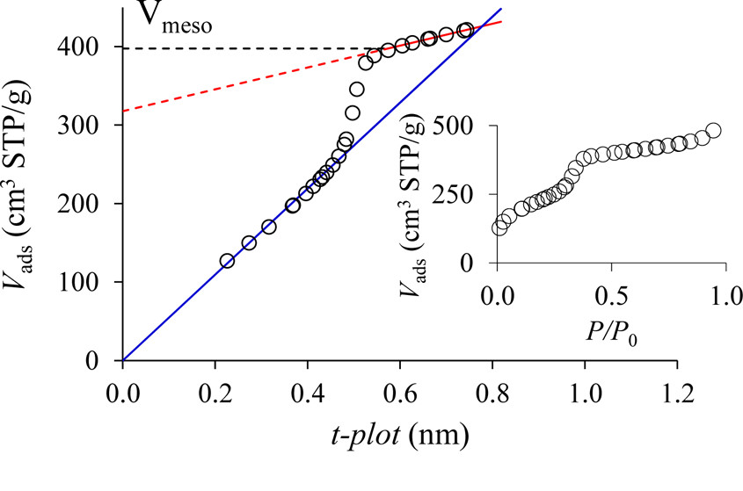

Slide 3
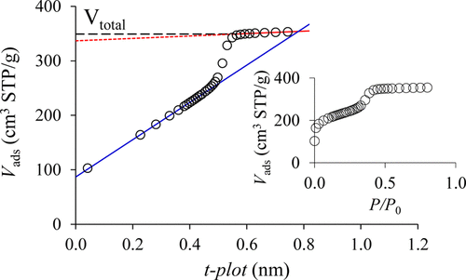
a(x) = a_{micro,max} + k S_{ext} t_{layer}(x)
For t [nm] , S [m²/g] and a [cm³/g STP] we obtain:
k = 1 / (4.3532 t_{mono})
where t_{mono} = 0.354 nm is monolayer thickness for N₂ adsorbed layers and 4.3532 is a coefficient for calculation of occupied area [m²/g] from adsorbed amount [cm³/g STP] (N₂ adsorption at LNT).

