Slide 1

EXAFS in a nutshell
Trieste Practicals
8-5-2025
E. Fonda
Synchrotron SOLEIL

Slide 2
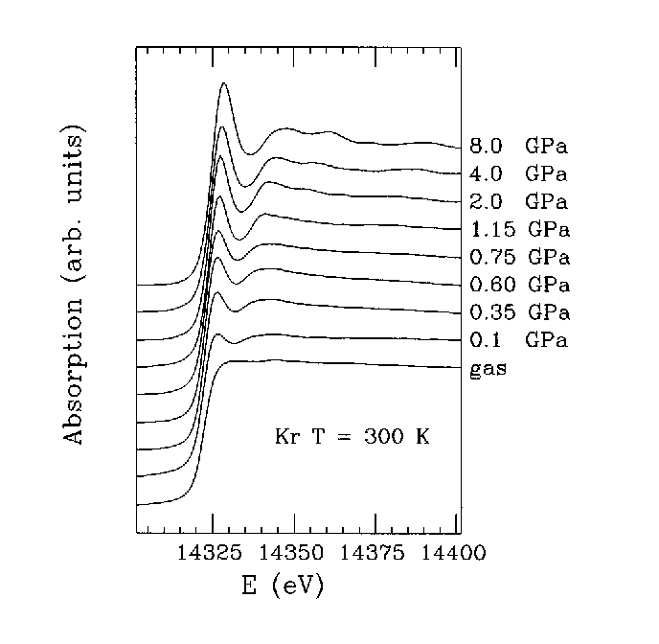
EXAFS explained in a single figure
Solid
Liquid
Gas…
High-pressure EXAFS of solid and liquid Kr
A. Di Cicco, A. Filipponi, J. P. Itié and A. Polian, Phys. Rev. B 54 (1996) 9086-9098

Slide 3
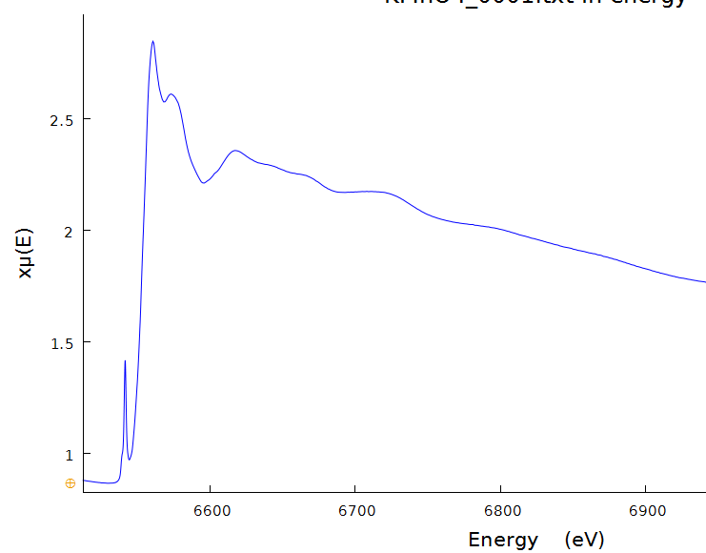
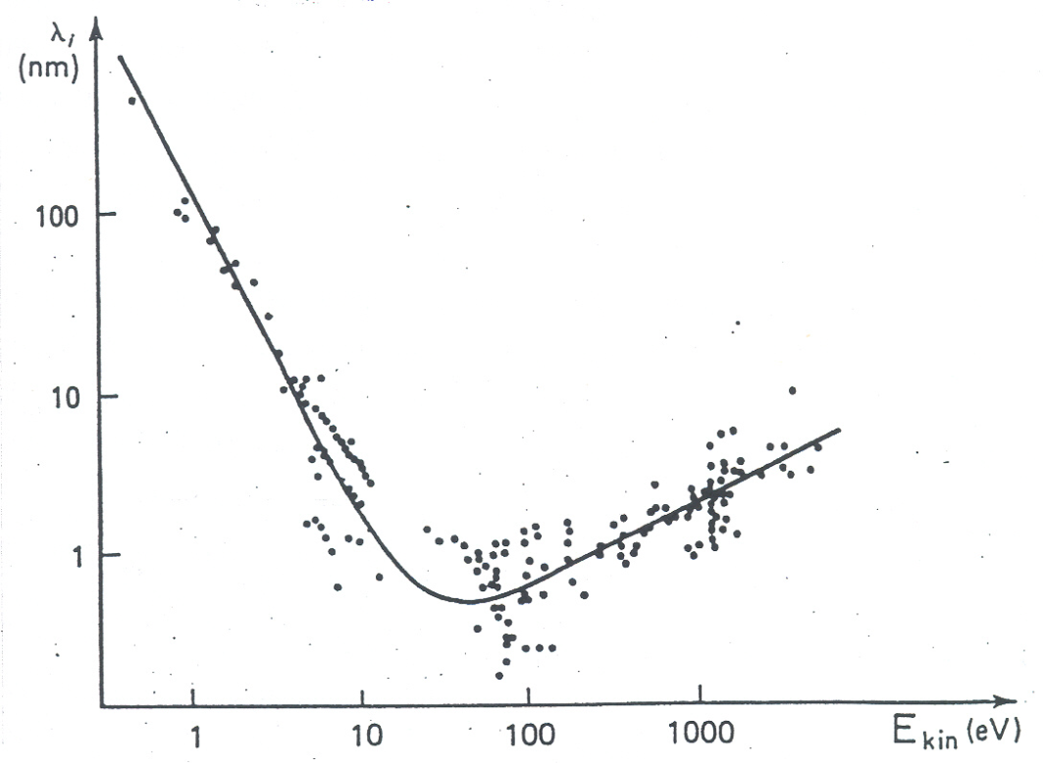
EXAFS: Extended X-ray Absorption Fine Structure
XANES
X-ray Absorption Near Edge Structure
Electron Mean Free Path λ(E)
e⁻
µ : linear absorption coefficient
χ : EXAFS signal
XANES
EXAFS
EXAFS
Extended X-ray Absorption Fine Structure
pre-edge
Mn K-edge

Slide 4
Excitation
Propagation
Back scattering
Photoelectron wavenumber:
$$\left|\vec{k}\right|=\frac{2π}{λ}=\sqrt{\frac{m}{ℏ^{2}}(E−E_{0})}$$
Core orbital
$$ψ_{i}$$
$$ψ_{f}^{0}$$
$$ψ_{f}^{0}+δψ$$
$$μ(ω) ∝{\left|\left\langle ψ_{f}^{0}+δψ | \hat{η}∙\vec{r} | ψ_{i}^{}\right\rangle \right|}^{2}$$
Projection over core orbital
As the wave travels, it’s shifted by absorber, scatterer and again absorber potentials.
It’s backscattered (angle= $π$ ) with effective amplitude f
R
$$δψ_{f}∝ψ_{f}^{0}i\frac{1}{2k}e^{iδ}\frac{e^{ikR}}{R}f(k,π)\frac{e^{ikR}}{R}e^{iδ}$$
Scatterer
Absorber

Slide 5
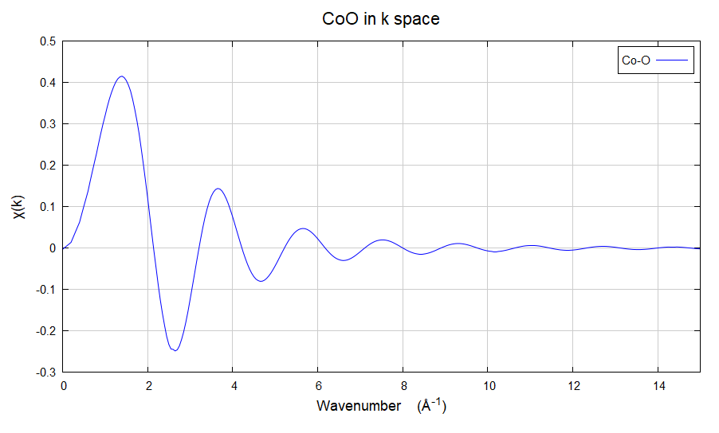
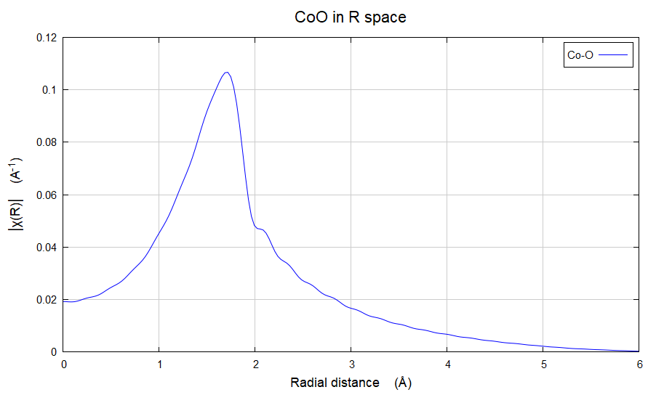
EXAFS equation
$$χ\left(k\right)=3{\left|\hat{η}∙\hat{R}\right|}^{2}\frac{1}{kR^{2}}{\left|f\left(k,π\right)\right|\sin\left(2Rk+Φ(k)\right)}^{ }$$
Polarization
$χ\left(k\right) o$scillates with
Frequency = 2 R
Simplifies to 1 in the following
if anysotropy can be neglected
Spherical wave

Slide 6
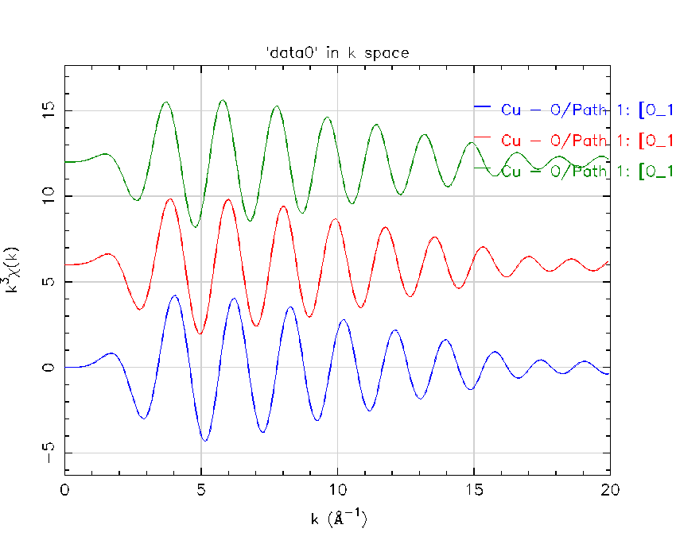
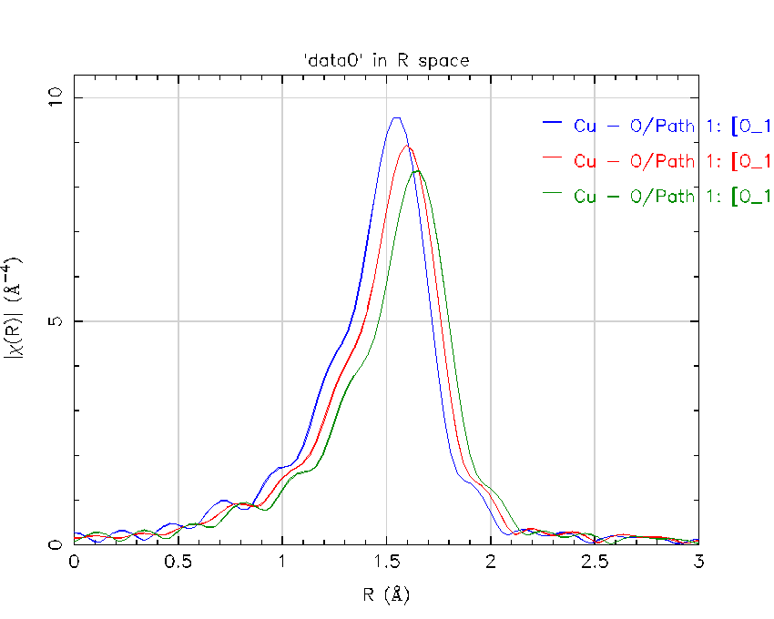
$$kχ\left(k\right)=\frac{1}{kR^{2}}{\left|f\left(k,π\right)\right|\sin\left(2Rk+Φ(k)\right)}^{ }$$
$χ\left(k\right) o$scillates with
Frequency = 2 R
Spherical wave
Fourier Transform
Cu-O
2.05Å
1.95Å
2.00Å
2.05Å
2.00Å
k³
1.95Å

Slide 7
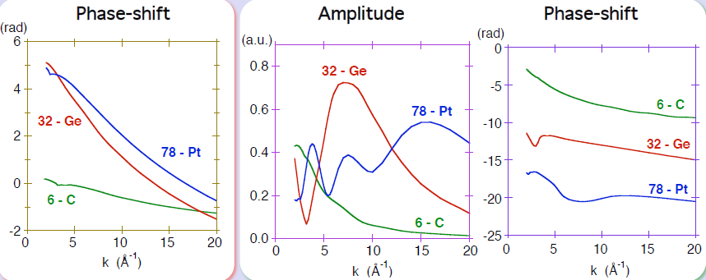
$$kχ\left(k\right)=\frac{1}{R^{2}}{\left|f\left(k,π\right)\right|\sin\left(2Rk+Φ(k)\right)}^{ }$$
Absorbing Atom
Scattering Atom
Potential
R
Different neighbors have different phases
and scattering amplitudes.
Higher Z higher |f| at higher |k| values
Scatterer
Absorber
Abs
Scatt.
R
Nuclei

Slide 8

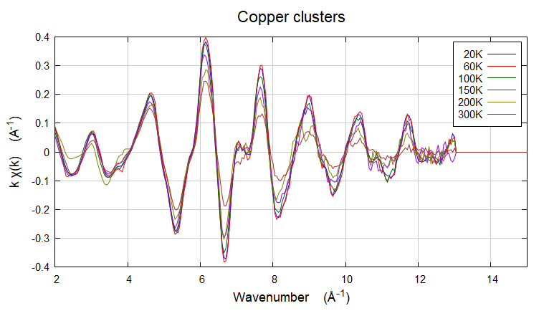
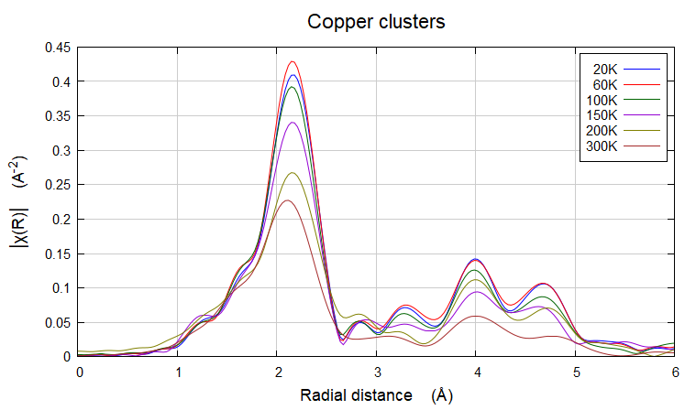
Pair distance distribution :
Picture of thermal motion, EXAFS depends on T
Damping term: « Debye Waller factor like»
$$kχ\left(k\right)=\frac{1}{R^{2}}{\left|f\left(k,π\right)\right|e^{−2{σ^{2}k}^{2}} sin\left(2Rk+Φ(k)\right)}^{ }$$
Temperature effect

Slide 9
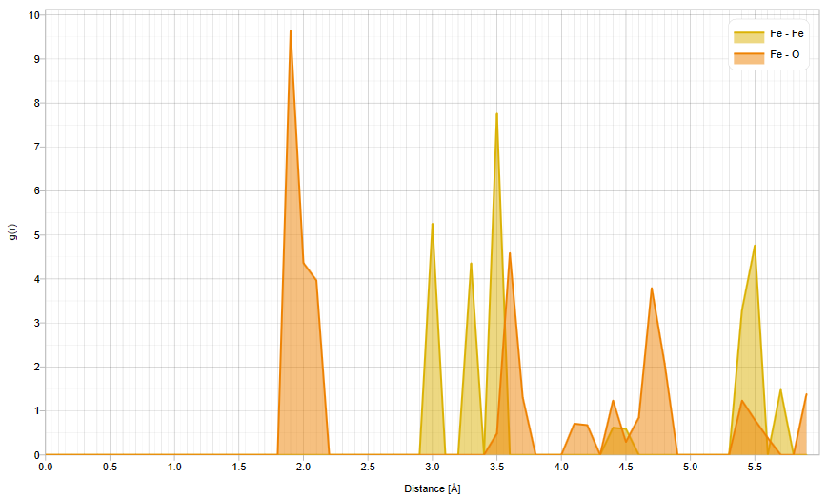
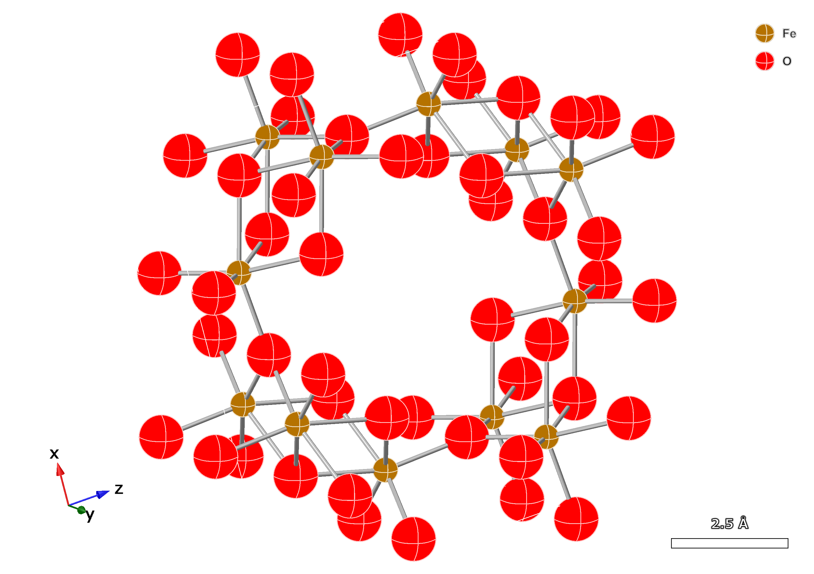
Pair distance distribution :
Picture of thermal motion, EXAFS depends on T
Structural average + structural disorder
Damping term: « Debye Waller factor like»
$$kχ\left(k\right)=\frac{1}{R^{2}}{\left|f\left(k,π\right)\right|e^{−2{σ^{2}k}^{2}} sin\left(2Rk+Φ(k)\right)}^{ }$$
Akaganeite

Slide 10
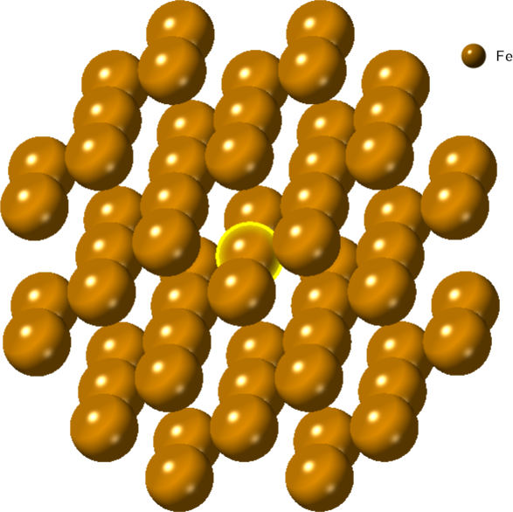
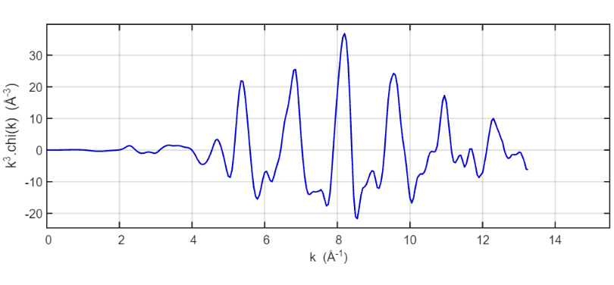
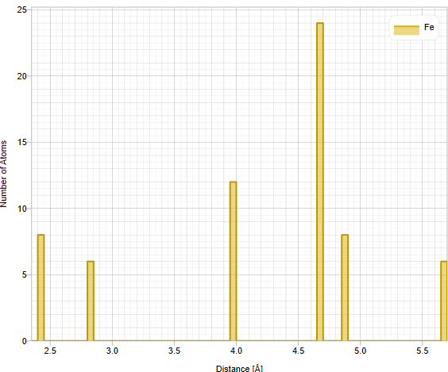
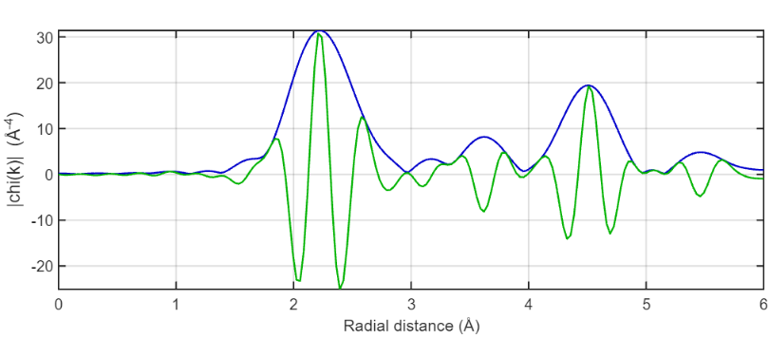
Adding up more atoms
k$χ\left(k\right)=\sum_{i}{3\cos^{2}{(θ_{i})}N_{i}\frac{1}{R_{i}^{2}}{\left|f_{i}\left(k,π\right)\right|e^{−2σ_{i}^{2}k^{2}}sin\left(2R_{i}k+Φ_{i}(k)\right)}^{ }}$
bcc Fe
8 Fe-Fe 2.45 Å
4 Fe-Fe 2.83 Å
12 Fe-Fe 3.97 Å
24 Fe-Fe 4.67 Å

Slide 11
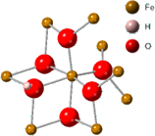
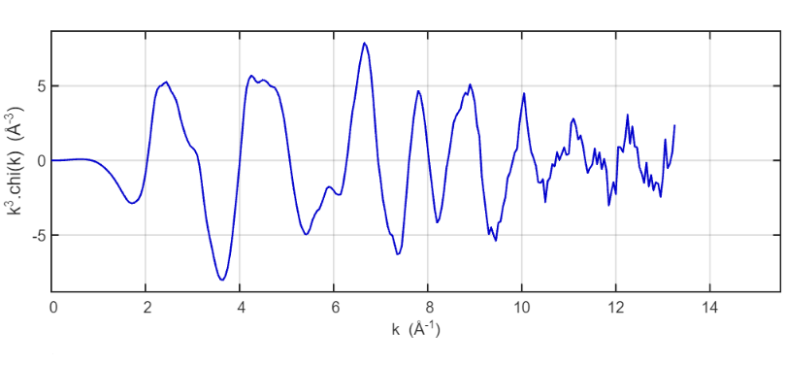
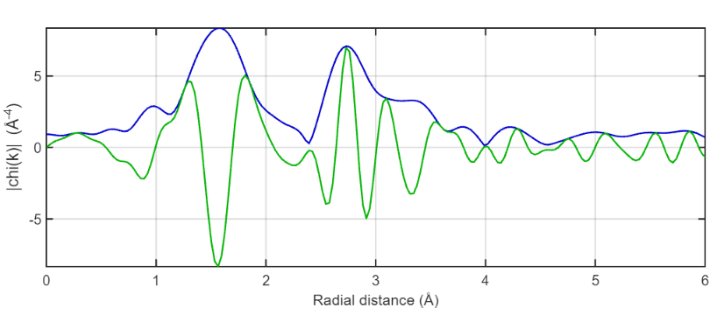
EXAFS examples: Fe bcc vs Fe in Goethite
8 Fe-Fe 2.45 Å
4 Fe-Fe 2.83 Å
12 Fe-Fe 3.97 Å
24 Fe-Fe 4.67 Å
3 Fe-O 1.96 Å
3 Fe-O 2.11 Å
2 Fe-Fe 3.02 Å
1 Fe-O 3.21 Å
2 Fe-Fe 3.31 Å
4 Fe-Fe 3.44 Å
Too high?
FT: a pseudo radial distribution representation

Slide 12
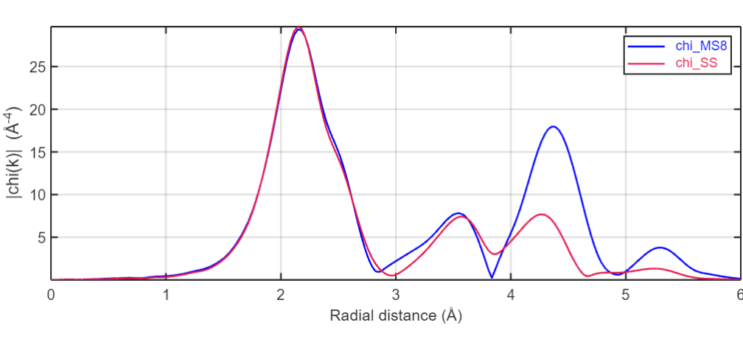
Multiple scattering the bcc-Fe case
8 Fe-Fe 2.45 Å
4 Fe-Fe 2.83 Å
12 Fe-Fe 3.97 Å
24 Fe-Fe 4.67 Å
Several intense MS
paths are possible
In collinear geometry
FEFF 8
calculations
MS
MS requires and provides
Geometrical information
SS

Slide 13
EXAFS take away messages
Information provided by EXAFS and advantages
Interatomic distances
Coordination numbers
Nature of atomic neighbors (for quite different Z)
Disorder/thermal effects via Debye Waller
It can be simulated via direct analytical methods
We can stop simulations to first coordination shell
Beamlines are getting better and better to provide high S/N
Many good simulation codes are freely available
Disadvantages
Signal is weak and thermal/structural disorders reduce it even more
Resolution depends on k space = length of EXAFS
Limited information versus complex structures in many cases

Slide 14
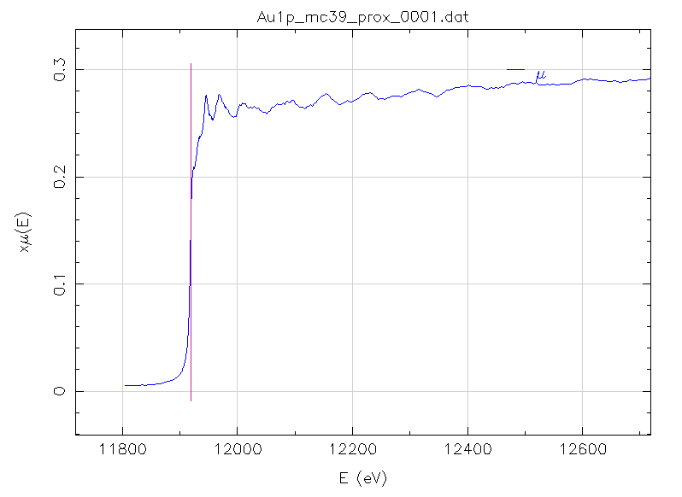
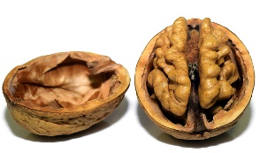
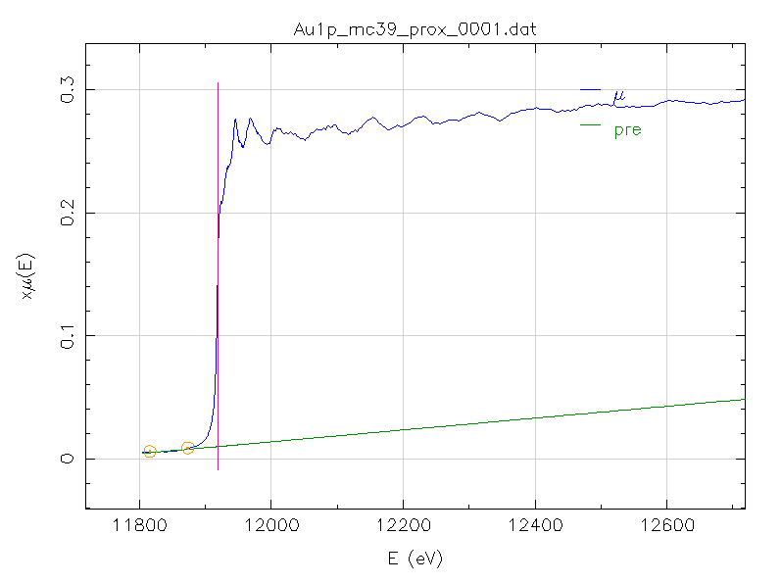
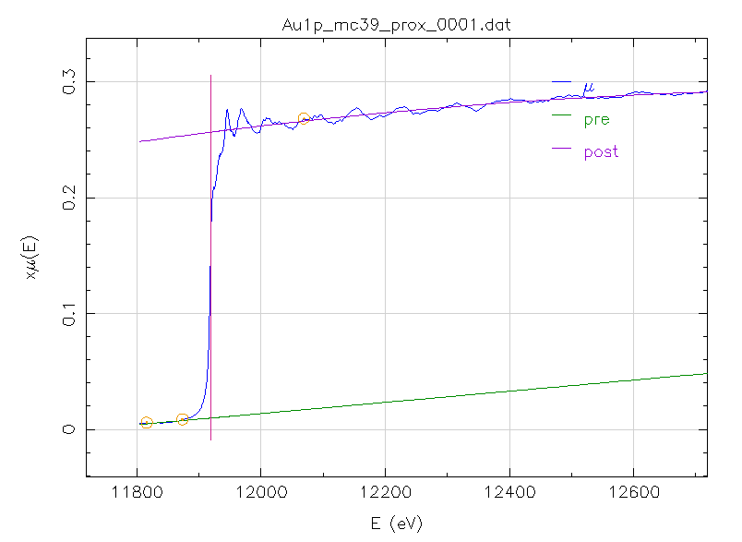
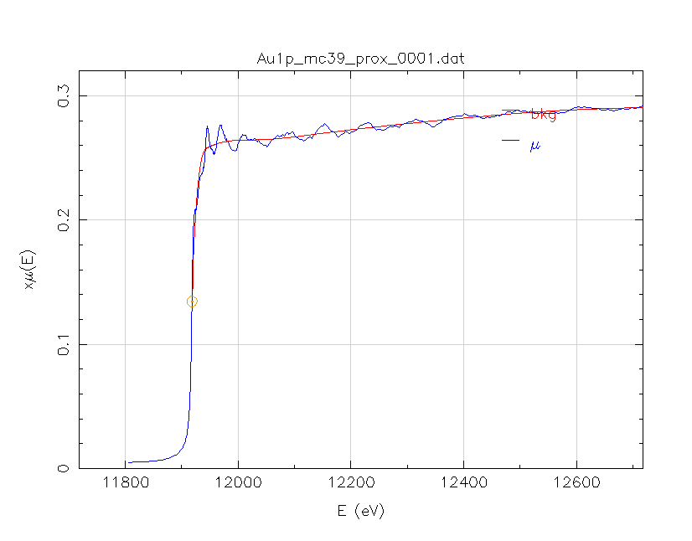
EXAFS data analysis in a nutshell
E₀
1. Define E₀
E₀
2. Extrapolate pre-edge
up to E₀ as a straight line
Δμx(E₀)
3. Extrapolate post edge down to E₀
4. Obtain edge jump at E₀
5. Normalize by jump
5. Fit a spline through
as EXAFS background

Slide 15
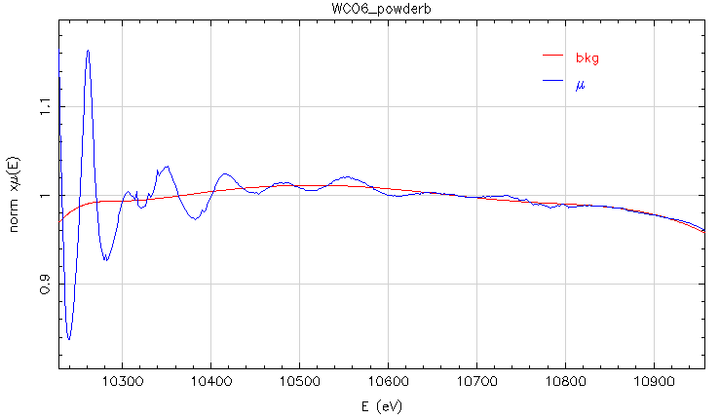
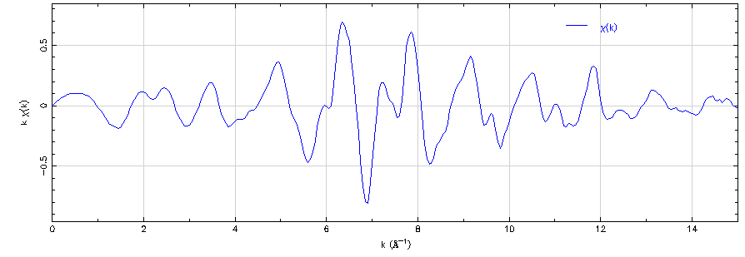
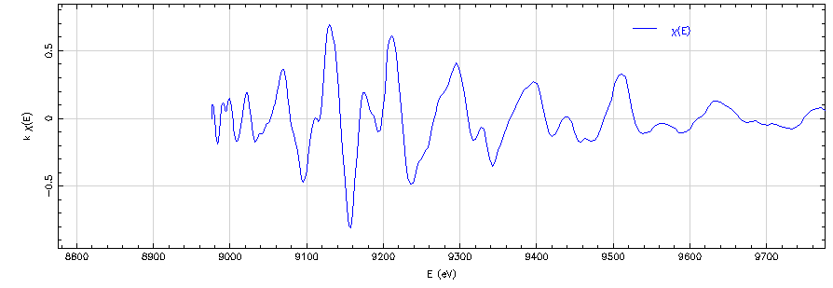
EXAFS data analysis in a nutshell
5. Fit a spline through
as EXAFS background
EXAFS
$$χ\left(k\right)$$
$$k≈\sqrt{0.2625\left(E−E_{0}\right)}$$

Slide 16
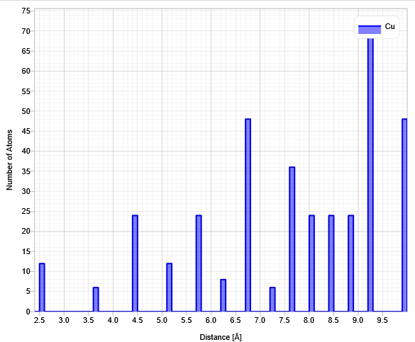
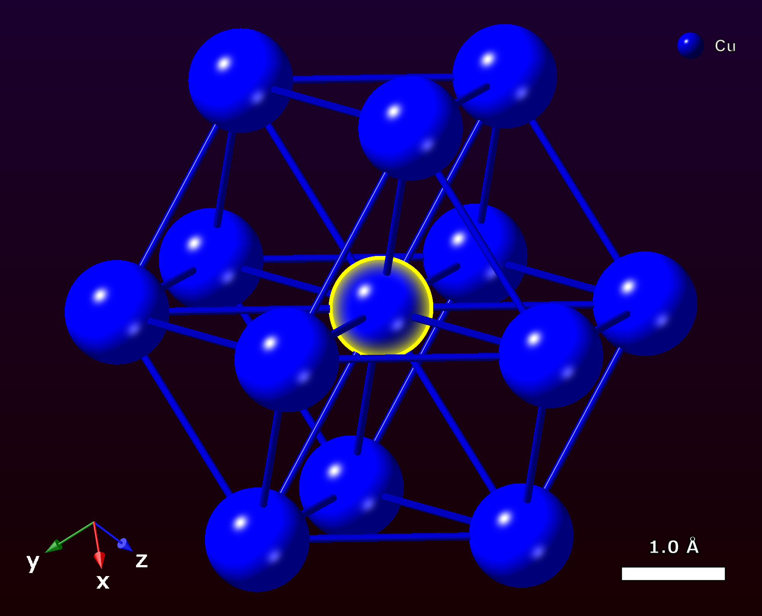
EXAFS data analysis in a nutshell
fcc-Cu
Radial distribution function contains too much information versus EXAFS.

Slide 17
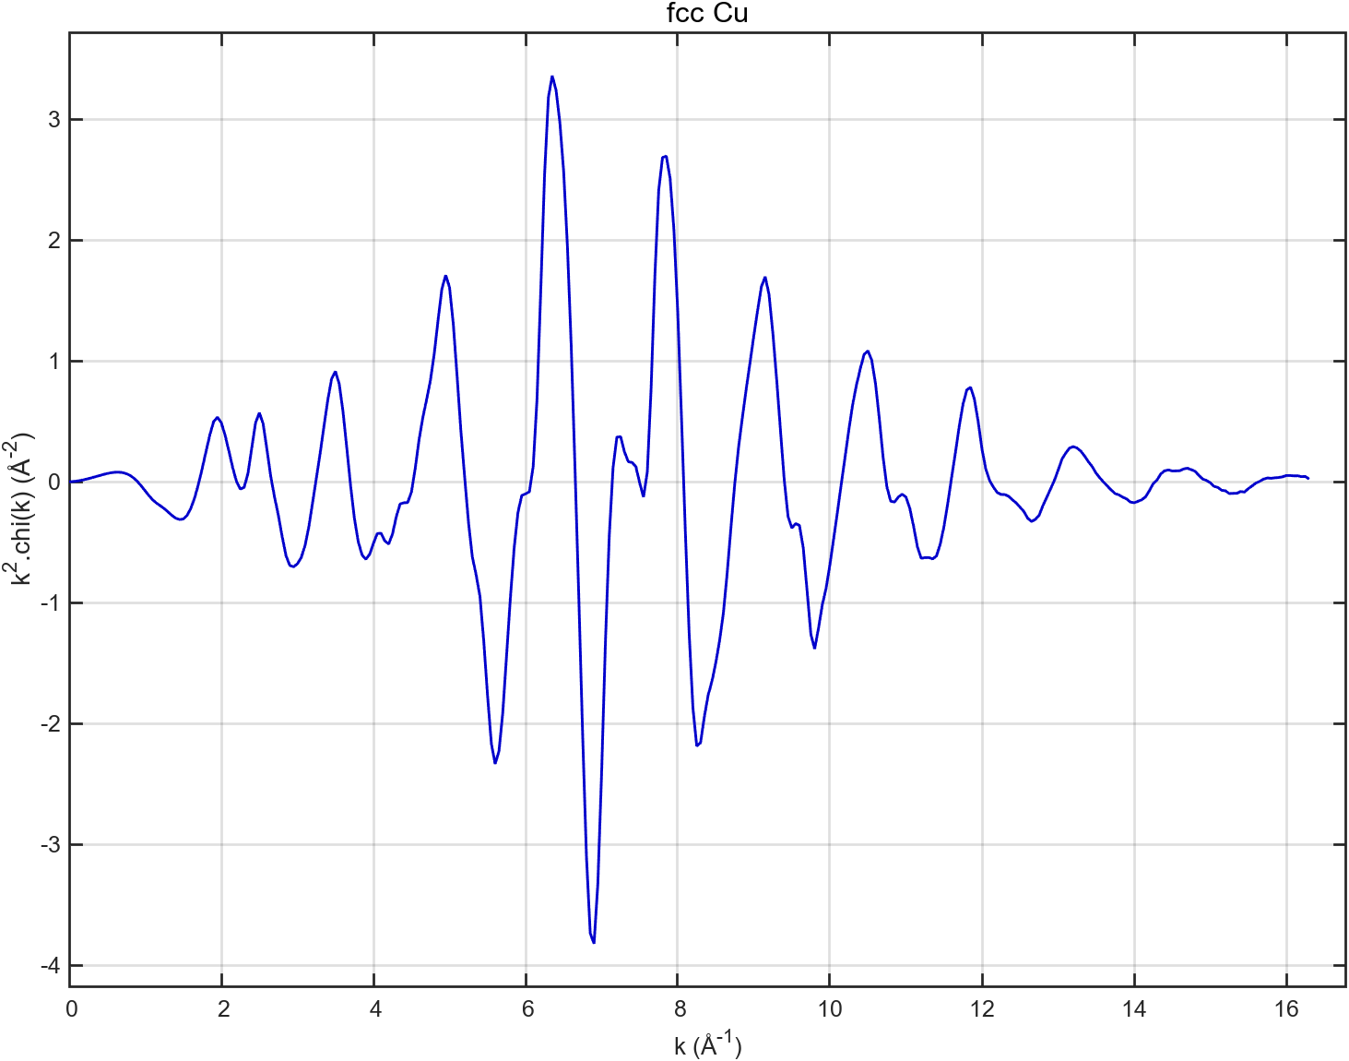
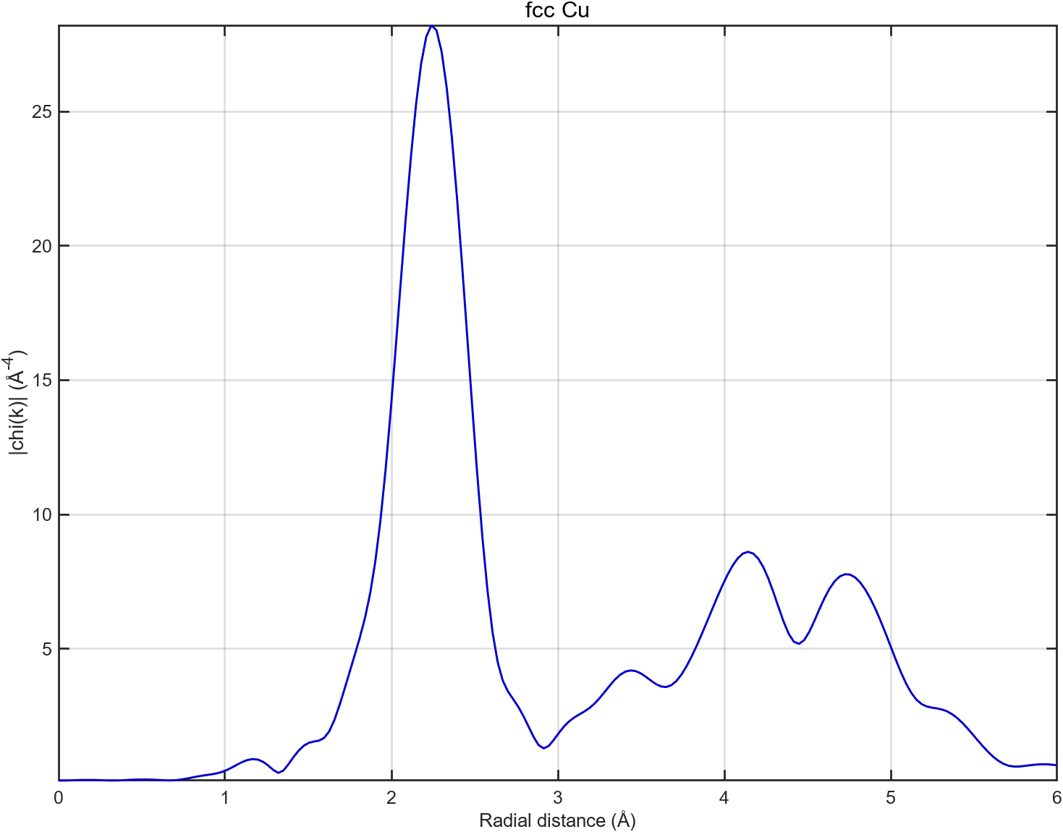
EXAFS data analysis in a nutshell
fcc-Cu
The Fourier transform helps in isolating a narrow set of frequencies, these correspond to limited information.
$$Δk$$
$$ΔR$$
$$N_{idp}=\frac{2ΔkΔR}{π}+\left(2\right)$$
Nyquist Shannon Theorem applied to EXAFS
Simulating the EXAFS signal implies:
Making a structural hypothesis
Fit a number of parameters N_{par}<N_{idp}

Slide 18
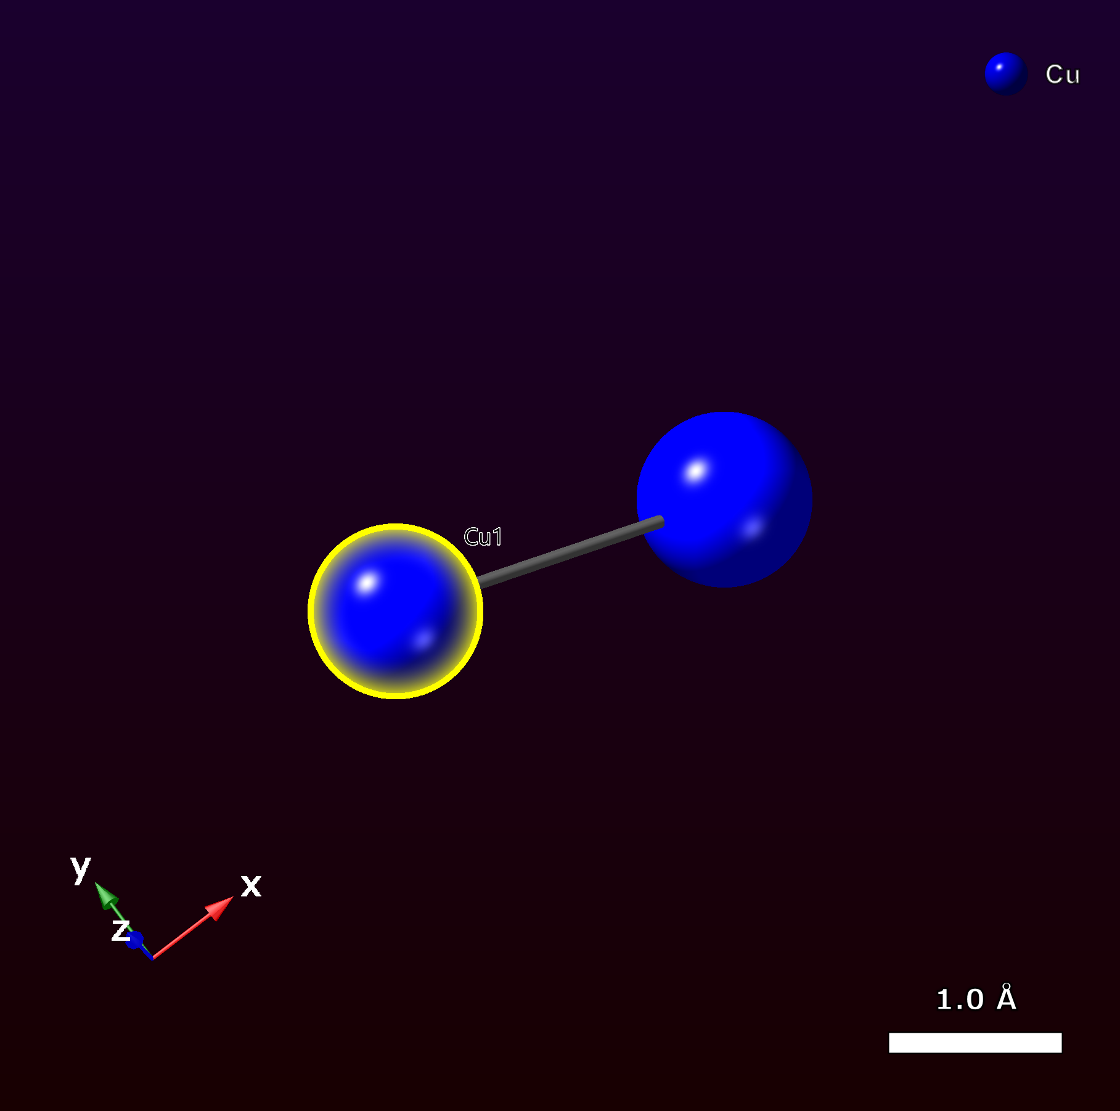
EXAFS data analysis in a nutshell
fcc-Cu
The Fourier transform helps in isolating a narrow set of frequencies, these correspond to limited information.
$$N_{idp}=\frac{2ΔkΔR}{π}+\left(2\right)$$
$$ΔR$$
Very simplified model ☺
Simplified Theoretical Calculation
$$kχ\left(k\right)=N\frac{\left|f\left(k,π\right)\right|}{R^{2}}{e^{−2{σ^{2}k}^{2}} sin\left(2Rk+Φ(k)\right)}^{ }$$
Fitting parameters

Slide 19
EXAFS data analysis in a nutshell
fcc-Cu
The Fourier transform helps in isolating a narrow set of frequencies, these correspond to limited information.
$$N_{idp}=\frac{2ΔkΔR}{π}+\left(2\right)$$
$$ΔR$$
Very simplified model ☺
Simplified Theoretical Calculation
$$kχ\left(k\right)=N\frac{\left|f\left(k,π\right)\right|}{R^{2}}{e^{−2{σ^{2}k}^{2}} sin\left(2Rk+Φ(k)\right)}^{ }$$
Fitting parameters

Slide 20
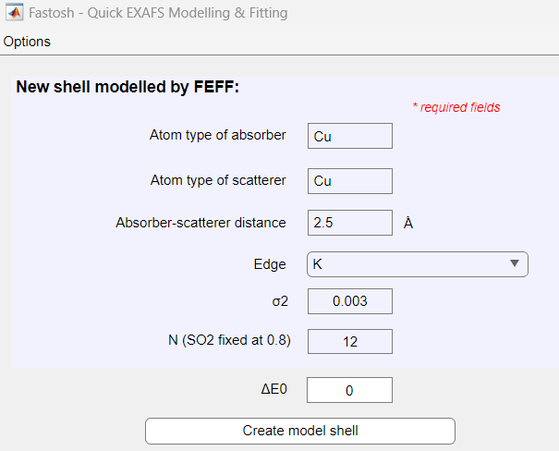
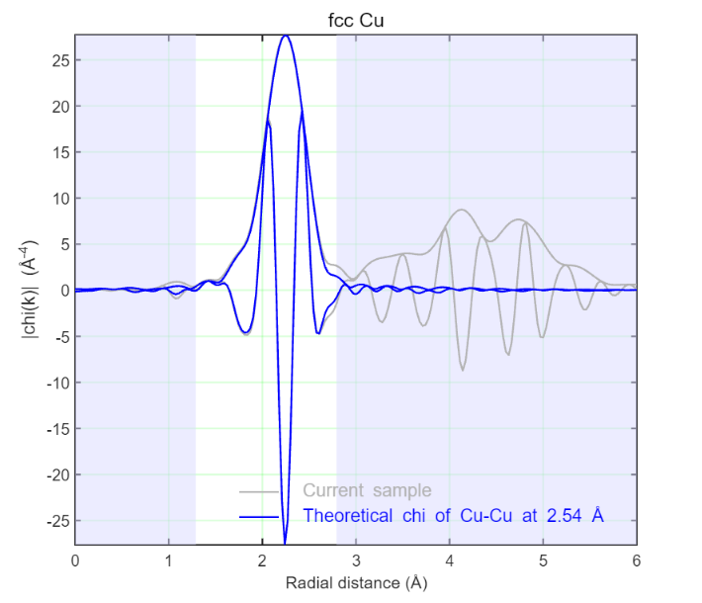
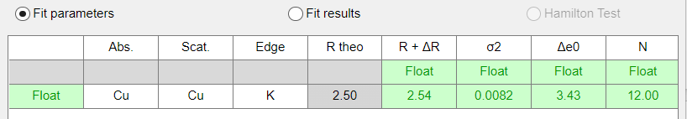
EXAFS data analysis in a nutshell
A two step procedure to model signal:
Create model
$$kχ\left(k\right)=N\frac{\left|f\left(k,π\right)\right|}{R^{2}}{e^{−2{σ^{2}k}^{2}} sin\left(2Rk+Φ(k)\right)}^{ }$$
Model creation
Get your simulation over the first shell range
Variate parameters to fit experiment

