Slide 1

Inflation and its components
Prof. PhD Stefania Rossi
Deams, University of Trieste

Slide 2
01
What causes inflation?
What causes inflation?
Inflation can be caused by multiple factors with demand-pull and cost-push inflation among the most common. The following are the major causes of inflation:
1. Demand-pull inflation
It occurs when demand exceeds supply. Upward pressure on prices occurs, causing inflation.
2. Cost-push inflation
It the increase of prices when the cost of wages and materials (intermediate goods) goes up.
These costs are often passed on to consumers in the form of higher prices for those goods and services. For example if the price of wheat increases it causes an increase in the price of bread, pasta, etc.

Slide 3
01
What causes inflation?
3. Increased money supply
It occurs if the money supply increases faster than the gdp growth rate (see the quantity theory of money).
4. Devaluation
Exchange rate devaluation implies a lower value of a country's currency. Devaluation makes a country's exports cheaper, and imports more expensive.
5. Policies and regulations
Some policies can cause cost-push or demand-pull inflation. If the government fiscally subsidizes some products and/services, it can increase demand for them. In this case if demand exceeds supply, costs may rise. Other example: strict building codes could increase construction costs and thus create inflation.
6. changes in price expectations

Slide 4
01
Causes of inflation in 2021/22
The causes of inflation in 2021/22 are a bit more complex and have been caused
in part because of the government's response to the pandemic, in addition to:
sudden increases in demand as coronavirus lockdown restrictions faded
bottlenecks in sectors affected by the pandemic, supply-chains disruptions and higher energy prices.
Recent energy and food price surges, in the wake of Russia’s invasion of Ukraine, have
exacerbated inflation pressures that are unusually high by the standards of the past two
decades.
This combination of unprecedented factors has led to concern about the possibility of persistently
high inflation.

Slide 5

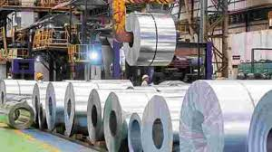
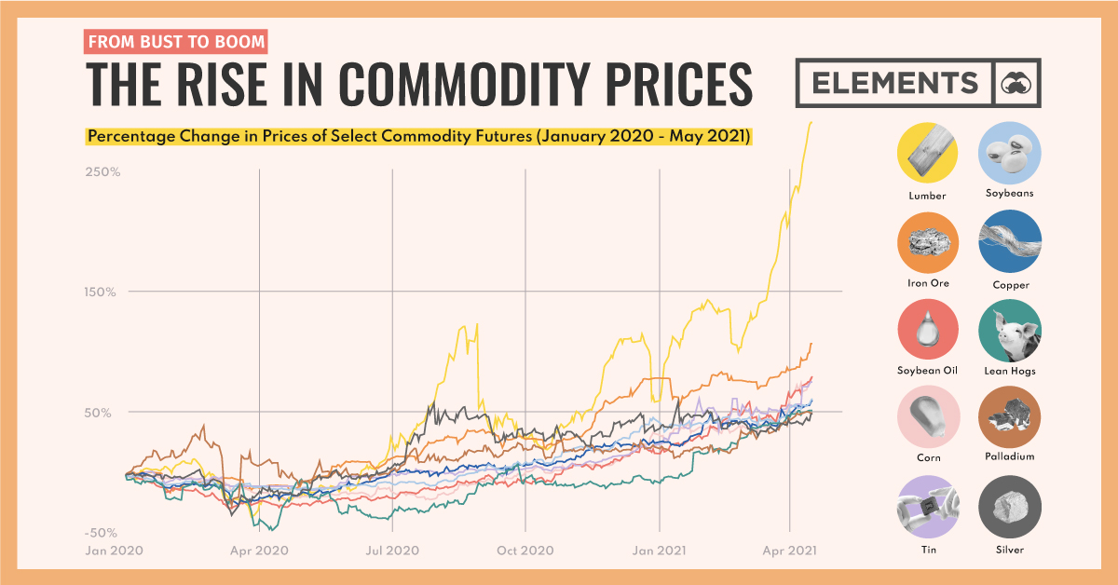
01
Causes of inflation in 2021/22
Path of Inflation 2021/22
Since the beginning of 2021, headline consumer price index (CPI) inflation has increased in advanced and
emerging market economies, driven by
firming demand,
input shortages,
rapidly rising commodity prices.

Slide 6
01
Causes of inflation in 2021/22
Path of Inflation 2021/22
The main impact of the war between Russia and Ukraine on global inflation is due to higher commodity prices and more persistent supply chain disruptions.
Russia and Ukraine are major exporters of many commodities—oil, natural gas, wheat, palladium, nickel, and seed oils.
Supply shortages, withdrawals of foreign firms from Russia, and shipping disruptions will add to price increases in the commodity markets, on top of the sharp price rises since mid-2020.

Slide 7
01
Causes if inflation in 2021/22
Harmonised Index of Consumer Prices (HICP)

Slide 8
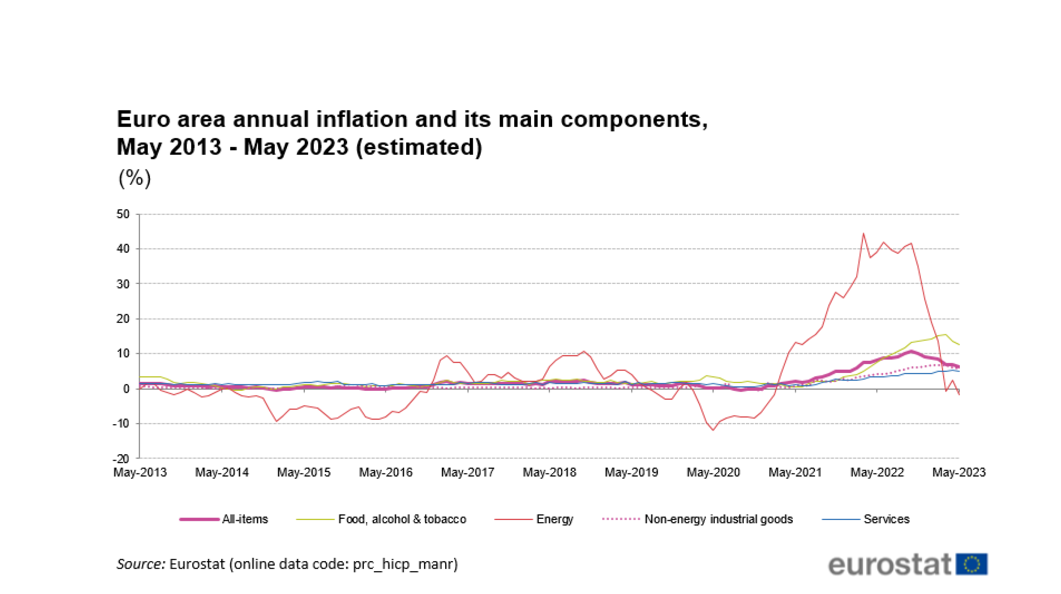

Slide 9
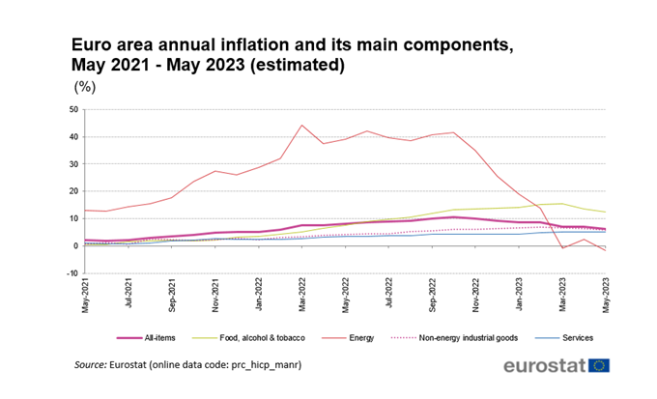

Slide 10
01
Concern about inflation
Concern about inflation
From a macroeconomic perspective, a sustained rise in inflation in advanced economies leading to an
unanticipated withdrawal of monetary accommodation could disrupt financial markets.
High inflation would also tend to hurt those who rely primarily on labor income (generally lower-income individuals) but could also benefit debtors while hurting lenders.
Inflation can, therefore, have complex distributional consequences.

Slide 11
01
Concern about inflation
Concern about inflation
Different pattern of inflation from past global recessions. The global recession of 2020 was unique in that it was caused by deliberate policies closing down economic activities to slow the spread of the COVID-19 pandemic.
It also led to a sharply different inflation pattern from the previous global recessions.
During recession episodes over the past five decades prior to the pandemic, global inflation fell steeply.
Recent energy and food price surges, in the wake of Russia’s invasion of Ukraine, have exacerbated inflation pressures that are unusually high by the standards of the past two decades (Ha et al., 2022).

Slide 12
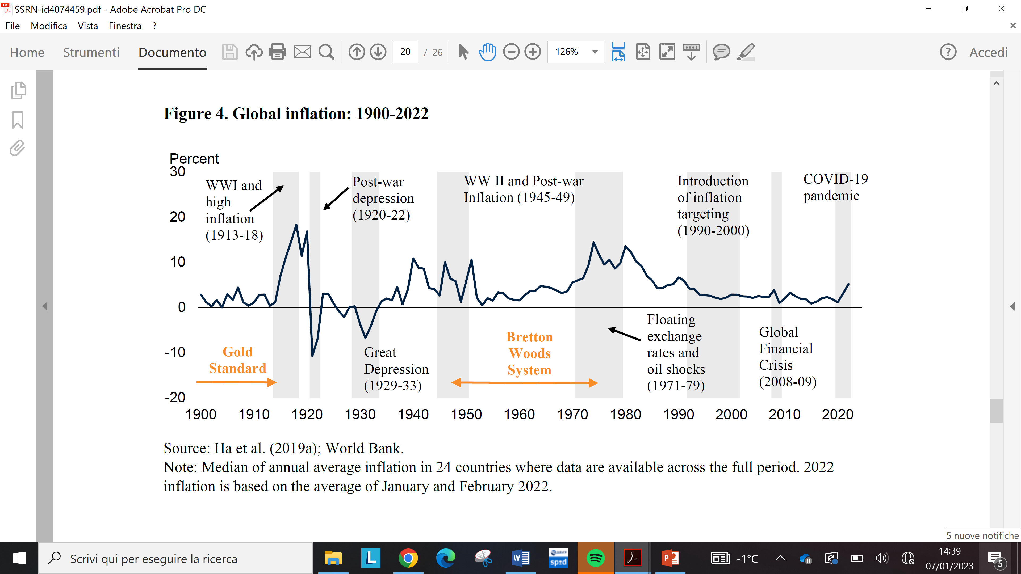
01
Concern about inflation
Global inflation 1900-2022

Slide 13
01
Concern about inflation
References
Bonatti, L., & Tamborini, R. (2022). HIGH INFLATION: IS IT THE NEW CHALLENGE FOR THE MAIN CENTRAL BANKS?. Rivista internazionale di scienze sociali, (1), 3-28.
Ha, J., M. A. Kose and F. Ohnsorge (2022), From Low to High Inflation: Implications for Emerging Market and Developing Economies, CAMA Working Paper 29/2022 April 2022.

