Slide 1
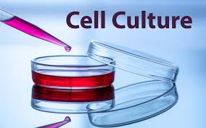
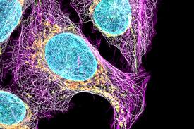
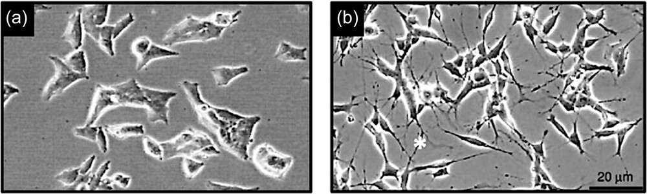
https://microbenotes.com/animal-cell-culture/

Slide 2
Introduction
In vitro cell cultures:
- cells isolated from their environment
- enabled to live within a defined system
- fundamental tool for biochemical, microbiological, pharmacological studies ...
- useful in the production of growth factors, monoclonal antibodies, vaccines, recombinant proteins in general ...

Slide 3
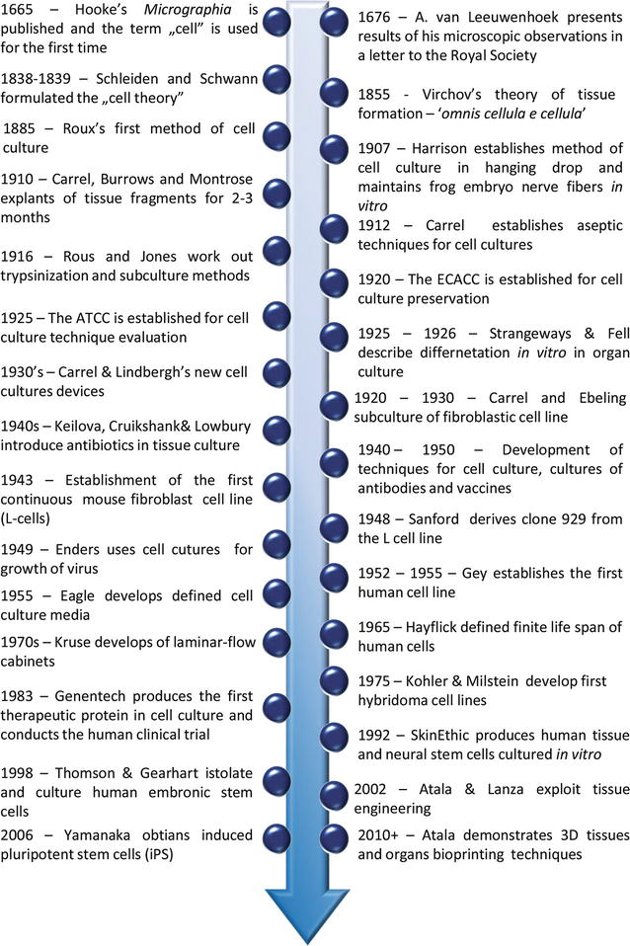

Slide 4
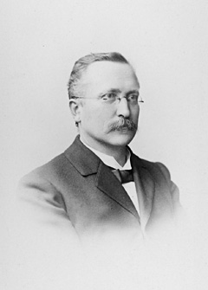
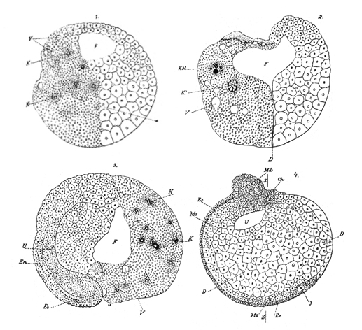
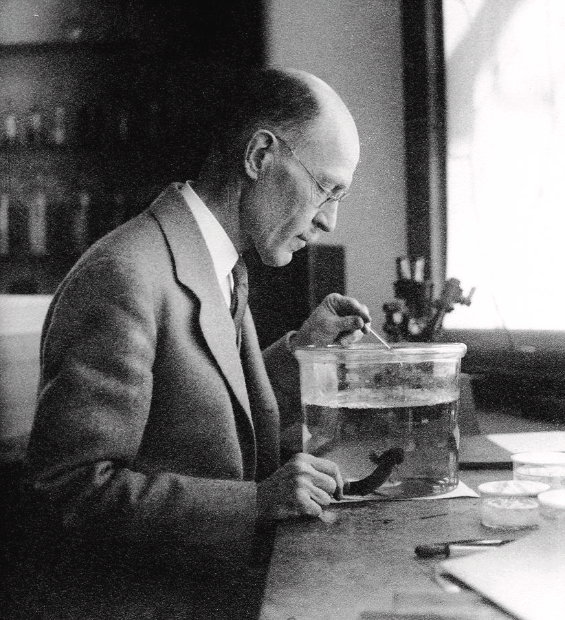
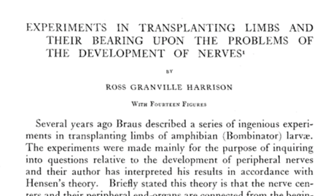
Cell culture is the process by which prokaryotic, eukaryotic or plant cells are grown under controlled conditions.
But in practice it refers to the culturing of cells derived from animal cells.
Roux in 1885 for the first time maintained embryonic chick cells in a cell culture
Cell culture was first successfully undertaken by Ross Harrison in 1907
1940s: The use of the antibiotics penicillin and streptomycin in culture medium decreased the problem of contamination in cell culture.

Slide 5
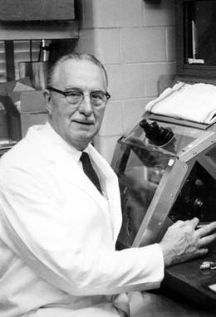
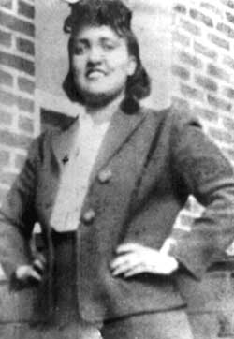
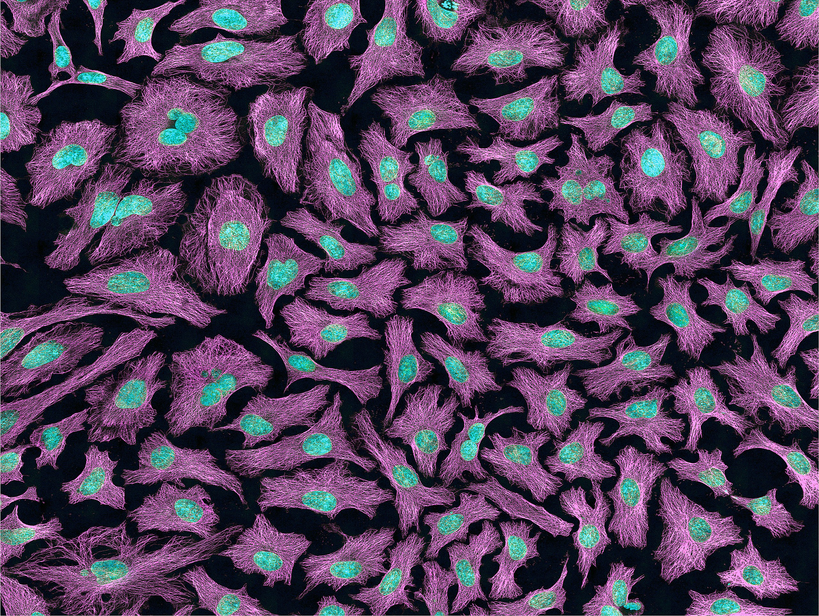
Introduction
1951 Gey established a continuous cell line from a human cervical carcinoma
The patients was Henrietta Lacks.
Cell line is known as HeLa cells
Notes:
Cenni introduttivi
Nel 1952 è stata messa in coltura la prima linea cellulare stabilizzata umana, proveniente da un tumore alla cervice: la linea HeLa. Da allora il contributo delle colture cellulari alla ricerca in campo biomedico è stato estremamente significativo, anche per la varietà dei campi d’applicazione considerabili.
Conoscendo le caratteristiche delle colture è possibile apprezzarne l’aiuto e i vantaggi offerti (ad esempio studi di tossicità sulla nostra specie, per la quale in vivo esistono evidenti problemi), limitando gli inconvenienti degli svantaggi, derivanti in parte dall’attuale stato delle tecnologie a disposizione, in parte intrinseche delle colture stesse quindi non superabili (evidentemente l’estrema semplificazione sperimentale rispetto ad un organismo pluricellulare complesso).

Slide 6
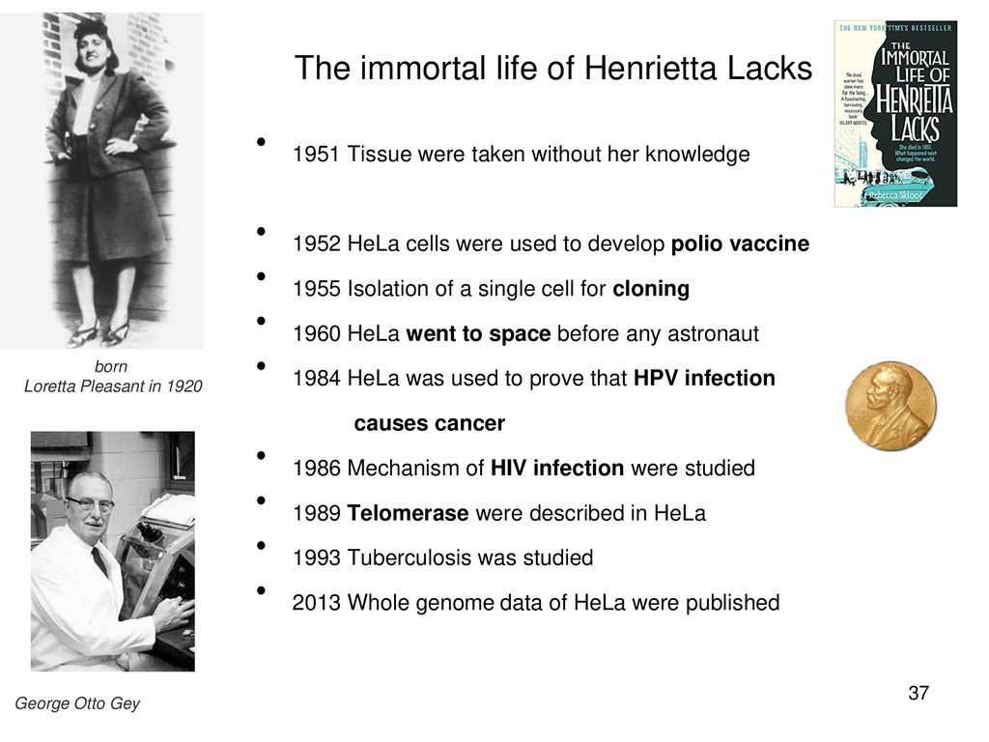

Slide 7
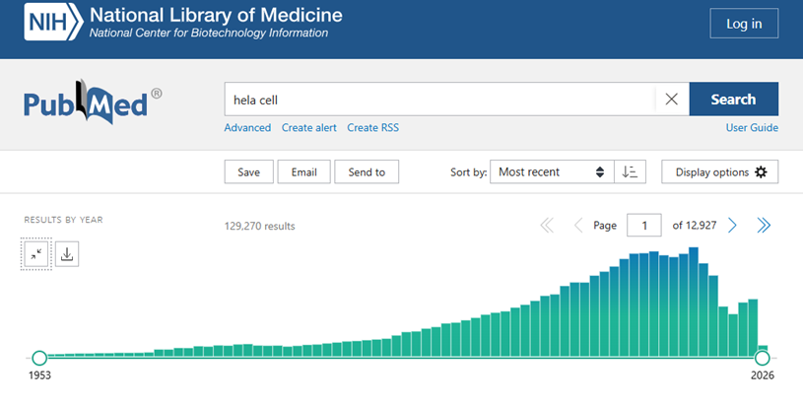

Slide 8
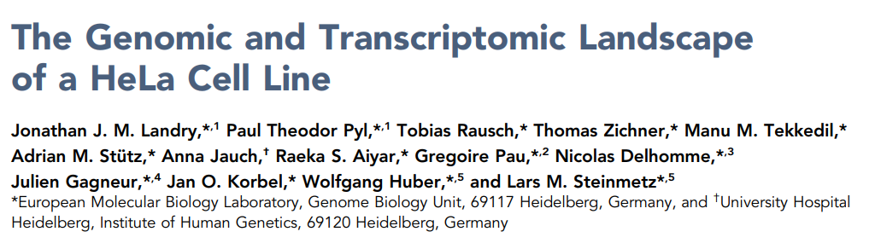
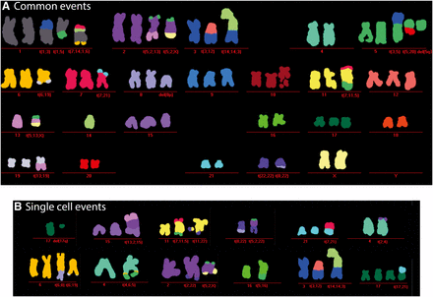

Slide 9
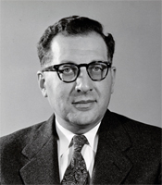
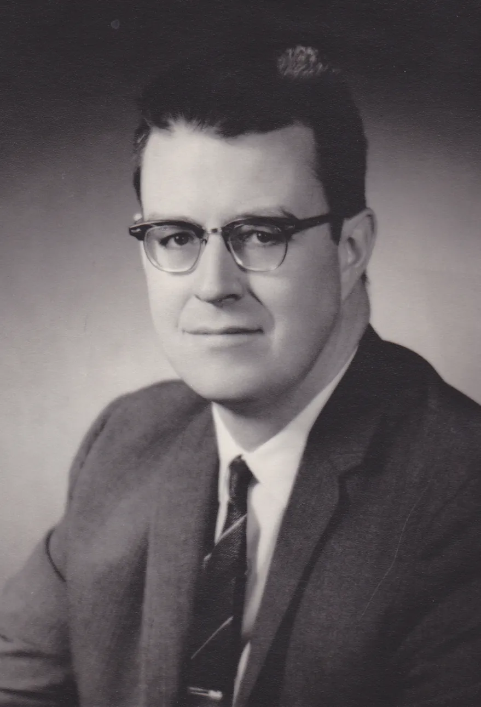
1955: Eagle studied the nutrient requirements of selected cells in culture and established the first widely used chemically defined medium.
1964: Littlefield introduced the HAT medium for cell selection.
1965: Ham introduced the first serum-free medium which was able to support the growth of some cells.

Slide 10
Major development’s in cell culture technology
First
the use of antibiotics which inhibits the growth of contaminants.
Second
the use of trypsin to remove adherent cells to subculture further from the culture vessel
Third
the use of chemically defined culture medium.

Slide 11
Cell culture
Bacteria
Yeast (lower eukaryotic)
Plant cell Cultures
Primary cultures of animal cells
Cell lines
In Suspension
Adherents

Slide 12
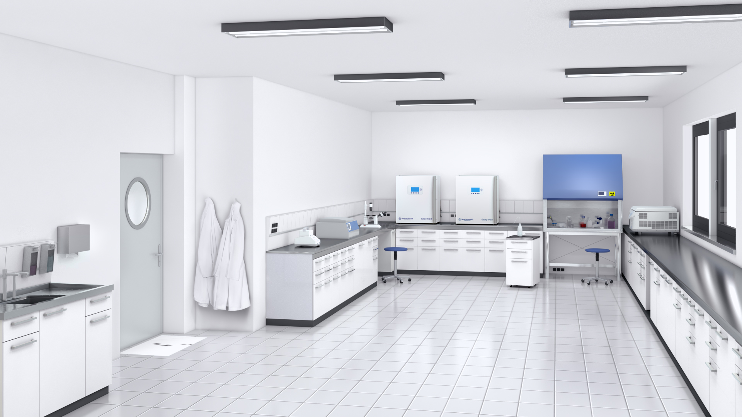
CELL CULTURE LABORATORY

Slide 13
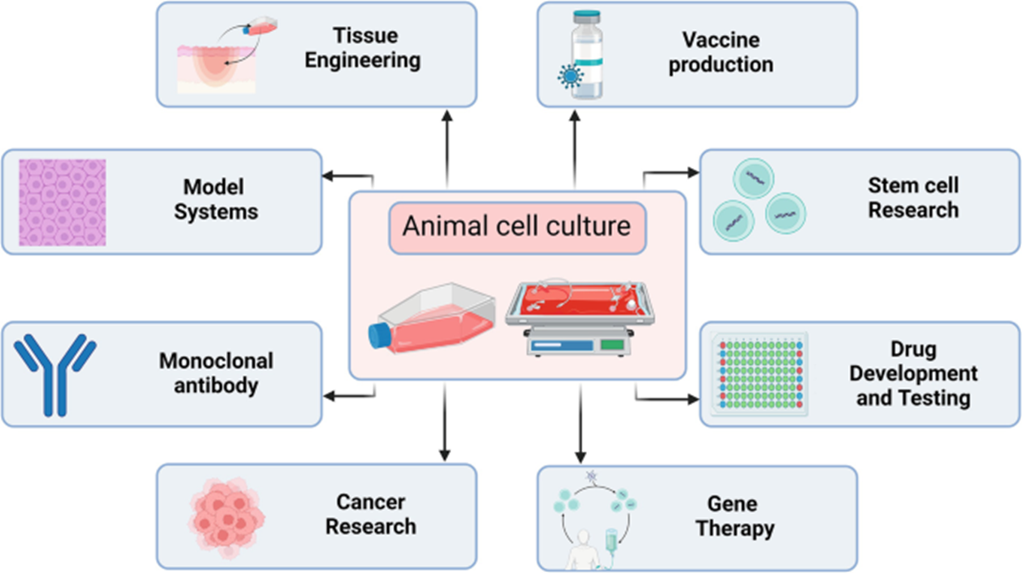
Cell cultures last longer and allow a variety of studies that are not possible with tissues.
-the study of cellular differentiation (cell cycle)
- pathological studies;
- experimental models in biochemistry, pharmacology, physiology;
- genetic manipulation;
- biotechnological applications

Slide 14
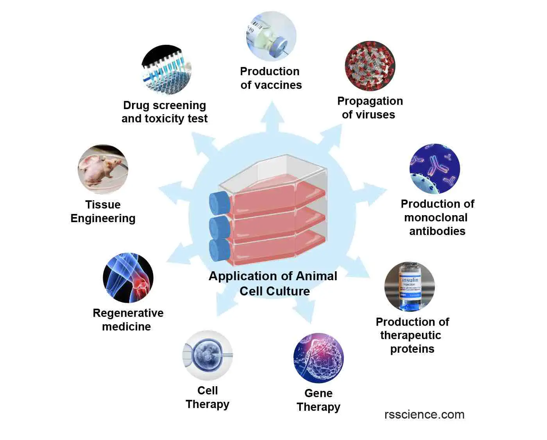
Application of Animal cell culture

Slide 15
Advantages in cell cultures
Commercial availability of media, factors, etc.
Documentation on insulation/preservation
Control of environmental variables (T, PH...)
Wide availability of cell types
Simplicity in replicating experiments
Possibility of sizing experiments with biotechnological purposes
Reduction in the number of animals killed

Slide 16
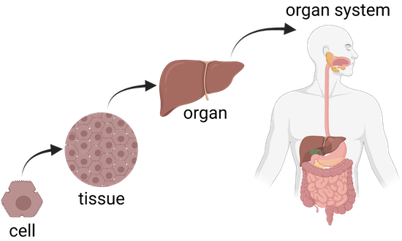
Disadvantages in cell cultures
Cost of materials required (eg, serum, growth factors...)
Very specialized and laborious methods
Simplified systems compared to an integrated body
Difficulty in correlating in vitro concentrations with those in vivo

Slide 17
Tipi di colture cellulari
Colture in monostrato/ in sospensione: le cellule tendono ad aderire alla superficie del recipiente di coltura; moltiplicandosi formano un monostrato, in quanto risentono dell’inibizione da contatto. Cellule trasformate possono formare pluristrati.
Colture a breve/lungo termine: nel primo caso il numero di cicli cui vanno incontro le cellule è ridotto; in colture a lungo termine le cellule si dividono molte volte, o addirittura illimitatamente (linee cellulari stabilizzate)
Colture clonali: le cellule vengono diluite prima della “semina” in modo da avere ogni cellula separata, che prolifera formando una singola colonia (clone).
Notes:
Le colture cellulari possono essere classificate secondo diversi parametri:
§ Colture a breve/lungo termine: nel primo caso il numero di cicli cellulari cui vanno incontro le cellule è ridotto, mentre per le colture a lungo termine le cellule si dividono molte volte, o addirittura illimitatamente nel caso delle linee cellulari stabilizzate.
§ Colture in monostrato/colture in sospensione: generalmente le cellule quando crescono tendono ad aderire alla superficie del recipiente di coltura, e questa adesione è richiesta come segnale di sopravvivenza. Moltiplicandosi le cellule formano uno monostrato, in quanto risentono dell’inibizione da contatto. Questo non vale per le cellule trasformate che possono formare anche colture pluristratificate. Le colture in sospensione contengono cellule che possono proliferare senza una superficie di adesione. Questa capacità è un indice di tumorigenicità, e può essere usata in vitro come test per riconoscere sostanze cancerogene. Va ricordato che il processo di formazione di un tumore, in vivo, è a stadi, e richiede una serie di mutazioni. Cellule che in vitro sono in grado di replicarsi indefinitamente sono senza dubbio mutate in alcuni geni (trasformate), ma non necessariamente possono produrre un tumore se impiantate in vivo, in quanto richiederebbero in tal caso alcune mutazioni non richieste per la proliferazione in vitro (es: neoangiogenesi, capacità di far crescere capillari per ottenere nutrimento, invasività…). Dato che le colture in sospensione sfruttano meglio il terreno sono indicate quando servano quantità di cellule massicce. Per ottenere tale sfruttamento anche con cellule che richiedono adesione alla superficie si possono usare i microcarriers, piccole sferette di materiale plastico (ø 100-200 μm), cui le cellule crescono come fossero in monostrato, ma a densità analoghe delle colture in sospensione.
§ Colture clonali: in questi tipi di coltura le cellule vengono diluite prima della semina in modo tale da avere ogni cellula separata dalle altre, che prolifera formando una colonia singola.
§ Co-colture: in questo caso si coltivano nello stesso recipiente cellule di tipo diverso, per permettere di ricostruire un semplice sistema tissutale.

Slide 18
Monolayer / suspension cultures:
Cells tend to adhere to the surface of the culture vessel; as they multiply, they form a monolayer, as they are sensitive to contact inhibition. Transformed cells can form multilayers.
Short-term / long-term cultures:
In the first case, the number of cycles the cells undergo is limited; in long-term cultures, cells divide many times, or even indefinitely (established cell lines).

Slide 19
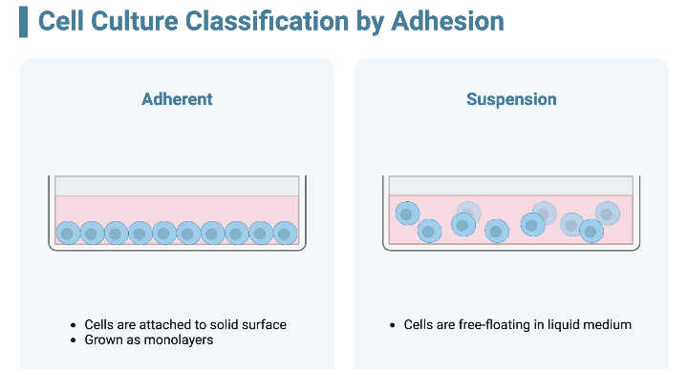
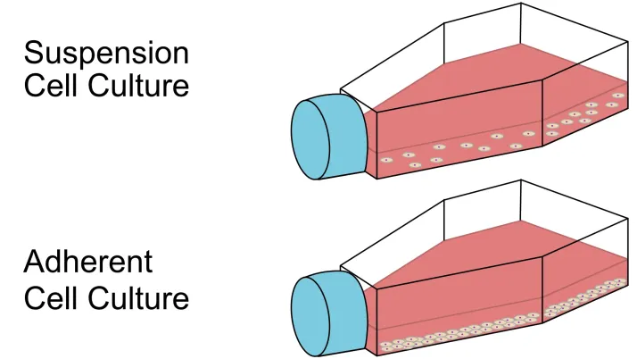
Culturing of cells
Cells are cultured as anchorage dependent or independent
Cell lines derived from normal tissues are considered as anchorage-dependent grows only on a suitable substrate e.g. tissue cells
Suspension cells are anchorage-independent e.g. blood cells
Transformed cell lines either grows as monolayer or as suspension

Slide 20
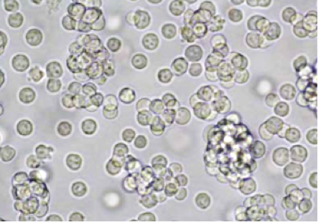
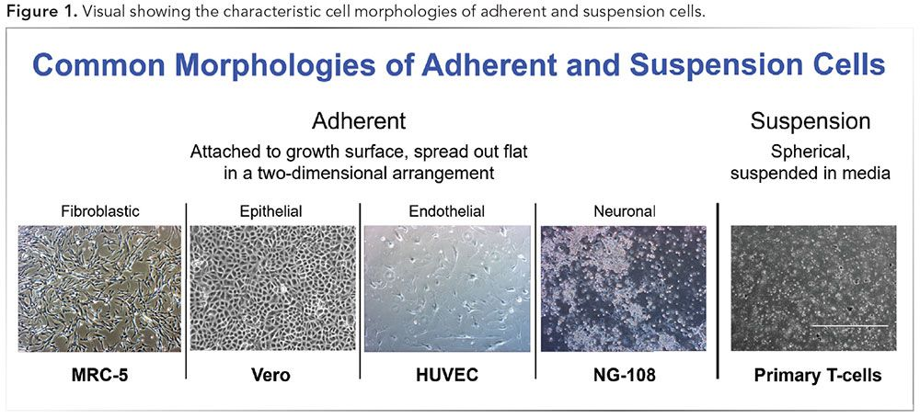
Cells that are part of solid tissues grow in vitro adhering to the surface of the culture plates.
The cells of haematopoietic origin, which normally grow in fluid medium, grow in suspension and multiply in vitro without adhering.
Confluent cells in monolayer L929 mouse fibroblast cells.

Slide 21
Monolayer / suspension cultures:
Cells tend to adhere to the surface of the culture vessel; as they multiply, they form a monolayer, as they are sensitive to contact inhibition. Transformed cells can form multilayers.
Short-term / long-term cultures:
In the first case, the number of cycles the cells undergo is limited; in long-term cultures, cells divide many times, or even indefinitely (established cell lines).

Slide 22
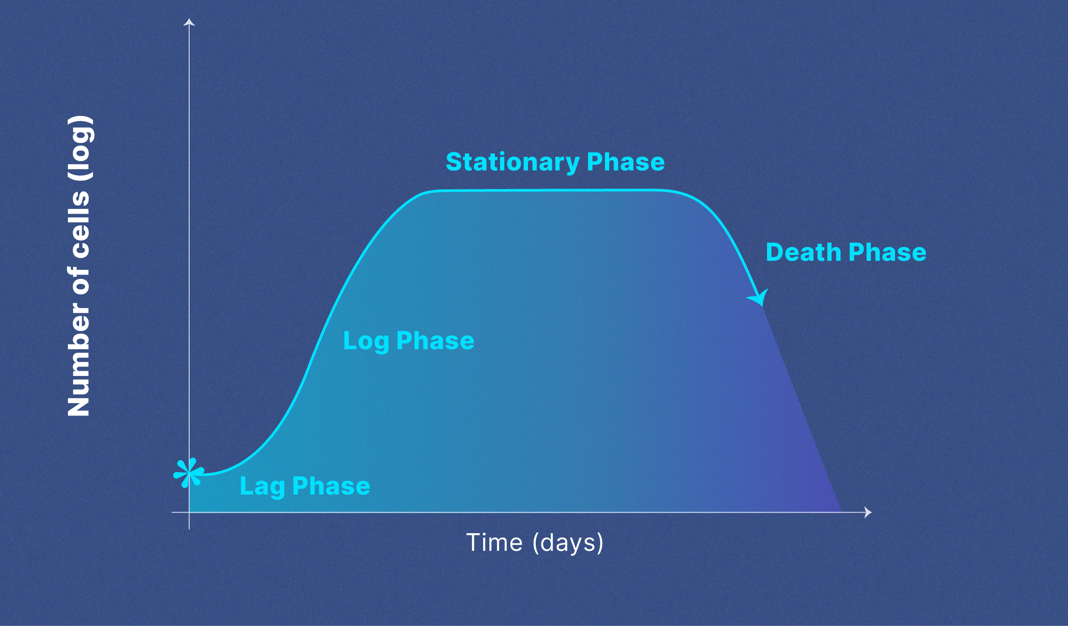
Cell culture growth generally occurs in four phases
Lag phase occurs when cells are acclimatizing to culture conditions and are not dividing.
Log phase occurs when cells are actively dividing. This is the best phase for cell experimentation and data collection.
Cells should be sub-cultured when they reach late log phase.
When cells approach overcrowding, cell growth slows. This is known as stationary phase or plateau phase.
When the natural process of cell death predominates, a cell population is considered to be in death phase
It is important to note that the amount of time spent in each phase differs between individual cell lines and cultures

Slide 23
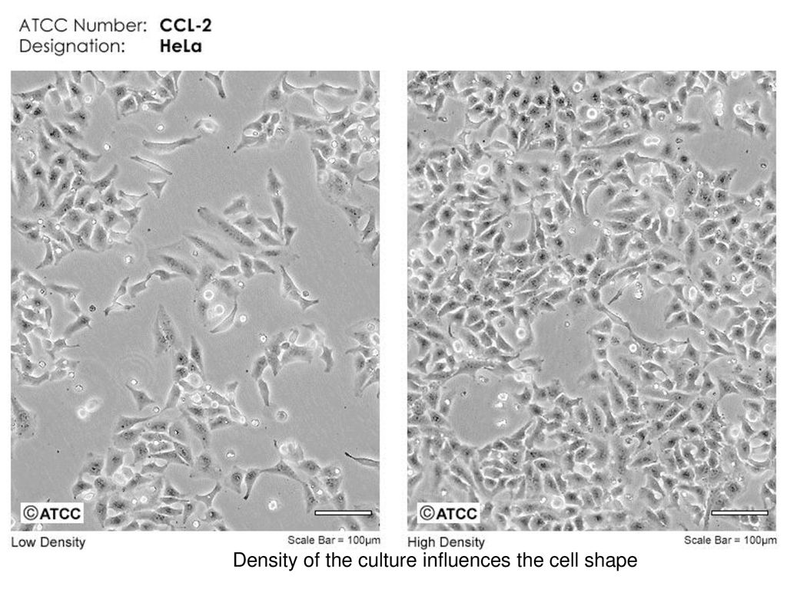
Anchorage dependent cells
At confluence, growth stops, and cells must be detached and transferred to new plates.
This action is called subculturing or passaging the cells.
Growth
Plate cells at correct seeding density
Collect and dilute

Slide 24
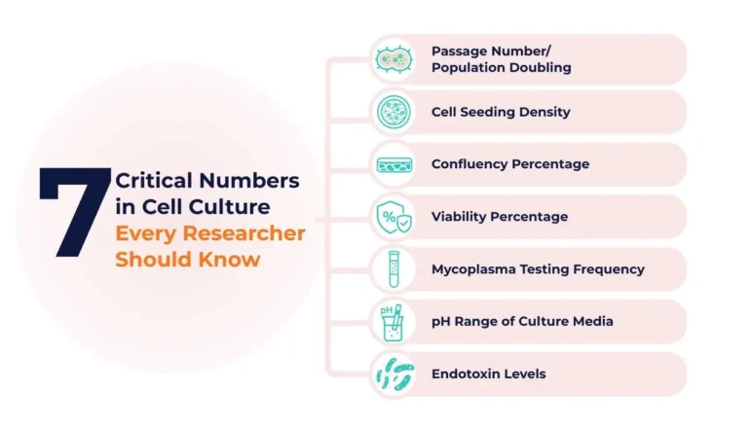
7 Critical Numbers in Cell Culture Every Researcher Should Know
https://www.atlantisbioscience.com/blog/7-critical-numbers-in-cell-culture-every-researcher-should-know/

Slide 25
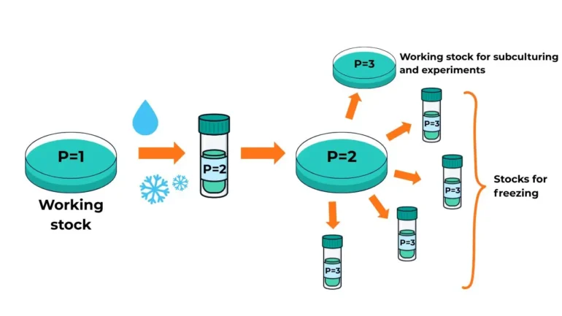
Cell Passaging
Cell passaging or splitting is a technique that enables an individual to keep cells alive and growing under cultured conditions for extended periods of time
What does ‘passage number’ mean?
The passage number of a cell culture is a record of
- the number of times the culture has been subcultured, i.e. harvested and reseeded into multiple ‘daughter’ cell culture flasks.
Although passage number is often treated as a routine metric, it plays a critical role in determining cell quality, performance, and experimental reproducibility. Over time, cells accumulate molecular and epigenetic changes during in vitro culture. These changes can lead to significant shifts in behaviour, such as altered gene expression, slower proliferation, reduced viability, or unwanted differentiation — even when cell morphology remains unchanged.

Slide 26
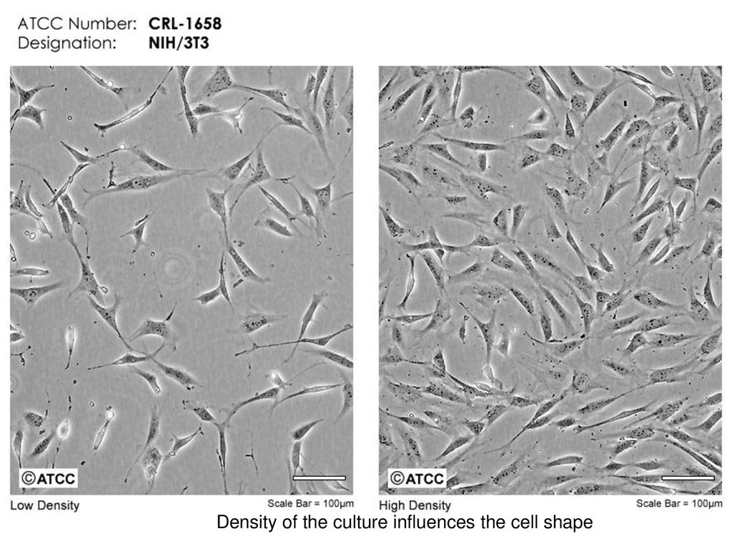
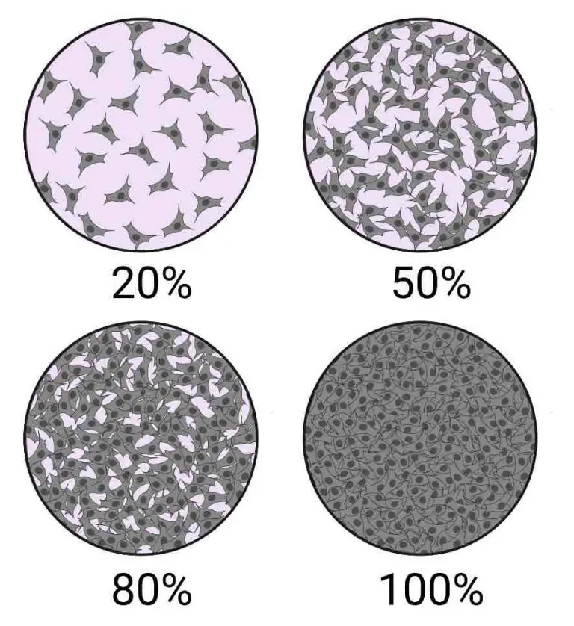
Cellular Confluence
Cellular confluence generally refers to the percentage of the culture vessel inhabited by attached cells.
For example, 100% cellular confluence means the surface area is completely covered by cells, whereas 50% confluence means roughly half of the surface is covered.

Slide 27
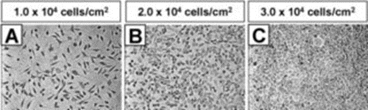
Cell Seeding Density
— the number of cells plated per unit area (for adherent cells) or per unit volume (for suspension cells)
— is a fundamental parameter in cell culture. It directly influences growth rate, morphology, gene expression, and the outcome of downstream assays.
Incorrect seeding can lead to:
Over-confluency, causing contact inhibition, altered signalling, or early senescence
Low density, which can stress cells, delay growth, or alter behaviour
Experimental variability, especially in assays dependent on cell–cell interactions, secreted factors, or differentiation cues

Slide 28
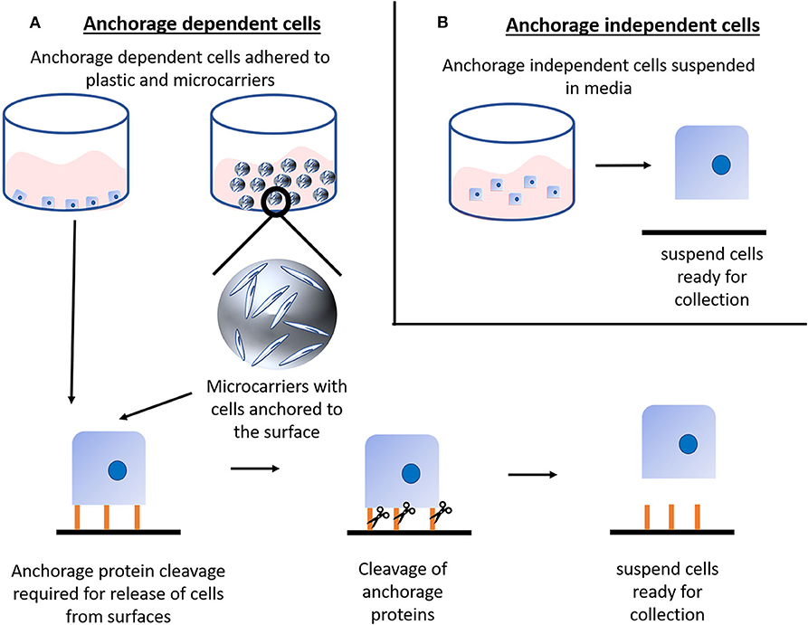

Slide 29
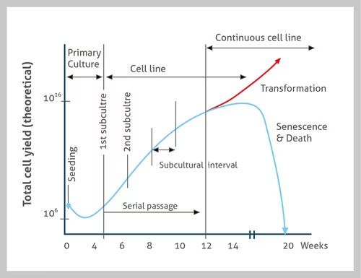
Evolution of a cell culture

Slide 30
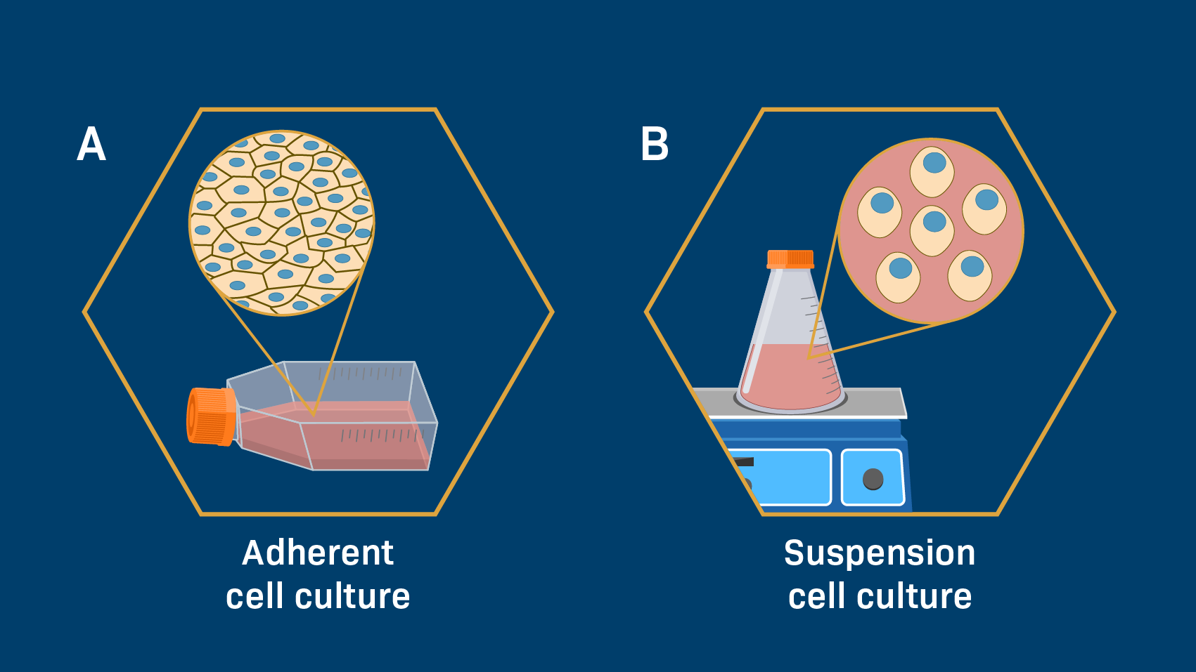
Passing Suspension cells
Aseptically remove 1/3rd of medium
Easier to passage as no need to detach them
As the suspension cells reach to confluency
Replaced with the same amount of pre-warmed medium

Slide 31
Anchorage dependent cells
At confluence, growth stops, and cells must be detached and transferred to new plates.
This action is called subculturing or passaging the cells.
Growth
Plate cells at correct seeding density
Collect and dilute

Slide 32
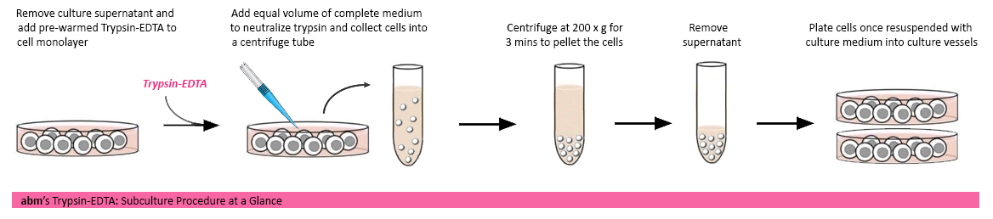
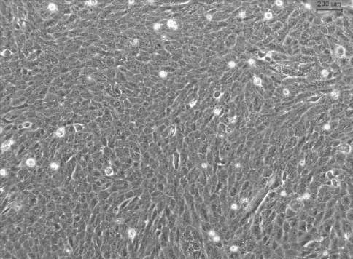
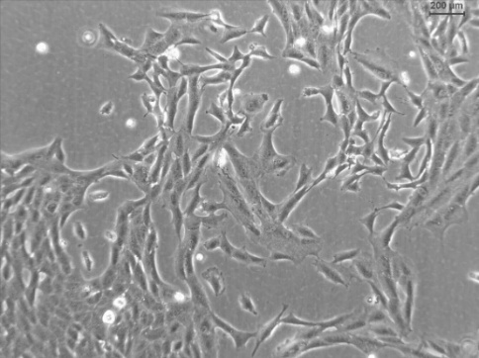
Adherent cells
100% confluence
60% confluence

Slide 33
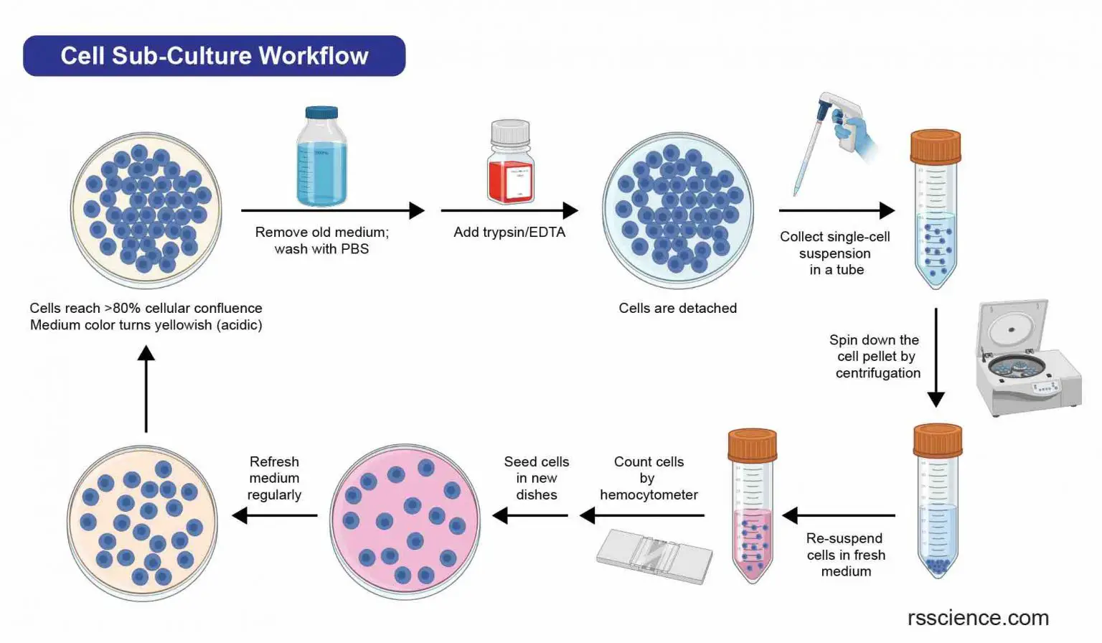
A) For the transfer, the use of EDTA (chel Ca² ⁺ and Mg² ⁺, indispensable for adhesion) and / or trypsin (degrades the proteins of the matrix) are used.
B) After detachment, the action of EDTA and trypsin is neutralized by the addition of a new culture medium containing excess divalent cations and trypsin inhibitors.
C) The cells are collected by centrifugation, resuspended, counted and diluted in new plates.

Slide 34
Primary cultures
Primary cultures are defined as
cultures obtained from cells coming directly from tissue; embryos, adult cells in suspension or from tumors.
They generally contain a relatively heterogeneous mixture of cells in different physiological states.
There are cells that can grow in suspension or attached to an artificial matrix such as plastic but also to collagen.
Secondary cultures
are subcultures of primary cultures that become necessary when the cells reach confluence or completely cover the matrix to which they are attached.

Slide 35
Evolution of a cell culture

Slide 36
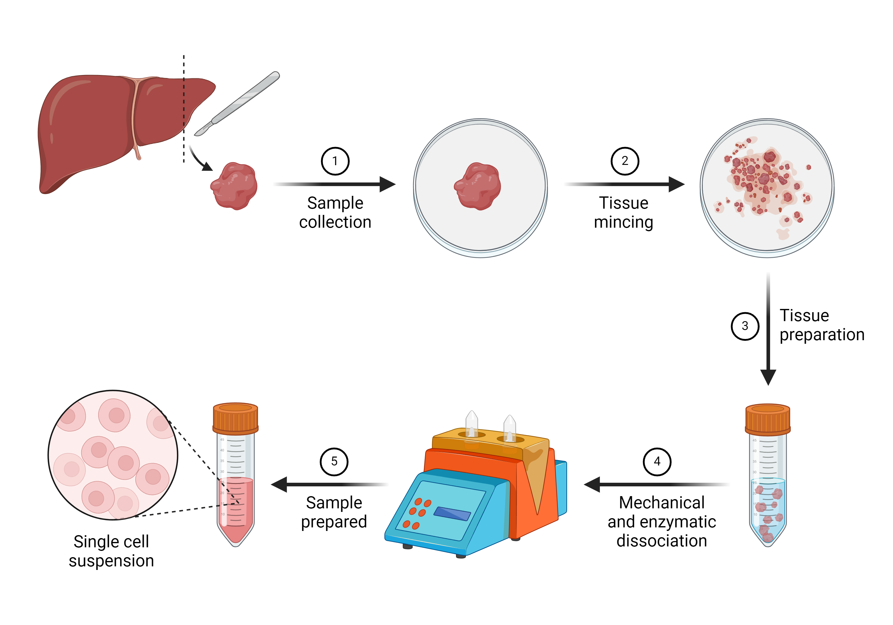
Primary cultures
Cells from a sample (organ, biopsy, embryos).
Mechanical dissociation
Enzymatic dissociation
Control of cell viability
and plating

Slide 37
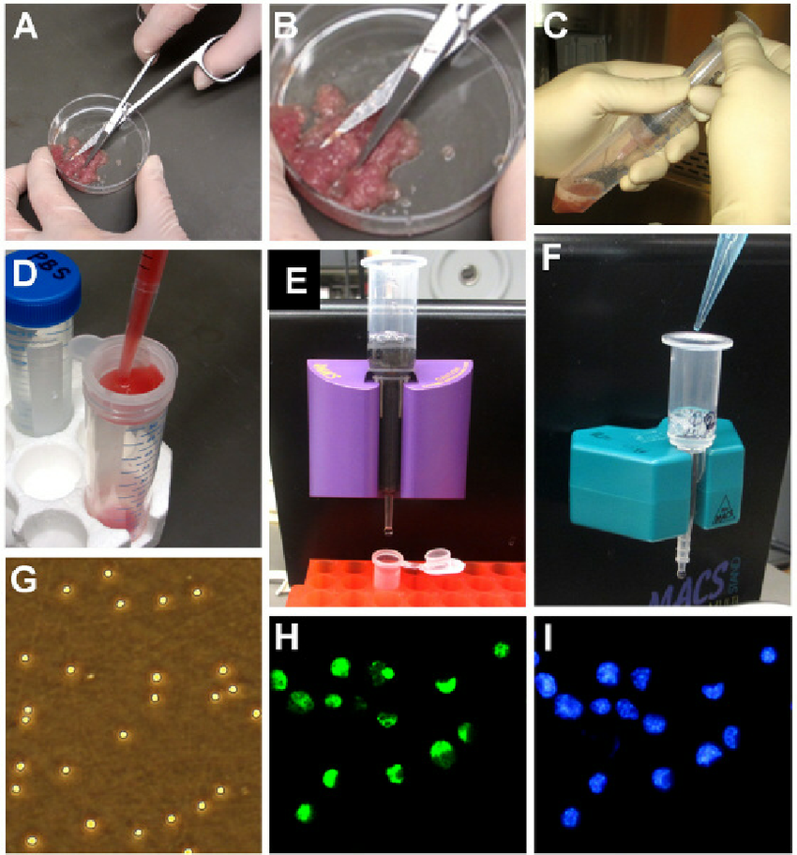
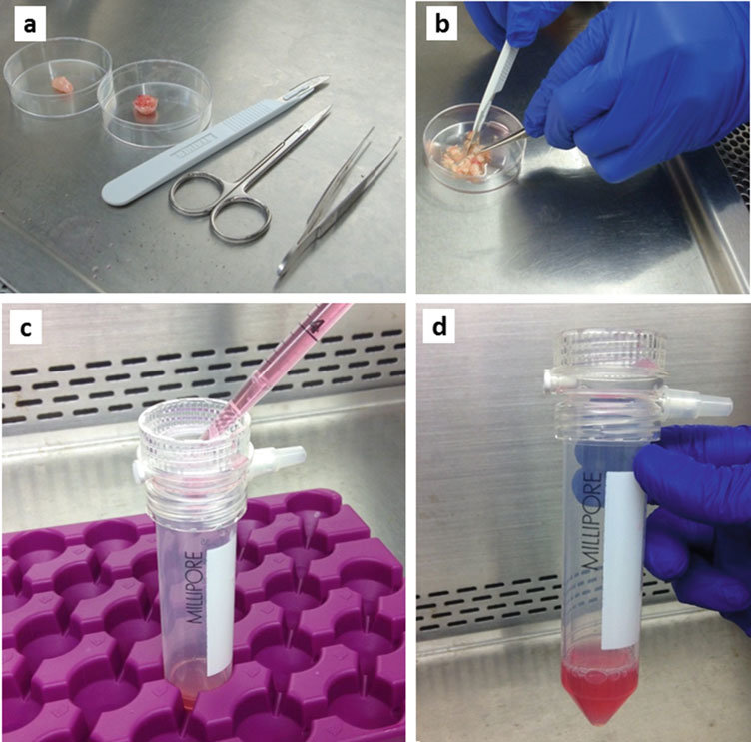
Mechanical dissociation
repeated mincing with scissors or sharp blades,
scraping the tissue surface,
homogenization,
vortexing, repeated aspiration through pipettes or sequentially smaller needles (e.g., 16-, 20-, and 23-gauge),
application of abnormal osmolarity stress,

Slide 38

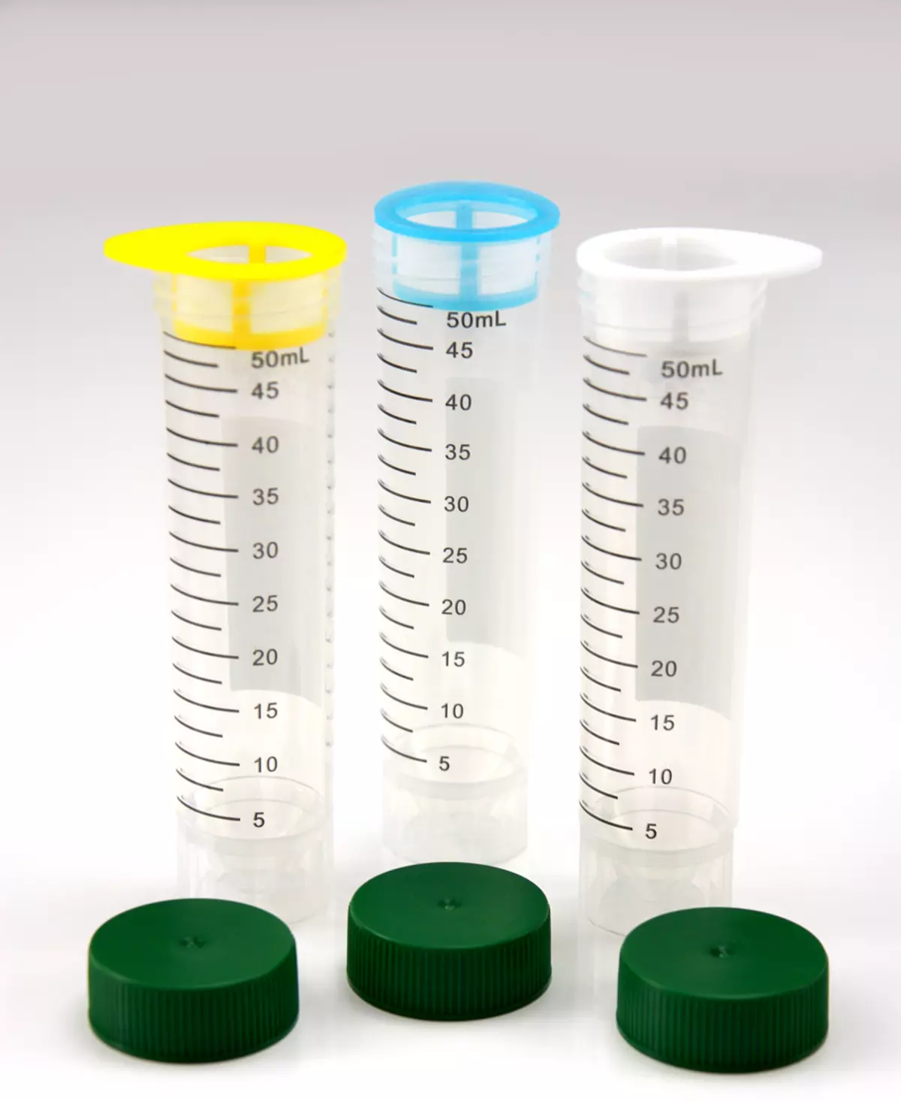
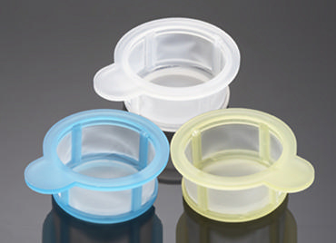
Cell strainers
are sterile, easy to use devices for rapidly isolating primary cells to consistently obtain a uniform single-cell suspension from tissues. Fits 50 ml Falcon® conical tubes.
filtration through a nylon or steel mesh (50–100 μm opening),
This process generates single cell suspensions quickly with a minimal number of steps.
However, dissociation of tumor tissue using mechanical methods is not often a suitable technique, for obtaining tumor cells for culture because the technique results in a high percentage of dead cells that secrete degrading enzymes

Slide 39
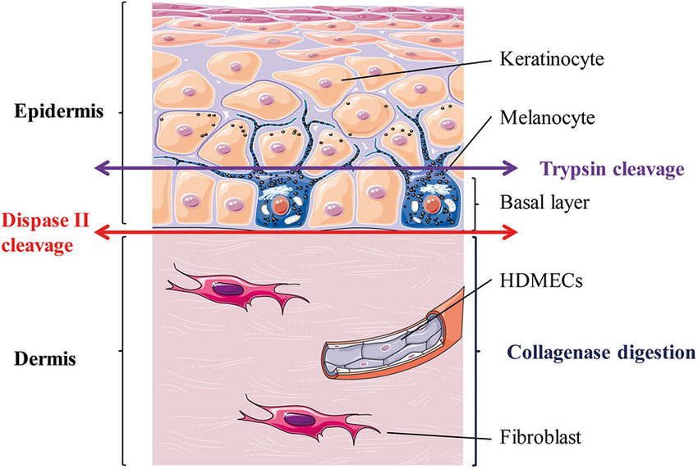
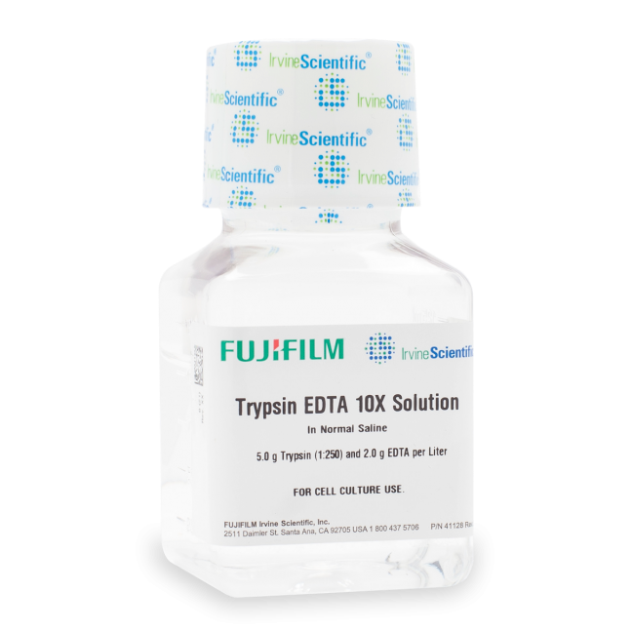
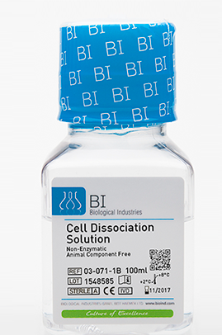
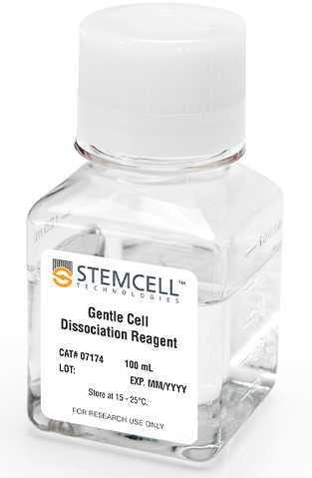
Enzymatic dissociation
Enzymatic dissociation is a commonly used practice to digest minced tissue into a single cell suspensions due to proper digestion of tissue and preservation of cell viability and integrity.
Numerous studies have shown that certain enzymes are more effective than others for dissociation of specific tissues.
papain,
elastase,
hyaluronidase,
collagenase,
pronase,
deoxyribonuclease.
Trypsin

Slide 40
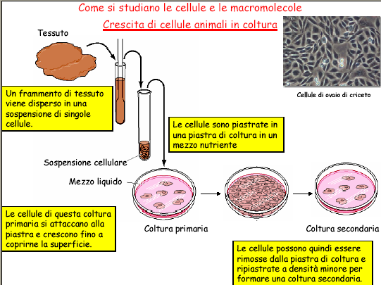

Slide 41
Primary culture
The cells are derived directly from the original tissue and retain many functional features that are also found in vivo.
During growth, selection occurs based on the degree of proliferation:
expansion of proliferating cells,
those that survive but cannot duplicate remain stationary,
while other cell types are not resistant.
This means that the proportions of the different cell types change over time until an equilibrium is reached that is significantly different from the initial situation.
When the proliferation has depleted the culture medium, a subculture must be established in a new container with fresh medium

Slide 42
Types of cell cultured in vitro
Primary cultures
  Derived directly from animal tissue
  embryo or adult?/ Normal or neoplastic?
  Cultured either as tissue explants or single cells
  Initially heterogeneous – become overpopulated with fibroblasts
  Finite life span in vitro
  Retain differentiated phenotype
  Mainly anchorage dependant
  Exhibit contact inhibition
Secondary cultures
  Derived from a primary cell culture
  Isolated by selection or cloning
  Becoming a more homogeneous cell population
  Finite life span in vitro
  Retain differentiated phenotype
  Mainly anchorage dependant
  Exhibit contact inhibition

Slide 43
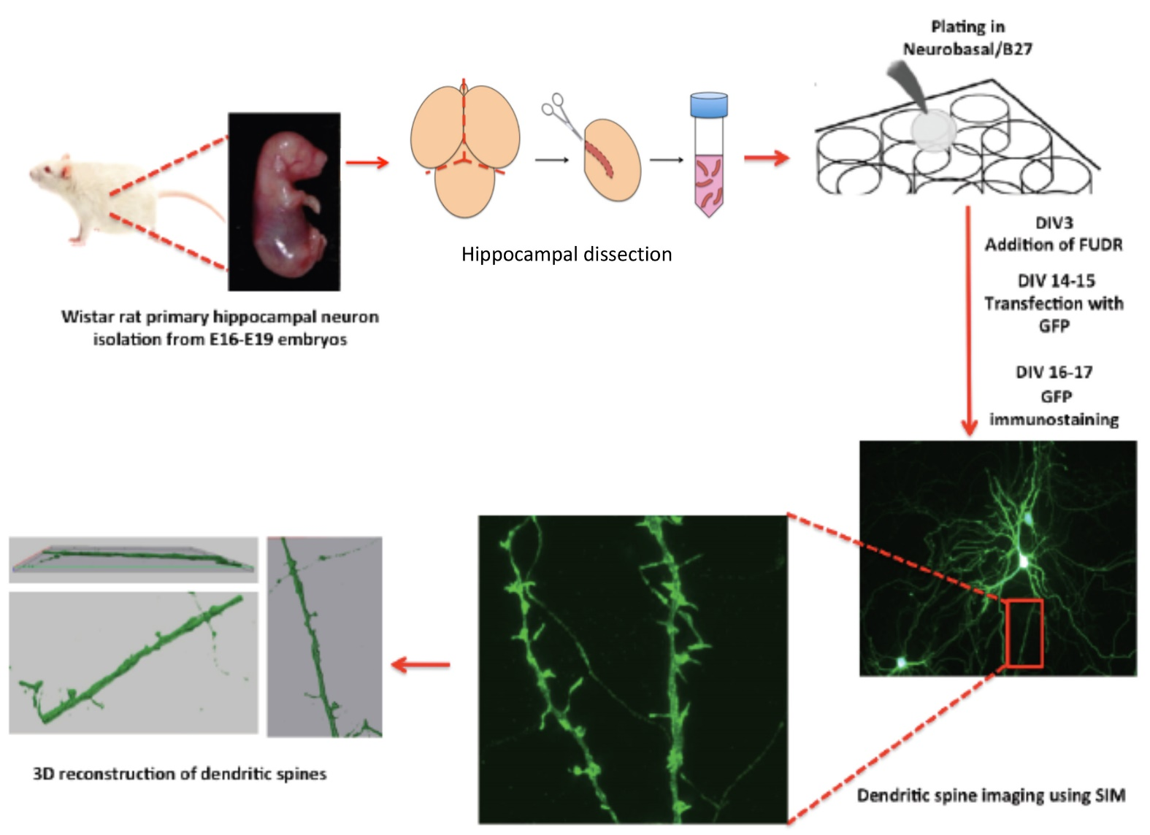

Slide 44


Slide 45

HUVEC - Human Umbilical Vein Endothelial Cells

Slide 46


HUVEC Human Umbilical Vein Endothelial Cell
Video isolamento cellule x2
isolation from umbilical cord was first described in 1973.
To date, this model is still widely used because of the high HUVEC isolation success rate, and because HUVEC are an excellent model to study a broad array of diseases, including cardiovascular and metabolic diseases.
https://www.stemcell.com/how-to-prepare-a-single-cell-suspension-from-mouse-spleen.html
https://www.youtube.com/watch?v=gePfThd2Hro

Slide 47



HUVEC
Human Umbilical Vein Endothelial Cells
NHLF
Normal Human Lung Fibroblasts
Human Hepatocytes
Normal Human Epidermal Keratinocytes

