Slide 1

PROCESS MODELING
BASIC PRINCIPLES

Slide 2
MODELLAZIONE DI PROCESSI
Processo di sviluppo → modo di organizzare le attività del ciclo di vita
Permette di assegnare risorse alle varie attività
Permette di fissare le deadline
FASE
intervallo di tempo in cui si svolgono certe attività
Ciascuna attività può essere ripartita fra più fasi.
MODELLO DI PROCESSO → descrizione generica di una famiglia di processi simili, che realizzano il modello in modi diversi.

Slide 3
MODELLAZIONE DI PROCESSI
Processo di sviluppo → modo di organizzare le attività del ciclo di vita
Permette di assegnare risorse alle varie attività
Permette di fissare le deadline
FASE
intervallo di tempo in cui si svolgono certe attività
Ciascuna attività può essere ripartita fra più fasi.
MODELLO DI PROCESSO → descrizione generica di una famiglia di processi simili, che realizzano il modello in modi diversi.

Slide 4
MODELLAZIONE DI PROCESSI
Modello Waterfall (a cascata)
Modello a V
Modelli evolutivi
Modelli basati su prototipi
Unified process
Modelli trasformazionali
Modelli a spirale
Modello lineare
Modello con feedback
AGILE

Slide 5
MODELLAZIONE DI PROCESSI
Studio di fattibilità
Analisi dei requisiti
Progettazione
Codifica e test di modulo
Integrazione e test di sistema
Consegna, installazione e manutenzione
DOCUMENTO DI STUDIO DI FATTIBILITÀ
DOCUMENTO DI ANALISI DEI REQUISITI
PROGETTO
MODULI
SISTEMA

Slide 6
CARATTERISTICHE
Elaborato all’inizio degli anni ‘70
È il modello di riferimento su cui si basano tutti gli altri modelli di processo
Cascata lineare:
Ogni fase deve essere completata prima di passare alla fase successiva
l’output del passo precedente costituisce l’input del passo successivo
Output = DELIVERABLE
Tutte le fasi vengono completate avendo come target l’intero sistema
Il modo in cui le fasi vengono affrontate dipende dal tipo di sistema

Slide 7
VANTAGGI
Introduce una disciplina di progettazione dopo il sistema code&fix
Introduce i concetti di pianificazione e gestione
Rimanda l’implementazione dopo che la fase di progettazione è stata completata

Slide 8
LIMITI
Modello ideale
Modello lineare→ non consente di avere feedback finché l’intero processo non è terminato
Modello rigido→ i risultati restano “congelati” finché non si passa alla fase successiva
Modello monolitico→
Orientato ad una singola fase di rilascio (del sistema completo)
La fase di rilascio può avvenire anche mesi/anni dopo la fase di progettazione
Non permette visibilità del prodotto fino alla sua completa implementazione
Difficile stimare a priori i costi e le risorse necessarie*
Il documento di specifica dei requisiti rappresenta un vincolo per l’intera progettazione e realizzazione → non tiene conto di possibili raffinamenti/variazioni da parte dell’utente
Basato su documentazione (deliverables) → può portare ad uno stile di lavoro troppo burocratico
Non risponde al principio di anticipazione del cambiamento

Slide 9
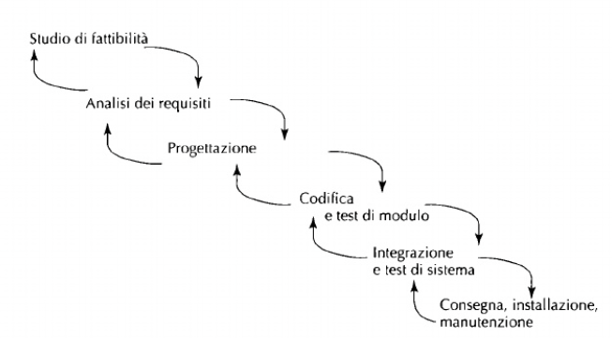
INTRODUZIONE DEL FEEDBACK
Feedback a singolo passo
Migliorato rispetto al waterfall classico ma ancora limitato

Slide 10
MODELLI EVOLUTIVI
CICLO 1
Analisi e specifica
Progettazione
Codifica
Test e convalida
CICLO 2
Analisi e specifica
Progettazione
Codifica
Test e convalida
…
CICLO N
Analisi e specifica
Progettazione
Codifica
Test e convalida

Slide 11
MODELLI EVOLUTIVI
Operano per versioni incrementali di un prodotto (prototipi)
Adatti allo sviluppo di software con forte connotazione evolutiva guidata dalla pratica
Consentono anche un rilascio evolutivo o incrementale (prodotti con raffinamento successivo)
Il concetto di evoluzione si applica a tutte le fasi del processo
Il prodotto di ciascun ciclo viene valutato e il risultato della valutazione determina il passo successivo:
Rilascio
Misura
Aggiustamento

Slide 12
PROTOTIPAZIONE
Versione approssimata e parziale ma FUNZIONANTE del sistema
Prototipo utilizzato per effettuare lo studio di fattibilità
Prototipo esplorativo per analisi dei requisiti (da far provare all’utente per esplorarne i bisogni) → prototipo throw away
Prototipo sperimentale in fase di progetto (implementazioni alternative)
Prototipo per rilascio parziale (sottosistema funzionante)
Il prototipo ha una struttura interna diversa dal sistema finale
Rischio → mantenere il prototipo invece che costruire il sistema intero

Slide 13
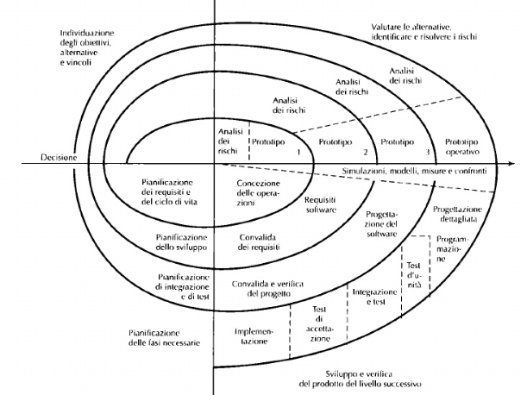
PROTOTIPAZIONE
Costo cumulativo

Slide 14
METODOLOGIA AGILE
La "metodologia agile" è un approccio allo sviluppo del software basato sulla distribuzione continua di software efficienti creati in modo rapido e iterativo.
Rilasciare rapidamente modifiche al software in piccole porzioni con l'obiettivo di migliorare la soddisfazione dei clienti.
Adottare un approccio più leggero alla stesura della documentazione software e di integrare le modifiche in qualsiasi fase del ciclo di vita, anziché ostacolarle.
Individui e interazioni rispetto a processi e strumenti
Un software efficiente rispetto a una documentazione esaustiva
La collaborazione con il cliente rispetto alla negoziazione dei contratti
La preparazione ad affrontare il cambiamento rispetto all'esecuzione di un piano

Slide 15
METODOLOGIA AGILE
1986 — Takeuchi & Nonaka describe fast, overlapping development (“rugby” approach).
1995 - Scrum introduced publicly at OOPSLA (Schwaber / early Scrum papers).
1999 - XP popularized (Beck, Extreme Programming Explained).
2000 - A number these articles referred to "Light methodologies, such as Extreme Programming, Adaptive Software Development, Crystal, and SCRUM"
Feb 2001 — Agile Manifesto authored by 17 practitioners.
2001 - Scrum “Development Process” paper circulated/updated from the OOPSLA work.
https://www.scrum.org/
https://agilemanifesto.org/history.html

Slide 16
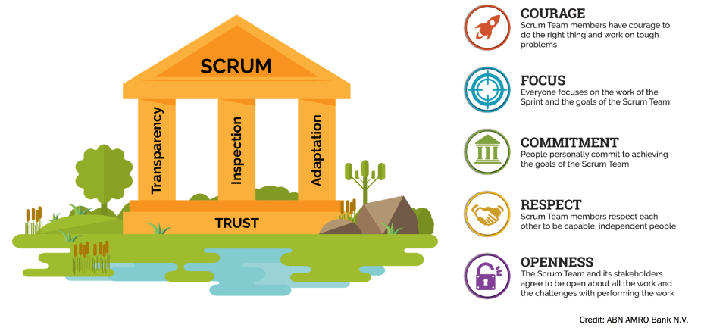
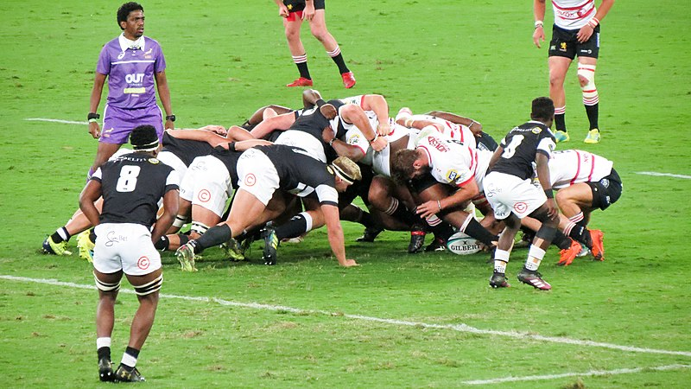
METODOLOGIA AGILE – SCRUM
PierreSelim - Opera propria
Luke Burgess introduces the ball into the scrum. CC BY-SA 3.0
It starts with understanding the Scrum framework which is defined in The Scrum Guide and was first introduced to the world in 1995 as a better way of team collaboration for solving complex problems. The Scrum framework is fairly simple being made up of a Scrum Team consisting of a Product Owner, a Scrum Master and Developers, each of which have specific accountabilities. The Scrum Team takes part in five events and produces three artifacts.
http://www.scrumguides.org/
from: https://www.scrum.org/resources/what-scrum-module

Slide 17


METODOLOGIA AGILE – SCRUM - RUOLI
Scrum Master: Role within a Scrum Team accountable for guiding, coaching, teaching and assisting a Scrum Team and its environments in a proper understanding and use of Scrum.
Other Stakeholders
Product Owner: Role in Scrum accountable for maximizing the value of a product, primarily by incrementally managing and expressing business and functional expectations for a product to the Developers.
User
Product Owner
Developer: any member of a Scrum Team, that is committed to creating any aspect of a usable Increment each Sprint regardless of technical, functional or other specialty.
Management
Development Team
Scrum Master
http://www.scrumguides.org/
from: https://www.scrum.org/resources/what-scrum-module

Slide 18

METODOLOGIA AGILE – SCRUM – RUOLI ESTESI
Other Stakeholders
DevOps Team
User / Caregiver
Tech Lead
Product Owner
Data Engineering
Team
Management
Development Team
Scrum Master
QA
http://www.scrumguides.org/
from: https://www.scrum.org/resources/what-scrum-module

Slide 19
METODOLOGIA AGILE – SCRUM - GLOSSARIO
Basic Scrum Glossary:
Scrum Artefacts:
1.Increment: Scrum Artifact that defines the complete and valuable work produced by the Developers during a Sprint. The sum of all Increments form a product.
2.Product Backlog: A Scrum Artifact that consists of an ordered list of the work to be done in order to create, maintain and sustain a product. Managed by the Product Owner.
3.Sprint Backlog: Set of tasks and user stories selected from the product backlog for completion within the current sprint.
In 2020 they introduced new artefacts:
Product Goal The Product Goal describes a future state of the product which can serve as a target for the Scrum Team to plan against. The Product Goal is in the Product Backlog. The rest of the Product Backlog emerges to define “what” will fulfill the Product Goal.
Sprint Goal a short expression of the purpose of a Sprint, often a business problem that is addressed. Functionality might be adjusted during the Sprint in order to achieve the Sprint Goal.
Definition of Done: is a formal description of the state of the Increment when it meets the quality measures required for the product. The moment a Product Backlog item meets the Definition of Done, an Increment is born. The Definition of Done creates transparency by providing everyone a shared understanding of what work was completed as part of the Increment. If a Product Backlog item does not meet the Definition of Done, it cannot be released or even presented at the Sprint Review.
https://www.scrum.org/resources/scrum-glossary

Slide 20
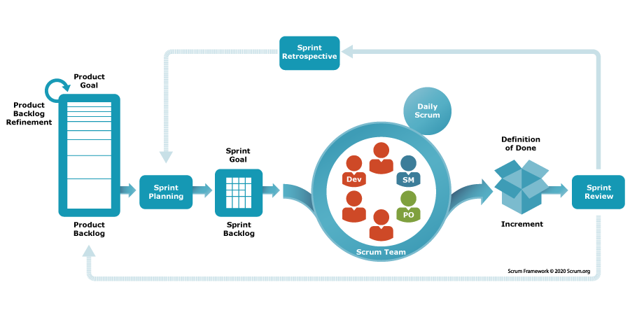
METODOLOGIA AGILE – SCRUM - SPRINT
Product Backlog Creation: Create a prioritized list of all desired features, enhancements, and fixes.
Sprint Planning: The Scrum team selects backlog items for the upcoming sprint and defines clear goals and tasks.
Sprint Execution: The team develops and tests features within the sprint timeframe.
Sprint Review: At the end of the sprint, the team demonstrates completed work to stakeholders, gathers feedback, and reviews progress.
Sprint Retrospective: The team reflects internally on the sprint's processes, identifying improvements for future sprints.
Acceptance Criteria!
Daily Scrum: During this brief meeting (time-boxed to 15 minutes), each member of the development team typically addresses:
What have I done since yesterday?.
What will I work on today?
What obstacles or impediments am I facing?
http://www.scrumguides.org/

Slide 21
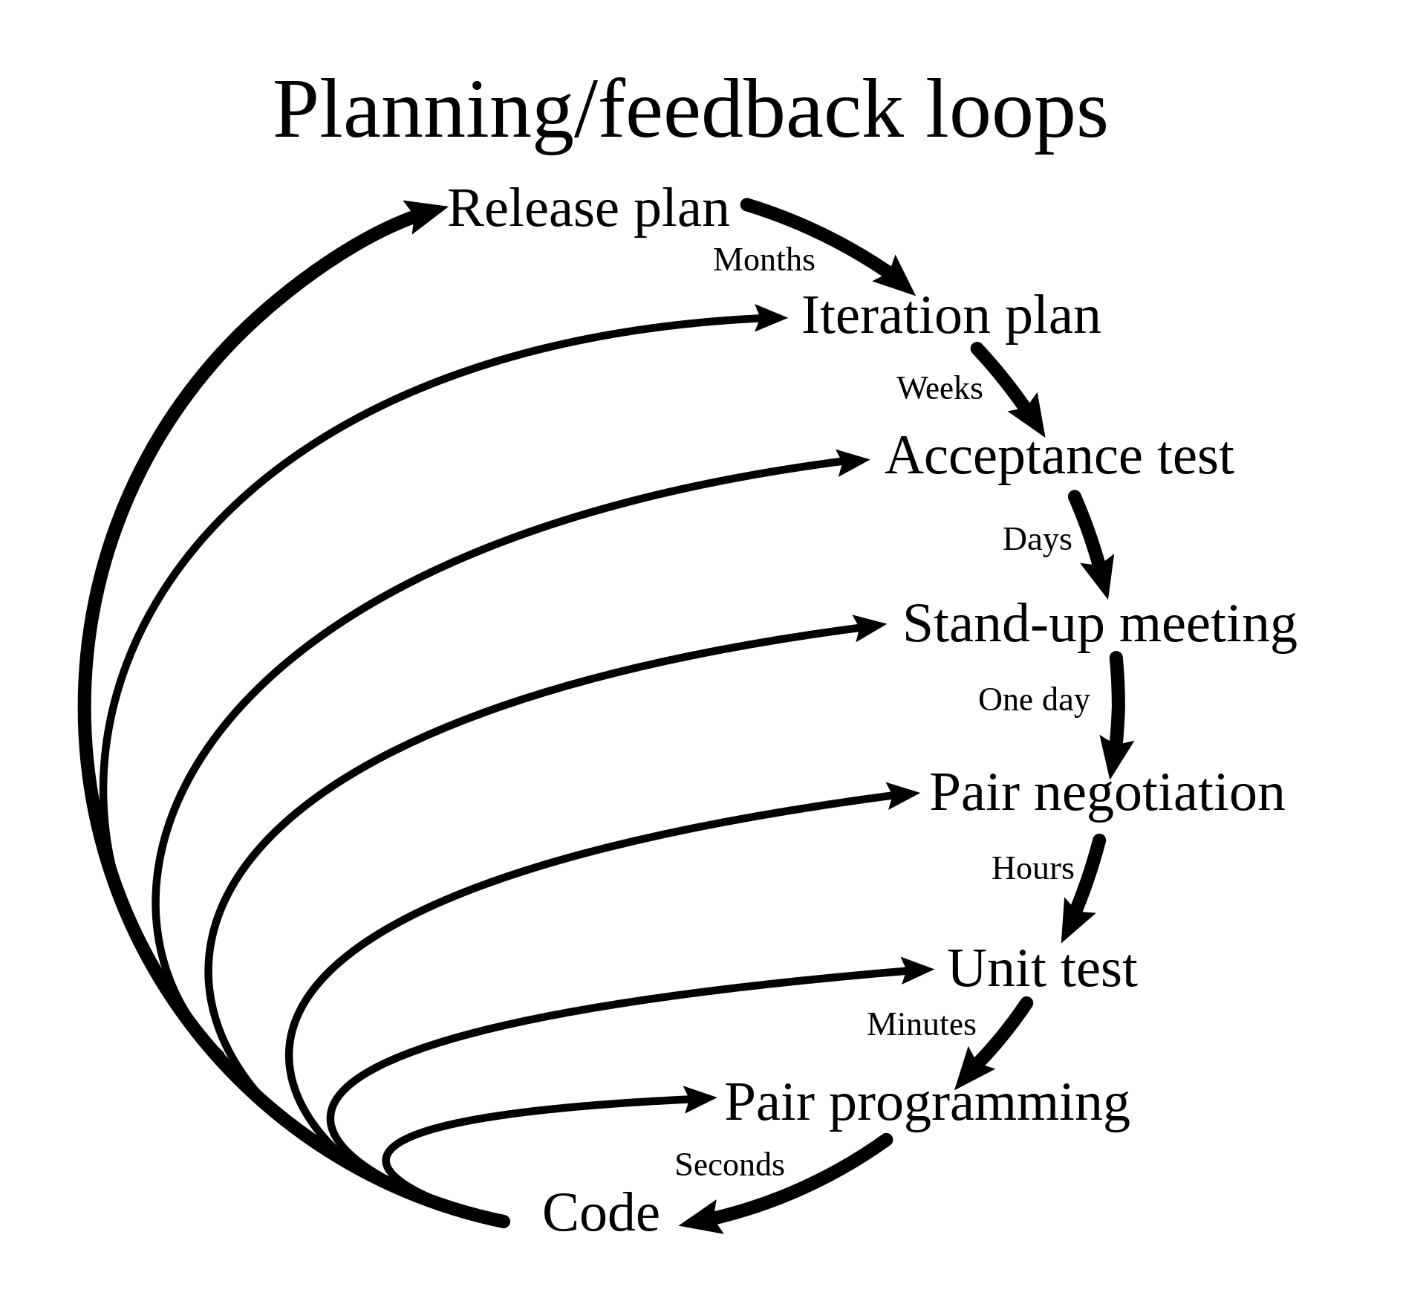
METODOLOGIA AGILE – XTREME PROGRAMMING (XP)
The general characteristics where XP is appropriate were described by Don Wells on www.extremeprogramming.org:
Dynamically changing software requirements
Risks caused by fixed-time projects using new technology
Small, co-located extended development team
The technology you are using allows for automated unit and functional tests
Pair Programming
Pair Programming means all production software is developed by two people sitting at the same machine. The idea behind this practice is that two brains and four eyes are better than one brain and two eyes. You effectively get a continuous code review and quicker response to nagging problems that may stop one person dead in their tracks.
Stories
Describe what the product should do in terms meaningful to customers and users. These stories are intended to be short descriptions of things users want to be able to do with the product that can be used for planning and serve as reminders for more detailed conversations when the team gets around to realizing that particular story.
DonWells - Own work based on: XP-feedback.gif
Extreme Programming (XP) requires planning and feedback at many levels and many frequencies. CC BY-SA 3.0
https://www.agilealliance.org/glossary/xp/

Slide 22
SISTEMI DI INFORMATICA MEDICA
PROGETTAZIONE DI SISTEMI DI INFORMATICA MEDICA E MODELLAZIONE DEI PROCESSI

Slide 23
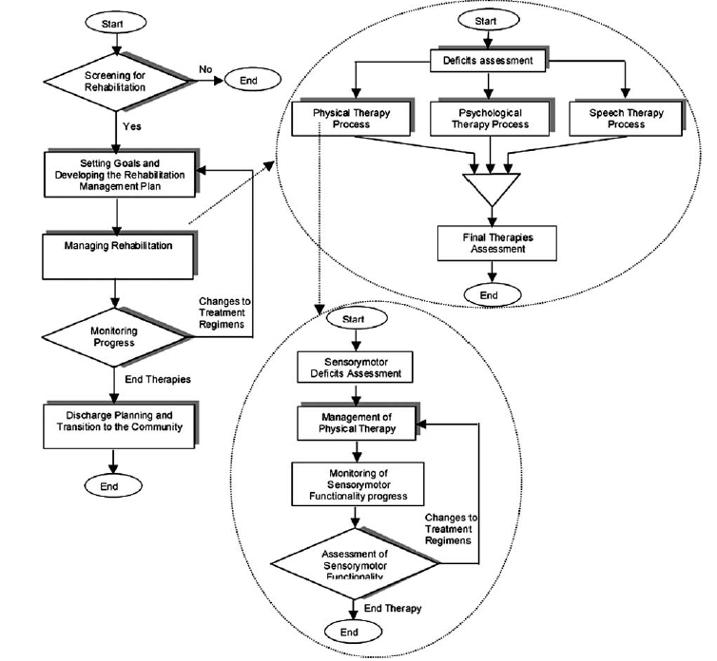
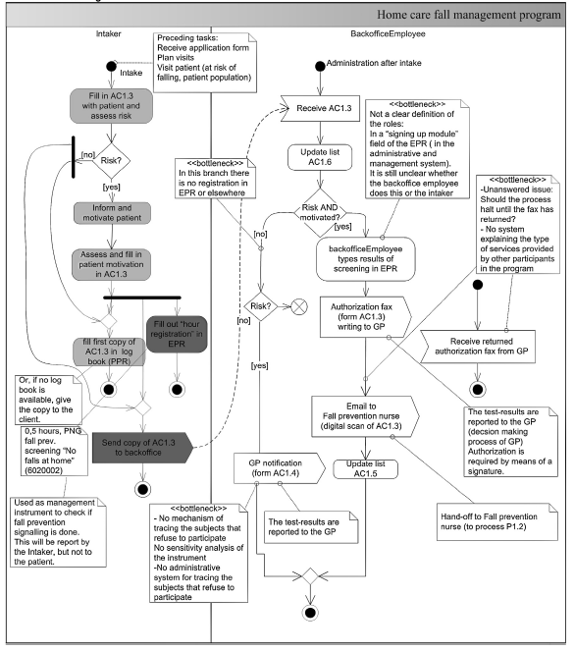
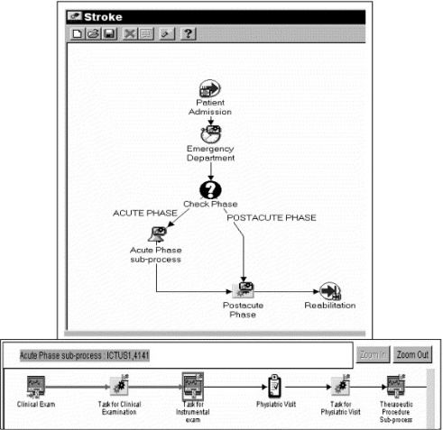
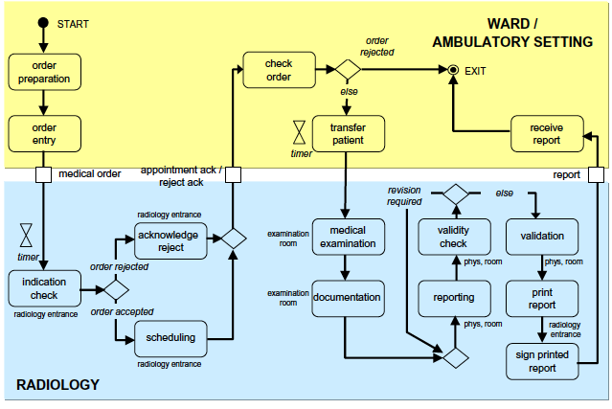
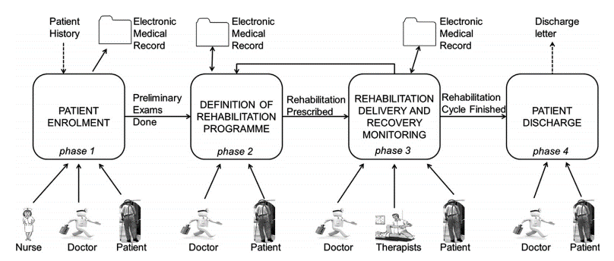
PROCESS MODELLING
Model → abstraction used to represent and describe the process under examination
Panzarasa et al, 2002
Quaglini et al, 2001
Askari et al, 2013
Ferrante et al, 2013
Lenz & Reichert, 2007
Notes:
Non si vedono bene le figure. Se vuoi dire «ci sono tanti esempi di modeling» va bene. Se vuoi portare l’attenzione su quello che dicono le figure, no.

Slide 24
HEALTHCARE PROCESSES
Multiple stakeholders
Patient’s response to treatment
Patient’s engagement
Multiple systems
COMPLEXITY
Patient’s empowerment
Evolving knowledge
Multiple action domains
Evidence based practices

Slide 25
CLINICAL EXPECTATIONS
Establishing shared protocols for patient’s care.
Facilitating adherence to the shared protocols, thus limiting problems due to incomplete communication or misunderstandings among different actors, ultimately increasing patient’s safety.
Monitoring deviances from the protocols, redundancies, and failures, thus early identifying problems that could lead to un-prevented errors.
ORGANIZATIONAL AND TECHNOLOGICAL EXPECTATIONS
Fully understanding the information flow, thus identifying requirements and specifications for information system re-engineering and interoperability.
Detecting process weaknesses thus designing corrective measures.
Optimizing the use of resources.
CLINICAL EXPECTATIONS
Notes:
«Actors» si usa anche in inglese in questo contesto?
È un po’ densa, come slide. Dividerla in due?

Slide 26
MODEL METHODOLOGY OVERVIEW

Slide 27
DOMAIN ANALYSIS
Identifying and analyzing the available sources of information to fully understand the domain of interest
Evidence-based knowledge → international guidelines and recommendations
Local domain →
local practices
specific clinical pathways already in use locally
focus groups and interviews to the medical staff and/or the patient/caregivers, to highlight the personal experience of the actors involved in the process
Description of the information systems already in use → helps planning the model deployment in the real everyday practice.
Notes:
Qui mi è un po’ oscuro il flusso di informazione. Parliamo prima di clinical need, poi di technological scenario, poi di aims, poi di clinical considerations. Bu. Pio pionfuso.

Slide 28
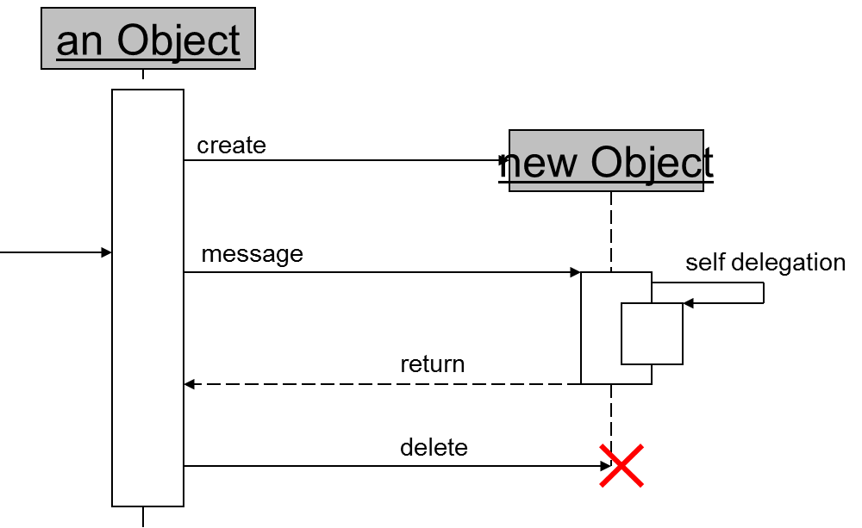
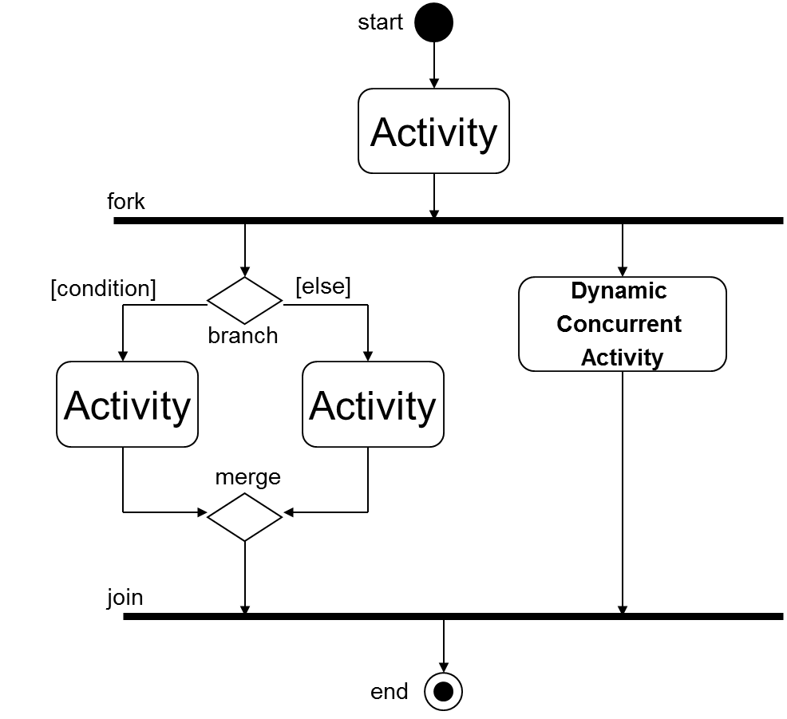
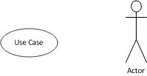
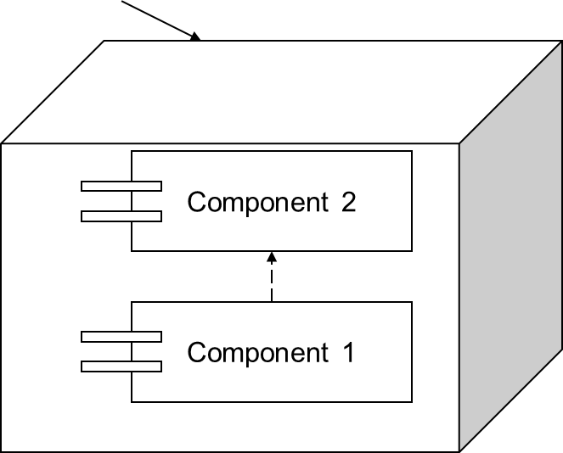
SELECTION OF THE FORMAL NOTATION: UML
“The Unified Modeling Language (UML) is a graphical language for specifying, visualizing, constructing, and documenting
the artifacts of software systems, as well as for business modeling and other non-software systems”.
STATIC VIEWS
DYNAMIC VIEWS
Class Diagram
Use-case Diagram
Sequence Diagram
Component Diagram
Activity Diagram
Notes:
Non si legge bene la tabellina Class Name

Slide 29
UML: ADVANTAGES
Graphical language →
Enables the communication between domain experts and analysts
Easy to understand by non-experts of computer sciences
Provides different views on the process→
Static and dynamic diagrams
Structural, Behavioural, and Interaction diagrams
The final UML model can be used as specification for the development of an IT system
The use of UML promotes modularity and facilitates future changes
It allows the evaluation of the whole system, also at the deployment level

Slide 30
PRE-MODELING
Provide a high-level process description (process phases)
Functional aspects (main activities of the process, objects and data items managed)
Organizational aspects (agents, roles, skills, availabilities, authorizations required to enact the process) → understand actors’ responsibilities on the main activities business aspects (goals to be achieved).
Define a list of goals of the process modeling effort
Identification of outcomes and integration with patient-reported outcome measures

Slide 31
MODELING
The modeling step starts from the previously collected information and produces a conceptual model of the process according to the formal notation adopted
The conceptual model comprises:
the schema of the process
its variables
the specification of the expected exceptions
the specification of the transactions
the access control model
the description of the interactions with the external information system.
The results of the modeling are then validated by the domain experts, before continuing with the design

Slide 32
MODEL EVALUATION
Assess if the model is “syntactically correct”
Verify the internal consistency of the model.
Assess its usability as a starting point for the logical modeling towards the software implementation.
Assess if the model is “semantically correct”
Iterative approach based on focus groups or external validators.
Analysis by actor type to validate the flow of information in the simplest activities of the process.
Analysis with multiple actors to test the whole model.
The model is final when a total agreement between experts and analysts is reached.
Askari et al. 2013
ANALYST
DOMAIN
EXPERTS

Slide 33
METRICS AND GQM
METRIC = a quantitative measure of the degree to which a system, component, or process possesses a given attribute
Metrics for the evaluation of health ITs cannot be directly derived from the model itself → the model can be the basis for identifying the outcome variables to be introduced into e-management techniques as metrics for evaluation.
Goal Question Metrics (GQM) →
allows selecting metrics with a top-down and goal-oriented approach
the identification of the metrics starts from the definition of goals
The definition of the goals is done during the conceptual modeling phase
GQM has three levels →
Goal: Conceptual level, defines the main purposes of a work to be measured;
Question: Operational level, defines a set of questions useful for achieving the goals;
Metric: Quantitative level, defines a set of metrics for answering the questions in a measurable way.

Slide 34
MODEL IMPLEMENTATION
Mapping to a specific executable language
Building a system implementing the model
Create new modules of an already existing system to implement the process

Slide 35
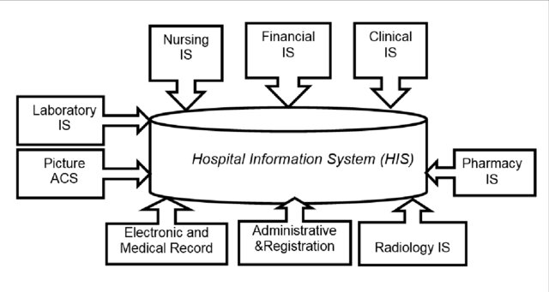
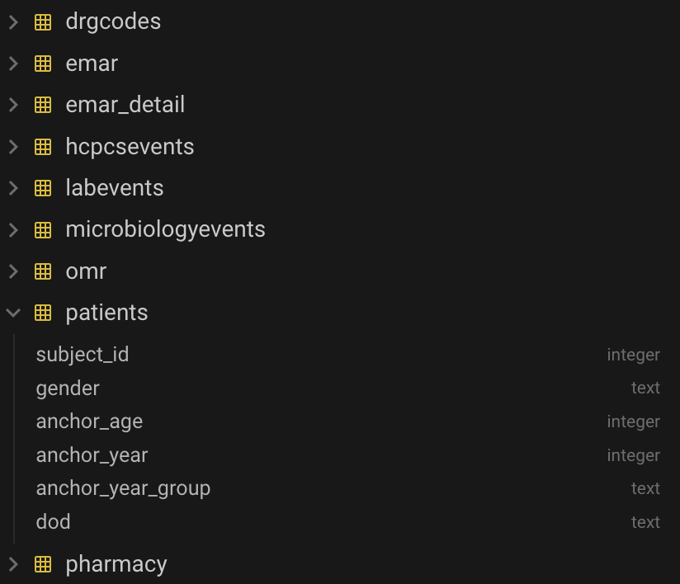
SIMPLE EXAMPLE – ABSTRACTION: HIS
1-Hospital Information Systems Integration Model Note: Source: Biomedical Informatics Ltd. (2006).
MIMIC-IV db snapshot
Notes:
Non si vedono bene le figure. Se vuoi dire «ci sono tanti esempi di modeling» va bene. Se vuoi portare l’attenzione su quello che dicono le figure, no.

Slide 36
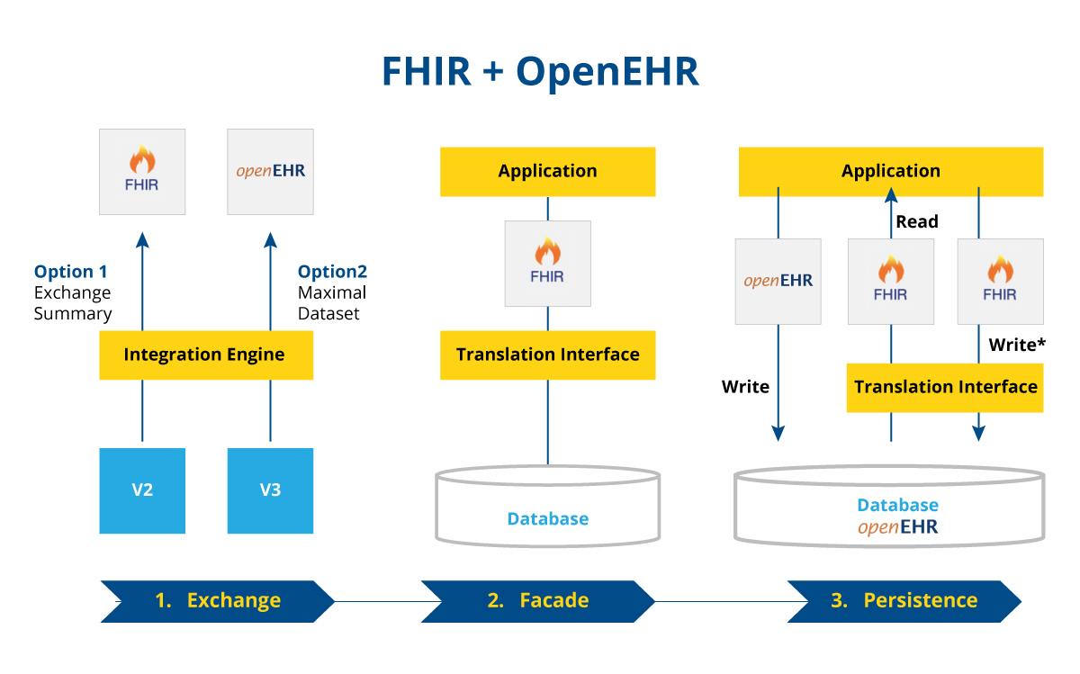
SIMPLE EXAMPLE – ABSTRACTION: FHIR+OpenEHR
from: https://www.ltts.com/blog/healthcare-digital-cloud-architecture
https://www.agendadigitale.eu/sanita/sanita-digitale-la-sfida-dellinteroperabilita-tra-hl7-fhir-e-openehr/
Notes:
Non si vedono bene le figure. Se vuoi dire «ci sono tanti esempi di modeling» va bene. Se vuoi portare l’attenzione su quello che dicono le figure, no.

Slide 37

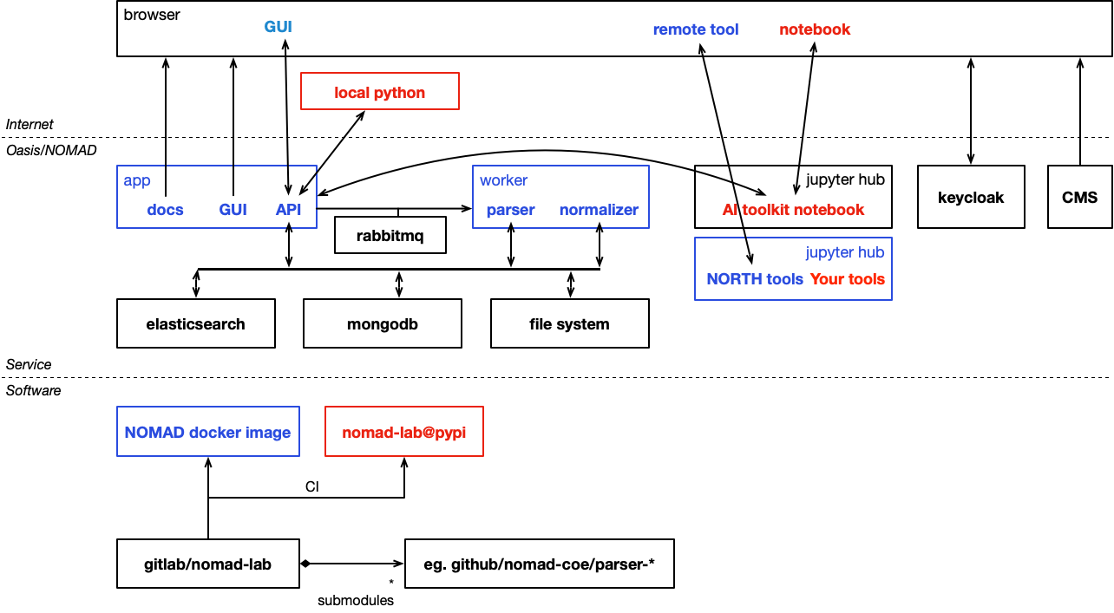
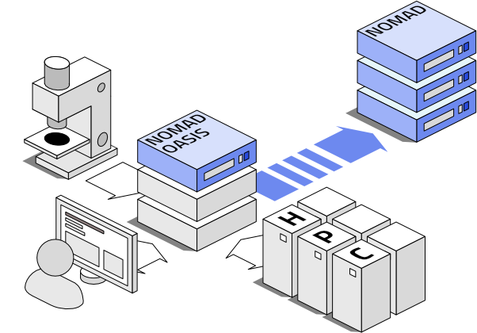
SIMPLE EXAMPLE – ABSTRACTION: NOMAD
Notes:
Non si vedono bene le figure. Se vuoi dire «ci sono tanti esempi di modeling» va bene. Se vuoi portare l’attenzione su quello che dicono le figure, no.

Slide 38
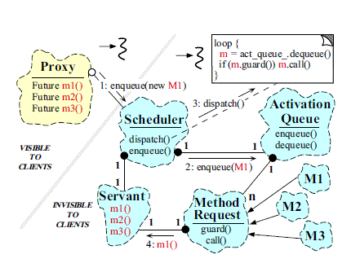
EXAMPLE – ABSTRACTION: ACTIVE OBJECT PATTERN
The Active object pattern's goal is to separate the method calling from method execution. It is like a waiter in a restaurant, who just hands the orders from the customers to the chef.
When a customer orders some food from the waiter
the customer is the Client, the waiter is the Proxy, the client writes the recipe on paper and gives it to the chef. The Chef decides which cook should prepare it (who has time).
The paper is the MethodRequest, the table's number on the paper is the Future object
The chef is the Scheduler who has a list of papers (ActivationList) and the cooks are the Servant-s
When the meal is ready, the cook places it on the serve bar and the waiter brings it to the customers table.
Client reads the method's result, from the Result object.
https://stackoverflow.com/questions/41676343/explain-active-object-pattern
Notes:
Non si vedono bene le figure. Se vuoi dire «ci sono tanti esempi di modeling» va bene. Se vuoi portare l’attenzione su quello che dicono le figure, no.

