Slide 1
Statistical learning in epidemiology
Lecture II
Giulia Zamagni
Clinical Epidemiology and Public Health Research Unit, IRCCS «Burlo Garofolo»
University of Trieste

Slide 2
Recalling the definitions – diagnostic tests
Diagnostic tests are designed to distinguish between diseased and non-diseased individuals
In particular, they are used to:
Detect a disease
Support clinical diagnosis
Guide treatment decisions
In real-world settings, no diagnostic test is perfect. Therefore, we need to evaluate how well a test performs.
How?
By comparing the test result with the true disease status, typically determined by a gold standard test.

Slide 3
Recalling the definitions – diagnostic tests
 | Disease + | Disease -
Test + | True Positive (TP) | False Positive (FP)
Test - | False Negative (FN) | True Negative (TN)
Sensitivity = TP/(TP+FN)
Specificity= TN/(TN+FP)
Positive Predicted Value (PPV) = TP/(TP+FP)
Negative Predicted Value (NPV) = TN/(TN+FN)
Accuracy = (TP+TN)/(TP+TN+FP+FN)

Slide 4
The confusion matrix
 | Disease + | Disease - | Total
Test + | 80 | 90 | 170
Test - | 20 | 810 | 830
Total | 100 | 900 | 1000
Sensitivity = TP/(TP+FN) = 80/(80+20)=0.80
Specificity= TN/(TN+FP)=810/(810+90)=0.90
Positive Predicted Value (PPV) = TP/(TP+FP)=80/(80+90)=0.47
Negative Predicted Value (NPV) = TN/(TN+FN)=810/(810+20)=0.98
Accuracy = (TP+TN)/(TP+TN+FP+FN)=0.89

Slide 5
What if the test is continuous?
So far we assumed that a diagnostic test produce only a binary result: negative or positive.
However, many diagnostic tests produce continuous values, for example:
Blood pressure levels, heart rate…
Laboratory values
Specific biomarkers concentrations
In these cases, defining a single threshold a priori to classify individuals as tested positive or negative would be problematic, as changing the threshold changes the test performance.
In general, there is a well-known trade-off:
lower thresholds typically correspond to higher sensitivity and lower specificity
higher thresholds correspond to lower sensitivity and higher specificity

Slide 6
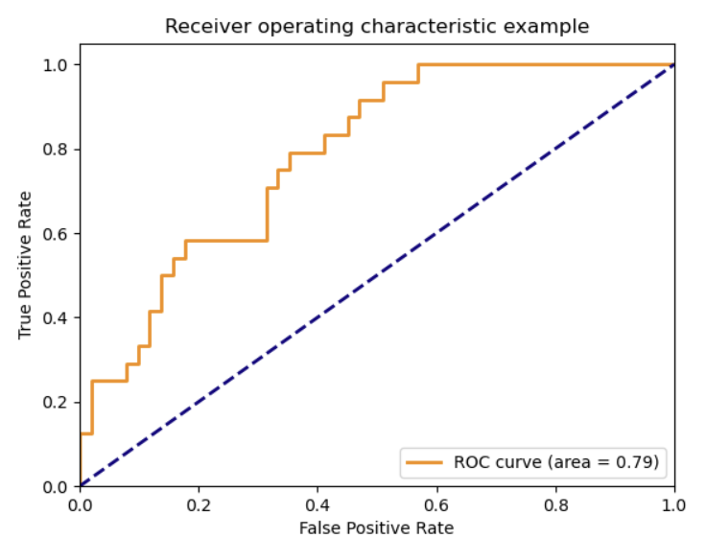
Solution: the Receiver Operating Characteristic (ROC) Curve
A ROC curve is a graphical tool used to evaluate the performance of a diagnostic test across all possible thresholds.
It plots:
Sensitivity on the y-axis
False Positive Rate (1-Specificity) on the x-axis
Each point on the ROC curve represents the performance of the test at a different threshold.
By examining all thresholds simultaneously, ROC curves provide a more complete picture of the test's diagnostic ability.

Slide 7
The Receiver Operating Characteristic (ROC) Curve
The ROC curve shows how well a test can distinguish between individuals with and without disease. Specifically:
A curve that approaches the upper-left corner indicates high diagnostic performance.
A curve close to the diagonal line indicates poor discrimination.
The diagonal line corresponds to random classification, meaning the test performs no better than chance.

Slide 8
The Area Under the ROC Curve (AUC or AUROC)
But how can we summarize all the information displayed in the graph of the ROC curve?
Using the AUC, i.e. the area under the ROC curve.
AUC | Interpretation
0.5 | No discrimination
0.6–0.7 | Poor
0.7–0.8 | Acceptable
0.8–0.9 | Good
>0.9 | Excellent
AUC = 0.8? Then, there is an 80% probability that the test assigns a higher score to a randomly selected diseased individual than to a randomly selected healthy individual.

Slide 9
ROC curves are useful, as they allow us to:
evaluate the overall diagnostic performance of a test
compare multiple diagnostic tests
choose an optimal threshold depending on the clinical context
For example:
screening tests may prioritize high sensitivity
confirmatory tests may prioritize high specificity.
→ ROC analysis helps identifying thresholds that achieve the desired balance.

Slide 10
How to identify an optimal cut-off for sensitivity and specificity?
One commonly used criterion is the maximum Youden index, which maximizes the difference between TP and FP rates
J = Sensitivity + Specificity – 1
This approach gives equal importance to detecting the disease (TP) and avoiding FP
It is a statistical criterion, therefore it does not always match the clinical objectives

Slide 11
How to identify an optimal cut-off for sensitivity and specificity?
In screening tests it is often preferable to prioritize high sensitivity to avoid missing true cases, even if this increases the number of false positives.
In contrast, for confirmatory tests, a higher specificity may be preferred to minimize unnecessary treatments or further investigations.
For instance, in screening for infectious diseases, a higher sensitivity may be chosen to ensure that most infected individuals are detected. Conversely, when confirming a diagnosis before starting an invasive or risky treatment, clinicians may prioritize a higher sensitivity to reduce false positive results.
→ Therefore, selecting an optimal cut-off involves both statistical criteria and clinical judgement, taking into account disease prevalence, the costs of misclassification, and the intended use of the test.

Slide 12
Some exercises…
1) Creatine kinase (CK) is a biomarker commonly used to distinguish between angina pectoris and myocardial infarction. Evaluate the diagnostic performance of CK using the following cut-offs:
CK ≥ 100 as indicative of myocardial infarction
CK ≥ 80 as indicative of myocardial infarction
2) The sFlt-1/PlGF ratio is a placental biomarker used in the diagnosis of preeclampsia in pregnant women. Calculate the area under the ROC curve (AUC) for this test and determine an optimal diagnostic cut-off.

Slide 13
Homework 1
As an example, the dataset Homework1 is composed by 5735 subjects and 62 variables, and examines the impact of
placing a right heart catheter (RHC or Swan Ganz catheter) on the survival of critically ill patients.
For our exercise it is sufficient to know that the exposure variable is “swang1”, the outcome is “death”
[the other variables are potential confounders]. Imagine that is an observational case-control study (subjects are not randomized to the treatment).
Questions:
Evaluate the “crude” association between the exposure and the outcome. Interpret the measure of association.
Evaluate the “adjusted” association between the exposure and the outcome including the variables age, sex, meanbp1 (blood pressure) and seps (presence of sepsis). Comment the results.

Slide 14
Homework 2
The dataset Homework2 is composed of 500 subjects and 4 variables (age, sex, dt2 and obese).
Imagine this is a cohort study aimed at evaluating the association between being obese and developing diabetes type 2 (dt2)
Questions:
Evaluate the “crude” association between the exposure and the outcome. Interpret the measure of association.
Evaluate the “adjusted” association between the exposure and the outcome including the variables age and sex. Comment the results.

