Slide 1
Statistical learning in epidemiology
Lecture I
Giulia Zamagni
Clinical Epidemiology and Public Health Research Unit, IRCCS «Burlo Garofolo»
University of Trieste

Slide 2
Recalling the definitions
In epidemiology, incidence and prevalence are two indicators of the occurrence of a disease in a population
Although closely related, they answer different questions:
Incidence:
Measures the occurrence of new cases over a specific time period
Captures the risk of developing a disease
Prevalence:
Measures the proportion of individuals in a population living with a disease in a specific time period
Captures how the disease is widespread in a given population
It depends on:
How many new cases occurr (incidence)
How long the disease lasts (duration)

Slide 3

Incidence
$$Incidence proportion=\frac{\# new cases during a time period}{Population at risk at the start}$$
$$Incidence rate= \frac{\# new cases}{Person−time∗}$$
*Person-time is a measure that accounts for both the number of people in a study and the amount of time each person is observed while at risk of developing the outcome.
Each participant contributes time from the start of observation until one of the following occurs:
they develop the disease (i.e., they become a case)
they are lost to follow-up or die
the study ends
The time contributed by all participants is summed across individuals.

Slide 4
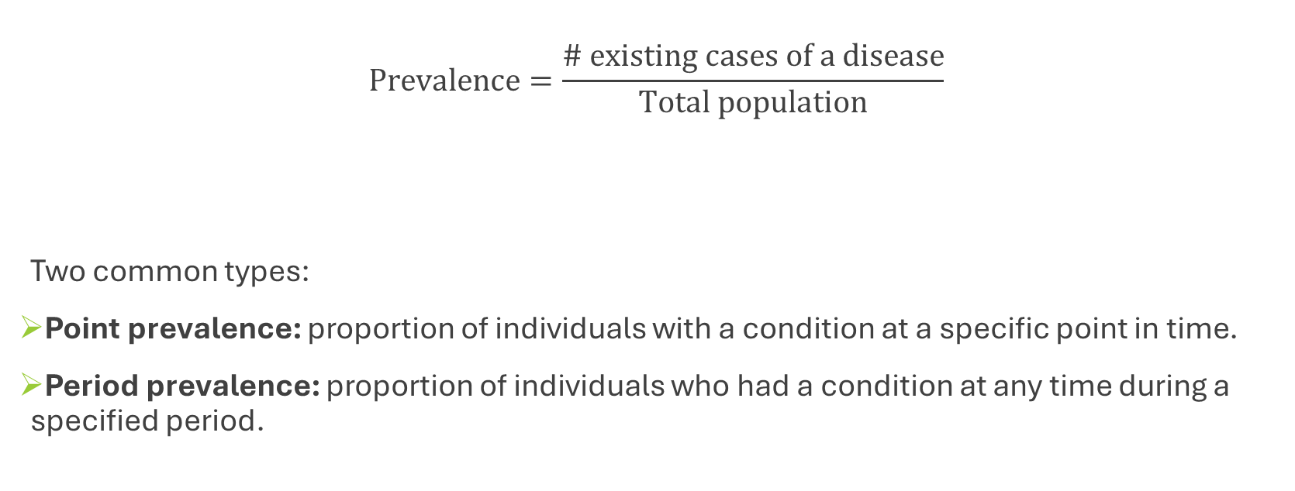
Prevalence
$$Prevalence=\frac{\# existing cases of a disease}{Total population}$$
Two common types:
Point prevalence: proportion of individuals with a condition at a specific point in time.
Period prevalence: proportion of individuals who had a condition at any time during a specified period.

Slide 5
Different tools, different applications
INCIDENCE
PREVALENCE
Acute or short-duration conditions, such as injuries, myocardial infarcion, infections…
→ In these cases, prevalence may remain low if many cases occur because the disease resolves quickly
→ Better suited to capture risk of onset and effectiveness of prevention strategies
Chronic and long-duration conditions, such as mental disorders, diabetes, hypertension…
→ Using prevalence we highlight the actual burden of these diseases, reflecting healthcare needs and service demand

Slide 6
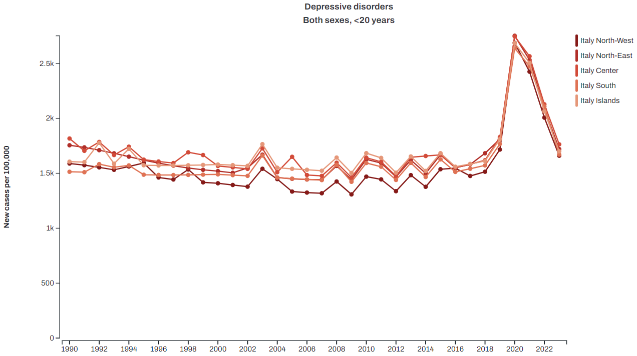
Incidence of depressive disorders <20 years of age, 1990-2023, Italy, both sexes combined.
A clear pattern appears:
From 1990 to around 2019, incidence remains relatively stable.
In 2020, there is a sharp increase in new diagnoses across all regions.
After 2020, incidence declines, although it remains somewhat higher than earlier years.
This spike likely reflects the impact of the COVID-19 pandemic, which dramatically affected mental health among children and adolescents.
As Incidence captures changes in the rate at which new cases appear, it is very sensitive to sudden events or shocks affecting population mental health.

Slide 7
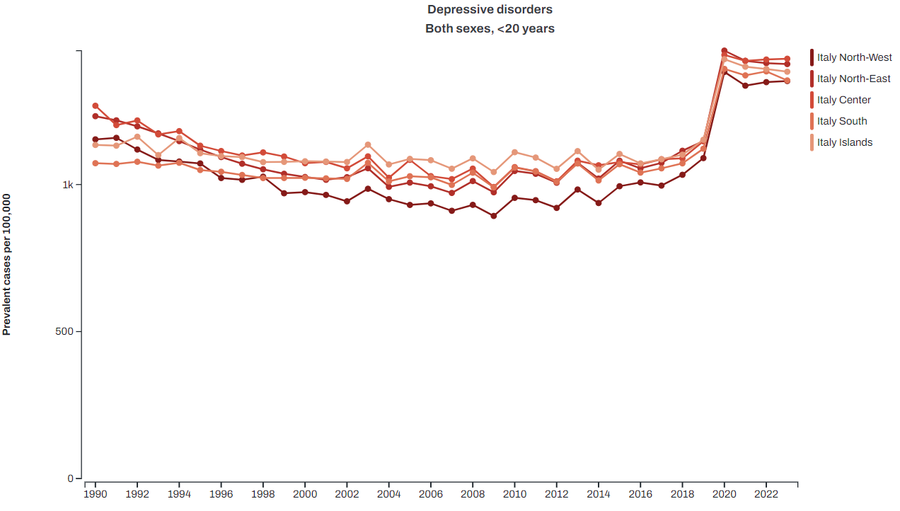
Prevalence of depressive disorders <20 years of age, 1990-2023, Italy, both sexes combined.
Prevalence also increases sharply around 2020.
However, conversely to incidence, which started declining after that year, prevalence did not return to previous levels.
Instead, it remains elevated and almost stable from 2020 to 2023.
The pandemic led to a sharp increase in new cases in 2020, and many of those individuals are still living with depression today, meaning the overall burden of the condition has not returned to pre-pandemic levels.

Slide 8
Incidence and Prevalence of ischemic stroke 75+ years of age, 2023,
Italy, both sexes combined.
Incidence: 680 new cases per 100,000
Prevalence: 4551 cases per 100,000
What these numbers tell us about the underlying disease?
Many patients survived after the ischemic stroke (prevalence>incidence)
The consequences of an ischemic stroke persisted often for several years
Cases accumulate over time in a population
Stroke is an acute event, but its consequences are often chronic. Even though new strokes occur each year, many survivors remain in the population, which leads to a much higher prevalence than incidence.

Slide 9
The Mortality-to-Incidence Ratio (MIR)
In 2023:
Incidence: 680 new cases per 100,000
Mortality: 508 deaths per 100,000
MIR=0.75
In 1990:
Incidence: 1396 new cases per 100,000
Mortality: 1298 deaths per 100,000
MIR=0.93
The MIR provides an indirect indication of how lethal a disease is at the population level:
higher values (close to 1) suggest lower survival, with most cases rapidly evolving to death
lower values (close to 0) indicate that many individuals survive after diagnosis.
MIR decreases over time → survival for that disease has improved
When a disease shows variability in survival over time or between populations, the MIR can help capturing this dimension.

Slide 10
Crude and age-standardized rates
Crude rates
Age-standardized rates
Describe the burden of a disease in a population as it actually occurs, given the current population age structure
Strong influence of the age distribution, therefore not suitable for comparisons:
Over time, the age structure of a population may change, for example due to population ageing, and crude rates for some conditions may increase simply as a result of this demographic shift.
Adjust for differences in age structure by applying age-specific rates to a standard population
In this way, we can make fair comparisons:
Over time within the same population, even if it has aged;
Between different populations which may have different structures

Slide 11
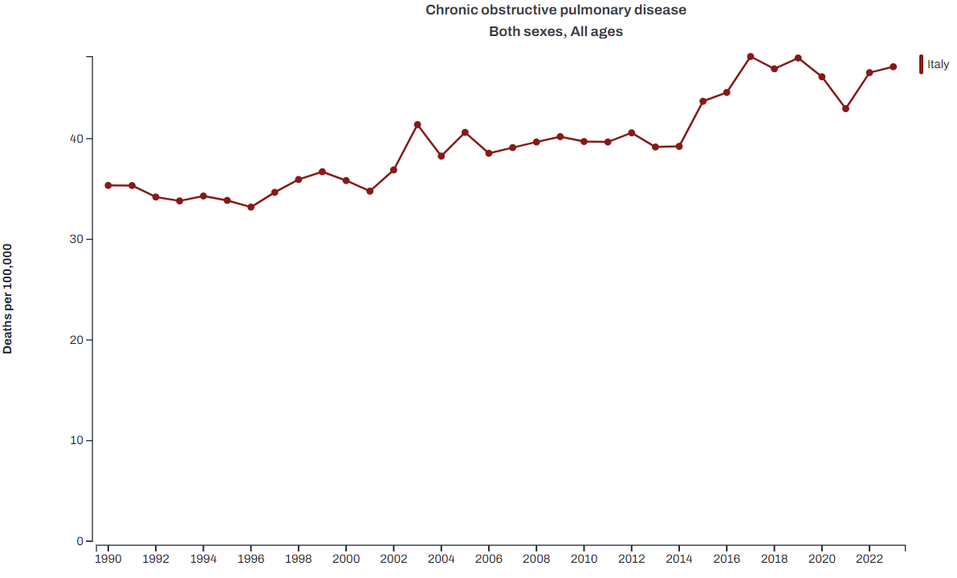
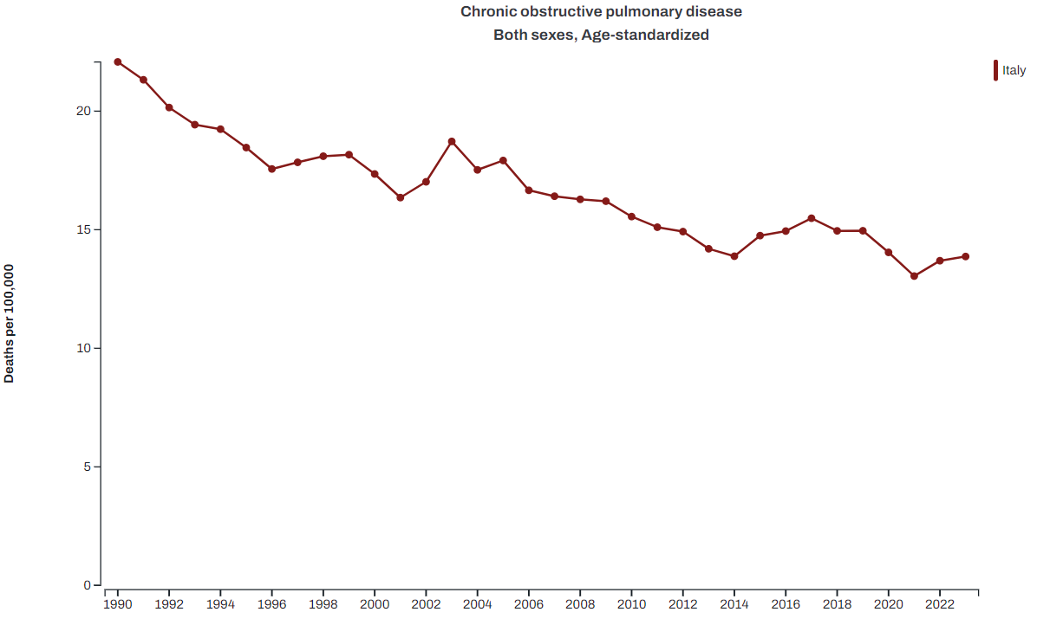
COPD mortality rates, 1990-2023, Italy, both sexes combined
When looking at crude rates, mortality caused by COPD increased since 1990
However, when focusing on age-standardized rates, mortality decreased markedly
→The apparent increase in crude mortality is largely driven by population ageing. As the population becomes older, more people reach ages where COPD mortality is more common.
→ The decline in age-standardized mortality indicates that the underlying risk of dying from COPD at a given age has decreased over time, likely reflecting reductions in the prevalence of major risk factors such as smoking.

Slide 12
Link to the Global Burden of Disease Study 2023: https://vizhub.healthdata.org/gbd-compare/#

