Slide 1
Diamanti artificiali

Slide 2
DND Detonation Nanodiamonds
Test Nos. 2, 5, and 6 were performed in the explosive chamber with a volume of 0.175 m³;
high explosives are TNT (2,4,6-trinitrotoluene), RDX (1,3,5-trinitro-1,3,5-triazacyclohexane), Z-TAKOT (2,4,8,10-tetranitro-5N-benzotriazolo/2,1-a/-benzotriazoli-6-um); HNAB (bis(2,4,6-trinitrophenyl)-diazin), TATB (1,3,5-triamino-2,4,6-trinitrobenzene), tetryl (N-methyl-2,4,6-trinitrophenyl nitramine), and picric acid (2,4,6-trinitrophenol); the gas medium in test Nos. 7–14 consisted of the detonation products after the previous tests.
Dolmatov, V.Y., et al. Obtaining of Detonation Diamonds from Individual Explosives. Combust Explos Shock Waves 57, 232–237 (2021). https://doi.org/10.1134/S001050822102012X

Slide 3
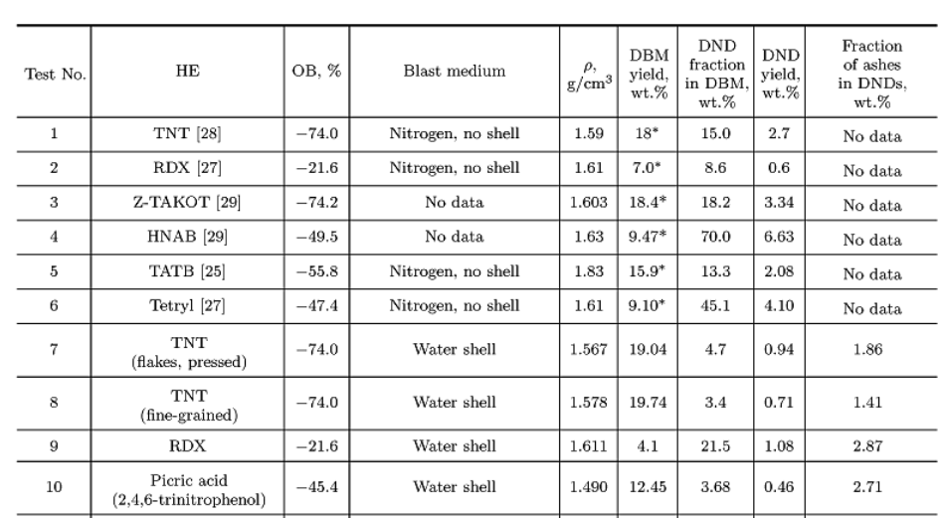
Yield of the diamond batch mixture (DBM) and DNDs
for different types of individual explosives and synthesis conditions

Slide 4
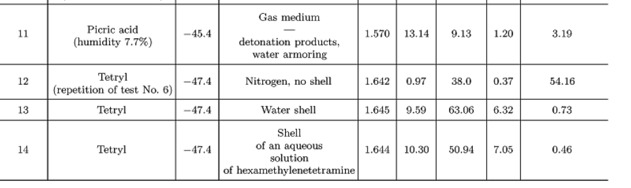
The pressure for tetryl was found to be 20–21 GPa, and the corresponding values for picric acid and TNT were approximately 19 GPa and 16–17 GPa
A new method was developed for industrial production of DND from an individual explosive (tetryl) with a large yield (6–7%) and a high content of DNDs in the diamond batch mixture (51–63%), which significantly simplifies chemical purification of DNDs.

Slide 5
The discovery of DND
The history is part of the development of explosive technologies in the synthesis of superhard materials
Diamonds were obtained by shock compression of graphite, and carbon black in spherical, and cylindrical storage ampoules
Phase diagram for carbon, and the parameters at the Jouguet point for the detonation of high-density charges of powerful explosives proved that the free carbon of DPs must condense in the form of diamond.
Vyacheslav V. Danilenko, 10 - On the Discovery of Detonation Nanodiamond, Editor(s): Olga A. Shenderova, Dieter M. Gruen, Ultrananocrystalline Diamond, William Andrew Publishing, 2006, 335-345, https://doi.org/10.1016/B978-081551524-1.50012-3 solo abstract

Slide 6
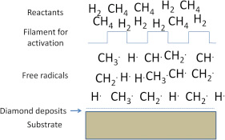
Diamanti da Chemical Vapor Deposition (CVD)
CVD di alcani, generalmente CH₄, in presenza di H₂. Eccesso di H₂ (>98%) Reazioni radicaliche. I radicali H· (atomi) sono prodotti o da un filamento caldo o in un plasma.
https://www.sciencedirect.com/topics/engineering/diamond-phase

Slide 7
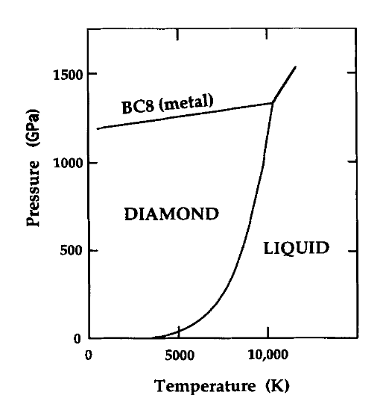
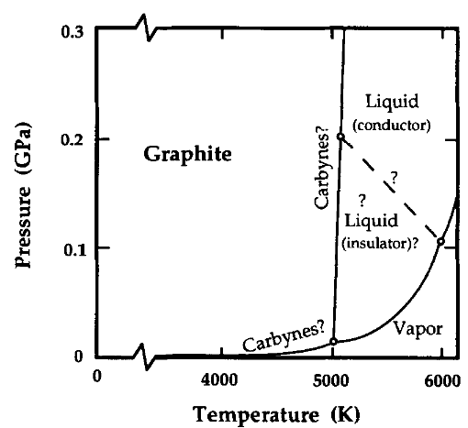
Digramma di fase del carbonio
1 GPa= 10000 bar
Regioni ad alta p e T (da calcoli teprici
Regioni a bassa p

Slide 8
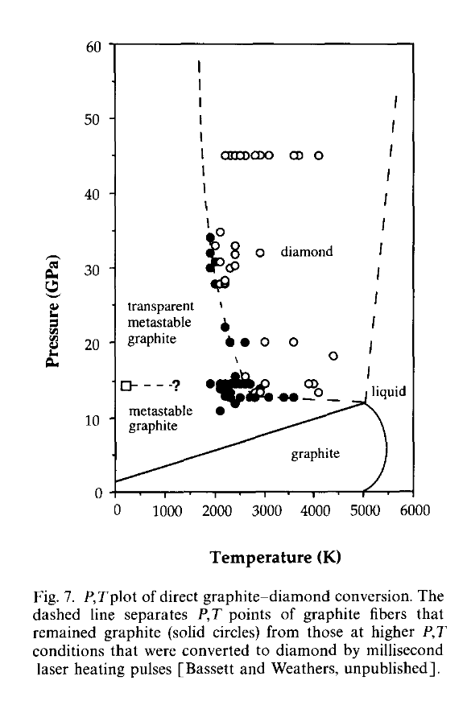
Diagramma di fase relativo alla conversione di C grafite in C diamante
F.P. Bundy, et al. The pressure-temperature phase and transformation diagram for carbon; updated through 1994, Carbon, 34,(2) 141-153, 1996
https://doi.org/10.1016/0008-6223(96)00170-4

Slide 9
Diamanti naturali
Diamond is the hardest natural material
Natural diamond is formed at depths of 150 km beneath the earth's surface in the mantle . After undergoing hundreds of millions of years of geological processes, the diamond was brought to the surface through events like volcanic eruptions.
In 1796, Tennant demonstrated that diamond is made of carbon by burning it to produce CO₂. The exploration of synthetic diamond began in 1871 after learning that natural diamond is created from carbon under extreme heat and pressure deep in the earth’s crust.
J. Zhang, et al. A review of diamond synthesis, modification technology, and cutting tool application in ultra-precision machining, Materials & Design, 2024, 237, 112577, https://doi.org/10.1016/j.matdes.2023.112577

Slide 10
Diamanti naturali
Diamond is one of three naturally carbon minerals native to the earth, the other two are graphite and lonsdaleite. Boyd et al [5] suggest that the vast majority of diamonds were formed in the deep lithospheric keel, approximately 150–200 km below the ancient Craton crust. Corresponding to pressures and temperatures of 70–80 kbar and 1400–1600 °C, some diamonds originated in the deeper lithospheric mantle (extending to a depth of at least 700 km) [27]. The Subsurface formation of diamond was brought to the surface by volcanic eruptions of kimberlite, and it was found at very low concentrations (parts per million) in kimberlite [5], as shown in Fig. 3.

Slide 11
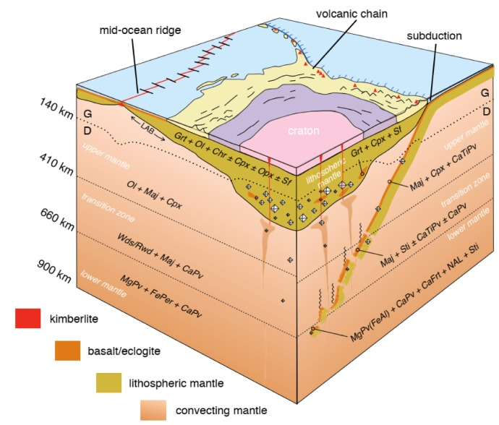
Distribuzione dei diamanti nella terra
In nature, diamond forms over a long time through the transformation of graphite under HTHP conditions in the Earth’s crust. The process requires extreme temperatures and pressures to surpass the reaction boundary without the help of a catalyst

Slide 12
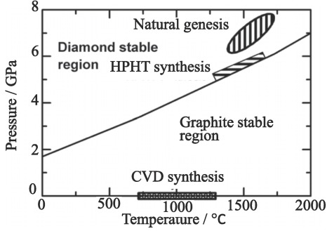
Diagramma di fase del carbonio

