Slide 1
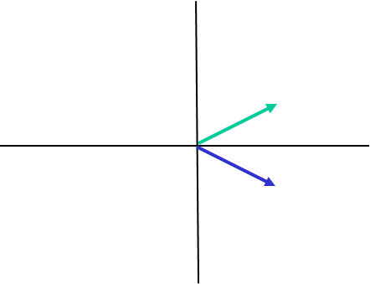
The Structure Factor
The diffracted wave from planes (hkl) is represented by the structure factor F_{hkl}
It is a complex number
Whose phase depends on the choice of the origin
Diffraction intensity
I_{hkl} = F_{hkl}·F*_{hkl} = |F_{hkl}|²
F_{hkl}
F*_{hkl}
F*_{hkl} is the complex conjugate of F_{hkl} |F*_{hkl}| = |F_{hkl}| φ*_{hkl} = - φ_{hkl}
The product of two complex numbers has a magnitude equal to the product of the magnitudes and a phase equal to the sum of the phases.

Slide 2
Origin and phase in the Argand diagram
The origin is chosen by convention on a symmetry element

Slide 3
Reflections with restricted phase
Centrosymmetric structures:
phase = 0 or 180°
Reflections from families of planes parallel to symmetry axes have
restricted phase. For example: h0l reflections in monoclinic system

Slide 4
Systematic absences
Reflections from planes perpendicular to symmetry with half-translation of odd order have zero intensity: e.g. 0k0 with k=2n+1 in P2₁
Reflections from planes perpendicular to symmetry with half-translation of even order have high intensity: e.g. 0k0 with k=2n in P2₁

Slide 5
Diffraction symmetry
-hk-l
hkl
In the monoclinic system, hkl reflections have the same structure factor as –hk-l reflections
In the orthorombic system F_{hkl}=F_{h-k-l}=F_{-hk-l}=F_{-h-kl}
In the tetragonal system the exchange of indices F_{hkl}=F_{khl} is added
Diffraction symmetry in one of the 32 crystalline classes

Slide 6
Friedel law
If the atomic species forming the crystal do not introduce a relative phase shift due to scattering (scattering factor without an imaginary component or crystals formed by a single element)
hkl
-h-k-l
|F_{hkl}|=|F_{-h-k-l}| φ_{hkl}=-φ_{−h-k-l} F_{-h-k-l}=F*_{hkl}
F_{hkl}²=F_{hkl}*F*_{hkl} = I_{hkl} I_{hkl}=I_{-h-k-l}
Neglecting small phase differences due to anomalous scattering, a center of symmetry is always present in diffraction intensities.
Diffraction symmetry in the 11 Laue classes

Slide 7
Scattering by an atom
s_{o}
t
1
p
s
2θ
r
o
q
2
The wave scattered at point p (identified by the vector r) by an infinitesimal volume element dv with electron density ρ(r) has:
amplitude ρ(r)dv (number of electrons in the infinitesimal volume dv)
phase ϕ relative to the origin O, which depends on the optical path difference t-q = r·s_{o}-r·s
where s_{o} and s are unit vectors in the directions of the incident and scattered beams.
The phase difference is equal to: 2π·r·(s_{o}-s)/λ.
By defining: r*=(s_{o}-s)/λ, the wave scattered from point p at scattering angle 2θ is: ρ(r)exp(2πir·r*)dv.
The total scattered wave from an atom is obtained by integrating over the entire atomic volume:
f(r*) = ∫_{vol.atom} ρ(r)exp(2πir·r*)dv

Slide 8
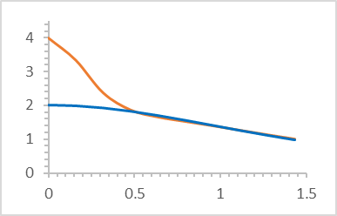
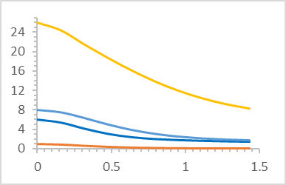
Atomic Scattering Factor
Due to spherical symmetry: f(r*) = f(|r*|) with |r*| = |s_{o}-s|/λ = 2senθ/λ
The scattering factor is function of 2senθ/λ
For θ = 0 all scattered waves of points p are in phase
f(0) = Z the number of electrons of the neutral atom
s_{o}-s
s_{o}
s
θ
θ
The atomic scattering factor (form factor), f(r*) is the Fourier transform of the atom’s electron density, ρ(r)
|s_{o}-s| = 2senθ
f(r*)
f(r*)
Fe
Be
Be²⁺
O
C
H
r* = 2senθ/λ [Å⁻¹]
r* = 2senθ/λ [Å⁻¹]

Slide 9
Scattering from the crystallographically independent unit
(Result of the interference of the N interpenetrating lattices defined by N atoms not related by symmetry)
O
r₃
Scattering of atom 1 f₁(r*) = f₁exp(2πir₁.r*)
where f₁ is the atomic scattering of atom 1
Total scattering F(r*) = f₁ + f₂ + f₃ + … f_{N}
F(r*) = ∑ f_{j} exp(2πir_{j}.r*)
sum of j from 1 to N
r₁
r₂
3
2
1
f₃
f₄
f₁
f₂
F
r real space of the cell with fractional coordinates x,y,z
r* reciprocal space with coordinate h,k,l
r*
1/d_{hkl}
hkl
r·r*= distance of point xyz from plane hkl/d_{hkl}
2πr·r*= φ phase of the wave scattered by point xyz
with respect to the plane hkl
r
xyx
d_{hkl}
r·r*= hx+ky+lz

Slide 10
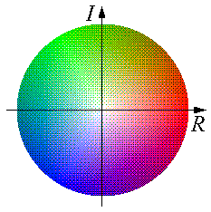
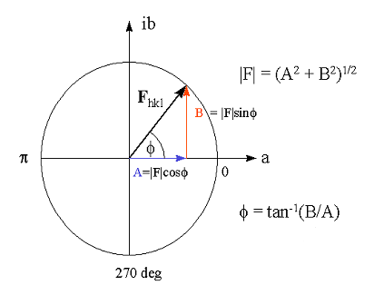
Structure Factor representation
Unit Cell
|F| intensity
Φ color
1
1
1
F
(
h
,
k
,
l
)
=
V
∫
∫
∫
ρ
(
x
,
y
,
z
).
exp[
2
π
i
(
hx
+
ky
+
lz
)]
.
dxdydz
x
=
0
y
=
0
z
=
0
Reflection
Electron Density
FOURIER TRANSFORM
F(h,k,l) = ∑_{j} f_{j} exp[2πi(hx_{j} + ky_{j} + lz_{j})]
http://www.ysbl.york.ac.uk/~cowtan/fourier/fourier.html
Each structure factor is the vector sum of the scattering from the individual atoms
Argand Diagram
2πi(hx_{j}+ky_{j}+lz_{j})
f_{j}e
F(hkl)
F(h,k,l) = |F(hkl)|exp[iφ(hkl)] = A(hkl) +iB(hkl)
|F(hkl)| amplitude and φ(hkl) phase

Slide 11

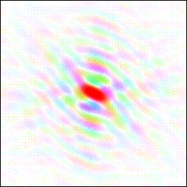
Electron Density
INVERSE FOURIER TRANSFORM OF STRUCTURE FACTORS
Fourier synthesis: F ⇒ ρ
ρ(xyz) = (1/V)∑_{h} ∑_{k} ∑_{l} |F(hkl)|exp[-2πi(hx+ky+lz)-φ(hkl)]
DIRECT SPACE
RECIPROCAL SPACE
Fourier
Transform
ELECTRON DENSITY
STRUCTURE FACTORS

Slide 12
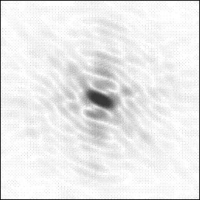
Phase Problem
|F|(cat)
Diffraction
Image
Fourier
Transform
φ(cat) ?
|F|(cat),φ(cat)

Slide 13

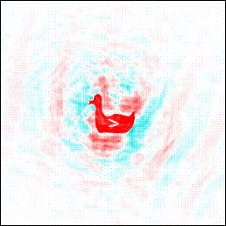
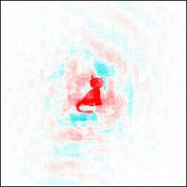
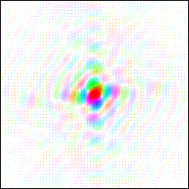
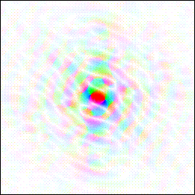
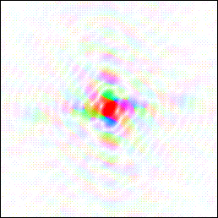
Importance of phase and amplitude
Fourier
Transform
Fourier
Transform
Fourier
Transform
Fourier
Transform
|F|(cat),φ(cat)
|F|(duck),φ(duck)
|F|(cat),φ(duck)
|F|(duck),φ(cat)

Slide 14
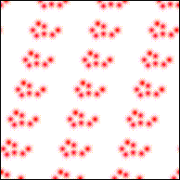
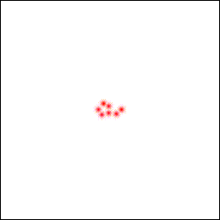
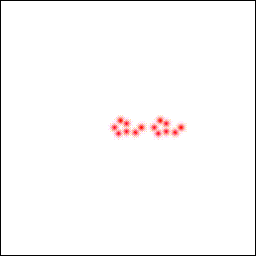
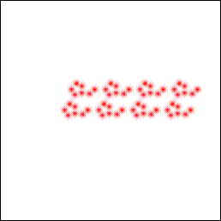
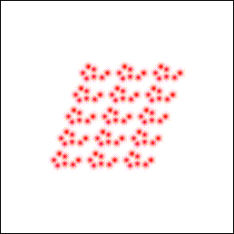
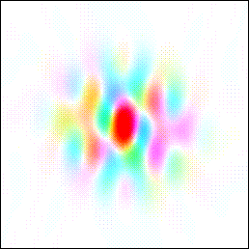
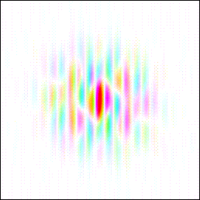
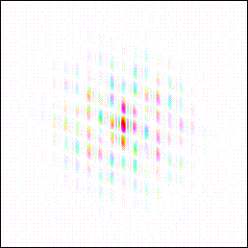
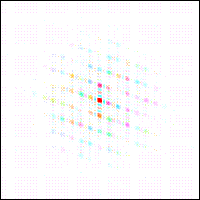
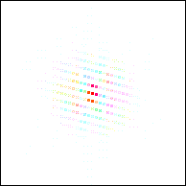
DIRECT SPACE
RECIPROCAL SPACE
Fourier
Transform
ELECTRON DENSITY
STRUCTURE FACTORS

Slide 15
Patterson Function
P(xyz) = 1/V ∑_{h}∑_{k}∑_{l} I(hkl) exp[-2πi(hx+ky+lz)]
“Structure”
Y
B
The Patterson function is the Fourier transform of the diffraction intensity
The Patterson function can be calculated directly from the measured intensities without knowing the phase
The maxima of the Patterson function represent the map of interatomic vectors of the structure
A
C
N atoms
X
“Patterson”
V
AB
U
AC
BC
N(N-1) interatomic vectors

