Slide 1
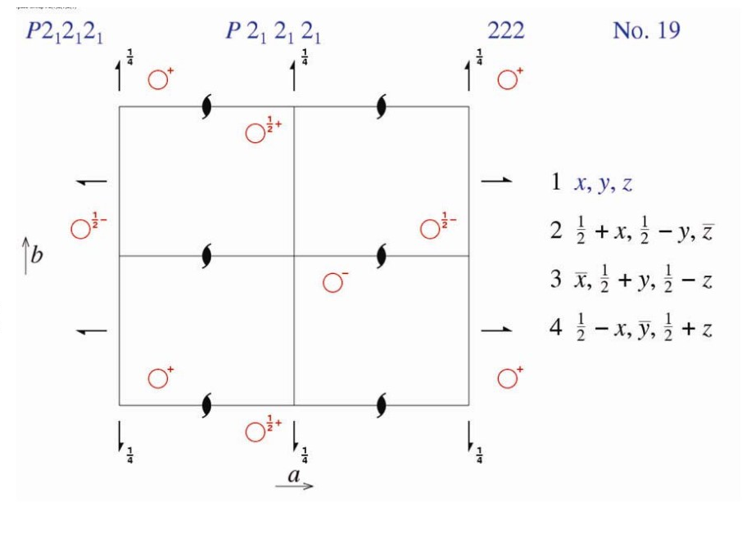
Patterson interpretation
Resolution of the phase problem by the heavy-atom
In the case of metal complexes, and more generally of crystals with atoms having many core electrons, the phase problem can be solved using the heavy-atom method by interpreting the Patterson function, whose maxima are dominated by the interatomic vectors between heavy atom and heavy atom
Equivalent positions
Space group P2₁2₁2₁
1 independent atom
4 atoms in cell

Slide 2
Theoretical Patterson
 | x,y,z | -x+1/2,-y,z+1/2 | -x,y+1/2,-z+1/2 | x+1/2,-y+1/2,-z
x,y,z | 0,0,0 | -2x+1/2,-2y,1/2 | -2x,1/2,-2z+1/2 | 1/2,-2y+1/2,-2z
-x+1/2,-y,z+1/2 | 2x-1/2,2y,-1/2 | 0,0,0 | -1/2,2y+1/2,-2z | 2x,1/2,-2z-1/2
-x,y+1/2,-z+1/2 | 2x,-1/2,2z-1/2 | 1/2,-2y-1/2,2z | 0,0,0 | 2x+1/2,-2y,-1/2
x+1/2,-y+1/2,-z | -1/2,2y-1/2,2z | -2x,-1/2,2z+1/2 | -2x-1/2,2y,1/2 | 0,0,0
Patterson map
If the number of heavy atoms to be located is small, the sites can be found directly using the Harker sections.

Slide 3
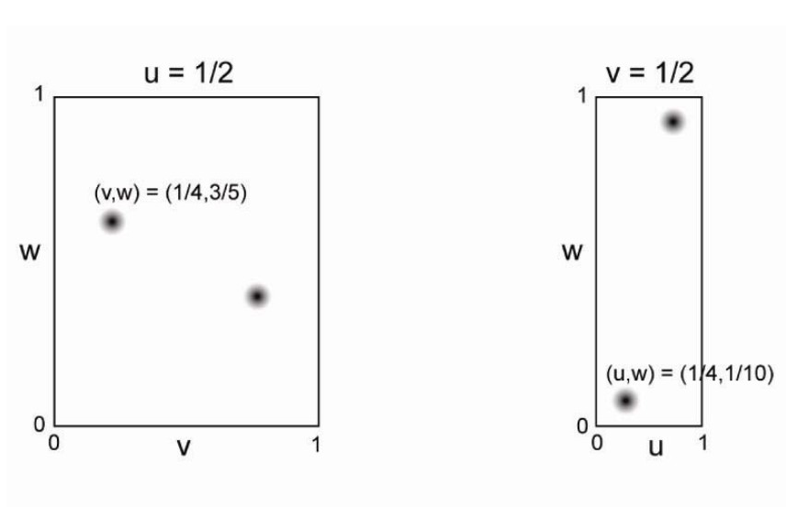
Harker sections
Relationships between symmetrically related atoms produce peaks in the Patterson function on certain planes or along certain lines. Harker sections are portions of the Patterson map that contain a large proportion of the readily interpretable information because they contain many such Harker peaks (vectors between space-group equivalent atoms).
Harker peaks
0.5, 0,25, 0.60
0.25, 0.5, 0.10
Harker sections
1/2,-2y+1/2,-2z = 0.5, 0.25, 0.60
y = 0.125 z = -0.30 or y = -0.125 z = 0.30
2x,1/2,-2z-1/2 = 0.25, 0.5, 0.10
x = 0.125 z = -0.30 or x = -0.125 z = 0.30
x = 0.125 y = 0.125 z = -0.30 or
x = -0.125 y = -0.125 z = 0.30

Slide 4
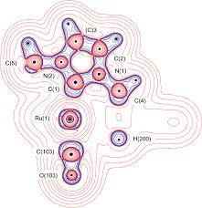
From the position of the heavy atom, its contribution to the structure factor (magnitude and phase) can be calculated
With the phases, electron density maps can be calculated, from which the other atoms of the structure can be located.
The new phases will be better than the previous ones, and the new map will be clearer. New atoms can be located.
Interactive cycles continue until the structure is completed.

Slide 5
Anomalous dispersion
Imaginary
When the wavelength is far from an element’s absorption edges (associated with electronic transitions), its atomic scattering factor can be treated as a real number.
Real
f₀
When the X-ray energy is close to an electronic transition (i.e., near an absorption edge), the real part of the atomic scattering factor is modified by Δf′, while the imaginary component Δf′′ appears, affecting the phase of the scattering
f_{j} = f₀ + Δf’ + iΔf”
Imaginary
Δf”
Real
f₀
Δf’
If f_{j} is real, the Friedel law is always valid:
|F(hkl)| = |F(-h-k-l)| |F(hkl)|² = I(hkl) = I(-h-k-l)
If f_{j} has an imaginary component and crystal in not centrosymmetric, generally:
|F(hkl)| ≠ |F(-h-k-l)| and therefore I(hkl) ≠ I(-h-k-l)

Slide 6
From Friedel pairs to Bijvoet pairs
iB
f”
f’
F_{PH}(hkl)
F_{H}
F_{P}(hkl)
A
F_{P}(-h-k-l)
F_{PH}(-h-k-l)
F_{H}
In the presence of anomalous scattering, the model with coordinates xyz can be distinguished from the model -x-y-z
It is possible to determine the handedness of crystals and the absolute configuration of molecules.

Slide 7
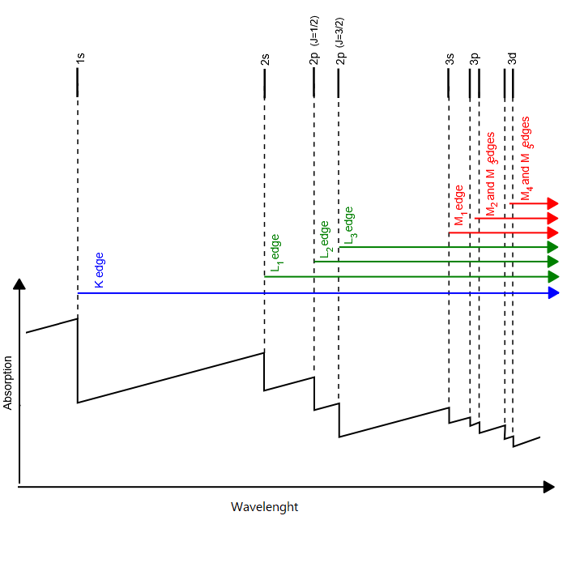
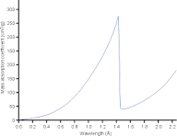
Absorption edges
Absorption K-edge of Ni
Nickel filters are used to selectively absorb Cu-Kβ
radiation

Slide 8
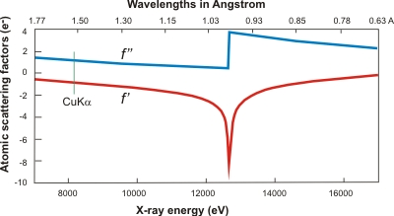
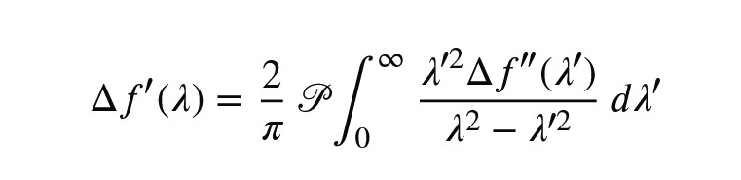
Scattering factor corrections
The imaginary dispersion correction Δf”
is directly proportional to the linear attenuator coefficient µ.
Δf”(λ)= µ(λ)/2r_{e}λ
where r_{e} is the classical electron radius = 2.818 10⁻¹⁵
The real dispersion correction Δf’
can be obtained by Kramers-Kronig integral
where is Cauchy principal value of the
integral (singularity for λ=λ’)
Δf′(λ) ∼ “weighted average” of Δf”​(λ′)
Selenium scattering factor corrections

Slide 9
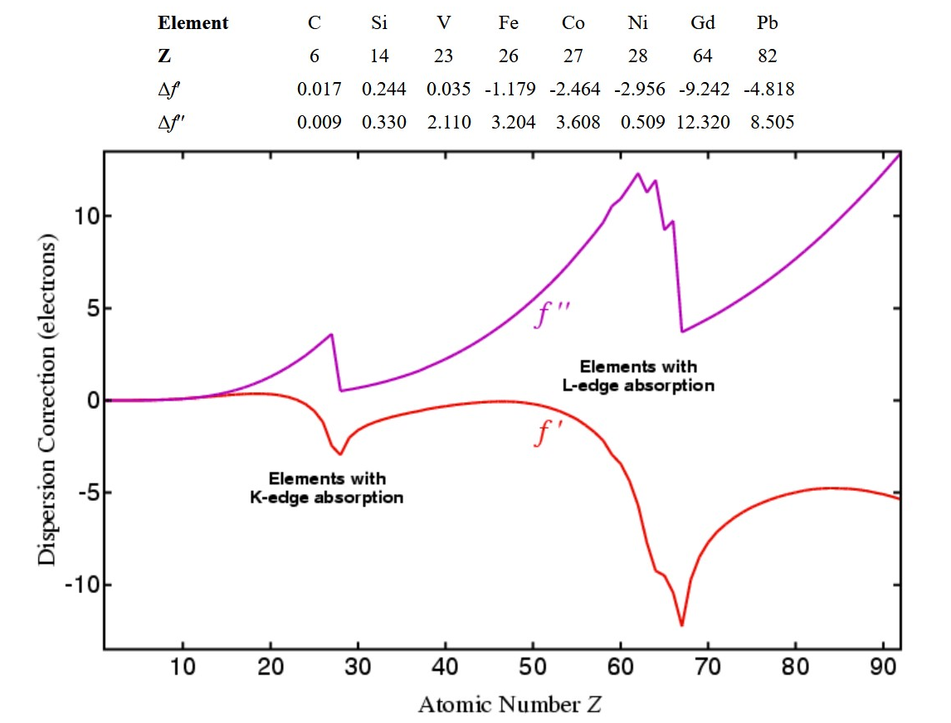
Dispersion corrections of few elements for Cu Kα radiation

Slide 10
Solution of the phase problem using direct methods
Phases from diffraction intensities through probabilistic relationships
It uses normalized structure factors (E_{hkl}) with respect to the mean value for reflections at same resolution <|F|²> corresponding to a random distribution of atoms in the unit cell
|E_{hkl}|²=|F_{hkl}|²/<|F|²>
Electron density
Atomicity: concentrated in discrete atoms
Positivity: cannot be negative.
Identical Atoms: same chemical type
ρ(xyz) and ρ²(xyz) are similar
The squaring method involves the self-convolution of the structure factors, leading to the Sayre equation
E_{hkl} = ΣE_{h’k’l’}E_{h-h’k-k’l-l’}

Slide 11
Triplet relationships
From Sayre's equation, considering triplets of strong reflections that dominate the summation, relations between the phases of these reflections are obtained:
φ_{hkl} ≈ φ_{h’k’l’} + φ_{h-h’k-k’l-l’}
Considering a small set of reflections to which a set of random phases is assigned, the phases are extended to all reflections in a manner consistent with the relations of the triplets (and other relationships, such as quadruplet, etc.)
extended phases
by relationships
|F_{hkl}|
φ_{hkl}
electron density
φ_{hkl}
figure
of merit
random
phases
|F_{hkl}|
ρ_{xyz}
The solution consistent with positive, localized electron density and chemically consistent molecular geometry is selected by figures of merit

Slide 12
Triplet relationship
E_{hkl} = f; φ_{hkl} = 0
E_{h’k’l’} = f; φ_{h’k’l’}=0 ⇒
E_{h-h’k-k’l-l’} = f; φ_{h-h’k-k’l-l’} =0
h’k’l’
hkl
h-h’k-k’l-l’

Slide 13
Triplet relationship
E_{hkl} = f; φ_{hkl} = 0
E_{h’k’l’} = f; φ_{h’k’l’}=π ⇒
E_{h-h’k-k’l-l’} = f; φ_{h-h’k-k’l-l’} = π
h’k’l’
hkl
h-h’k-k’l-l’

Slide 14
Solution of the phase problem via Patterson Function Superposition
“Structure”
“Patterson superposition”
y
B
A
y
N atoms
y
C
x
O
O
x
x
“Patterson”
y
CB
AB
CA
O
x
2N massimi
AC
BA
BC
N² maxima

Slide 15
Algorithm of SHELXT program
Patterson overlay and model building
Iterative cycles in reciprocal space using the space group P1 (Fourier transform and inverse Fourier transform)
modifying the electron density (masks to define the atoms,
randomly removing some peaks of electron density)
Selection of the solution using figures of merit
Determination of the origin position using the phases
Determination of the space group by testing possible solutions
Assignment of chemical elements to the electron densities
Isotropic refinement
Real Space
Reciprocal Space

