Slide 1

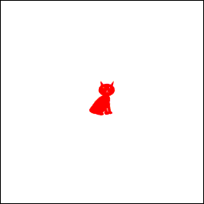
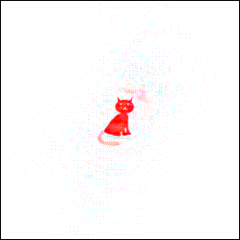
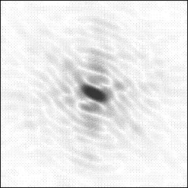
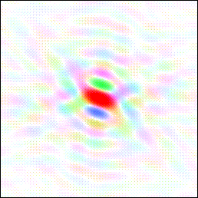
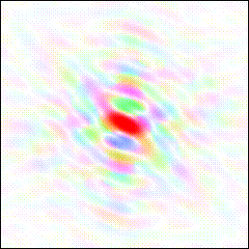
Electron density maps |F_{o}|
?
Fourier
transform
Fourier
synthesis
Diffraction
|F|(cat) = |F_{o}|
F(cat-tail)=|F_{c}|φ_{c}
|F_{o}| φ_{c}

Slide 2

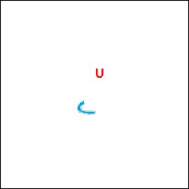
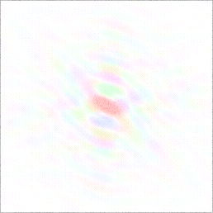
Fourier Difference |F_{o}|-|F_{c}|
Diffraction
Fourier
Transform
Fourier
Synthesis
|F|(cat) = |F_{o}|
F(cat-tail+horns)=|F_{c}|φ_{c}
|F_{o}|-|F_{c}| φ_{c}

Slide 3
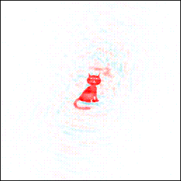
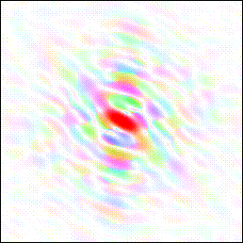
2Fo-Fc maps
Fourier
Transform
Fourier
Synthesis
Fourier
Synthesis
F(cat-tail)=|F_{c}|φ_{c}
|F_{o}| φ_{c}
2|F_{o}|-|F_{c}| φ_{c}

Slide 4
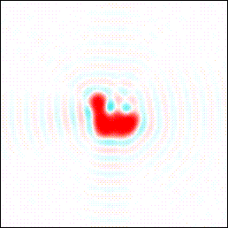

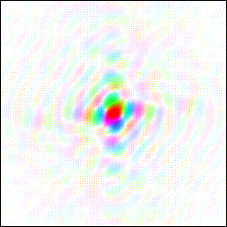
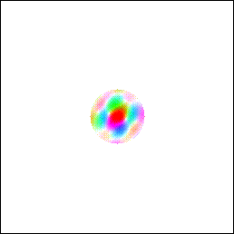
Resolution limits
Fourier
Transform
RESOLUTION = d_{mim} = λ/2senθ_{max}
2.0-3.0 Å Typical resolution of protein structures with convoluted electron density. Amino acid side chains can be identified with 50% probability without additional information. The most strongly bound water molecules can be located, and the structure is refined with isotropic thermal motions using geometric constraints for atoms.
1.2-0.7Å Density maps with resolved atoms, atomic-level resolution. Possibility to locate even hydrogen atoms. Independent atom refinement with anisotropic thermal B-factors.

Slide 5
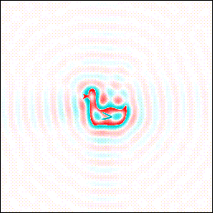
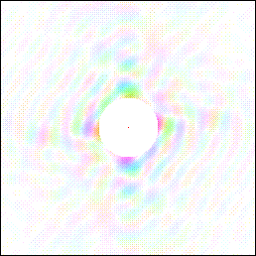
Effects on maps of incomplete data
Fourier
Tranform
Lack of low-resolution data (e.g., due to beamstopper or detector saturation)
The map is noisy and it may be difficult to locate the most mobile part of the structure/solvent

Slide 6
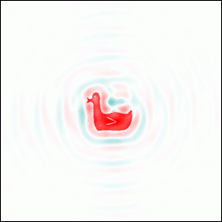
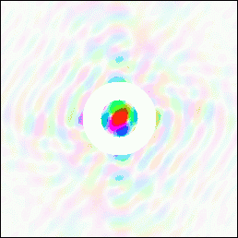
Effects on maps of incomplete data
Fourier
Transform
Missing a complete data shell (e.g., due to ice diffraction rings)
Edges are quite sharp (good resolution), but are marred by the lack of intermediate resolution data

Slide 7
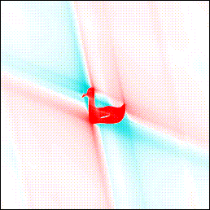
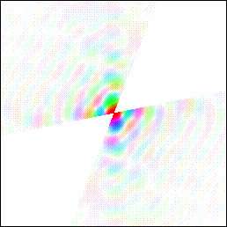
Effects on maps of incomplete data
Trasformata
di Fourier
Missing entire data areas (e.g., due to low symmetry and loss of azimuthal reflections)
The electron density perpendicular to the missing data is weaker and there may be problems with anisotropic refinement of the atoms

Slide 8
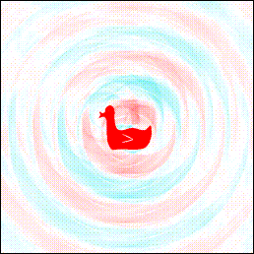
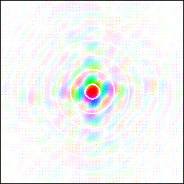
Effects on maps of incomplete data
Fourier
Transform
10% missing data in narrow shells (e.g., due to overlap with a powder spectrum)
Presence of significant noise in the electronic density

Slide 9
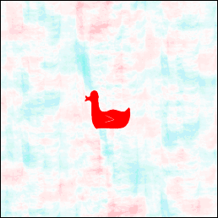
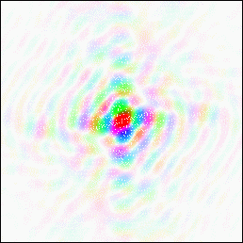
Effects on maps of incomplete data
Fourier
Transform
10% data missing at random
Small noise in the electron density

Slide 10
REFINEMENT
STARTING MODEL
REFINEMENT CYCLES TO MINIMIZE THE DIFFERENCES BETWEEN|
F_{O}|² and |F_{C}|² OR ⏐F_{O}⏐ and ⏐F_{C}⏐.
by changing xyz and B of the atoms
STRUCTURE FACTORS CALCULATION
(Phases)
Electron density maps calculation
|F_{o}|; 2|F_{o}|-|F_{c}| ; |F_{o}|-|F_{c}|
Modeling of atoms in the electron density maps
END of
REFINEMENT

Slide 11
From intensities to the moduli of structure factors
I_{hkl} = k |F_{hkl}|² L(θ) p(θ) A(θ) d(t)
L(θ) is the Lorentz factor, which accounts for the angular scanning velocity at which the reciprocal lattice point passes through the Ewald sphere (it depends on the diffraction geometry).
p(θ) is the polarization factor of the radiation, due to diffraction by the crystal and possibly also due to the source (synchrotron) and/or the monochromator crystal.
A(θ) is the attenuation factor of the primary and diffracted beams due to absorption (of the Lambert–Beer type I = I0 exp^{-μx}) integrated over the entire volume of the crystal for all the different optical paths. It depends on the shape and size of the crystal and on its chemical composition. For spherical crystals, the correction depends only on θ.
d(t) is the decay of diffraction intensity over time (due to X-ray damage or non-constant X-ray dose on the crystal).

Slide 12
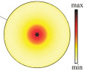
The thermal motion
Up to now, we have considered atoms as “static” scattering centers,
i.e., fixed at specific positions within the unit cell.
However, they are subject to oscillations around their equilibrium positions.
These oscillations depend on temperature and also occur at T=0 K.
The parameter that describes the oscillation of a given atom as a function of the mean square displacement from the equilibrium position is:
B = 8π²<u²> = 8π²U
<u²> is the mean square displacement for
isotropic harmonic motion around the
equilibrium position (in Å²)

Slide 13
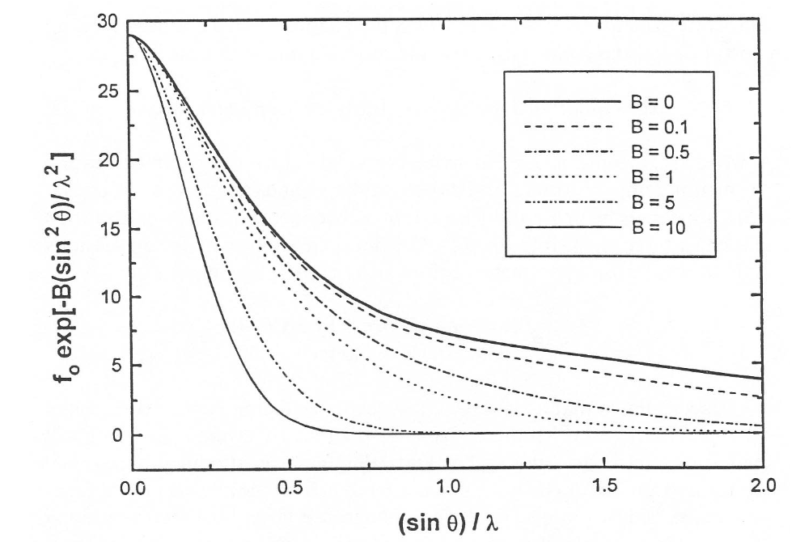
The effect of thermal motion on scattering
The thermal motion, by distributing the electron density, attenuates the atomic scattering as a function of the diffraction angle according to the Debye–Waller factor.
f_{j} = f_{j}ºexp −B(sin²θ/λ²)

Slide 14
The effect of thermal motion on scattering
At room temperature, typically:
Ionic crystals have 0.5 < Biso < 2.0
Molecular crystals have 3.0 < Biso < 6.0
At 100 K, the B values decrease by more than half.
B_{iso} =1.5 corresponds √<u²> = 0.14 Å (9% of d(C-C) 1.5 Å)
B_{iso} = 4 corresponds √<u²> = 0.22 Å (15% of d(C-C) 1.5 Å)
At high θ (>30° for Mo-Kα radiation),
ionic crystals show diffracted intensity, while molecular crystals do not.
Lowering the temperature increases the maximum diffraction angle (better resolution) and improves the accuracy of atomic positions.

Slide 15
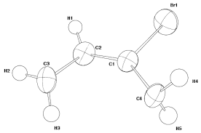
Anisotropic thermal factors
The mean square displacement can be isotropic or anisotropic (i.e., different depending on the direction, and therefore the region of space will be an ellipsoid described by six parameters: U11, U22, U33, U12, U13, U23​).
Anisotropic thermal factor
exp−2π²(h²a*²U₁₁+k²b*²U₂₂+l²c*²U₃₃+hka*b*U₁₂+hla*c*U1₃+klb*c*U₂₃)
Representation with ellipsoids enclosing 50% probability.

Slide 16
Least Squares Method (Legendre, 1806)
A numerical technique used to find the best agreement between a given model and a set of experimental data.
It is assumed that the best parameters describing the model are those that minimize the sum of the squared differences between observed and calculated quantities (i.e., minimize R).
Weighted least squares assign a statistical weight to each observable (typically inversely proportional to its estimated error).
Given a set of parameters P = {p1, ..pm}, the values |Fc(P)| are compared with |Fo| and the following quantity is minimized with respect to P:
Q = Σhkl w_{hkl}[|Fo_{hkl}|-|Fc_{hkl}|]² (refinement on F)
or: Q = Σhkl w_{hkl}[|Fo²_{hkl}|-|Fc²_{hkl}|]² (refinement on F²)
where w_{hkl} = 1/σ²(|Fo_{hkl}|)

Slide 17
P includes, for each non-H atom, x, y, z and B (isotropic model, 4 parameters) or x, y, z, b₁₁​, b₂₂, b₃₃, b₂₃​, b₁₃​ and b₁₂ (anisotropic model, 9 parameters), and possibly an occupancy factor (in the case of disorder).
In addition, there is always a scale factor, plus a possible correction for secondary extinction (affecting strong low-angle reflections)
The number of parameters to be refined for N non-H atoms is 9N+1
For example, for a simple structure such as sucrose (C₁₂H₂₂O₁₁)
23 non-H atoms, the number of parameters is 23 x 9 + 1 = 208
For sufficient accuracy without over-refinement problems, about 7 to 12 experimental data points per parameter are required, i.e. around 2000 independent observed reflections for an anisotropic model of sucrose.
If about 1000 reflections are collected, refinement can be carried out by modeling the thermal motion of atoms only in an isotropic way.

Slide 18
From a mathematical point of view: one must find the absolute minimum of a function Q, which is nonlinear in 208 real variables, by setting to 0 the derivative of Q with respect to each parameter pi
This process cannot be solved analytically without a starting model.
However, it can be approached if approximate values po are known, by calculating the derivatives using a first-order Taylor expansion.
The solution can be obtained through several least-squares cycles, until convergence is reached
Convergence issues may arise due to correlations between the parameters being refined (for example, between thermal motion and occupancy parameters, and/or overlapping electron densities in the case of structural disorder).

Slide 19
Constraints and Restraints
To facilitate the convergence process of least squares, or to impose specific geometric conditions, it is possible to constrain the refinement process by reducing the number of parameters or limiting the range of variability of parameters.
Constraint: an exact mathematical relationship that fixes a parameter or relates different parameters.
Examples:
Atoms located on crystallographic symmetry elements: for example, on a twofold axis along the b axis, the coordinate y=0 is fixed; for an atom on a diagonal plane xxz, x and y are set equal. Anisotropic thermal motions have the constraints imposed by crystal symmetry.
For a phenyl group one can impose exact D6h symmetry: out of the 6x3(xyz)=18 parameters, only 7 remain independent (xyz, Rx,Ry,Rz e dC-C) or alternatively use rigid-body models by refining only the position of the center of mass and its rotation.
For substituting atoms (site disorder), for example Fe(II) and Mg(II) located on the same site, the occupancy parameters can be constrained as: occ(Fe) = [1.0 - occ(Mg)]

Slide 20
Restraint: Additional experimental observation from the analysis of databases, external models, or spectroscopy (NOE, IR), which constrains the range of possible values for certain parameters (pi ± Dpi) or for a function of them, d(pi,n)±Δd(pi,n).
It increases the number of equations (one for each observation), and these observations need to be “weighted”.
QTOT = Σhkl w(hkl)[|Fo(hkl)|-|Fc(hkl)|]² + WΣp wp[do-dc]²
QTOT, overall function to be minimized, which may include geometric, energetic, spectroscopic, and other terms.
Examples:
Distances between atoms; bond angles.
Isotropic thermal parameters (variation within a certain σ)
Anisotropic thermal parameters (with restrained anisotropy)

Slide 21
Structural Model Refinement and Evaluation Procedure
During the model-building and refinement process:
• The disagreement factor Rw must decrease (minimization of Q).
• The atoms must remain close to their starting positions.
• The B factors must be homogeneous and consistent with connectivity
• The bij factors must not be excessively anisotropic or produce negative ellipsoids.
• The difference Fourier map must flatten out (through interpretation of peaks and minima) absolute electron density residuals very low.
The weighting scheme is checked and updated.
Refinement must be brought to convergence by removing any possible parameter correlation issues.
Outlier reflections are checked (for example, when (|Fo(hkl)|-k|Fc(hkl)|/σ|Fo(hkl) > 6) and may be omitted if necessary.

Slide 22
At the End of the Refinement Process:
-The R factor must be acceptable (depending on the complexity of the structure and the disorder present), and the goodness-of-fit (gof) should be close to 1.000.
-The final difference Fourier map must show absolute peaks (Δρ) smaller than σ(Δρ).
-Any geometrical anomalies in the molecule or in packing interactions must be evaluated, commented on, and justified.
- The checkcif program systematically checks for anomalies in the model refinement, displaying Alerts ranked according to their level of importance.

Slide 23
The esds of each parameter obtained from the refinement procedure have statistical meaning only for random errors, assuming the absence of systematic errors (which are very common).
They often represent precision, not accuracy.
If the distribution of random errors is normal, then least-squares theory estimates that:
Two values differing by less than 2 esd are equal with 95% probability.
Two values differing by less than 2.7 esd are equal with 99% probability.
Commonly, two values are compared using the rule:
If they differ by less than 3 esd, they are not statistically different.
For example:
1.560(7) is not significantly different from 1.542(3)
Whereas 1.560(3) is significantly different from 1.542(2)

Slide 24
Common Systematic Errors:
Scattering factor curves are generally assumed to be spherical. Covalently bonded atoms are not spherical, and their electron density deformation toward the bonds is not always negligible.
Atomic motion in a crystal can be correlated (e.g., collective lattice vibrations) or anharmonic (ellipsoids alone are insufficient).

