Slide 1

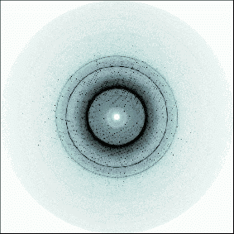

Recording of the diffraction pattern
Diffraction pattern
crystal
X-ray beam
X-ray
source
diffraction
detector
goniometer
The direction of the diffracted X-rays is related via Bragg's law to the unit cell parameters of the crystal; the intensities are characteristic of the type of atoms and their relative position within the unit cell.

Slide 2
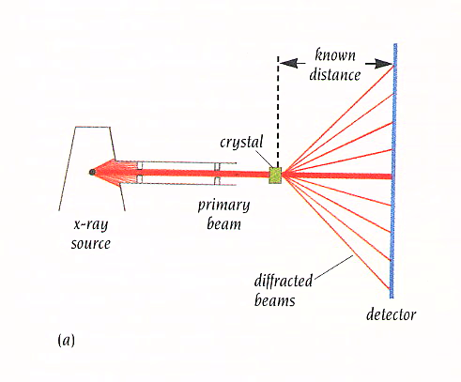
Data collection
2θ

Slide 3
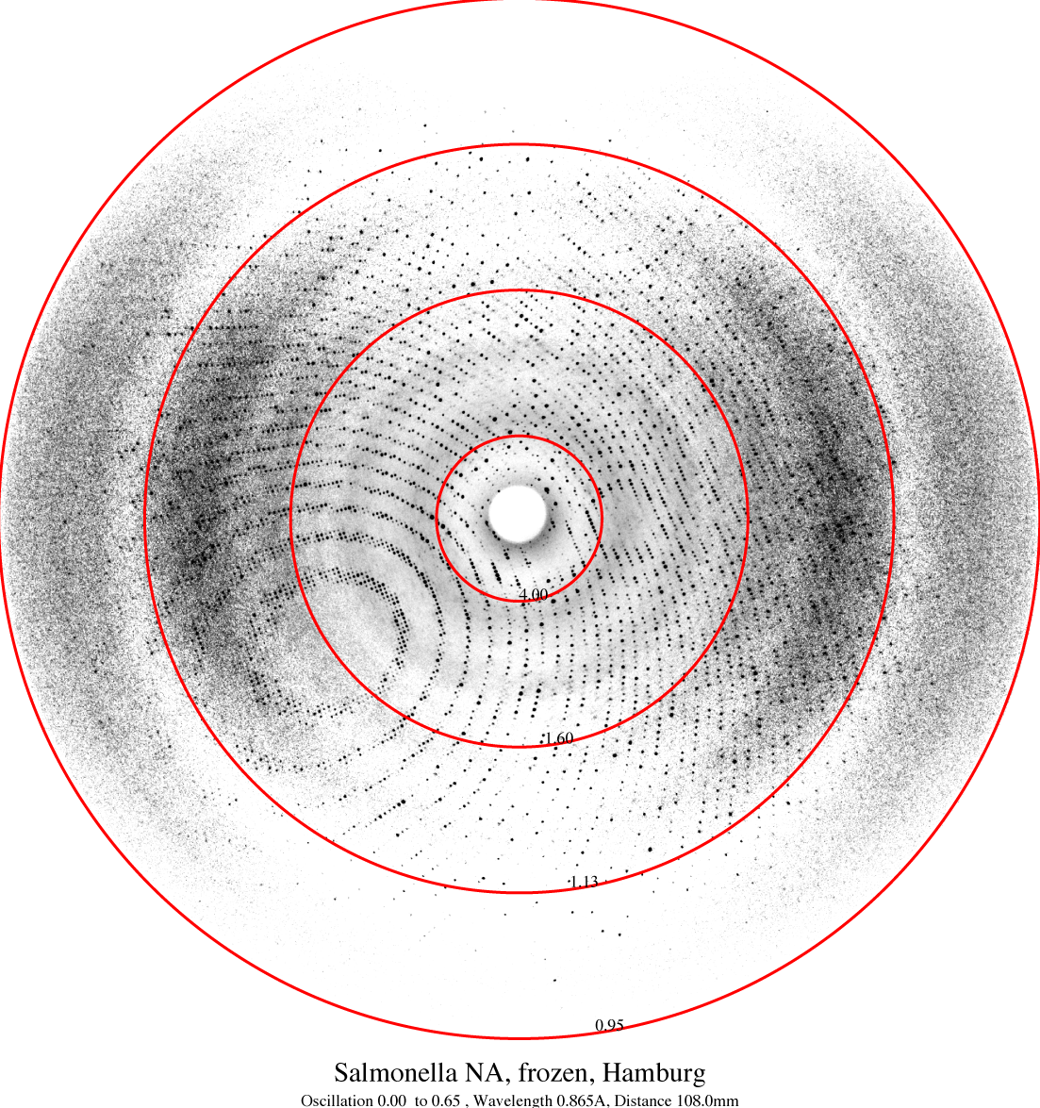
Indexing = assigning the HKL indices to all reflections = determining the real lattice (unit cell) by means of the reciprocal lattice (reciprocal cell).
0.95
1.13

Slide 4
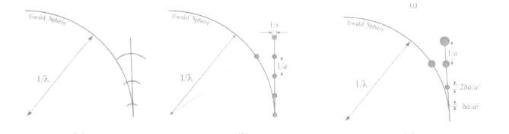
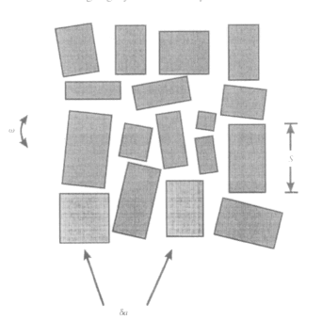
Mosaicity
In principle, the points of a reciprocal lattice obtained from an infinite-sized crystal are mathematical points; in practice, this is not true both because the crystal is finite and because:
The single crystal can be viewed as being composed of numerous partially misaligned domains.
The various domains (which diffract at the same Bragg angles) are brought into diffraction at different times and crystal rotation angles.
The intensity of a single reflection typically follows a Gaussian distribution in an ideally imperfect crystal

Slide 5
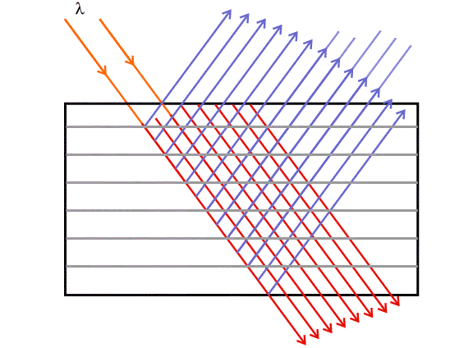
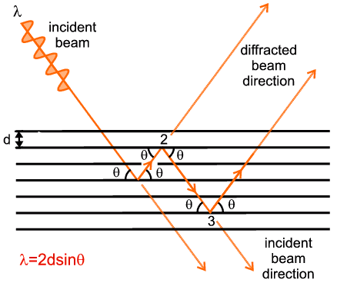
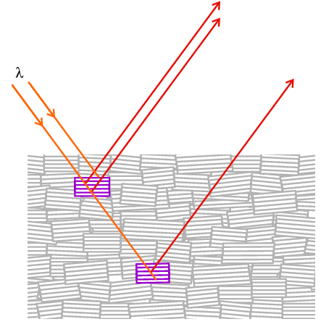
Crystal Perfection and Diffraction Theory: Kinematic versus Dynamic Diffraction
Ideally Perfect Crystal = Dynamic Diffraction
Dynamic Diffraction: I ∝ |F|
Kinematic Diffraction: I ∝ |F|²
Ideally Imperfect Crystal = Kinematic Diffraction

Slide 6
Radiation Damage
High-brilliance sources produce radiation damage to crystals.
Radiation damage causes a reduction in crystal lifetime, observed both as a decrease in the maximum diffraction angle (resolution) and a worsening of the individual reflection profiles.
For example, protein crystals are damaged by exposure to the X-ray beam. X-rays promote the radiolysis of water molecules, which can lead to damage in the protein structure chemically induced by radicals. Disulfide bridges can be broken, and the carboxyl groups of exposed aspartic or glutamic acid can be lost.
Radiation damage depends on the absorbed X-ray dose and the energy of the incoming photons.
The effects of radicals can be reduced by freezing the crystals at low temperatures (100 K).

Slide 7
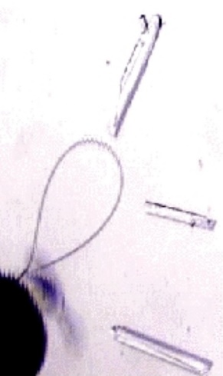
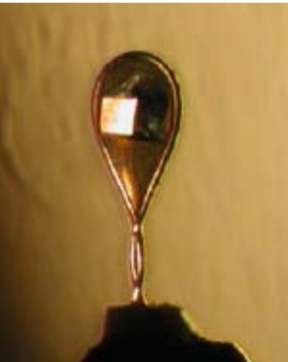
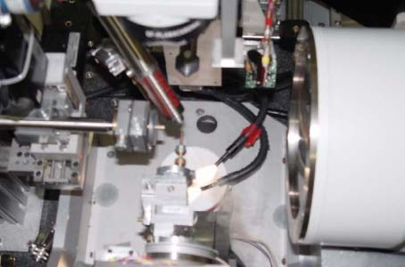
Cryofreezing
To avoid decay, the crystal is subjected to very low temperatures, for example, by using a liquid stream (typically at 100K).
Before freezing, it is necessary to add a cryoprotectant to the mother liquor, a substance that forms an amorphous glass at low temperatures, preventing the formation of ice crystals that would damage the crystal.
A screening is performed using different cryoprotectants at various concentrations to find the best conditions.
drop
The crystal is 'fished' using a nylon loop of appropriate size and quickly immersed in the cryostream.

Slide 8
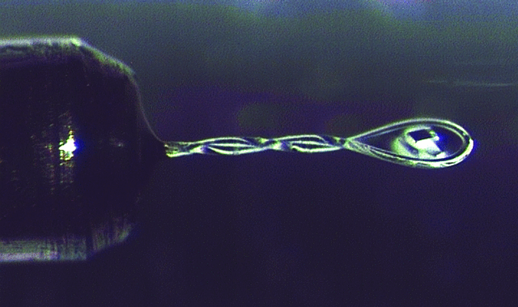
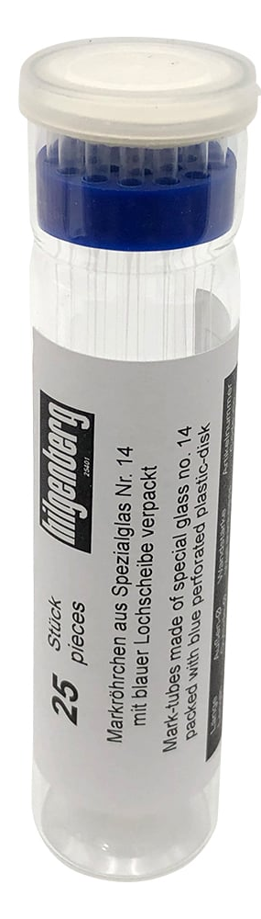

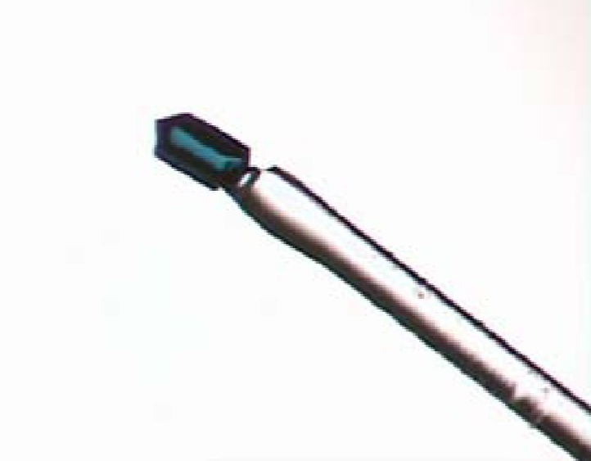
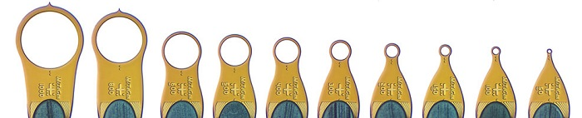
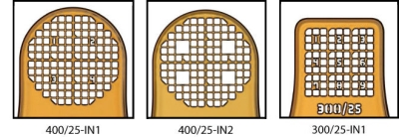
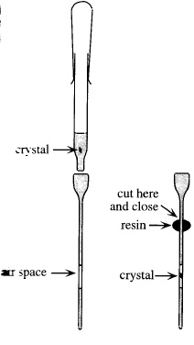
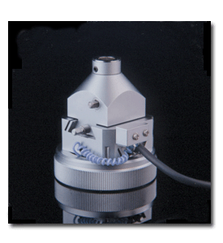
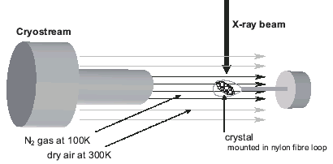
Crystal mouting
Loops
Glass capillaries
(Lindemann capillaries
lithium borate glass)
Glass fibre
with glue
naylon loops
polyimide micro-loops -meshes
Goniometer head

Slide 9
Data Collection Methods
The different methods depend on:
Monochromaticity or non-monochromaticity of the light
The data collection geometry
The type of detector, mono- or bidimensional
-Polychromatic / White radiation (White beam) Laue method
-Monochromatic
Rotating Crystal Method / Rotation Method

Slide 10
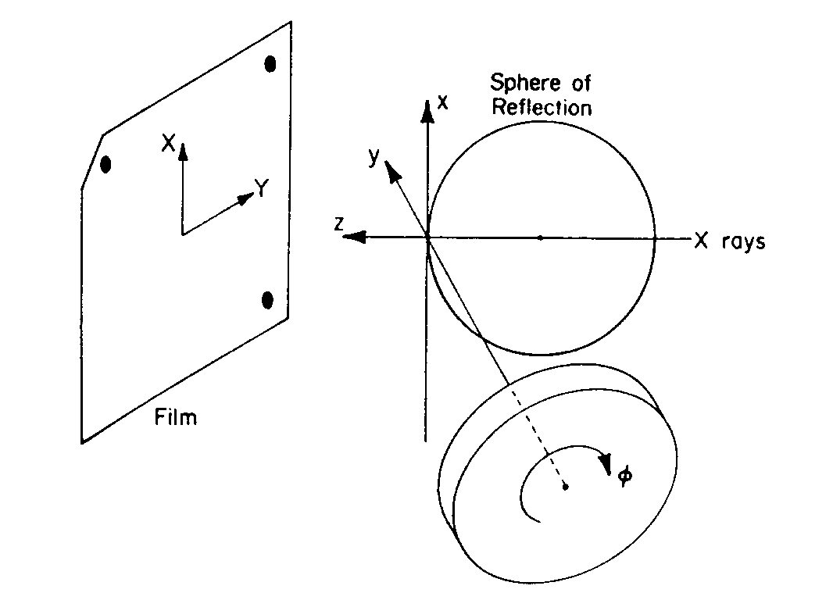
Rotating Crystal Method
The crystal is rotated around a generic axis in order to bring a certain number of reflections into diffraction.
It is the standard method for data collection at the synchrotron
The simplest setup consists of a monochromatic X-ray beam, a goniometer with a single axis of rotation orthogonal to the incident beam, and a 2D flat panel detector. The detector is normally placed parallel to the rotation axis and orthogonal to the incident beam.

Slide 11
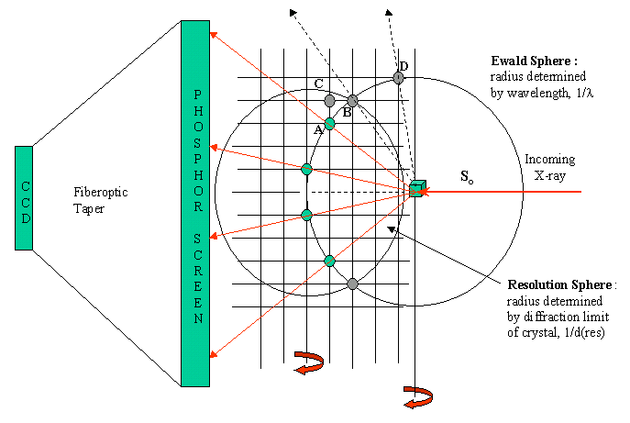
Geometry
The crystal is rotated around the goniometer axis by a determined angle.
The diffracted X-rays are collected by the detector behind the crystal.
The rotation is repeated at intervals of contiguous angles until the entire independent part of the reciprocal lattice is explored.

Slide 12
Simulation of the diffraction experiment
X-ray source
Detector

Slide 13
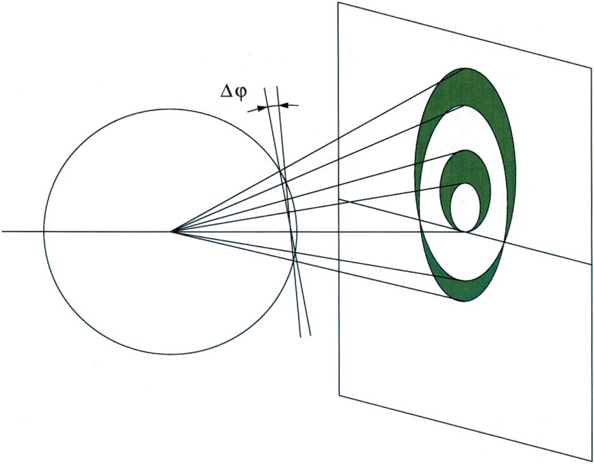
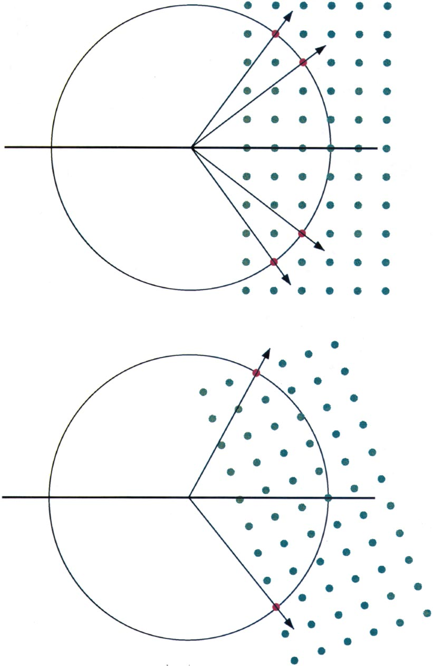
Rotating method
For a particular crystal orientation, only a few reflections will be in the diffraction position.
To measure more reflections, the crystal is rotated (and with it its reciprocal lattice) around a single axis for a rotation angle Δϕ, during which the diffraction image is recorded on the detector. The rotation is repeated for contiguous Δϕ
Until the asymmetric unit of the reciprocal lattice is fully collected."
“lune”
Reflections from the same plane of the reciprocal lattice form a “lune”

Slide 14
Goals of a data collection
Maximize the number of high-angle reflections (maximum resolution).
High signal-to-noise ratio: I_{hkl}/σ(I_{hkl})
High data completeness → % of measured reflections compared to theoretical ones contained in the asymmetric unit of the reciprocal lattice at the same resolution.
This asymmetric unit contains the unique reflections that are not related by the symmetry of the Laue class of the crystal (a centrosymmetric crystal class due to Friedel’s Law). The number of unique reflections, N, depends on the effective resolution (d) at which the crystal diffracts (N∝1/d³).
High redundancy → the total number of measured reflections divided by the number of unique reflections.
The hkl reflection and its symmetry-equivalent reflections are measured multiple times. Redundancy improves measurement accuracy and the scaling process.

Slide 15
Data collection steps
Choice of data collection parameters
Indexing
Integration
Scaling
Merging
Data quality analysis

Slide 16
Data collection parameters
Wavelength (λ)
Crystal-to-detector distance
Oscillation angle Δϕ
Total rotation angle
Exposure time

Slide 17
Wavelength Choice
The X-ray wavelength (λ) must be chosen based on the unit cell size, the atomic composition of the crystal, and the required resolution, typically operating in the range of 0.5–2 Å
Common Laboratory Sources
Molybdenum (λ=0.7107 Å):
Best for: General inorganic, organic, and organometallic compounds.
Pros: Higher-resolution data, High penetration power, lower absorption for heavy atoms.
Cons: Lower scattering power from light atoms.
Copper (λ=1.5418 Å):
Best for: Small and large molecule organics, light element structures, and absolute configuration determination.
Pros: Higher intensity, stronger anomalous scattering.
Cons: High absorption/fluorescence for heavy atoms (e.g., Fe, Co, Ni).

Slide 18
Synchrotron Radiation (λ is tunable):
Wavelength can be precisely tuned to the absorption edge of a specific atom to maximize anomalous scattering (determination of absolute configuration or MAD techniques for solving the phase problem of difficult-to-solve data sets.
For crystals diffracting at atomic resolution:
Wavelength < 0.7 Å for collecting high-resolution data sets with lower crystal absorption.
For crystals not diffracting at atomic resolution: Wavelength > 1.0 Å for increasing the beam intensity and data quality.

Slide 19
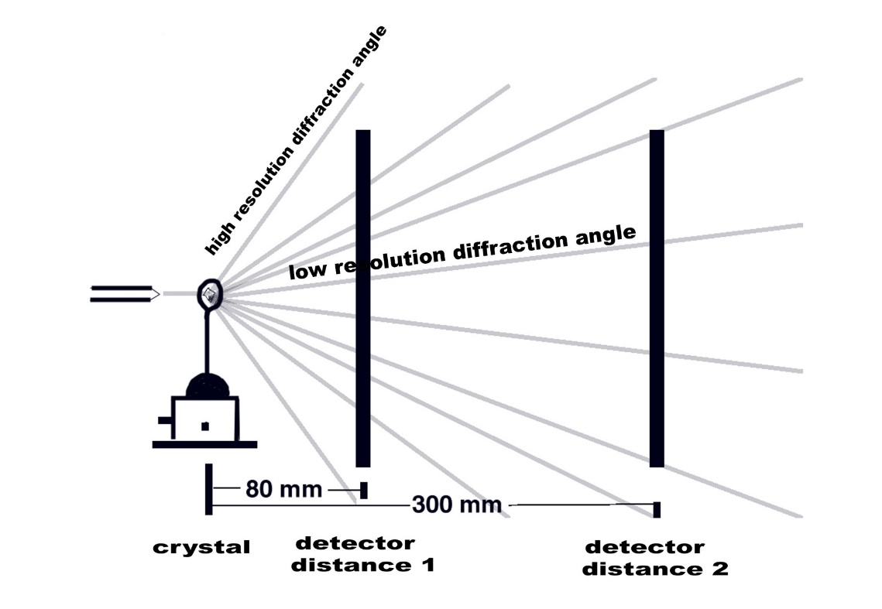
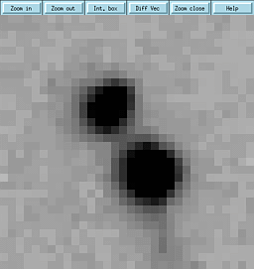
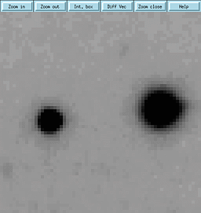
Crystal-to-detector distance (D)
The closer the detector is, the greater the Bragg angle intercepted by the detector.
The crystal's maximum effective diffraction resolution needs to be evaluated.
:Additional factors to consider:
Possible spot overlap
Increasing D, the distance between spots increases (important for unit cells with long axes)
X-ray absorption by air (especially for long wavelength)
Increasing D, the absorption increases and the intensity decreases.
Signal-to-noise ratio
Increasing D, the signal-to-noise ratio increases because the measured background scattering decreases (random scattering from air, from the mounted material, and inelastic scattering from the crystal).
µ of air I/Io=0.5 1m air
cm⁻¹ cm I/Io
Mo-Kα 0.0015 460 86%
Cu-Kα 0.012 58 30%

Slide 20
Oscillation Angle (Δϕ)
The angle by which the crystal is rotated during the acquisition of a single diffraction image.
Optimal Spot Separation
The primary goal is to avoid spatial overlap of diffraction spots on the detector.
Larger unit cells (e.g., proteins with long axes) produce spots that are closer together, requiring a smaller Δϕ (typically 0.1 to 0.5 °).
Smaller unit cells (e.g., small molecules) can tolerate a larger Δϕ (typically 1.0 °).
Small Δϕ vs. Large Δϕ
Small Δϕ:
Improves signal-to-noise ratio by reducing the background,
but reflections are splitted across multiple frames.
Large Δϕ:
More full reflections in a single image,
but more background and more overlap.

Slide 21
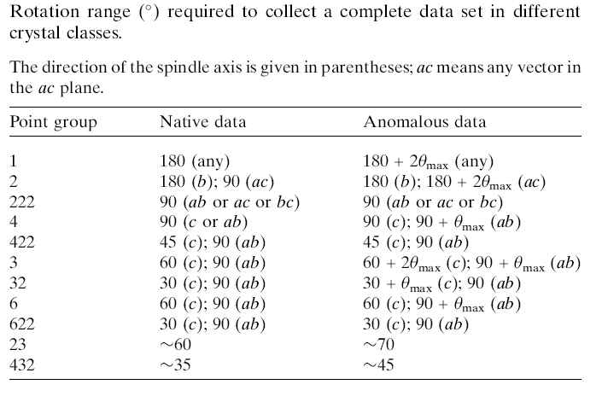
Total rotation angle
The minimum rotation range to be covered is dictated by the symmetry of the crystal’s space group and the crystal’s orientation relative to the X-ray beam.
In cases where no anomalous signal is measured (Friedel's law is valid), the minimum necessary range is less than 180°
If the crystal does not exhibit significant radiation damage, collecting redundant data improves the quality of the dataset.

Slide 22
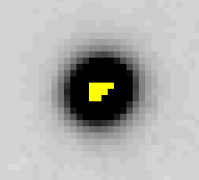
Exposure time
In theory, the longer the exposure time, the greater the diffracted intensity and the higher the I_{hkl}/σ(I_{hkl}) ratio ⇒ more accurate measurement.
[In a diffraction experiment, one “counts” the number of photons that hit the detector pixels over a given amount of time. This is a process governed by probabilistic laws: the Poisson distribution, also known as “counting statistics.” The standard deviation of a variable that follows a Poisson distribution is given by the square root of the number of measured counts. Therefore, if the intensity doubles (2I) due to a double exposure time, its standard deviation σ(I) becomes √2I , and the I/σ(I) ratio increases by √2 only]
In practice, there are other factors to consider when choosing the exposure time:
Radiation damage, in the case of data collection at room temperature or even at low temperatures when using very intense synchrotron beams
“overloads,” i.e., reflections that become saturated
detectors have a dynamic range, meaning there is a number of
counts (photons) that saturates the detector pixels)
Time limitations available for the data collection
Typical exposure times per image (with Δϕ = 1°) range from 15–30 minutes with an “image plate” detector on conventional sources, to a few seconds with a CCD or Pilatus detectors on synchrotron sources.

Slide 23
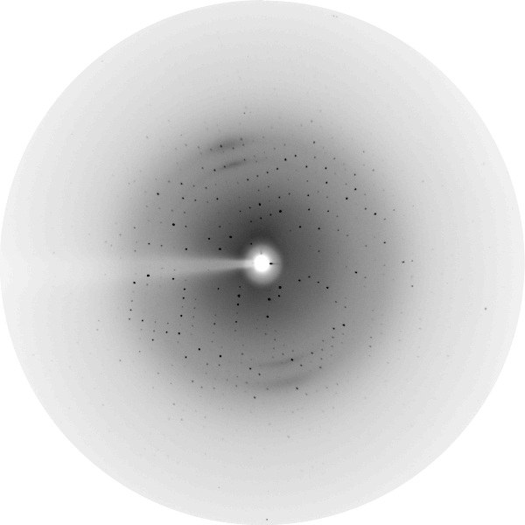
Data Reduction
Indexing
The process converts raw 2D image spot positions into a 3D reciprocal lattice.
Indexing of reflections: each spot is associated with the hkl point of the reciprocal lattice. In this way, the orientation of the crystal is determined with respect to a set of reference axes, as well as the dimensions of the unit cell.
105
118
205
206
207
208
139
307
308
309
316
415
425
524
525
-213
-214
-224

Slide 24
Data Collection for Indexing: 10–30 initial images (Δϕ =1°)
Spot Hunting: identifies bright spots (diffraction maxima) on the detector and measures their 2D positions, then converts these positions into a 3D reciprocal lattice
Indexing the Reciprocal Lattice: Determines the reciprocal unit cell and assigns the (hkl) Miller indices to each reflection. The unit cell parameters and orientation matrix are then determined
Orientation Matrix (U Matrix): This matrix connects the crystal’s internal coordinate system with the laboratory coordinate system, defining the crystal orientation in space.
Lattice Type and Laue Symmetry: Through the reduced cell, the Niggli matrix suggests the lattice type and possible Laue symmetry compatible with the unit cell parameters.

Slide 25
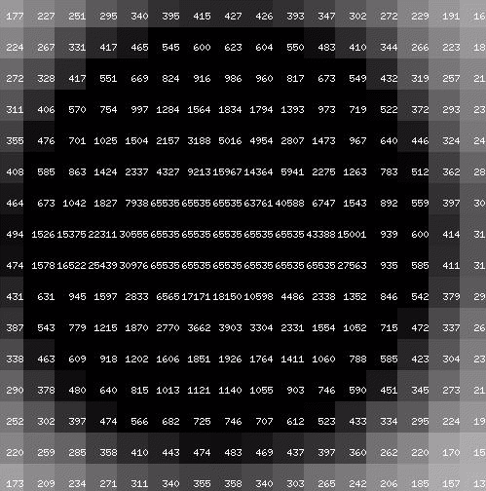
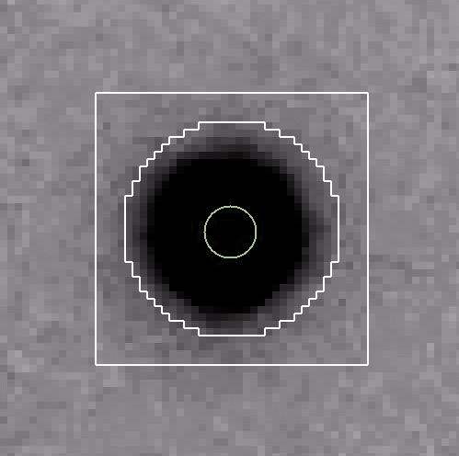
Integration
Integration of the spot intensity
Pixel Intensity of one reflectio

Slide 26
Diffraction Intensity:
H K L I Sig(I)
Integration

Slide 27
Scaling and Merging
All integrated intensities from the different images, corrected for Lorentz-polarization and other factors, are placed on a common scale.
The partial reflections (whose intensity is collected across multiple images) are summed together.
Reflections related by symmetry are averaged
A final dataset is obtained, which will be used for the subsequent steps in determining the three-dimensional structure of the molecule.

Slide 28
Data quality analysis
Number of unique reflections (independent reflections)
Total number of data collected / Total reflections
Internal consistency (R_{merge})
Completeness (percentage of theoretical data)
Number (or fraction) of measurements rejected by statistics
Mean Intensity / standard deviations (<I/σ(I)>)
RESOLUTION d_{min} = λ/2senθ_{max}
R_{merge} = ∑_{hkl} ∑_{i}^{nhkl} | I_{i}(hkl) - <I(hkl)>| / ∑_{hkl} | <I(hkl)>|
In general, the lower the R_{merge}, the better the dataset; however, it is important to remember that this index is influenced by data redundancy (it increases as redundancy increases).
R_{meas} = ∑_{hkl}√n_{hkl}/(n_{hkl}-1) ∑_{i}^{nhkl} | I_{i}(hkl) - <I(hkl)>| Redundancy-independent Merging R-factor
R_{pin} = ∑_{hkl} √1/(n_{hkl}-1) ∑_{i}^{nhkl} | I_{i}(hkl) - <I(hkl)>| Precision-indicating Merging R-factor

Slide 29
Criteria for High-Resolution Cutoff Selection
1. Data Organization: Resolution Shells
Diffraction data is not analyzed as a single block but is divided into concentric shells (or bins) based on d-spacing:
Inner Shells: Low-resolution reflections (center of the detector). These have very high intensity and strong signal-to-noise ratios.
Outer Shells: High-resolution reflections (edges of the detector). These contain the fine structural details but have much weaker signals.
The Cutoff Decision: Quality metrics are monitored shell-by-shell. The "resolution" of the dataset is defined by the point where the data in the outermost shell is no longer statistically significant.

Slide 30
Key Data Quality Indicators (Highest Resolution Shell)
Signal-to-Noise ((I /σ(I)): Should ideally be ≥ 2.0, though useful data can exist as low as 0.5 if other metrics are strong.
Correlation Coefficient (CC_{1/2}): Indicator internal consistency and statistical data significance. A value above 0.2 is generally acceptable.
Merging R-factors (R_{merge}, R_{meas}, R_{pim}): While R_{merge} is common,
R_{meas} (redundancy-independent) is preferred. Values can exceed 60% or even 100% in the outer shell if the CC_{1/2} remains high.
Completeness: The dataset should remain as close to 100% as possible in the outer shell to avoid biased electron density maps.

Slide 31
Criteria for High-Resolution Cutoff Selection
To determine the optimal resolution for structure refinement, you must balance the inclusion of meaningful signal against the introduction of noise.
1. Traditional vs. Modern Metrics
Traditional (I ≥ 2σ(I)): Historically, data were truncated where the signal-to-noise ratio fell below 2.0.
Modern (CC_{1/2} ≥ 0.2): Modern practice recommends keeping data as long as the correlation between random half-datasets (CC_{1/2}) remains statistically significant (typically 0.2).

