Slide 1
Quantum Ideal Gases

Slide 3
Classical Particles: Distinguishable and do not obey Pauli Exclusion Principle.
Particles are identical but distinguishable because their positions and velocities are assumed to be traceable, i.e., their trajectories over time are deterministic.

Slide 4
Maxwell Boltzmann distribution

Slide 5
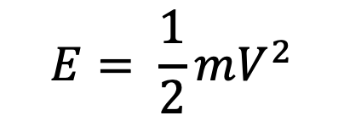
Maxwell-Boltzman distribution → Molecules → distinguishable
N₂
$$E= \frac{1}{2}mV^{2}$$

Slide 6
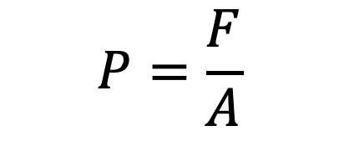
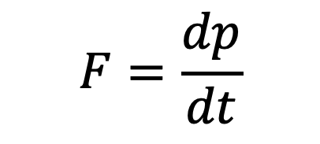
Maxwell-Boltzman distribution → Molecules → distinguishable
Collision → change in momentum
$$F=\frac{dp}{dt}$$
Force = rate of change in momentum
$$P=\frac{F}{A}$$
Pressure = Force per area

Slide 7

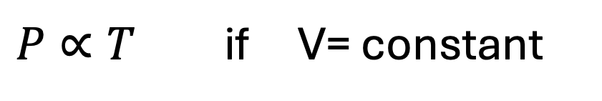
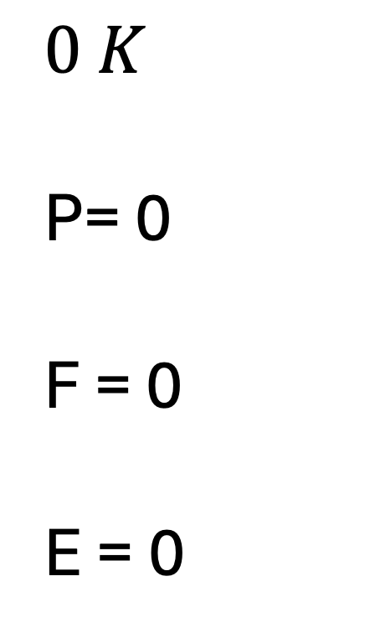


Pressure law (Gay-Lussac's Law)
$$0 K$$
P= 0
F = 0
E = 0
$P∝T$ if V= constant
$$P$$
$$0 K$$
$$T$$
Nothing is moving

Slide 8



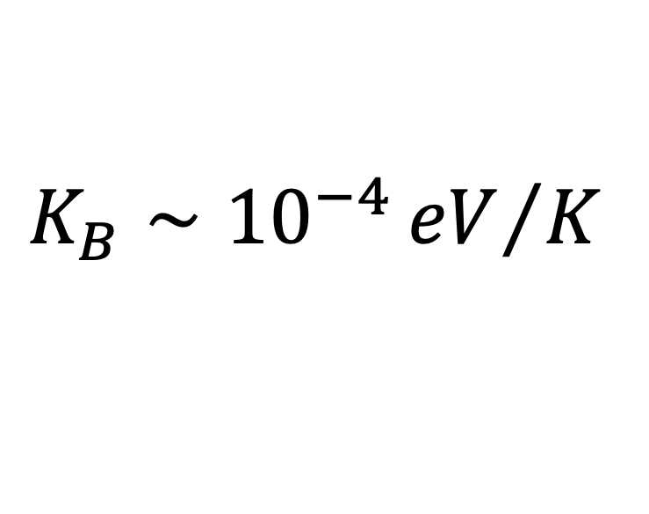
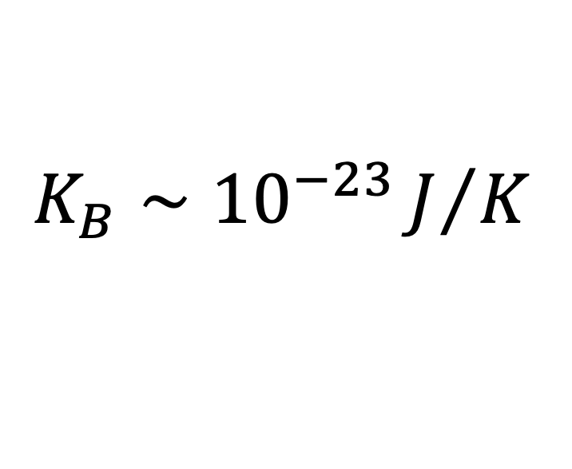
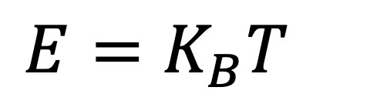
Maxwell-Boltzman distribution
$$Area=constant$$
$$N=constant$$
$E=K_{B}T$
$$N$$
$$K_{B}∼{10}^{−23}J/K$$
$$K_{B}∼{10}^{−4}{eV}/K$$
$$E$$

Slide 9


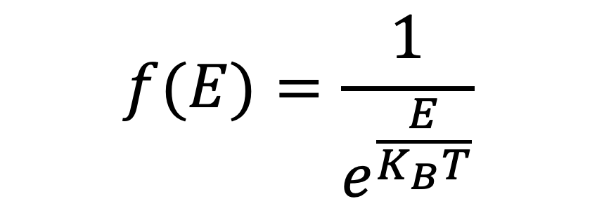
Maxwell-Boltzman distribution
→ Probability of an Energy State being occupied by a particles
$$\frac{N}{N_{T}}$$
$$f(E)=\frac{1}{e^{\frac{E}{K_{B}T}}}$$
$$E$$

Slide 10
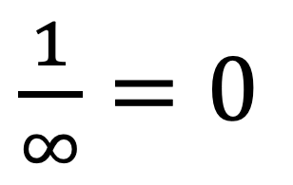
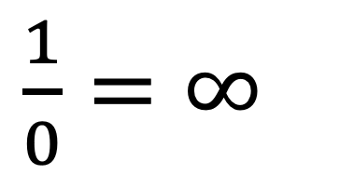
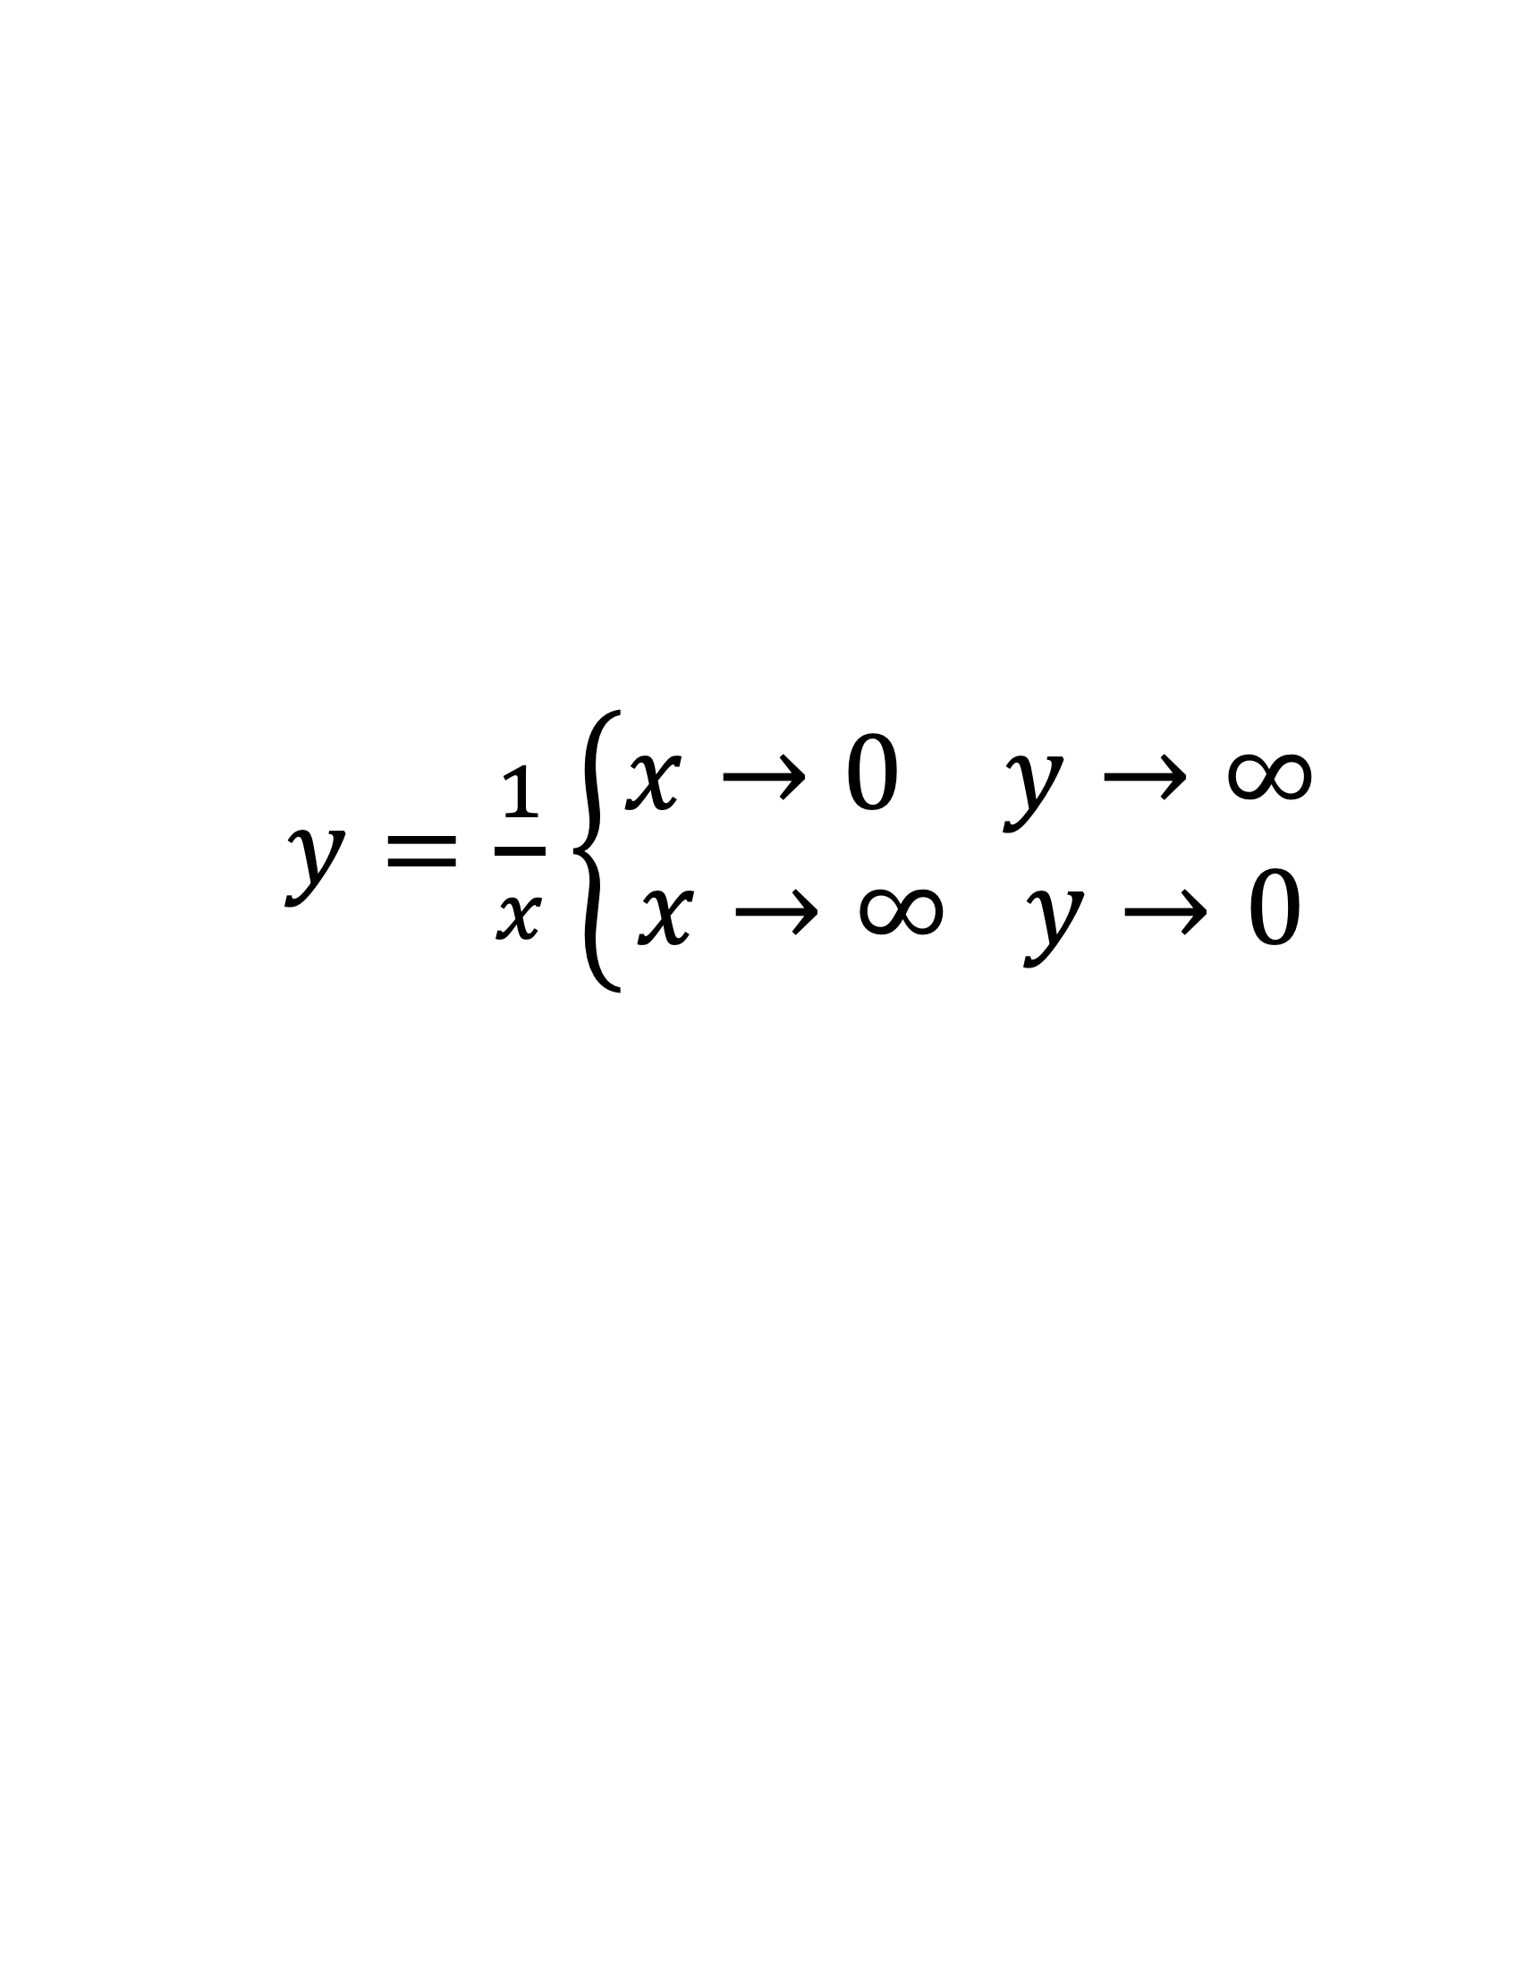
Math disclaimer
$\frac{1}{0}=∞$
$\frac{1}{∞}=0$
$y=\frac{1}{x}$ $\left\{\begin{aligned}x→0 y→∞ \\ x→∞ y→0\end{aligned}\right.$

Slide 11
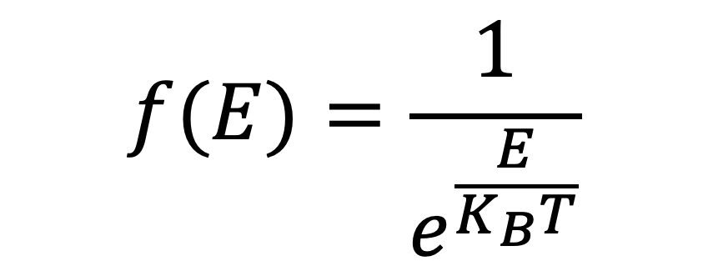
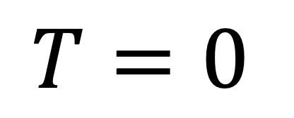
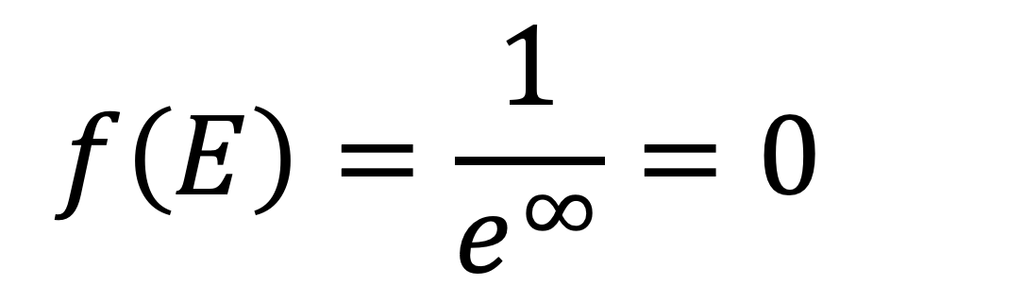
Maxwell-Boltzman distribution
$$f(E)=\frac{1}{e^{\frac{E}{K_{B}T}}}$$
$$f\left(E\right)=\frac{1}{e^{∞}}=0$$
$$T=0$$
→ All molecules occupy the lowest energy state

Slide 12


Maxwell-Boltzman distribution
Increase in temperature
$$f(E)$$
$$E$$

Slide 13
Maxwell-Boltzman distribution → implications to catalysis
Catalysis → Collision theory
Collision theory states that particles must collide with correct orientation and enough kinetic energy to overcome the activation energy barrier

Slide 14
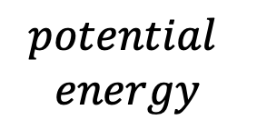




Maxwell-Boltzman distribution → implications to catalysis
$$potential$$
$$energy$$
$$E_{a}$$
$$A+BC$$
$$AB+C$$
$$Reaction coordinate$$

Slide 15
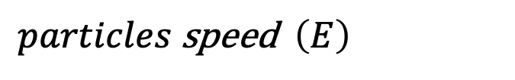
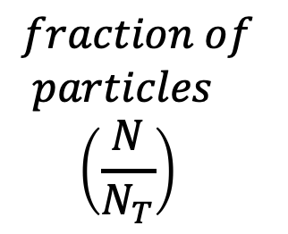

Maxwell-Boltzman distribution → implications to catalysis
$$fraction of$$
$$particles$$
$$\left(\frac{N}{N_{T}}\right)$$
$$E_{a}$$
$particles$speed $\left(E\right)$

Slide 16
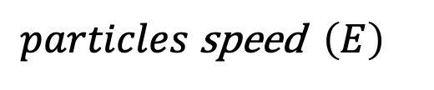

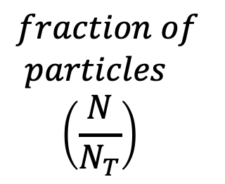



Maxwell-Boltzman distribution → implications to catalysis
Increase in temperature
$$fraction of$$
$$particles$$
$$\left(\frac{N}{N_{T}}\right)$$
$$f(E)$$
$$E_{a}$$
$$E_{a}$$
$particles$speed $\left(E\right)$
$$E$$

Slide 17
Maxwell-Boltzman distribution → implications to catalysis
Increase in concentration
$$fraction of$$
$$particles$$
$$\left(\frac{N}{N_{T}}\right)$$
$$f(E)$$
$$E_{a}$$
$$E_{a}$$
$particles$speed $\left(E\right)$
$$E$$

Slide 18
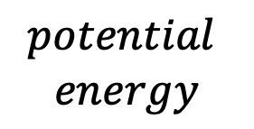


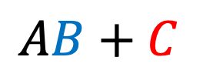

Maxwell-Boltzman distribution → implications to catalysis
Effect of adding a catalyst
$$potential$$
$$energy$$
$$E_{a2}$$
$$A+BC$$
$$AB+C$$
$$Reaction coordinate$$

Slide 19


Maxwell-Boltzman distribution → implications to catalysis
Effect of adding a catalyst
$$fraction of$$
$$particles$$
$$\left(\frac{N}{N_{T}}\right)$$
$$f(E)$$
$$E_{a2}$$
$$E_{a}$$
$$E_{a2}$$
$$E_{a}$$
$particles$speed $\left(E\right)$
$$E$$

Slide 20
Maxwell–Boltzmann statistics works when the gas is hot, dilute, and non-degenerate, and fails when the system becomes dense or cold enough for quantum statistics to matter.

Slide 21
When the Maxwell–Boltzmann distribution works
For classical particles:
High temperatures → Thermal energy is large compared to quantum energy spacing.
Low particle density → Particles are far apart and behave independently.
Distinguishable particles → Individual particles can be labelled and treated independently.
Weak quantum effects → The thermal de Broglie wavelength is much smaller than the average distance between particles.
Non-degenerate gas → The occupancy of each quantum state is much less than 1.
Ideal gas approximation → Particle interactions are negligible except during collisions.

Slide 22



When the Maxwell–Boltzmann distribution works
For quantum particles (as an approximation):
High temperature limit of quantum statistics (Bose–Einstein or Fermi–Dirac).
Low density quantum gases where:
i.e. the degeneracy parameter is small
Systems where quantum indistinguishability does not affect occupation probabilities significantly.
$$Nλ^{3}≪1$$
$$λ=\frac{h}{\sqrt{2πmK_{B}T}}$$
Thermal de Broglie wavelength of a particle i.e. quantum “wave size” of a particle due to thermal motion.
$$N=number of particles$$

Slide 23
When the Maxwell–Boltzmann distribution fails
✖ When particle indistinguishability is important.
✖ When quantum state occupancy is not small.
✖ When wavefunctions overlap significantly.
Examples where Maxwell–Boltzmann fails
✖ Electrons in metals (Fermi gas).
✖ White dwarf stars (degenerate electron gas).
✖ Bose–Einstein condensates at very low temperatures.
✖ Photons and phonons (bosons with zero chemical potential).

Slide 24
Quantum Particles

