Slide 1
Quantum Ideal Gases

Slide 2
Quantum indistinguishable particles
Quantum indistinguishabe particles are particles that cannot be distinguished from one another even in principle, such that exchanging any two particles leaves the physical state unchanged. This is reflected in their joint wavefunction, which is either symmetric (for bosons) or antisymmetric (for fermions) under particle exchange, giving rise to Bose–Einstein and Fermi–Dirac statistics, respectively.

Slide 3
TYPE EXAMPLE CHARACTERISTIC STATISTICS
Classical Molecules Distinguishable Maxwell-Boltzmann
Fermions Electrons Indistinguishable Fermi-Dirac
Bosons Photons Indistinguishable Bose-Einstein
Fermions Obey Pauli exclusion principle Spin: n/2 (half)
Bosons Disobey Pauli exclusion principle Spin: n (integer)

Slide 4
3 energy levels, 2 particles - Classical
How many possible permutation?

Slide 5
3 energy levels, 2 particles - Fermions
How many possible permutation?
Only 1 particle per quantum state

Slide 7
Fermi-Dirac distribution

Slide 8
Fermi-Dirac distribution → Fermions → indistinguishable
+
H
H
1s¹
1s¹
Same quantum numbers → forbidden by Pauli’s exclusion principle
CB
H
VB
H
1s¹
1s¹

Slide 9
Fermi-Dirac distribution → Fermions → indistinguishable
Cu
…
[Ar] 3d¹⁰ 4s¹
4s¹
4s¹
4s¹
4s¹
4s¹
4s¹
4s¹
4s¹
Same principle:
CB
E_{F}
∼ 2-3 eV
VB
“Fermi sea”

Slide 10


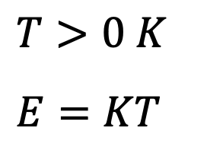

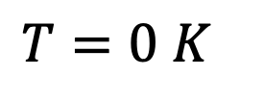

Fermi-Dirac distribution → Fermions → indistinguishable
-
+
CB
$$RT∼300 K$$
E_{F}
e⁻
$$K_{B}∼{10}^{−4}{eV}/K$$
VB
$$E∼0.03 eV$$
$$T=0 K$$
$$T>0 K$$
$$E=KT$$

Slide 11
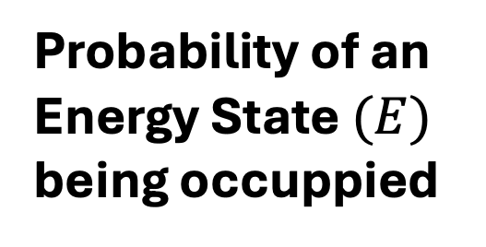
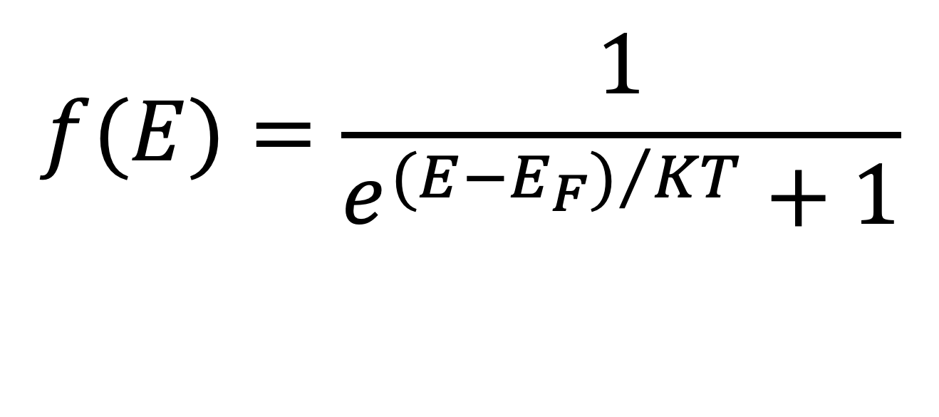
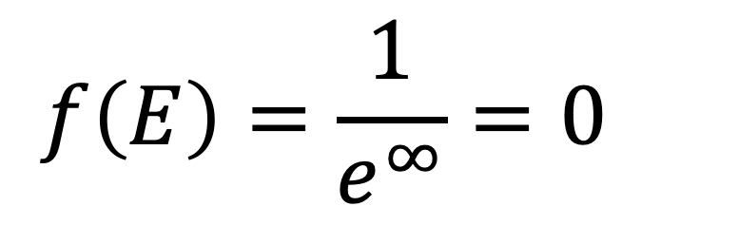
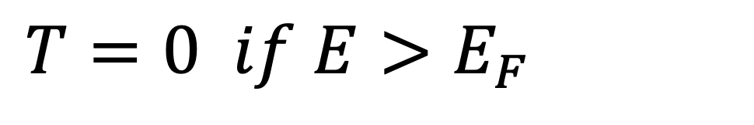
Fermi-Dirac distribution → Fermions → indistinguishable
$$f(E)=\frac{1}{e^{{(E−E_{F})}/{KT}}+1}$$
Probability of an Energy State $(E)$ being occuppied
$$f\left(E\right)=\frac{1}{e^{∞}}=0$$
$T=0 if E>E_{F}$
→ No electrons above the Fermi level

Slide 12
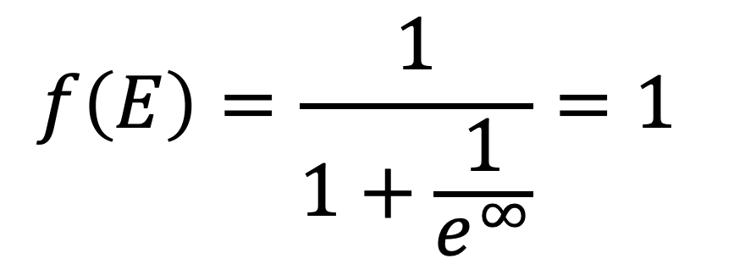
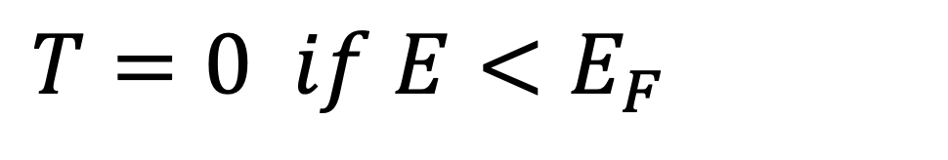
Fermi-Dirac distribution → Fermions → indistinguishable
$$f\left(E\right)=\frac{1}{1+\frac{1}{e^{∞}}}=1$$
$T=0 if E<E_{F}$
→ All electrons are below the Fermi level

Slide 13

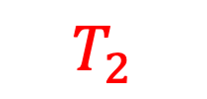





Fermi-Dirac distribution → Fermions → indistinguishable
1
$$T=0$$
$$f(E)$$
$$T_{1}$$
0.5
$$T_{2}$$
$$E_{F}$$
$$E$$

Slide 14
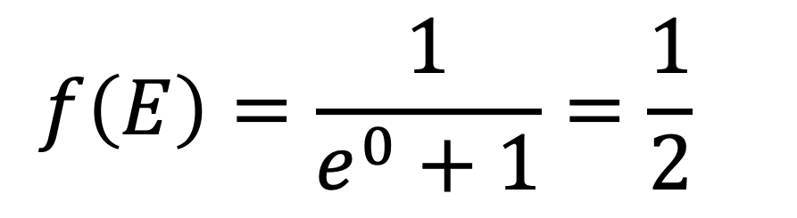
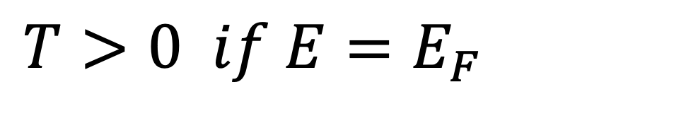
Fermi-Dirac distribution → Fermions → indistinguishable
$$f\left(E\right)=\frac{1}{e^{0}+1}=\frac{1}{2}$$
$T>0 if E=E_{F}$
→ Above T> 0 the probability that the Fermi level is occuppied is 50%

Slide 15
Fermi-Dirac distribution → Fermions → indistinguishable
1
$$T=0$$
$$f(E)$$
$$T_{1}$$
0.5
$$T_{2}$$
$$E_{F}$$
$$E$$

Slide 16
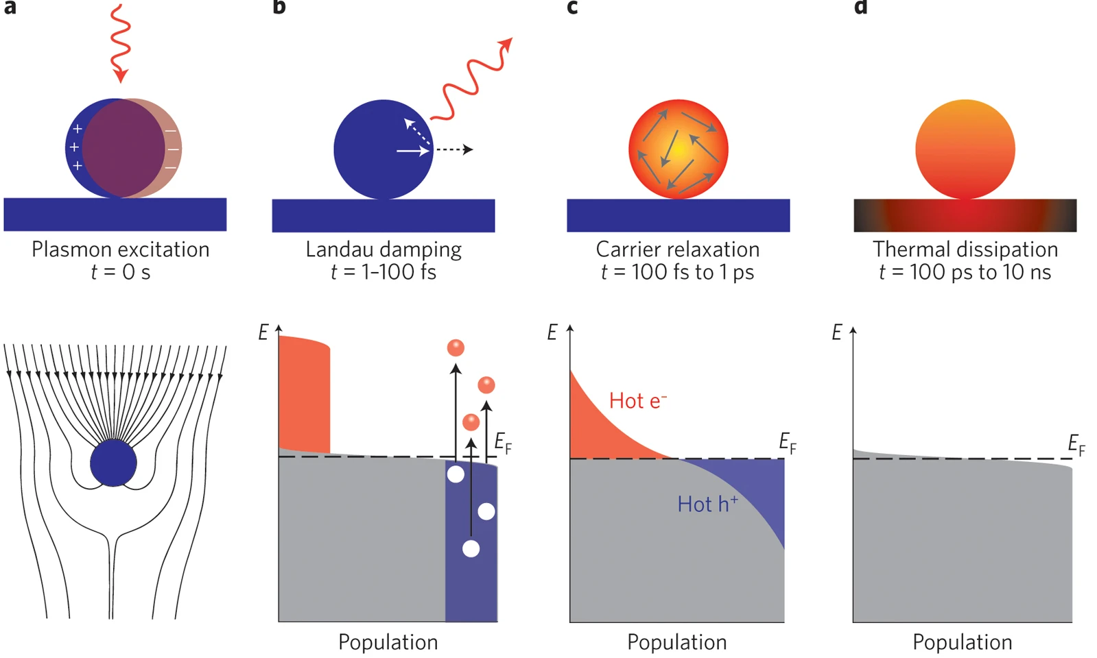
Fermi-Dirac distribution → Fermions → indistinguishable
Brongersma et al. Nat. Nanotechnol. 10 (2015) 25

Slide 17
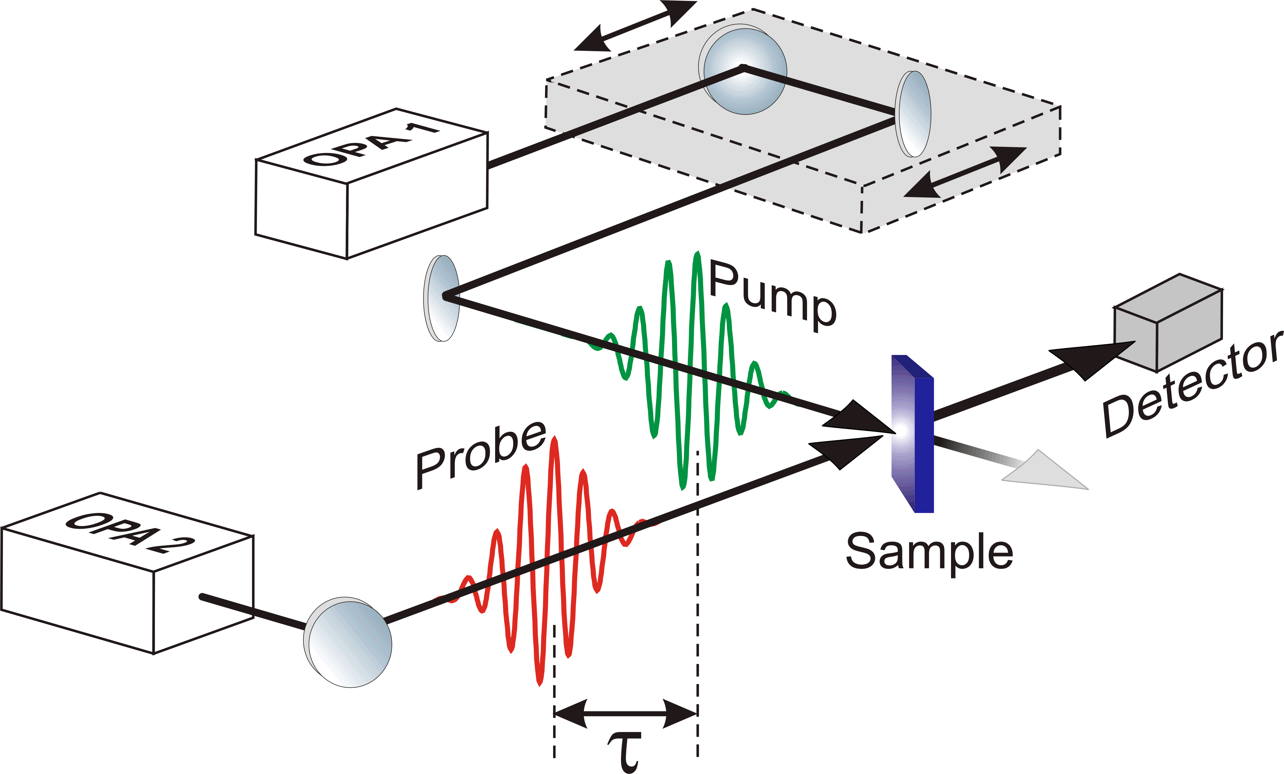
Pump-probe methodology

Slide 18
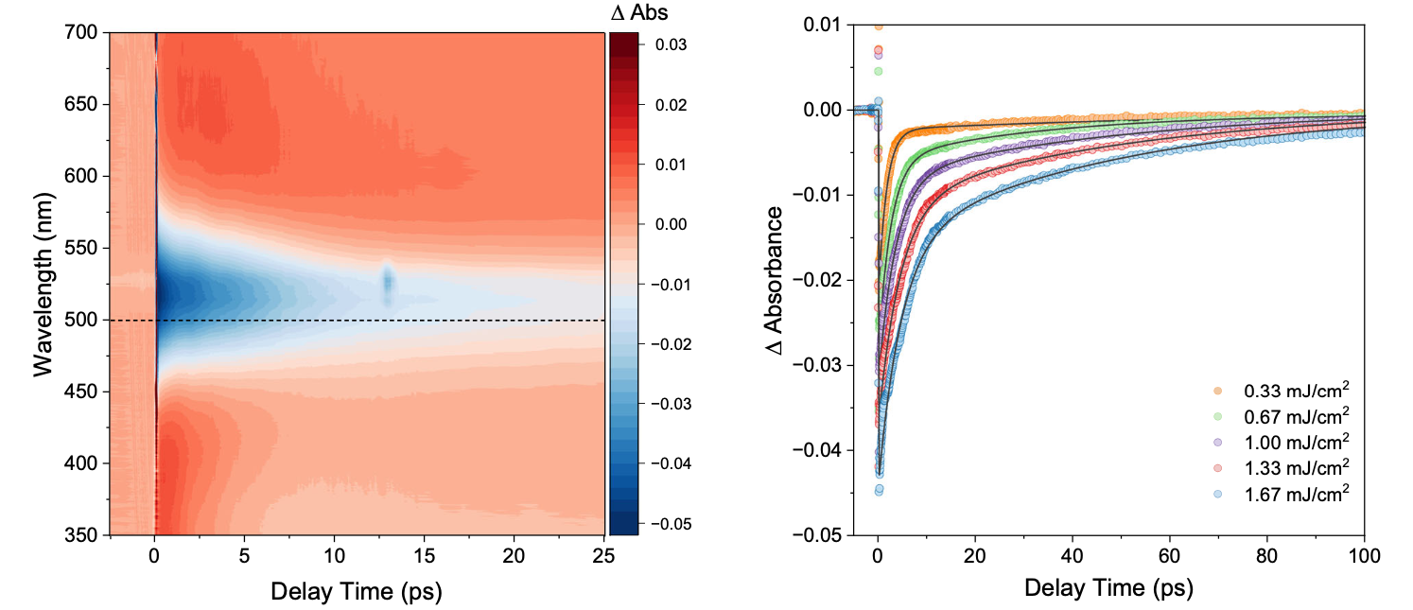

Fermi-Dirac distribution → Fermions → indistinguishable
$$τ_{e−ph}$$
$1^{st}exponential decay$
Wach et al. Nat. Commun. 16 (2025) 2274

Slide 19

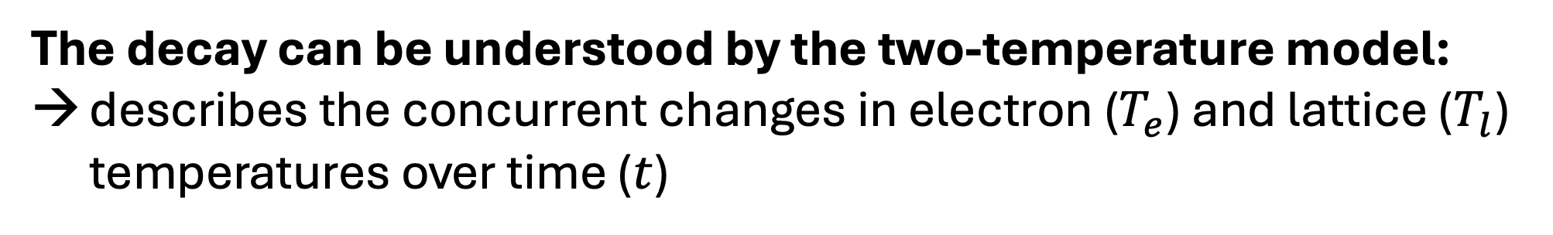
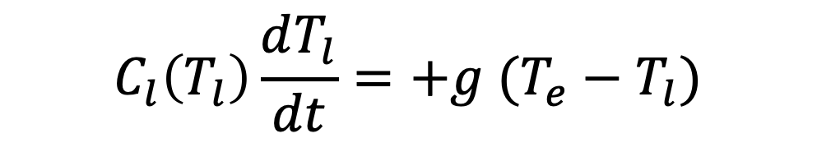
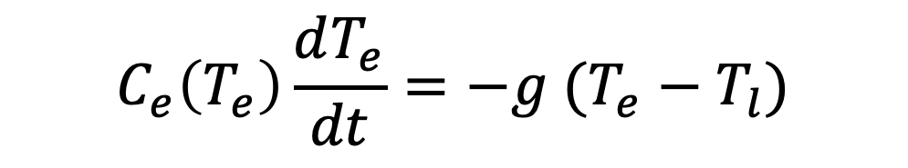
The decay can be understood by the two-temperature model:
describes the concurrent changes in electron ($T_{e}$) and lattice ($T_{l}$) temperatures over time ($t$)
the interaction is governed by the electron-phonon coupling constant ($g$)
$$C_{e}\left(T_{e}\right)\frac{dT_{e}}{dt}=−g (T_{e}−T_{l})$$
$$C_{l}\left(T_{l}\right)\frac{dT_{l}}{dt}=+g (T_{e}−T_{l})$$
Electron heat capacity
Lattice heat capacity

Slide 20

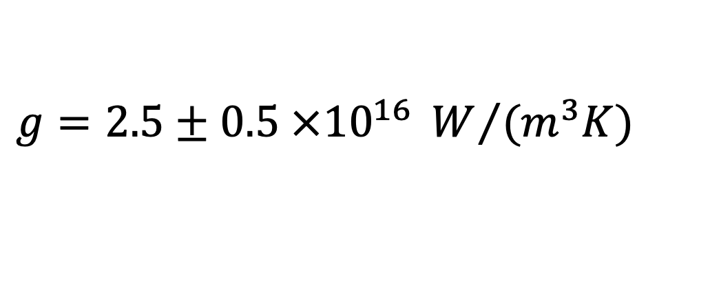
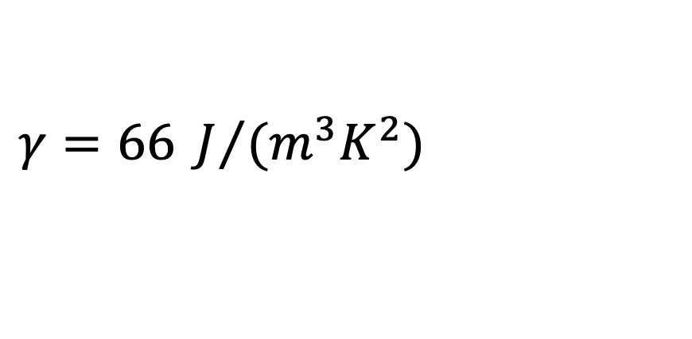
$C_{e}$ is temperature-dependent according to:
$$C_{e}\left(T_{e}\right)=γ T_{e}$$
Electron heat capacity constant
for gold:
$$γ=66 J/{(m^{3}K^{2})}$$
$$g=2.5±0.5 ×{10}^{16} W/{(m^{3}K)}$$

Slide 21
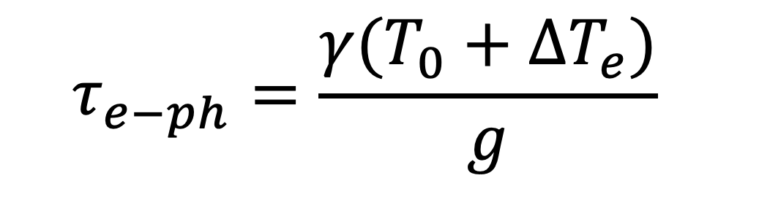
Fermi-Dirac distribution → Fermions → indistinguishable
Excitation-induced temperature change of the electrons (K)
$$τ_{e−ph}=\frac{γ(T_{0}+{ΔT}_{e})}{g}$$
Ambient temperature in K
Wach et al. Nat. Commun. 16 (2025) 2274

Slide 22
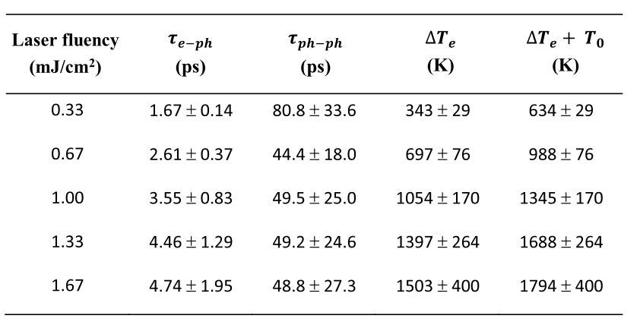
Fermi-Dirac distribution → Fermions → indistinguishable
Wach et al. Nat. Commun. 16 (2025) 2274

Slide 23
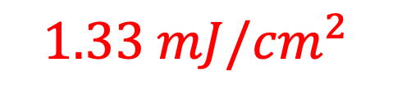
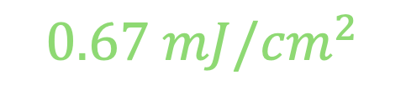
Fermi-Dirac distribution → Fermions → indistinguishable
1
$$f(E)$$
$$0.67 mJ/{cm}^{2}$$
$$1.33 mJ/{cm}^{2}$$
0.5
$$E_{F}$$
$$E$$

Slide 24
Fermi-Dirac distribution applications (1):
Electron behavior in solids
Describes how electrons occupy energy levels in metals, semiconductors, and insulators.
Semiconductor physics
Used to calculate carrier concentrations (electrons and holes) in devices like diodes and transistors.
Band theory of solids
Helps determine how electrons fill energy bands and explains conductivity and band gaps.
Low-temperature physics
Explains why electrons in metals behave differently at very low temperatures (degenerate Fermi gas).

Slide 25
Fermi-Dirac distribution applications (2):
Astrophysics (degenerate matter)
Models dense systems like white dwarfs and neutron stars where fermions are tightly packed.
Statistical mechanics of fermions
Fundamental for systems of particles that obey the Pauli exclusion principle (e.g., electrons, protons, neutrons).
Thermal and electrical properties of materials
Used to derive properties like heat capacity and electrical conductivity in metals.

