Slide 1
Quantum Ideal Gases

Slide 2
Quantum indistinguishable particles
Quantum indistinguishabe particles are particles that cannot be distinguished from one another even in principle, such that exchanging any two particles leaves the physical state unchanged. This is reflected in their joint wavefunction, which is either symmetric (for bosons) or antisymmetric (for fermions) under particle exchange, giving rise to Bose–Einstein and Fermi–Dirac statistics, respectively.

Slide 3
TYPE EXAMPLE CHARACTERISTIC STATISTICS
Classical Molecules Distinguishable Maxwell-Boltzmann
Fermions Electrons Indistinguishable Fermi-Dirac
Bosons Photons Indistinguishable Bose-Einstein
Fermions Obey Pauli exclusion principle Spin: n/2 (half)
Bosons Disobey Pauli exclusion principle Spin: n (integer)

Slide 4
3 energy levels, 2 particles - Classical
How many possible permutation?

Slide 5
3 energy levels, 2 particles - Fermions
How many possible permutation?
Only 1 particle per quantum state

Slide 6
3 energy levels, 2 particles - Bosons
How many possible permutation?
Only 6 because of indistinguishable characteristics

Slide 8
Bose Einstein distribution

Slide 9
Bose-Einstein distribution → Bosons → indistinguishable
E₁
E₂
E₃
E_{G}
…
G = number of energy levels
n = number of particles
Number of microstates → how many ways can the n particles be arranged in the energy levels?

Slide 10
Bose-Einstein distribution → Bosons → indistinguishable
E₁
E₂
E₃
E_{G}
n₁
n₂
n₃
n_{G}
…
g₁
g₂
g₃
g_{G}
n = number of particles
g = number of degenerated states
Very complex problem!!

Slide 11
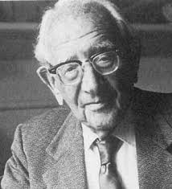
The "Pólya" Mindset
Pólya famously stated, "If you can't solve a problem, then there is an easier problem you can solve: find it." By finding the simplest version, you build the mental intuition required to tackle the original, more complex challenge.
György Pólya – ETH Zurich

Slide 12
Bose-Einstein distribution → Bosons → indistinguishable
g_{i} = 2
2 energy levels
3 particles

Slide 13
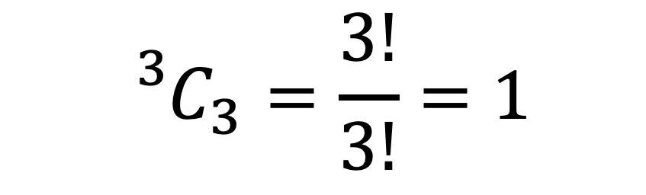
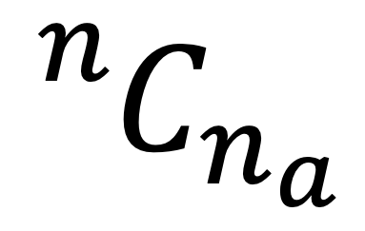
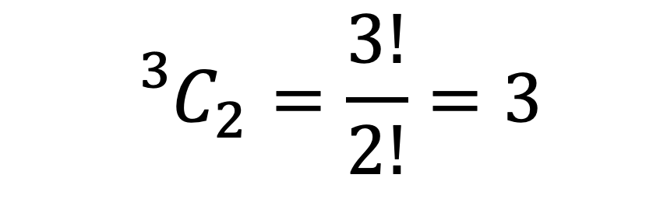
number of particles
$${}_{}^{3}{C_{3}}=\frac{3!}{3!}=1$$
$${}_{}^{n}{C_{n_{a}}}$$
$${}_{}^{3}{C_{2}}=\frac{3!}{2!}=3$$
How many we want to chose?

Slide 14
Bose-Einstein distribution → Bosons → indistinguishable
g_{i} = 2
How many lines are needed to create this degenerated levels?
for g_{i} = 2
We need:
Nº lines = g_{i} + 1
0
1
2

Slide 15
Bose-Einstein distribution → Bosons → indistinguishable
g_{i} = 2
4 combinations

Slide 16
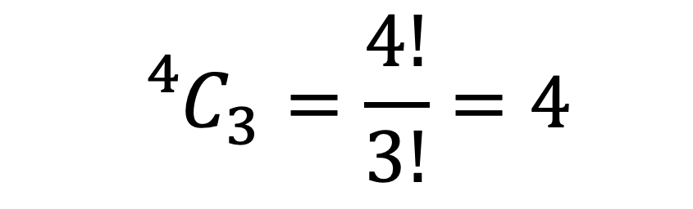
Bose-Einstein distribution → Bosons → indistinguishable
$${}_{}^{4}{C_{3}}=\frac{4!}{3!}=4$$
4 combinations
extra
particle

Slide 17
Bose-Einstein distribution → Bosons → indistinguishable

Slide 18
Bose-Einstein distribution → Bosons → indistinguishable
Reality
- Many energy levels (g_{i})
- Many particles (n_{i})
№ of particles* = n_{i} + g_{i} + 1 – 2 = n_{i} + g_{i} – 1
number of particles
number of lines
top and bottom lines don’t count

Slide 19
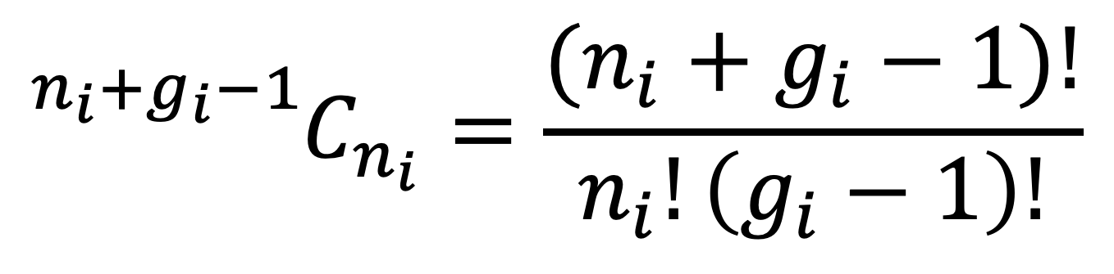
Bose-Einstein distribution → Bosons → indistinguishable
1 energy level
$${}_{}^{n_{i}+g_{i}−1}{C_{n_{i}}}=\frac{(n_{i}+g_{i}−1)!}{n_{i}!\left(g_{i}−1\right)!}$$

Slide 20
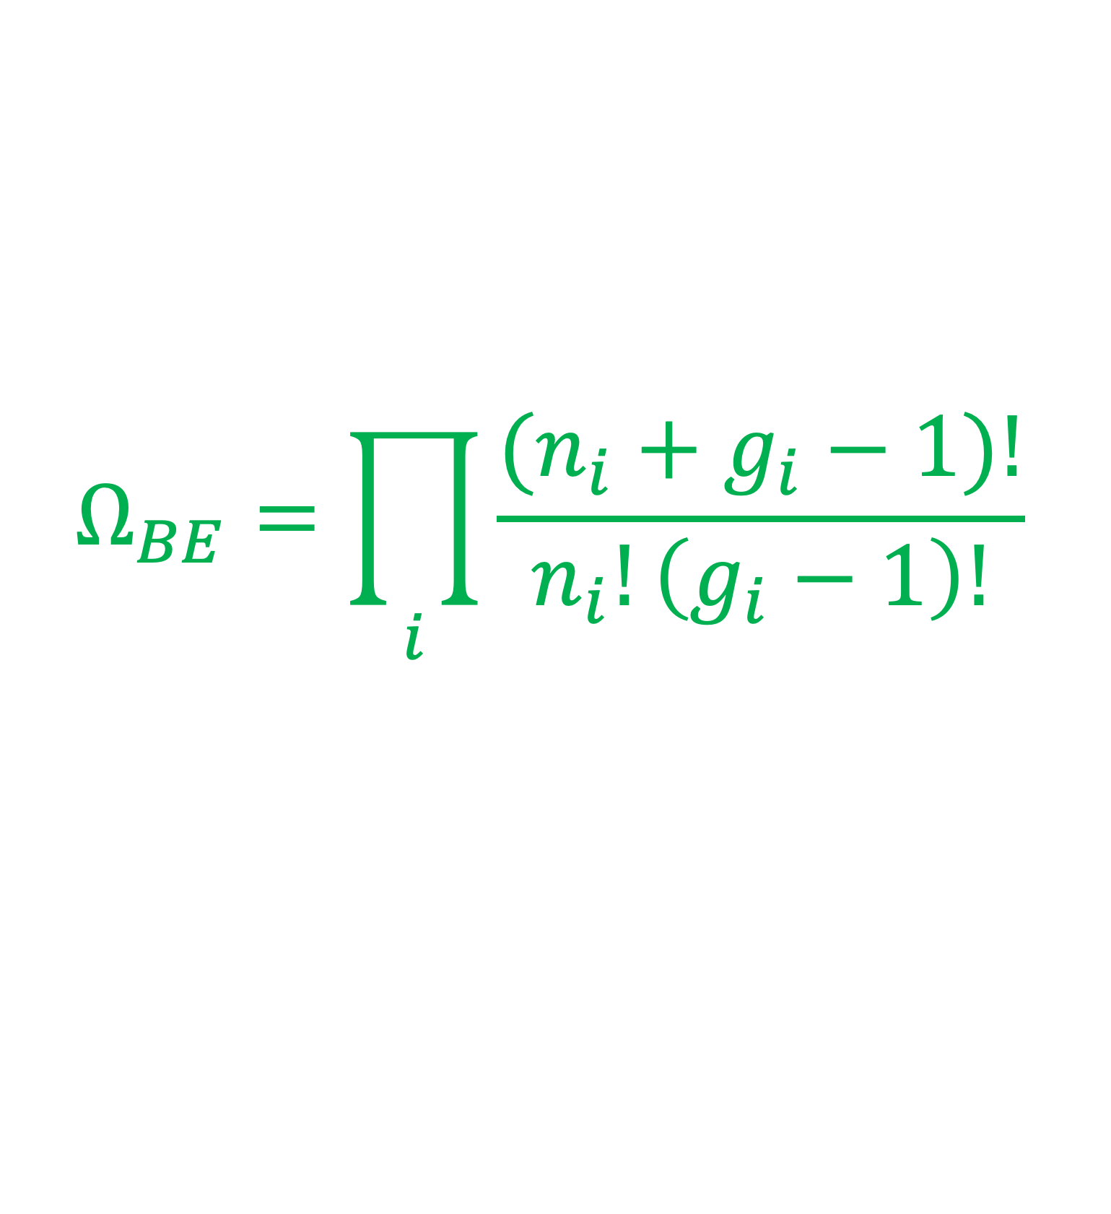
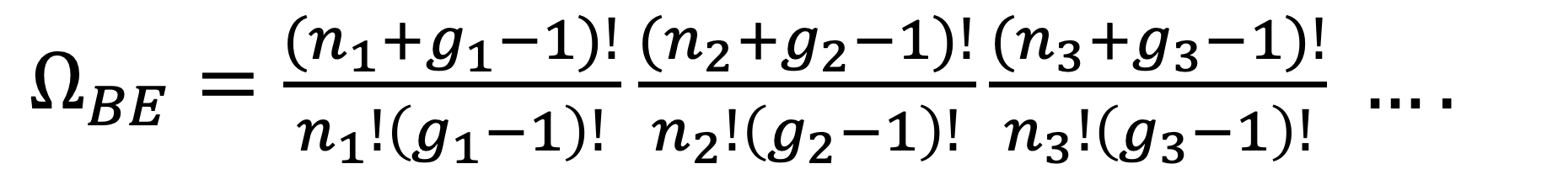
Bose-Einstein distribution → Bosons → indistinguishable
n energy levels
$Ω_{BE}=\frac{(n_{1}+g_{1}−1)!}{n_{1}!\left(g_{1}−1\right)!}$ $\frac{(n_{2}+g_{2}−1)!}{n_{2}!\left(g_{2}−1\right)!}\frac{(n_{3}+g_{3}−1)!}{n_{3}!\left(g_{3}−1\right)!} ….$
Bose-Einstein thermodynamic probability
$$Ω_{BE}=\prod_{i}{\frac{(n_{i}+g_{i}−1)!}{n_{i}!\left(g_{i}−1\right)!}}$$

Slide 21
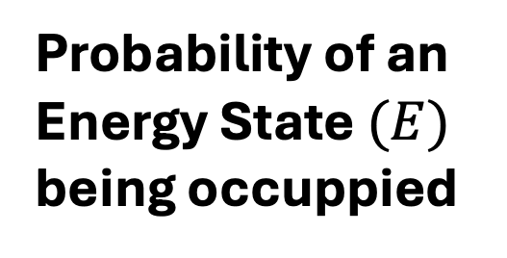
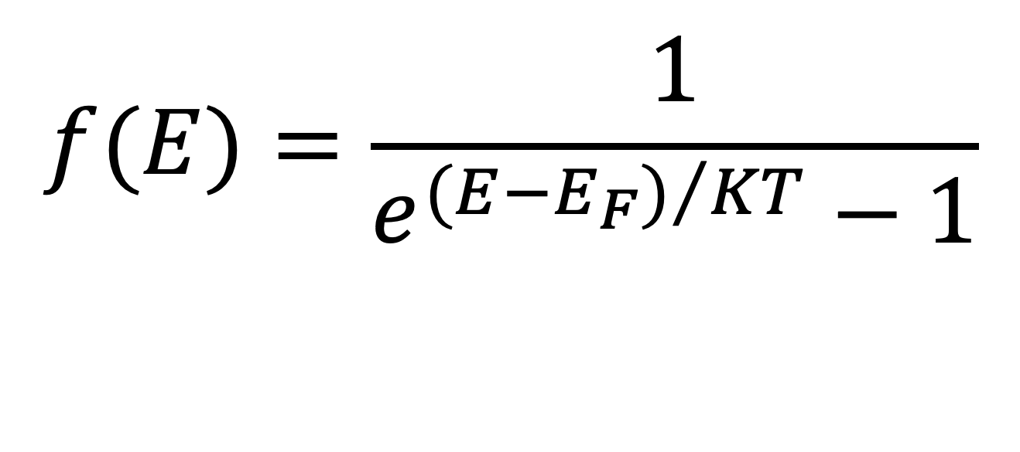
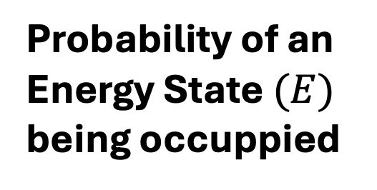
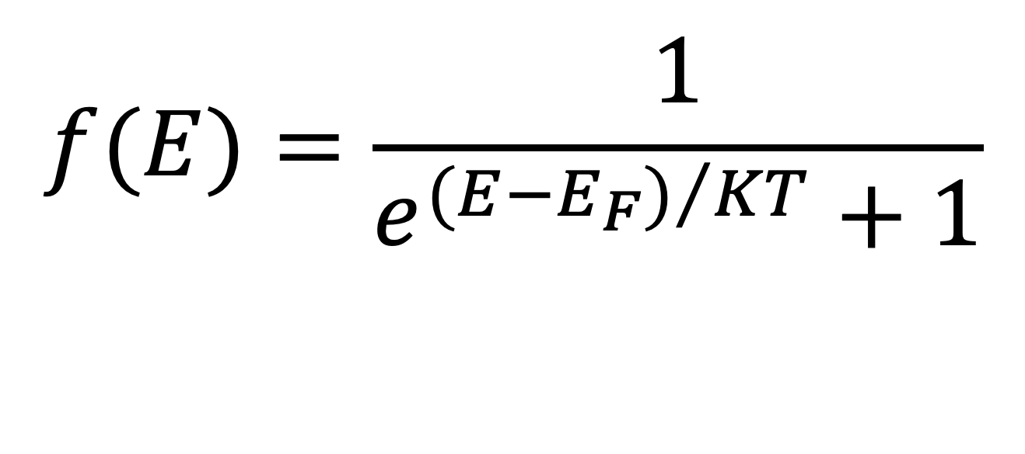
Bose-Einstein distribution → Bosons → indistinguishable
$$f(E)=\frac{1}{e^{{(E−E_{F})}/{KT}}−1}$$
Probability of an Energy State $(E)$ being occuppied
Fermi-Dirac distribution → Fermions → indistinguishable
$$f(E)=\frac{1}{e^{{(E−E_{F})}/{KT}}+1}$$
Probability of an Energy State $(E)$ being occuppied

Slide 22
Bose-Einstein distribution applications (1):
Blackbody radiation (photons) Explains how light is distributed in thermal equilibrium → foundation of Planck’s law.
Bose–Einstein condensates Describes ultra-cold atoms collapsing into a single quantum state (quantum fluids).
Superfluidity (e.g., helium-4) Helps explain frictionless flow and macroscopic quantum behavior.
Laser physics Relevant for understanding photon statistics and stimulated emission.
Phonons in solids Describes quantized lattice vibrations → important for heat capacity and thermal conductivity.

Slide 23



Bose-Einstein condensate:
The 2001 Nobel Prize in Physic: New state of matter revealed: Bose-Einstein Condensate
Carl Wieman
Wolfgang Ketterle
Eric Cornell
https://www.nobelprize.org/prizes/physics/2001/popular-information/

Slide 24
Bose-Einstein distribution applications (1):
Blackbody radiation (photons) Explains how light is distributed in thermal equilibrium → foundation of Planck’s law.
Bose–Einstein condensates Describes ultra-cold atoms collapsing into a single quantum state (quantum fluids).
Superfluidity (e.g., helium-4) Helps explain frictionless flow and macroscopic quantum behavior.
Laser physics Relevant for understanding photon statistics and stimulated emission.
Phonons in solids Describes quantized lattice vibrations → important for heat capacity and thermal conductivity.

Slide 25
Bose-Einstein distribution applications (2):
Magnons (spin waves) Used in solid-state physics to describe collective spin excitations.
Cosmology / early universe physics Applied to photon gases and other bosonic particles in thermal equilibrium.
Cold atom experiments / quantum simulations Used to model trapped bosonic gases in optical lattices.
Superconductivity (indirectly) Cooper pairs behave like bosons → distribution helps describe their collective behavior.
Quantum statistical mechanics Fundamental framework for systems of indistinguishable bosons.

