Slide 1
Bose-Einstein condensates

Slide 2
Quantum indistinguishable particles
B
A
B
A
We cannot tell by observing the system which is which

Slide 3



Quantum indistinguishable particles
$$ψ$$
$$e^{−}$$
Wave function
(contains all the info about the system)
$$E$$
Probability distribution

Slide 4




Quantum indistinguishable particles
$$∣{ψ∣}^{2}$$
$$ψ$$
Probability of certain result when we do a measurement
$$e^{−}$$
$$E$$

Slide 5

Quantum indistinguishable particles
$$ψ$$
$$E$$

Slide 6

Quantum indistinguishable particles
$$∣{ψ∣}^{2}$$
$$E$$

Slide 7



Quantum indistinguishable particles
B
A
B
A
$$∣{ψ_{(A,B)}∣}^{2}$$
$$=∣{ψ_{(B,A)}∣}^{2}$$
$$∣{ψ∣}^{2}$$
Is the same
$$E$$

Slide 8


Quantum indistinguishable particles
B
A
B
A
$$∣{ψ_{(A,B)}∣}^{2}$$
$$≠∣{ψ_{(B,A)}∣}^{2}$$
Distinguishable particles
$$∣{ψ∣}^{2}$$
$$∣{ψ∣}^{2}$$
$$E$$

Slide 9
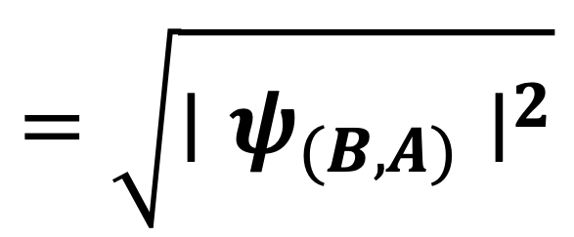
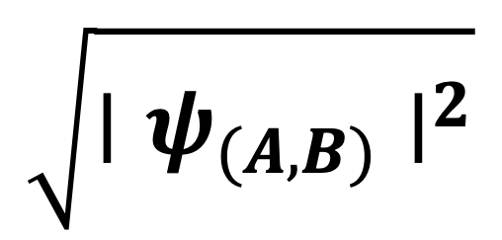
Quantum indistinguishable particles
B
A
B
A
$$∣{ψ_{(A,B)}∣}^{2}$$
$$=∣{ψ_{(B,A)}∣}^{2}$$
$$\sqrt{∣{ψ_{(A,B)}∣}^{2}}$$
$$=\sqrt{∣{ψ_{(B,A)}∣}^{2}}$$

Slide 10
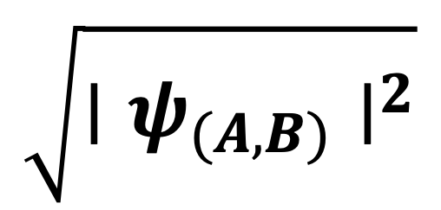
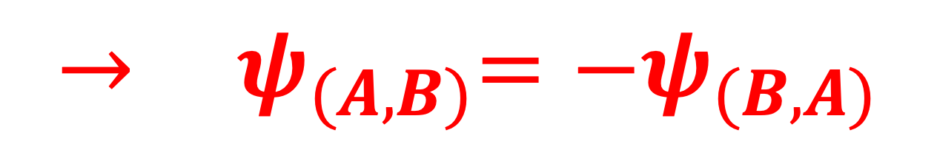

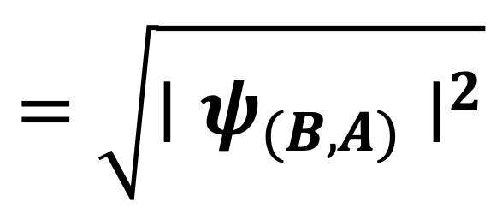
Quantum indistinguishable particles
$$\sqrt{∣{ψ_{(A,B)}∣}^{2}}$$
$$=\sqrt{∣{ψ_{(B,A)}∣}^{2}}$$
$$→{ ψ}_{(A,B)}= +ψ_{(B,A)}$$
Bosons
$$→{ ψ}_{(A,B)}=−ψ_{(B,A)}$$
Fermions

Slide 11


Quantum indistinguishable particles
$$ψ_{(A,B)}= +ψ_{(B,A)}$$
Bosons
A
B
Symmetric under particle exchange
$$ψ_{(A,B)}=−ψ_{(B,A)}$$
Fermions
A
B
Antisymmetric under particle exchange

Slide 12

Quantum indistinguishable particles - Bosons
A
B
1
B
0
A
$$ψ= ?$$

Slide 13
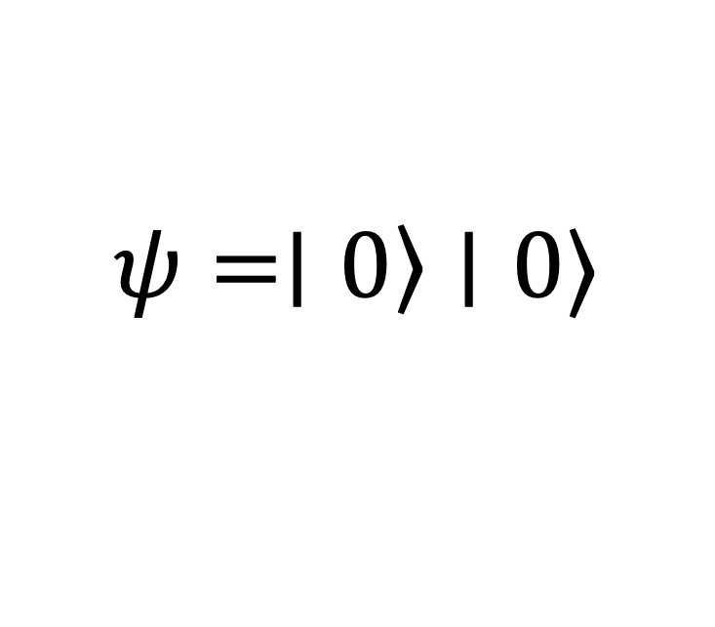
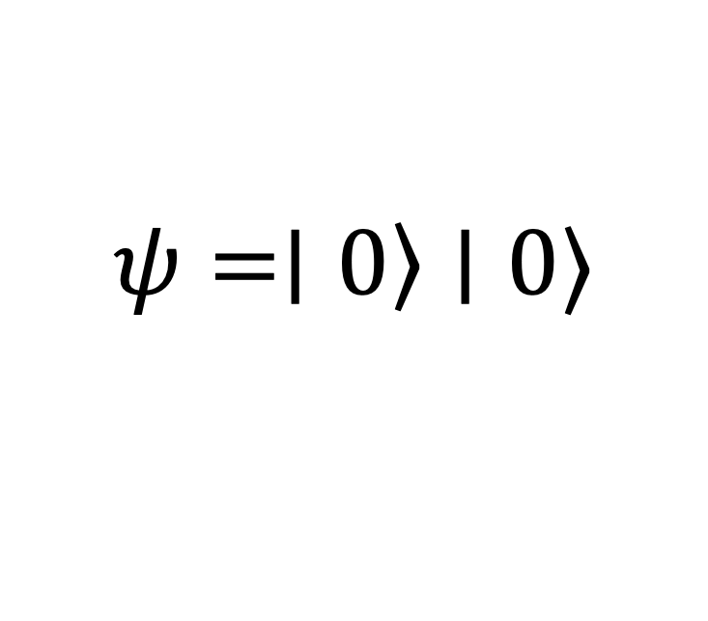
Quantum indistinguishable particles - Bosons
1
1
0
0
B
A
B
A
A
B
B
A
$$ψ=∣\left.0\right\rangle ∣0⟩$$
$$ψ=∣\left.0\right\rangle ∣0⟩$$
Bosons can occupy the same state

Slide 14
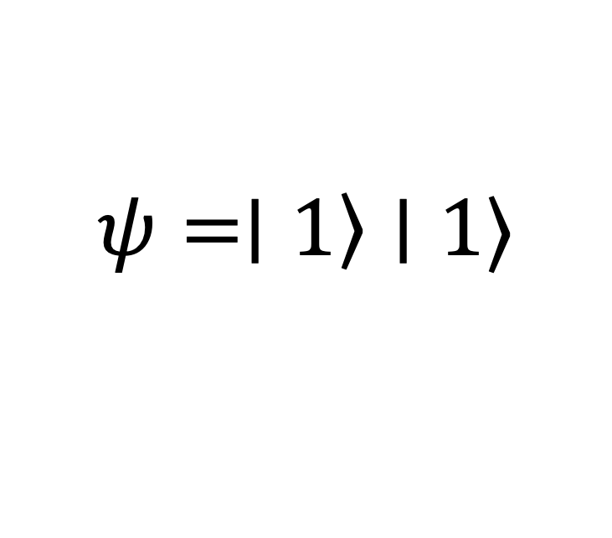
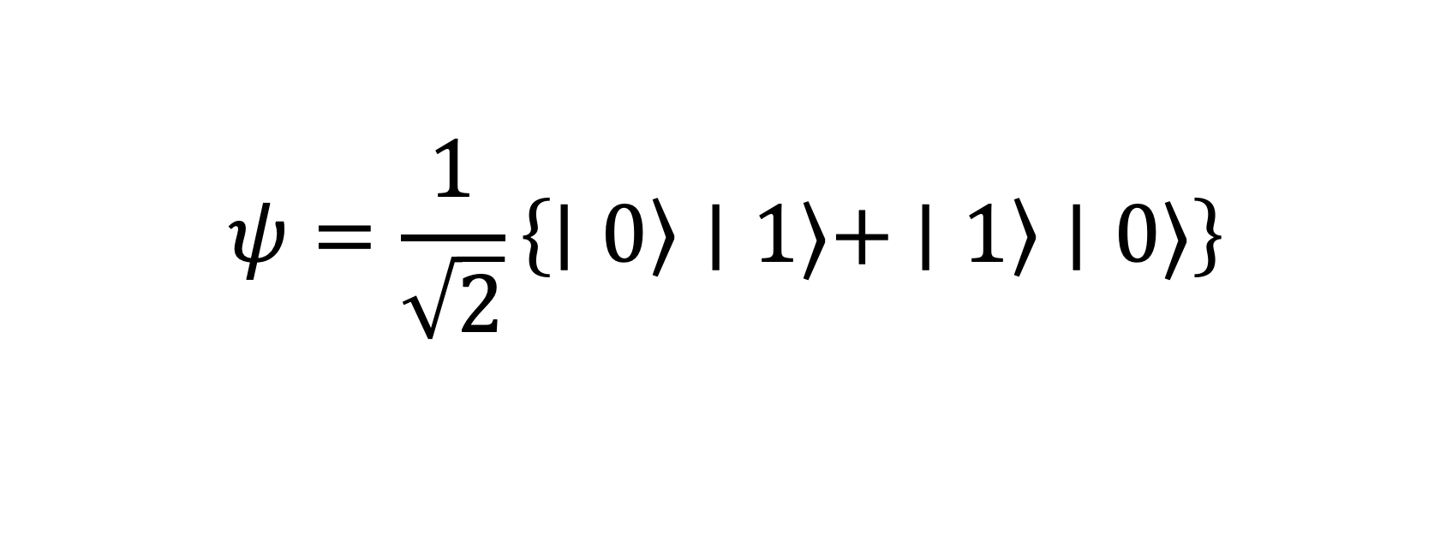
Quantum indistinguishable particles - Bosons
$$ψ=∣\left.1\right\rangle ∣1⟩$$
$$ψ=\frac{1}{\sqrt{2}}\left\{∣\left.0\right\rangle ∣1⟩+ ∣\left.1\right\rangle ∣0⟩\right\}$$

Slide 15
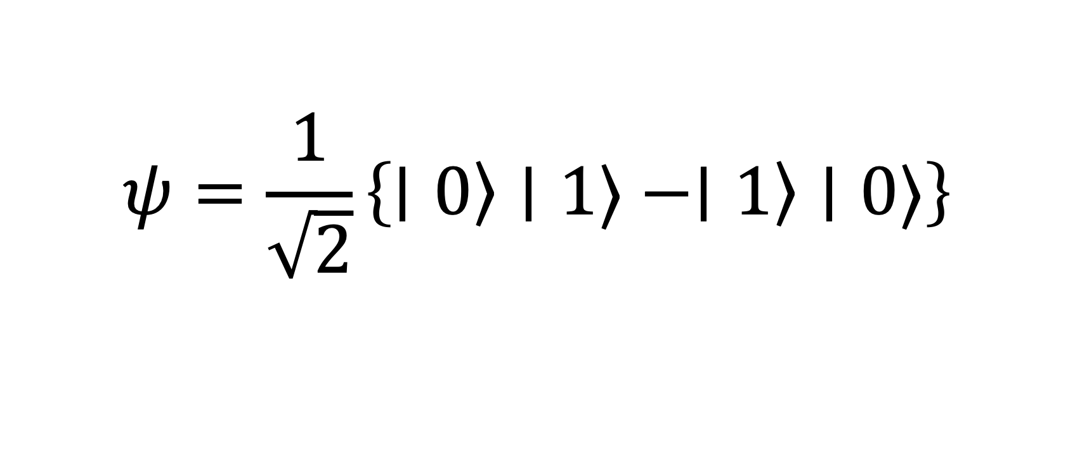
Quantum indistinguishable particles - Fermions
Antisymmetric under particle exchange
1
B
1
A
0
0
B
A
A
B
B
A
$$ψ=\frac{1}{\sqrt{2}}\left\{∣\left.0\right\rangle ∣1⟩−∣\left.1\right\rangle ∣0⟩\right\}$$
Superposition

Slide 16
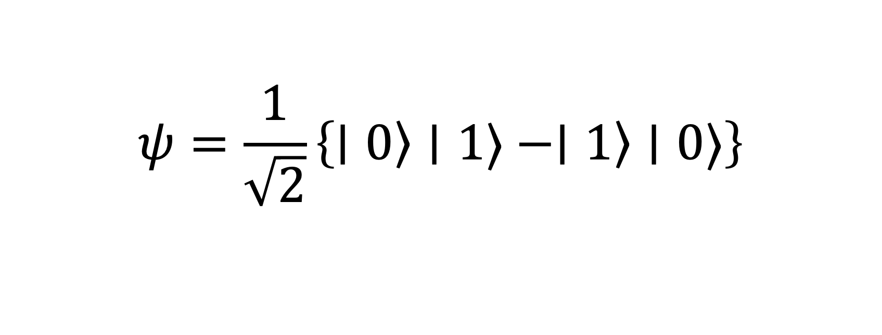
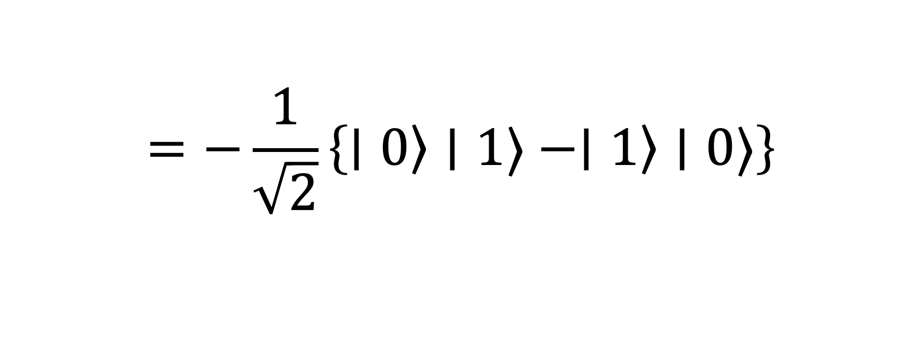
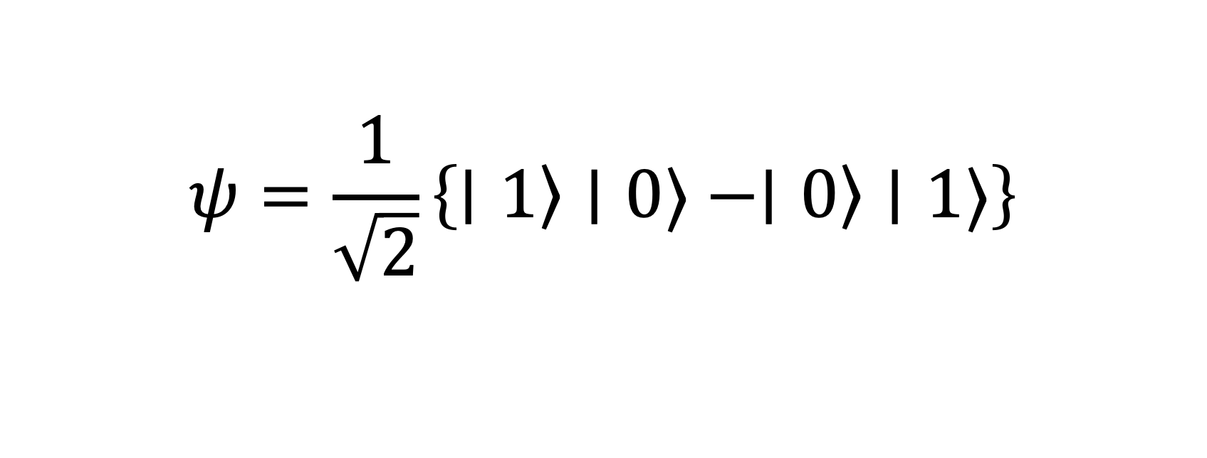
Quantum indistinguishable particles - Fermions
A
B
B
A
$$ψ=\frac{1}{\sqrt{2}}\left\{∣\left.0\right\rangle ∣1⟩−∣\left.1\right\rangle ∣0⟩\right\}$$
B
A
A
B
$$ψ=\frac{1}{\sqrt{2}}\left\{∣\left.1\right\rangle ∣0⟩−∣\left.0\right\rangle ∣1⟩\right\}$$
$$=−\frac{1}{\sqrt{2}}\left\{∣\left.0\right\rangle ∣1⟩−∣\left.1\right\rangle ∣0⟩\right\}$$

Slide 17

Boson-Einstein Condensate
Low density collection of Bosons
$$T↓$$
2
1
Energy levels
0

Slide 18
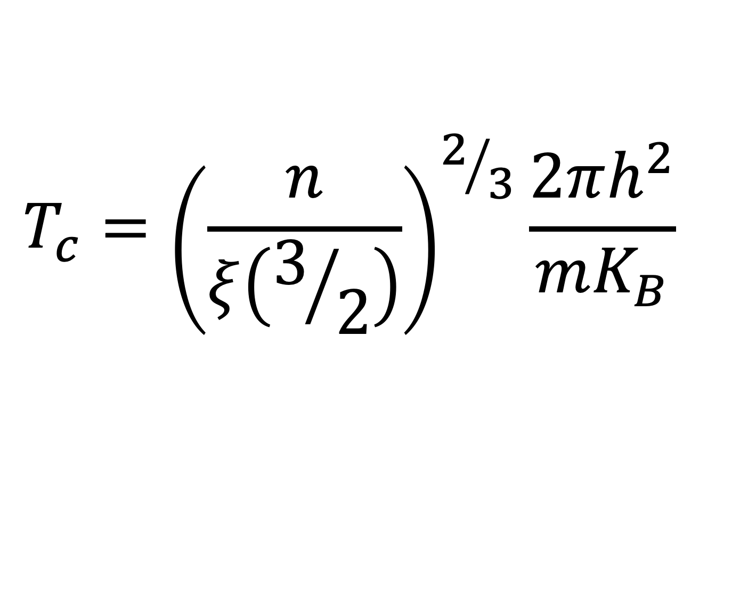
Boson-Einstein Condensate
particle density
$$T_{c}={\left(\frac{n}{ξ\left(3/2\right)}\right)}^{2/3}\frac{2πh^{2}}{mK_{B}}$$
critical temperature
mass of boson

Slide 19

Boson-Einstein Condensate
1
We can see Quantum effects on a large scale
0
Superfluidity → fluid flows with nearly NO viscosity
Fluids flowing forever

