Slide 1

DATA PROTECTION AND CYBERSECURITY IN eHEALTH SYSTEMS 3

Slide 2
Cybersecurity risk assesment
Identification of assets, threats, and vulnerabilities
Assessment of the impact of threats and vulnerabilities on device functionality and end users/patients;
Assessment of the likelihood of a threat and of a vulnerability being exploited
Determination of risk levels and suitable mitigation strategies;
Assessment of residual risk and risk acceptance criteria

Slide 3
Identification of threats step 1. System Modeling
Formal process and system modeling helps identifying threats and vulnerabilities
Multiple techniques:
  UML
  Data flow diagrams (DFDs)

Slide 4
Data flow diagram
DFDs are a way to represent the entities involved with the functioning of the medical device, how those entities are related, and the assumed trust boundaries between them.

Slide 5
Example: definition of the system and use cases

Slide 6
Example: core technology

Slide 7
Example: AMPS device

Slide 8
Example: patient app

Slide 9
Example: cloud service

Slide 10
Example: high-level diagram

Slide 11
Example: detailed DFD

Slide 12
Trust boundaries
Trust boundaries do not physically reside in a given organization’s system, but instead represent ideas and assumptions being made by the threat modeling team about how different entities interact.
Trust boundaries help in later stages of the threat modeling process by identifying areas that require enhanced investigation.
Trust boundaries help capture the thought process of the threat modeling team and can be used to help convey that information to external reviewers.

Slide 13
Example: Trust boundaries

Slide 14
Example: Trust boundaries within a device

Slide 15
Identification of threats step 2. threat identification
There are several techniques:
  STRIDE (Spoofing, Tampering, Repudiation, Information disclosure, Denial of service, Elevation of privilege)
  Attack trees
  Kill Chains and Cyber Attack Lifecycles
  ATT&CK Framework
  Where do we find the threats types?

Slide 16
MITRE, CVE, CWE and ATT&CK
MITRE
A nonprofit organization that develops widely used cybersecurity knowledge frameworks and programs.
CWE (Common Weakness Enumeration)
A catalog of software and hardware weakness types, such as buffer overflows or improper input validation.
CVE (Common Vulnerabilities and Exposures)
A standardized list of publicly known security vulnerabilities, each identified by a unique CVE ID.
ATT&CK (Adversarial Tactics, Techniques, and Common Knowledge)
A knowledge base of real-world attacker behaviors, organized by tactics and techniques.
MITRE
CWE
CVE
ATT&CK
e.g., CWE: https://cwe.mitre.org/data/definitions/798.html
e.g., CVE: https://www.cve.org/CVERecord?id=CVE-2026-0049 -.> https://cwe.mitre.org/data/definitions/400.html
e.g., ATT&CK:

Slide 17
STRIDE
STRIDE is a mnemonic that articulates six types of potential threats against a system.

Slide 18
STRIDE per ELEMENT
STRIDE can be applied to the DFD elements or dataflow (“STRIDE per Element” approach).
This method is developed by analyzing which STRIDE threats tend to appear for individual DFD element types.
This approach creates a mapping where for a particular DFD element, there will be a list of STRIDE threats commonly associated with it.

Slide 19
STRIDE per application

Slide 20
Example: STRIDE per application

Slide 21
Attack trees
Top-down approach: starts from the threat
CWE

Slide 22
Attack trees
Bottom-up approach: starts from the damage
CVE

Slide 23
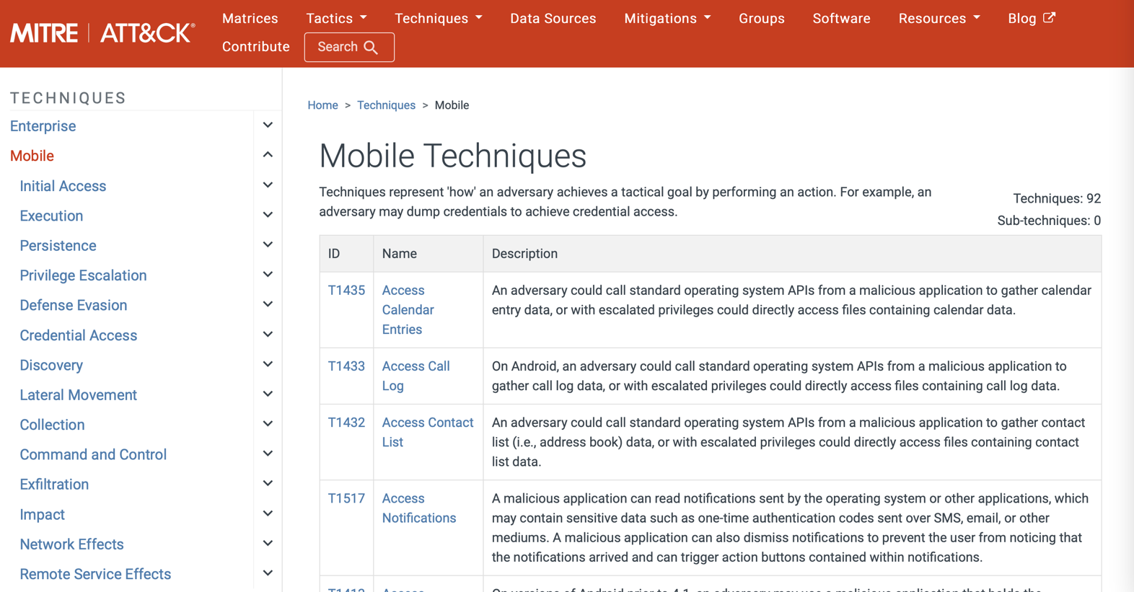
ATT&CK framework
ATT&CK is a public repository and framework for capturing and describing what attackers have done based on real-world data (https://attack.mitre.org)

Slide 24
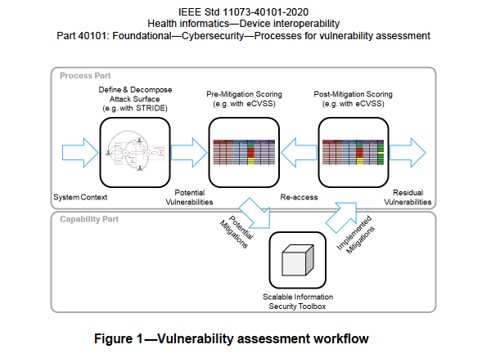
Scoring

Slide 25
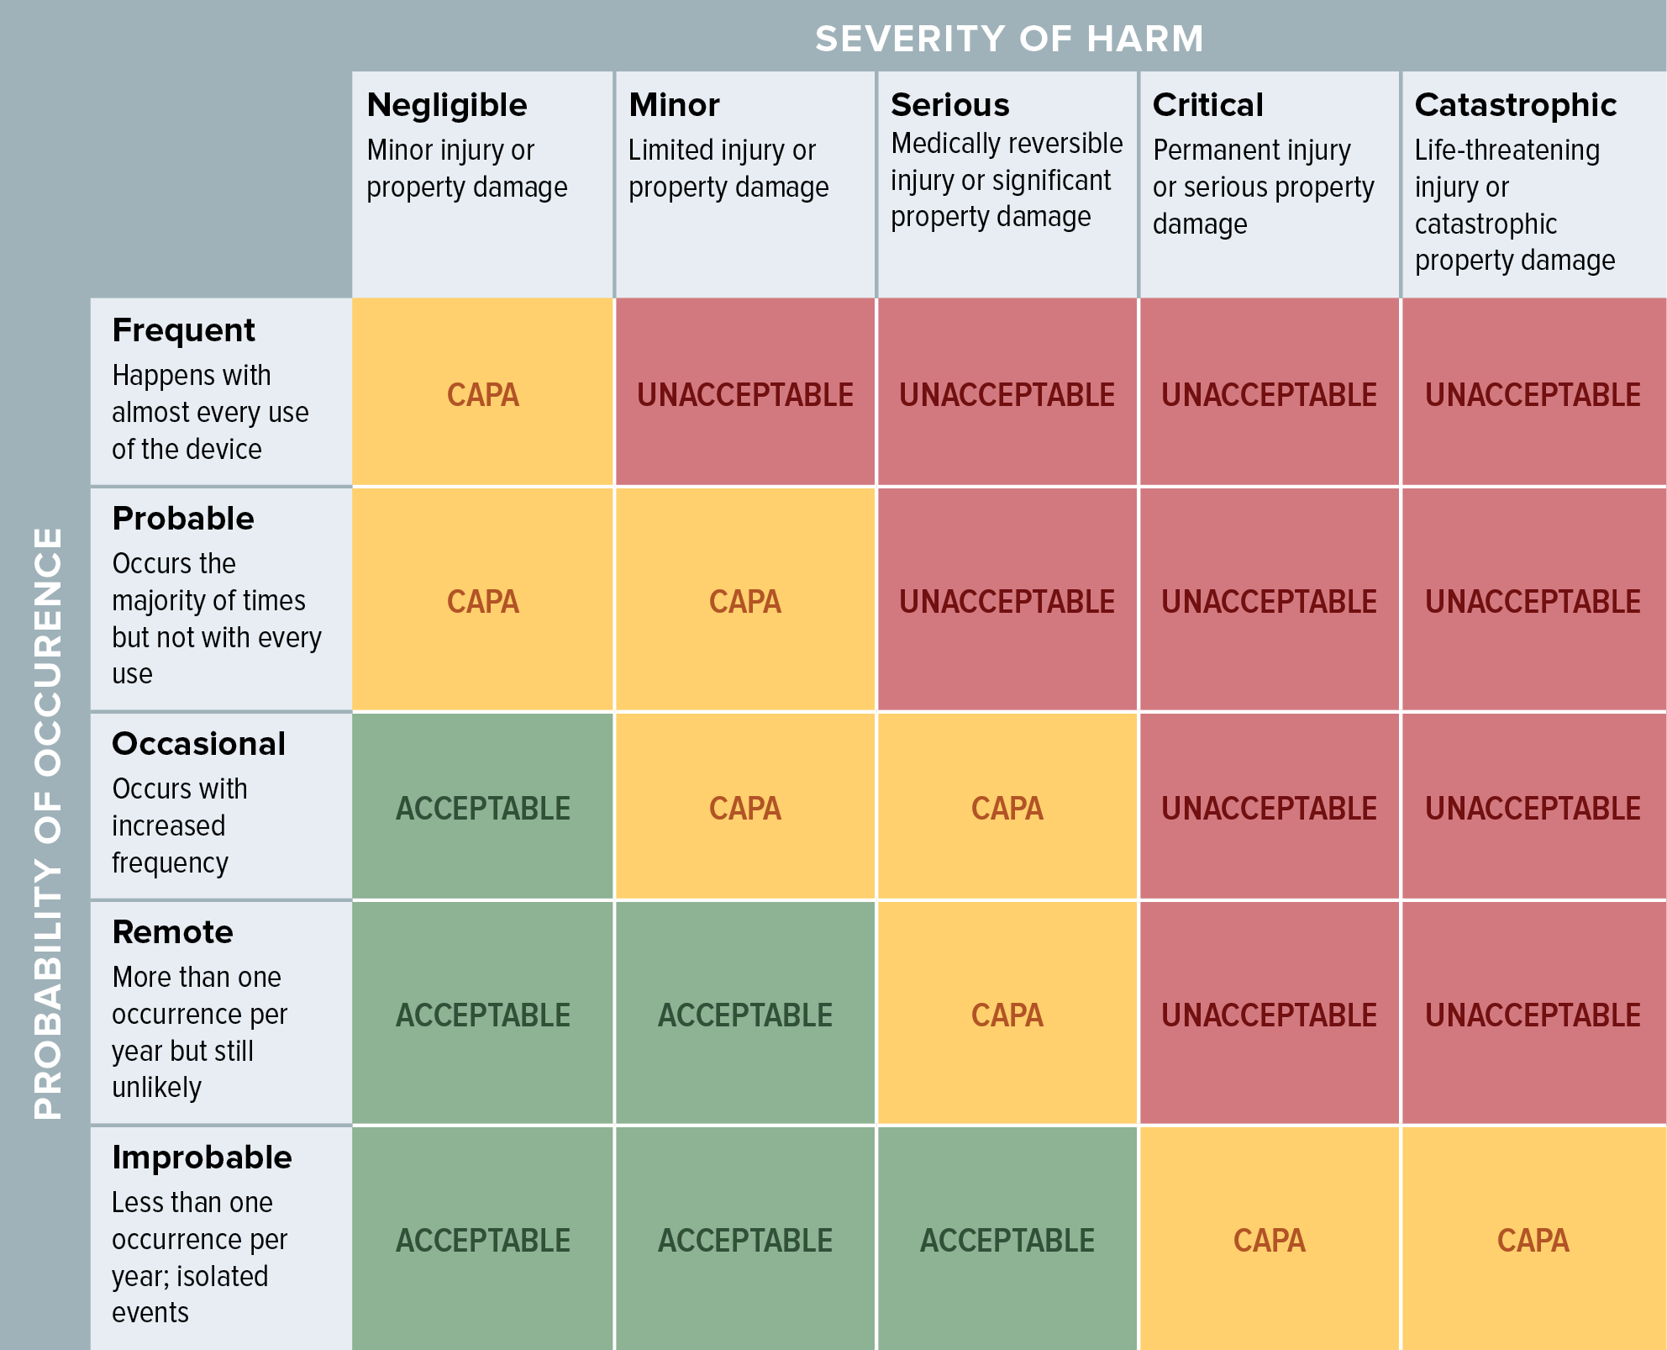
Assessment of impact and likelihood

Slide 26
Common vulnerability Scoring System –CVSS
The assessment has to be done before and after mitigation measures are put in place
Even in the case of security/privacy by design the mitigation measures are not considered in the first assessment
Two-level assessment:
  System-wide level (system-wide metric): Represents the system requirements for a confidentiality, integrity, and availability (CIA) triad that are set once for the product and then applied to all vulnerabilities
  Vulnerability level
    base metric: intrinsic and fundamental characteristics of a vulnerability that are constant over time and user environments.
    environmental metric: the characteristics of a vulnerability that are relevant and unique to a particular user’s environment.
https://nvd.nist.gov/vuln-metrics/cvss/v4-calculator

Slide 27
Common vulnerability Scoring System –CVSS
Environmental metrics
  Used by the asset owner or defender.
  They adapt the vulnerability assessment to the local environment, business impact, and deployed controls.
Supplier metrics
  Not an official CVSS 4.0 metric group.
  Usually means the information published by the vendor, mainly the Base metrics and sometimes Supplemental metrics.
Core difference
  Supplier view = general severity for everyone.
  Environmental view = actual severity for your specific organization.
https://nvd.nist.gov/vuln-metrics/cvss/v4-calculator

Slide 28
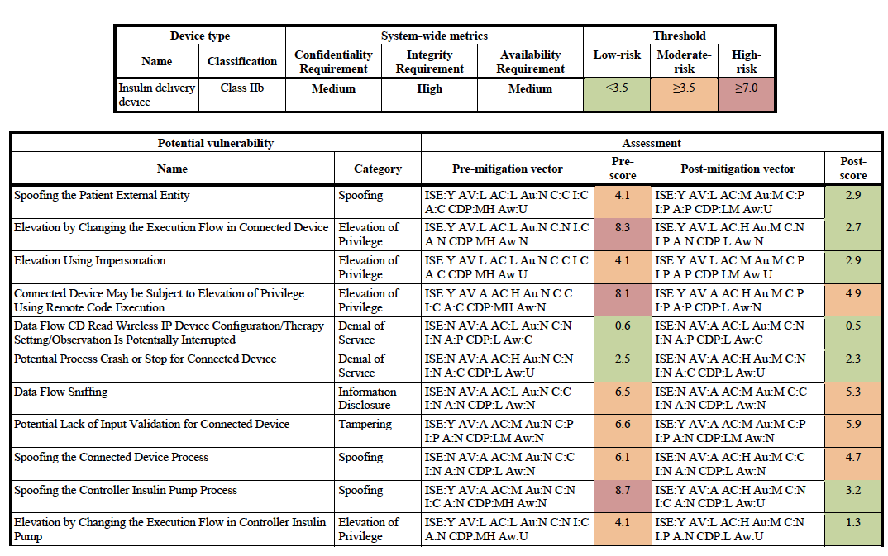
(embedded) CVSS example

Slide 29
Mitigation measures
There are four main strategies for addressing threats:
  Eliminate
  Mitigate
  Accept
  Transfer
Major mitigation measures:
  Protect
  Detect
  Respond
  Recover

Slide 30
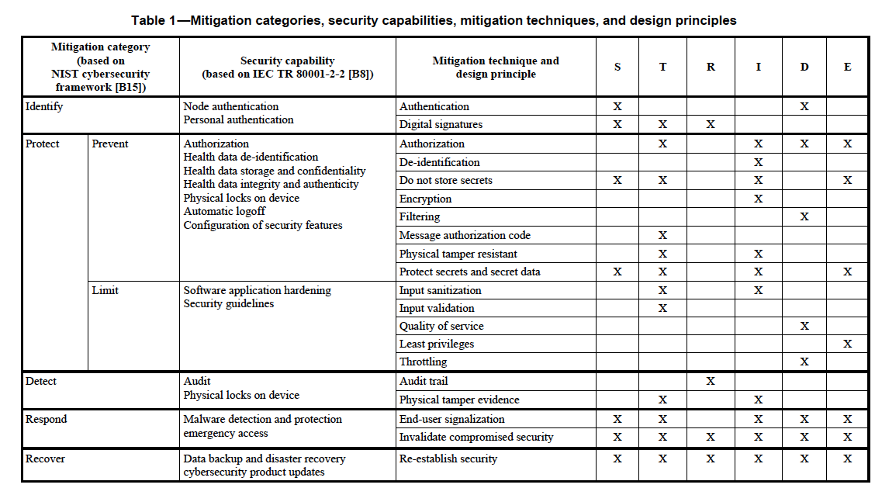
Mitigation measures
IEEE 11073 - 40102

Slide 31
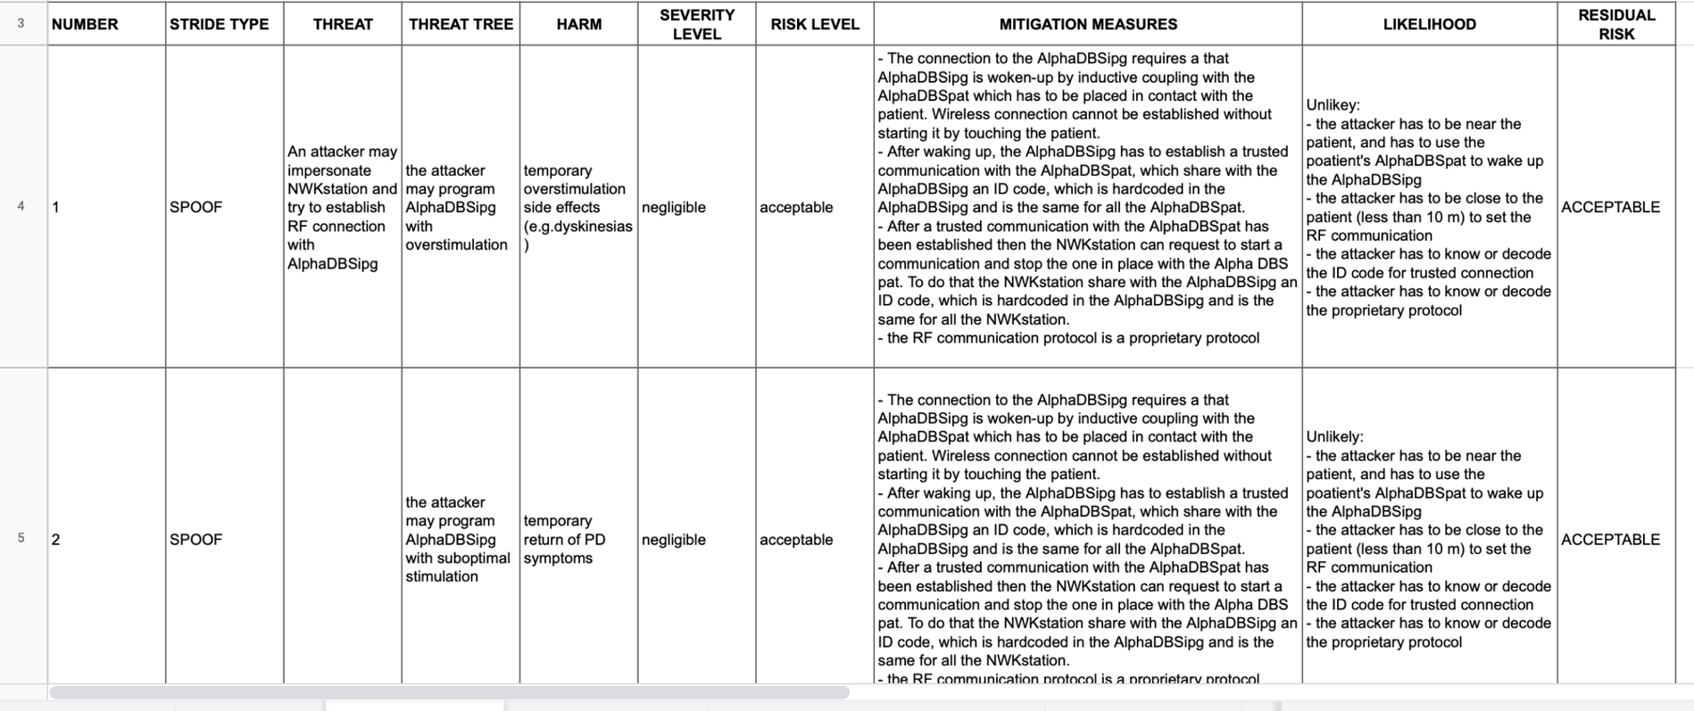
Cybersecurity risk assessment matrix

Slide 32
Traceability matrix
Traceability among requirements, specifications, identified hazards and mitigations, and Verification and Validation testing.
Mitigation measure | System requirement | Test case | Test execution | Test result | Issues

Slide 33
REAL CASE
CISA issues Security Alert for Customers Affected by Oracle Data Breach
Posted By Steve Alder on Apr 21, 2025
The U.S. Cybersecurity and Infrastructure Security Agency (CISA) has issued a security alert about the recently confirmed Oracle data breach. Oracle has confirmed that an unauthorized individual gained access to its legacy cloud environment, although limited details about the incident have been disclosed by Oracle, and the extent of the breach is currently unconfirmed. There have been reports of threat actor activity targeting Oracle customers, but the scope and impact of that activity are not yet known.
Information compromised in the incident includes credentials such as usernames, email addresses, passwords, authentication tokens, and encryption keys, and as such, the breach poses a risk to enterprise environments. CISA recommends that Oracle customers take steps to protect against unauthorized access and warns that when credential material has been embedded into scripts, applications, infrastructure templates, and automation tools, it can be hard to detect. Should action not be taken, unauthorized actors could potentially use credential material for long-term access to enterprise environments.
Breaches of credential material carry a risk, as threat actors frequently harvest and weaponize credentials. The stolen data can be enriched with information obtained in prior breaches, the information could be sold to other threat actors, and could be used to conduct BEC attacks or phishing campaigns. Valid credentials could be used to escalate privileges and move laterally within networks, or access cloud and identity management systems.
https://www.hipaajournal.com/oracle-health-data-breach/

Slide 34
TIMELINE
March 31, 2025: Oracle Health Breach Affects Patients of Multiple U.S. Hospitals
Oracle suffered two security incidents. The first involved Oracle Health (formerly Cerner), where a cyberattack on a legacy server allowed a threat actor to exfiltrate electronic health record (EHR) data using stolen credentials. Oracle Health detected the breach on February 20, 2025, with the breach dating back to at least January 22, 2025. Affected healthcare providers are being notified but must handle HIPAA breach notifications themselves. Extortion attempts by a threat actor named “Andrew” have been reported.
The second incident involved an individual (rose87168) claiming to exploit a vulnerability (CVE-2021-35587) in Oracle Access Manager, allegedly stealing about 6 million records containing sensitive authentication data. Oracle Cloud denies any breach but has not offered a full explanation, despite confirmations from affected companies that the leaked data is genuine. (https://nvd.nist.gov/vuln/detail/cve-2021-35587)
April 3, 2025: Oracle Sued Over Healthcare Data Breach
A class action lawsuit was filed against Oracle Corporation in the U.S. District Court for the Western District of Texas by Michael Toikach, after a January 2025 data breach. Oracle has not publicly confirmed the breach yet, and it is not listed on the HHS OCR breach portal. The lawsuit claims that Oracle failed to use reasonable security measures to protect personal and health information stored through a healthcare provider using Oracle software. Alleged failures include poor network segmentation, insufficient cybersecurity training, and lack of monitoring systems. The breach was detected on February 20, 2025, but plaintiffs argue Oracle delayed required breach notifications under HIPAA and Texas law. Plaintiffs say the delay and lack of transparency put them at greater risk of identity theft and fraud. The lawsuit seeks compensatory damages, reimbursement, long-term credit monitoring, and injunctive relief demanding major security improvements like encryption, penetration testing, audits, and better security training.
April 15, 2025: Oracle Confirms Hacking Incident Involving Obsolete Servers
Oracle notified customers of a security incident but confirmed that Oracle Cloud Infrastructure (OCI) was not breached. Instead, a hacker accessed two obsolete servers (not part of OCI), exposing usernames but no usable passwords or customer data. Security researcher Kevin Beaumont criticized Oracle for downplaying the breach, noting the compromised servers were Oracle-managed cloud services (Oracle Cloud Classic). Separately, Oracle Health (formerly Cerner) suffered a breach involving legacy servers not yet migrated to Oracle Cloud, with stolen credentials used to access them. A hacker is allegedly trying to extort Oracle Health customers by threatening to release stolen data. A lawsuit has been filed, accusing Oracle Health of negligence after sensitive information like Social Security numbers and clinical results were stolen. Plaintiffs claim they were not properly notified and now face risks of identity theft. Oracle Health stated that healthcare providers must assess and handle HIPAA breach notifications themselves.

Slide 35
MITIGATION
The suggested mitigations include resetting passwords across enterprise servers, especially in cases where local credentials may not be federated through enterprise identity solutions. Source code should be reviewed, along with infrastructure as code templates, configuration files, and automation templates, to identify embedded credentials, which should be replaced with secure authentication methods. Authentication logs should be monitored for anomalous activity, especially for privileged, service, or federated identity accounts, and if possible, phishing-resistant multifactor authentication should be implemented and enforced, especially for administrator accounts.
Oracle has stressed that the breach involved legacy servers and there was no breach of Oracle Cloud, but has yet to issue any public advisory to help customers mitigate risk.

