Slide 1

DATA PROTECTION AND CYBERSECURITY IN eHEALTH SYSTEMS 2

Slide 2
ESERCIZIO STRIDE
Una struttura sanitaria vuole introdurre RXView, una web application per la visualizzazione di esami radiologici, in particolare RX, tramite browser. Il sistema consente ai medici di accedere alle immagini archiviate in un server PACS senza utilizzare software desktop dedicato. L’accesso alla piattaforma avviene esclusivamente tramite Single Sign-On (SSO) integrato con la directory LDAP aziendale, così da centralizzare l’autenticazione degli utenti sanitari.
Quando il medico apre RXView dal browser, la web application lo reindirizza al sistema SSO. Dopo la verifica delle credenziali tramite LDAP, il sistema restituisce alla web application l’identità dell’utente autenticato. RXView crea quindi una sessione applicativa e consulta il proprio database interno per determinare ruoli, permessi e preferenze dell’utente. Una volta autenticato, il medico può cercare un paziente, visualizzare l’elenco degli esami RX disponibili, selezionare uno studio e aprire le relative immagini direttamente nel viewer web. Per farlo, la web application interroga il server PACS, dal quale ottiene immagini diagnostiche e metadati associati. Il sistema registra inoltre nei log applicativi e negli audit log le operazioni principali, come accessi, ricerche e aperture degli esami.
Il sistema è accessibile dalla rete ospedaliera e, per alcuni utenti autorizzati, anche da remoto. Alcuni medici possono soltanto visualizzare le immagini, mentre altri possono anche esportare referti o immagini. Tutti i dati trattati includono informazioni sanitarie personali e contenuti diagnostici sensibili.
Compito: costruire il Data Flow Diagram (DFD) del sistema, identificando entità esterne, processi, archivi di dati e flussi informativi, e successivamente svolgere un’analisi delle minacce usando il modello STRIDE. Non è richiesto proporre soluzioni o contromisure.

Slide 3
PRIVACY AND CONFIDENTIALITY
Privacy is an important part of confidentiality, especially when it comes to protected health information(PHI).
PHI is defined as individually identifiable health information transmitted or maintained by a covered entity or its business associates in any form or medium (45CFR160.103 [B1]).
The U.S. Health Insurance Portability and Accountability Act (HIPAA) limits the circumstances in which an individual’s PHI may be used or disclosed by covered entities (HHS [B7]).
Similarly, the EU General Data Protection Regulation states that personal data shall be processed lawfully, fairly, and in a transparent manner; collected for specified, explicit, and legitimate purpose; and kept in a form that permits identification of data subjects for no longer than is necessary for the purposes for which the personal data is processed (Official Journal of the EU [B19]).
loss of confidential protected health information (PHI), are not considered “patient harms” but are regulated by national privacy rules (GDPR, HIPAA)
Little excerpt from https://en.wikipedia.org/wiki/Cyberattack

Slide 4

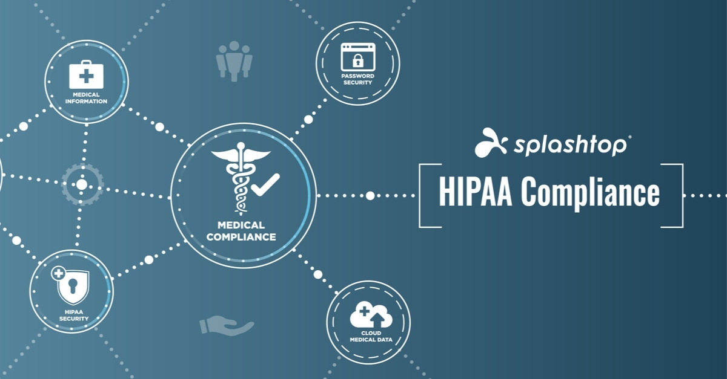

PROTECTION OF DATA

Slide 5
GDPR GOALS

Slide 6
GDPR PERSONAL DATA AND PROCESSING
Processing: operations performed on personal data, including by manual or automated means. It includes the collection, recording, organisation, structuring, storage, adaptation or alteration, retrieval, consultation, use, disclosure by transmission, dissemination or otherwise making available, alignment or combination, restriction, erasure or destruction of personal data.

Slide 7
GDPR: FINES

Slide 8
GDPR: INDIVIDUAL RIGHTS

Slide 9
GDPR: SUBJECTS

Slide 10
GDPR: SUBJECTS

Slide 11

HIPAA Security Rule
Health Insurance Portability and Accountability Act
The HIPAA Security Rule contains the standards that must be applied in order to safeguard and protect electronically created, accessed, processed, or stored PHI (ePHI) when at rest and in transit.
It has three parts:
technical safeguards
physical safeguards
administrative safeguards

Slide 12
HIPAA techincal safeguard

Slide 13
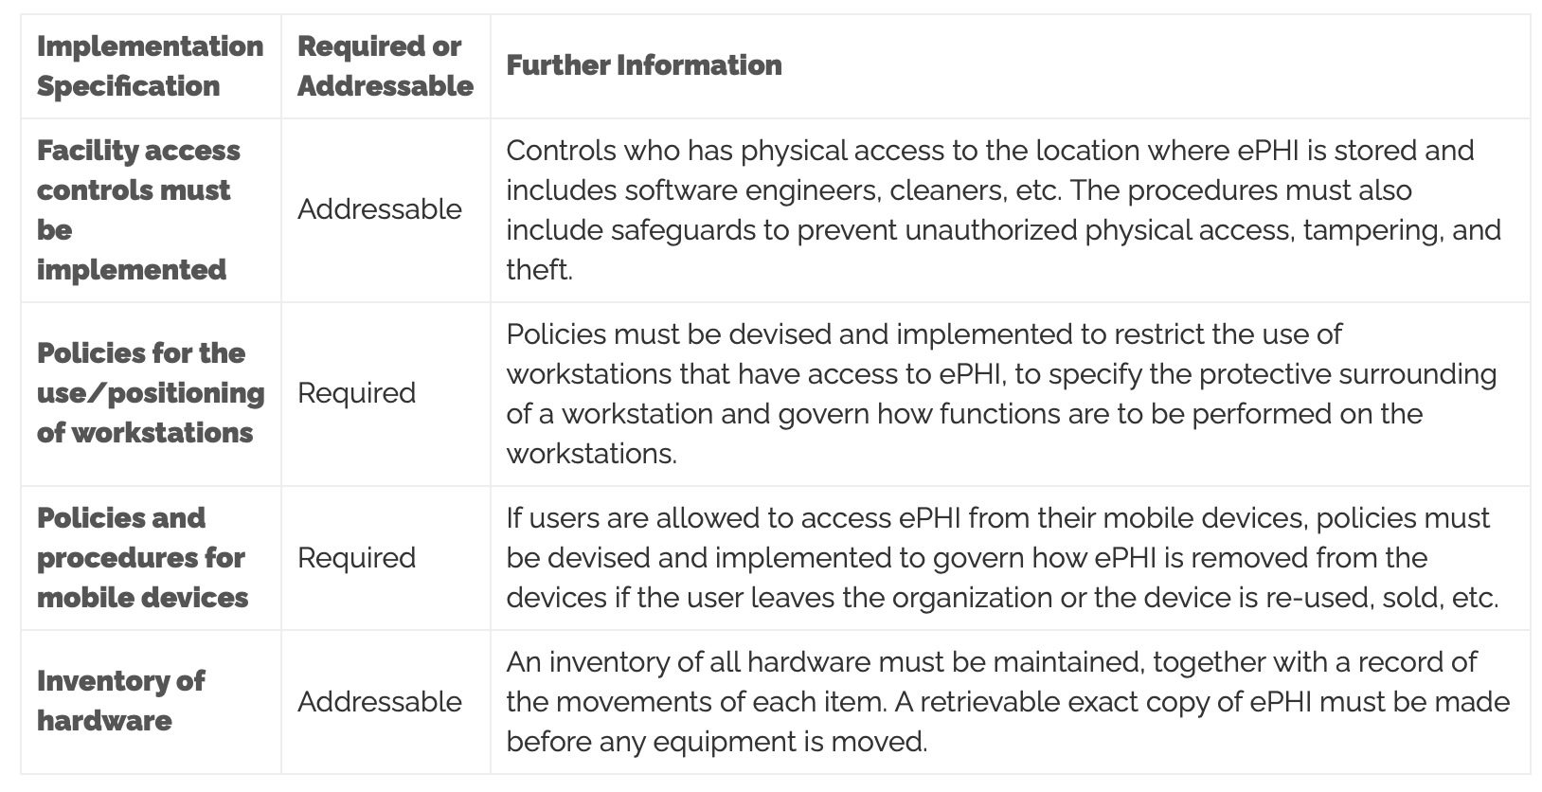
HIPAA physical safeguard

Slide 14
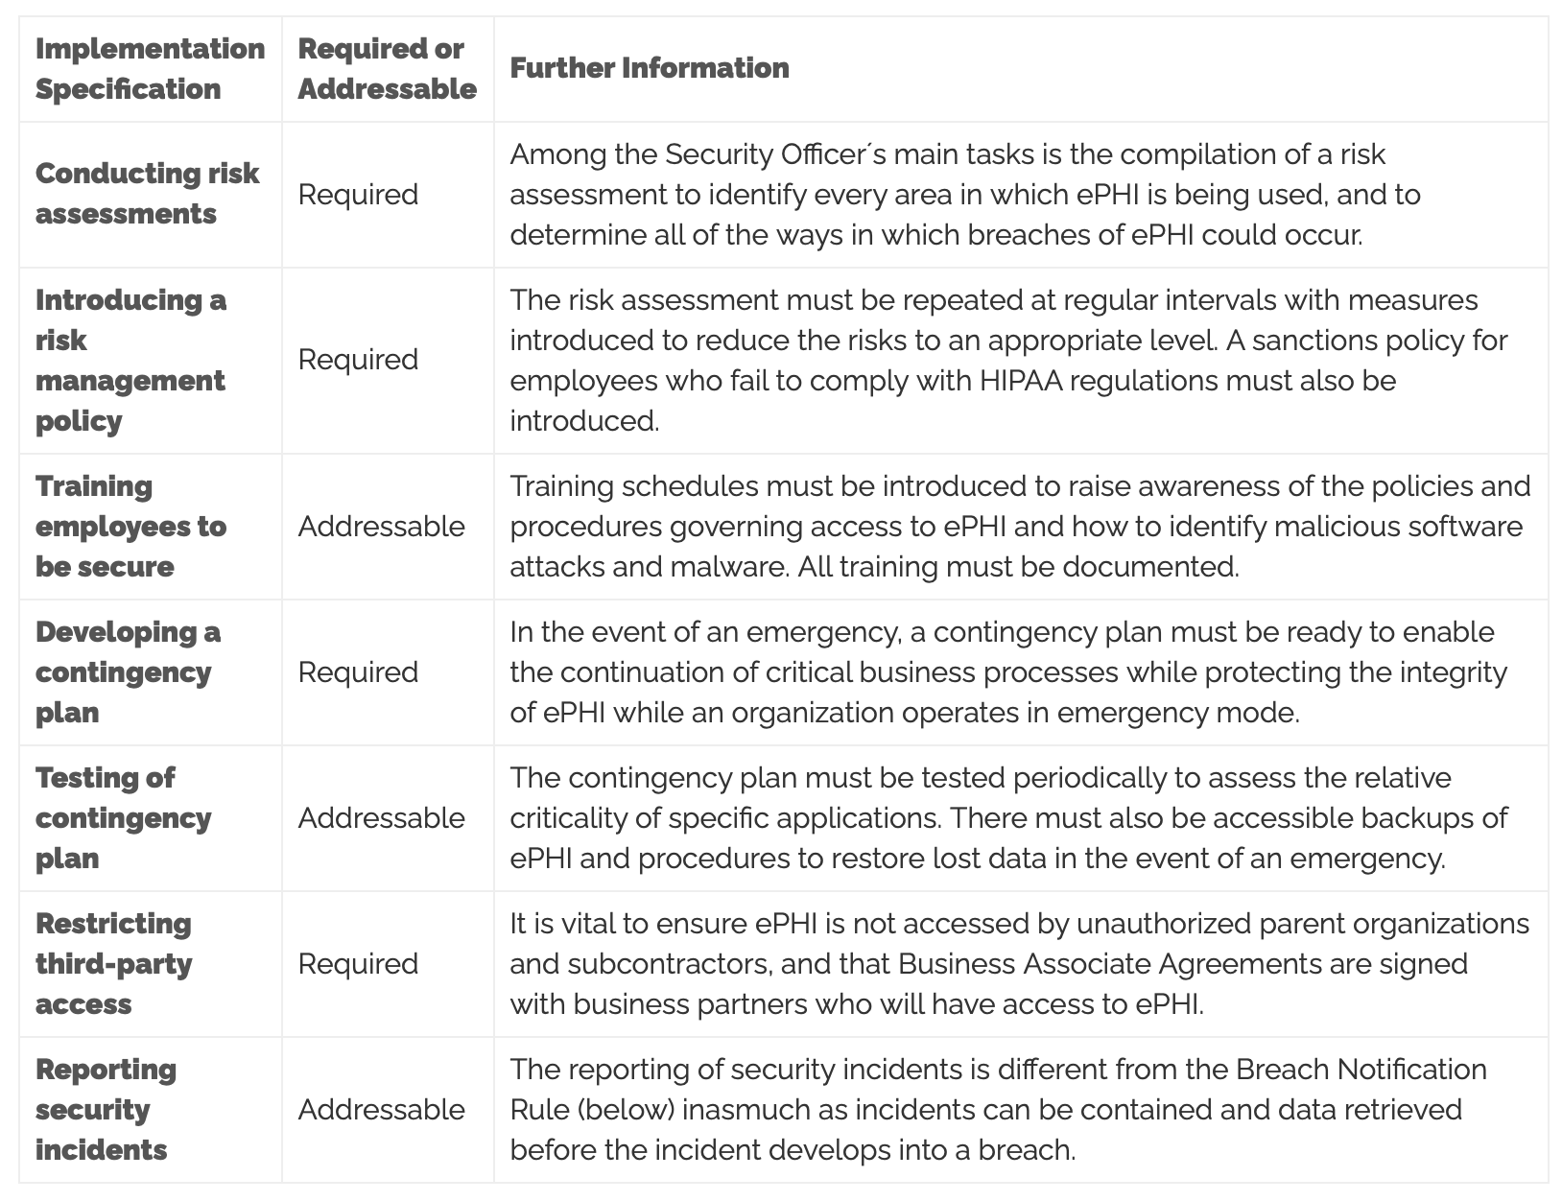
HIPAA administrative safeguard

Slide 15
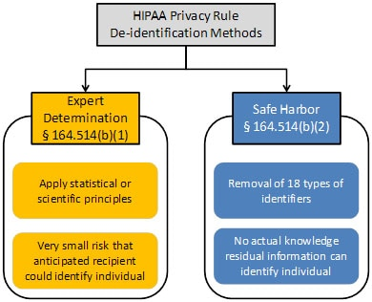
HIPAA de-identification
EXPERT DETERMINATION + SAFE HARBOR

Slide 16
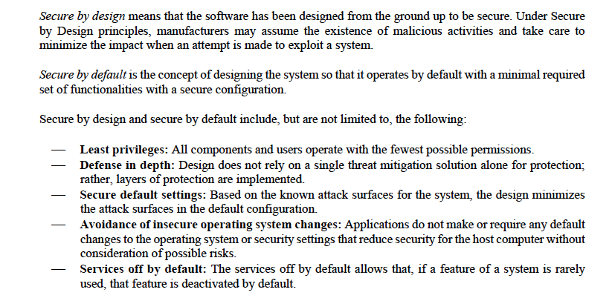
Secure by design and secure by default

Slide 17
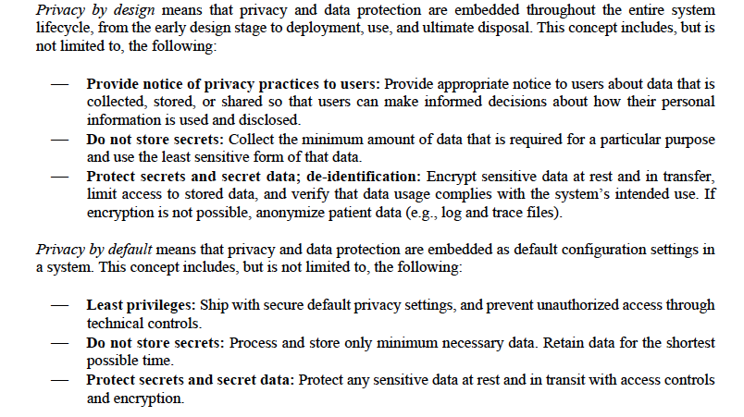
Privacy by design and privacy by default

Slide 18
Cybersecurity measures: detect, respond, and recover
Appropriate design should anticipate the need to detect and respond to dynamic cybersecurity risks, including the need for deployment of cybersecurity routine updates and patches as well as emergency workarounds
Detect:
Routine security and antivirus scanning
Tracking and control of software updates
Respond:
User notification of cybersecurity risk detection
Architecture to rapid deploy of patches and updates
Recover:
Implement features to protect critical functionality
Recovery of device configuration by authorized user

Slide 19
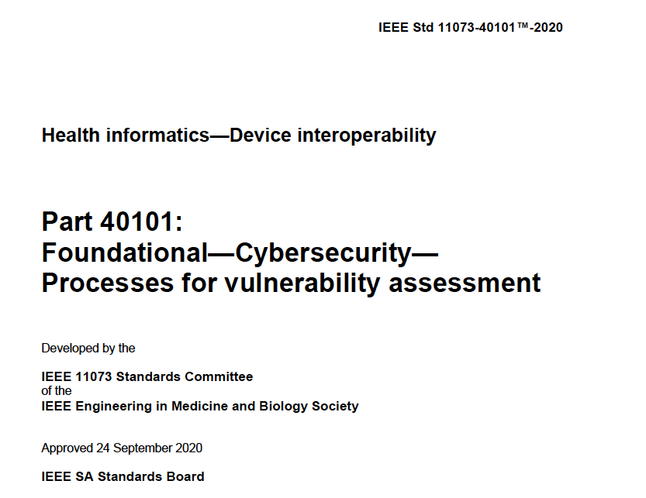
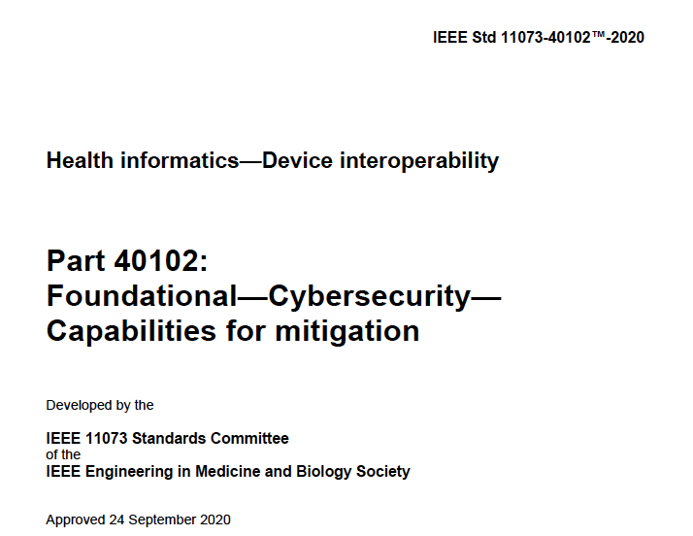
Approach to cybersecurity assessment
Family of standards devoted to point-of-care/personal complex eHealth devices/systems requiring interoperability

