Slide 1

CODE VERSIONING and
GIT - GITHUB

Slide 2
VERSION CONTROL SYSTEMS and GIT
Il controllo di versione è un sistema che registra i cambiamenti di un lavoro che sia un software, un testo, una grafica eccetera eccetera.
Il controllo di versione (informatico) lavora principalmente sui file, permette di:
Tenere traccia del lavoro:
  Quando e Chi ha modificato il lavoro
  Cosa e come è stato modificato
Ritornare a un punto precedente del lavoro o ripristinare solo alcuni file

Slide 3
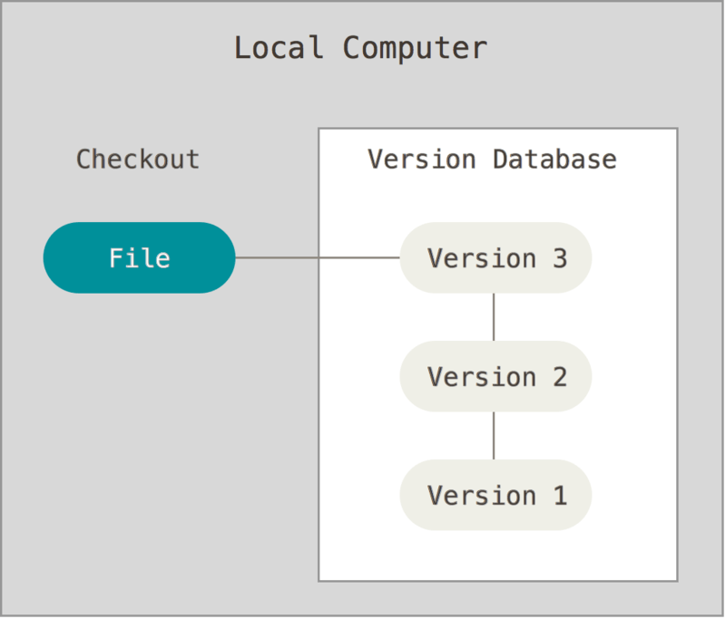
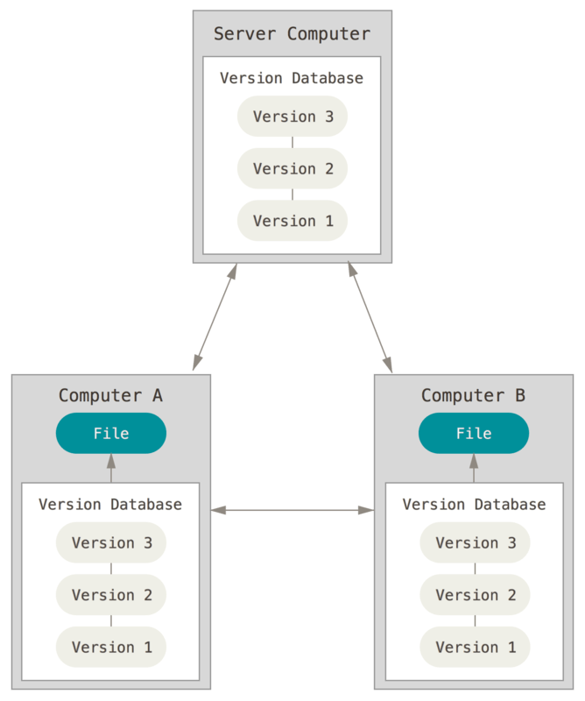
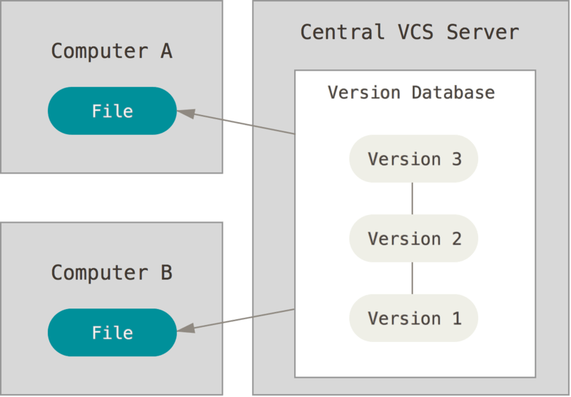
BRIEF HISTORY

Slide 4
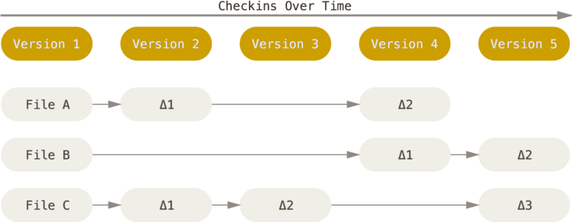
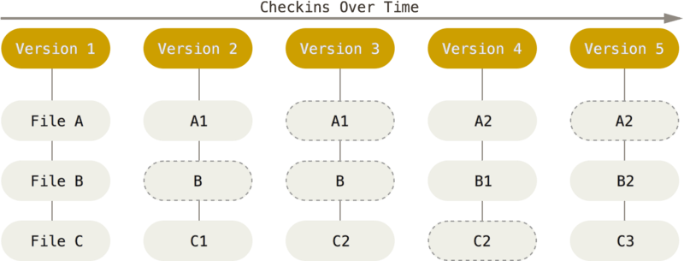
EVOLUTION of FILE CHECKS
Snapshot check

Slide 5
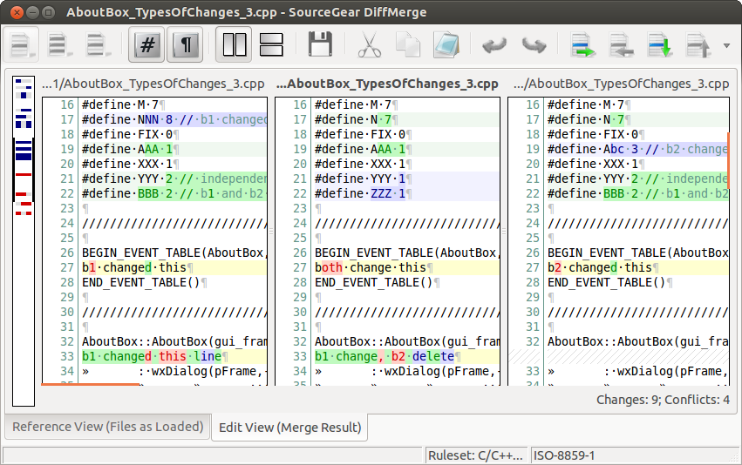
MERGE

Slide 6
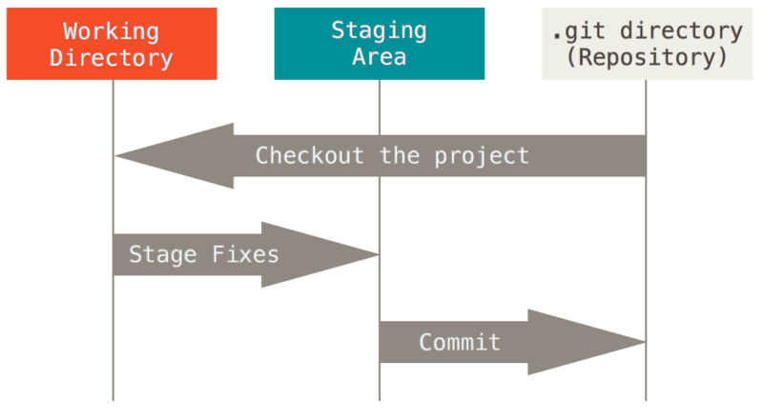
BASIC WORKFLOW (NOT USED MUCH)

Slide 7

TRUE WORKFLOW (BRANCHING)
https://learngitbranching.js.org/

Slide 8
GIT in WINDOWS and GITHUB
Use Git Bash or PowerShell
Run the same Git commands in Git Bash, PowerShell, or Command Prompt after installing Git for Windows.
Navigate folders with Windows paths
Example commands:
cd C:\Users\YourName\Projects\git-tutorial
or in Git Bash:
cd /c/Users/YourName/Projects/git-tutorial
Edit files with a Windows editor
Instead of nano, you can use:
notepad README.md
or edit the file with VS Code.
Main Git workflow stays the same
Commands such as these do not change on Windows:
git clone https://github.com/marcoprenassi/git-tutorial.git
git add .
git commit -m "message"
git checkout main
git merge dev
git push
GitHub access [OPTIONAL and NOT MANDATORY]
Register on Github
Generate a personal private/public ssh key pair
https://docs.github.com/en/authentication/connecting-to-github-with-ssh/generating-a-new-ssh-key-and-adding-it-to-the-ssh-agent

Slide 9
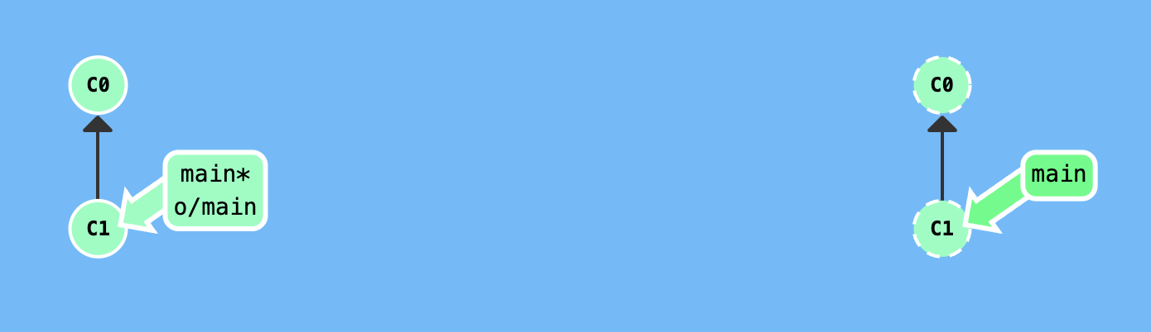
REPOSITORY SETUP AND FIRST LOCAL WORK
Create the repository on Remote (GitHub)
The remote repository is created first, establishing the central project location.
Clone the repository locally
git clone copies the remote repository to the local machine.
Enter and prepare the local workspace
Navigate into the project folder and prepare the working directory.
Publish the main branch and set upstream
git push -u origin main connects the local main branch to the remote one for easier future push/pull operations.
https://github.com/
https://learngitbranching.js.org/?NODEMO=&locale=it_IT

Slide 10
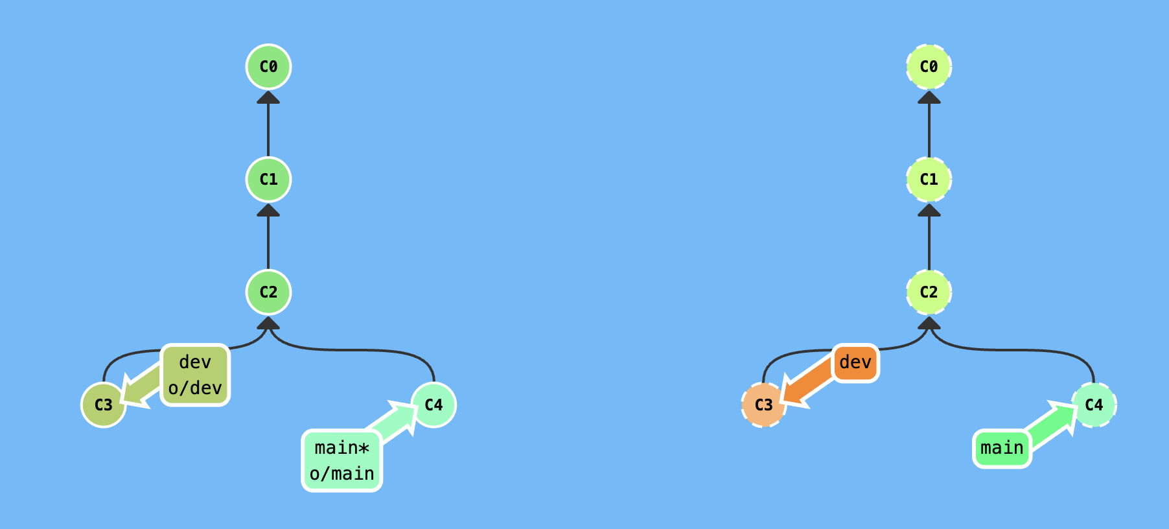
EDITING, COMMITTING, AND BRANCH ORGANIZATION
5. Edit and stage files
Modify files and stage them for commit.
Commands:
nano/edit README.md
git add README.md
Or
git add . (UNIX)
6. Create commits
Store snapshots of project changes in Git history.
Commands:
git commit -m "added words to README.md"
git commit -m "edited that"
git commit -m "added experimental feature"
git commit -m "new hotfix added"
git commit -m "new conflicting feature added"
git commit -m "ANOTHER new conflicting feature added"
7. Organize branches
Rename or structure working branches for development and features.
Commands:
git branch -M dev
git branch -M feature/new01

Slide 11
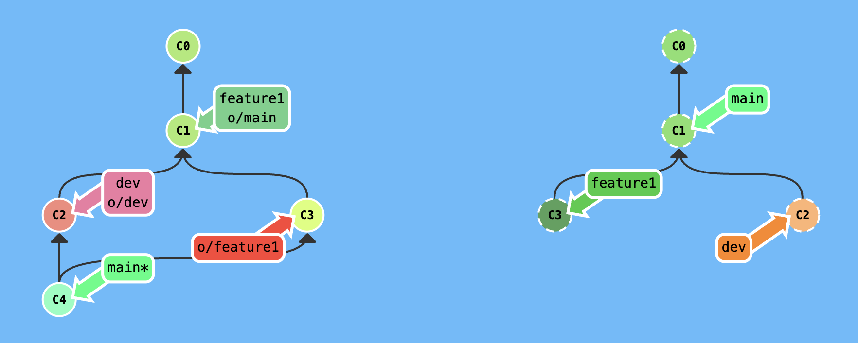
EDITING, COMMITTING, AND BRANCH ORGANIZATION
8. Switch between branches
Move between main, dev, and feature branches.
Commands:
git checkout main
git checkout dev
git checkout feature/new01
9. Synchronize with the remote repository
Update local knowledge of the remote and exchange commits.
Commands:
git fetch
git pull
git pull origin dev
git push
git push origin dev
git push origin feature/new01
10. Merge branches
Integrate changes from one branch into the current branch.
Commands:
git merge
git merge dev
git merge feature/new01

Slide 12
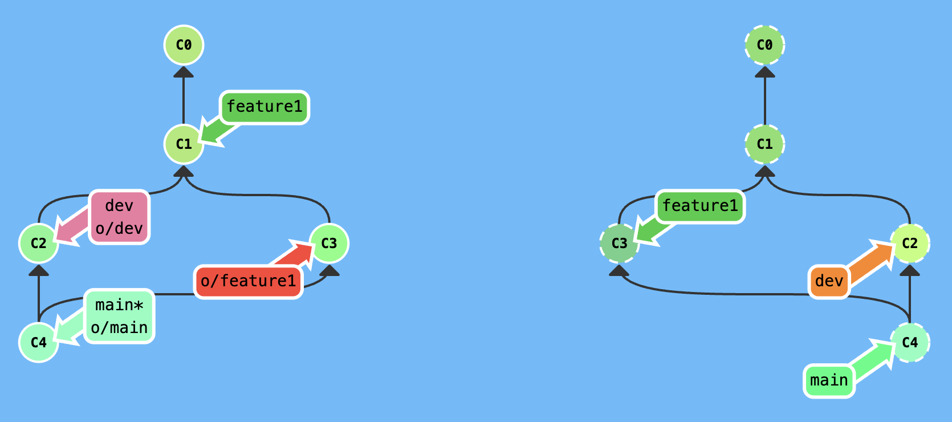
MERGE
11. Resolve merge conflicts
Use a merge tool when Git cannot combine changes automatically.
Command:
git mergetool
12. Complete or cancel the merge
Abort the merge if needed or proceed after resolution.
Command:
git merge --abort
13. Finalize successful integration
Record the completed merge in project history.
Command:
git commit -m "merge dev into main"
16. Clean branch integration workflow
Typical flow: feature branch into development, then development into main.
Commands:
git checkout main
git merge dev
or
git checkout dev
git merge feature/new01

Slide 13
REVERT, RESET, CHANGE HEAD and TAGS
Revert — create a new commit that undoes an earlier one
Useful when you want to cancel a commit without rewriting branch history.
Command: git revert <commit-hash>
Reset
--soft : move HEAD but keep changes staged Moves the branch pointer back while preserving changes in the staging area.
mixed : move HEAD and unstage changes
Moves the branch pointer back and keeps changes only in the working directory.
--hard : move HEAD and discard changes
Moves the branch pointer back and deletes staged and working directory changes.
Commands:
git reset --soft <commit-hash>
git reset <commit-hash> *Mixed
git reset --hard <commit-hash>
Change HEAD by checking out another branch
HEAD moves to the selected branch tip.
Command:
git checkout main
Change HEAD to a specific commit (detached HEAD)
HEAD points directly to a commit instead of a branch.
Command:
git checkout <commit-hash>
Return HEAD to the current branch tip
Reconnect HEAD to a normal branch after detached mode.
Command:
git checkout feature/new01
Create a tag on a specific past commit
Assigns a version label to an older commit instead of the current HEAD.
Command:
git tag -a v1.0 <commit-hash> -m "Version 1.0"

