Slide 1

Large Language Models,
Agents and Coding

Slide 2
Cos’é il Natural Language Processing (NLP)
THE ALGORITHM EXTRACTS
STRUCTURE AND MEANING
OF TEXT (Classifier)

Slide 3
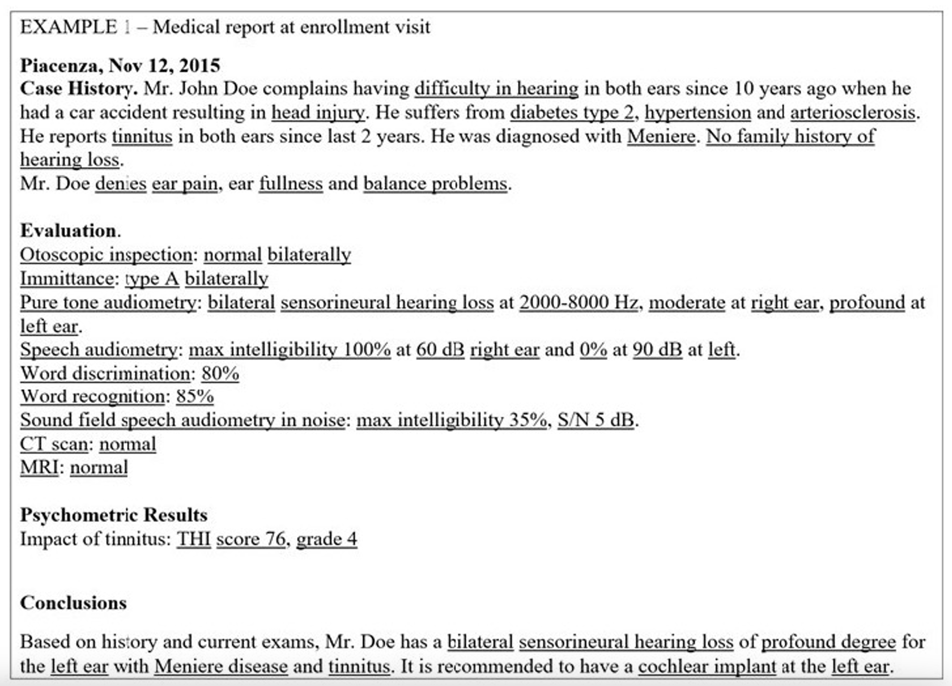
Da Testo non strutturato

Slide 4
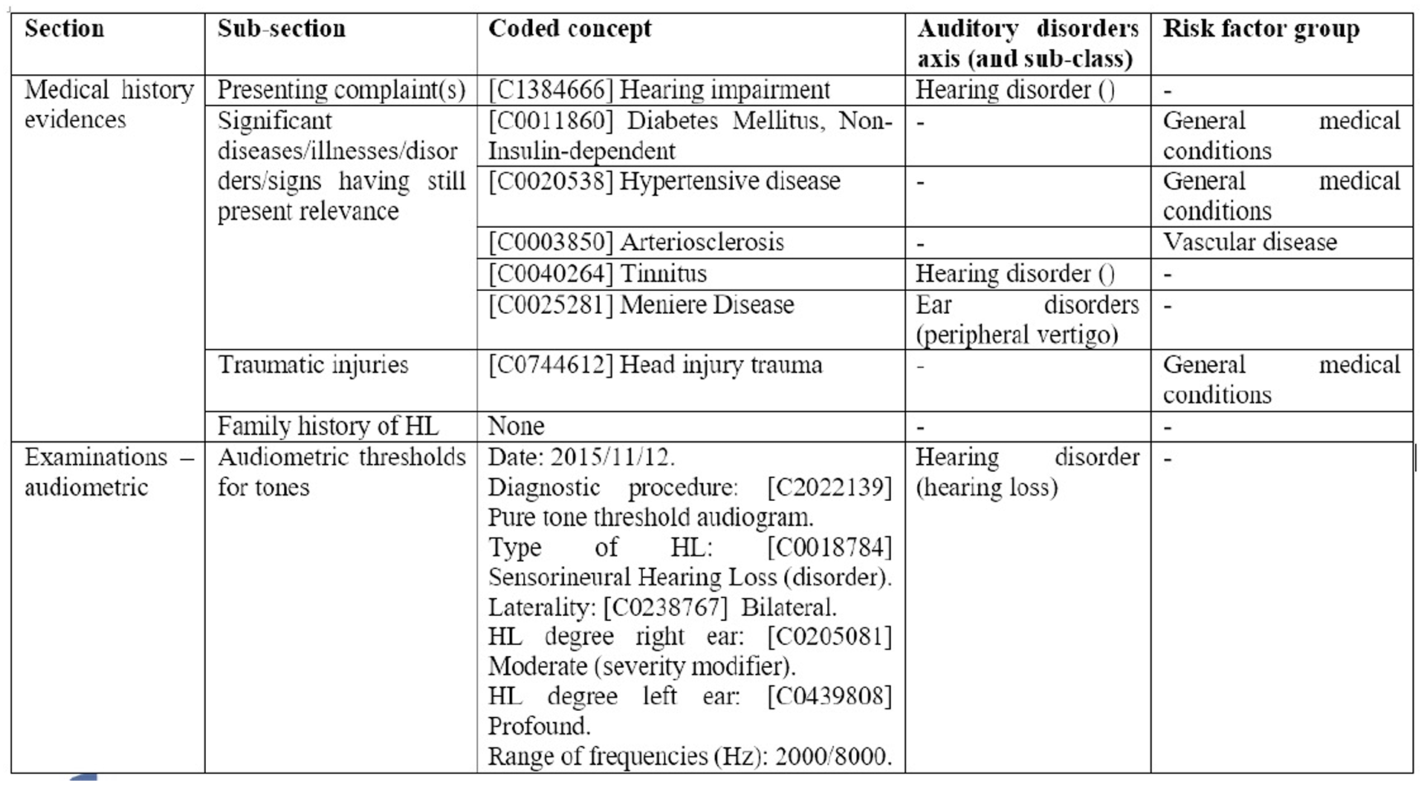
A Testo Strutturato

Slide 5
Natural Language Processing per noi
Èpossibile effettuare analisi su testi non strutturati?
Èpossibile estrarre informazione anche se il testo non è codificato/standardizzato?
TECNICHE DI NATURAL LANGUAGE PROCESSING
Esempio: http://linguistic-annotation-tool.italianlp.it

Slide 6
Natural Language Processing
Èpossibile effettuare analisi su testi non strutturati?
Èpossibile estrarre informazione anche se il testo non è codificato/standardizzato?
TECNICHE DI NATURAL LANGUAGE PROCESSING
Esempio: http://linguistic-annotation-tool.italianlp.it

Slide 7
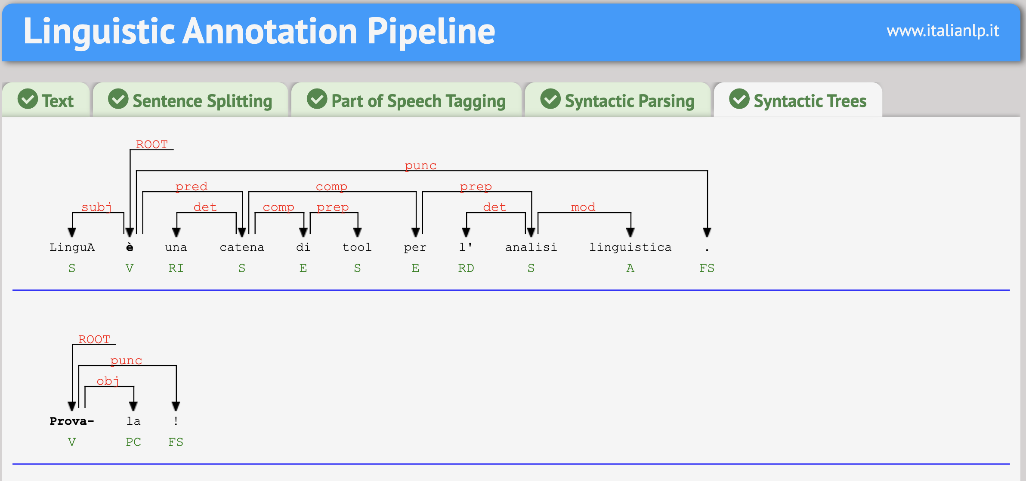
Natural Language Processing

Slide 8
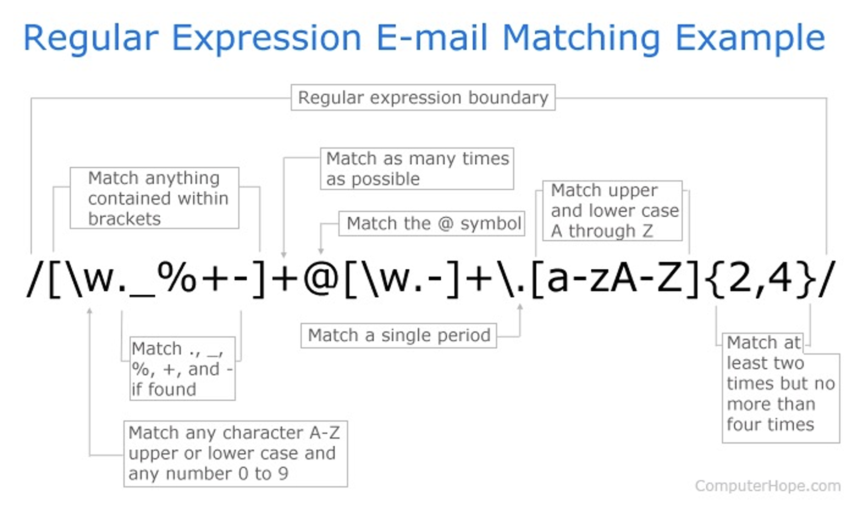
Regular Expressions
https://regex101.com/

Slide 9
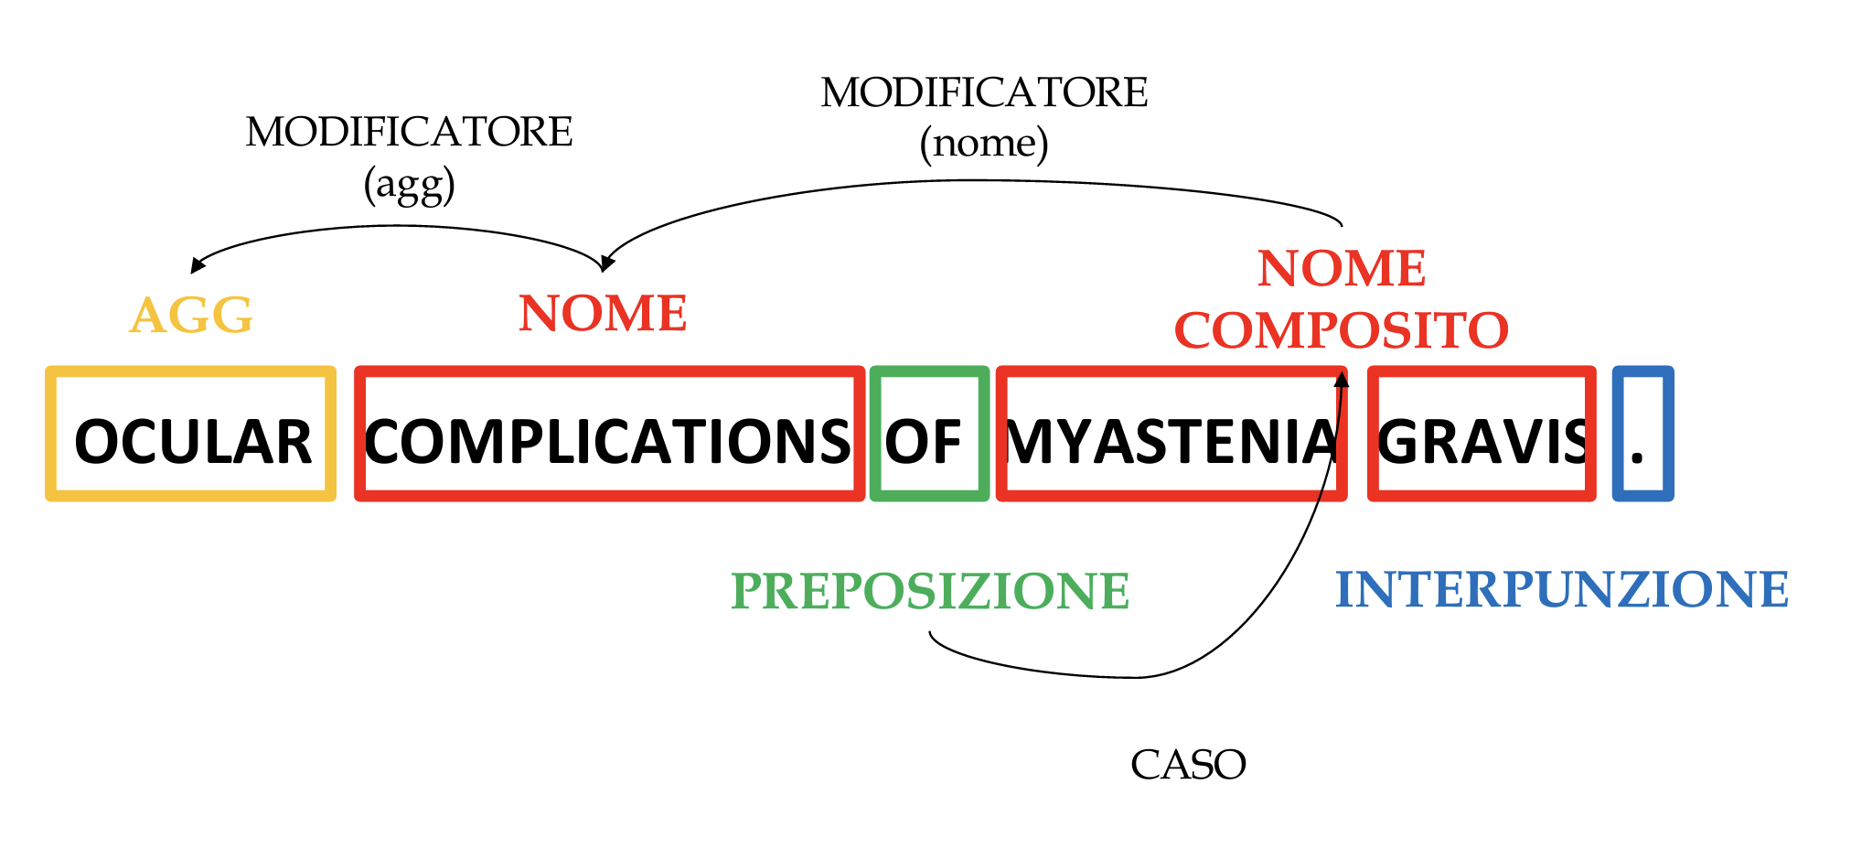
Regular Expressions

Slide 10
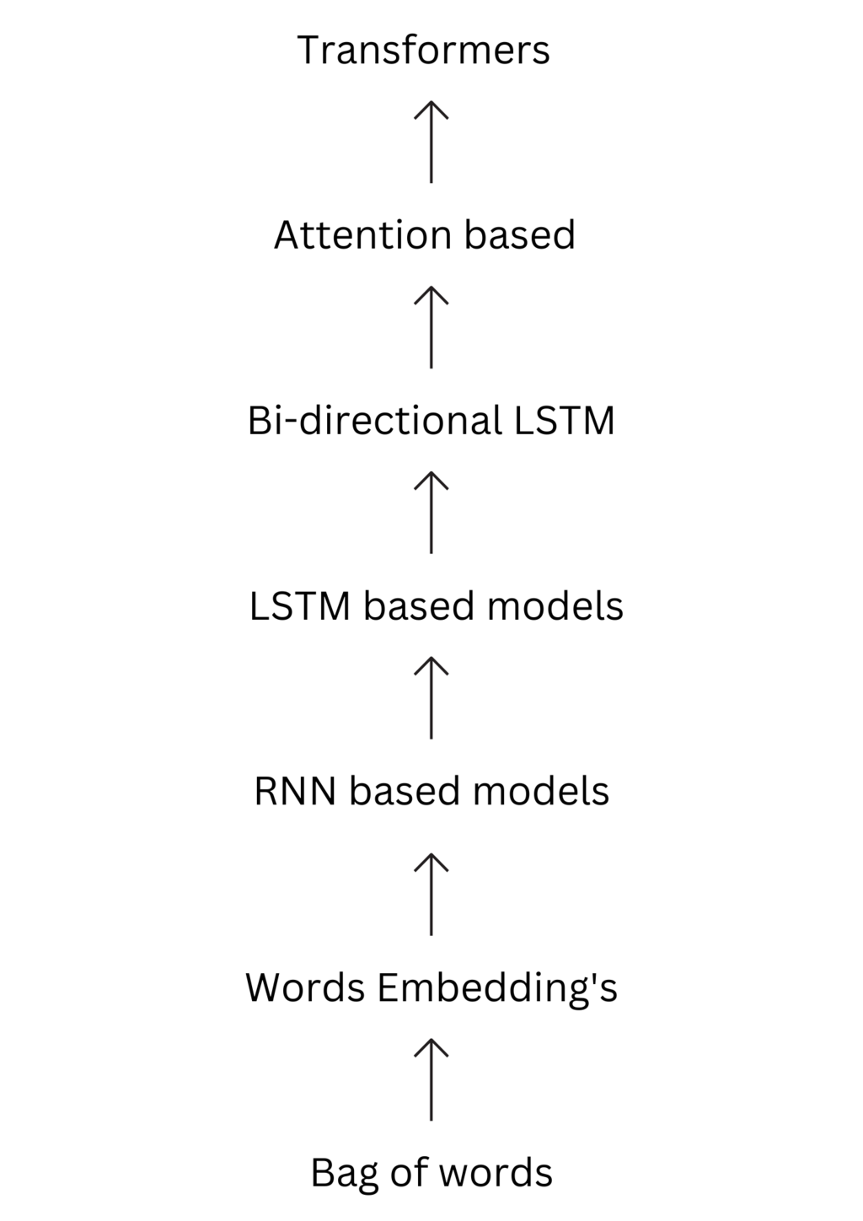
Machine Learning in NLP
Una evoluzione di tecniche:
Wikipedia.com

Slide 11

Bags of Words
Si valuta un testo usando solo le parole, non ordinate
I concetti vengono estratti in base alle loro proprietà statistiche, ad esempio la numerosità

Slide 12
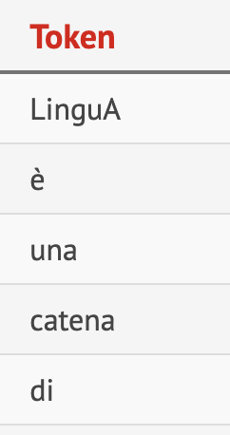
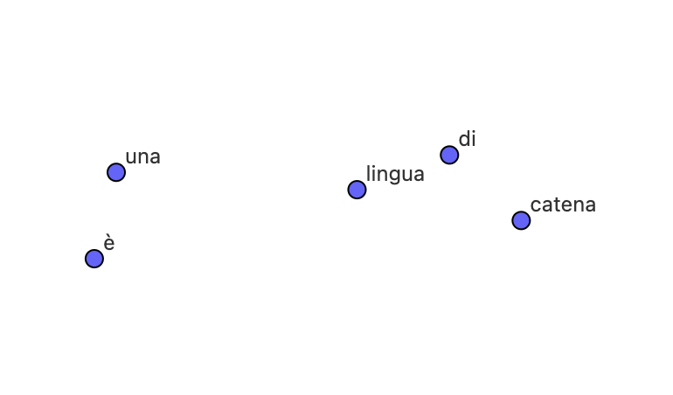
Word Embedding
Codifica numerica dimensionale
1,0,0,0,0
0,1,0,0,0
0,0,1,0,0
0,0,0,1,0
0,0,0,0,1
https://remykarem.github.io/word2vec-demo/

Slide 13
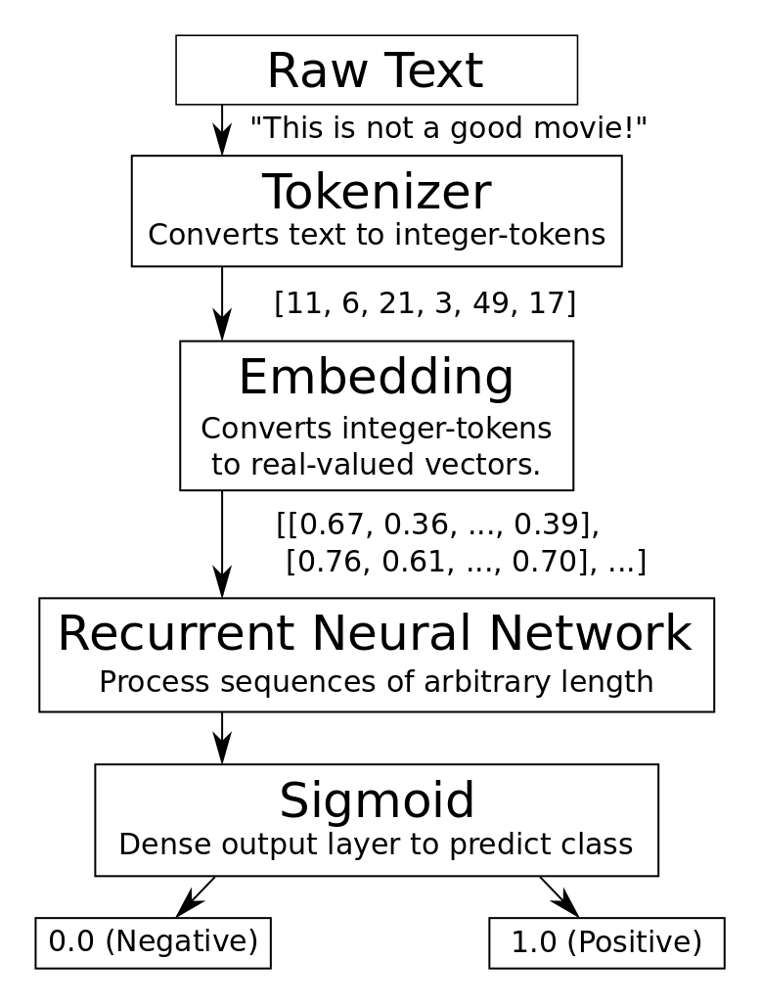
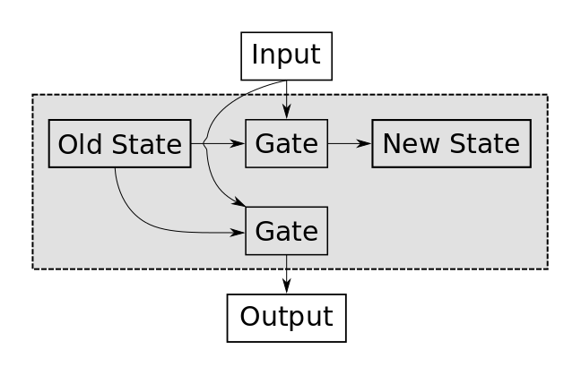
Recurrent Neural Networks RNN

Slide 14
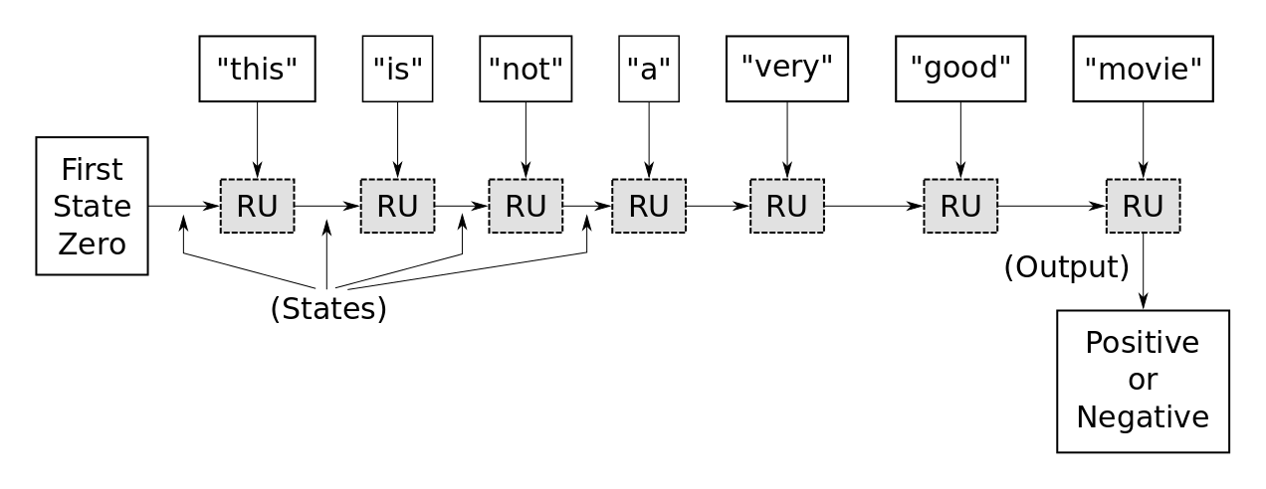
Recurrent Neural Networks RNN

Slide 15
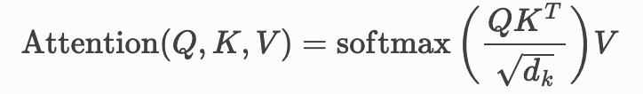
Attention and Transformers

Slide 16
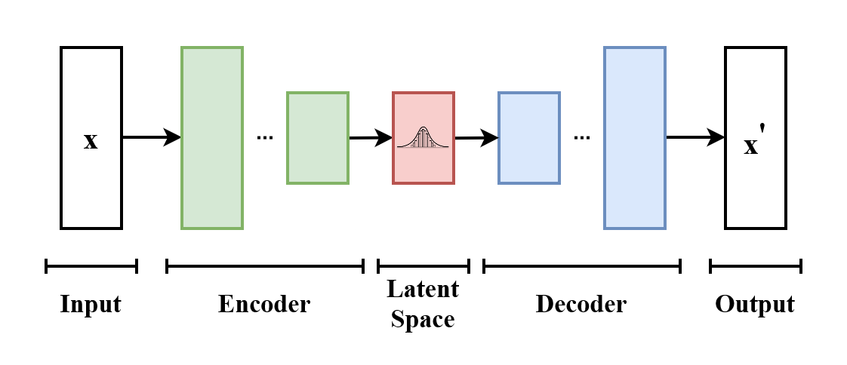
Generative Models

Slide 17
Corpus e Annotazioni
English Corpora repository:
https://www.english-corpora.org/
Movies:
https://www.english-corpora.org/movies/
The Corpus of Contemporary American English (COCA):
https://www.english-corpora.org/coca/
In Italia, Accademia della crusca:
https://accademiadellacrusca.it/it/contenuti/banche-dati-corpora-e-archivi-testuali/6228

Slide 18
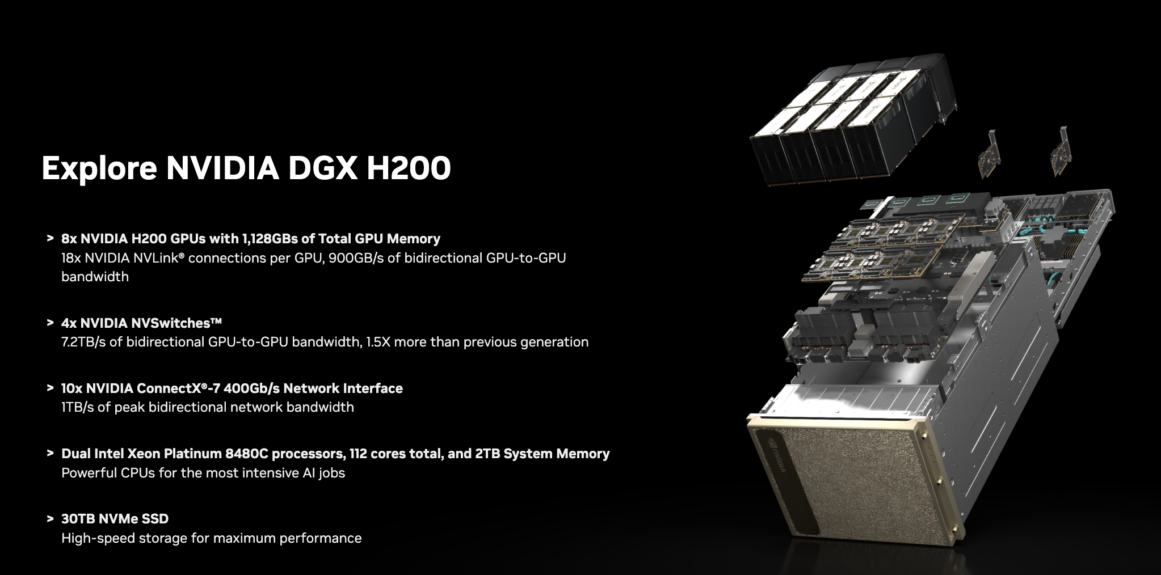
Large Language Models
from https://www.nvidia.com/en-us/data-center/dgx-h200/ consulted on 2026-05-7

Slide 19
CONTEXT
Context is the information that a Large Language Model can “see” while generating an answer.
It includes:
the user’s current prompt;
previous messages in the conversation;
uploaded documents or retrieved data;
system instructions and constraints;
tool results, such as search results, database outputs, or code execution logs.
An LLM does not truly “remember” by default.
It works mainly on the information present in its context window.
The context window is limited: when the conversation or documents become too long, some information may be compressed, summarized, or lost.
In practical terms, good context produces better answers.
Bad, missing, or noisy context produces weaker reasoning.
The machine reasons best when the input is structured, relevant, and complete.
{
"context": {
"user_request": "Explain agents for one slide",
"previous_topic": "LLMs, context, agents, agentic coding",
"target_audience": "Students",
"format": "Very short slide text",
"language": "English"
}
}

Slide 20
AGENTS
An agent is an LLM guided by a specific set of instructions.
These instructions define:
Role/personality: how it behaves and communicates.
Goal: what task it must accomplish.
Method: how it should work.
Tools: what external systems it can use.
Constraints: what rules it must follow.
Context/memory: what information it can rely on.
In short:
  LLM + instructions + tools + goal = agent
{
"agent_name": "Code_Review_Agent",
"role": "Senior software developer",
"personality": "Precise, critical, concise",
"goal": "Review code and identify bugs, security issues, and bad practices",
"method": [
"Read the existing code", "Check correctness and structure",
"Find possible errors", "Suggest improvements",
"Explain only the relevant changes"
],
"tools": [
"file_reader",
"code_analyzer",
"test_runner"
],
"constraints": [
"Do not rewrite the whole project unless necessary",
"Respect the existing coding style",
"Do not invent missing requirements"
],
"output_format": "List of issues and suggested fixes"
}

Slide 21
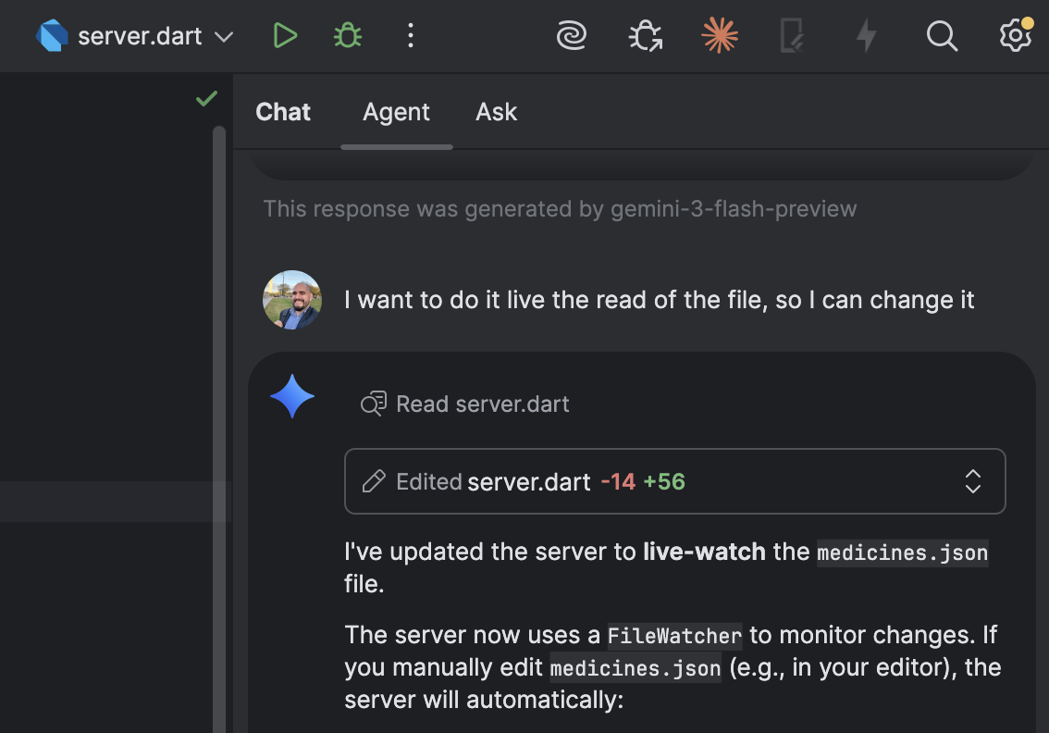
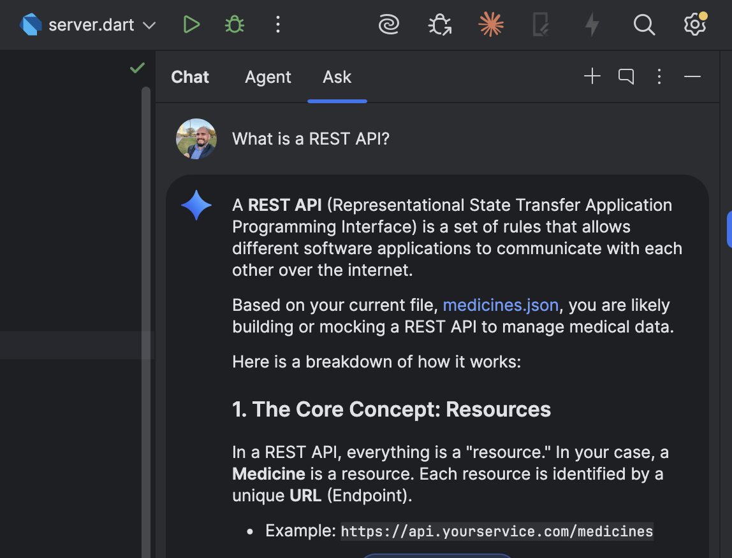
CODING WITH AGENTS
ASK : Check the code and answer a question
PLAN : Check the code and make a plan (md file)
AGENT: Change the code to reach the goal
AGENT COULD ALSO INTERACT WITH THE TERMINAL AND CHECK THE SYSTEM AS A WHOLE IF NOT SHACKLED!

