Slide 1
History of Czechoslovakia in the 20th Century
Milada Polišenská
Anglo-American University, Prague, Czechia

Slide 2
Key historical intersections, discourses
1. Czech lands within Austria-Hungary – main issues
2. Czechoslovak independence, T. G. Masaryk, Edvard Beneš (Maffia)
3. „Idea of Czech state“, Czechoslovak identity, 1st Republic (1918-1938)
4. Munich Dictate, occupation by Nazi Germany, independent
Slovakia, government and President in exile, Czechoslovakia 1945-1948
5. Communist take-over in 1948, belonging to the the Soviet bloc, Prague Spring
6. „Normalization“ , Velvet revolution and collapse of comunism

Slide 3
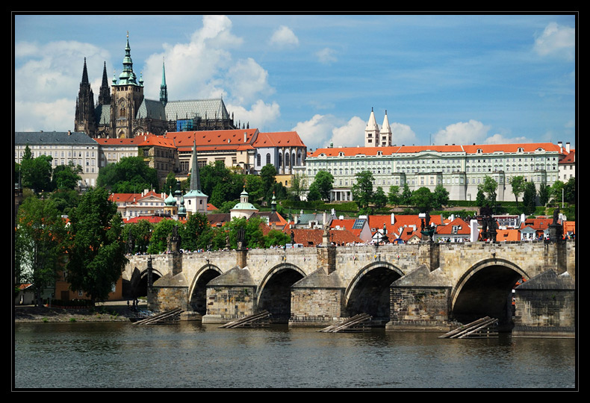
1. Czech lands within Austria-Hungary
Prague
Czech Kingdom
1526: Battle at Mohácz against the Ottomans, Czech and Hungarian King killed
Ferdinand Habsburg from Austria elected King of Bohemia and Hungary
Beginning of Habsburg Empire (till 1918)

Slide 4
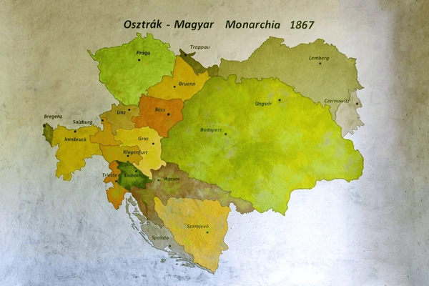
Czech Kingdom (Bohemia+Moravia)
National revival (renascence, awakening)
Romantic interpretation of history
„Sweetness of life“
Nationalism
Mobility
Large economic space

Slide 5
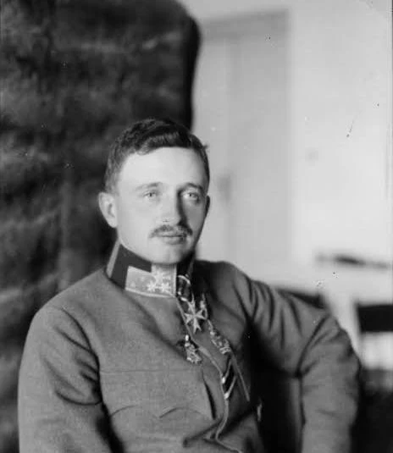
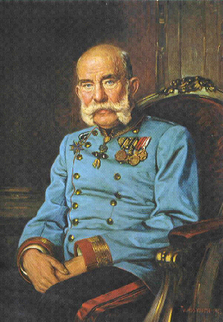
Franz Joseph I., born 1830, died 1916
Karl I, born 1887, died 1922

Slide 6
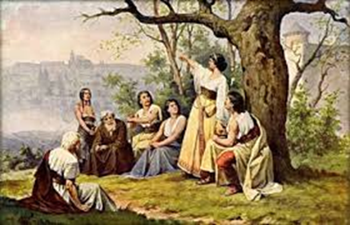
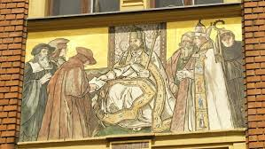
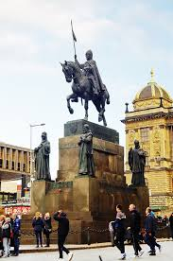
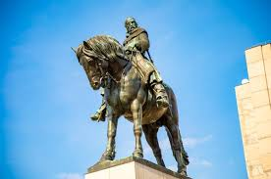

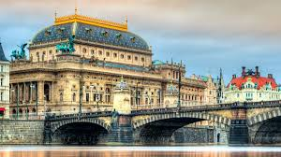
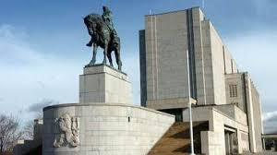

Slide 7
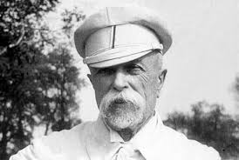
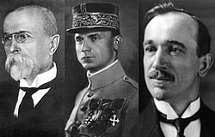
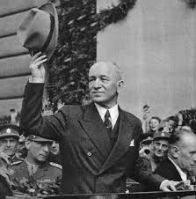
2. Czechoslovak independence, T. G. Masaryk, Edvard Beneš, Milan R. Štefánik (Maffia)

Slide 8
Establishment of independent Czechoslovakia
Thomas Garrigue Masaryk (1850-1937)
  World War I – in exile :
  France, England, in 1918 in the United States
  Small team but a great support of Czech and Slovak communities in the United States
  Role of the United States
  Role of Czechoslovak legion in Siberia

Slide 9
3. Idea of Czech state“, Czechoslovak identity, 1st Republic (1918-1938)
Against „Idea of the House of Habsburgs“
Main argument:
Liberation from the Jail of Nations
Czech history was drastically interrupted by Habsburg forced recatholization and germanization during the Period of Darkness (1620 – National awakening)
The greatest ethical peak in our history was the Hussite movement in the 15th century and the subsequent Unity of Brethren.
Thanks to the selfless efforts of national awakeners, the Czech language and the Czech nation were saved from extinction.

Slide 10
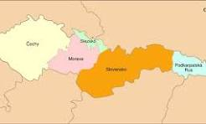
1st Republic – 1918-1938
Idealized
Masaryk – very popular and iconic
Concept of Czechoslovakism
Unitary Czechoslovak state
National issues: Slovak autonomist; German and Hungarian minority radicalized after Hitler came to power in Germany :
Culmination: Munich Dictate, September 29, 1938

Slide 11
Ethnic structure
Population total: 15 millions
Czech Lands (Bohemia and Moravia): 10 mil.
Slovakia: 5 mil.
In detail:
Czechs: 6,7 mil. = 51 % of population
Germans: 3,1 milionu = 23,4 %
Slovaks: 1,9 mil. = 14,5 %
Hungarians: 750,000
Poles: 76,000
Ruthenians: 462.000
Jews: 181,000

Slide 12
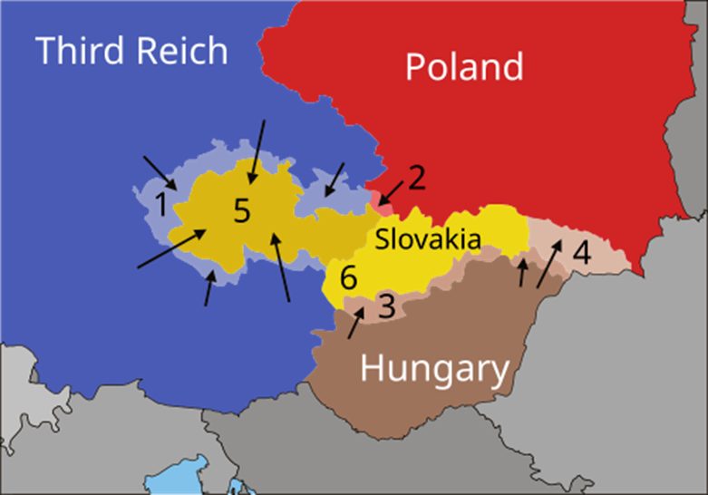
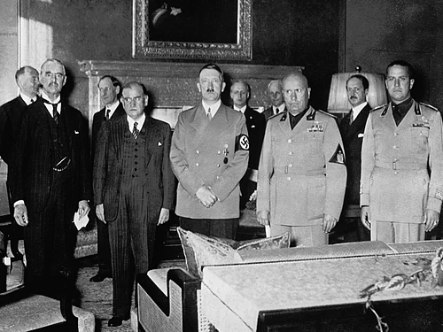
4. Munich Dictate, occupation by Nazi Germany, independent
Slovakia, government and President in exile
29-30 September 1938

Slide 13
Context
Cz. Beneš abdicated on 5 October and 22 October left for London
In November new Cz. President Emil Hácha was elected
Slovakia declared an autonomy
On March 15, 1939, Nazi Germany occupied Czech lands and declared a Protectorate Böhmen und Mähren
Slovakia separated the day before and declared to be an independent state and an ally of Germany
Period between Munich Dictate and Occupation = 2nd Republic

Slide 14
Edvard Beneš in Exile and Government in Exile – question of recognition
Important factors:
Existing diplomatic missions
Czechoslovak military units in France and in England
Assassination of Reichsprotektor Reinhardt Heydrich
Martial law in the country, Lidice
Questionable: Beneš abdicated, President in exile elected by whom???
Munich Syndrom, Munich Trauma
Can an event or process to “break a nations’s back bone”?
Fight or not to fight? Be or not to be?
Lost battle does not mean a lost war
Lessons from the Munich
Interpretation used by surrent political interests
Interpretative discourses today

Slide 15
Political goals of President Benes in exile and Czechoslovakia 1945-1948
Reestablishment of Czechoslovakia in the pre-war constitutional arrangement
Nullification of Munich Dictate
Balanced foreign policy (West and East)
National policy
State of only Czechs and Slovaks
State without Germans and Hungarians
Role of the Communists
Position of Allies

Slide 16
1. Beneš Presidential decrees
2. Ethnic changes of Czechoslovakia Expulsion and transfer of Germans
- Policy towards Hungarians: attemps to achieve transfer or exchange of population, removal of Czechoslovak Citizenship from Hungarians
Subcarpathian Russia (now Transcarpathian Ukraine) annexed by Soviet Union
4. Jews and many Romas lost

Slide 17
Transfer of Germans
  Final solution of historical confrontation with Germans
  Considered as right and just decision in line with a main trend of Czech history
  Was it result of Munich trauma of Beneš?
  Very important: On 27 February 1992, Treaty on Good-Neighbourliness, Friendship and Co-operation between the Federal Republic of Germany and Czech and Slovak Federal Republic was signed
  21 January 1997, German-Czech Declaration on Mutual Relations and their Future Development was signed. This declaration was to directly address the painful issues related to Munich Dictate, the Nazi occupation and the expulsion of the German population from the Czech lands.
  The cited treaty and declaration demonstrate that only reconciliation based on good coexistence, friendship, and trust has a chance to bring peace, security, and happiness to people.
  Current situation

Slide 18
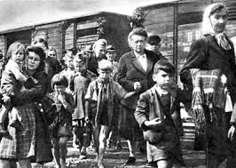
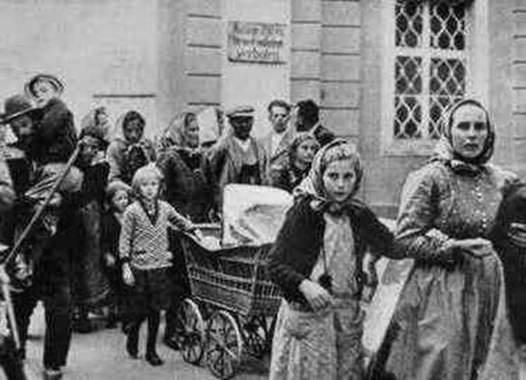
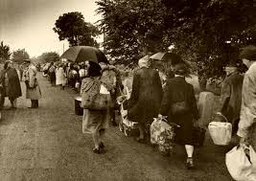
After the war
Expulsion of Germans

Slide 19
Change of approach after the collapse of communism
President Vaclav Havel: apology
  Criticized, most of Czechs did not accept
Czech EU accession and President Benes Decrees

Slide 20
5. Communist take-over in 1948, belonging to the the Soviet bloc, Prague Spring
Increasing position of Communist party
Weakeness of 1st Republic elites
Issue of abdication of non-communist ministers“
25 February 1948 – Communists assumed the power, Klement Gottwald
Edvard Beneš died in June 1948
1948-1953 Hard Stalinist style régime
End of 50´s and in 1960´s – mild liberalization
1968 January-August – Prague Spring
August 21, 1968 Invasion of Warsaw Pact Armies in Czechoslovakia

Slide 21
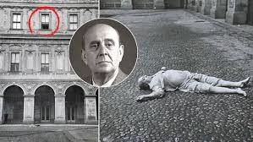
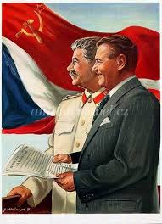
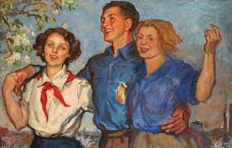
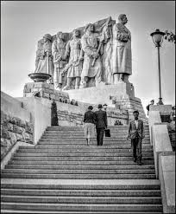
1948-1953 Hard Stalinist style régime
Minister of Forein Affairs Jan Masaryk found dead on 10 March 1948; show trials; 5-year plans; collectivization; church policy
Socialist Realism style and propaganda; class vigilance; ideological offensive ....

Slide 22
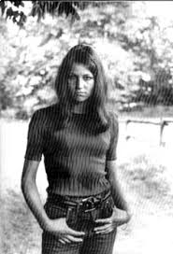
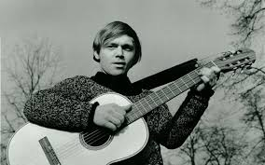
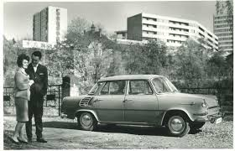
Very popular: Beatles, rock and roll, French and Italian films and actors, domestic groups, jeans, long hair, hippie culture (=freedom)
Generation born in 1930s.
Marta Kubišová, Karel Kryl, Škoda 1000 MB
„New wave of Czechoslovak cinema“- very successfull:
Miloš Forman, Ján Kádár and Elmar Klos, Jiří Menzel ....more
Literature: Milan Kundera, Ivan Klíma, Josef Škvorecký, Pavel Kohout....more
Slight easing of restrictions of travel

Slide 23
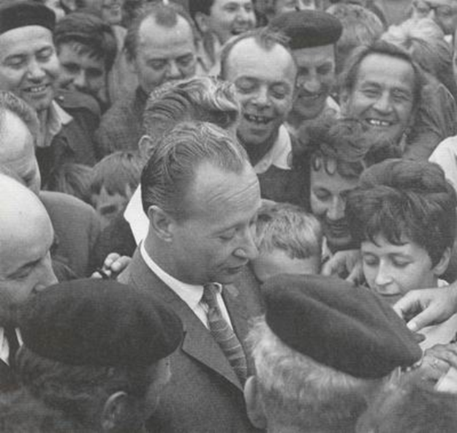
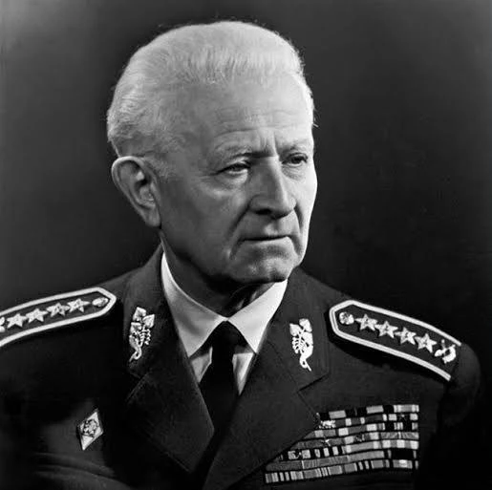
Prague Spring: Reform Communist movement
Alexander Dubček, Ludvík Svoboda
Very popular and influential: politicians, journalists, commentators
Political leadership very popular:
Alexander Dubček (Gen. Secretary of Communist Party), Ludvík Svoboda (President)
Conservative dogmatic section in Central Committee
Invitation Letter

Slide 24
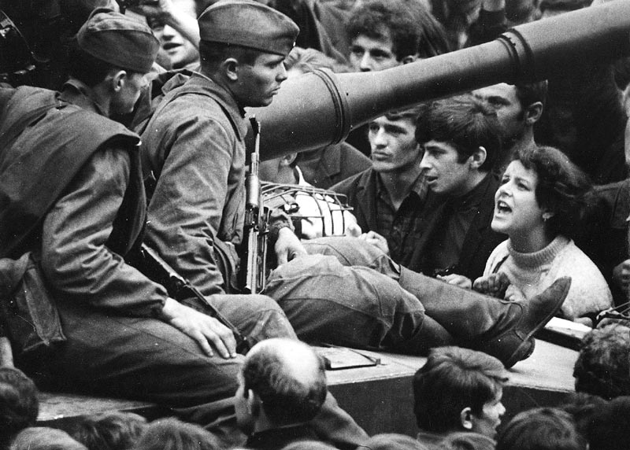
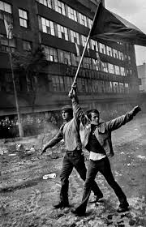
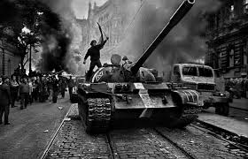
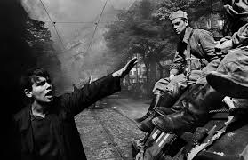
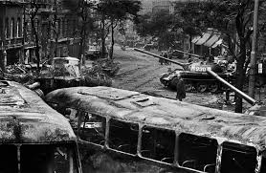
August 21, 1968, Warsaw Pact invasion
Photographer Josef Koudelka

Slide 25
6. „Normalization“ , Velvet revolution and collapse of communism
January 1969
March 1969
Student of history and political economy of Charles University Jan Palach set himself in fire in protest against the increasing depressed and passive situation in the country
Several more peole followed
Czechoslovaks won gold medal in ice hockey world championship in Stockholm over the Soviets
Great celebration in Prague in Wenceslas Square, deliberately provoked vandalism of the Aeroflot office
An excuse for the USSR to enforce a change in the Czechoslovak Government and Party (Gustáv Husák) - the beginning of normalization régime

Slide 26
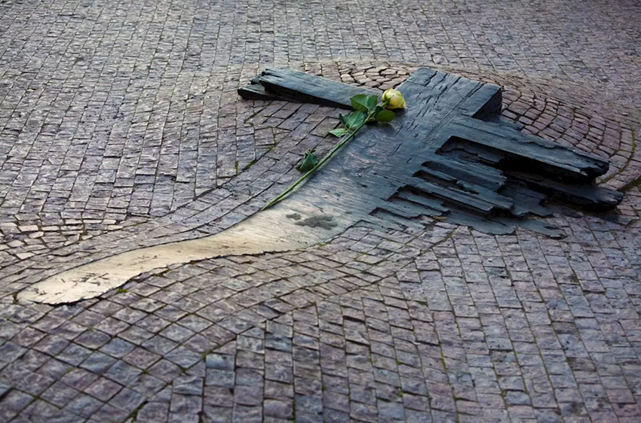
Memorial of Jan Palach and Jan Zajíc at Wenceslas Square
Recommended:
Czech film Vlny (Waves), 2024
Dir. Jiří Mádl
Soviet invasion in Czechoslovakia in 1968, on situation in Czechoslovak Radio and struggle of the journalists to broadcast even under fire

Slide 27
Régime of Gustáv Husák
Lessons learned from the crisis development in the party and society – 1970
Process of screening of all employes at all workplaces from the highest level down, firing those who did not go through = normalization
Stress from „provierka“, ever present stress
Many highly qualified people lost jobs
Exodus abroad
Hugh party membership

Slide 28
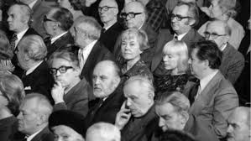
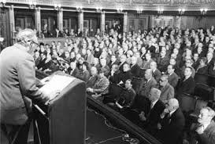
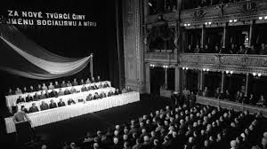
Dissent movement
For new creative acts in the name of socialism and peace (Anti-Charter ), January 28, 1977, National Theatre
Charter 77 January 1, 1977 ( by title of article in leading official Communist daily Losers and Impostors)
Final Actof Helsinki Conference on Security and Cooperation in E
Václav Havel, Pavel Kohout – main authors. Signatories: Jan Patočka, Jiří Hájek, Jiří Němec, Petr Uhl....

Slide 29
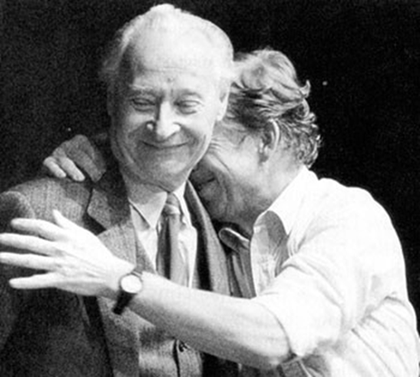
Velvet revolution
Important precondition:
Stagnation
Gorbachev, glasnost and perestroika
Human rights movement and Helsinki process

Slide 30
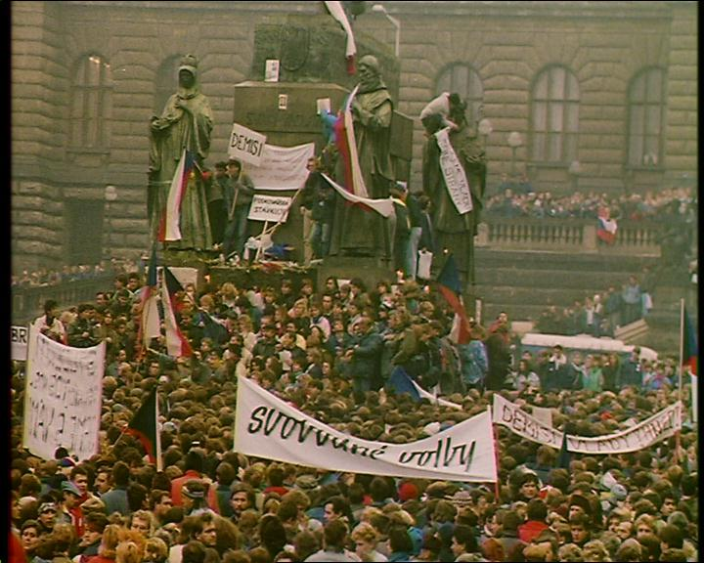
Velvet Revolution 1989:
November 17 – December 10
Meeting in university campus to commemorate November 17, 1939 (International Day of Students)
Particiants then walked to the city center
Police blocked from both sides, police brutality

Slide 31
More people (Hundreds of thausends) meet next days
Media did not report, students organized strikes and information rides to all regions
Civic Forum formed, chair Václav Havel
Army did not react
Communist leadership passive
Gustáv Husák resigned in 1987 from position of Secretary General of Communist Party
The next was Miloš Jakeš, who resigned during collapse of Communism
Husák as President of Czechoslovakia appointed December 10, 1989, a democratic government, and resigned. Nex
Next President of Czechoslovakia – Václav Havel

Slide 32
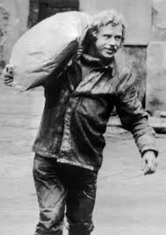
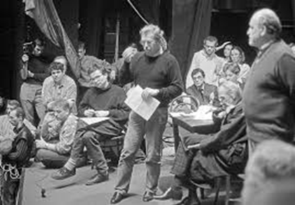
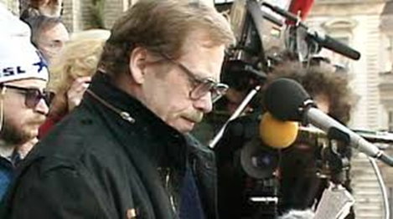
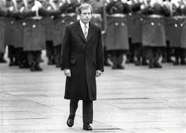
Further development:
1991 - dissolution of the Warsaw Pact
1991 - the withdrawal of Soviet army from Czechoslovakia completed
"Hyphen war " - Czechoslovakia or Czecho-Slovakia
from 1st January 1993 two independent states
1999 - joined (also Poland and Hungary) NATO
2004 - accessed the European Union

