Slide 1
Chapter 2
Marketing Strategy Planning
Copyright © 2014 by The McGraw-Hill Companies, Inc. All rights reserved
Notes:
For use only with Perreault/Cannon/McCarthy or Perreault/McCarthy texts.
© 2014 McGraw-Hill Companies, Inc. McGraw-Hill/Irwin
CHAPTER TWO
Lecture Notes for
Basic Marketing 19e

Slide 2
At the end of this presentation, you should be able to:
2-2
Understand what a marketing manager does.
Know what marketing strategy planning is—and why it is the focus of this book.
Understand target marketing.
Be familiar with the four Ps in a marketing mix.
Know the difference between a marketing strategy, a marketing plan, and a marketing program.
Notes:
At the end of this presentation, you should be able to:
Understand what a marketing manager does.
Know what marketing strategy planning is—and why it is the focus of the book.
Understand target marketing.
Be familiar with the four Ps in a marketing mix.
Know the difference between a marketing strategy, a marketing plan, and a marketing program.
This slide refers to material on pp. 32.

Slide 3
You should now be able to:
2-3
Understand what customer lifetime value and customer equity are and why marketing strategy planners seek to increase them.
Be familiar with the text’s framework for marketing strategy planning..
Know four broad types of marketing opportunities that help in identifying new strategies.
Understand why strategies for opportunities in international markets should be considered.
Understand the important new terms.
Notes:
You should now be able to:
Understand what customer lifetime value and customer equity are and why marketing strategy planners seek to increase them.
Be familiar with the text’s framework for marketing strategy planning.
Know four broad types of marketing opportunities that help in identifying new strategies.
Understand why strategies for opportunities in international markets should be considered.
Understand the important new terms.
This slide refers to material on pp. 32.

Slide 4
The Management Job in Marketing (Exhibit 2-1)
2-4
Whole-Company
Strategic
Management
Planning
Marketing
Planning
Control Marketing
Plan(s) and Program
Implement Marketing
Plan(s) and Program
Notes:
Summary Overview
The marketing management process refers to the planning, implementation, and control of marketing activities. These activities are continuous, and decisions made in the past in one area can have implications on the other areas as well.
Key Issues
Planning—required because marketing managers must seek new opportunities.
→Implementation—the process of putting marketing plans into action.
Discussion Question: Which is more important—good planning or good implementation? Explain.
→Control—assessing and evaluating marketing performance.
When performance falls short of expectations, the marketing manager must take corrective action.
→Strategic (management) planning—developing and maintaining a match between an organization’s resources and its market opportunities.
It is a top management job.
It includes planning for marketing, production, finance, human resources, and other areas.
Though, marketing strategies are not whole-company plans, company plans should be market-oriented.
The marketing plan sets the tone and direction for the whole company.
This slide relates to material on pp. 32-33.
→Indicates place where slide “builds” to include the corresponding point (upon mouse click).

Slide 5
What is a Marketing Strategy? (Exhibit 2-2)
2-5
The
marketing mix
TARGET
MARKET
Notes:
Summary Overview
Marketing strategy planning means finding opportunities and developing profitable marketing strategies that the company can use to capitalize on the opportunities.
Key Issues
Marketing strategy—specifies a target market and a related marketing mix; provides a “big picture” of what the firm will do.
Target market—a fairly homogeneous (similar) group of customers to whom a company wishes to appeal.
Marketing mix—the controllable variables the company puts together to satisfy the target market.
The customer is surrounded by the controllable variables that we call the “marketing mix.”
Discussion Question: Why does the target market appear in the center of the diagram of a marketing strategy?
This slide relates to material on pp. 33-34.
→Indicates place where slide “builds” to include the corresponding point (upon mouse click).

Slide 6


Selecting a Marketing-Oriented Strategy Is Target Marketing (Exhibit 2-3)
2-6
Production-oriented manager sees everyone as basically similar and practices “mass marketing”
Marketing-oriented manager sees everyone as different and practices “target marketing”
Notes:
Summary Overview
The difference between target marketing and mass marketing is directly linked to the concept of a marketing strategy, because a marketing strategy specifies some particular target customers.
Key Issues
Target marketing—tailoring the marketing mix to meet the needs of a specific group of target customers.
It can be considered as “rifle approach.”
→Mass marketing—offering a single marketing mix combination to everyone.
It can be considered as “shotgun approach.”
It assumes that everyone is the same.
It considers everyone to be a potential customer.
Mass marketing and mass marketers do not mean the same thing.
Mass marketers like Kraft Foods and Walmart are aiming at clearly defined target markets.
Their target markets are large and spread out.
Discussion Question: Why are organizations moving in the direction of target marketing as opposed to mass marketing?
→Target marketing can mean big markets and profits
Target marketing is not limited to small market segments—only to fairly homogeneous ones.
The basic reason to focus on some specific target customers is so that you can develop a marketing mix that satisfies those customers’ specific needs better than they are satisfied by some other firm.
This slide relates to material on pp. 34-35.
→Indicates place where slide “builds” to include the corresponding point (upon mouse click).

Slide 7




Developing Marketing Mixes for Target Markets (Exhibit 2-4)
2-7
TARGET
MARKET
Notes:
Summary Overview
Marketers have to make many decisions in developing a marketing mix that will satisfy their target customers. All of these variables making up the marketing mix can be reduced to four basic categories.
Key Issues
The four Ps make up a marketing mix:
product;
place;
promotion;
and price.
These “Four Ps” are combined in differing ways to match the needs and wants of different target markets.
The C stands for some specific customers— the target market.
→Product: concerned with developing the right “product” for the target market.
→Place: concerned with all the decisions involved in getting the “right” product to the target market’s place.
→Promotion: concerned with telling the target market or others in the channel of distribution about the “right” product.
→Price: concerned with the kind of competition in the target market and the cost of the whole marketing mix.
Discussion Question: The customer is not part of the marketing mix. Why?
The four Ps are things that the marketer can control, but the marketer cannot directly control the customer’s behavior.
This slide relates to material on pp. 35-38.
→Indicates place where slide “builds” to include the corresponding point (upon mouse click).

Slide 8
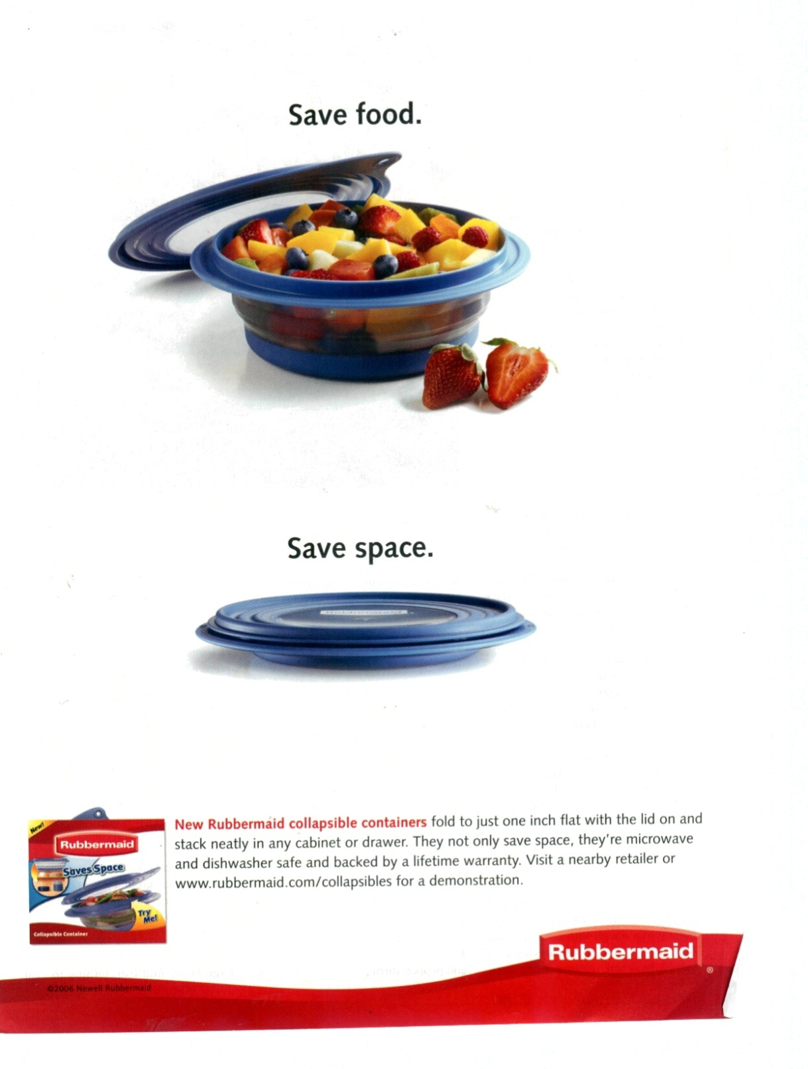
The Product Element of the Marketing Mix
2-8
Courtesy of Clear Blue Inc.
Notes:
Summary Overview
Newell Rubbermaid is a global marketer of consumer and commercial products.
Key Issues
New Rubbermaid collapsible containers can be collapsed with the lid on and they are only one inch high for storage.
The size of the container can be changed once it is filled, so there is less air in the container, which keeps food fresh for longer time.
The collapsing feature is easy to use.
The containers take lesser space in the shelves or drawers.
Discussion Question: What are the tangible elements of the New Rubbermaid collapsible containers promoted in this ad?
Product considerations include:
physical characteristics;
warranties;
new product development.
This slide relates to material on p. 36.

Slide 9
The Place Element of the Marketing Mix (Exhibit 2-6)
2-9
Manufacturer or producer
Geico
Toyota
Sara
Nestle´
Lee
Wholesaler
Wholesaler
Wholesaler
Retailer
Retailer
Retailer
Consumer
Notes:
Summary Overview
The objective for the place, or distribution, element of the marketing mix is to get the right product, to the right consumer, in the right place, at the right time, in the right quantity, and in the right condition, hopefully all at a reasonable cost.
Key Issues
Channel of distribution—any series of firms or persons used to move goods from producers to final users. Channels can be:
short;
complex.
Marketers must:
find the best kinds and types of channels for the product;
effectively manage the channel.
Discussion Question: What are some of the reasons why marketers are paying increased attention to their distribution strategies and tactics? Hint: Think about what happens when distribution does not work as it should.
This slide relates to material on pp. 37.

Slide 10
The Promotion Element of the Marketing Mix
2-10
Personal
Selling
Mass Selling
Telling and
Selling
the Customer
Sales
Promotion
Notes:
Summary Overview
Promotion involves telling the target market about the product and selling the product to the target customer. There are three main types of promotion.
Key Issues
→Personal selling—direct spoken communication between sellers and potential customers. Sometimes this involves customer service—a personal communication between a seller and a customer who wants the seller to resolve a problem with a purchase.
→Mass selling—communicates with large numbers of customers at the same time.
Advertising—any paid form of nonpersonal presentation of ideas, goods, and services by an identified sponsor.
Publicity—unpaid, nonpersonal presentation of ideas, goods, or services. It also includes creating and placing content on the web for customers to find or pass along to others.
Discussion Question: An old adage in marketing is that “Advertising is paid for, publicity is prayed for.” What is meant by this statement? What implications does the statement have for the marketing manager?
→Sales promotion—promotion activities—other than advertising, publicity, and personal selling—that stimulate interest, trial, or purchase.
This slide relates to material on pp. 38.
→Indicates place where slide “builds” to include the corresponding point (upon mouse click).

Slide 11
The Price Element of the Marketing Mix
2-11
Pricing Objectives
Price Flexibility
Price
Setting
Competition
Price Over the Life Cycle
Geographic Pricing Terms
Discounts and Allowances
Notes:
Summary Overview
Price is the revenue-generating function of the marketing mix. In setting the “right” price, marketing managers must consider many factors, all of which combine to make pricing a combination of science and art.
Key Issues
→Marketers can choose from several different pricing objectives and policies. Among the policies are:
→price flexibility;
how price changes over the product life cycle;
→various allowances, discounts;
geographic terms that affect the final price; and
→competition.
A manager must try to estimate customer reaction to possible prices.
The manager must know current practices as to markups, discounts, and other terms of sale.
Discussion Question: Can you think of examples of products, introduced in the last few years, whose prices changed significantly the longer they were in the market? Is the age of the product the only factor in these price changes?
This slide relates to material on pp. 36, 38.
→Indicates place where slide “builds” to include the corresponding point (upon mouse click).

Slide 12
All Four Ps Contribute to the Whole
2-12
Product
Place
Selection
of Target
Market
Promotion
Price
Understanding the Target Market Leads to Good Strategies!
Notes:
Summary Overview
All of the four Ps—product, place, promotion, and price—have an impact on satisfying the needs of consumers in the target market. No single area is more important than the others—they are all interconnected.
Key Issues
When a marketing mix is being developed, all decisions about the Ps should be made at the same time. That’s why the four Ps are arranged around the target customer in a circle—to show that they all are equally important.
Strategy jobs must be done together.
→ Understanding target markets leads to good strategies
Discussion Question: Choose a product or service and discuss how the elements of the marketing mix interact with each other. For example, how do product decisions affect decisions about place, promotion, and price?
Your text provides an example of Toddler University, a shoe company whose shoes were targeted to a specific type of parent. The company’s founder understood the target market very well, developed a marketing mix aimed at the needs of the target market, and increased sales from $100,000 to $40 million in four years!
This slide relates to material on pp. 38-40.
→Indicates place where slide “builds” to include the corresponding point (upon mouse click).

Slide 13
Elements of a Firm’s Marketing Program (Figure 2-8)
2-13
Target Market
Marketing Strategy
+
=
Marketing Mix
Marketing Plan
+
=
A Firm’s Marketing Program
Time-Related Details
+
=
Other Marketing Plans
Notes:
Summary Overview
A marketing plan is a written statement that fills out the marketing strategy by specifying the time-related details for carrying out the strategy.
Key Issues
A marketing strategy, as we have already discussed, includes a target market and a marketing mix.
→When time related details are added to the marketing strategy, you have a marketing plan. Marketing plans should make clear the following:
What marketing mix will be offered, to whom, and for how long.
What company resources will be needed at what rate.
What results are expected (this should also specify some means of control).
The plan should also include some control procedures—so that whoever is to carry out the plan will know if things are going wrong.
→Adding together more than one marketing plan results in a firm’s marketing program.
Marketing program: blends all of the firm’s marketing plans into one “big” plan.
This slide relates to material on pp. 40-42.
→Indicates place where slide “builds” to include the corresponding point (upon mouse click).

Slide 14
Customer Lifetime Value
2-14
Relationships That Develop
Satisfied Customers
Time
Return Business
+
=
Notes:
Summary Overview
→Customer Lifetime Value is the total stream of purchases that a customer could contribute to the company over the length of the relationship.
Key Issues
Recall from chapter 1 that developing relationships with satisfied customers leads them to buy more over time. Over a customer’s lifetime, this can add up.
Consider a customer of fast food restaurant Taco Bell. If their parents go to Taco Bell even just once a month during their youth, this person could purchase $600 worth of fast Mexican food before they turn 18. This assumes about $4 per visit, leading to about $50 for 12 years a year from age 6 – 18. At age 18, consumption could double or triple – or more, as college students tend to eat more cheap, fast food. Possibly resulting in purchases of $150 a year during that time – another $600 over four years. Later as an adult consumption may increase if this person has children and takes them to Taco Bell.
The point here is to recognize that while a single transaction at Taco Bell may be small, a single satisfied customer might be worth thousands of dollars. This is customer lifetime value and reinforces the importance of satisfying customers.
This slide relates to material on p. 42.
→Indicates place where slide “builds” to include the corresponding point (upon mouse click).

Slide 15
Customer Equity
2-15
Profits depend on customer equity
Identify opportunities to enhance customer equity
Marketing
Program
should benefit
firm
Focus should be on long-term profits
Notes:
Summary Overview
→Customer equity is the expected earnings stream or the profitability of a firm’s current and prospective customers over time. Marketing strategy planning should guide the firm to increasing customer equity.
Key Issues
→Top management expects marketing strategy planners to help identify opportunities that will lead to an increase in the firm’s customer equity.
→Customer equity directs managers to focus on long-term profits.
This slide relates to material on pp. 42-43.
→Indicates place where slide “builds” to include the corresponding point (upon mouse click).

Slide 16
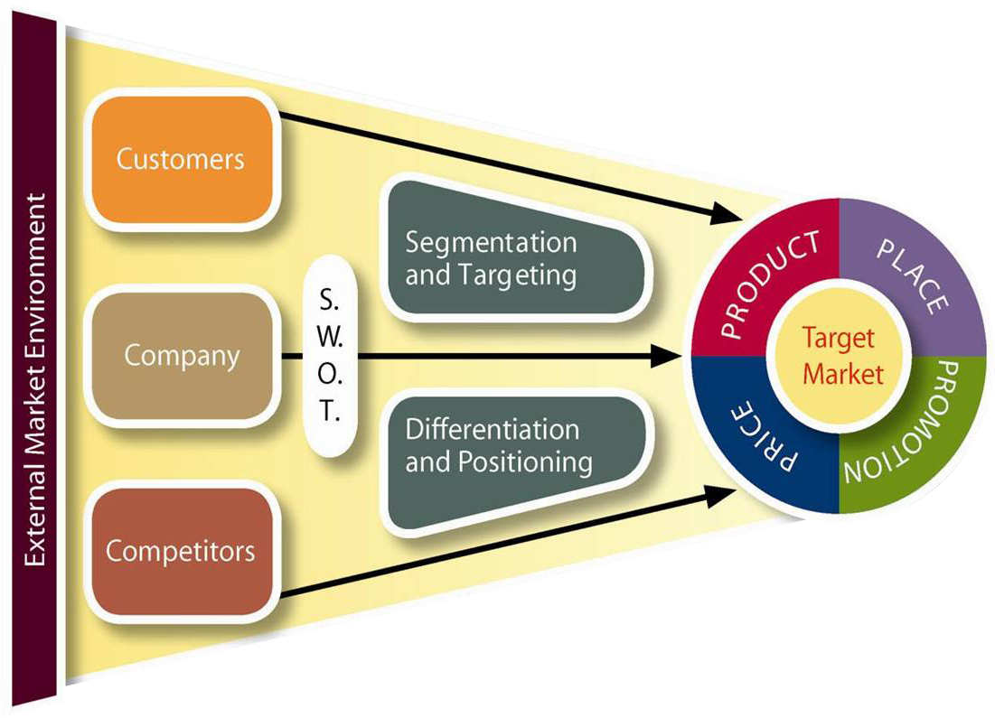
Marketing Strategy Planning Process Highlights Opportunities (Exhibit 2-9)
2-16
Notes:
Summary Overview
The marketing strategy planning process guides the selection of a target market and the development of a marketing mix.
Key Issues
Marketing strategy planning begins by gathering information about the market and company.
Marketing strategy planning narrows down from broad opportunities to specific strategy.
Screening criteria makes it clear why you select a strategy.
Segmentation helps pinpoint the target.
Narrow down to a superior marketing mix.
S.W.O.T. analysis highlights advantages and disadvantages.
This slide relates to material on pp. 47-49.
→Indicates place where slide “builds” to include the corresponding point (upon mouse click).

Slide 17
Interactive Exercise: Marketing Strategy
2-17
Present products
New products
Present
Market
Product
markets
penetration
development
New
Market
Diversification
markets
development
Notes:
The purpose of this exercise is to help students extend their conceptual knowledge of the strategic marketing planning process, specifically as it relates to the broad types of strategies that a firm might choose to pursue.
For each of the four strategic opportunities (market penetration, market development, product development, and diversification), students are shown statements describing marketing actions undertaken in the context of specific brands. Students are expected to select the statement description that best illustrates the particular type of strategic opportunity that is under consideration.
For complete information and suggestions on using this Interactive Exercise, please refer to the “Notes on the Interactive Exercise” section for this chapter in the Multimedia Lecture Support Package to Accompany Basic Marketing. That same information is available as a Word document in the assets folder for the PowerPoint file.
This slide relates to material on pp. 50-51.
→Indicates place where slide “builds” to include the corresponding point (upon mouse click).

Slide 18

International Opportunities Should Be Considered
2-18
Smaller World
Risks Involved
Competitive Advantage
Better Trends?
Early Start
Notes:
Summary Overview
In the ever-increasing interdependency of the global economy, marketing managers should consider international opportunities.
Key Issues
→The world is getting smaller:
Traditional barriers to international trade are improving in favor of more trade.
Telecommunications infrastructure is rapidly improving and expanding.
→Competitive advantage: Successful expansion into international markets can help drive down per unit manufacturing costs.
→Getting an early start in a new international market may be the key to long-term success for many firms.
→Marketers may also find better trends in international markets, because there may be more favorable combinations of variables affecting how well a firm competes.
→Risks are high in foreign markets.
Discussion Question: The percentage of cigarette smokers in the U.S. population has declined dramatically in the past several years. However, there is still industry growth in international markets. Why?
This slide relates to material on pp. 51-52.
→Indicates place where slide “builds” to include the corresponding point (upon mouse click).

Slide 19
Key Terms
2-19
marketing management process
strategic (management) planning
marketing strategy
target market
marketing mix
target marketing
mass marketing
channel of distribution
personal selling
customer service
mass selling
advertising
publicity
sales promotion
marketing plan
implementation
operational decisions
marketing program
Notes:
Summary Overview
These are key terms you should be familiar with based upon the material in this presentation.
Key Issues
Marketing management process: the process of (1) planning marketing activities, (2) directing the implementation of the plans, and (3) controlling these plans.
Strategic (management) planning: the managerial process of developing and maintaining a match between an organization’s resources and its market opportunities.
Marketing strategy: specifies a target market and a related marketing mix.
Target market: a fairly homogeneous (similar) group of customers to whom a company wishes to appeal.
Marketing mix: the controllable variables the company puts together to satisfy this target group.
Target marketing: a marketing mix that is tailored to fit some specific target customers.
Mass marketing: the typical production-oriented approach—vaguely aims at “everyone” with the same marketing mix.
Channel of distribution: any series of firms (or individuals) that participate in the flow of products from producer to final user or consumer.
Personal selling: direct spoken communication between sellers and potential customers.
Customer service: a personal communication between a seller and a customer who wants the seller to resolve a problem with a purchase.
Mass selling: communicating with large numbers of customers at the same time.
Advertising: any paid form of nonpersonal presentation of ideas, goods, or services by an identified sponsor.
Publicity: any unpaid form of nonpersonal presentation of ideas, goods, or services.
Sales promotion: promotion activities—other than advertising, publicity, and personal selling—that stimulate interest, trial, or purchase by final customers or others in the channel.
Marketing plan: a written statement of a marketing strategy and the time-related details for carrying out the strategy.
Implementation: putting marketing plans into operation.
Operational decisions: short-run decisions to help implement strategies.
Marketing program: blends all of the firm’s marketing plans into one “big” plan.
Customer equity: the expected earnings stream (profitability) of a firm’s current and prospective customers over some period of time.
This slide refers to boldfaced terms appearing in Chapter 2.

Slide 20
Key Terms
2-20
customer lifetime value
customer equity
breakthrough opportunities
competitive advantage
s.w.o.t. analysis
differentiation
market penetration
market development
product development
diversification
Notes:
Summary Overview
These are additional key terms you should be familiar with based upon the material in this presentation.
Key Issues
Breakthrough opportunities: opportunities that help innovators develop hard-to-copy marketing strategies that will be very profitable for a long time.
Competitive advantage: when a firm has a marketing mix that the target market sees as better than a competitor’s mix.
S.W.O.T. analysis: an aid which includes and lists the firm’s strengths and weaknesses and its opportunities and threats.
Differentiation: the marketing mix is distinct from and better than what is available from a competitor.
Market penetration: trying to increase sales of a firm’s present products in its present markets—probably through a more aggressive marketing mix.
Market development: trying to increase sales by selling present products in new markets.
Product development: offering new or improved products for present markets.
Diversification: moving into totally different lines of business—perhaps unfamiliar products, markets, or even levels in the production-marketing system.
This slide refers to boldfaced terms appearing in Chapter 2.

